Slide 1
Data Collection and Process Mapping
Chapter4

Slide 2
Data Collection
Data collection is a big challenge
A model will not provide accurate output data unless the input data has been collected and analysed in an appropriate manner.

Slide 3
Data Required for a Simulation Model
Logic Data Required for the Process Map & the Activity Cycle Diagram
Process Routing
Decision Points
Additional data for the model
Process Time
Resource Availability
Demand Pattern
Process Layout

Slide 4
Data Collection
Which one comes first, the data or the model?
Sources of Data
Historical Records
Observations
Interviews
Process owner/vendor estimate
……….. Data collection activities are ongoing process throughout the simulation project

Slide 5
Process Mapping
A process map is also called a conceptual model.
The idea is to construct a diagrammatic representation of the process understudied.
It provides an understanding between the simulation developer and the process owner.
Process Mapping can be done using one of the following methods:
Activity Cycle Diagrams
Process Maps

Slide 6
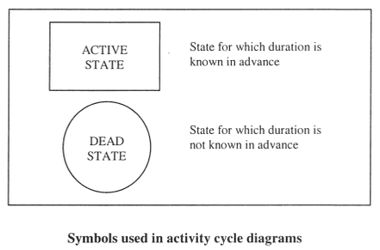
Activity Cycle Diagrams
The diagram aims to show the lifecycle of the components of the system.
Each component is shown in either of two states, dead and active.
Each component can be shown moving through a number of dean and active states in a sequence that must form a loop.

Slide 7
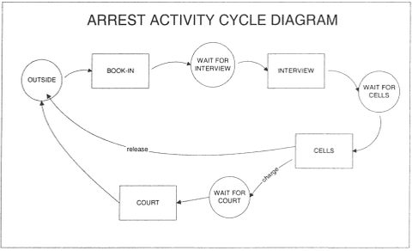
Activity Cycle Diagrams
An example of an activity cycle diagram for a simplified arrest process

Slide 8
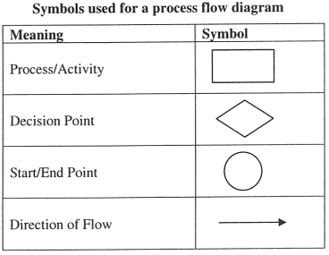
Process Maps
It is a process flow diagram
A useful way to understand and document a process and show the interrelationships between the process activities.
It is widely used in business process re-engineering (BPR) projects.

Slide 9
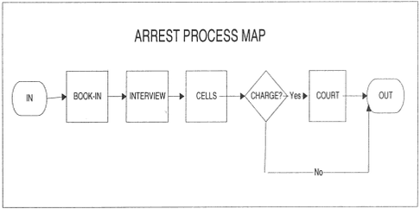
A
An example of a process map for a simplified arrest process

Slide 10
Exercise
Students, as a group or individuals, should propose a real process and draw an activity cycle diagram and a process map….

