Slide 1
Repetition Statements
Visual Basic 2010 How to Program

Slide 2
Repetition Statements
A repetition statement (also called a looping statement, an iteration statement or a loop) allows you to specify that an action should be repeated, depending on the value of a loop-continuation condition or a loop-termination condition.

Slide 3
Repetition Statement
Counter-controlled repetition statements includes the Do While…Loop – Do ...Loop While – For...Next statement.
Counter-controlled repetition requires:
  the name of a control variable (or loop counter) that is used to determine whether the loop continues to iterate
  the initial value of the control variable
  the increment (or decrement) by which the control variable is modified each time through the loop
  the condition that tests for the final value of the control variable (that is, whether looping should continue).

Slide 4
Do While....Loop
Milk
Tomatoes
Bread
Strawberry
Coffee
The pseudocode statements
      While there are more items on my shopping list
      Put next item in cart
      Cross it off my list
The loop-continuation condition “there are more items on my shopping list”
  If it’s true, the following actions are performed (execute repeatedly while the condition remains true):
    “Put next item in cart”
    “Cross it off my list”
  The condition becomes false, when the last remaining item on the shopping list has been purchased and crossed off the list.
Shopping List
Notes:
What is pseudocode

Slide 5
Repetition Statements: Do while…Loop
  Performing a Calculation in a Do While…Loop Repetition Statement
Consider a program segment designed to find the first power of 3 larger than 100.
    product = 3 ' Initialaization
    Do While product <= 100
    product = product * 3 ' compute next power of 3
    Loop

Slide 6
Repetition Statements: Do while…Loop
When the Do While…Loop statement begins execution, product is 3.
The body statement repeatedly multiplies product by 3, so it takes on the values 3, 9, 27, 81 and 243, successively.
When product becomes 243, the condition
  product <= 100 becomes false
This terminates the repetition with 243 as product’s final value.
Then, execution continues with the next statement after the keyword Loop.
If the condition in a Do While…Loop is initially false, the body statement(s) do not execute.

Slide 7
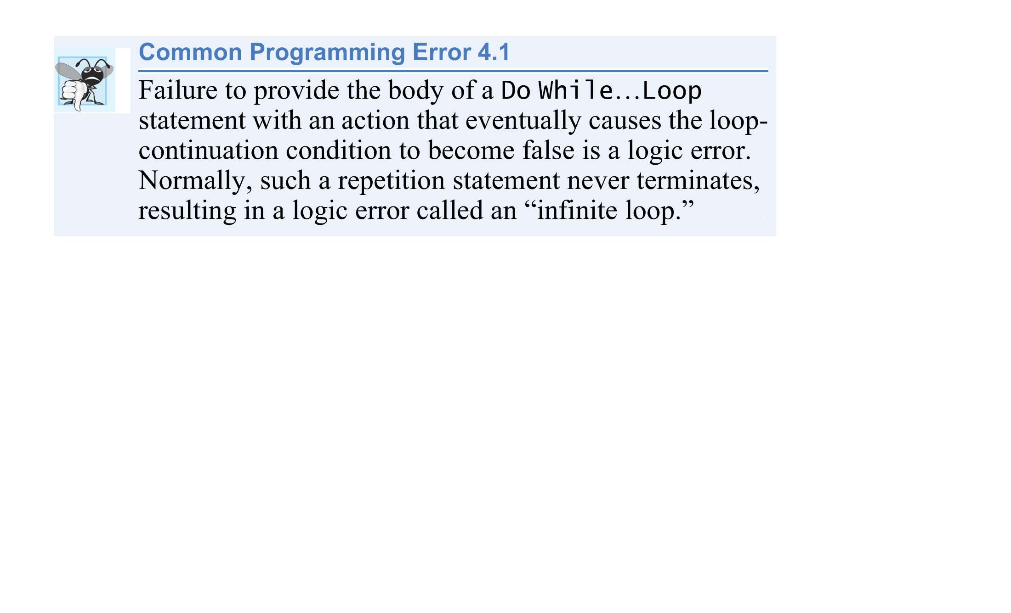
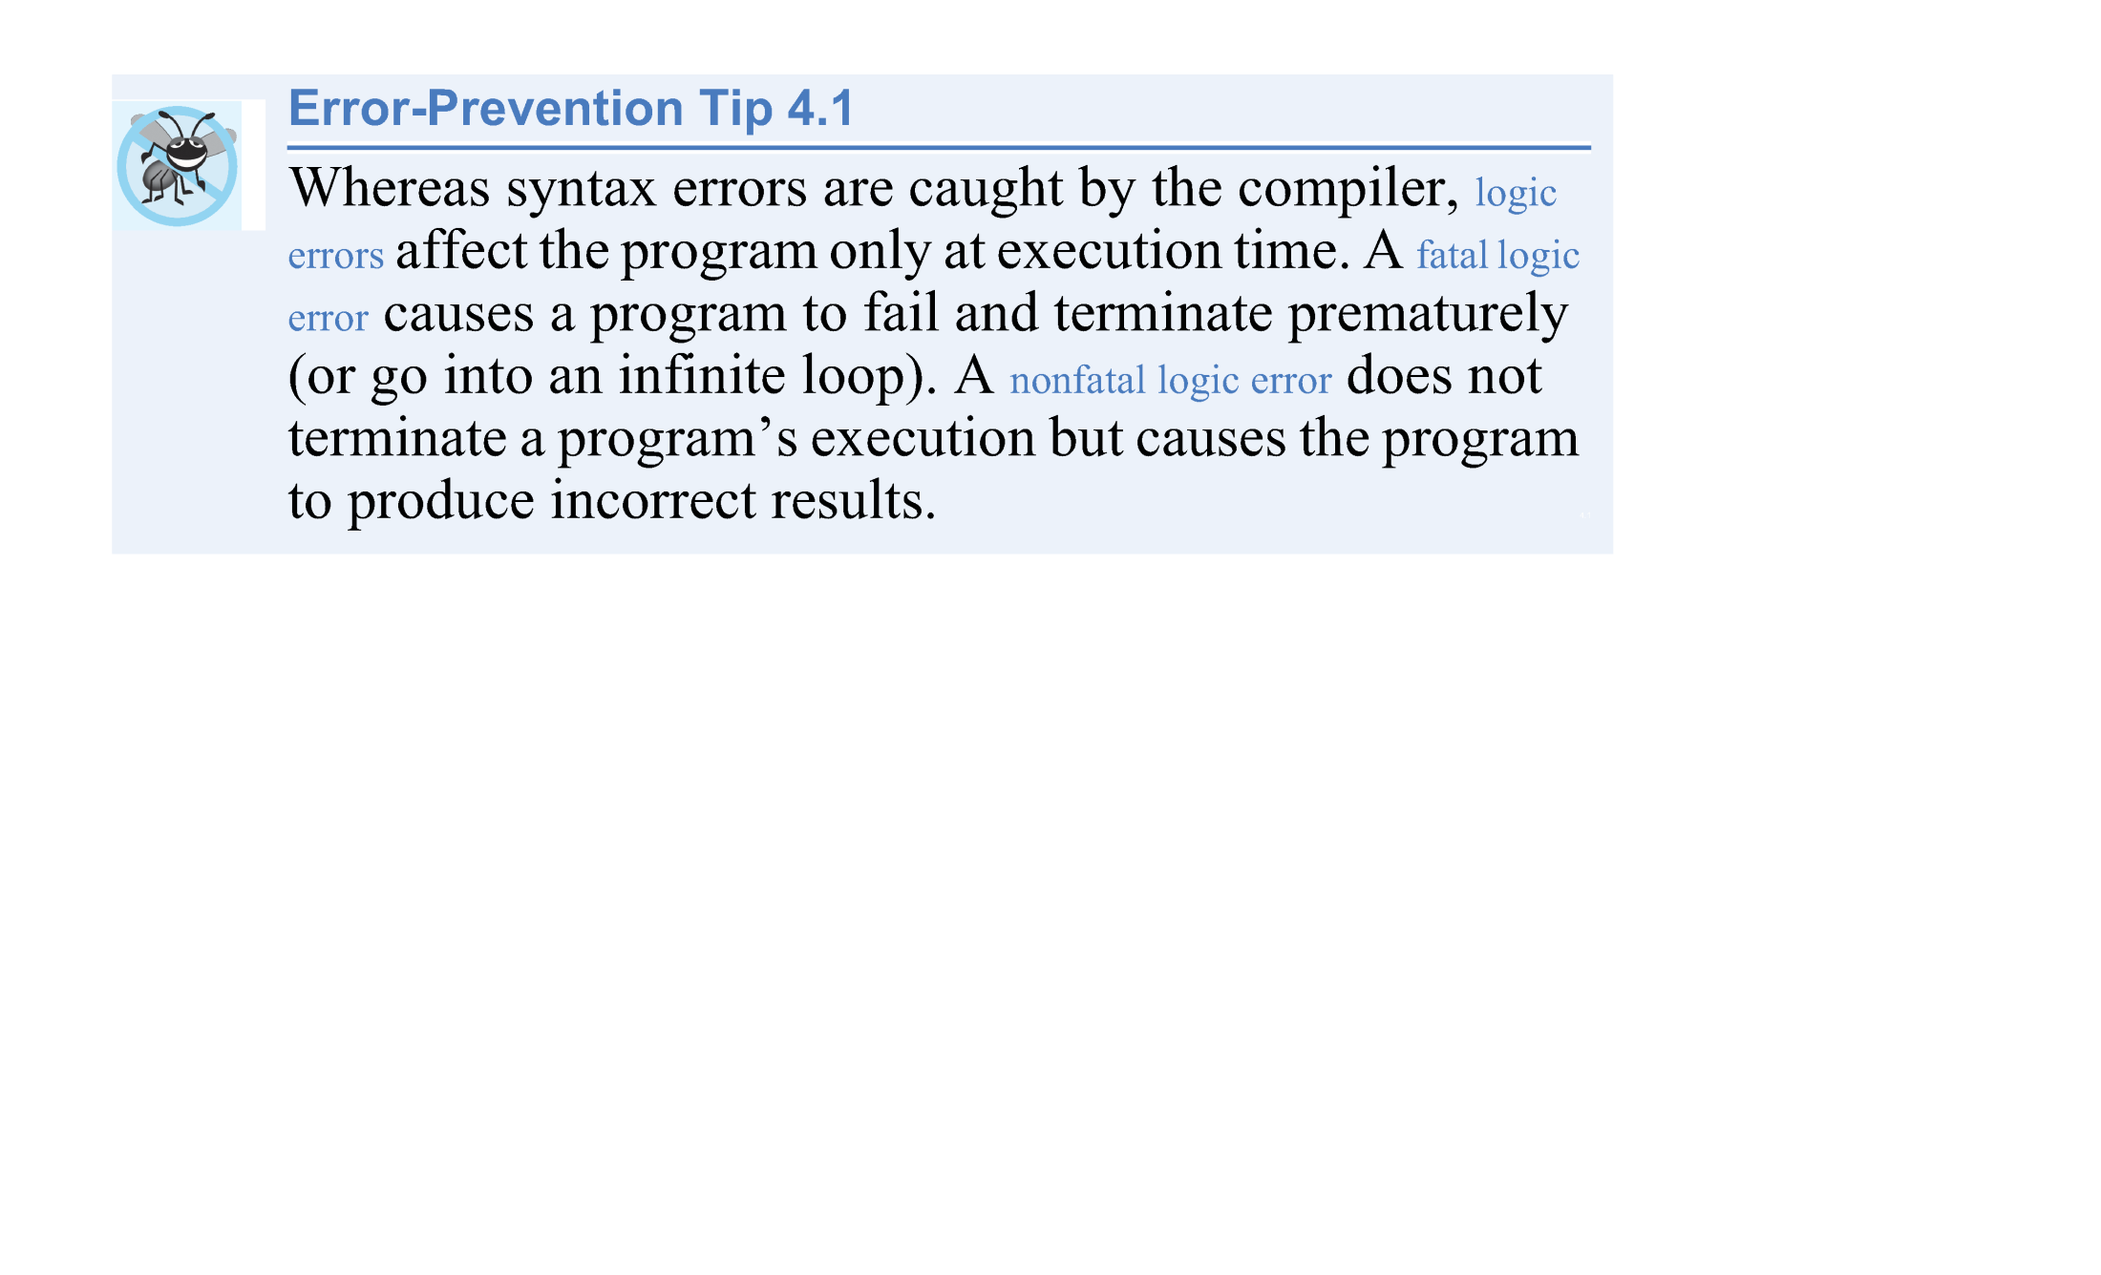

Slide 8
Repetition Statements: Do …Loop While
The Do…Loop While repetition statement is similar to the Do While…Loop statement.
In the Do While…Loop statement, the loop-continuation condition is tested at the beginning of the loop, before the body of the loop is performed, so these are referred to as pre-test loops.

Slide 9
Repetition Statements: Do …Loop While
The Do…Loop While statement tests the loop-continuation condition after the loop body is performed, so it’s referred to as a post-test loop.
In a Do…Loop While statement, the loop body is always executed at least once.
When a Do…Loop While statement terminates, execution continues with the statement after the Loop While clause.
The program in Fig. 5.11 uses a Do…Loop While statement to output the even integers from 2 to 10.

Slide 10
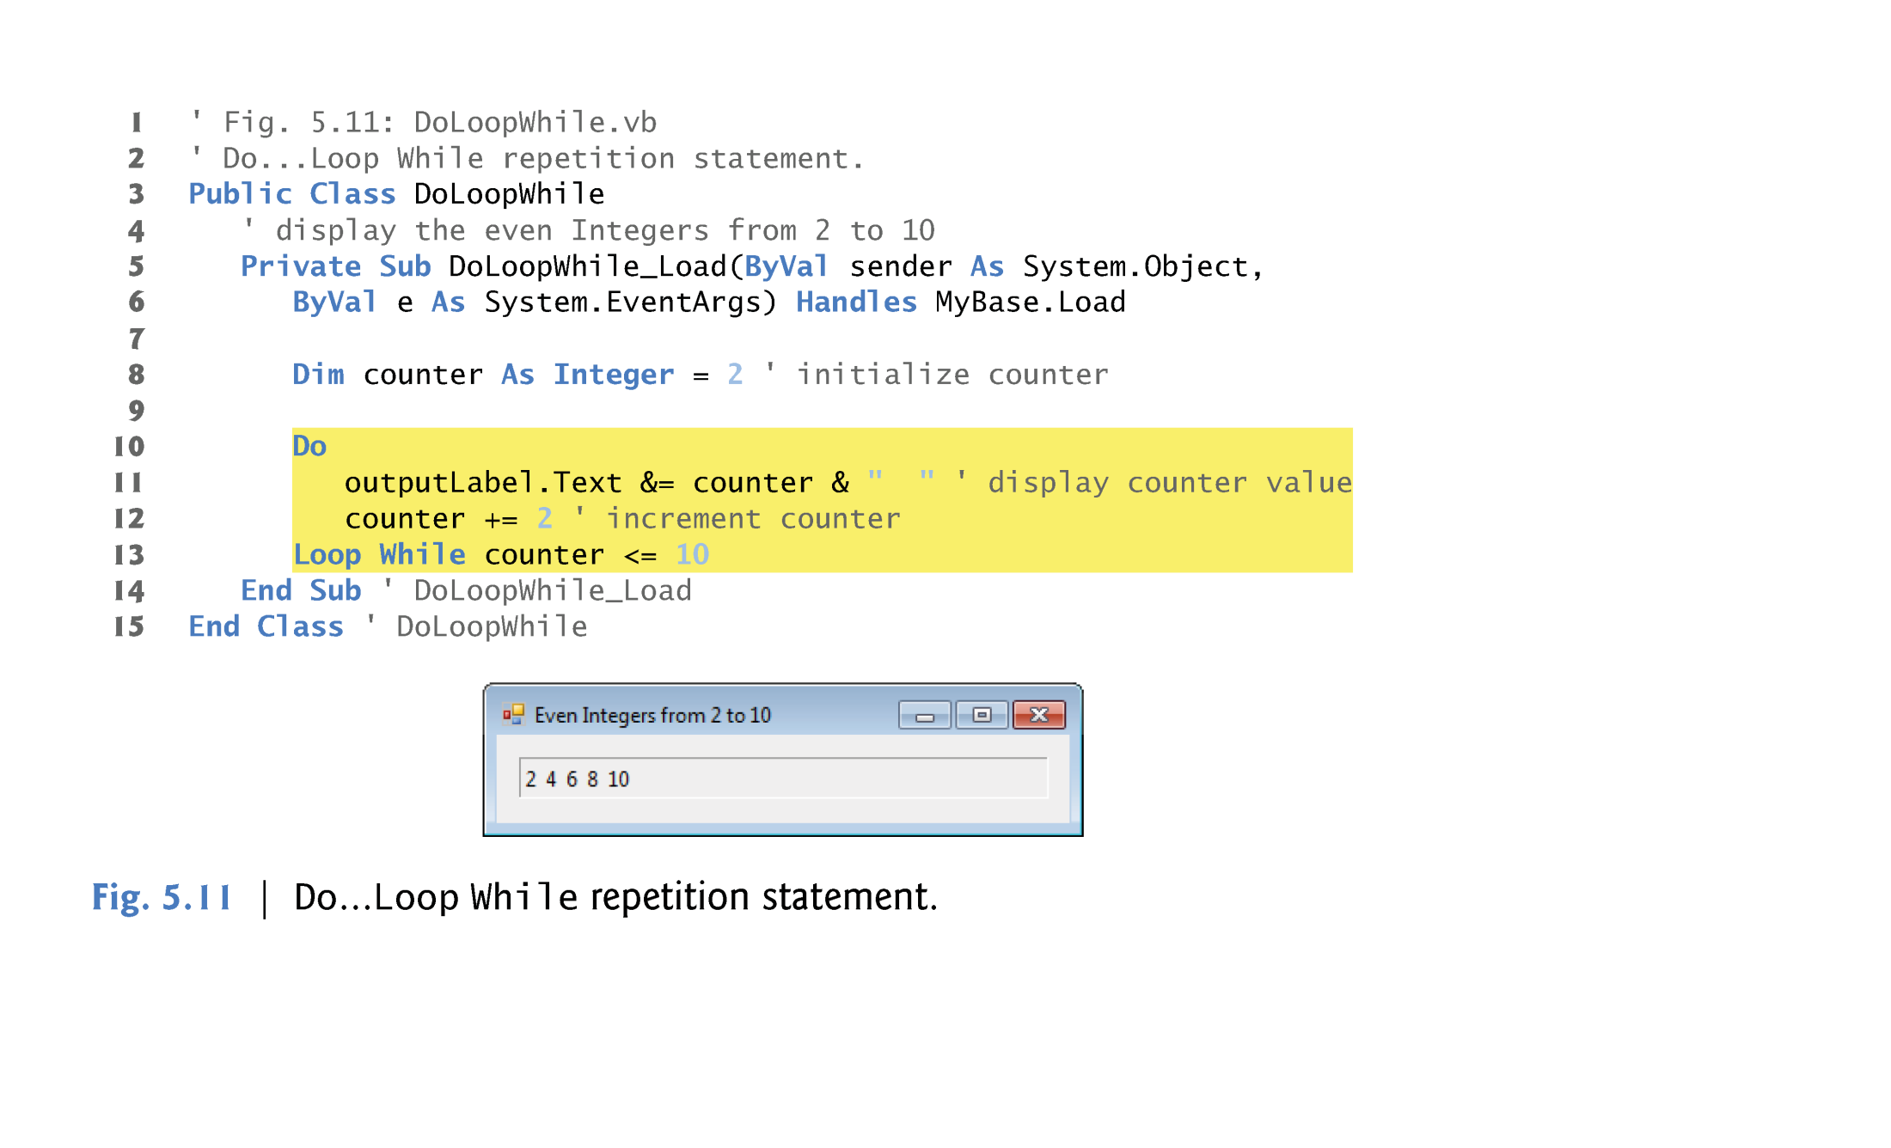
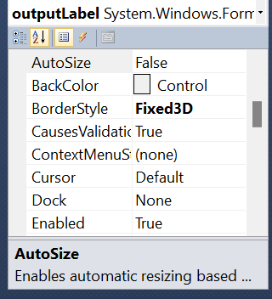
Code view
Design View
outputLable

Slide 11
Repetition Statements: Do …Loop While
When lines 11–12 execute, it displays the value of counter (at this point, 2), then increments counter by 2.
Then the loop-continuation condition in line 13 is evaluated.
Variable counter is 4 <= 10, so the Do…Loop While statement executes lines 11–12 again.
In the 5th iteration of the statement, line 11 outputs the value 10, and line 12 increments counter to 12.
At this point, the loop-continuation condition in line 13 evaluates to false, and the program exits the Do…Loop While statement.

Slide 12
Do While...Loop (Vs.) Do... Loop While
Do While...Loop
Example:
Dim Counter As Integer = 6
Do While Counter<=5
TextBox1.AppendText(Counter & vbTab)
Counter+=1
Loop
Do...Loop While
Example:
Dim Counter As Integer = 6
Do
TextBox1.AppendText(Counter & vbTab)
Counter+=1
Loop While (Counter<=5)
Output:
6
Output: Nothing in the output
Noter: vbTab is ..

Slide 13
Repetition Statements: For…Next
The general form of the For…Next statement is
    For initialization To finalValue Step increment
    statement
    Next
initialization expression initializes the loop’s control variable,
finalValue determines whether the loop should continue executing
increment specifies the amount the control variable should be incremented (or decremented) each time through the loop.

Slide 14
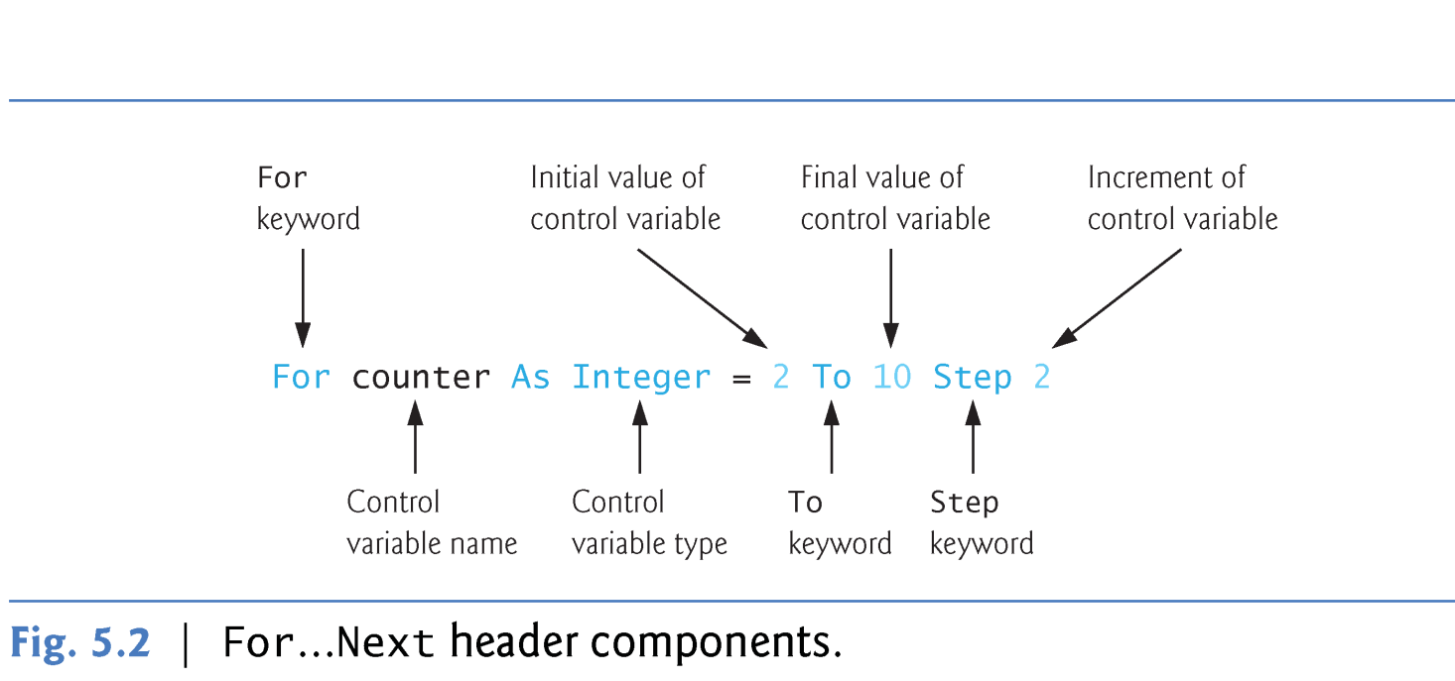
Repetition Statements: For…Next
The For…Next repetition statement specifies counter-controlled repetition details in a single line of code.

Slide 15
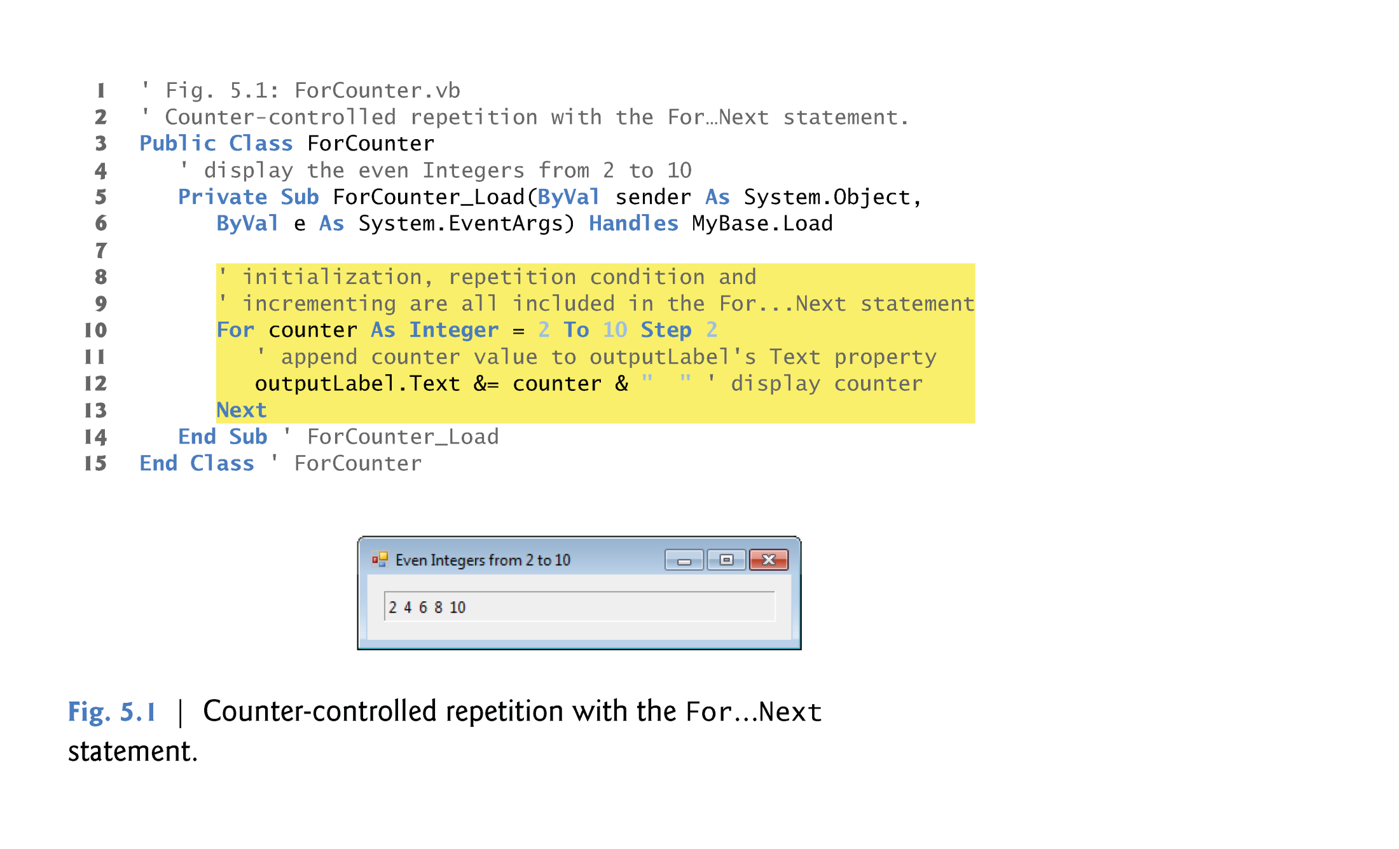
This means that when the Form of the Program Loads, this event handler will be executed
This equivalent to:
counter+=2
Or counter =counter+2

Slide 16
Repetition Statements: For…Next
At(lines 10–13) the control variable counter is declared as an Integer and initialized to 2.
Next, the loop-continuation condition counter <= 10 is tested.
The To keyword is required in the For…Next statement.
The optional Step keyword specifies the increment, that is, the amount that’s added to counter at each iteration.
If Step and the value following it are omitted, the increment defaults to 1.
  Example: Removing the Step keyword
      Code: Output:
  For Counter As Integer=2 To 10
  Label1.Text&=Counter & ” “ 2 3 4 5 6 7 8 9 10
  Next

Slide 17

Repetition Statements: For…Next
The increment of a For…Next statement could be negative, in which case it’s called a decrement, and the loop actually counts downward.
Example:
For counter As Integer = 6 To 1 Step -1
Label1.Text &= counter & " "
Next

Slide 18

Repetition Statements: For…Next
If the loop-continuation condition is initially false (for example, if the initial value is greater than the final value and the increment is positive), the For…Next’s body is not performed.
Instead, execution proceeds with the first statement after the For…Next.
Example:
For counter As Integer = 6 To 1
Label1.Text &= counter & " "
Next

Slide 19
Repetition Statements: For…Next
First Iteration of the Loop
  In Fig. 5.1, the initial value of counter is 2, so:
    loop-continuation condition (counter <= 10) is true,
    And the counter’s value 2 is appended to outputLabel’s Text property (line 12).
  When Next is reached, variable counter is incremented by the Step value (2), and then the loop-continuation test is performed again.

Slide 20
Repetition Statements: For…Next
Second and Subsequent Iterations of the Loop
  Now, the control variable is equal to 4.
  This value still does not exceed the final value, so the program performs the body statement again.
  This process continues until the counter value 10 is displayed which means:
    The control variable counter is incremented to 12
    The loop-continuation test fails and the loop to terminate.
  The program continues by performing the first statement after the For…Next statement (line 14).

Slide 21
Declaring the Control Variable Before a For…Next Statement
In Fig. 5.1, the counter variable is declared and initialized in the For…Next header.
The counter variable may be declared before the For…Next statement. Example
Different Declaration for Control Variable
(counter) gives different scopes
Dim counter As Integer
For counter = 2 To 10 Step 2
outputLabel.Text &= counter & " “
Next
‘ counter variable here will be
‘ recognized
counter ^= counter
For counter As Integer= 2 To 10 Step 2
outputLabel.Text &= counter & " “
Next
‘ counter variable here will not be
‘ recognized
counter ^= counter
A
B

Slide 22
Declaring the Control Variable Before a For…Next Statement
The difference between the two forms of declaration in the previous example:
  If the control variable is declared as in A it can be used inside the For…Next body and after it.
  If the control variable is declared as in B the control variable can be used only inside the body of the For…Next.
The variable’s scope specifies where the variable can be used in a program.

Slide 23
Using Expressions in the For…Next Statement’s Header
The starting value, ending value and increment portions of a For…Next statement can contain arithmetic expressions.
The expressions are evaluated once and used as the For..Next header.
  For example, assume that
  Dim x As Integer= 2
  Dim y As Integer= 10
  The header
      For j As Integer = x To 4 * x * y Step y \ x
  is equivalent to the header
      For j As Integer = 2 To 80 Step 5

Slide 24
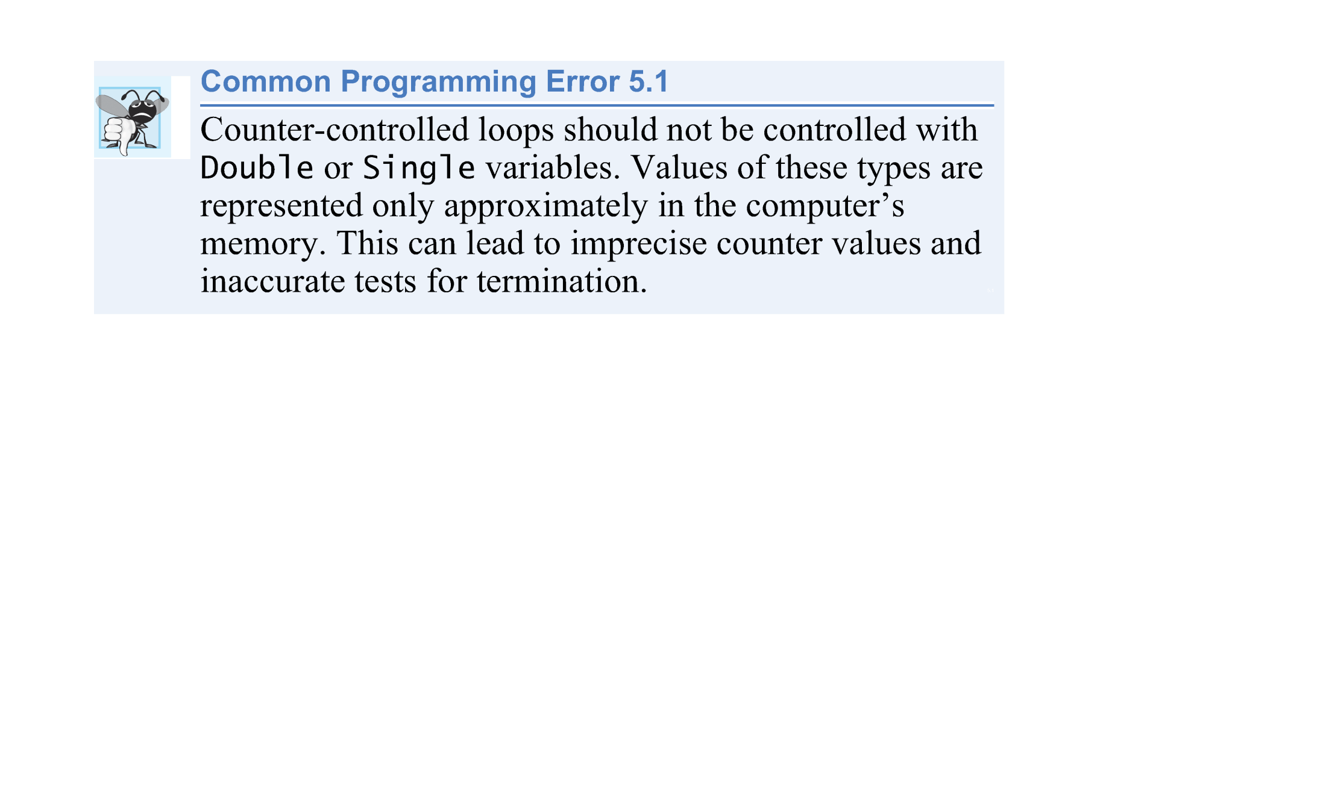

Slide 25
Local Type Inference
The For…Next header can be written as one of the following:
    Dim counter As Integer
    For counter = 1 To 10
    2) For counter As Integer = 1 To 10
    3) For counter = 1 To 10
In the 3rd case, counter is of type Integer because it is initialized with an Integer literal (1).

Slide 26
Examples Using the For…Next Statement
The following examples demonstrate different ways of varying the control variable in a For…Next statement.
  Vary the control variable from 1 to 100 in increments of 1.
    For i = 1 To 100 or For i = 1 To 100 Step 1
  Vary the control variable from 100 to 1 in increments of -1 (decrements of 1).
    For i = 100 To 1 Step -1
  Vary the control variable over the sequence of the following values: 99, 88, 77, 66, 55, 44, 33, 22, 11, 0.
    For i = 99 To 0 Step -11

Slide 27
Examples Using the For…Next Statement
  Vary the control variable from 7 to 77 in increments of 7.
    For i = 7 To 77 Step 7
  Vary the control variable from 20 to 2 in increments of -2 (decrements of 2).
    For i = 20 To 2 Step -2
  Vary the control variable over the sequence of the following values: 2, 5, 8, 11, 14, 17, 20.
    For i = 2 To 20 Step 3

Slide 28
Formulating Algorithms: Nested Repetition Statements
Consider the following problem statement:
  Write a program that displays in a TextBox a filled square consisting solely of one type of character, such as the asterisk (*). The side of the square and the character to be used to fill the square should be entered by the user. The length of the side should be in the range 1 to 20.

Slide 29
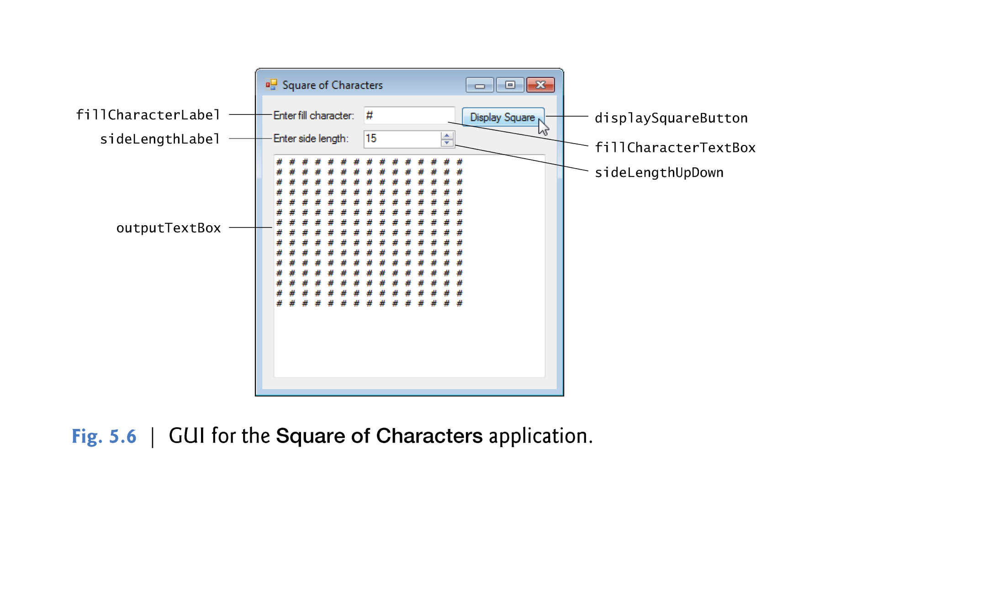
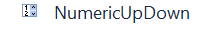
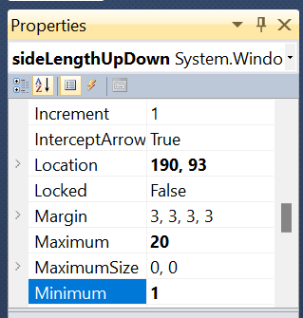
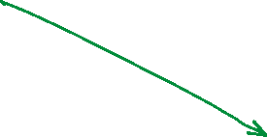


Design View

Slide 30
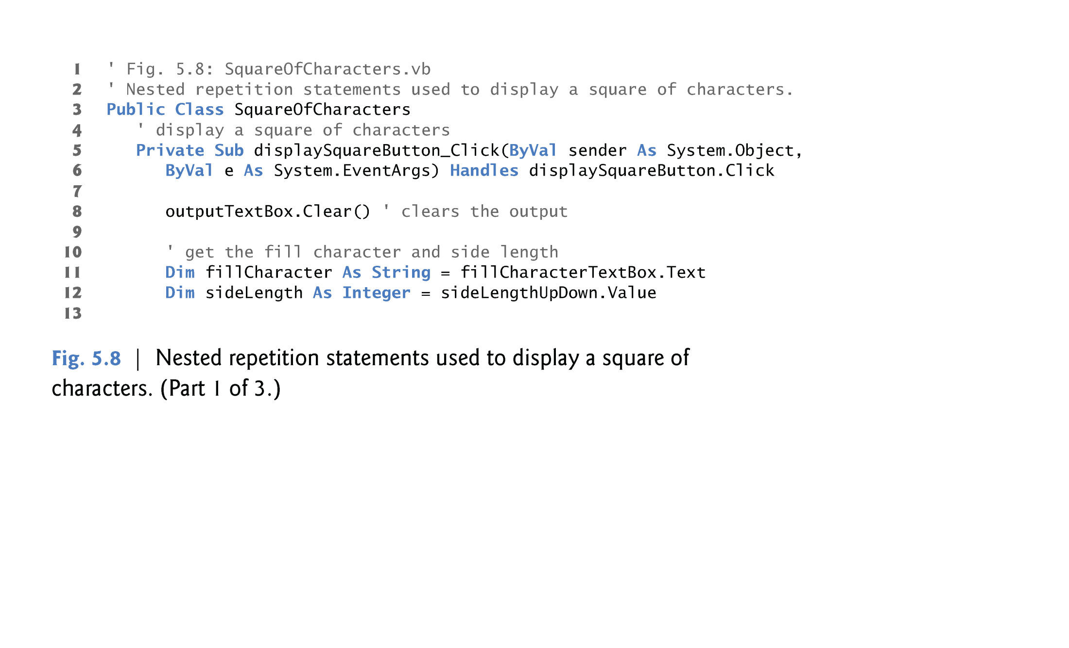
Code View

Slide 31
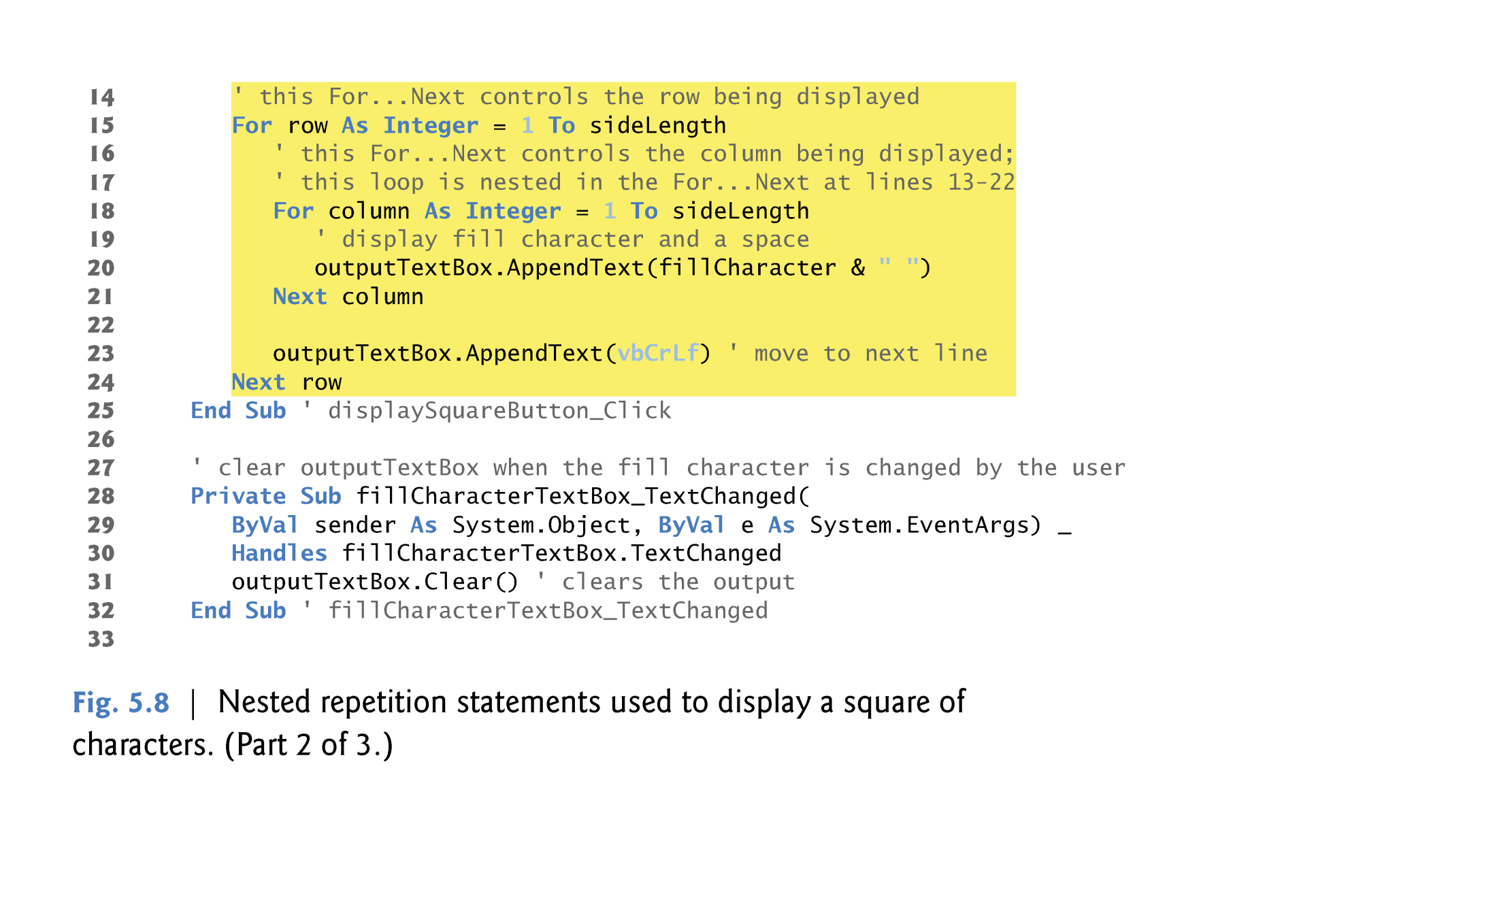
Code View

Slide 32
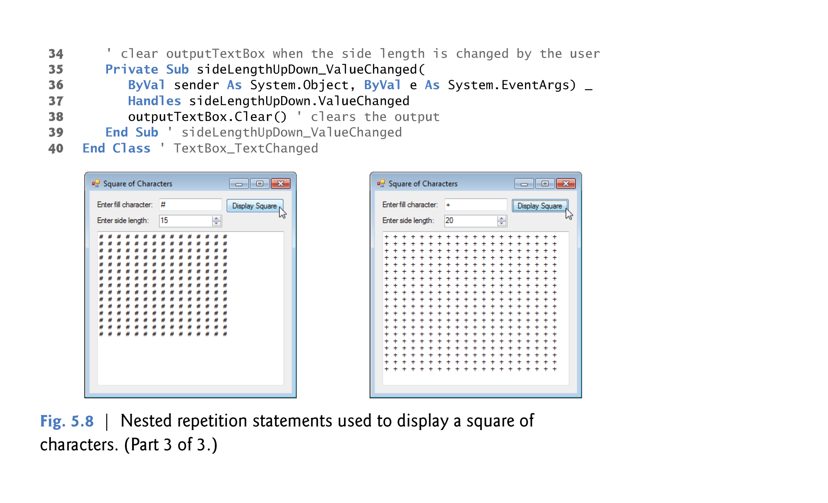
Code View

