Slide 1

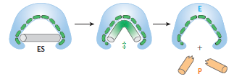
Chapter 4: Enzymes
Protein Biochemistry (BCH 303)
2022-2023
Dr. Mansour Gatasheh
Biochemistry Department, Science College
King Saud University

Slide 2

Enzymes
Enzymes:
- are specific protein catalysts that increase the rate of reaction without being changed in the overall process. (Enzymes are not consumed during the reaction).
Enzymes (E) act on certain substances which are known as substrate (S), they form an enzyme – substrate complex (ES) which is broken to give the product (P).

Slide 3
Nomenclature of enzymes:
Each enzyme is assigned two names:
A) Recommended name:
i) Many enzymes have been named by adding the suffix ‘ase’
a) to the name of the substrate
Maltase
e.g., Maltose Glucose + Glucose
b) or to a word describing action or activity.
ii) Some enzymes given trivial names.
(e.g., pepsin, trypsin)

Slide 4
B) Systematic name:
The international union of Biochemistry developed a system of nomenclature.
i) This system divide enzymes into six major classes:
1. Oxidoreductases
2. Transferases
3. Hydrolases
4. Lyases
5. Isomerases
6. Ligases

Slide 5
ii) The enzyme name has 2 parts:
The first name the substrate or substrates.
The second, ending in –ase, indicates the type of reaction catalyzed.
iii) This system give each enzyme a code number (EC) and it contains 4 digits separated by points.
first digit : Class
second digit : sub-class
third digit : sub-sub-class
fourth digit : serial number of the enzyme.

Slide 6
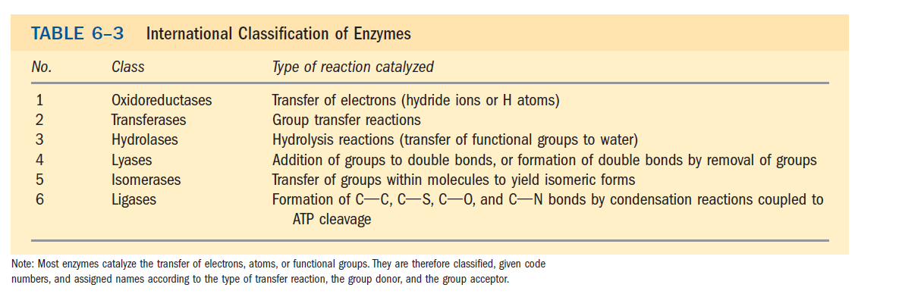

Slide 8
General Characteristics of Enzymes:
1) They are proteins.
2) High molecular weight proteins.
3) They act at specific pH and temperature.
4) Active site:
- Enzyme molecule contain a special pocket or cleft called the active site.
- (active site is relatively small portion of the total volume of an enzyme that bind the substrate).
- The active site contains amino acid side chains that participate in substrate binding and catalysis.

Slide 10
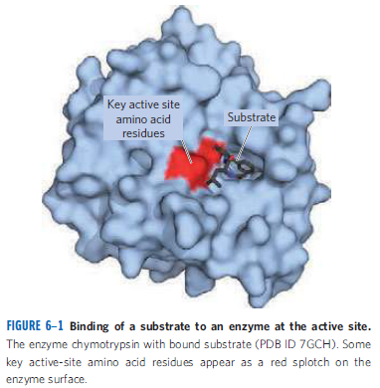

Slide 11
5) Cofactors:
enzymes depend for activity only on their structure as proteins (simple proteins)
Enzymes
While other enzymes require one or more non-protein component known as the cofactor (these are conjugated proteins).

Slide 12
Inorganic (metal ions e.g., Zn⁺², Fe⁺²)
Cofactor
OR
Organic molecule called coenzymes (Coenzymes are derivatives of vitamins)
example of coenzymes: NAD⁺, FAD

Slide 14
Holoenzyme: A complete, catalytically active enzyme together with its non- protein component (coenzyme or metal ion).
Apoenzyme: The protein part of an enzyme.( enzyme without its non-protein moiety).
Apoenzyme + cofactor Holoenzyme
inactive active

Slide 15
6) Specificity:
- Enzymes are highly specific, interacting with one or a few specific substrates and catalyzing only one type of chemical reaction.
Specificity Absolute specificity:
(the enzyme can act only on one substrate)
Group specificity:
(the enzyme can act on a group of related substrates).

Slide 16
7) Enzyme inhibitors:
Some substances combine with the enzyme and reduce its activity These are known as inhibitors.
8) Enzyme activator:
Some substances combine with the enzyme and increase its activity These are known as activators.
- Activators include:
a) Metal ions
b) HCl HCl
Pepsinogen Pepsin
(inactive enzyme) (active enzyme)
c) Enzymes
enterokinase
  Trypsinogen Trypsin
  (inactive enzyme) (active enzyme)

Slide 17
How do enzymes increase the rate of a reaction?
- Enzymes increase rate of reaction by decreasing energy of activation (ΔG҂) .
- Enzymes do not change ΔG ͦ (standard free energy change).
Transition state:
- An unstable state in which new bonds are formed and old bonds are broken.

Slide 18
Activation energy (ΔG҂) :
- Difference in the energy level of S (or P) and the transition state.
ΔG ͦ (standard free energy change):
- It is energy difference between substrate and product.

Slide 19
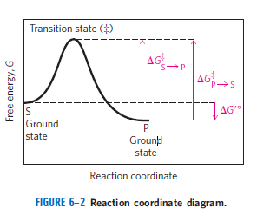

Slide 20
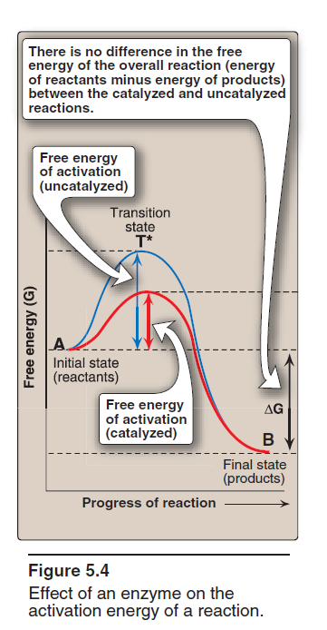

Slide 21
Enzyme mechanism:
During enzyme action, there is a temporary combination between enzyme and its substrate forming enzyme-substrate complex (ES complex).
- This is followed by dissociation of this complex into enzyme and product.

Slide 22
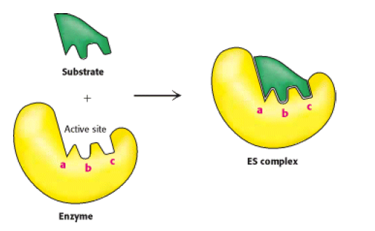
Models to explain enzyme specificity towards substrate:
a) Lock and key model of enzyme-substrate binding:
The active site of the unbound enzyme is complementary in shape to the substrate.

Slide 23
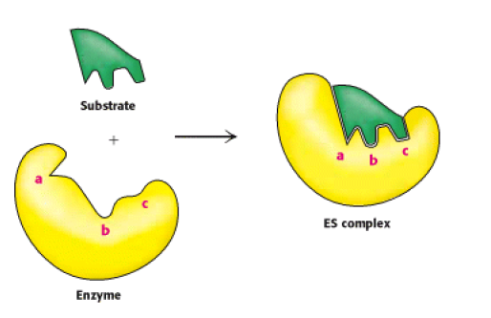
b) Induced-fit model of enzyme-substrate binding:
The enzyme change shape on the substrate binding.
The active site forms a shape complementary to the substrate only after the substrate has been bound.

Slide 24
Factors affecting reaction velocity of enzymes:
1) Substrate Concentration
2) Enzyme concentration
3) pH
4) Temperature
5) Inhibitors
6) Activators

Slide 25
1) Effect of substrate concentration:
- Velocity is usually expressed as μmol of product formed per minute.
- The rate of an enzyme-catalyzed reaction increases
with substrate concentration until a maximal velocity (Vmax) is reached.
- Increased substrate concentration after this point (Vmax) will not increase the rate.
[The leveling off of the reaction rate at high substrate
concentrations reflects the saturation with substrate of all
available binding sites on the enzyme molecules present].

Slide 26
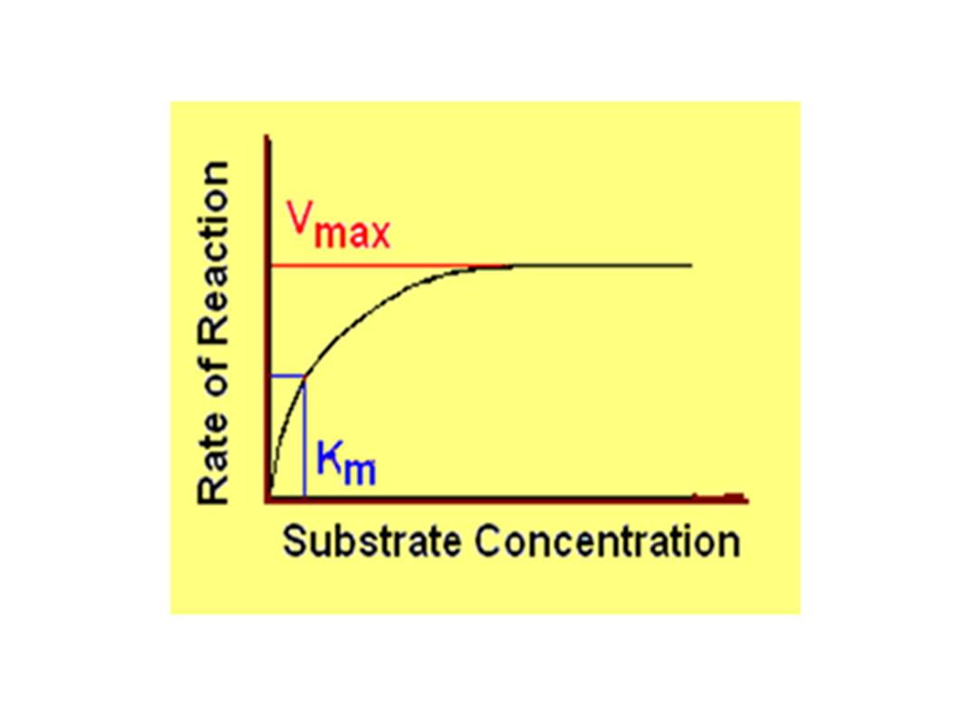
- At low substrate concentrations, an increase in
substrate concentration increases the rate of reaction because there are many active sites available to be occupied.
At high substrate concentrations, the reaction rate levels
off because most of the active sites are occupied.
Michaelis-Menten plot

Slide 27
- Vmax is the maximum reaction rate (maximum velocity).
- The Michaelis-Menton constant , Km is the substrate concentration when the rate is ½ Vmax .
- Most enzymes show Michaelis-Menten kinetics.
- In Michaelis-Menten model, the enzyme reversibly combines with its substrate to form an ES complex that subsequently yields product, regenerating the free enzyme.
where S is the substrate
E is the enzyme
ES is the enzyme–substrate complex
P is the product

Slide 28
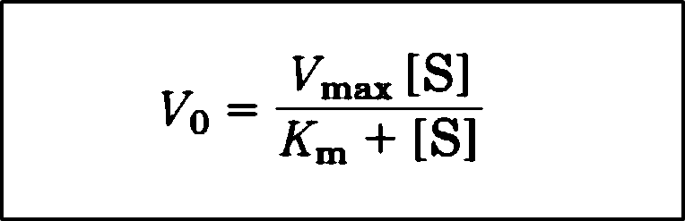
In Michaelis-Menten kinetics, the plot of initial reaction velocity (v_{o}) against substrate concentration ([S]), is hyperbolic.
Michaelis-Menten Equation:
where Vo = initial reaction velocity
Vmax = maximal velocity
Km = Michaelis constant
[S] = substrate concentration

Slide 29

The Double-Reciprocal Plot (Lineweaver-Burk plot):
Transformations of the Michaelis-Menten equation give Lineweaver-Burk equation.
- Michaelis-Menten equation can be algebraically transformed into equations that are more useful in plotting experimental data.
One common transformation is derived simply by taking the reciprocal of both sides of the Michaelis-Menten equation

Slide 30

- Separating the components of the numerator on the right side of the equation gives
which simplifies to:
-This equation is called the Lineweaver-Burk equation.

Slide 31
A plot of ( 1/V₀ ) versus ( 1/[S] ) yields a straight line.
This line has a slope of ( Km/Vmax), an intercept of (1/Vmax).
on the (1/V₀) axis, and an intercept of (-1/Km) on the (1/[S]) axis.

Slide 32
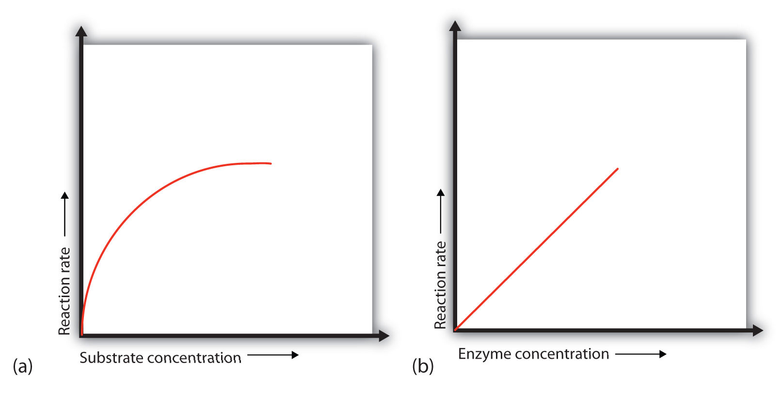
2) Effect of enzyme concentration:

Slide 33
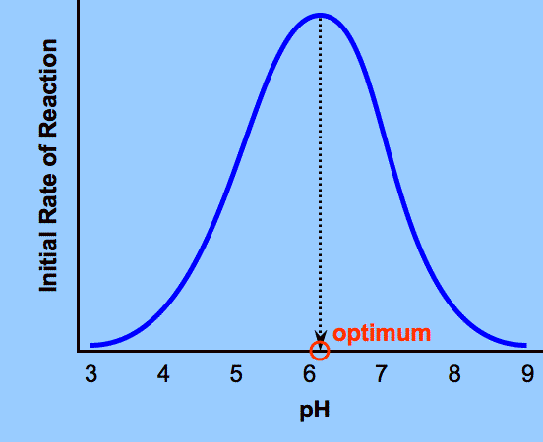
3) Effect of pH:

Slide 34
Optimum pH:
- It is the PH at which the enzyme has its maximum activity.
- Each enzyme has an optimal pH at which it is most efficient.
- The optimum pH varies for different enzymes.
For example, pepsin, a digestive enzyme in the stomach, is maximally active at pH 2, whereas other enzymes, designed to work at neutral pH, are denatured by such an acidic environment.

Slide 35
A change in pH can alter the ionization of the groups of the amino acids.
Extremes of pH can lead to denaturation of the enzyme,

Slide 36
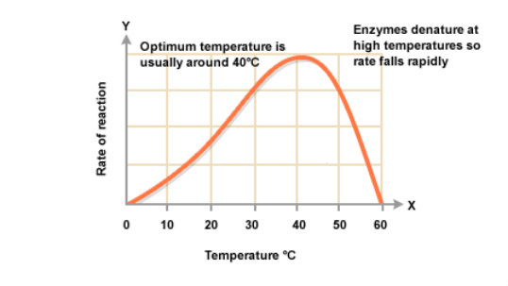
4) Effect of temperature:

Slide 37
- The reaction velocity increases with temperature until a peak velocity is reached.
Optimum temperature:
- It is the temperature at which the enzyme has its maximum activity.
- Further elevation of the temperature results in a decrease in reaction velocity as a result of temperature-induced denaturation of the enzyme.
- Most enzymes are fully denatured at 70°C.

Slide 38
5) Effect of inhibitors:
- Inhibitors: are chemicals that reduce the rate of enzymic reactions.
- Enzyme inhibitors are among the most important
pharmaceutical agents.
There are two broad classes of enzyme inhibitors:
A) Irreversible inhibitors.
B) Reversible inhibitors

Slide 39
A) Irreversible inhibitors:
• Combine with the functional groups of the enzyme in the active site, irreversibly (combine covalently to enzyme so as to permanently inactivate it).
• Most bind to a functional group in active site of enzyme to block that site.
Example:
Diisopropyl fluorophosphate (DFP) binds covalently to serine in serine proteases & acetylcholinesterase .

Slide 40
B) Reversible inhibitors:
Types of reversible inhibitors:
a) Competitive inhibitors
b) Noncompetitive inhibitors
c) Uncompetitive inhibitor
- The two most commonly encountered types of reversible inhibition are:
a) Competitive inhibition
b) Noncompetitive inhibition

Slide 41
a) Competitive inhibition:
- The inhibitor compete with the substrate to bind the active site.
- Competitive inhibitor structure usually resemble substrate.
- The competitive inhibitor’s action is proportional to its concentration. (The effect of a competitive inhibitor is reversed by increasing [S]).
Effect of competitive inhibitor on Km and V_{max}:
- Same Vmax
- increase Km

Slide 42
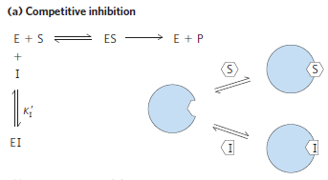

Slide 44
b) Noncompetitive inhibition:
-The inhibitor bind the enzyme at a site other than the active site.
- The noncompetitive inhibitor can bind either free enzyme or the ES complex.
-This type of inhibition not affected by the concentration of the substrate.
Effect of non-competitive inhibitor on Km and Vmax:
- Decrease Vmax
- Same Km

Slide 46
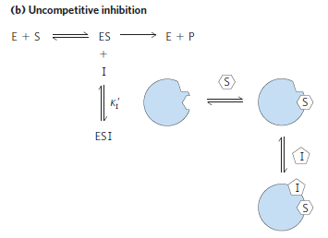

Slide 47
References
Lehninger, A.L., Nelson,D.L., Cox,M.M, Principles of Biochemistry,Worth publishers,Inc.,NewYork .

