Slide 1
Concentration based on degree of saturation

Slide 2
Saturation Degree
Saturated solution
is one where the concentration is at a maximum - no more solute is able to dissolve at a given temperature.
A saturated solution represents an equilibrium.
Unsaturated Solution
less than the maximum amount of solute for that temperature is dissolved in the solvent.
No solid remains in flask.
Supersaturated
Solvent holds more solute than is normally possible at that temperature.

Slide 3
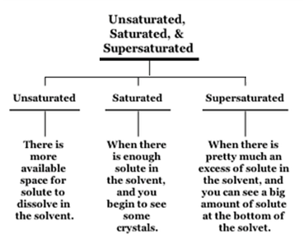

Slide 4
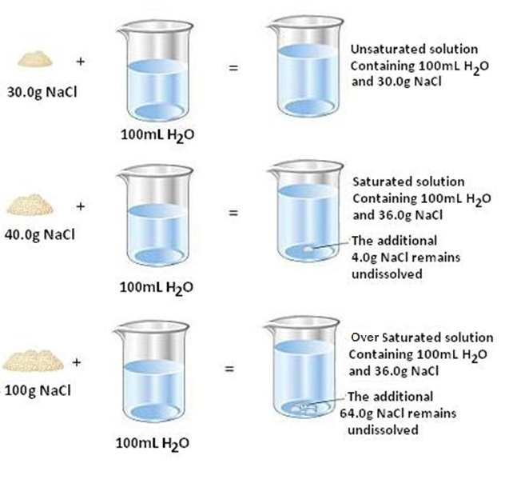

Slide 5
Percent saturation
The concentration of salt in a solution as a percent of the maximum concentration possible at a given temperature.
Vol (ml) = 100 (S₂-S₁)
1 – S₂
At the equation above:
Volume is the volume of the saturated salt needed.
S1 is the initial low saturation ( used as a decimal).
S2 is the final high saturation ( used as a decimal).
This is to the volume to be added to 100 ml at saturation S1.

Slide 6
Example
How many ml of a saturated ammonium sulfate solution must be added to 40 ml of a 20% saturated solution to make the final solution 70% saturated?
100 (0.70 – 0.20) = 166.6 ml
1 – 0.70
Given values:
S1= 20% = 0.2 ,
S2= 70% =0.7
(according to the formula, this is to the volume to be added to 100 ml at saturation S1)
V (ml) = 100 (S2-S1) = 100 (0.70 – 0.20) = 166.6 ml
1-S2 1 – 0.70

Slide 7
100 ml 166.6 ml
40 m ?
The volume needed = 40 × 166.6
100
= 66.6 ml

Slide 8
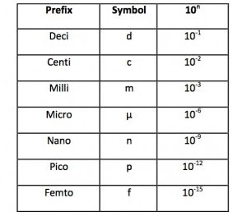
Units Conversion

Slide 9
Expression | Symbol | Definition
Based on volume:
Molarity | M | = No. of moles of solute volume of solution (L)
Normality | N | = no. of equivalents volume of solution (L) OR = nxM (n= number of OH or H)
Osmolarity | O | = nx M ( n= number of dissociable ions)
Weight/Vol % | wt/V% | = Wt in gram of solute 100ml of solution
Milligram % | mg% | = Wt in mg of solute 100ml of solution
Vol/Vol% | V/V% | = volume in ml of a solute 100ml of solution
Based on weight:
Weight/We ight% | w/w% | = Wt in gram of solute 100g of solution
Molality | m | = No. of moles of solute 1000g of solvent
Mole fraction | MF | MF₂ = n₂ / (n₁ + n₂ + n₃)
Based on saturation:
percent saturation |  | V (ml) = 100 (S2-S1) 1 – S2

Slide 10
Preparations of Solutions

Slide 11

Preparation of stock solutions
The concentrations of many acids are given in the terms of w/w%
In order to prepare a stock solution for acids we need to know:
Density (ρ) : wt/ unit volume
Specific gravity : Density relative to water
Wt(g) =V (ml) x ρ x w/w% (as decimal)

Slide 12
Since density of water is 1 gm/ml
SG = Density (ρ) of substance
Density of water
SG = Density of substance (ρ)
1
SG = Density (ρ)

Slide 13
Preparation of Solutions
It could be prepared either from:
1- Solid material.
2-Liquid.

Slide 14
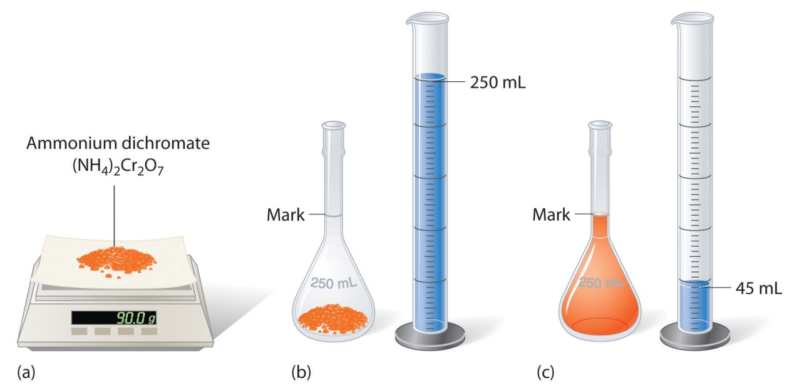
Preparation of Solutions from Solid Material
In general it follows a 4 steps:
Weigh the solute.
Dissolve the solute.
Make up the solution to a known volume.
Homogenise.

Slide 15
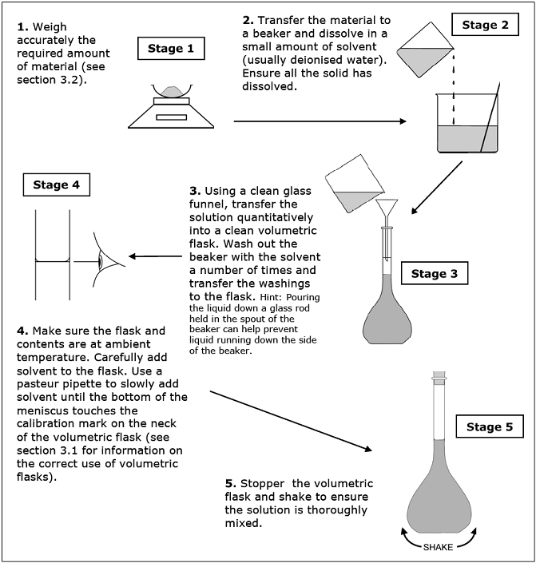

Slide 16
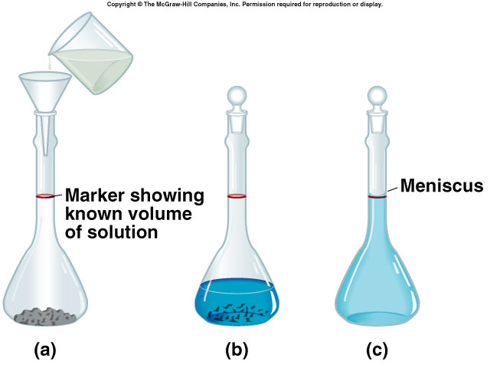
After calculating the weight required to prepare any given
solution, you do the following:

Slide 17
Preparation of Solutions from Liquid
Solutions are often prepared by diluting a more concentrated stock solution.
A known volume of the stock solution is transferred to a new container.
Make up the solution to a known volume.
Homogenize

Slide 18
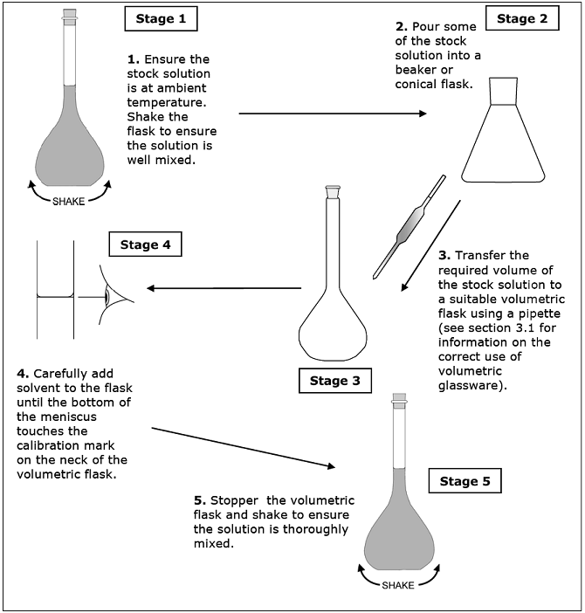

Slide 19
Dilutions
Dilution of solution:
When a solution is diluted, solvent is added to lower its concentration.
Means to add more solvent without the addition of more solute
To make it less concentrated.
The amount of solute remains constant before and after the dilution:
moles BEFORE = moles AFTER
C₁V₁ = C₂V₂

Slide 20
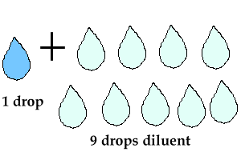
This type of dilutions describes the ratio of the solute to the final volume of the dilute solution.
For example: to make 1:10 dilution of 1M NaCl solution, one part of the 1M NaCl solution, should be mixed with nine parts of water, for a total of ten parts.
1:10 dilution means ➔1 part of 1M NaCl + 9 parts of water.
Thus:
if 10 ml of the 1:10 dilution was needed,
then 1ml of 1M NaCl should be mixed with 9 ml of water.
if 100 ml of 1:10 dilution was needed
then 10 ml of the 1M NaCl should be mixed with 90 ml of water.
[The final concentration of NaCl in both cases will be [0.1 M (1/10) = 0.1]

Slide 21
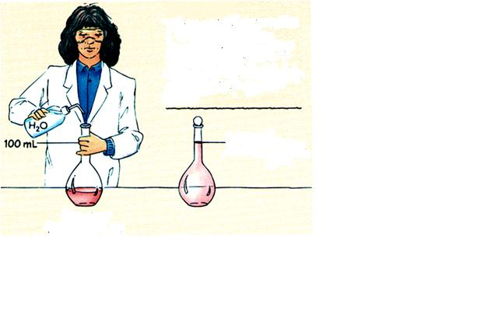
Example (1)
A bottle of 0.500 M standard sucrose stock solution is in the lab.
How can you use the stock solution to prepare 250 ml of a 0.348 M sucrose solution.
C₁X V₁= C₂X V₂
0.5 M X V₁= 0.348 M X 0.25 L
0.348 X 0.25 / 0.5 = 0.174 L
Therefore:
174 ml of the stock solution will be diluted with water
to reach the volume of 250 ml
Concentration 0.500 M Sucrose
250 mL of 0.348 M
sucrose

Slide 22
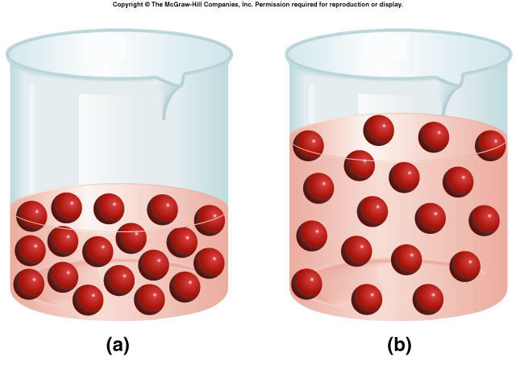
Dilution of Solutions
Always remember that the number of moles DOES NOT CHANGE

Slide 23
Example (2)
Describe how you would prepare 800mL of a 2.0M H₂SO₄ solution, starting with a 6.0M stock solution of H₂SO₄ .
800mL x 1L/ 1000mL
= 0.800L
C₁V₁ = C₂V₂
6.0M x V₁ = 2.0M x 0.800L
6.0M x V₁ = 1.6M x L
V₁ = 1.6M x L/ 6.0M
V₁ = 0.26L
0.26L of the 6.0M H₂SO₄ solution should be diluted to give a final volume of 800mL.

Slide 24
Example (3)
A 0.8 M HCl was diluted at final volume of 500ml.
If the new concentration is 0.20 M, what was the original volume of the solution?
How much water was added to make this happen?
A.
C₁V₁ = C₂V₂
0.8 M x V₁ = 0.20 M x 500 ml
0.8M x V₁ = 100
V₁ = 100/0.8
V₁ = 125ml of HCl
B.
V of water= (final volume _{of solution} )-( intial volume _{of aliquot})
V of water = 500ml – 125 ml
V of water = 375 ml

Slide 25
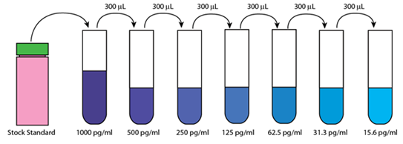
Serial Dilution
Serial Dilution
The progressive dilution of a substance or infectious agent in a series of tubes or wells in a tray in predetermined ratios.
Dilution starts first with stock solution and each diluted solution produced is used to prepare the next.
A serial dilution is any dilution where the concentration decreases by the same quantity in each successive step.
To calculate the concentration
use the equation:
C₁ V₁ = C₂V₂

Slide 26
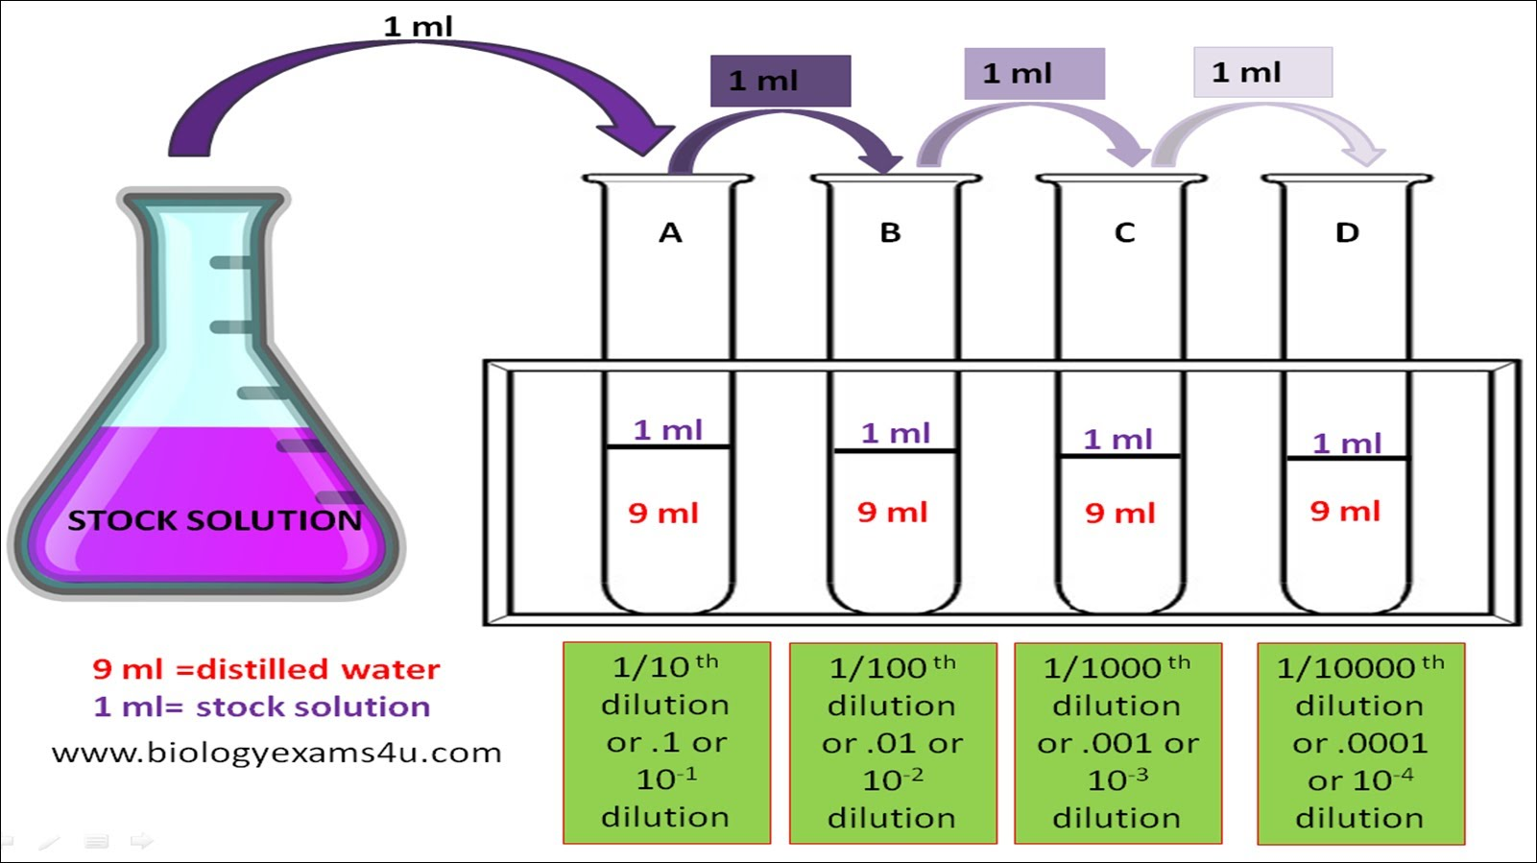
Linear Dilution
Same stock solution is used to produce samples of different concentrations.
To calculate the concentration: C₁ V₁ = C₂V₂

Slide 27
Importance of Dilution
Example (5)
175 mL of a 1.6 M aqueous solution of LiCl is diluted with water to a final volume of 1.0 L. What is the final concentration of the diluted solution?
C1 X V1= C2X V2
(1.6 M)(175 mL) = C₂(1000 mL)
C₂ = 0.28 M
Notes:
Lithium chloride

Slide 28
Dilution Factor
Dilution factor refers to the ratio of the volume of the initial (concentrated) solution to the volume of the final (dilute) solution.
To make a dilute solution without calculating concentrations use a dilution factor.
Divide the final volume by the initial volume.
DF=Vf / Vi
Vi = initial volume
Vf = final volume (aliquot volume + diluent volume)
DF of 100 = ratio 1:100
Volume of solute
Total volume

Slide 29









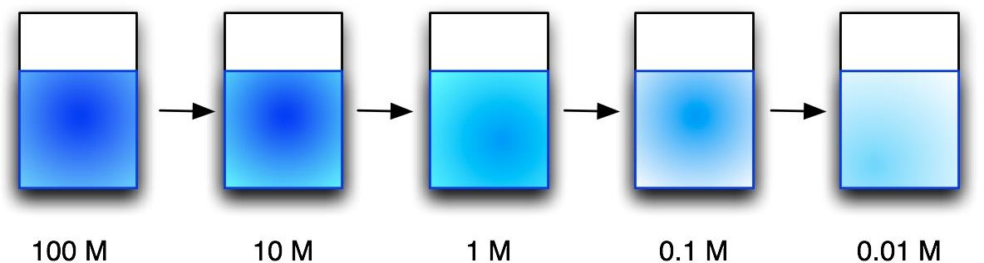









Dilution factor (D.F) = final volume / aliquot volume = 10 /1 = 10 (for each step)
From the lower concentrated solution to the higher one
X10 X10 X10 X10
÷10 ÷ 10 ÷ 10 ÷ 10
From the more concentrated solution to the lower one
8

Slide 30
Dilution Factor Continue
Example (1)
What is the dilution factor if you add 0.1 ml aliquot of a specimen to 9.9 ml of diluent?
The final volume is equal to the aliquot volume PLUS the diluent volume: 0.1 mL + 9.9 mL = 10 mL
The dilution factor is equal to the final volume divided by the aliquot volume:
Df = 10 mL/0.1 mL
= 1:100 dilution.

Slide 31
Dilution Factor Continue
Example (2)
What is the dilution factor when 0.2 ml is added to 3.8 ml diluent?
Dilution factor = final volume/aliquot volume
Final volume = 0.2 +3.8 = 4.0 ml
Aliquot volume = 0.2 ml
Df =Vf / Vi
Df = 4.0/0.2
= 1:20 dilution.

Slide 32
Dilution Factor Continue
Example (3)
From the previous example if you had 4 tubes what would be the final dilution of tube 4?
Since each dilution is 1:20 and we want to know the dilution of the FORTH tube so in this case it would be 1:20 multiplied FOUR times.
Df _{for the fourth tube} = 1:20 * 1:20 * 1:20 *1:20
= 1:160,000

Slide 33
Importance of Dilution
Example (4)
A blood glucose of 800 mg/dl was obtained. According to the manufacturer the highest glucose result which can be obtained on this particular instrument is 500 mg/dl.
The sample must be diluted.
The serum was diluted 1:10 and retested.
The result is 80 mg/dL.
THIS IS NOT THE REPORTALBE RESULT!
You must multiply by the dilution factor of 10.
10 x 80 = 800 mg/dl.

Slide 34
Do you have questions?

