Slide 1
Industrial microbiology
FERMENTATION
TECHNOLOGY

Slide 2
Introduction
Fermentation
Products
Industrial scale
Types
Advantages
Disadvantages
Summary
Contents

Slide 3
introduction
FERMENTATION TECHNOLOGY
microorganisms, grown on a large scale, to produce valuable commercial products or to carry out important chemical transformations.
FERMENTATION
Pasteur’s “life without air”,
Latin word fervere, to boil

Slide 4
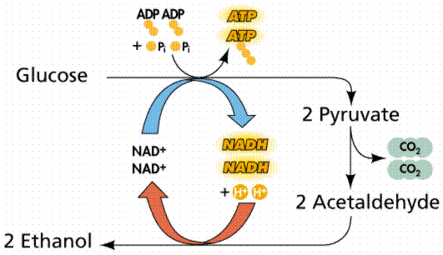
ZYMOLOGY OR ZYMURGY.
Eduard Buchner 1897
Fermented no living yeast cells in the mixture
1907, Nobel Prize in Chemistry

Slide 5
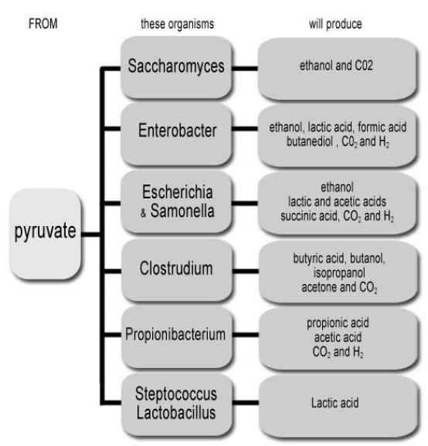

Slide 6
Some important fermentation products
Product | Organism | Use
Ethanol | Saccharomyces cerevisiae | Industrial solvents, beverages
Glycerol | Saccharomyces cerevisiae | Production of explosives
Lactic acid | Lactobacillus bulgaricus | Food and pharmaceutical
Acetone and butanol | Clostridium acetobutylicum | Solvents
α-amylase | Bacillus subtilis | Starch hydrolysis

Slide 7
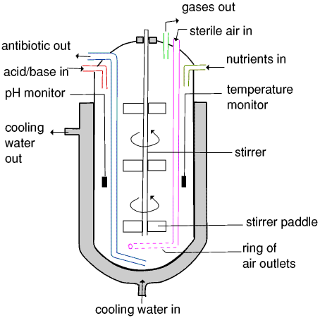
INDUSTRIAL SCALE
Fermentor is the basic equipment used for fermentation.
contains the media to carry out fermentation, and creates environment for fermentation at large scale.
http://web.ukonline.co.uk/webwise/spinneret/microbes/penici.htm)

Slide 8
REQUIREMENTS
Pure culture: organism, quantity, physiological state
Sterilised medium: for microorganism growth
Seed fermenter: inoculum to initiate process
Production fermenter: large model
Equipment i) drawing the culture medium
ii) cell separation iii) collection of cell
iv) product purification v) effluent treatment.

Slide 9
Fermentation techniques
surface (solid state) submersion techniques.
microorganisms cultivated on the surface of a liquid or solid substrate.
complicated and rarely used in industry.
Mushroom, bread, cocoa, tempeh
microorganisms grow in a liquid medium.
(biomass, protein, antibiotics, enzymes and sewage treatment) are carried out by submersion processes.

Slide 10
TYPES ON THE BASIS OF CULTURE
BATCH FERMENTATION
Sterile nutrient substrate , inoculated, grow until no more of the product is being made, "harvested" and cleaned out for another run.
lag phase (adapt to their surroundings)
exponential growth (grow in numbers)
stationary phase (stop growing)
death phase

Slide 12
CONTINUOUS FERMENTATION
Substrate is added continuously to the fermenter, and biomass or products are continuously removed at the same rate.
Under these conditions the cells remain in the logarithmic phase of growth
FED-BATCH FERMENTATION
Substrate increments as the fermentation progresses.
started as batchwise with a small substrate concentration.
Initial substrate is consumed, addition of fermentation medium

Slide 13
RANGE OF FERMENTATION
TECHNOLOGY
Microbial cell (Biomass) | Yeast
Microbial enzymes | Glucose isomerase
Microbial metabolites | Penicillin
Food products | Cheese, yoghurt, vinegar
Vitamins | B12, riboflavin

Slide 14
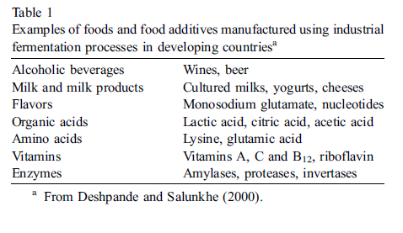

Slide 15
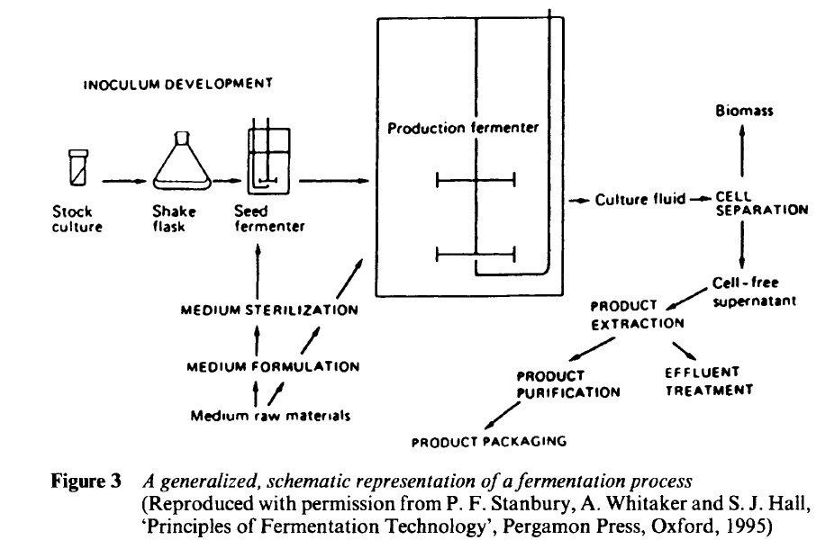
P.F. STANBURY, A. WHITAKER AND S. J. HALL, PRINCIPLES OF FERMENTATION TECHNOLOHY

Slide 16
ADVANTAGES
Preserves and enriches food, improves digestibility, and enhances the taste and flavour of foods.
Potential of enhancing food safety by controlling the growth and multiplication of a number of pathogens in foods.
Important contribution to human nutrition, particularly in developing countries, where economic problems pose a major barrier to ensuring food safety.

Slide 17
3- Low energy consumption due to the mild operating conditions relatively low capital and operating costs relatively simple technologies.
4- They cause highly specific and controlled changes to foods by using enzymes.
5- Preservation and detoxification of the food.
6- Waste treatment.
7- Health related product.

Slide 19
DISADVANTAGES
hazardous microbial contamination always exist in
fermented food
The uneven distribution of salt in lactic acid
fermented fish products and contamination of
Aspergillus flavus in traditional starter cultures for rice
wine and soybean sauce result in severe food poisoning incidences
Health(obesity, cancer)
C.H. LEE, 1989

Slide 21
References
Stanbury, P.F., A. Whitaker, and S. J. Hall, (2000) Principles of Fermentation Technology, 2nd ed., Butterworth Heinemann, Oxford.
Shuler, M. L. and F. Kargi., (2002). Bioprocess Engineering Basic Concepts, 2nd ed., Prentice Hall, Upper Saddle River, NJ,
Lee, C.H., (1989) Fish fermentation technology, Korean J. Applied Microbiology and Bioengineering, 17(6), 645-654
Daniel I. C., et al., (1979)“Fermentation and Enzyme Technology,”
John Wiley, New York .
Willey, J. M. Shrewood, L. M. (2008) Microbiology .7th ed. Mc Graw Hill.,1067-1069

Slide 22
