Slide 1
Work Charting Methods
Topics:
Pareto Chart – part 1
Fishbone (Cause-Effect) Diagram – part 1
Operation Process Charts – part 1
Flow Process Charts – part 1
Flow Diagrams – part 2
Worker and Machine Process Charts – part 2
Gang Process Charts – part 2
Two-Handed Process Charts – part 2

Slide 2
Objectives of Work Charting Methods
Objectively document the work task or process for analysis
Examine some of many available methods (new ones invented regularly)
Break down job into sub-components (tasks)
Describe the tasks in a meaningful way
Notes:
What do we mean by objectively? i.e. using values and quantities (not subjectively, e.g. high, low, etc.)

Slide 3
Work Charting Methods
Pareto Chart

Slide 4
1 - Pareto Chart
Items of interest:
identified
measured on a common scale
then ordered in ascending order
used to create a cumulative distribution
Pareto principle:
80% of total activity found in first 20% of items
Goal: identify appropriate 20% for analysis
e.g. 80% of inventory associated 20% of parts
e.g. 80% of injuries associated 20% of jobs
Notes:
* This is a partial repeat from chapter 2: “Introduction to Methods Engineering”

Slide 5
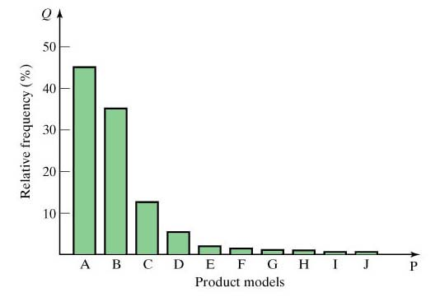
1 - Pareto Chart
Notes:
Q: can you interpret the above distribution? 20% of the models represent almost 80% (45 + 35) of the relative frequency (e.g. sales)

Slide 6
Work Charting Methods
Fishbone (Cause-Effect) Diagram

Slide 7
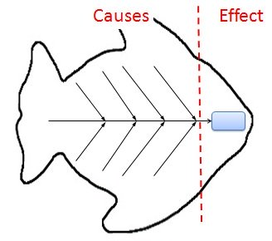
2 - Fishbone (Cause-Effect) Diagram
Identifies components that lead to undesirable event in a process
Event / problem / effect: identified at “fish head”
Associated contributing factors:
grouped into categories (shown in boxes)
potential root causes identified using tree type structure (using arrows)
Closely related to many different charts used in safety analysis (Fault-Tree method)
Notes:
* This is a partial repeat from chapter 2: “Introduction to Methods Engineering”

Slide 8
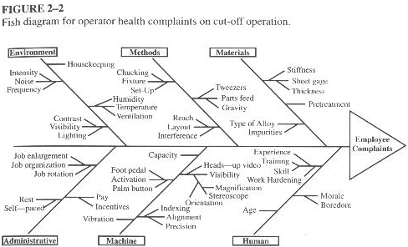
2 - Fishbone (Cause-Effect) Diagram

Slide 9
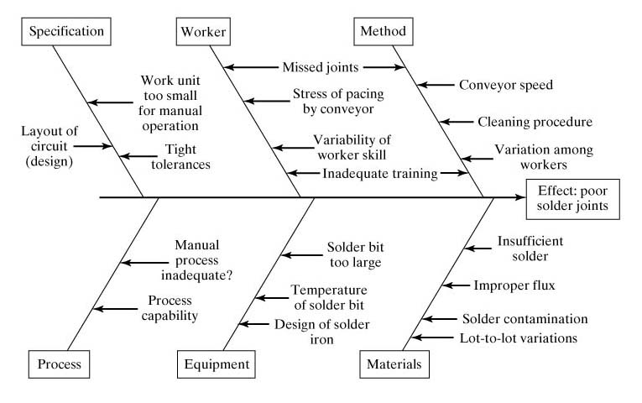
2 - Fishbone (Cause-Effect) Diagram
Notes:
Note how the categories for the contributing factors are almost the same in all cases (e.g. process/method, equipment/machine, materials, workers/humans, etc.)

Slide 10
2 - Fishbone (Cause-Effect) Diagram
Simple Fault-Tree
Notes:
Can you compare between fishbone diagram and fault-tree? (conditions here are compound unlike fishbone diagram)

Slide 11
Work Charting Methods
Operation Process Charts

Slide 12
3 - Operation Process Charts
Represents the chronological sequence of:
Operations
Inspections
Time allowances, and
Materials used in a process
Spans time from
arrival of raw material to
packaging of finished product
Focuses on products and/or facilities
Two symbols used in the chart (see next slide):
Operations: denoted using a small circle
Inspections: denoted using a small square

Slide 13
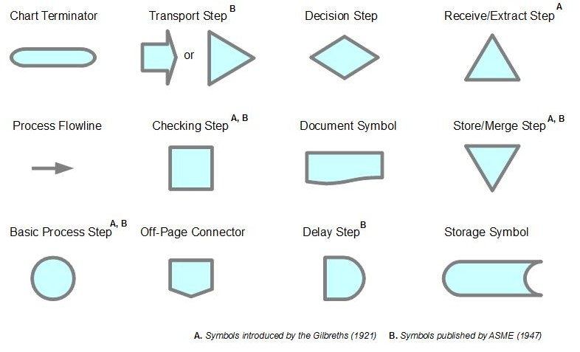
3 - Operation Process Charts
Process Flow Diagram Symbols
Notes:
Note how “process” and “operation” mean the same thing; same for “check” and “inspection”

Slide 14
3 - Operation Process Charts
Vertical lines: indicate general flow of process as work is completed
Horizontal lines feeding into vertical lines: parts or subassemblies (see next slide)
Lines should not cross in the chart.
Time* values are assigned on the chart to:
operations and
inspections
Notes:
Note, time values can be omitted from OPC’s (since they are analyzed in another type of chart; which will be mentioned in a future chapter)

Slide 15
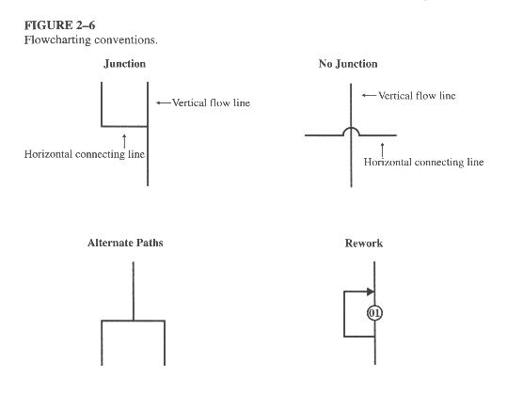
3 - Operation Process Charts
Notes:
Q: what is the difference between horizontal and vertical lines in operations? A: horizontal line: usually means more than operation at the same time; vertical line: denotes the next step (flow)

Slide 16
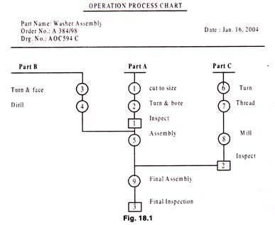
3 - Operation Process Charts
Notes:
Note how all operations here involve only inspections and operations; also in this type of OPC time values have been omitted.
Q: where are the junctions in this OPC (operation process chart)? A: between P-A and P-B; between P-A&B and P-C (note there are no reworks or alternative paths here)

Slide 17
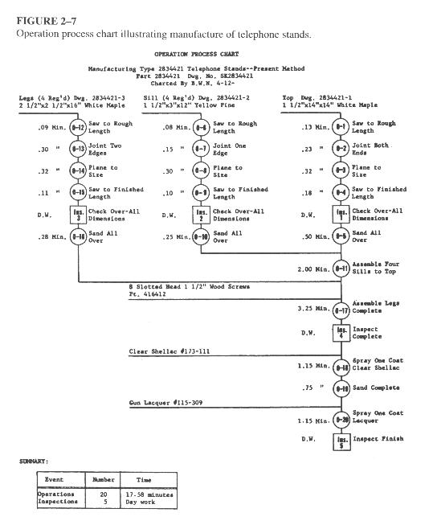
3 - Operation Process Charts
Notes:
Note how all operations here involve only inspections and operations, no matter how detailed or complex the process(es).
Q: how many operations and how many inspection? Can you trace the sequence (flow) of events in the process here? How many junctions?

Slide 18
Work Charting Methods
Flow Process Charts

Slide 19
4 - Flow Process Charts
Identify functions involved in making a part or completing a process:
Operations
Inspections
Materials
Moves
Storages and
Delays
Show all events in the correct sequence
Show the relationship between
Parts and
Fabrication complexity

Slide 20
4 - Flow Process Charts
Used for
Workers
Components, or
Sub-assemblies
Distinguish between
Produced and
Purchased parts.
Provide information on
Number of employees utilized and
Time* required to perform each
Operation and
Inspection
Notes:
* Time here is optional

Slide 21
4 - Flow Process Charts
More details than operations process charts
Two types are commonly used:
Product (or material)
Operative (or person)
Help identify nonproduction (hidden) costs:
Distances traveled
Delays, and
Temporary storage

Slide 22
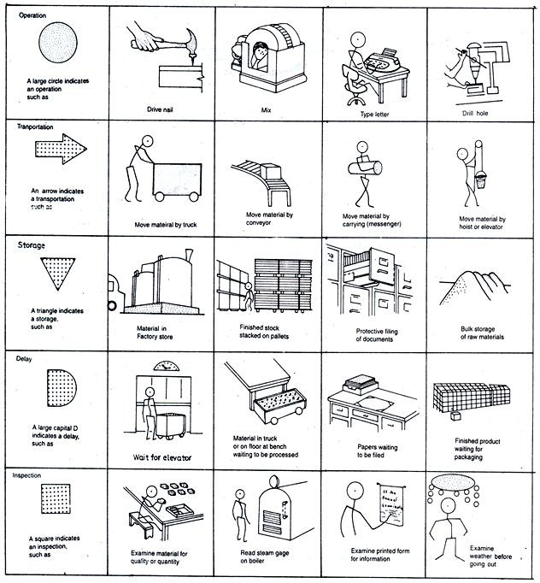
4 - Flow Process Charts
The ASME standard set of process chart symbols
Notes:
Note how mentioning of time here is omitted (since obtained from time study charts – to be discussed in a future chapter)
Fun fact: the five symbols can be easily memorized as: DISTO (like distance)

Slide 23
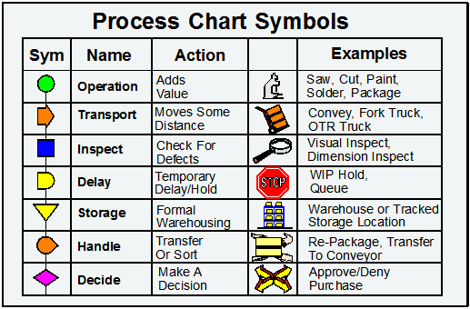
4 - Flow Process Charts
Notes:
Fun fact: the five symbols can be easily memorized as: DISTO (like distance)
Q: can you guess what the “handle” symbol consists of?

Slide 24
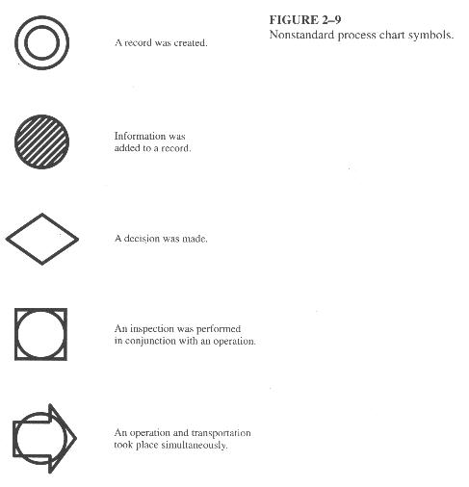
4 - Flow Process Charts
Notes:
Note how if nonstandard symbol (above) is used, priority (basis) is given to the one outside; e.g. last one is primarily transportation (with element of operation/production)

Slide 25
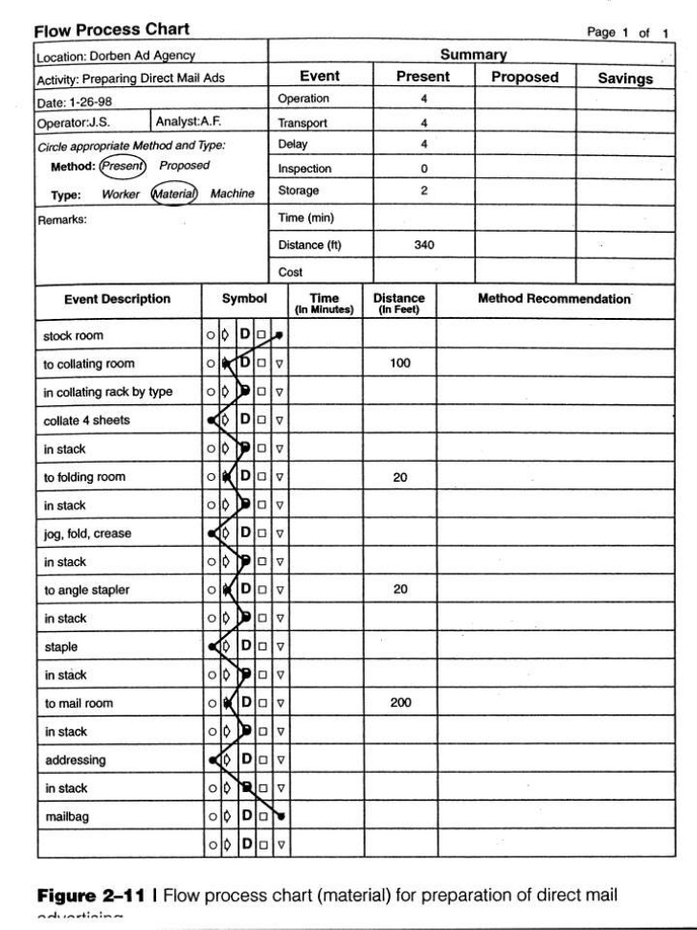
4 - Flow Process Charts
advertising
Notes:
Note how mentioning of time here is omitted (since obtained from time study charts – to be discussed in a future chapter)

Slide 26
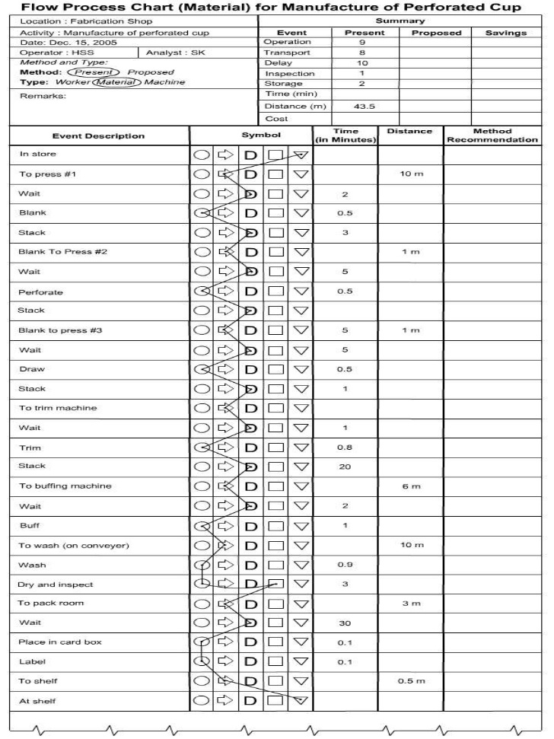
4 - Flow Process Charts
8
Notes:
Although time is mentioned here, the total event time (see top of FPC) is not mentioned, why?

Slide 27
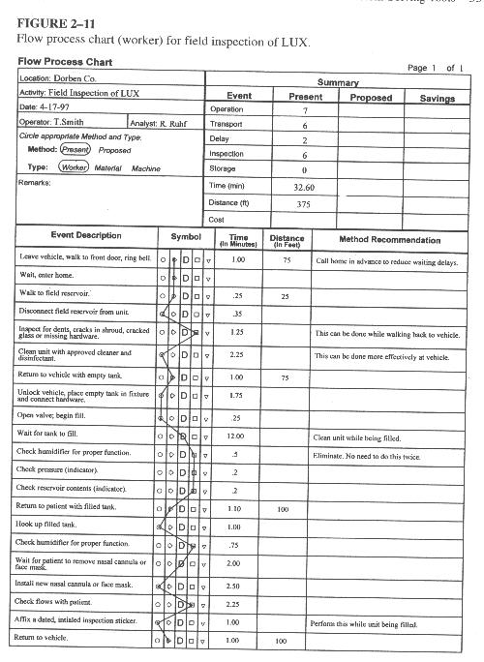
4 - Flow Process Charts
8
Notes:
Although time is mentioned here, the total event time (see top of FPC) is not mentioned, why?

