Slide 1
Work Charting Methods
Topics:
Pareto Chart – part 1
Fishbone (Cause-Effect) Diagram – part 1
Operation Process Charts – part 1
Flow Process Charts – part 1
Flow Diagrams – part 2
Worker and Machine Process Charts – part 2
Gang Process Charts – part 2
Two-Handed Process Charts – part 2

Slide 2
Objectives of Work Charting Methods
Objectively document the work task or process for analysis
Examine some of many available methods (new ones invented regularly)
Break down job into sub-components (tasks)
Describe the tasks in a meaningful way
Notes:
What do we mean by objectively? i.e. using values and quantities (not subjectively, e.g. high, low, etc.)

Slide 3
Work Charting Methods
Flow Diagrams

Slide 4
5 - Flow Diagrams
Diagram in a system representing
process flow or
set of dynamic relationships
Supplement flow process charts
Provides overhead pictorial plan of the facility
Examples:
structure and order a complex system
show structure of the elements and their interaction

Slide 5
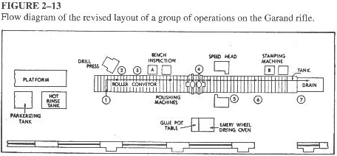
5 - Flow Diagrams

Slide 6
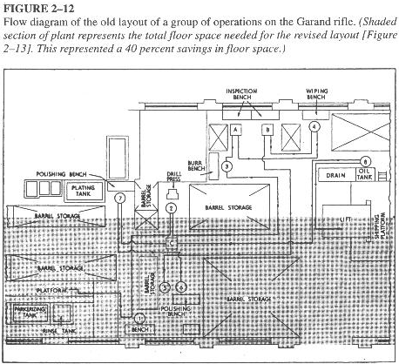
5 - Flow Diagrams

Slide 7
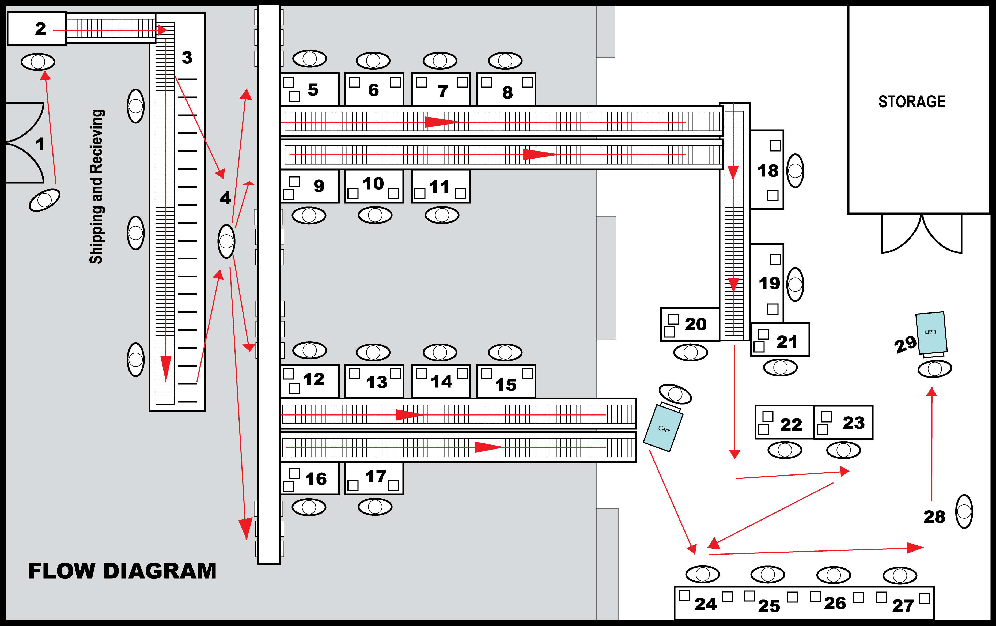
5 - Flow Diagrams

Slide 8
Work Charting Methods
Worker and Machine Process Charts

Slide 9
6 - Worker and Machine Process Charts
Show at a single workstation time relationship between:
working cycle of a person and
operating cycle of a machine(s)
Machine times and operator times must be known for each element
Chart drawn vertically to scale
Useful in describing any repetitive worker-machine system
Notes:
Q: what is meant to scale here? (A: time scale; e.g. shorter process times are shorter, and longer process times are longer)

Slide 10
6 - Worker and Machine Process Charts
Solid lines represent: productive time
Breaks indicate: idle time
Dotted lines represent: non-productive time

Slide 11
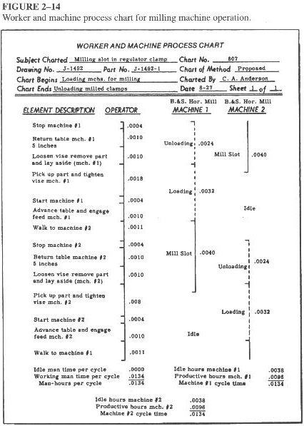
Notes:
Q: why does the line connecting the machine 1 and machine 2 time line appear dotted at the Unloading and Loading sections? (A: these are non-productive times)
Note how the cycle time for operator, machine 1, and machine 2 are all the same; also note how machine 1 and machine 2 are complementary (completing) each other

Slide 12
Work Charting Methods
Gang Process Charts

Slide 13
7 - Gang Process Charts
These are Worker and Machine Process charts showing
many workers
workers are interacting with a piece of equipment or a machine
Purpose: determine if interaction between workers is efficient and coordinated
Examples:
workers at a coal furnace
workers in a steel mill

Slide 14
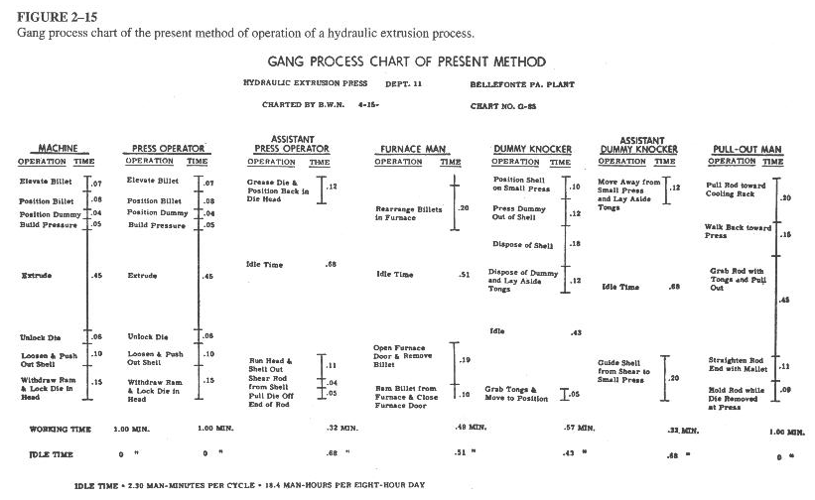
7 - Gang Process Charts
Notes:
Note the following: there are 6 operators, all working with the same cycle time; also note how times (all in min.) are drawn vertically to scale

Slide 15
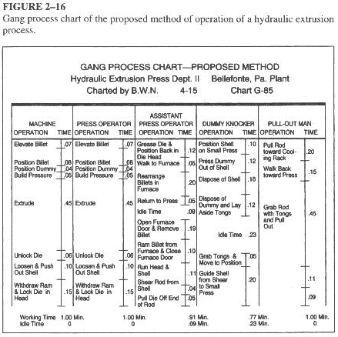
7 - Gang Process Charts
Notes:
Note how all operators are working in coordination

Slide 16
Work Charting Methods
Two-Handed Process Charts

Slide 17
8 - Two-Handed Process Charts
Left-hand / right-hand chart
Operator process chart
Flow process chart directed at an operator
Each hand is documented separately
Activities of worker’s hands (or limbs): recorded in their relationship to one another
Useful when doing work methods analysis

Slide 18
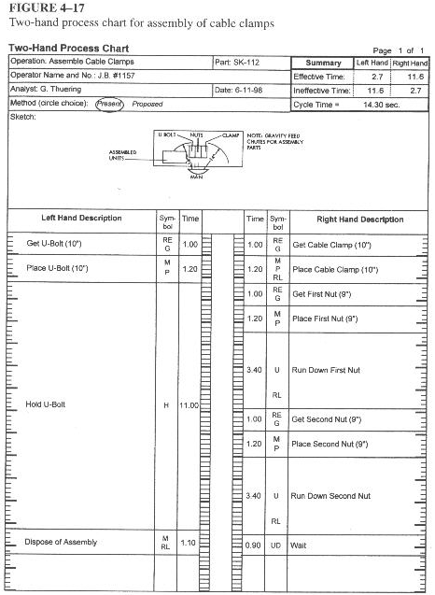
Notes:
Note how this is work designed for right-handed people (right-hand work represents about 80%); also note how two hands are not working simultaneously (effective time in one hand is balanced with ineffective time in the other hand)

Slide 19
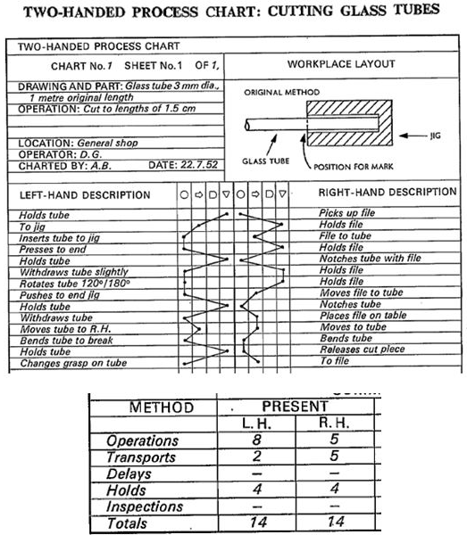
8 - Two-Handed Process Charts
Notes:
Read more about two-handed process charts: http://tohproblemkyahai.com/left-hand-right-hand-chart-two-handed-process-chart/

