Slide 1
King Saud University College of Engineering IE – 341: “Human Factors” Fall – 2015 (1st Sem. 1436-7H)
Human Capabilities
Part – C. Vision (Chapter 4)
Prepared by: Ahmed M. El-Sherbeeny, PhD

Slide 2
Lesson Overview: Vision
Process of Seeing (Vision)
Visual Capabilities
Accommodation
Visual Acuity
Convergence
Color Discrimination
Dark Adaptation
Perception
Factors Affecting Visual Discrimination
Luminance Level
Contrast
Exposure Time
Target Motion
Age
Training

Slide 3
Cont. Lesson Overview: Vision
Alphanumeric Displays
Characteristics
Typography
Typography Features
Hardcopy
Visual Display Terminals (VDT)
Graphic Representations
Symbols
Codes

Slide 4
Process of Seeing (Vision)

Slide 5
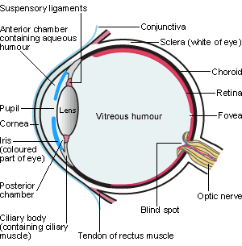

Slide 6
Process of Seeing (Vision)
The human eye works like a camera.
Light rays reflected from object
enter the transparent cornea
pass through
clear fluid (aqueous humor) that fills the space between the cornea
and the pupil (a circular variable aperture)
and adjustable lens behind the cornea (light rays are transmitted and focused)
Close objects: lens bulges
Distant objects: lens relaxes (flattens)
Muscles of the iris change size of pupil:
larger in the dark, (about 8 mm diameter; dilation)
smaller in bright conditions (2 mm; constriction)

Slide 7
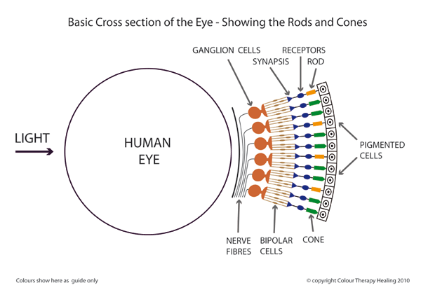
Cont. Process of Seeing (Vision)
Light rays transmitted through pupil to lens
refracted by adjustable lens
then transverse the vitreous humor (a clear jellylike fluid filling the eyeball, behind the lens).
In normal or corrected vision persons
light rays are focused exactly on the sensitive retina
The retina consists of
about 6 to 7 million cones
receive daytime, color vision
concentrated near center of retina (fovea)
and about 130 million rods
rods important in dim light, night.
distributed in the outer retina, around the sides of the eyeball.

Slide 8
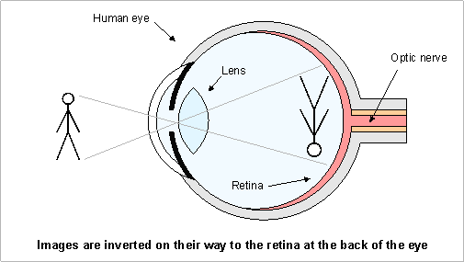
Cont. Process of Seeing (Vision)
Greatest sensitivity is in the fovea
the “dead center” of the retina
For clear vision, the eye must be directed so that the image of the object is focused on the fovea.
The image on the retina is inverted.
Cones and rods connected to optic nerve
Transmits neural impulses to the brain which integrates impulses, giving visual impression of object
process also corrects inverted image on the retina.

Slide 9
Visual Capabilities: 1. Accommodation
Accommodation: ability of the lens to focus light rays on the retina
Near point: closest distance possible for focus (i.e. any closer will be blurry)
Far point: farthest dist. for focus (usu. = ∞)
Diopter: measure of focus (for eye, camera)
Diopter [D] = 1 / target distance
e.g. 1 D = 1 m; 2 D = 0.5 m; 3 D = 0.33 m; 0 D =∞
More powerful lens ⇒ higher diopters
Dark focus: eye accommod. in dark (=1D)
Nearsightedness (myopia):far point: too close; i.e. lens remains bulged with far objects
Farsightedness: near point: too far (i.e. can’t see close objects); lens: flat for close objects

Slide 10
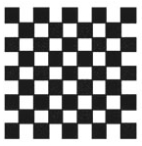
Visual Capabilities: 2. Visual Acuity
Visual Acuity:
ability of eye to discriminate fine details
depends largely on accommodation
Minimum separable acuity:
most common measure of VA
Def^{n}: smallest feature or space between the parts of a target (e.g. letter ‘E’ below) that eye can detect
Visual angle: (<10º):
H = stimulus height
D = dist. from eye
H,D: same units
Normal VA = 1 min.
Note, 1º = 60 min.

Slide 11
Visual Capabilities: 2. Visual Acuity
Cont. Visual angle (VA):
reciprocal of VA (for smallest detail that eye can see) is used as measure for visual acuity
i.e. Visual Acuity = [1 / VA]
e.g. VA = 1.5 min. ⇒ Acuity = 0.67
e.g. VA = 0.8 min. ⇒ Acuity = 1.25
Note, as acuity ↑ ⇒ detail that can be resolved is ↓
Clinical testing: D = 20 ft (i.e. 6 m) from chart
e.g. Snellen acuity: 20/30 (6/9) ⇒ person barely reads @ 20 ft what normal (20/20, 6/6) person reads @ 30 ft
e.g. 20/10 ⇒ person reads @ 20 ft what normal person must bring to 10 ft to read (far- or near-sightedness?)
e.g. 20/20 ⇒ resolving 1 min. arc of detail @ 20 ft (normal vision)
e.g. Given VA = 1.75 min. ⇒ Snellen Acuity = 20 / x i.e. x = (20) (1.75) = 35 ⇒ Snellen Acuity = 20 / 35

Slide 12
Visual Capabilities: 2. Visual Acuity
Other types of visual acuity measures:
Vernier acuity: ability to differentiate the lateral displacement of one line from another Minimum perceptible acuity: ability to detect a spot from its background Stereoscopic acuity: ability to differentiate different images received by the retinas of the two eyes of a single object with depth (i.e. converting 2D → 3D).
Most difference is when the object is near the eyes.
Try the following game to see if you have Stereo vision
Center your nose over the brown eye and focus on the eye
Put a free thumb in front of your nose
Continue to focus on the eye
If both eyes are on, you see two thumbs framing one eye.
Now, switch your focus to your thumb
You should see two eyes framing one thumb
Source: http://www.vision3d.com/frame.html

Slide 13
Visual Capabilities: 3. Convergence
Two eyes must converge on an object ⇒
images of the object on the two retinas are in corresponding positions to get the impression of a single object (the images are fused).
Convergence is controlled by muscles surrounding the eyeball.
Some individuals converge too much
others tend not to converge enough
These two conditions are called phorias
This cause double images which are visually uncomfortable and may cause muscular stresses and strains
Orthoptics:
aims to strengthen eye muscles to correct common eye problems (e.g. convergence insufficiency)

Slide 14
Visual Capabilities: 4. Color Discrimination
Cones
Located in fovea (center of retina)
basis for color discrimination
3 types of cones, each sensitive to light wavelengths corresponding to primary colors: Red, Green, Blue
In dark: cones not activated ⇒ no color is visible
Color vision:
Trichromats: people distinguishing different colors
Color deficiency (color blind):
Monochromats (v. v. rare): non-color vision
Dichromats: deficiency in red or green cones
Inherted or acquired (e.g. accident or disease)
Existent in ~ 8% males and 0.5% females
Poorer performance in practical tasks vs. trichromats (e.g. traffic signals)

Slide 15
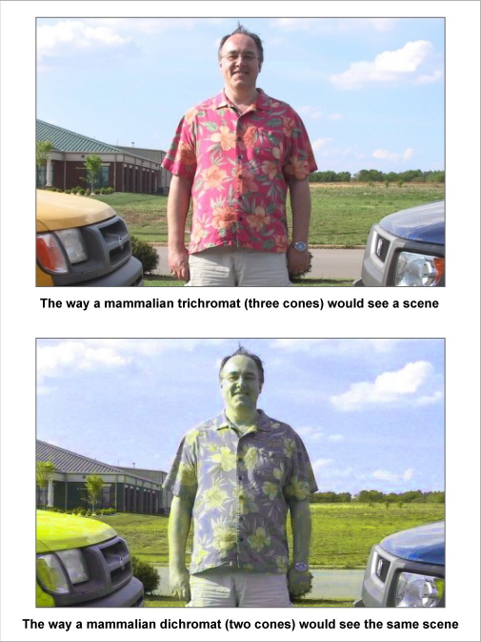
Visual Capabilities: 4. Color Discrimination
Color Images:
This slide: trichromat vs. dichromat
Optical Illusions
Next slide: “rotating turtles”
Slide 17: “doughnut of rotating snakes”
Note slides 16, 17: static -not dynamic- images! (how?????)
Source (much more fun): www.diycalculator.com/ sp-cvision.shtml

Slide 16
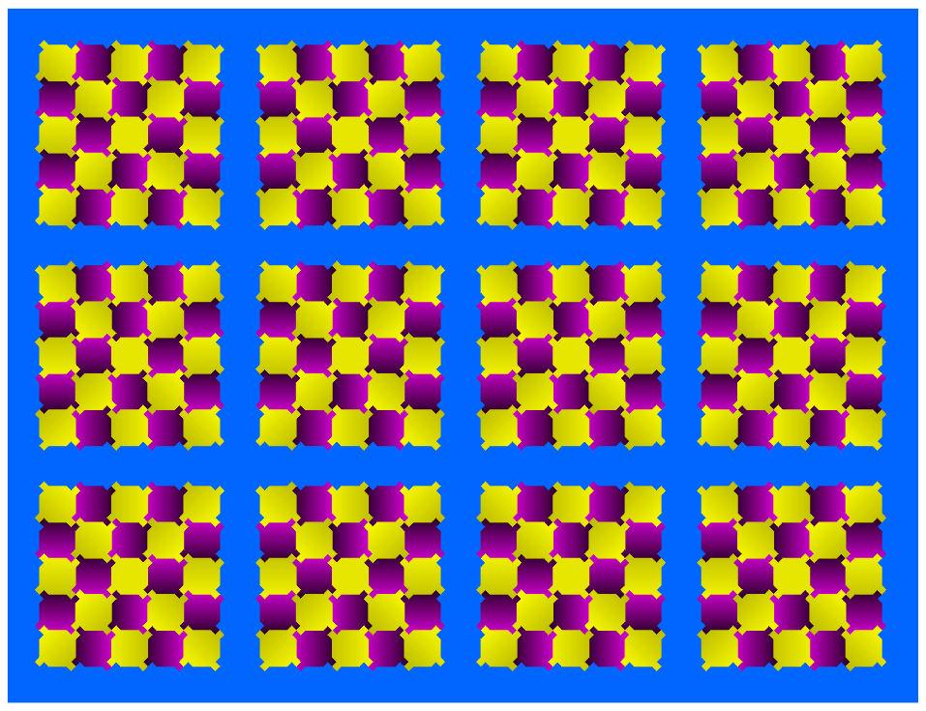
Visual Capabilities: 4. Color Discrimination

Slide 17
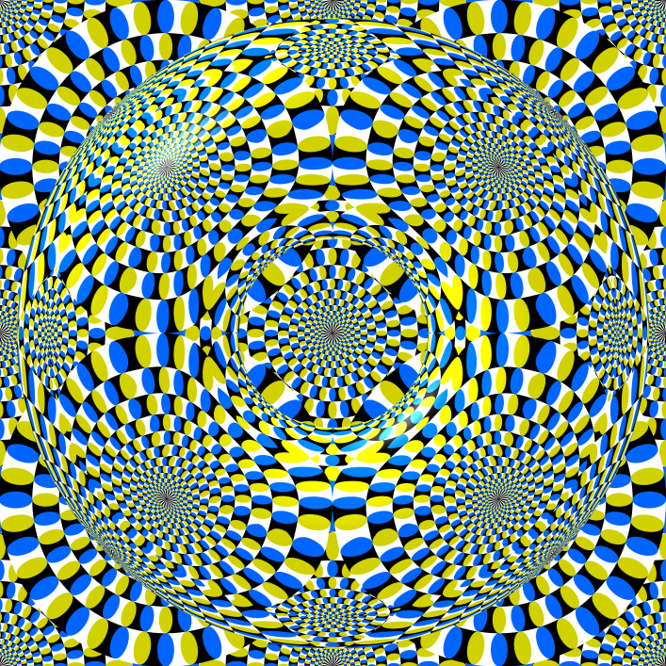

Slide 18
Visual Capabilities: 5. Adaptation
Adaptation: changes in sensitivity to light
Entering dark room:
This is dark adaptation
Pupil increases in size ⇒ more light enter eyes
Sensitivity of eye ↑ gradually (up to 30-35 mins.)
Cones lose most sensitivity in dark (mostly rods)
Exiting dark room to light
This is light adaptation
Pupil contracts to limit light entering eyes
Adaptation requires about 1 min. (why faster?)
More light ⇒ cones are activated

Slide 19
Visual Capabilities: 6. Perception
When viewing visual displays
Displayed features and information may not be enough to make appropriate decisions
Meaning of displayed information must also be understood
Perception: interpreting sensed information
The interpretation process
sometimes straightforward
most displays: depends on previous learning (experience or training)
Visual displays design must meet 2 objectives
display must be seen clearly
design must help viewer to correctly perceive/understand meaning of display

Slide 20
Factors Affecting Visual Discrimination
Visual discrimination depends mostly on visual acuity.
Some factors external to the individual affect visual discrimination:
Luminance Level:
As light or background light levels ↑
⇒ cones are activated ⇒ visual acuity ↑
This is required for complex, intricate tasks
Contrast (AKA brightness contrast):
Refers to difference in luminance of viewed objects
Most important consideration: difference in luminance between: object (target) and background
When contrast is low, target must be larger to be equally discriminable to target with greater contrast

Slide 21
Cont. Factors Affecting Vis. Discrimin.
Cont. Contrast:
Measure # 1: Michelson Contrast: measures deviation above and below a mean luminance
L_{MAX}: max. luminance in pattern
L_{min}: min. luminance in pattern
Note, MC varies bet. 0 and 1
Measure # 2: Luminous Contrast :
Measure # 3: Contrast Ratio:
it’s recommended to have CR:
3:1 for target: adjacent surrounding
10:1 for target: remote darker area
1:10 for target: remote lighter area
Note, Can you show the mathematical relation between each of these 3 formulae?

Slide 22
Cont. Factors Affecting Vis. Discrimin.
Exposure Time:
Under high illumination
As exposure time ↑ ⇒ Acuity ↑ for first 100-200 ms.
After that acuity levels off
Target Motion:
Acuity ↓ with motion of:
Target
Observer
or Both
Dynamic visual acuity:
Ability to make visual discriminations under such conditions (e.g. driver looking at objects on sidewalk)
This acuity rapidly ↓ as rate of motion ↑

Slide 23
Cont. Factors Affecting Vis. Discrimin.
Age:
Visual acuity, contrast sensitivity (ability to see details at low contrast levels) ↓ with age
Decline starts at age 40
At age 75: acuity = 20/30
⇒ visual displays for old people must provide:
Large targets
Adequate illumination
Training:
Besides contacts, glasses, eye surgery, vision can be improved by:
Training to improve focus
Improves Snellen acuity by 14%
Improves contrast sensitivity by 32%
Dynamic visual acuity can be improved with practice

Slide 24
Alphanumeric Displays
Most important characteristics:
Visibility:
quality of the character that makes it separately visible from its surroundings (i.e. detectability)
Legibility:
attribute that makes a character identifiable from others (i.e. discriminability)
depends on stroke width, form of characters, contrast, and illumination
Readability
ability to recognize information content of material when represented by alphanumeric characters, words, sentences (i.e. meaningfulness)
depends more on spacing between lines and letters, etc. than on specific features of characters

Slide 25
Alphanumeric Displays: Typography
Typography≡ various features of alphanumeric displays
Circumstances when it is important to use preferred forms of typography:
Viewing conditions are unfavorable (e.g. low illumination, limited viewing time)
Information is important/critical (e.g. emergency labels, important instructions)
Viewing occurs at a distance
Displays for low vision people
Note, above forms must still satisfy all conditions mentioned in last slide
When faced with ≥ 1 of these conditions, typography features must be considered:

Slide 26
A-N Displays: Typography Features
Hardcopy
Stroke Width
Width-height Ratio
Styles of Type
Size of Characters
at Reading Distance
at a Distance
Layout of Characters
VDT Screens
Illuminated Alphanumeric Characters
Character Distance and Size

Slide 27
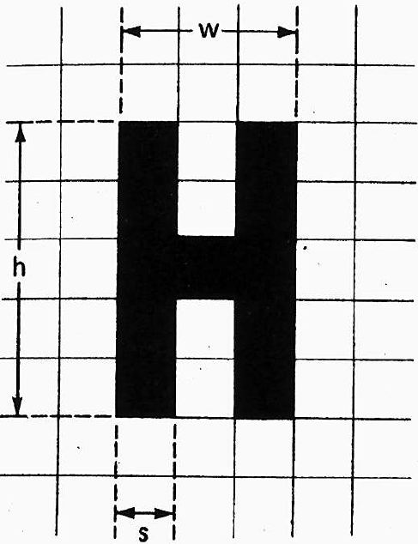
A-N Displays: 1. Stroke Width
Stroke-Width-to-height-ratio ≡ ratio of the thickness of the stroke (s) to the height (h) of the letter/number (stroke ratio for short)
Example (right):
Stroke width-to-height:1:5 = 0.2
Note, width-to-height: 3:5 = 0.6
Stroke Width is affected by:
Background
black on white or
white on black
Illumination

Slide 28
A-N Displays: 1. Stroke Width (Cont.)
Irradiation:
causes white features on a black background to appear to ‘spread’ into adjacent dark areas
But reverse (black on white) isn’t true (no spread)
Thus, black-on-white letters should be thicker i.e. lower ratios than white-on-black letters
With good illumination, stroke width ratios:
Black on white: 1:6 to 1:8
White on black: 1:8 to 1:10
With reduced illumination:
Thick letters become more readable (both types above)
Letters should be: boldface with low stroke ratios (e.g. 1:5)
For highly luminous letters, ratios: 1:12 to 1:20.
For black letters on a very highly luminous background, very thick strokes are needed

Slide 29
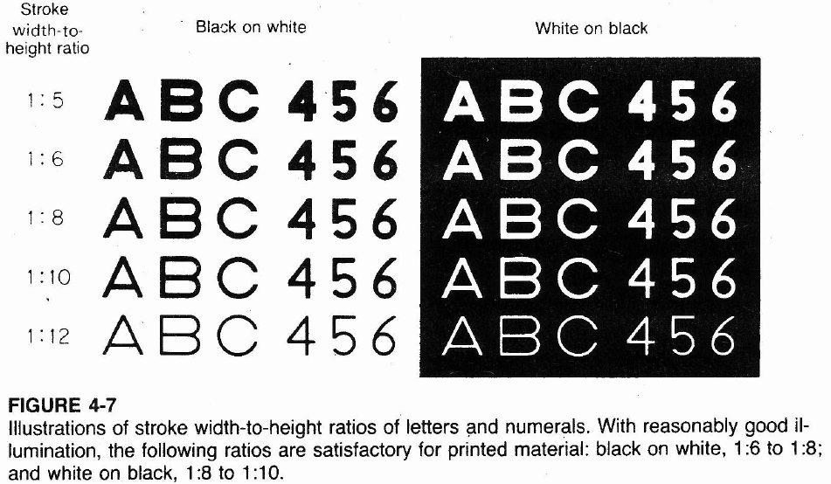
A-N Displays: 1. Stroke Width (Cont.)

Slide 30
A-N Displays: 2. Width-height ratio
Width-to-height (AKA width-height ratio):
Relationship between width and height of alphanumeric character
Expressed as ratio (e.g. 3:5 = 0.6; back 3 slides)
e.g. B: width-height ratio = 3:5
3 vertical strokes (or layers)
5 horizontal strokes
Most letters can be expressed with ratio 3:5
Heglin:
Disagrees with fixed ratios for letters:
For O: perfect circle
For A and V: equilateral triangles

Slide 31
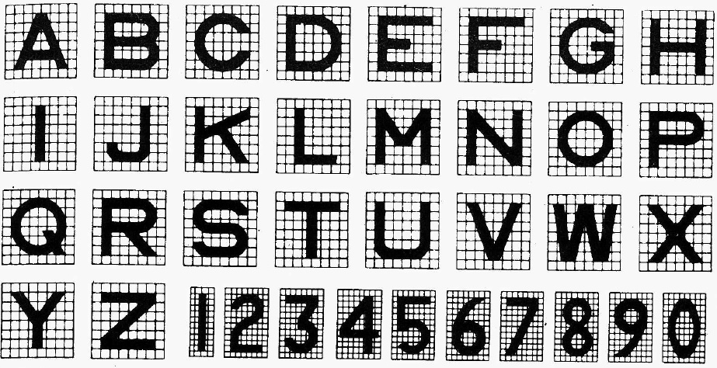
A-N Displays: 2. Width-height Cont.
Cont. width-height ratio
3:5 satisfactory for most purposes
wider letters: appropriate certain circumstances:
e.g. engraved legends
such cases 1:1 ratios are more appropriate
Below: letters: 1:1 (except?); numbers: 3:5 (except?)

Slide 32
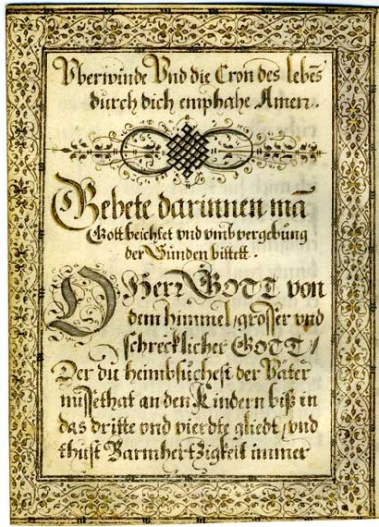
A-N Displays: 3. Styles of Type
Styles (AKA typefaces, fonts of type)
> 30,000 exist!
4 major classes (each including many types)
Roman: most common class; letters have serifs (little flourishes, embellishments)
Sans serif (AKA Gothic): uniform stroke width;
Script: simulate modern handwriting. (eg wedding cards)
Block Letter: resembles German manuscript handwriting used in the fifteenth century (above)
Roman: most used styles for conventional text
Italics: emphasis, titles, names, special words, etc
Boldface: headings, labels, special emphasis, legibility in poor reading conditions
Last slide: style used for military (non-standard)
Notes:
Watch this great video on the font, “comic sans”: http://youtu.be/GUCcObwIsOs

Slide 33
A-N Displays: 4. Character Size
Points:
used to measure size of type in printing business
1 point (pt) = 1/72 in. (0.35 mm)
this is the height of the slug on which the type is set, e.g.
tail of the letter “q” (called descender)
top of letter “h” (called ascender)
space between lines of text
Capital letters
Better approximation to letter size:
1 pt = 1/100 in. (0.25 mm)
e.g. letter size, with slug size, heights of cap. letters (in.):
This line is set in 4-pt type (slug = 0.055; letters = 0.04).
This line is set in 6-pt type (slug = 0.084; letters = 0.06).
This line is set in 8-pt type (slug = 0.111; letters = 0.08).
This line is set in 9-pt type (slug = 0.125; letters = 0.09).
This line is set in 10-pt type (slug = 0.139; letters = 0.10).
This line is set in 11-pt type (slug = 0.153; letters = 0.11).
This line is set in 12-pt type (slug = 0.167; letters = 0.12).

Slide 34
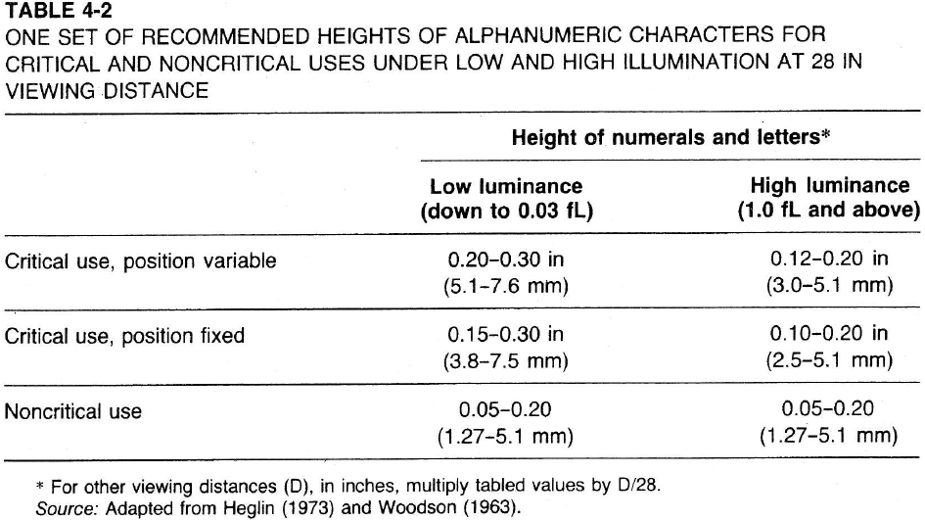
A-N Displays: 4. Size (Cont.)
For Close-Up Reading:
Normal reading distance (e.g. book)
12-16 in.
14 in. (35.5 cm): nominal reading distance
Type size in most printed material
from 7 to 14 pt
most common about 9 to 11 pt
i.e. letters = 0.09 – 0.11 in. (2.3-2.8 mm; VA = 22-27 min??)
Character heights should be increased:
poor illumination (see table)

Slide 35
A-N Displays: 4. Size (Cont.)
For Distance Reading:
Readability and legibility of alphanumeric characters are equal at various distances, provided that:
As viewing distance ↑ ⇒
Characters size ↑ (and vice versa) ⇒
VA (visual angle) subtended at the eye stays the same
Formula: letter height as function of distance and Snellen visual acuity:
W_{s}= 1.45 * 10⁻⁵ * S * d
H_{L} = W_{s}/R
W_{s}, d, H_{L} must be in same units (mm, in.)
W_{s}: stroke width
S: denom. of Snellen visual acuity (e.g. acuity = 20/40 ⇒ S = 40)
d: reading distance
H_{L}: letter height
R: stroke width-to-height ratio of font (e.g. R = 0.20 for ratio: 1:5)
For low illumination, low contrast ⇒ use large letters
Design signs for people with at best: Snellen acuity:20/40

Slide 36
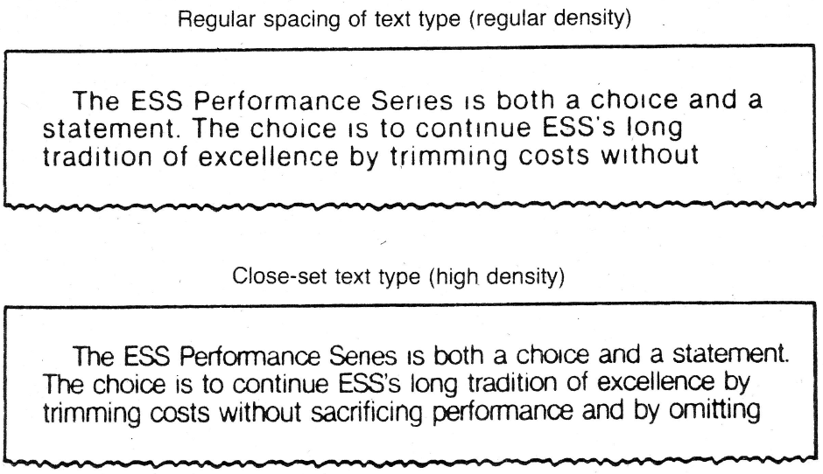
A-N Displays: 5. Layout of Characters
Previous discussion: design of characters
Layout of characters can influence reading:
Interletter Spacing:
i.e. how “tight” are letters packed (i.e. density)
High-density letters: read faster than low density
Reason: more characters viewable in quality visual field (i.e. fovea) at each fixation (see figure below)
Interline Spacing:
More spacing ⇒ ↑ text clarity
Less spacing ⇒ eye strain, headache

Slide 37
A-N Displays: 6. Illuminated AN Characters
Characters also presented on
VDT (visual display terminal), AKA:
VDU (visual display unit, i.e. computer screen)
Characters on VDT
readable: 20-30% slower than on hardcopy
reason:
Dot-matrix VDT: composed of pixels “picture elements”
Horiz. line of pixels form “raster scan” or scan lines
Pixels are lit (turned “on” and “off” to form images)
e.g. 640 * 480 VDT screen: 480 lines by 640 pixels
Higher “resolution” ⇒ more pixels per image ⇒ less difference between reading from VDT vs. hardcopy
Lower resolution (or old VDT): poor accommodation

Slide 38
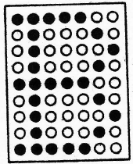
A-N Displays: 6. Illuminated Characters (Cont.)
Dot-Matrix displays:
Characters made up of a matrix of pixels
Individual character: matrix 5 * 7 to 15 * 24
See e.g. below: 7 * 9 dot matrix letter ‘B’
Note, ALL letters/numbers can be created on this formation of dots
7 * 9: minimum size for reading continuous text
Small matrices (e.g. 5 * 7):
individual matrix pixels: visible
⇒ reading is affected
Large matrices:
Individual pixels: not distinct
⇒ performance improves

Slide 39
A-N Displays: 7. Distance & Size (VDT)
Distance
VDT Viewed normally farther than hardcopy text
Eye-to-screen distances:
24-36 in. (61-93 cm)
Mean: 30 in. (76 cm)
ANSI standard: viewing monitor: upright position
18-20 in.
Take 20 in. (50 cm): nominal VDT reading distance
Size
At 20 in. reading distance
Recommended subtended VA = 11-12 min. of arc
⇒ character height = 0.06–0.07 in. (1.5-1.8 mm) (?)
This is smaller than for hardcopy (0.09-0.11 in.)

Slide 40
A-N Displays: 7. Distance & Size (cont.)
Size (Cont.)
ANSI: size for high legibility reading (@ 20 in.)
Minimum: 16 min. ⇒ Height = 0.09 in. (2.3 mm)
Preferred: 20-22 min. ⇒ 0.116-0.128 in. (2.9 – 3.3 mm) Note, these are closer to hardcopy reading heights
Maximum: 24 min. ⇒ 0.14 in. (3.6 mm)
This is threshold height for comfortable reading
When character size ↑ ⇒ more foveal fixation required

Slide 41
GRAPHIC REPRESENTATIONS
Graphic Representations of Text
Pictorial information: important for speed
Text information: important for accuracy
Instructional material: should combine:
Pictures + Text ⇒ speed + accuracy + retention
Graphic Representations of Data
Data graphs:
e.g. Pie charts, bar charts, line graphs
2-D graphs, 3-D graphs
graph should be
consistent with numerical data
Properly, clearly labelled (all variables, units, etc.)
Some representations: distort data perception
e.g. May change differences between 2 variables
e.g. May give impression of false increases (next)

Slide 42
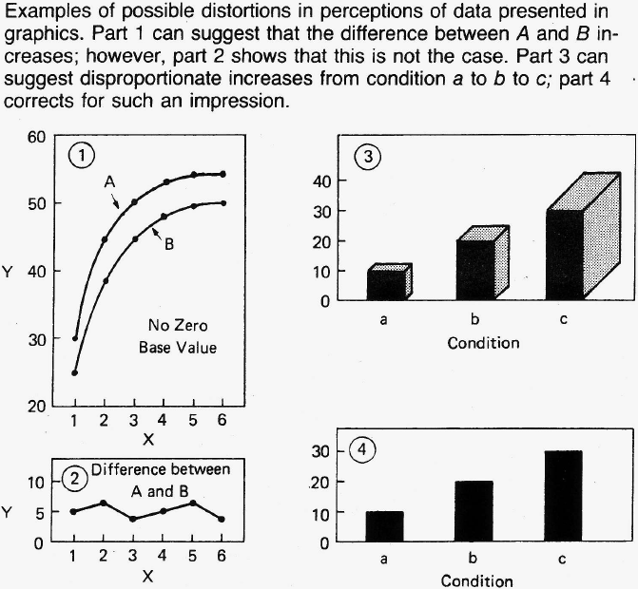
GRAPHIC REPRESENTATIONS (cont.)

Slide 43
SYMBOLS
Visual symbols should be very clear
e.g. men vs. women restroom sign
Comparison of Symbolic & Verbal Signs
Verbal sign may require “recoding” (i.e. interpretation)
E.g. sign saying “beware of camels”
Symbols mostly do not require “recoding”
E.g. Road sign showing camels crossing
⇒ no recoding (i.e. immediate meaning)
Note, some symbols require learning & recoding
Ells and Dewar (1979):
Conducted study on traffic signs and symbols
Mean reaction time for correct response was less for symbols

Slide 44
SYMBOLS (cont.)
Objectives of Symbolic Coding Systems
Symbolic coding system consists of:
symbols: that best represent their referents
referents: concept that symbol represents
Objective: strong association: symbol-referent
Association depends on:
any established association, “recognizability”
ease of learning such an association
Guidelines for using coding systems (discussed earlier)
Detectability
Discriminability
Compatibility
Meaningfulness
Standardization

Slide 45
SYMBOLS (cont.)
Symbols:
Either are used confidently
Tested experimentally for suitability
Criteria for Selecting Coding symbols
Recognition: Subjects presented with symbols and asked:
to write down
or say what each represents
Matching:
symbols are presented to subjects along with a list of all referents represented
Subjects match each symbol with its referent
⇒ confusion matrix : indicating number of times each symbol is confused with every other one
Also reaction time may be measured

Slide 46
SYMBOLS (cont.)
Criteria for Selecting Coding symbols (cont)
Preferences and Opinions: subjects are asked to express their preferences or opinions about design of symbols
Examples of Code Symbol Studies
Mandatory-Action Symbols
E.g.: “recognition” testing of symbols + training

Slide 47
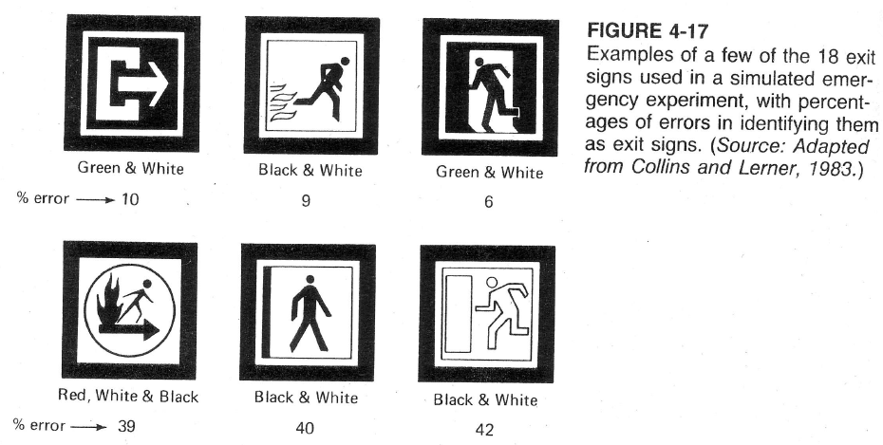
SYMBOLS (cont.)
Examples of Code Symbol Studies (cont.)
Comparison of Exit Symbols for Visibility:
Example of symbol recognition/matching
Note, Some “no-exit” symbols: perceived as “exit”!

Slide 48
SYMBOLS (cont.)
Examples of Code Symbol Studies (cont.)
Generalizations about features of signs
Filled figures superior to outline figures
Square or rectangular backgrounds: better identified than circular figures
Simplified figures (i.e. reduced number of symbol elements) are better than complex figures

Slide 49
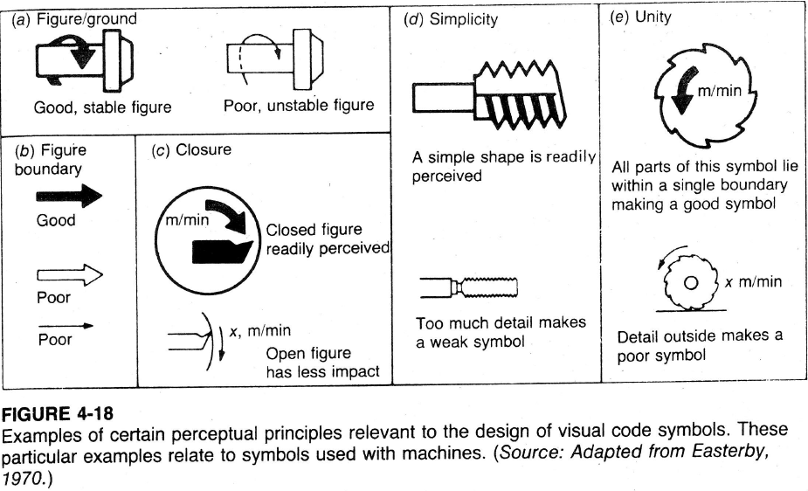
SYMBOLS (cont.)
Perceptual Principles of Symbolic Design
Figure to Ground: e.g. Direction must be clear
Figure Boundaries:
solid boundary better than outline boundary
Closure: figure should be closed (ie continuous)
Simplicity: include only necessary features
Unity:
Include text and other detail close to symbol

Slide 50
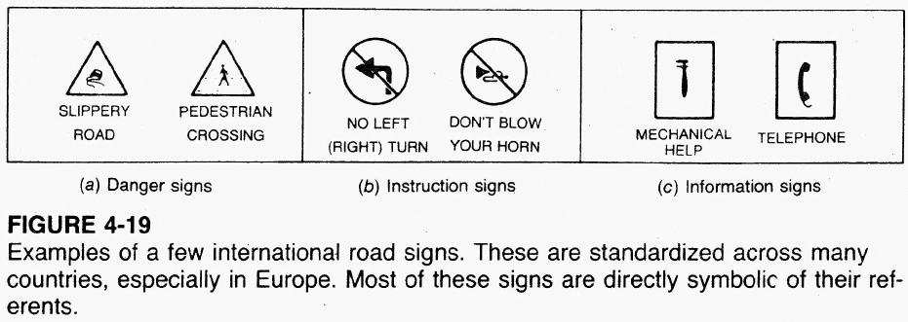
SYMBOLS (cont.)
Standardization of Symbolic Displays
Symbols should be standardized if:
Used for same referent
Used by the same people
E.g. international road signs (below)

Slide 51
CODES
Coding elements:
Referents: items to be coded
Code: sign/symbol used to indicate referent
coding dimensions: visual stimuli used (e.g. colors, shapes, sizes, numbers, letters)
codes could have
single dimension
or more than one dimension (multidimensional)

Slide 52
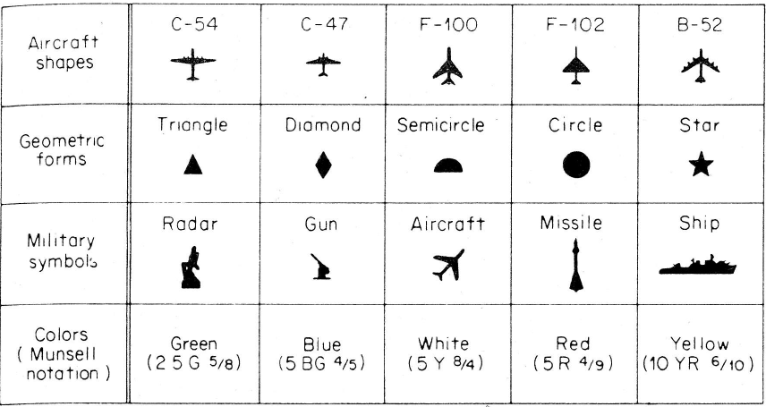
CODES (cont.)
Single Coding Dimensions
Experiments done to see best dimension
Experiment: Smith and Thomas: varied
Shapes, geometric form, symbols, colors (below)
Mean time to count target class was measured
Color showed greatest superiority

Slide 53
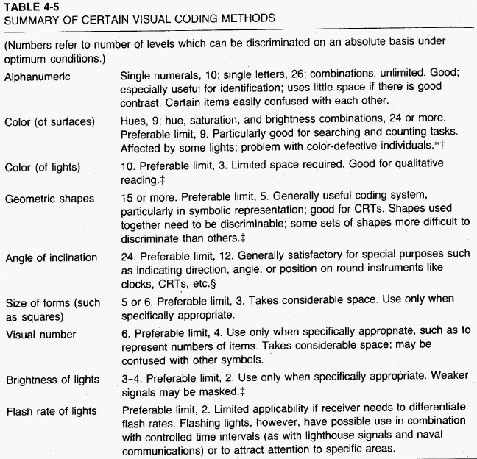
CODES (cont.)
Single Coding Dimensions (cont.)
Different coding dimensions differ in relevance for various tasks and situation
Table (right): guide to selecting appropriate visual code

Slide 54
CODES (cont.)
Color coding
Color is a very useful visual code
Q: What is # of distinct colors that normal color vision person can differentiate (absolute basis)?
Jones (1962) found that the normal observer could identify 9 surface colors
With training, people are able to identify around 24 colors
But when dealing with untrained people, it is wise to use a smaller number of colors
Color coding is very useful in “searching”/ “spotting” (as compared to other dimensions)
e.g. searching maps, items in a file, identifying color-coded wires
Note, color not universal “identification” code

Slide 55
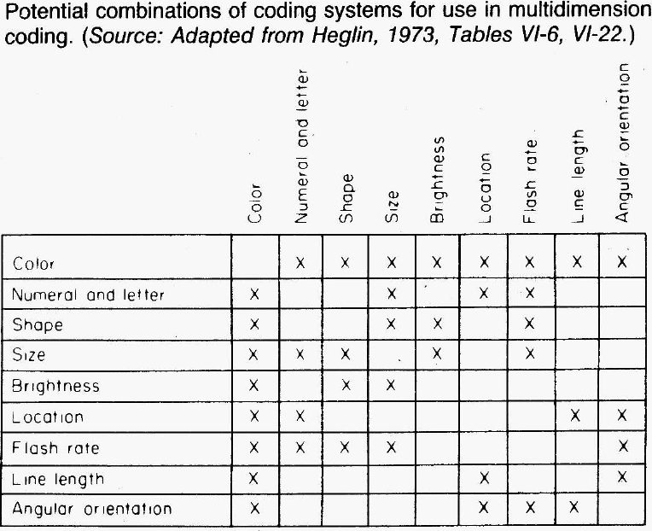
CODES (cont.)
Multidimensional codes
Recommended: no more than 2 dimensions be used together for rapid interpretation
Certain combinations do not ‘go well’ together (see figure)
⇒ not always more effective than single- dimension codes

Slide 56
References
Human Capabilities - Vision
Human Factors in Engineering and Design. Mark S. Sanders, Ernest J. McCormick. 7th Ed. McGraw: New York, 1993. ISBN: 0-07-112826-3.
Slides by: Dr. Khaled Al-Saleh; online at: http://faculty.ksu.edu.sa/alsaleh/default.aspx
More Optical Illusions Sites
http://upload.wikimedia.org/wikipedia/commons/6/60/Grey_square_optical_illusion.PNG
http://www.illusion-optical.com/Optical-Illusions/Circles.php

