Slide 1
Small Bowel procedures
MEAAD AL-MUSINED

Slide 2
Small Bowel Procedures
Barium meal follow through.
Enteroclysis
Intubation ( Small bowel enema).
Barium follow through (Small Bowel only Series).
1
2
3
4

Slide 3
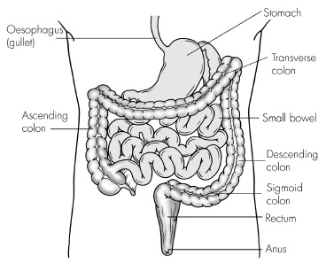
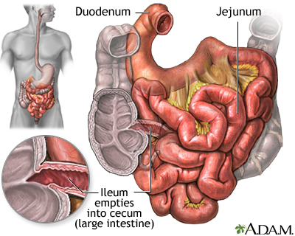
Anatomy

Slide 4
Anatomy
Parts of S.I:
Duodenum: 1st,shortest,widest and most fixed.
Jejunum: 2/5 and feathery appearance.
Ileum: 3/5, longest, smooth no feathery appearance, and joins large intestine at ileocecal valve.

Slide 5
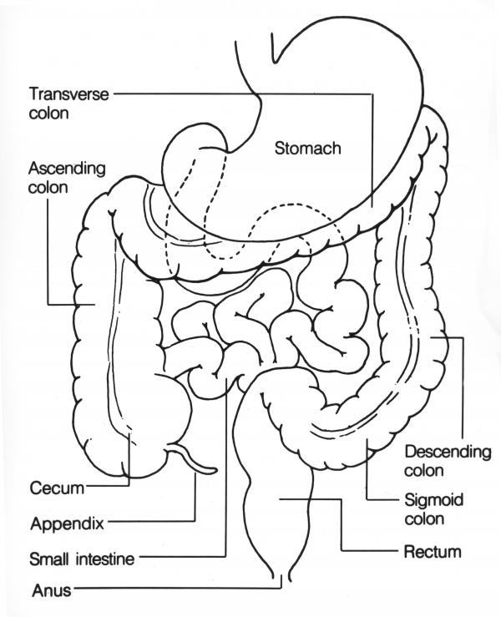
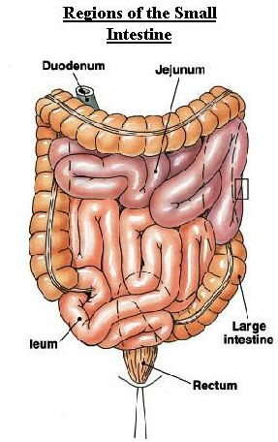

Slide 6
A: duodenum
C: jejunum
D:ileum
E: area of ileocecal valve
PA 30 mins

Slide 7
1. Ba Meal Follow through
Routine UGI first
Patient ingests a cup of Ba when UGI series is completed (note the time)
30 min PA radiograph (30 min after 1st Ba ingestion, usually 15 min after UGI series is completed)
Half-hour interval radiographs until Ba reaches large bowel (usually 2 hours)
If more time is needed(< 2hrs) 1-hour interval radiographs are obtained.
Optional: spot films of ileocecal valve using compression cone??
To separate the bowel loops that may obscure the terminal ileum

Slide 8
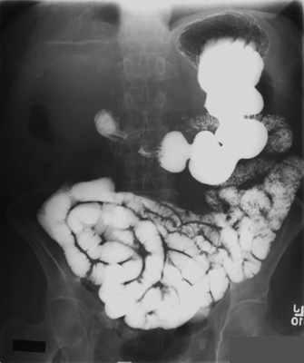
PA 30 min 1 hr

Slide 9
2 hr

Slide 10
Ileocecal valve
Spot film with compression cone?
To separate the bowel loops that may obscure the terminal ileum

Slide 11
2. Ba Follow through (S.B only)
Plain radiograph(scout).
2 cups of Ba ingested (note the time.)
15 or 30 min radiograph (center to the iliac crest “high” to include the stomach, because most of the Ba is in the stomach and proximal S.B.)
Half-hour interval radiographs until Ba reaches large bowel (usually 2 hours)
If more time is needed(< 2hrs) 1-hour interval radiographs are obtained.

Slide 12
3. Enteroclysis
Injection of c/m into the S.B.
It is a Double contrast method used to evaluate the S.B.
the pt is intubated under flouroscopic control with a special catheter. Stomach → duodenum → duodenojujinal junction.
CM:
Thin BaSO4. ( Coats the mucosa).
Air or Methylcellulose why ? Which is better?
To distend the bowel and provide double contrast
Methylcellulose, because it adheres to the bowel while distending it

Slide 13
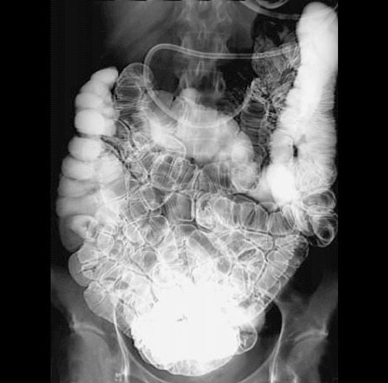
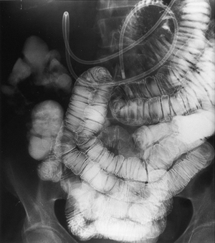
3. Enteroclysis
Double Contrast

Slide 14
4. Intubation ( S.B enema)
It is a single contrast method where a nasogastric tube is passed through:
pt’s nose→esophagus→stomach→duodenum and into the jejunum. (RAO position is preferred ? )
To help pass the tube from stomach →duodenum by gastric peristalsis.
C.M:
thin BaSO4 or water soluble iodinated c.m
diagnostic
Therapeutic

Slide 15
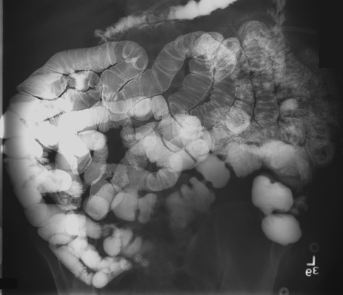
4. Intubation
Single Contrast

Slide 16
Thank you

