Slide 1

CHEM 344 (REQUIRED COURSE)
ORGANIC REACTION MECHANISM
FOR CHEMISTRY’ STUDENTS, COLLEGE OF SCIENCE
Pre-requisites Course; CHEM 241
Credit Hours: 2(2+0)
Prof. Mohamed El-Newehy
Chemistry Department, College of Science, King Saud University
https://faculty.ksu.edu.sa/en/melnewehy
Prof. Zainab Almarhoon
Chemistry Department, College of Science, King Saud University
https://faculty.ksu.edu.sa/en/zalmarhoon

Slide 2
Elimination Reactions

Slide 3
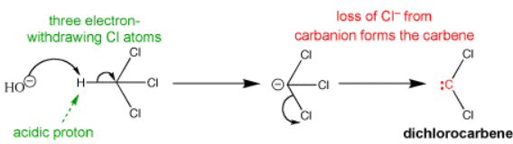
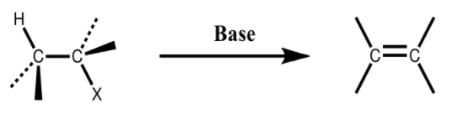
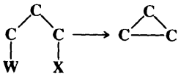
Types of Elimination Reactions
Elimination reactions, are those reactions in which hydrogen along with a leaving group will be eliminated.
Elimination reactions are used for the generation of double and triple bonds from a saturated compounds.
Based on the position of eliminating groups, elimination reactions are classified as:
α-Elimination; Both groups are lost from the same atom to give a carbene.
Unstable species are formed, which undergo further reactions.
β –Elimination; Both groups are lost from the two adjacent carbon atoms to give alkene.
γ -Elimination; A three-membered ring is formed

Slide 4
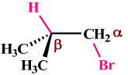
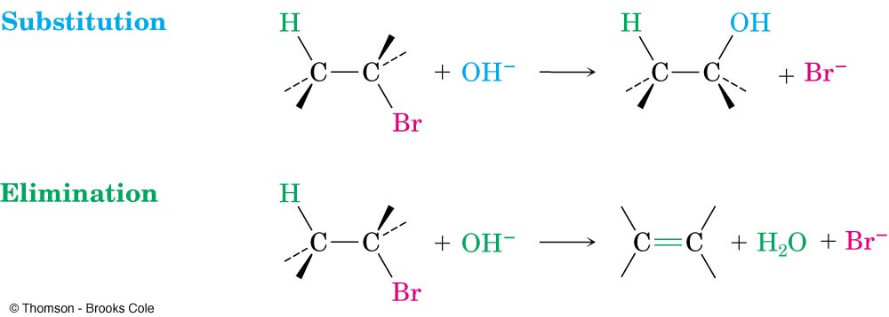
Types of Elimination Reactions: β-Elimination
β–elimination proceeds through two mechanisms;
E2; Biomolecular Elimination Reactions
E1; Unimolecular Elimination Reactions
E2 & E1 mechanism differ in the timing of bond cleavage and bond formation, analogous to the S_{N}² & S_{N}¹ mechanisms.
E2 & S_{N}² reactions have some features in common, as do E1 & S_{N}¹ reactions, respectively.

Slide 5
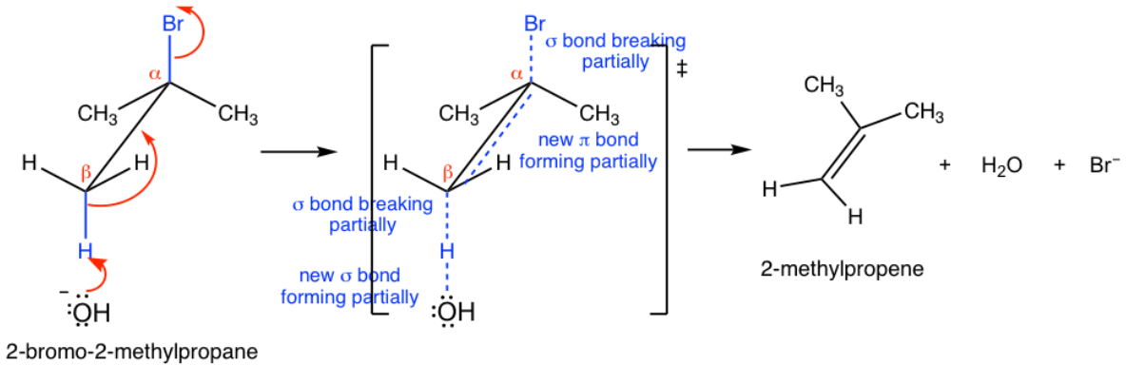
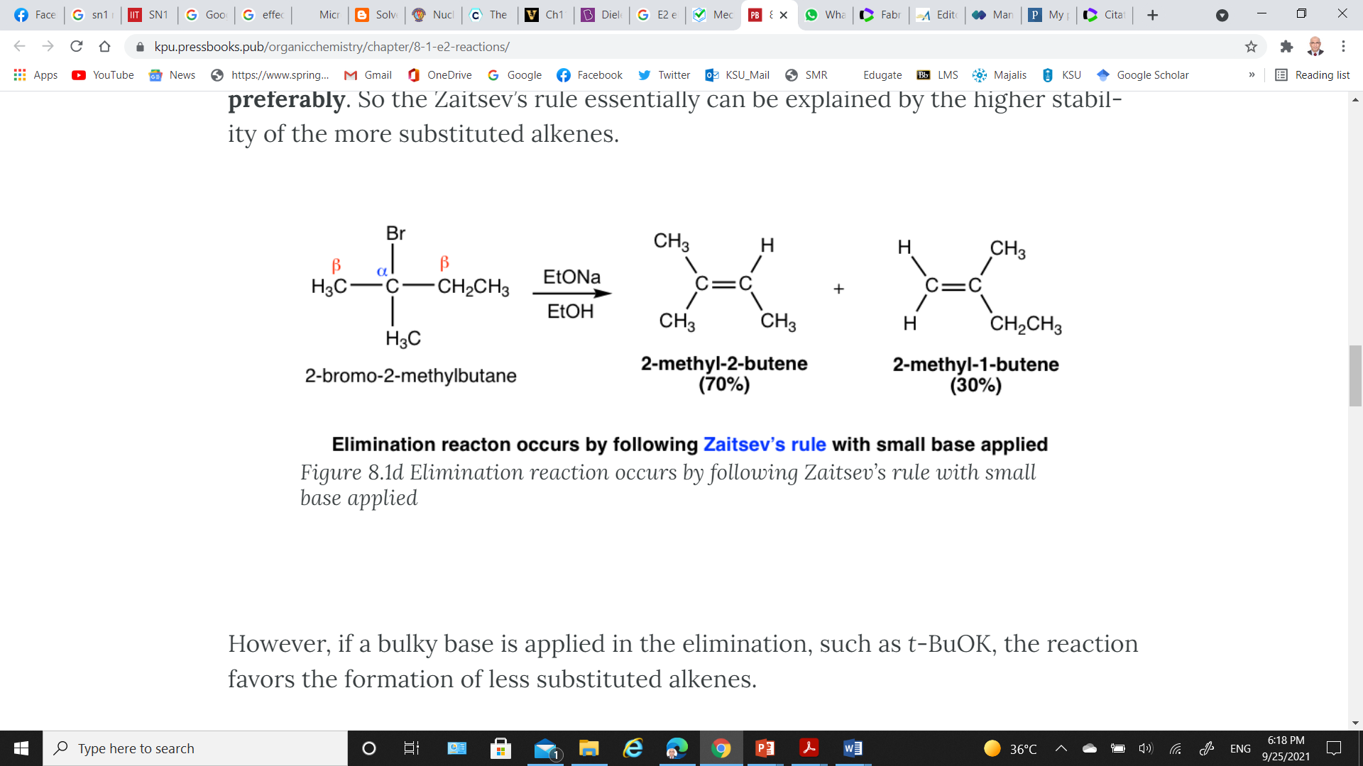
E2 Reaction: Reaction Mechanism
E2 reaction is a concerted process (one step reaction; the formation of a double bond, and departure of the leaving group (X⁻ and H⁺) all occur in one step), with a single transition state
if there are different β-carbons in the substrate, the elimination reaction may yield more than one products.
Example: Dehydrohalogenation of 2-bromo-2-methylbutane can produce two products, 2-methyl-2-butene and 2-methyl-1-butene
t-But O⁻

Slide 6
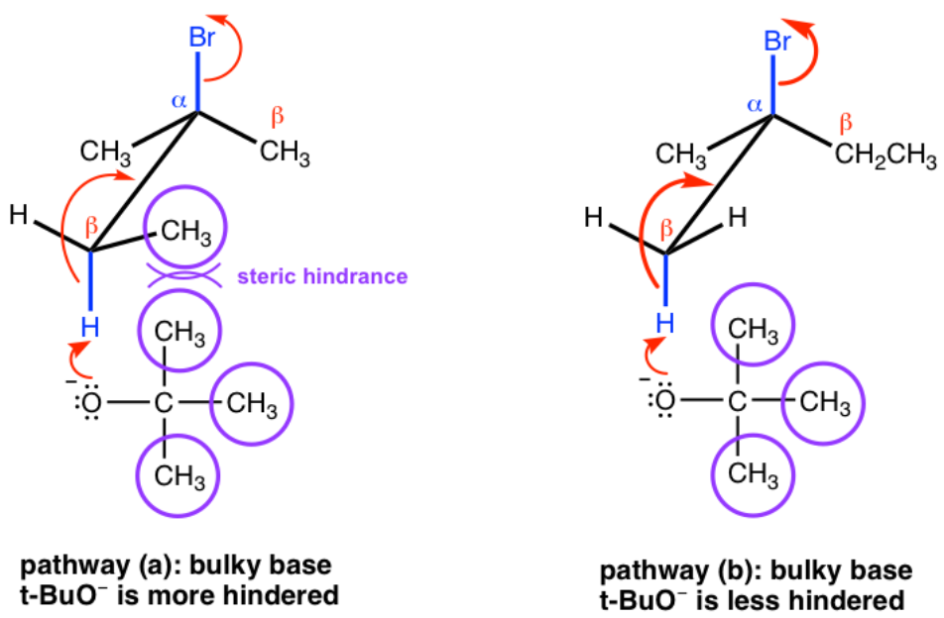
E2 Reaction: Regioselectivity of E2 Reaction
Zaitsev’s Rule
When small base, such as OH–, CH₃O–, EtO–, is applied, the elimination products can be predicted by Zaitsev’s rule, i.e., the major product is the more stable product - the one with the more substituted double bond.
Hofmann’s Rule
If a bulky base such as t-BuO⁻, is applied in the elimination, the reaction favors the formation of less substituted double bond.
This is mainly because of Steric Hindrance.

Slide 7
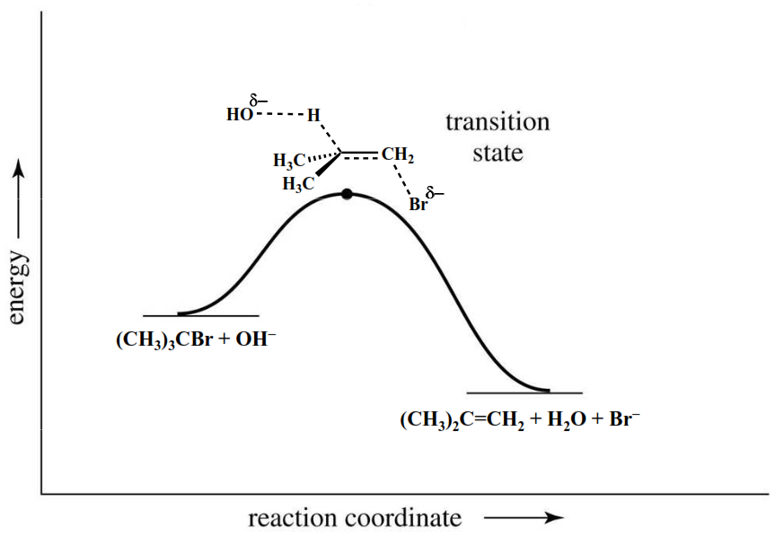
E2 Reaction: Reaction Kinetics
E2 reaction is a concerted process, with a bimolecular rate-determining step.
The reaction rate is second order, because it's influenced by both the alkyl halide and the base (bimolecular).
Rate = k [R-X][B:]
Reaction goes faster with stronger base and better leaving group.
E2 Reaction: Energy Profile Diagram
In the transition state;
The double bond is partially formed.
Thus, the transition state for a more substituted alkene is lower in energy, reducing the activation energy for the reaction and making the reaction faster.

Slide 8
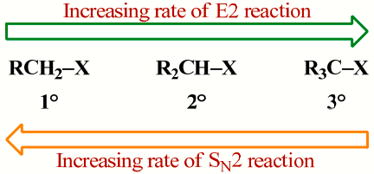
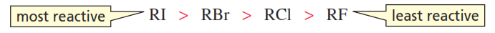
E2 Reaction: Factors Affecting the Rate of E2 Reaction
The rate of the E2 reaction increases with
Structure of the alkyl group; As the number of R groups on the carbon with the leaving group increases, the rate of the E2 reaction increases.
The S_{N}² and E2 mechanisms differ in how the R group affects the reaction rate.
Strong, negatively charged bases like HO⁻ and RO⁻.
Polar aprotic solvents
Leaving group; Rate of reaction follows the order,
Alkyl iodides are the most reactive
Alkyl fluorides the least reactive
}
because weaker bases are better leaving groups

Slide 9
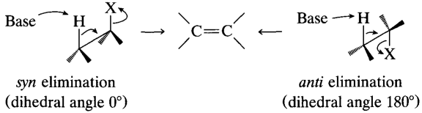
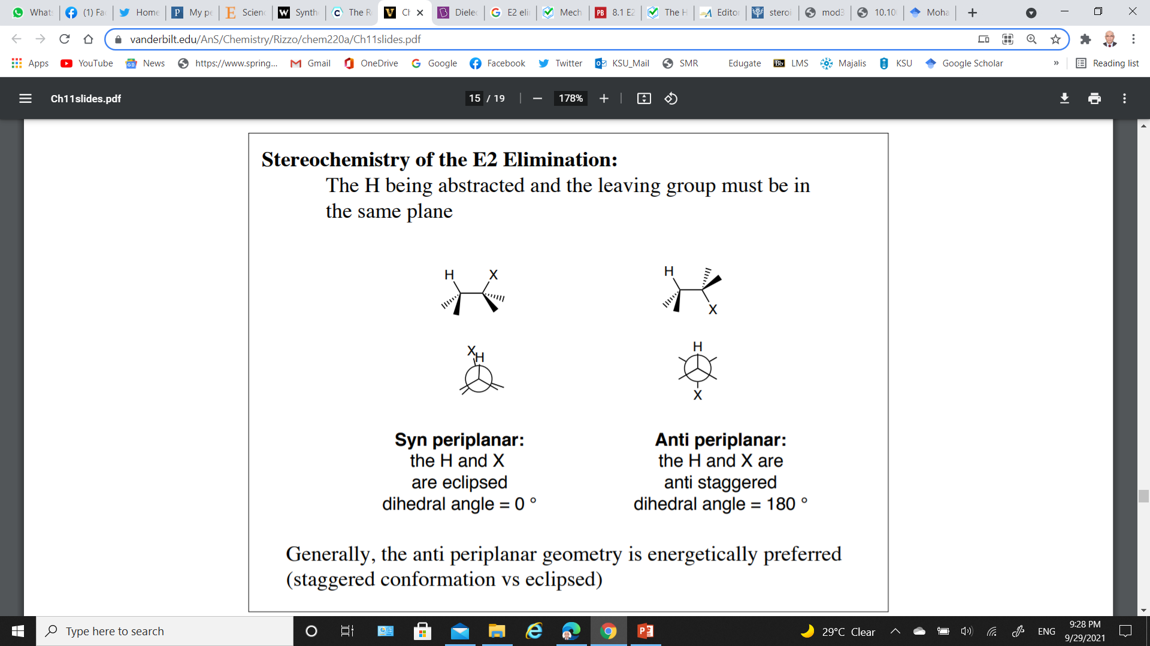
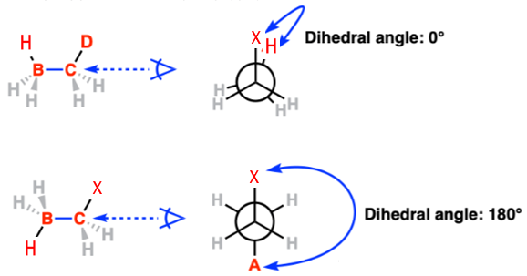
E2 Reaction: Stereochemistry
The H being abstracted and the leaving group must be in the same plane
Syn elimination Syn periplanar); the proton and leaving group depart from the same sides of the bond.
Anti elimination (Anti periplanar); the proton and leaving group depart from opposite sides of the bond.
Eclipsed conformation has the maximum potential energy.
Staggered conformation has a lower potential energy
E2 reactions are highly stereospecific, and anti elimination is preferred over syn elimination

Slide 10
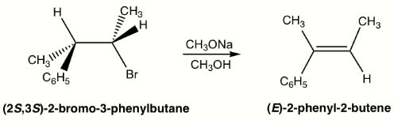
E2 Reaction: Stereochemistry
E2 reactions are stereoselective, resulting in the formation of trans-double bonds preferably.
Example; Elimination of (2S,3S)-2-bromo-3-phenylbutane produces the E isomer specifically, not Z isomer.
This is because when H is in anti-position to the leaving group Br, the whole compound is in staggered conformation, and the other groups retain their relative position in elimination that leads to the E isomer.

Slide 11
E2 Reaction: Summary
Reaction is:
Stereospecific (Anti-periplanar geometry preferred, Syn-periplanar geometry possible), E isomer is formed.
Concerted - all bonds form and break at the same time
Bimolecular - rate depends on concentration of both base and substrate
Substrate: As the number of R groups on the carbon with the leaving group increases, the rate of the E2 reaction increases..
Nucleophile: Favored by strong bases
Leaving Group: I- > Br- > Cl- > F- (poor)
Solvent: Polar Aprotic (i.e. no OH) is best

Slide 12
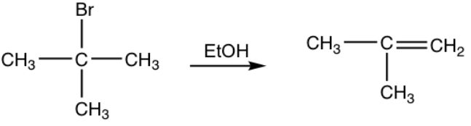
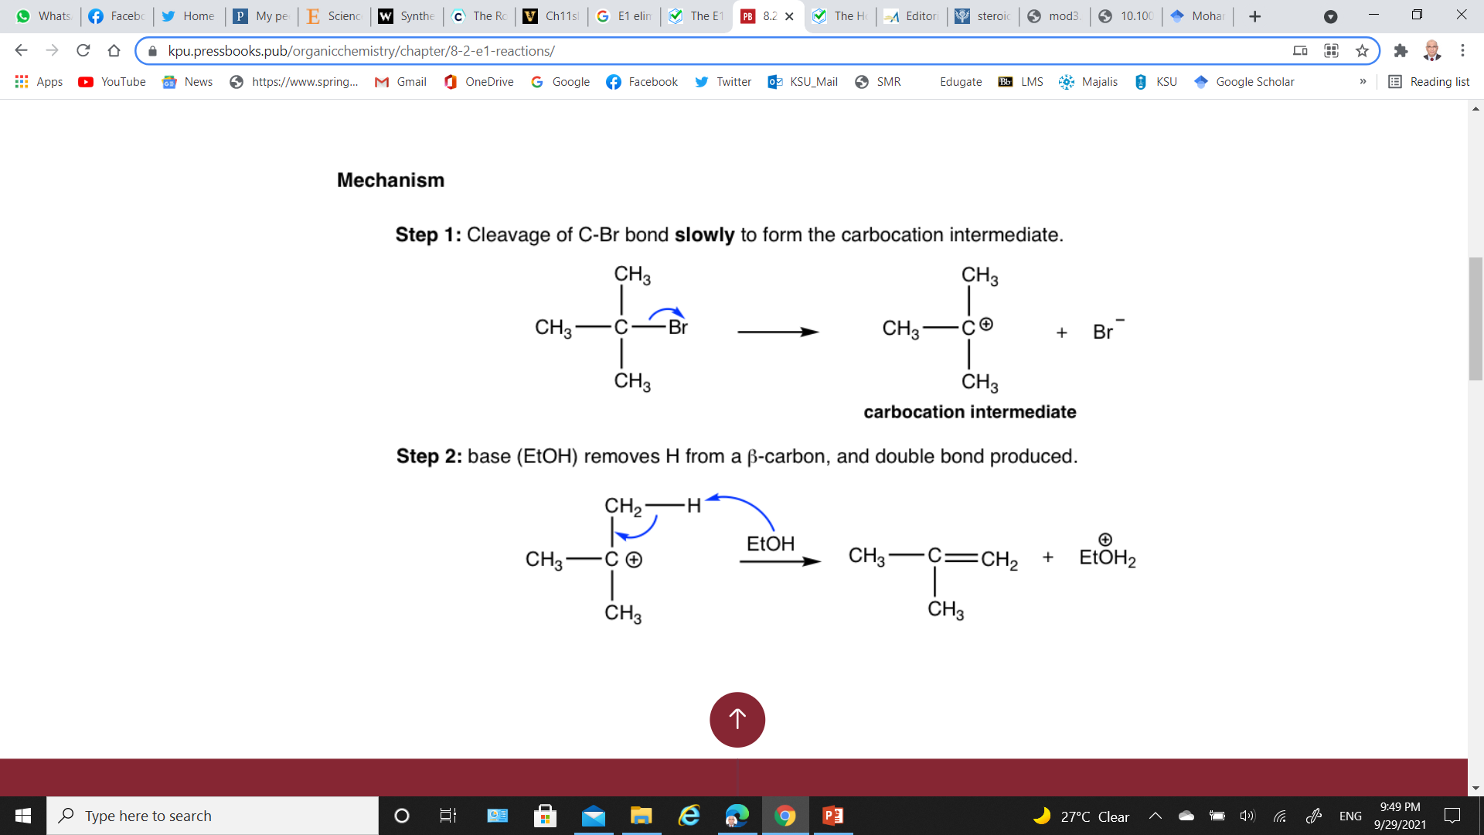
E1 Reaction: Reaction Mechanism
When t-butyl bromide reacts with ethanol, small amount of elimination products obtained via E1 mechanism.
The overall elimination involves two steps:
Step 1: Cleavage of C-Br bond slowly to form the carbocation intermediate.
Spontaneous dissociation of tertiary alkyl bromide yields carbocation intermediate in slow, rate-determining step
Step 2: base (Et-OH) removes H from β–carbon, and double bond produced.
Loss of a neighboring H+ in a fast step yields the neutral alkene product.

Slide 13
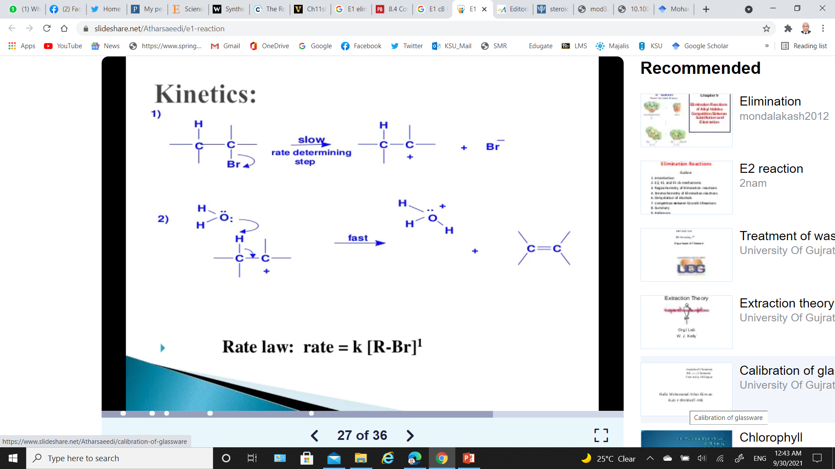
E1 Reaction: Reaction Kinetics
E1 reactions follow first order (Unimolecular) kinetics.
Rate = k [R-X]
The solvent helps to stabilize the carbocation, but it does not appear in the rate law

Slide 14
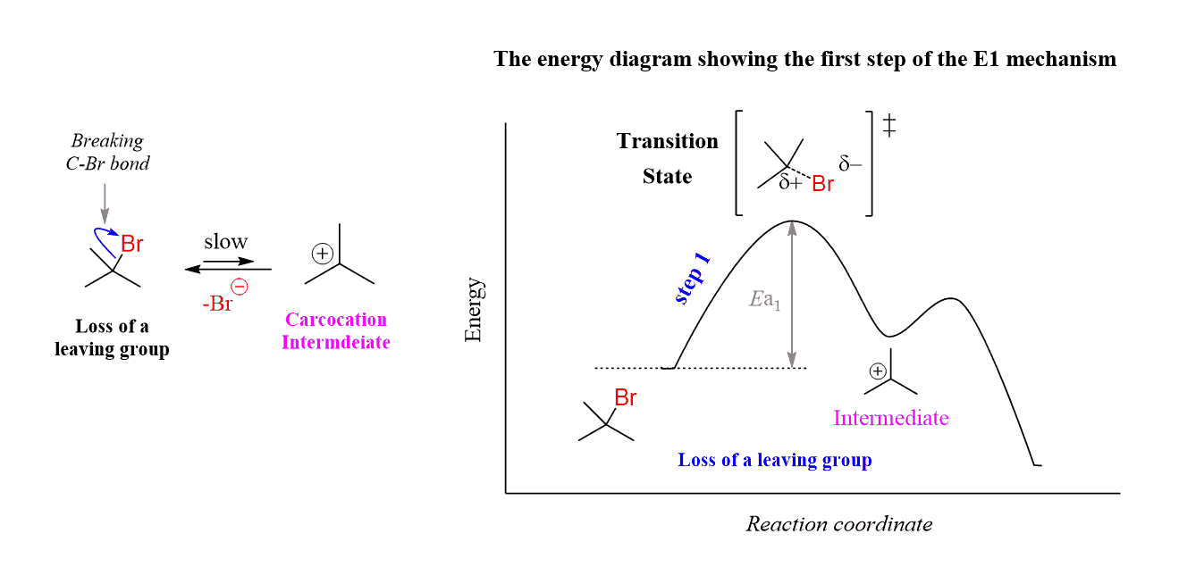
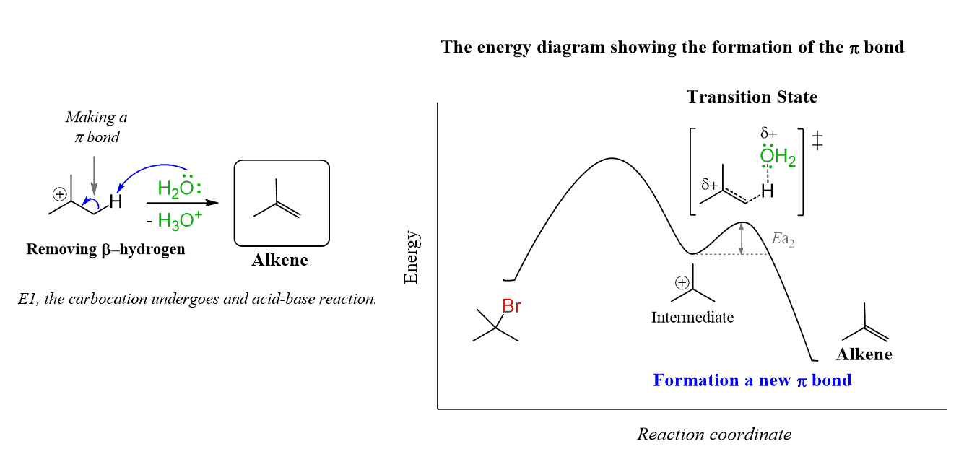
E1 Reaction: Energy Profile Diagram
Step 1: Formation of carbocation intermediate.
Step 1: Formation of the π bond.

Slide 15
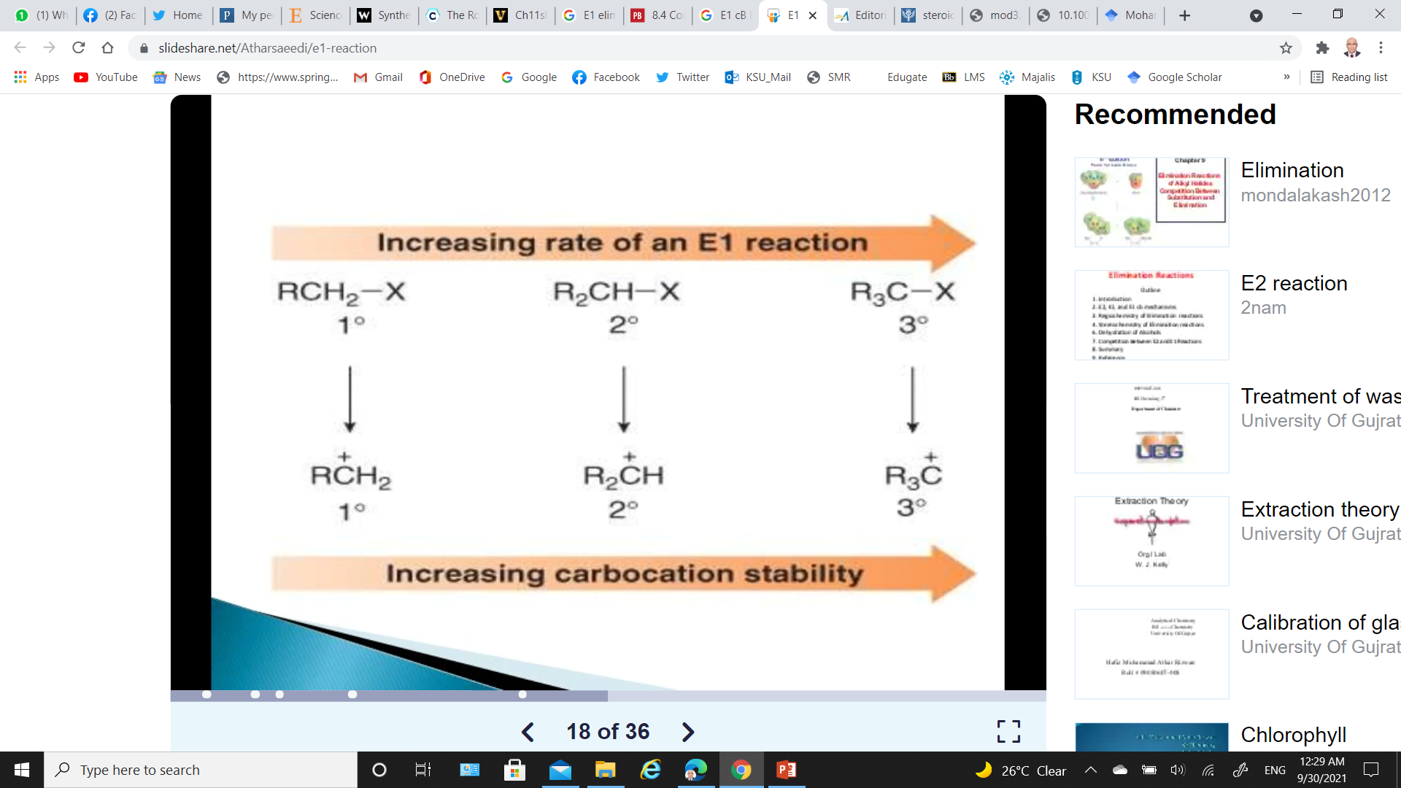
E1 Reaction: Factors Affecting the Rate of E1 Reaction
Substrate Effect
The order of the reactivity of the alkyl groups is: Tertiary > Secondary > Primary
This is because the rate-determining step is the formation of carbocation and the stability of these ions increases; Tertiary > Secondary > Primary
It is hard (but not impossible) to get primary carbocations are not stable.

Slide 16
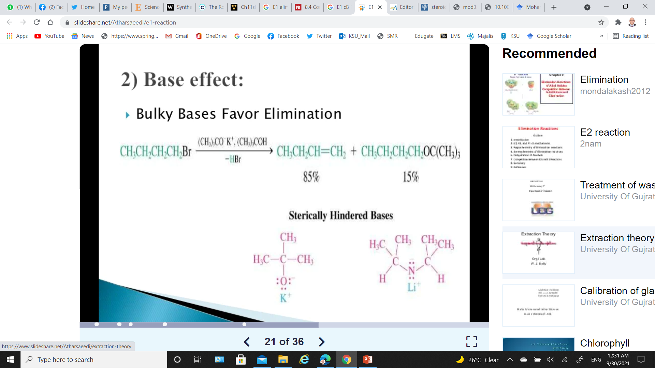
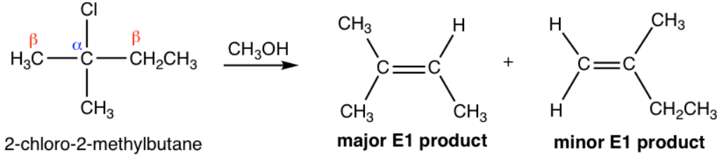
E1 Reaction: Factors Affecting the Rate of E1 Reaction
Base Effect
Bulky bases favor elimination
Orientation of Elimination: Zaitsev’s Rule
E1 reactions follow Zaitsev’s rule.
The major product should be the product that is the most highly substituted.

Slide 17
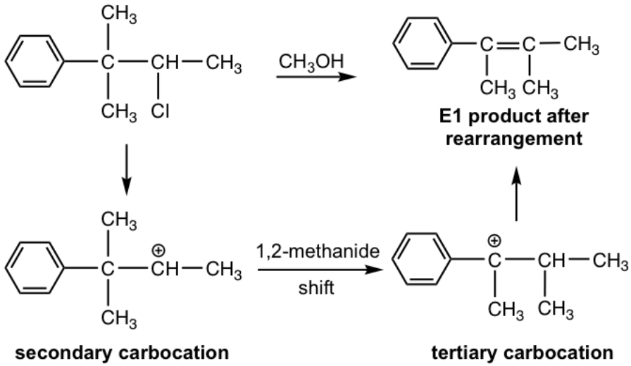
E1 Reaction: Rearrangements
Since E1 reaction involves a carbocation intermediate, the carbocation rearrangement might occur if such rearrangement leads to a more stable carbocation.

Slide 18
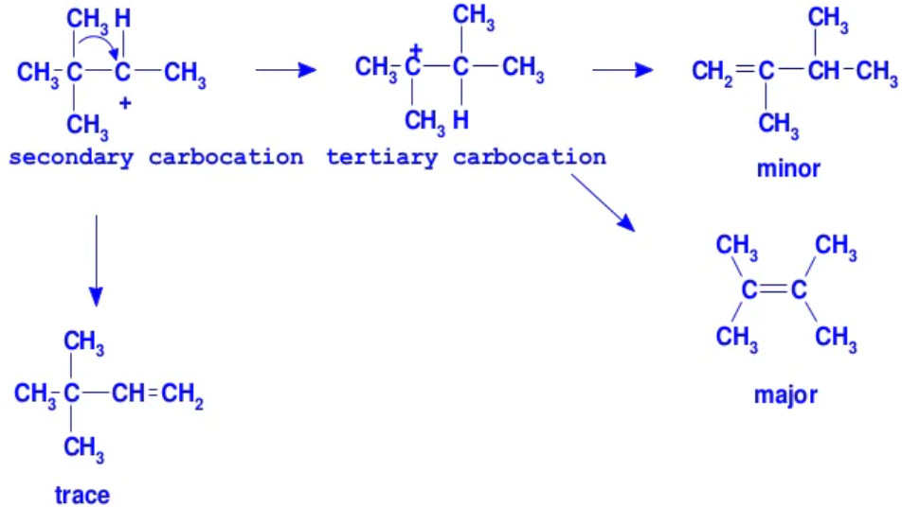
E1 Reaction: Rearrangements
Alkyl groups and hydrogen can migrate in rearrangement reactions to give the more stable intermediate carbocations.

Slide 19
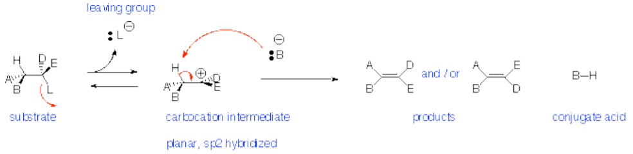
E1 Reaction: Summary
Reaction is:
Non-stereospecific- follows Zaitsev (Saytseff) Rule
Non-concerted - has carbocation intermediate - favored for tertiary leaving groups
Unimolecular - rate depends on concentration of only the substrate.
Substrate: Does NOT occur with primary alkyl halides (leaving groups).
Nucleophile: Strong acid can promote loss of OH as H₂O or OR as HOR if tertiary or conjugated carbocation can be formed.
Leaving Group: I- > Br- > Cl- > F- (poor)
Solvent: Polar protic (i.e., OH) is best

Slide 20
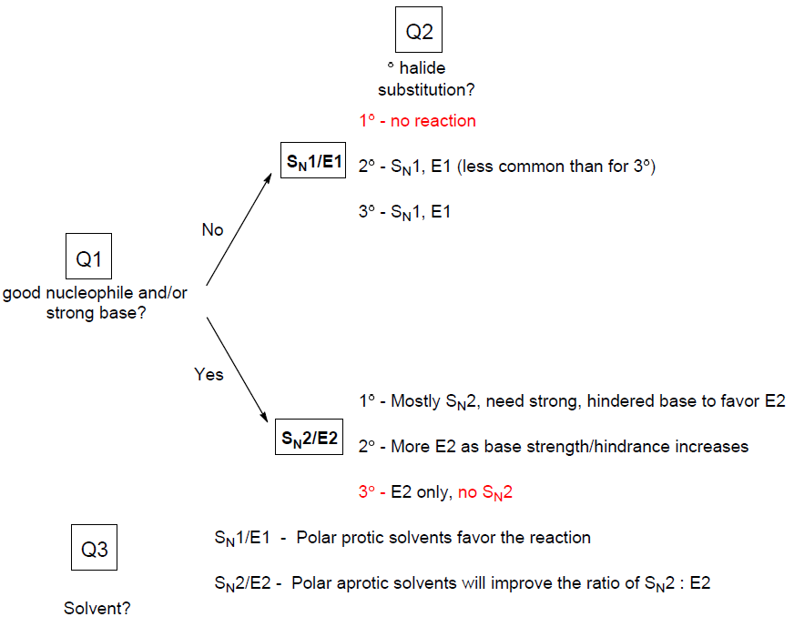
Substitution or Elimination: Substitution / Elimination Flowchart
Ask these three questions:

Slide 21
Substitution or Elimination:
Summary of Alkyl Halides and S_{N}¹, S_{N}², E1 and E2 Mechanisms Chart

Slide 22
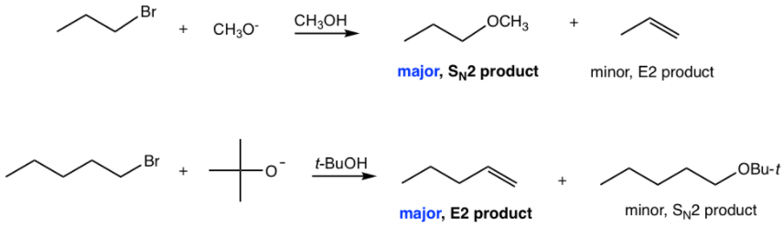
Comparison and Competition Between S_{N}¹, S_{N}², E1 & E2
Summary of Alkyl Halides and S_{N}¹, S_{N}², E1 and E2 Mechanisms Chart
Methyl substrate only go with S_{N}2 reaction,
Primary (1°) substrates
No S_{N}¹/E1, because primary carbocations are too unstable to be formed.
S_{N}² is the predominant pathway when good nucleophile is used; Cl–, Br–, I–, RS–, N₃–, CN–, RCO₂–.
E2 becomes the major reaction when big bulky base/nucleophile is used; t-BuO–

Slide 23
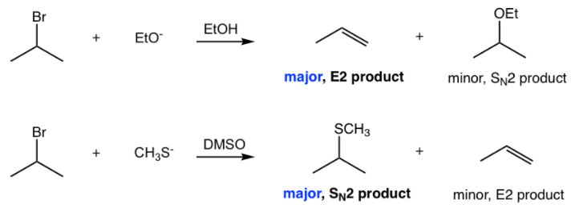
Comparison and Competition Between S_{N}¹, S_{N}², E1 & E2
Summary of Alkyl Halides and S_{N}¹, S_{N}², E1 and E2 Mechanisms Chart
Secondary (2°) substrates
It is most complicated or challenging because all the pathways are possible.
E2: favored by a strong base; –OH, RO–(R: small size alkyl group), NH₂–
S_{N}²: favored by a good nucleophile (relatively weaker base); Cl–, Br–, I–, RS–, N₃–, CN–, RCO₂–.
S_{N}¹/E1: favored by poor nucleophile/weak base; H₂O or ROH (solvolysis).
It is hard to separate S_{N}¹ and E1 completely apart, because they both go through carbocation intermediates.
With increasing the reaction temperature, E1 favors over S_{N}¹.

Slide 24
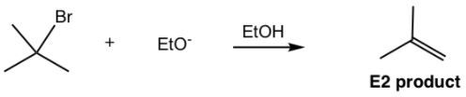
Comparison and Competition Between S_{N}¹, S_{N}², E1 & E2
Summary of Alkyl Halides and S_{N}¹, S_{N}², E1 and E2 Mechanisms Chart
Tertiary (3°) substrates
No S_{N}² reactions, because of steric hindrance.
E2 reaction is the choice when strong base applied; ; –OH, RO–(R: small size alkyl group), NH₂–
S_{N}¹/E1 pathway with neutral condition (poor nucleophile/weak base); H₂O or ROH (solvolysis).
E1 always combine with S_{N}¹, and it is almost impossible to avoid the substitution product.

