Slide 1

CHEM 342 (REQUIRED COURSE)
POLYMERS AND PETROCHEMICALS
FOR CHEMISTRY’ STUDENTS, COLLEGE OF SCIENCE
Pre-requisites Course; CHEM 241
Credit Hours: 2(2+0)
Prof. Mohamed El-Newehy
Chemistry Department, College of Science, King Saud University
http://fac.ksu.edu.sa/melnewehy/home

Slide 2
Chain-Growth Polymerization
(Addition Polymerization)
Chain-growth polymerizations require the presence of an initiating molecule that can be used to attach a monomer molecule at the start of the polymerization

Slide 3

Chain-Growth Polymerization
Polymerization of a particular monomer can occur by one or more mechanisms
Free radical polymerization
Cationic polymerization
Anionic polymerization
Coordination polymerization
Polymerization mechanism depends on the chemical nature of the substituent group;
Monomers with an electron withdrawing group can polymerize by an anionic pathway.
Monomers with an electron donating group follow a cationic pathway.
Some important vinyl monomers such as methyl methacrylate and styrene can be polymerized by more than one pathway (e.g., free-radical and anionic).

Slide 4
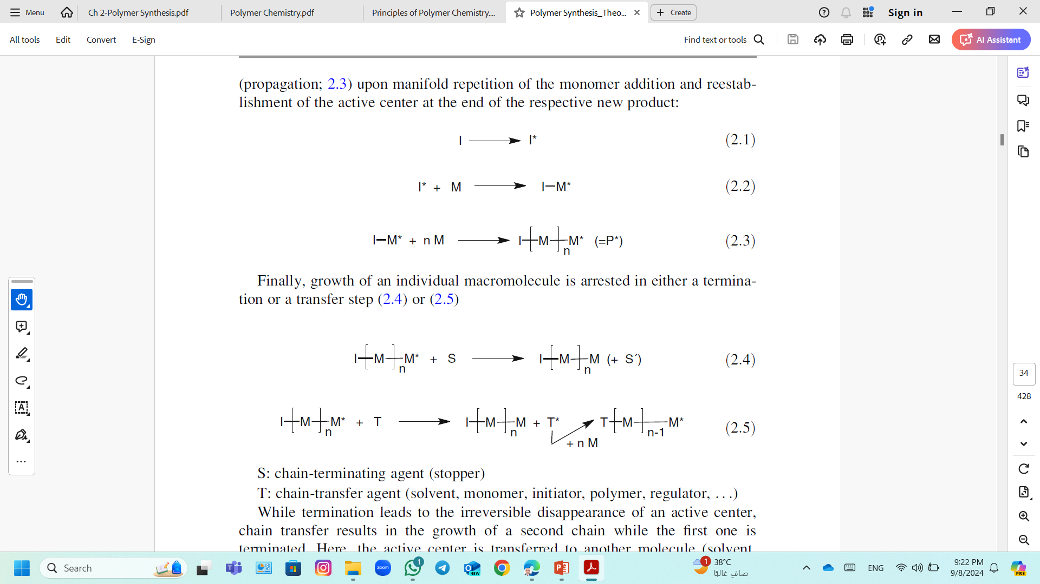
Chain-Growth Polymerization
Chain-growth polymerizations share three common steps:
1) Initiation Step; Radicals via homolytic bond scission, or from ionic molecules.
2) Propagation Step; From there the chain growth can start as a cascade reaction.
3) Termination Step; Finally, growth of an individual macromolecule is arrested in either a termination or a transfer step.

Slide 5
Chain-Growth Polymerization
Free Radical Polymerization

Slide 6

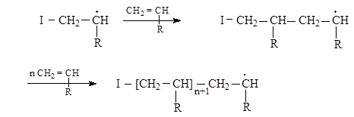
Free Radical Polymerization; Mechanism
A Free-Radical Polymerization has three principal steps:
1) The Initiation Step; Initiation in a free-radical polymerization consists of two steps.
Dissociation of the initiator to form two radical species,
Association step; a monomer molecule (M) is attached to the initiator radical
2) The Propagation Step; Additional monomer units are added to the initiated monomer species as

Slide 7
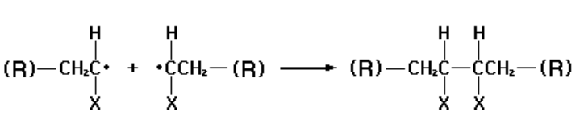
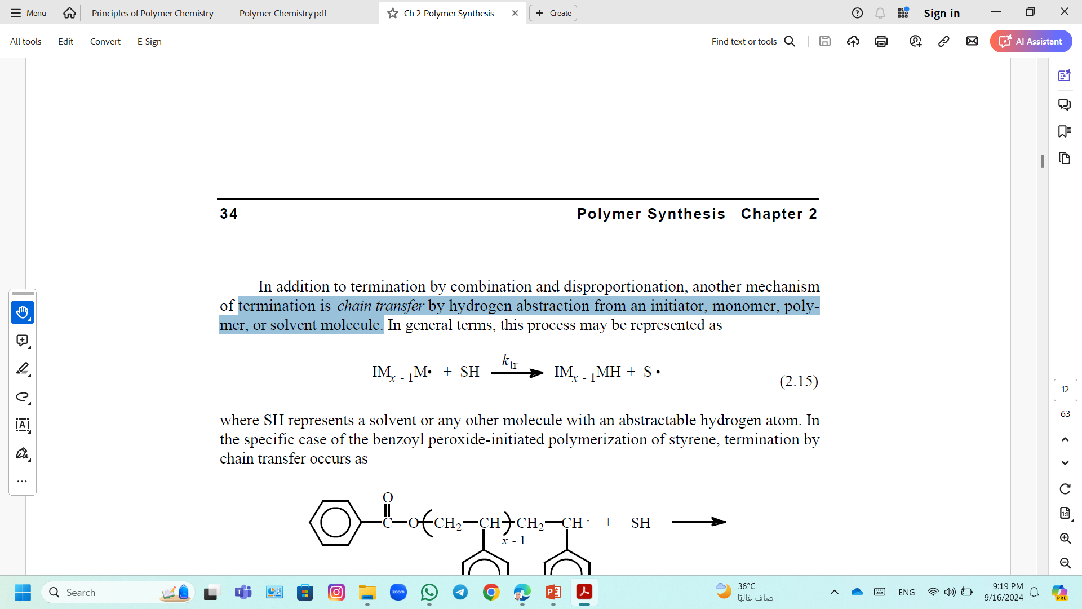
Free Radical Polymerization; Mechanism
3) The Termination Step
Termination by combination to give a single terminated chain of degree of polymerization x+y through the formation of a covalent bond between the two combining radical chains
Termination by a disproportionation to give two terminated chains, (1) one terminated chain will have an unsaturated carbon group and (2) the other terminated end is fully saturated.
Termination is chain transfer by hydrogen abstraction from an initiator, monomer, polymer, or solvent molecule.
where SH represents a solvent or any other molecule with an abstractable hydrogen atom.

Slide 8
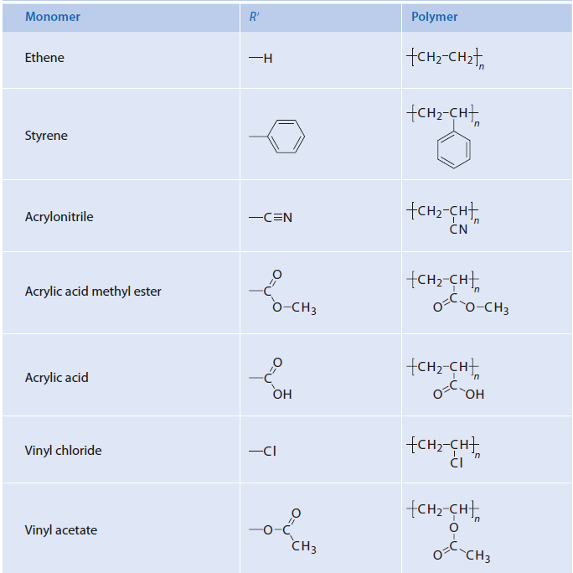
Free Radical Polymerization; Mechanism
Typical examples for radically polymerizable monomers of the structure H₂C=CHR′

Slide 9
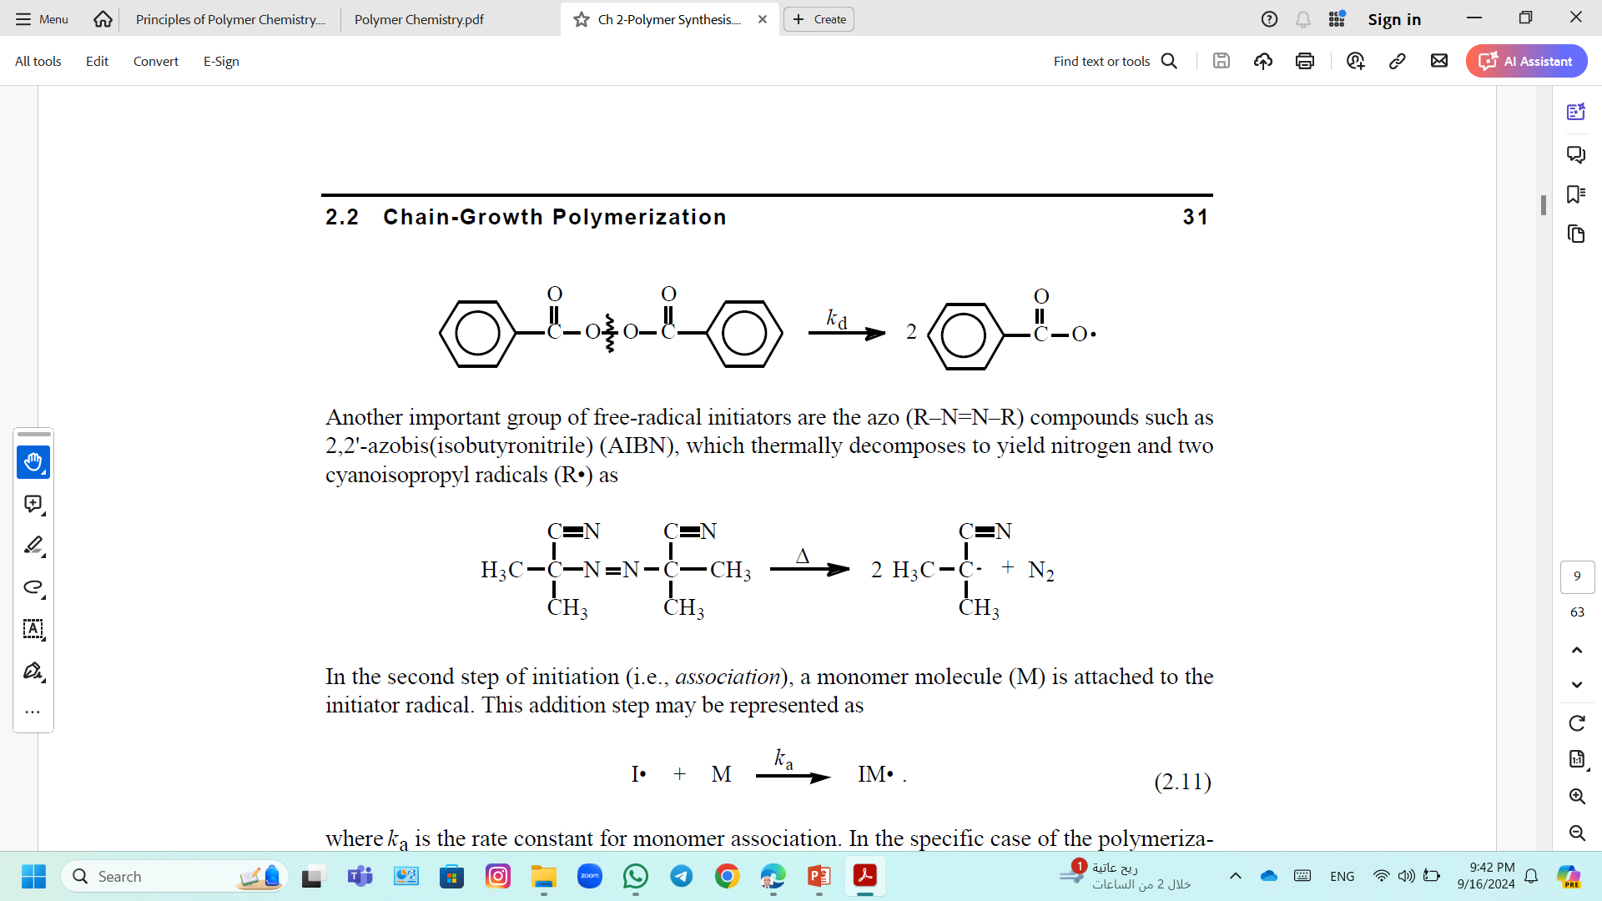
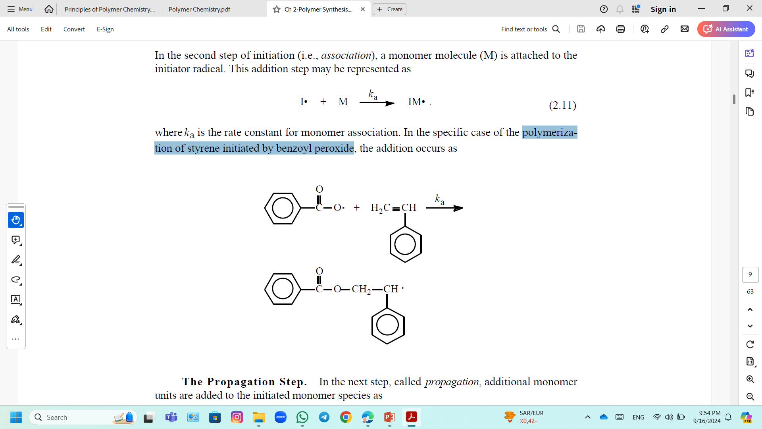
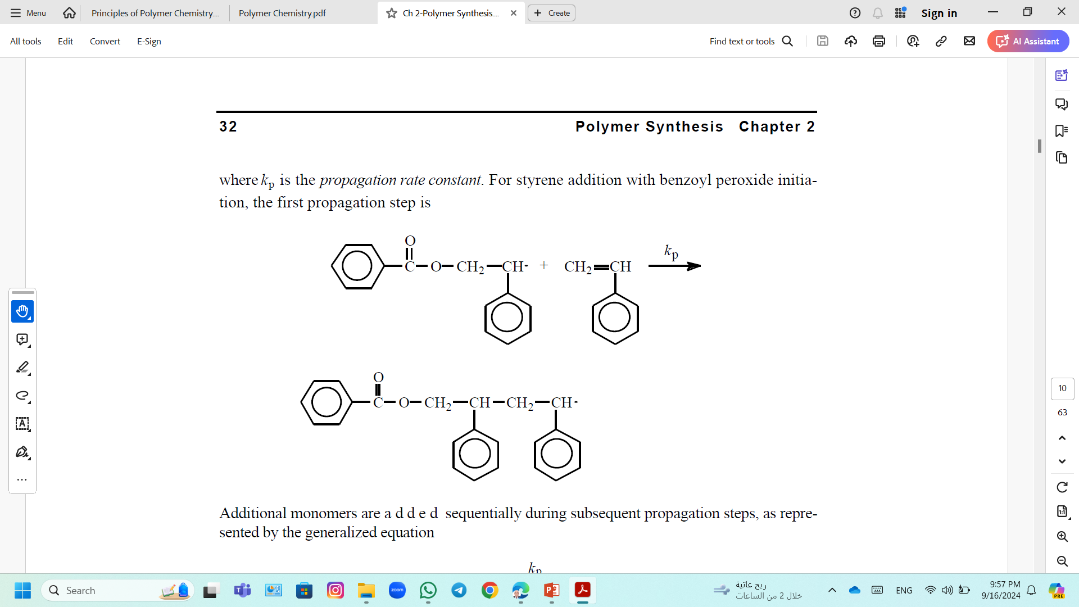
Free Radical Polymerization; Example
Polymerization of Styrene Initiated By Benzoyl Peroxide:
1) The Initiation Step
Dissociation of the initiator (benzoyl peroxide)
Association step
2) The Propagation Step; Additional monomer units are added to the initiated monomer.

Slide 10
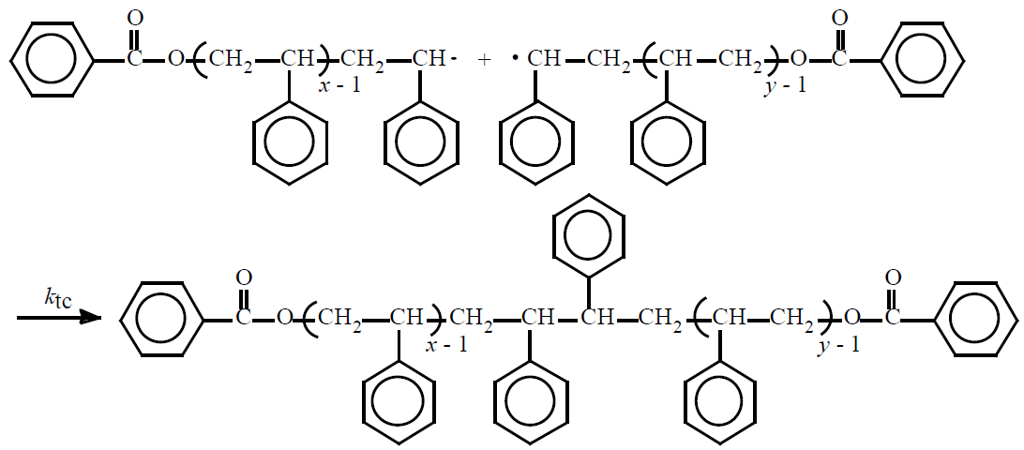
Free Radical Polymerization; Example
3) The Termination Step
Termination by combination

Slide 11
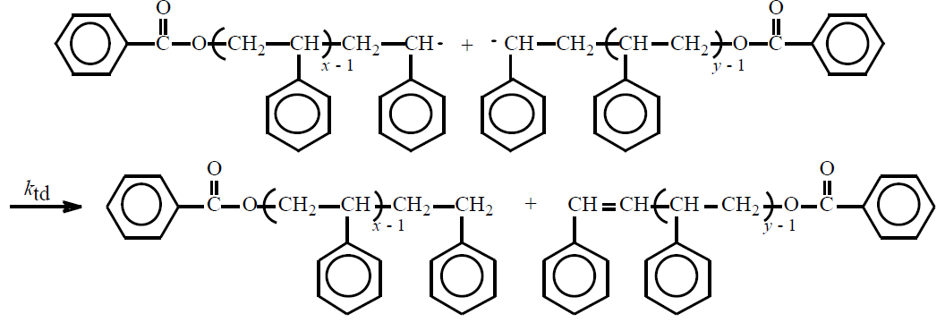
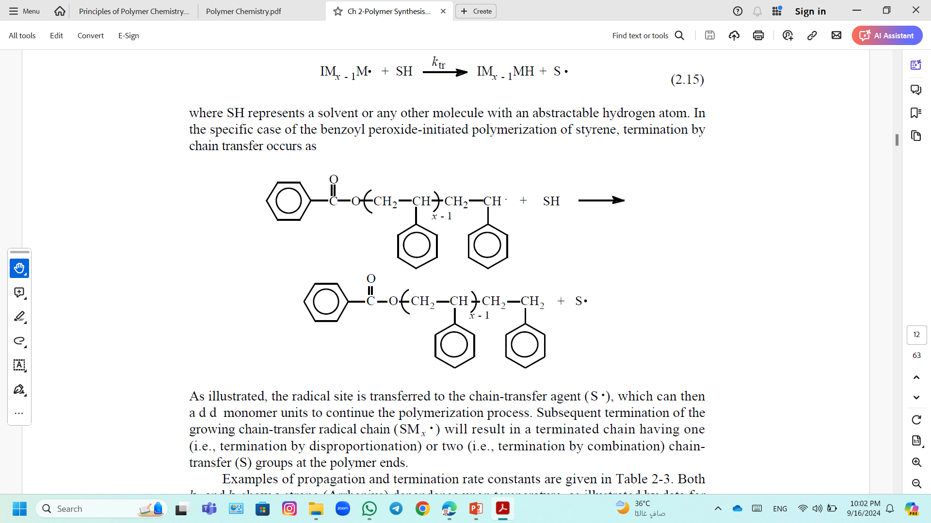
Free Radical Polymerization; Example
Termination by a disproportionation
Termination is chain transfer
where SH represents a solvent or any other molecule with an abstractable hydrogen atom

Slide 12
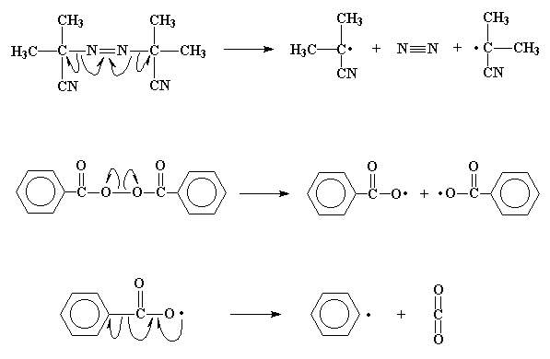

Free Radical Polymerization; Initiators
Initiators include any organic compound with a labile group, such as an azo (–N=N–), disulfide (–S–S), or peroxide (–O–O–) compound.
Thermal initiators
Photo initiators
Redox initiators

Slide 13
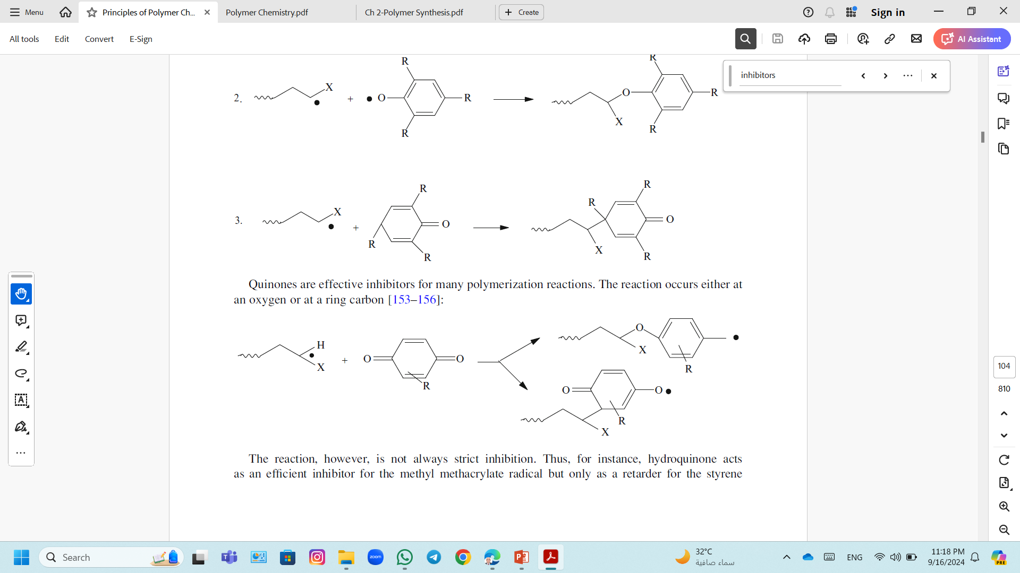
Free Radical Polymerization; Inhibition and Retardation
Free-radical polymerizations are subject to inhibition and retardation from side reactions with various molecules.
Inhibition
Inhibitors are compounds that react very rapidly with every initiating free radical and prevent polymerization reaction from taking place until the inhibitor is completely consumed in the process.
Examples; Phenols and arylamines, and quinones.
Quinones; the reaction occurs either at an oxygen or at a ring carbon

Slide 14
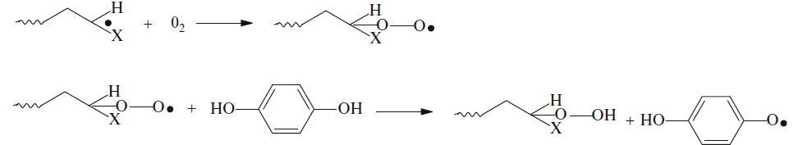
Free Radical Polymerization; Inhibition and Retardation
Retarders
Retarders are compounds that also react with initiating radicals.
This affects the general rate of the reaction and slows it down.
Hydroquinone acts as an efficient inhibitor for the methyl methacrylate radical but only as a retarder for the styrene radical.
Hydroquinone is often employed as an inhibitor; it requires, however, oxygen for activity

Slide 15
Free Radical Polymerization; Polymer Preparation Techniques
Techniques of Free Radical Polymerization
Heterogeneous Polymerization
Homogenous Polymerization
Emulsion
Suspension
Solution
Bulk

Slide 16
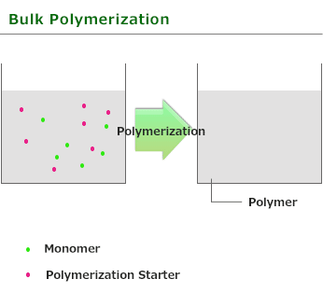
Polymer Preparation Techniques; Bulk (Mass) Polymerization
Only the monomer and the initiator are present in the reaction mixture.
It is exotherm reaction that might be hard to control.
Depending upon the solubility of the polymer, there can be two types of results;
If the polymer is soluble in the monomer,
Polymer remaining soluble with increasing the viscosity of the reaction mixture.
If the polymer is insoluble,
It precipitates out without any noticeable increase in solution viscosity.
The molecular weights of the polymerization products are inversely proportional to the polymerization temperatures and to initiator concentrations.
Common Problems; Heat transfer and increase in viscosity
Commercial uses; Low Mw polymers for adhesives, plasticizers and lubricant additives.

Slide 17
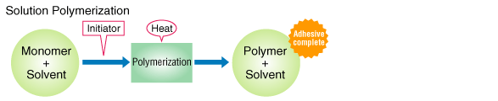
Polymer Preparation Techniques; Solution Polymerization
Solution polymerization reactions can be carried out simply as combining the monomer and the initiator in a solvent and then applying agitation, heat and an inert atmosphere.
Common problems
Solvent residues; difficult to remove completely.
Environmental concerns; organic solvent waste.

Slide 18
Polymer Preparation Techniques; Solution Polymerization
The monomer may be fully or only partially soluble in the solvent and the polymer may be completely soluble, or partially soluble or insoluble.
Both monomer and polymer are soluble in the solvent
Initiation and propagation occur in a homogeneous environment of the solvent.
The rate of the polymerization is lower than in bulk.
The higher the dilution of the reactants, the lower is the rate and the lower is the molecular weight of the product due to chain transferring to the solvent.
Monomer is soluble, but polymer is partially soluble or insoluble in the solvent
The initiation still takes place in a homogeneous medium.
As the chains grow, there is some increase in viscosity followed by precipitation.
Propagation continues in the precipitated swollen polymer, the precipitation does not exert a strong effect on the molecular weight of the product.

Slide 19
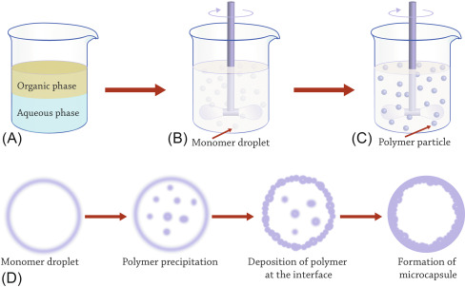
Polymer Preparation Techniques; Suspension Polymerization
It can be considered as a form of mass polymerization
Small droplets of liquid (initiator is dissolved in the monomer) dispersed in nonsolvent liquid (water) using suspending or dispersing agent and stabilized in the medium by agitation.
The suspending agent is used in small quantities (0.01–0.5% by weight/monomer) and the main difficulty in forming and in maintaining uniform suspensions.
The role of suspending agent;
The suspending agent prevents the coalescing of the sticky particles and the tendency of the sticky particles to attach to form one big mass.

Slide 20
Polymer Preparation Techniques; Suspension Polymerization
There are many different suspending agents;
Organic suspending agents; methylcellulose, ethyl cellulose, poly(acrylic acid), poly(methacrylic acid), poly(vinyl alcohol), gelatins, starches, gums, and alginates.
Inorganic suspending agents; magnesium carbonate, calcium carbonate, calcium phosphate, titanium and aluminum oxides, silicates, clays, such as bentonite.
The diameter of the resultant beads varies from 0.1-5 mm and often depends upon the rate of agitation.
Suspension polymerization is used in many commercial preparations of polymers.
The size of microspheres
decreased with increasing the amount of stabilizer
increased with increasing the amount of monomer and initiator.
decreased with increasing of the rate of agitation.
increased with an increase in the reaction temperature.

Slide 21
Polymer Preparation Techniques; Emulsion Polymerization
The reaction is commonly carried out
In water (emulsifier or a surface-active agent) containing the monomer
Using water-soluble initiator.
Initiation may be accomplished through thermal decomposition of the initiator or through a redox reaction.
The droplets are about 1 μ in diameter.
The polymer forms as a colloidal dispersion of fine particles (1,000 A in diameter).
It is used widely in commercial processes that yields high-molecular-weight polymers.
The polymerization rates are usually high.
Water allows efficient removal of the heat of polymerization.
The product from the reaction, the latex, is relatively low in viscosity.
A disadvantage of the process is that completely removal of water-soluble emulsifiers and may leave some degree of water sensitivity.

Slide 22
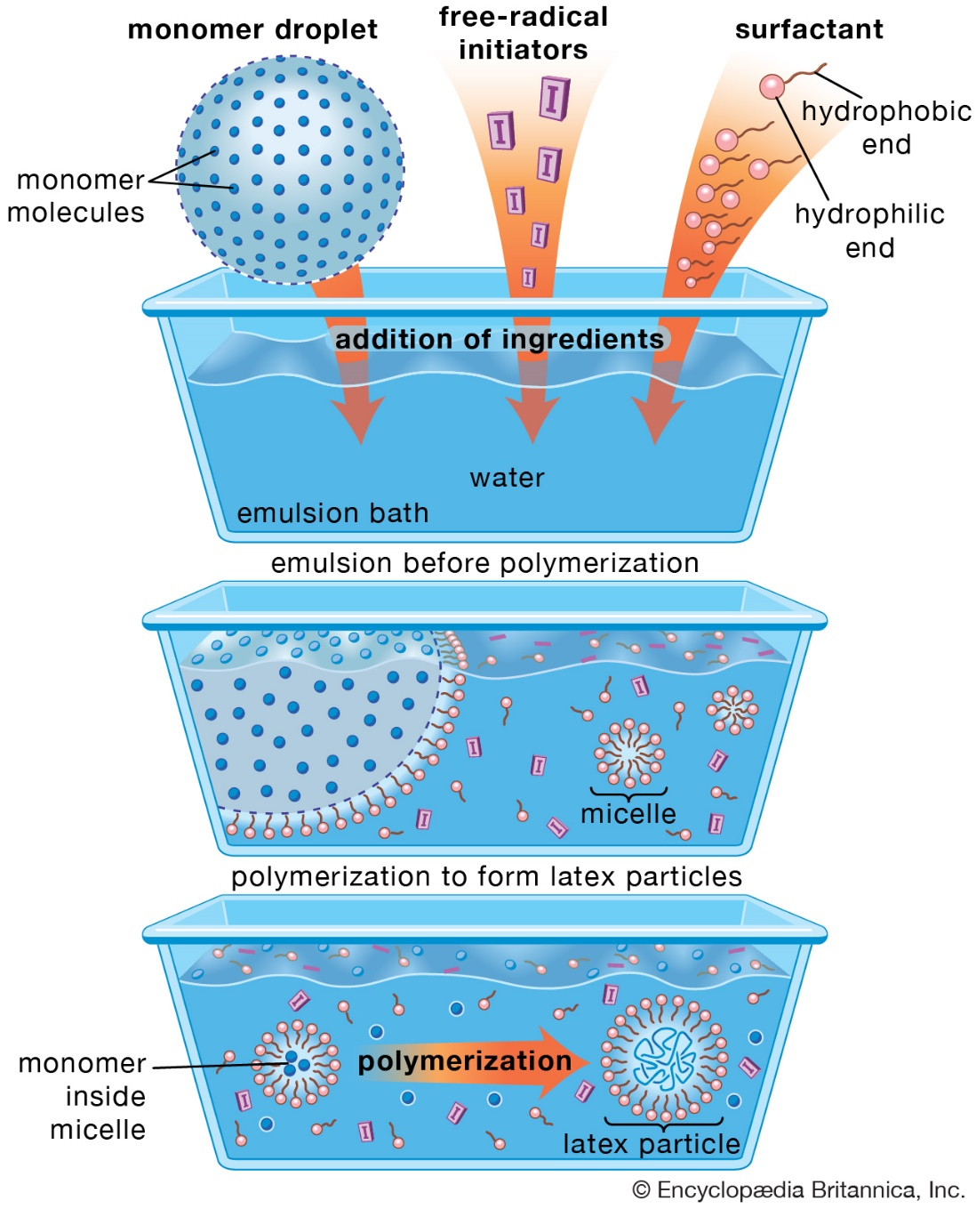
Polymer Preparation Techniques; Emulsion Polymerization
At the start of the reaction;
The emulsifier exists in three loci as:
(a) solute in water;
(b) micelles (the main)
(c) stabilizing emulsifier at the interface between the monomer droplets and water.
The monomer is also present in three loci:
(a) monomer droplets that are emulsified (1–10 μ in diameter) (the main)
(b) solubilized in the micelles (50–100A°in diameter)
(c) individual molecules dissolved in the water.

Slide 23
Polymer Preparation Techniques; Emulsion Polymerization
The monomer is supplied from the droplets to radical-containing micelles of diffusion through the aqueous phase.
The water-soluble initiator decomposes in the aqueous phase forming primary radicals that .
The primary radicals react with the monomer molecules dissolved in the water
Additional monomer molecules may add to the growing radicals in the water.
These growing radical-ions tend to diffuse into the monomer-water interfaces.

Slide 24
Chain-Growth Polymerization
Ionic Polymerization
Cationic polymerization
Anionic polymerization

Slide 25
Chain-Growth Polymerization
Cationic polymerization

Slide 26
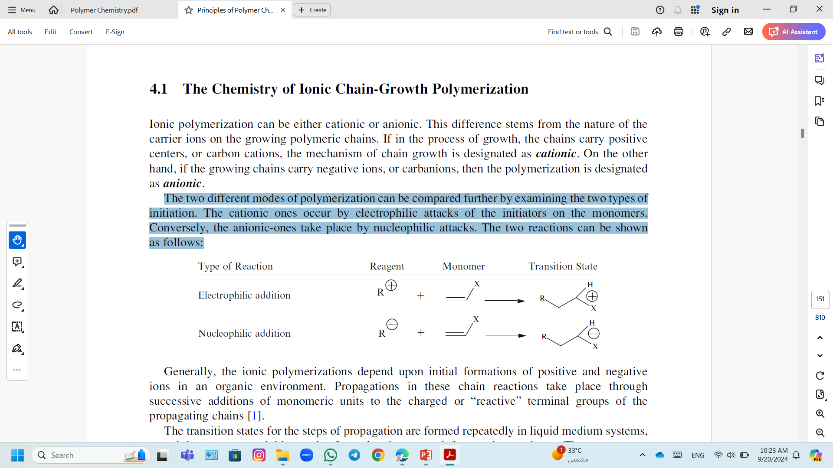
Cationic Polymerization
A monomer can be polymerized depends on the substituents.
Cationic polymerization
Monomers with an electron donating group follow a cationic pathway (i.e., the substituents induce a donor effect (OR, NR₂, C₆H₄–CH₃)).
Cationic polymerization occurs by electrophilic attacks of the initiators on the monomers.
The higher the nucleophilicity of the carbon-carbon double bond, the easier it is for cationic polymerization to take place.
Vinyl monomers (e.g., isobutene, vinyl ether), carbonyl compounds (e.g., formaldehyde, acetaldehyde), and heterocyclic compounds (e.g., tetrahydrofuran, trioxane).

Slide 27
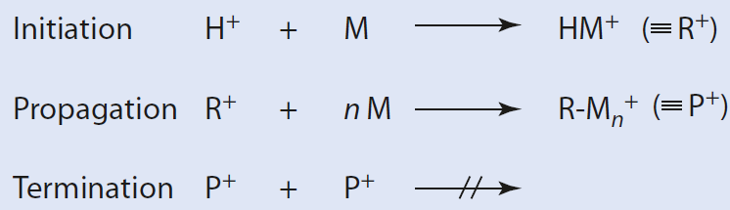
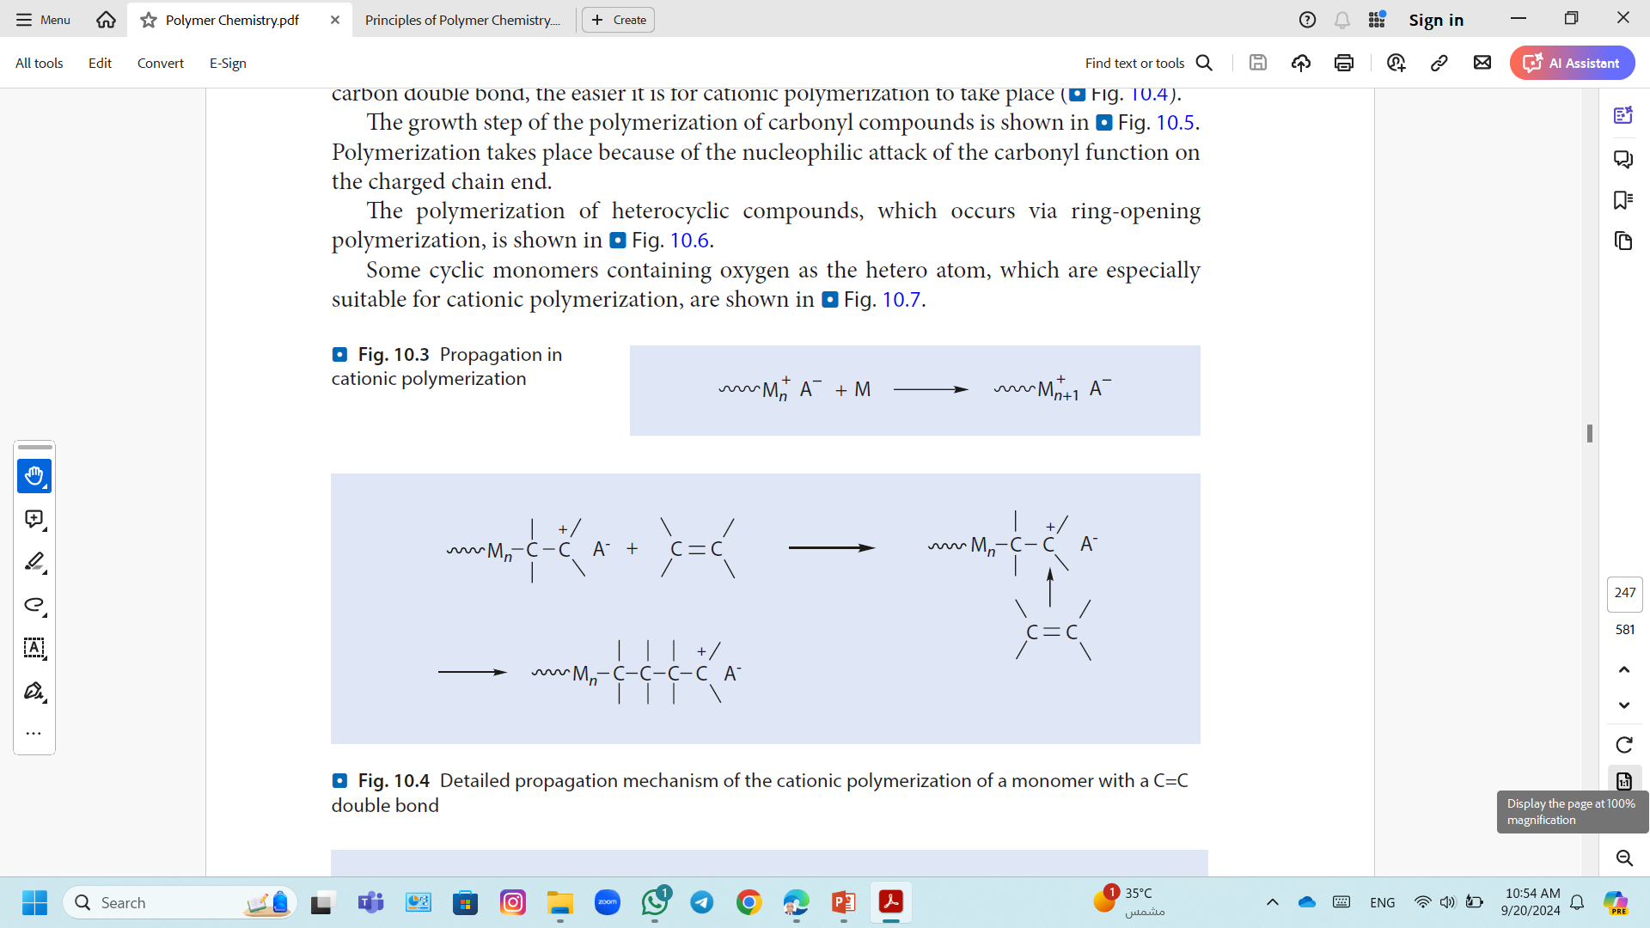
Cationic Polymerization
Cationic polymerization has two distinguishable parts; initiation and propagation.
A termination of the reaction caused by two growing chains reacting with one another, a typical feature of radical polymerization, is not possible.
Polymerization of a vinyl monomer; the growing chain has a terminal positive charge ~ Mn⁺.
These coordinate with an additional monomer molecule to yield a chain with an additional monomer and a terminal charge ~M_{n+1}⁺.
The counterion A⁻ ensures the electroneutrality of the system.

Slide 28
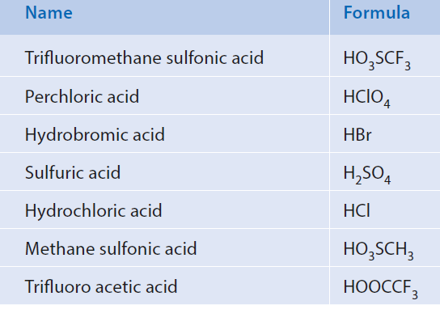
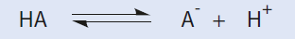
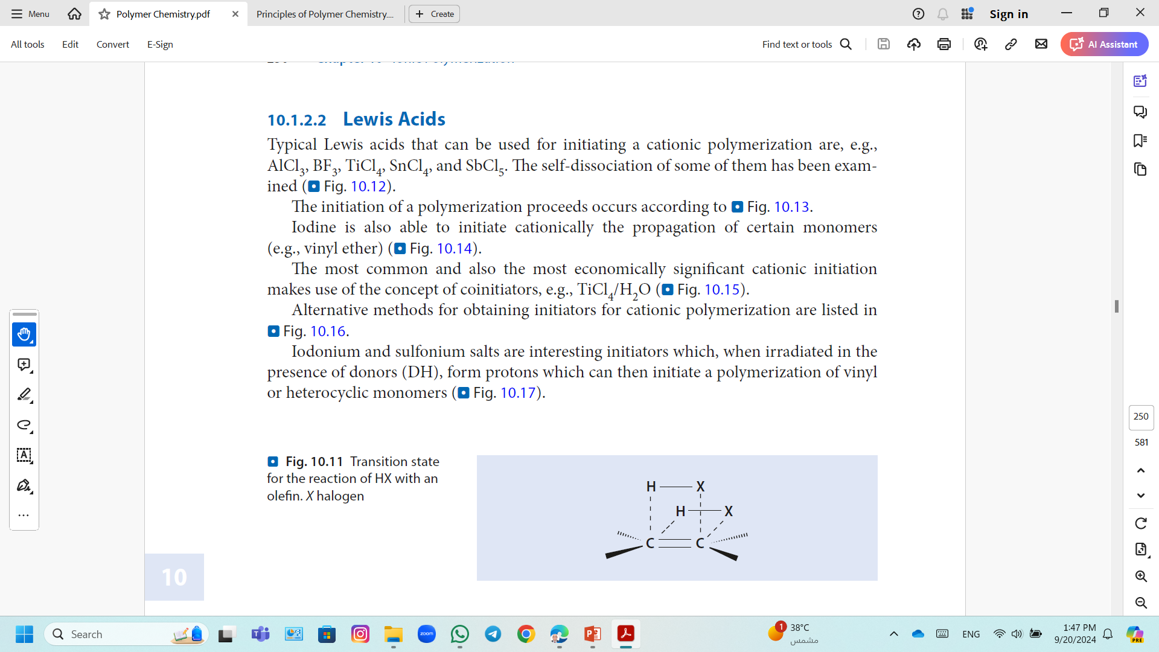
Cationic Polymerization; Mechanism
Initiation
Brønsted acids
Transition state for the reaction of HX with an olefin. X halogen
Proton acids can easily be added onto carbon-carbon double bonds.

Slide 29
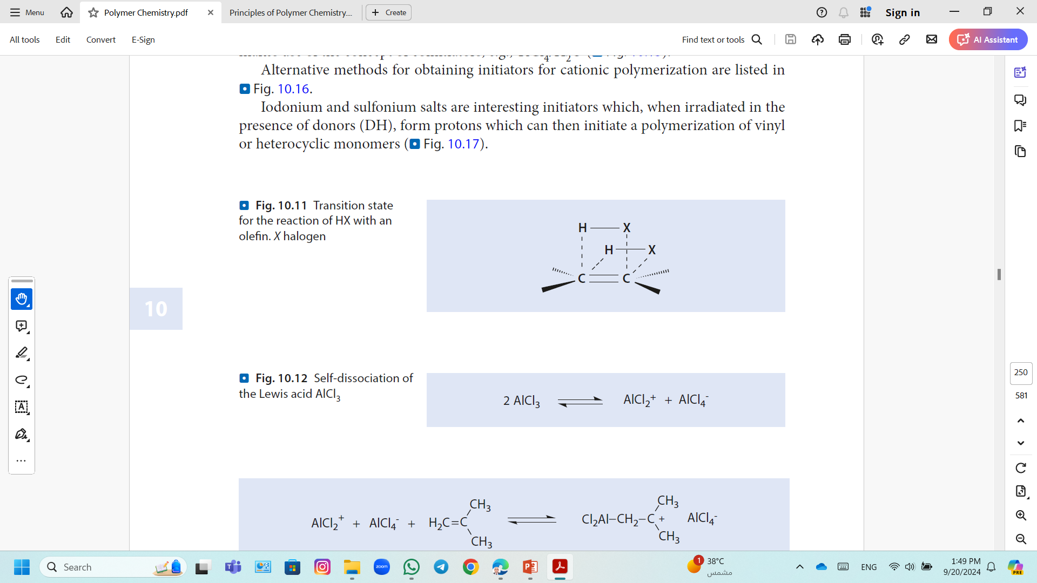
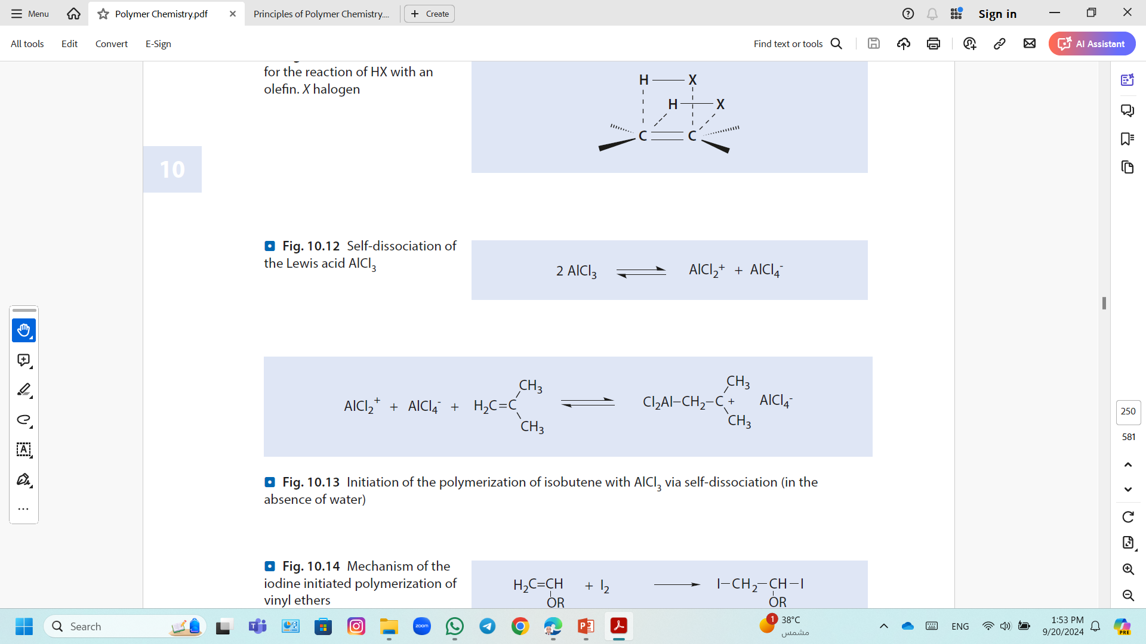
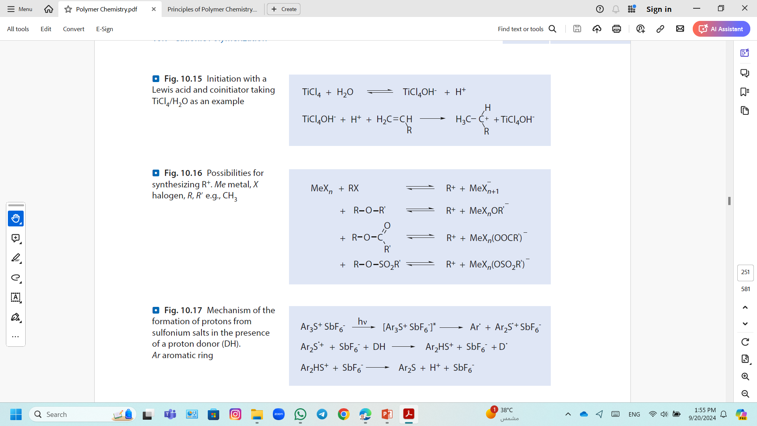
Cationic Polymerization; Mechanism
Initiation
Lewis's acids
Typical Lewis acids are, e.g., AlCl₃, BF₃, TiCl₄, SnCl₄, and SbCl₅.
Self-dissociation of the Lewis acid AlCl₃.
Initiation of the polymerization of isobutene with AlCl₃ in the absence of water
Carbonium ion salts
Initiation with a Lewis acid and coinitiator taking TiCl₄/H₂O as an example

Slide 30
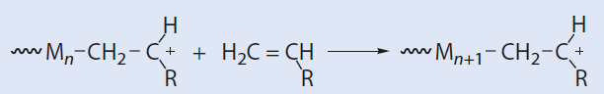
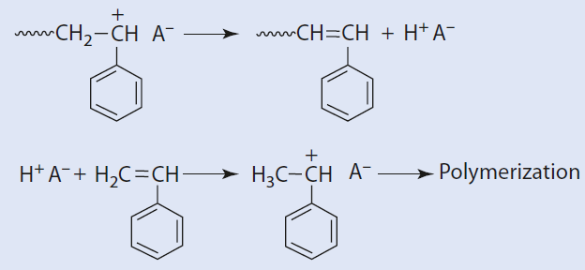
Cationic Polymerization; Mechanism
Chain Growth During Cationic Polymerization
Propagation via electrophilic addition of the chain carriers (carbon cations) to monomer
Transfer and Termination
Transfer Reactions
A transfer reaction that occurs during the cationic polymerization of vinyl monomers is a β-H-elimination.

Slide 31
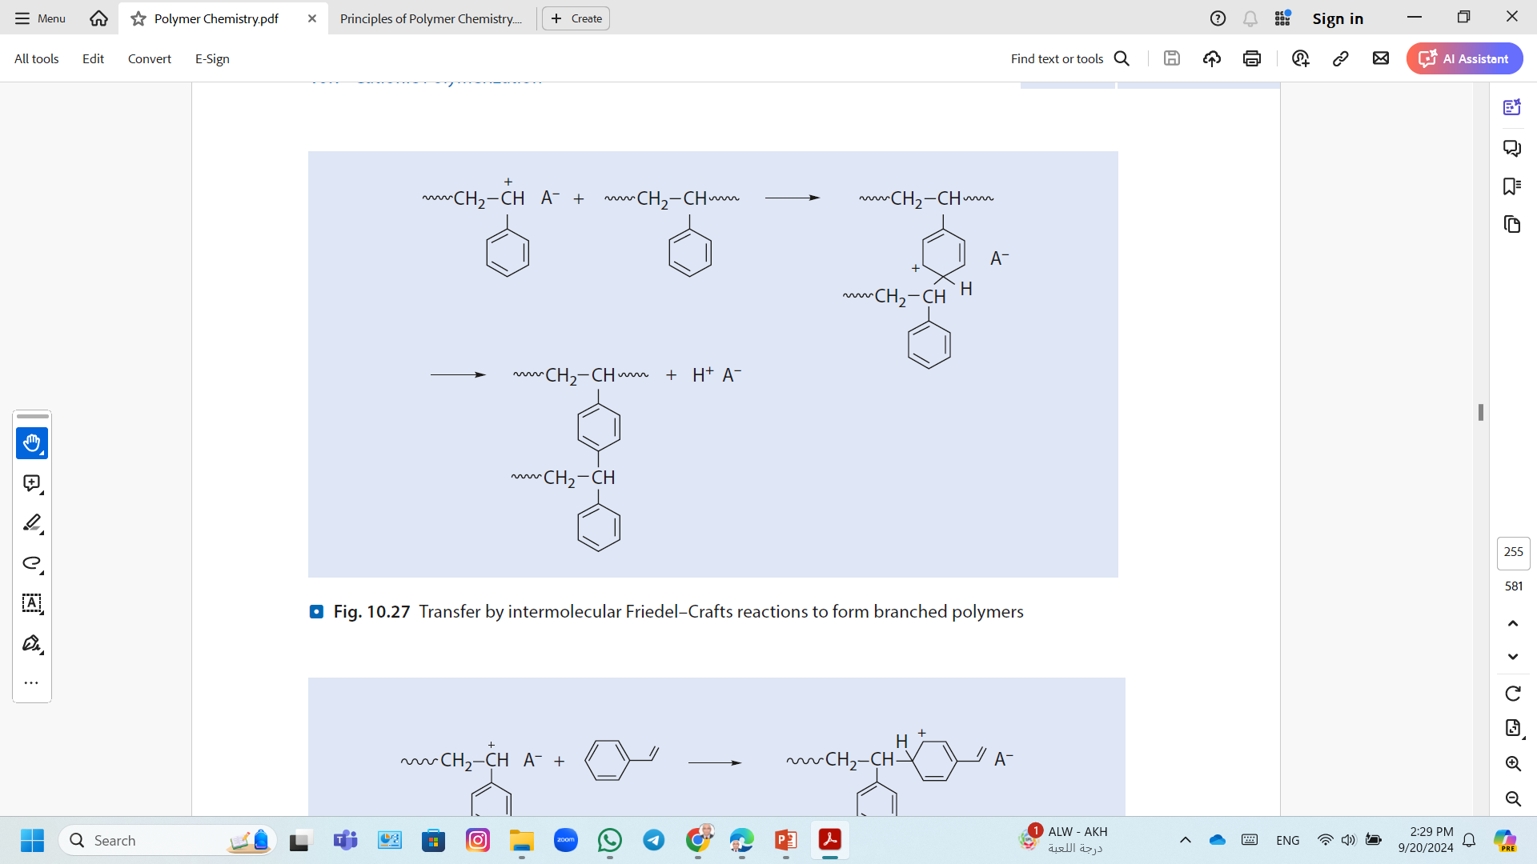
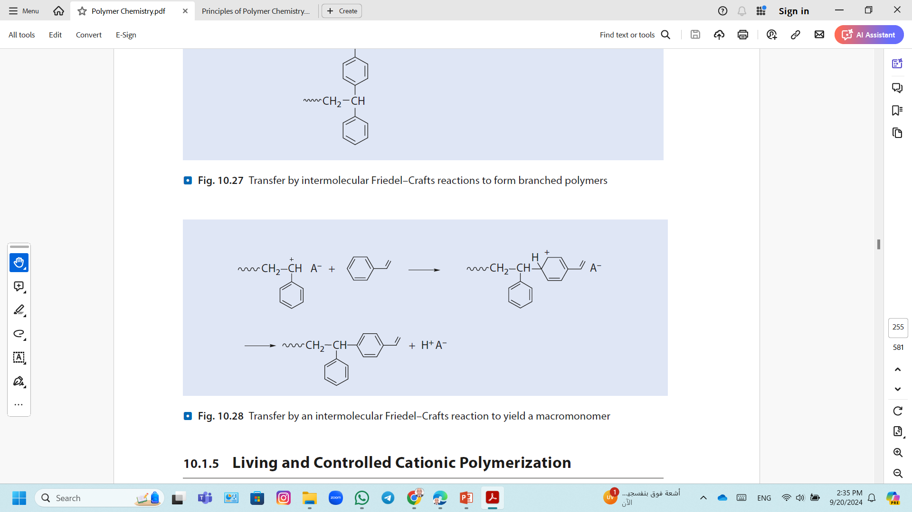
Cationic Polymerization; Mechanism
Transfer and Termination
Transfer Reactions
Transfer by intermolecular Friedel–Crafts reactions to form branched polymers or macromonomers (If aromatic groups are present).
Transfer by intermolecular Friedel–Crafts reactions to form branched polymers
Transfer by an intermolecular Friedel–Crafts reaction to yield a macromonomer

Slide 32
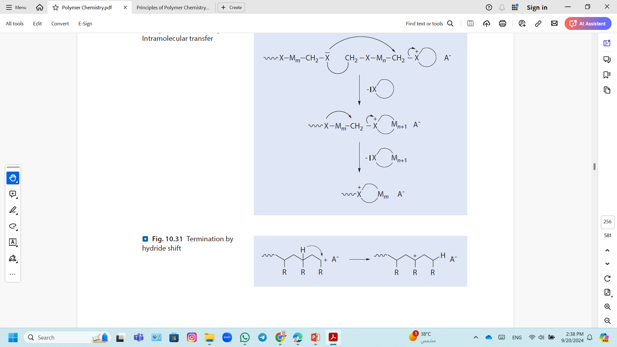
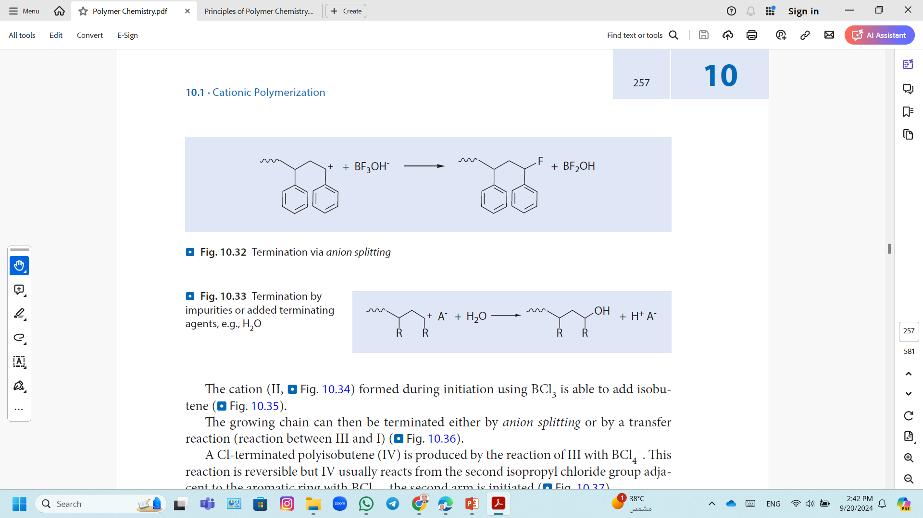
Cationic Polymerization; Mechanism
Transfer and Termination
Transfer Reactions
Termination by hydride shift
A hydride shift can lead to an inactive species caused by steric considerations.
Termination via anion splitting
The decomposition of the anion, then termination occurs through the reaction of the active cation with part of the counterion
Termination by impurities or added terminating agents, e.g., H₂O

Slide 33
Cationic Polymerization; Living Cationic Polymerization
The important aspect of living cationic polymerization is
The propagating centers are sufficiently low in reactivity.
Transfer and termination reactions are suppressed.
The lifetimes of the propagating species can be extended in such polymerizations by carrying out continuous slow additions of the monomer.
To achieve living conditions, it is necessary
to match the propagating carbon cation with the counterion,
the solvent polarity, and
the reaction temperature.

Slide 34
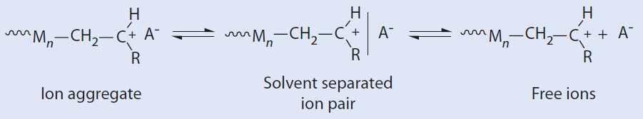
Cationic Polymerization
Effect of temperature
Low reaction temperatures, are preferred for producing longer chains.
Polymerizations are usually carried out at low temperatures to avoid undesirable side reactions, such as Friedel–Crafts reactions or deprotonation, at higher temperatures.
Effect of solvent and counter ion
The counterion can exist as
an ion pair with the active chain end, or
as a solvent separated ion pair, or
as a free ion
The propagation rate increased with increased solvating capability of the solvent.
A smaller counter ion is more easily solvated by a polar solvent than a counter ion with low charge density.
A smaller counter ion, with a higher charge density, will have stronger electrostatic interactions with the carbonium ion than will a larger counter ion which has a lower charge density.

Slide 35
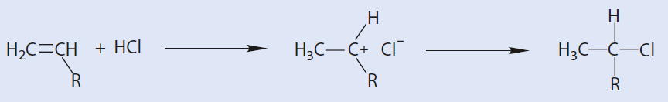
Cationic Polymerization
If the anion is more nucleophilic than the monomer, a covalent bond forms between the anion and cation, for example, HCl.
Preferred solvents are CH₂Cl₂, CH₃Cl, CHCl₃, benzene, and toluene.

Slide 36
Cationic Polymerization; Polymerization of Isobutylene
1. Chain initiation
2. Chain propagation
3. Chain termination;

Slide 37
Chain-Growth Polymerization
Anionic Polymerization

Slide 38
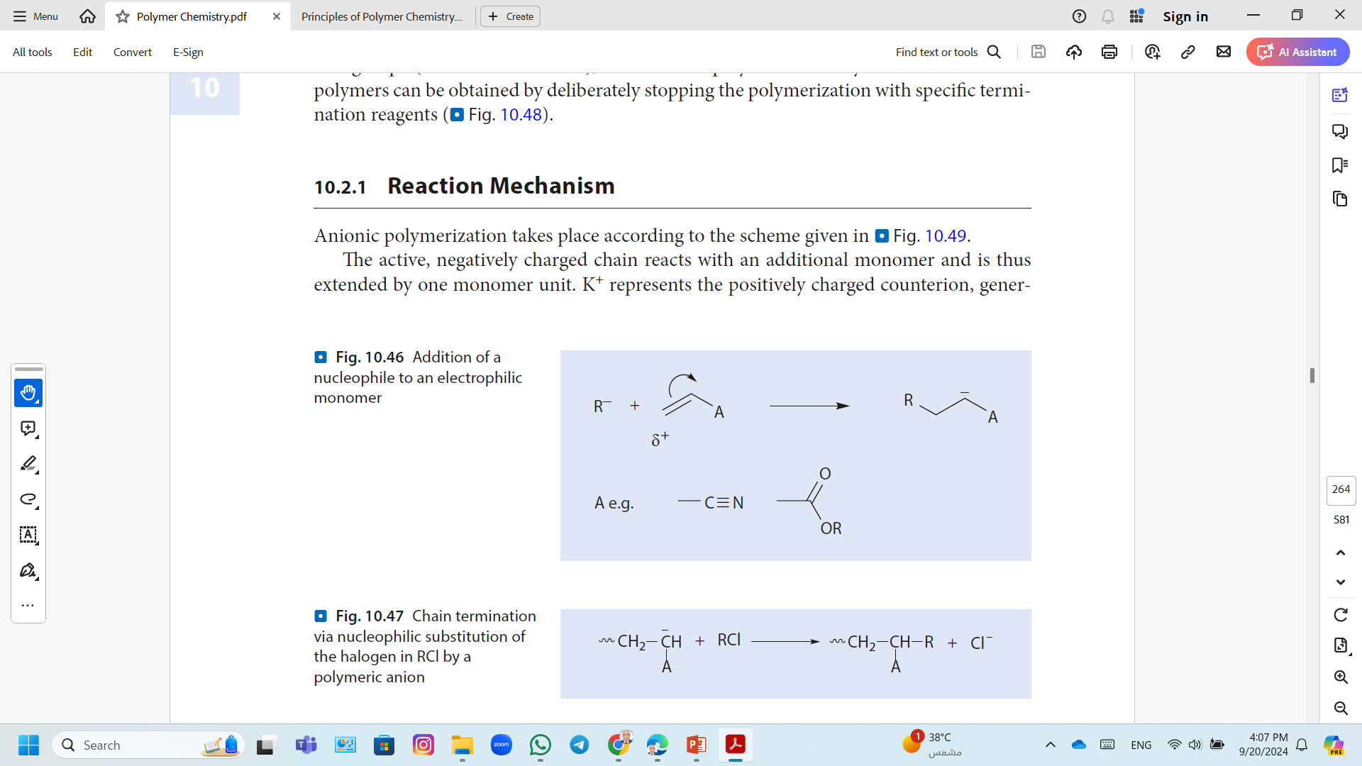
Anionic Polymerization
A monomer can be polymerized depends on the substituents.
Anionic polymerization
Monomers with an electron withdrawing group follow an anionic pathway (i.e., the substituents induce acceptor-substituents (CN, COOR, CONR₂)).
Addition of a nucleophile to an electrophilic monomer
Anionic polymerization occurs by nucleophilic attacks of the initiators on the monomers.

Slide 39
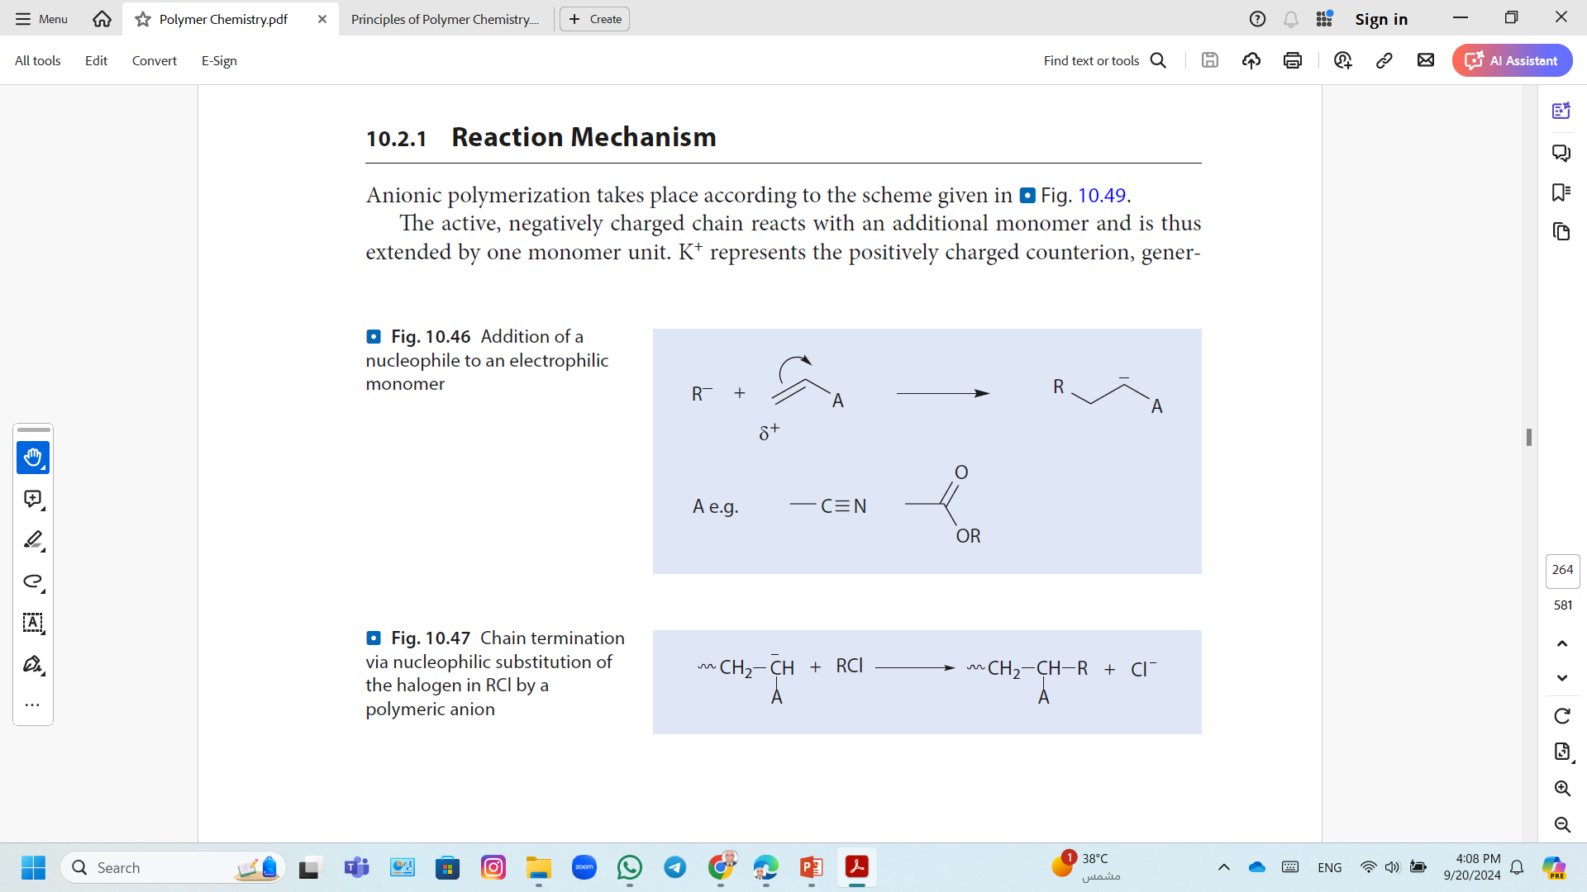
Anionic Polymerization
Solvents
Example; tetrahydrofuran and aliphatic and aromatic hydrocarbons.
High purity
Traces of water and alcohols should be avoided as these deactivate the growing chains.
Solvents such as CH₂Cl₂ and CHCl₃ also lead to chain termination
The polymerizations are generally carried out at temperatures below room temperature to facilitate control of the otherwise rapid reactions and to suppress side reactions.

Slide 40
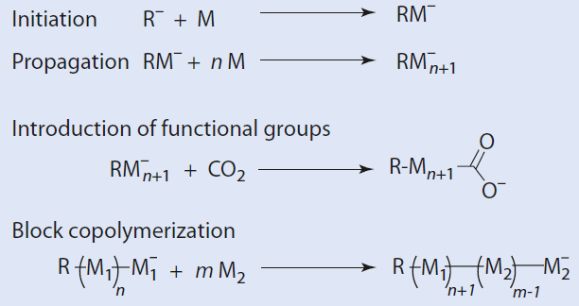
Anionic Polymerization
The absence of termination and transfer steps;
Allows living polymerization
Enables polymers with narrow molar mass distributions (M_{w}/M_{n} < 1.1), well-defined functional end groups.
Block copolymers to be synthesized.

Slide 41
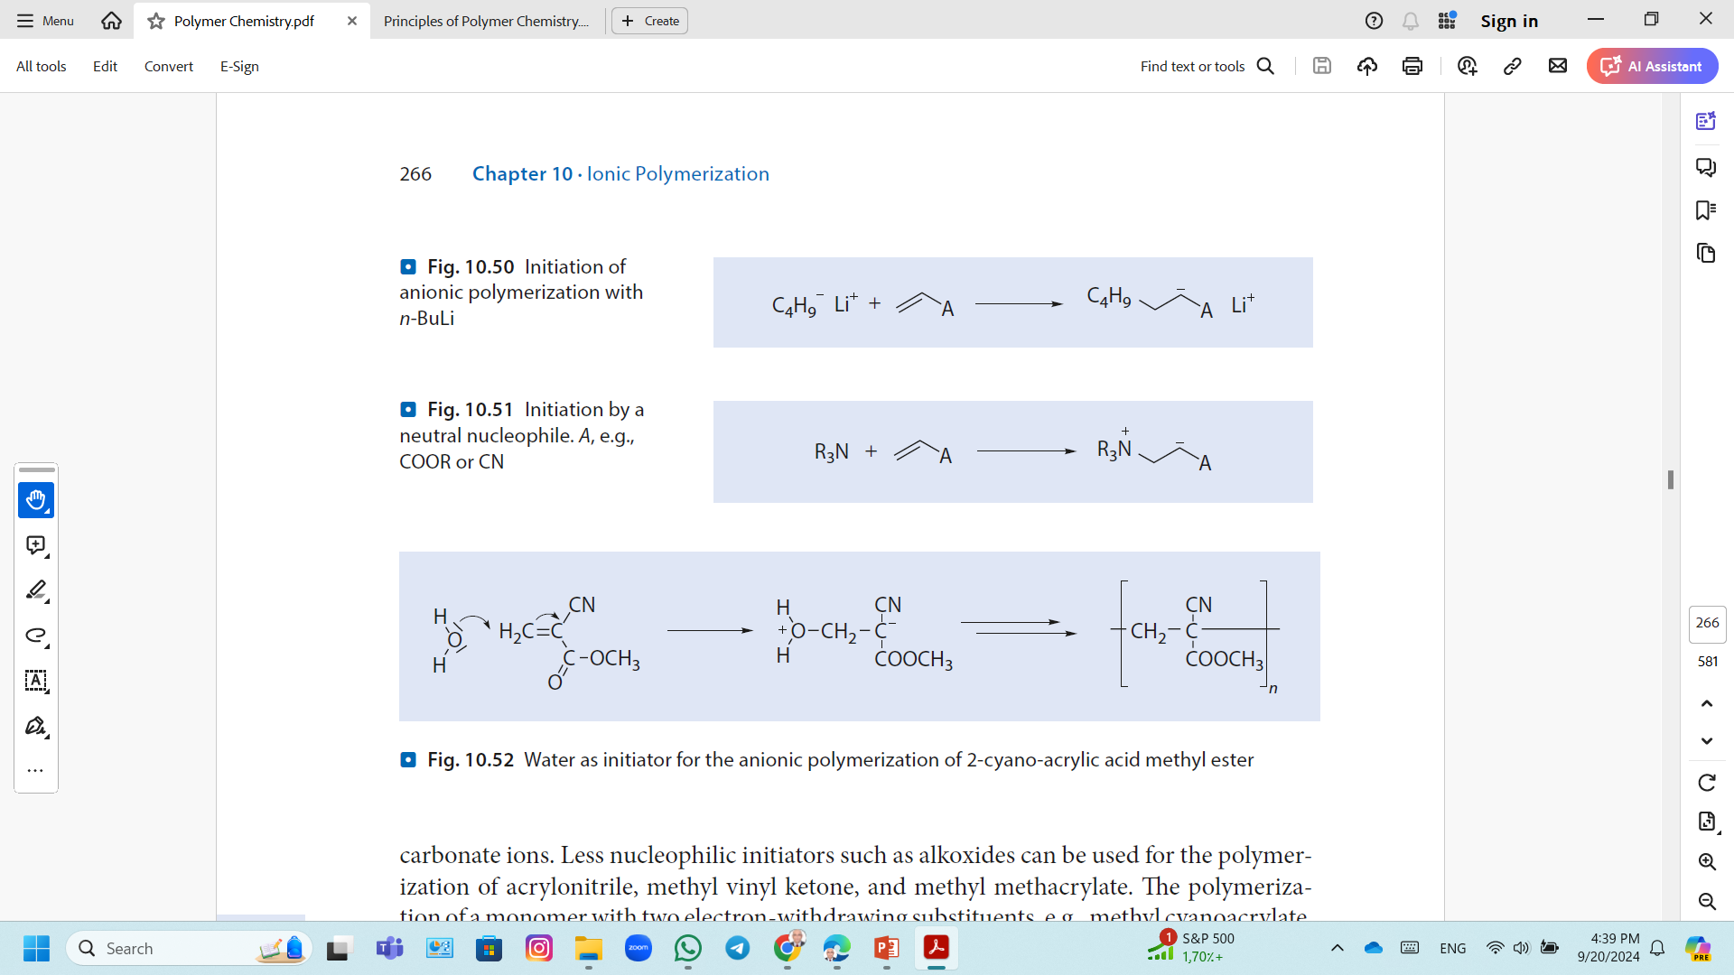
Anionic Polymerization; Mechanism
Initiation
Nucleophilic Initiators
Covalent or ionic metal amides such as NaNH₂ and LiN(C₂H₅)₂, alkoxides, hydroxides, cyanides, phosphines, and amines.
Organic metal compounds such as n-C₄H₉Li (soluble in hydrocarbons) and Grignard compounds such as PhMgBr are especially popular.
Initiation of anionic polymerization with n-BuLi
Neutral nucleophiles, which generate zwitterionic growing chain ends, are not so frequently used as initiators for anionic polymerization
Initiation by a neutral nucleophile.

Slide 42
Anionic Polymerization; Mechanism
Initiation
The choice of initiator depends on the monomer to be polymerized.
More nucleophilic initiators such as amide or alkyl carbonate ions can be used for the polymerization of styrene and 1,3-butadiene.
Less nucleophilic initiators such as alkoxides can be used for the polymerization of acrylonitrile, methyl vinyl ketone, and methyl methacrylate.
Very weak nucleophiles such as Br−, CN−, amines, phosphines, and even water (“Superglue”) can be used for the polymerization of a monomer with two electron-withdrawing substituents, e.g., methyl cyanoacrylate,
Water as initiator for the anionic polymerization of 2-cyano-acrylic acid methyl ester

Slide 43
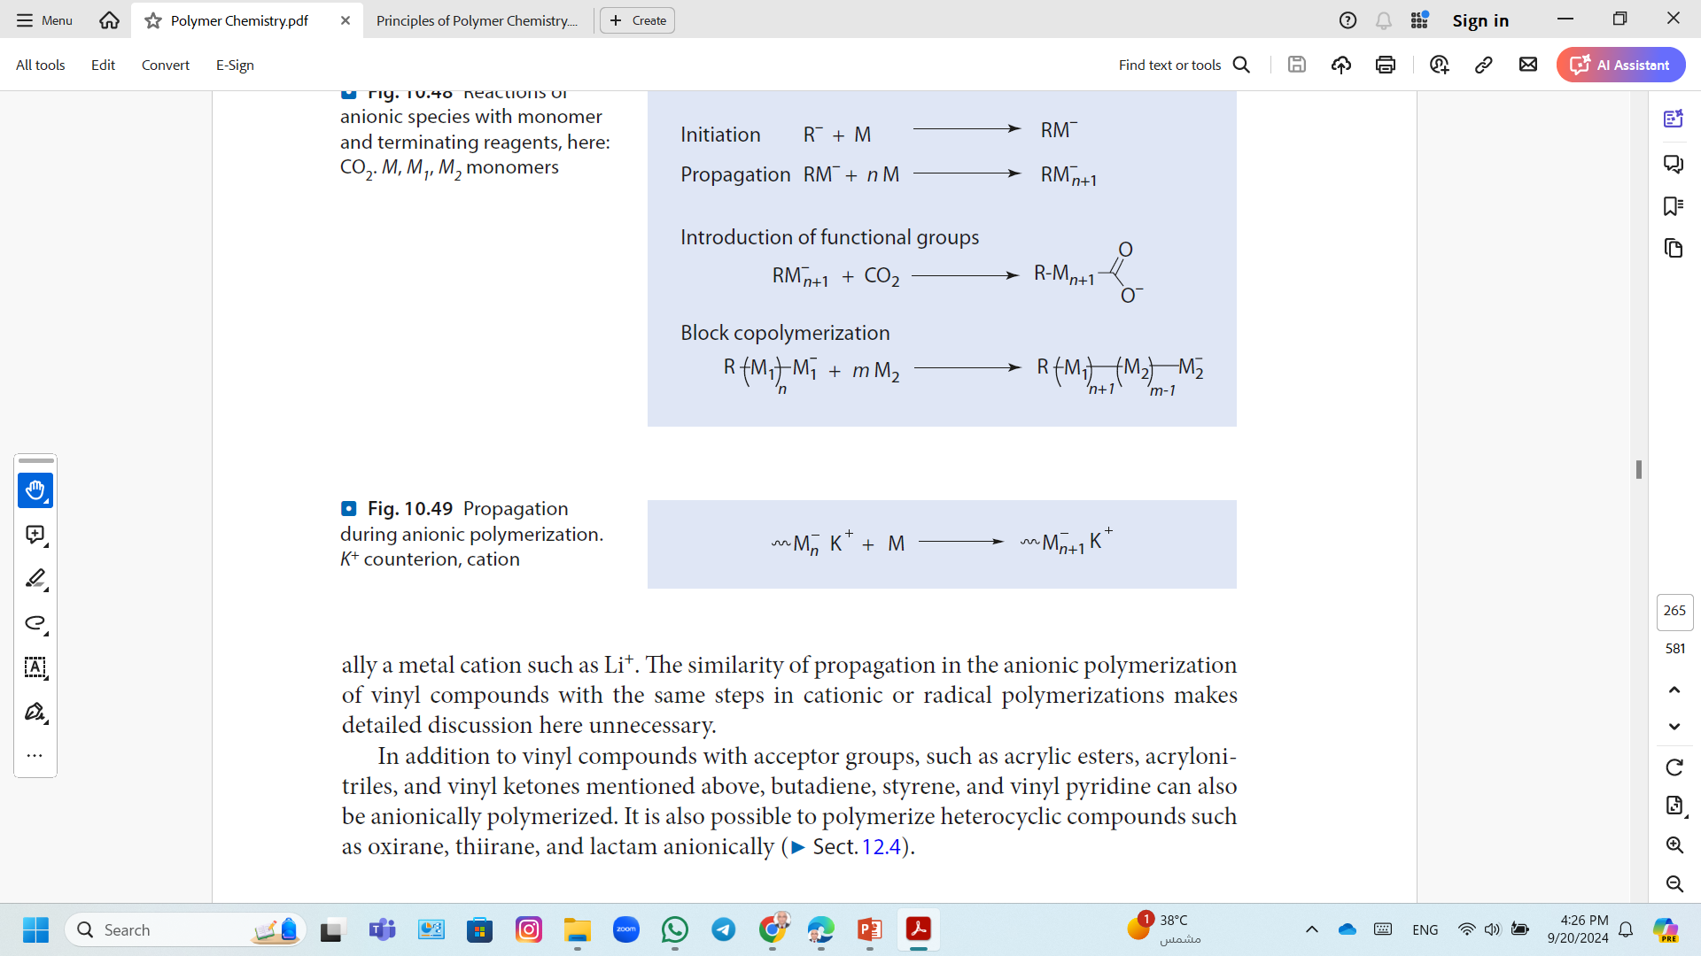
Anionic Polymerization; Mechanism
Propagation in Anionic Polymerization
Propagation during anionic polymerization. K⁺ counterion, cation
Propagation in the anionic polymerization of vinyl compounds is the same steps in cationic or radical polymerizations.

Slide 44
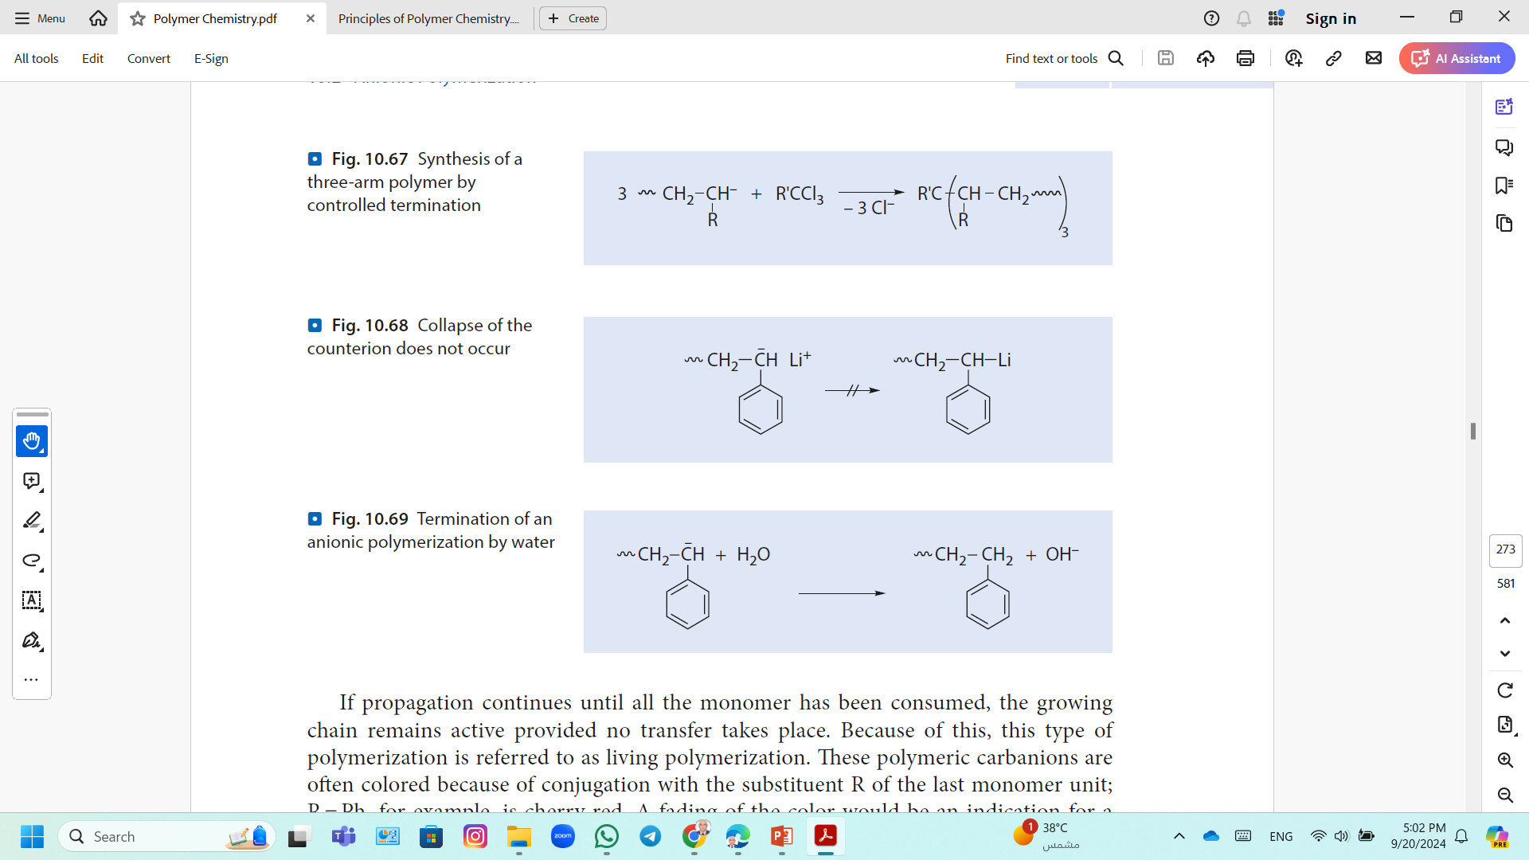
Anionic Polymerization; Mechanism
Role of Termination Reactions and Reagents in Anionic Polymerization
Polymerization Without Termination
Anionic polymerization of non-polar monomers such as styrene and 1,3-butadiene takes place without termination.
Because the growing chain ends are relatively weak nucleophiles and rarely terminated by proton abstraction from the solvent or the formed polymers.
A simple collapse of the counter ions is also not observed
Living polymerization; If propagation continues until all the monomer has been consumed, the growing chain remains active provided no transfer takes place.

Slide 45
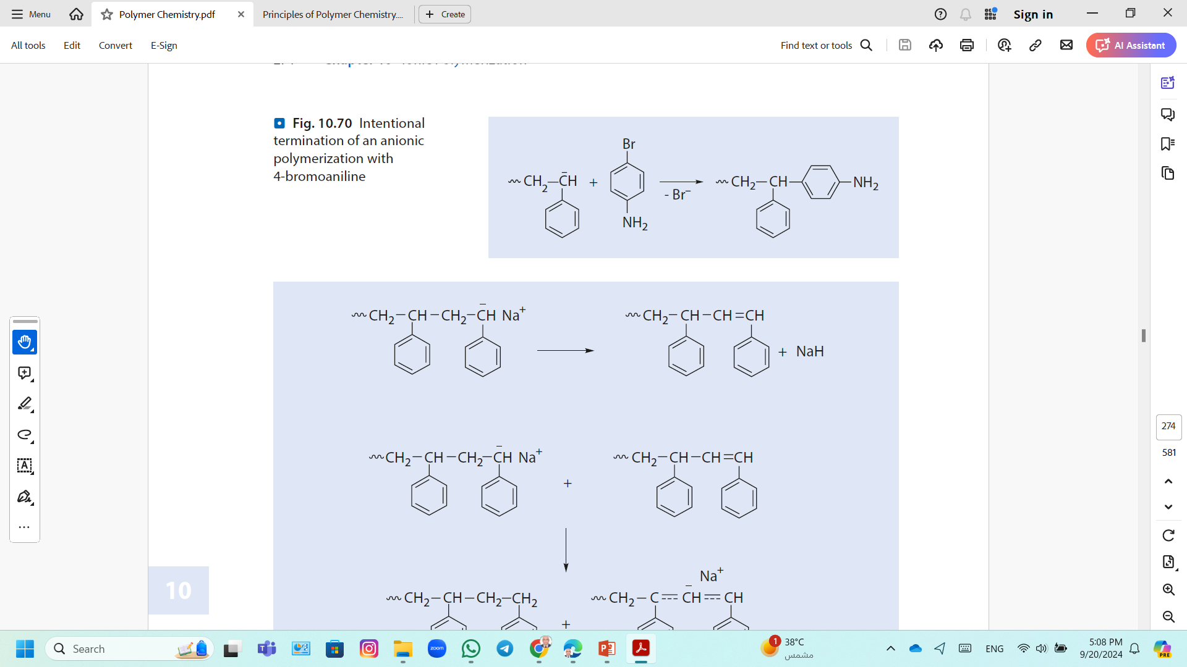
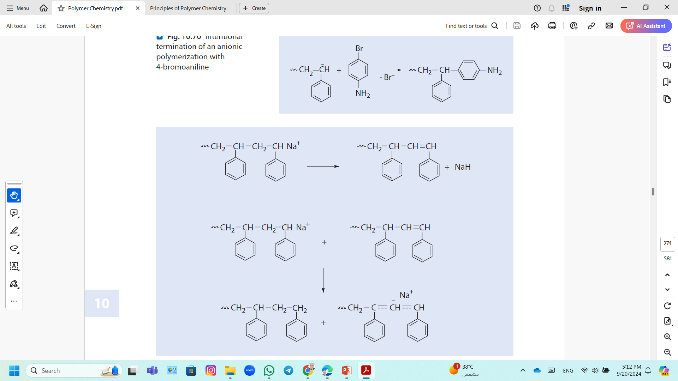
Anionic Polymerization; Mechanism
Role of Termination Reactions and Reagents in Anionic Polymerization
Termination by Contamination and Added Reagents
The introduction of –COOH or –OH or –NH₂ end groups may be desired to terminate polystyrene
Termination of an anionic polymerization with 4-bromoaniline
Hydride Elimination
Over a longer period (days or weeks), a decrease in the carbanion concentration in a solution of polystyryl anions in THF is often observed despite the absence of termination reagents.

Slide 46
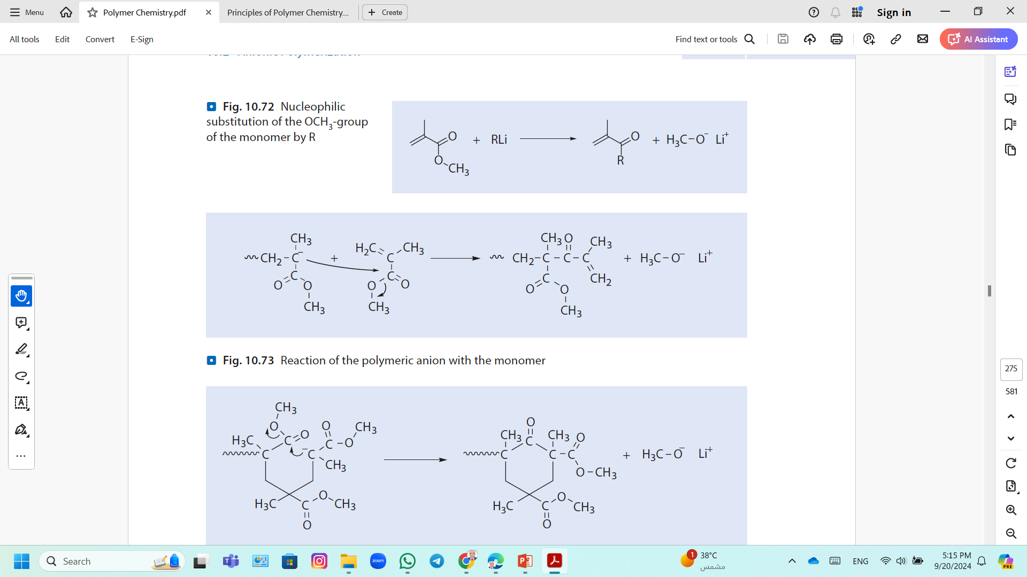
Anionic Polymerization; Mechanism
Role of Termination Reactions and Reagents in Anionic Polymerization
Termination Reactions During Anionic Polymerization of Methyl Methacrylate
Different termination reactions can be observed :
1. A reaction of the initiator with the functional group of the monomer leading to the less reactive alkoxide.
Nucleophilic substitution of the OCH₃-group of the monomer by R
2. A nucleophilic reaction of the polymeric anion with the monomer.
Reaction of the polymeric anion with the monomer

Slide 47
Anionic Polymerization; Polymerization of Acrylonitrile
1. Chain initiation
2. Chain propagation
3. Chain termination;
Anionic addition polymerizations have no formal termination pathways because proton transfer from solvent or other positive species does not occur.

Slide 48
Anionic Polymerization; Living Polymer
Living polymerization; If propagation continues until all the monomer has been consumed, the growing chain remains active provided no transfer takes place.
Living polymerization was demonstrated by Szwarc and co workers in 1956.
In the absence of impurities, the carbanion would still be active and capable of adding another monomer.
The chains will remain active indefinitely unless there is deliberate termination or chain transfer.
Chain initiation
Chain propagation

Slide 49
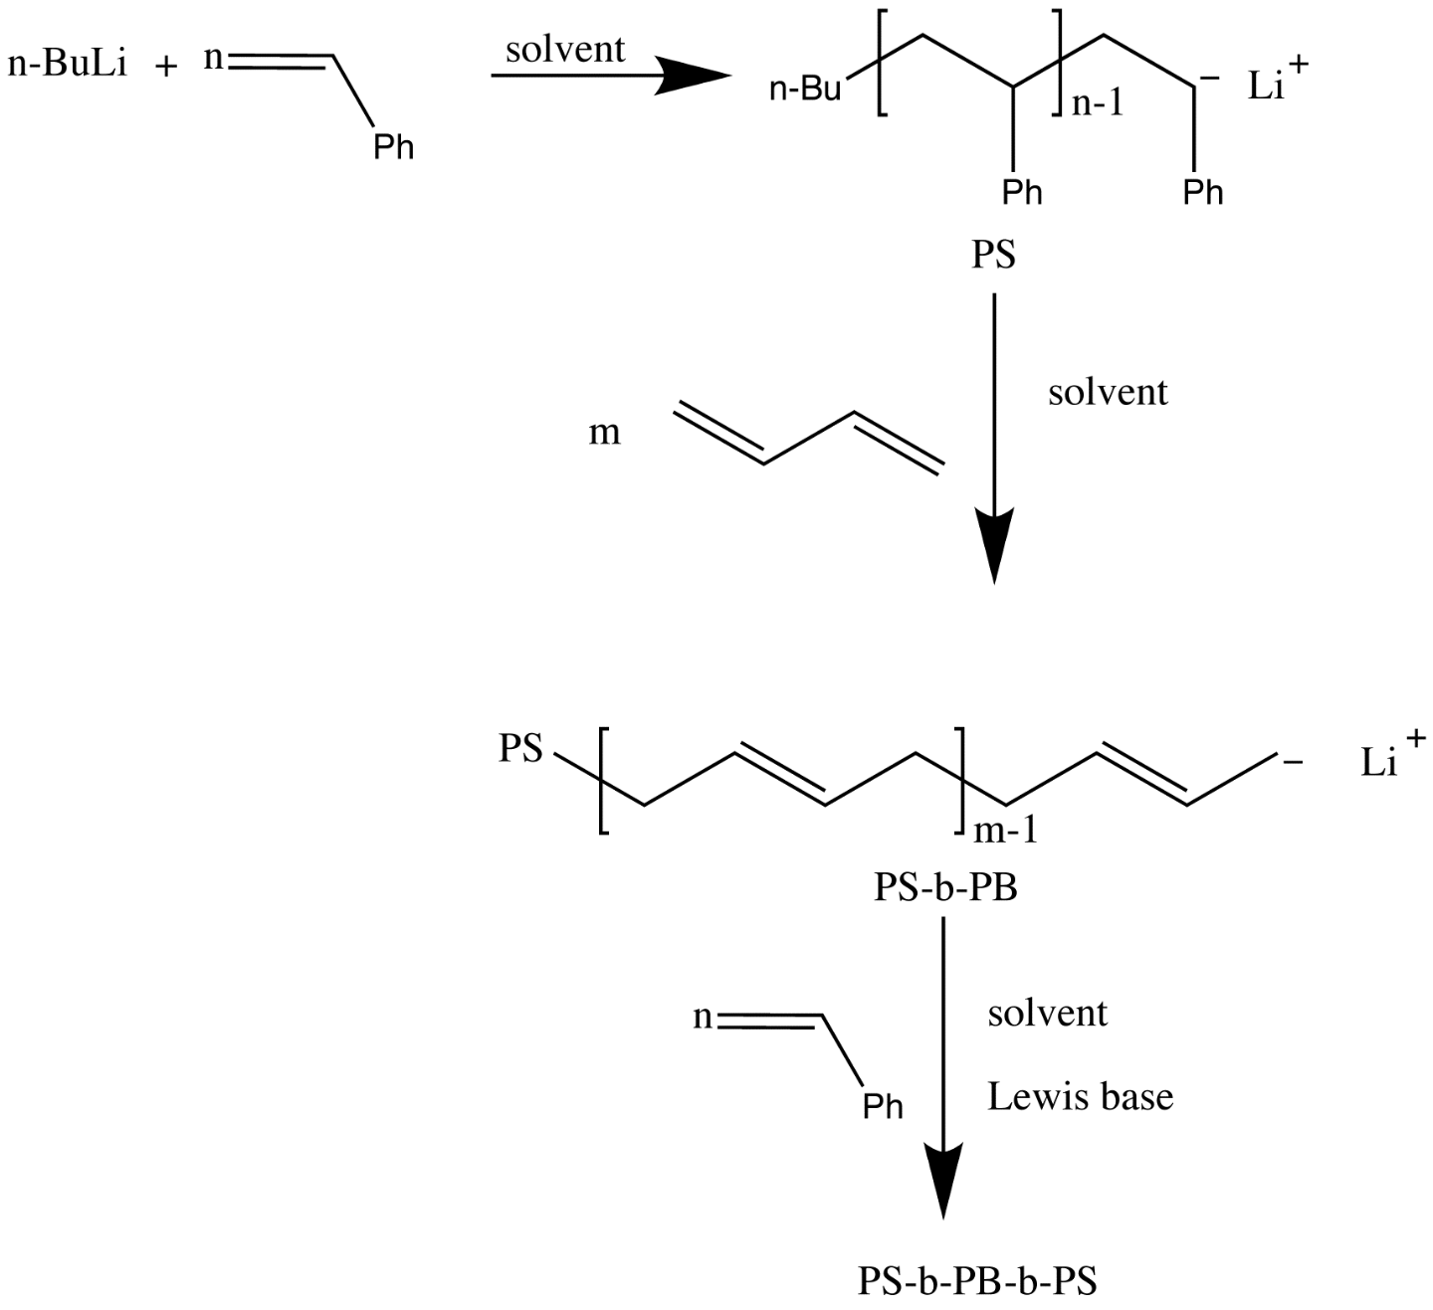
Anionic Polymerization; Living Polymer
Block copolymers

Slide 50
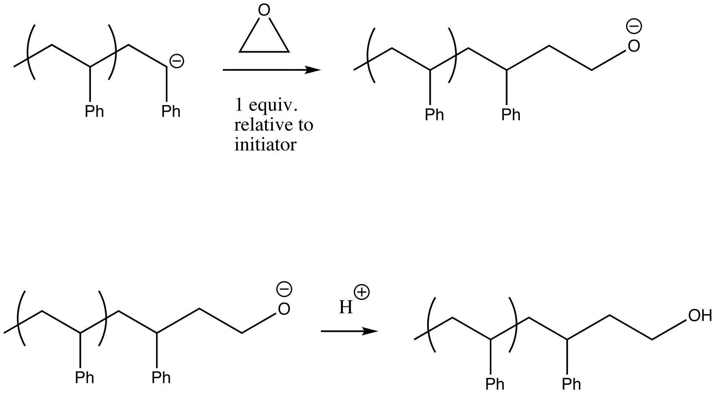
Anionic Polymerization; Living Polymer
End-group functionalization
Living anionic polymerization can also be used to incorporate functional groups.
These end-groups are usually added post-polymerization.
End-groups that have been used in the functionalization of α-haloalkanes include hydroxide, -NH₂, -OH, -SH, -CHO,-COCH₃, -COOH, and epoxides.

Slide 51
Chain-Growth Polymerization
Coordination Polymerization

Slide 52
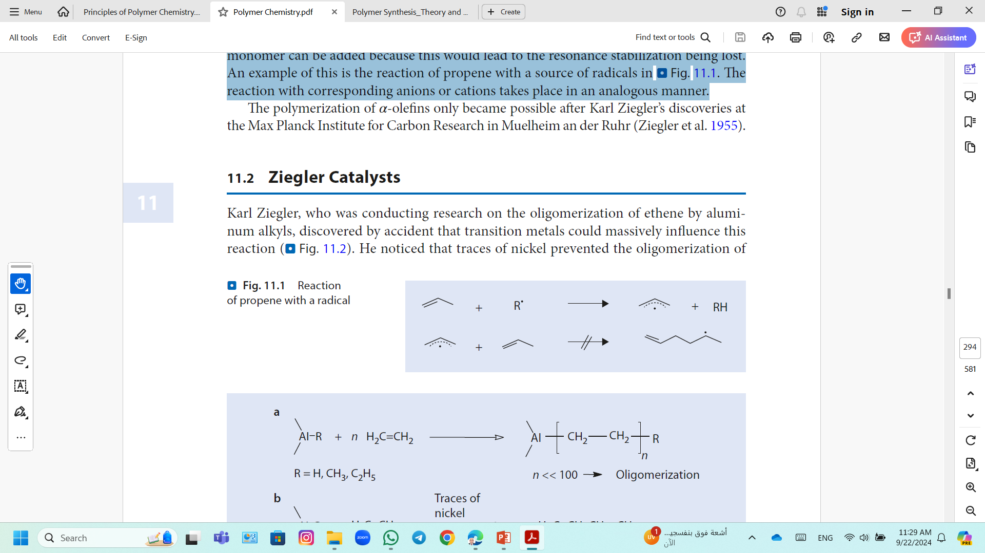
Coordination Polymerization
Nearly half of all polymers are produced worldwide by catalytic polymerization reactions carried out in the presence of transition metal compounds.
Simple α-olefins (terminated alkenes) cannot be polymerized (except for ethene) via the radical or ionic polymerizations.
This chain carrying the active center, a radical, referring to abstract a hydrogen atom or an ion from the carbon atom adjacent to the double bond results in an allyl species (stable that no other monomer can be added).
The reaction with corresponding anions or cations takes place in an analogous manner.
Reaction of propene with a radical

Slide 53
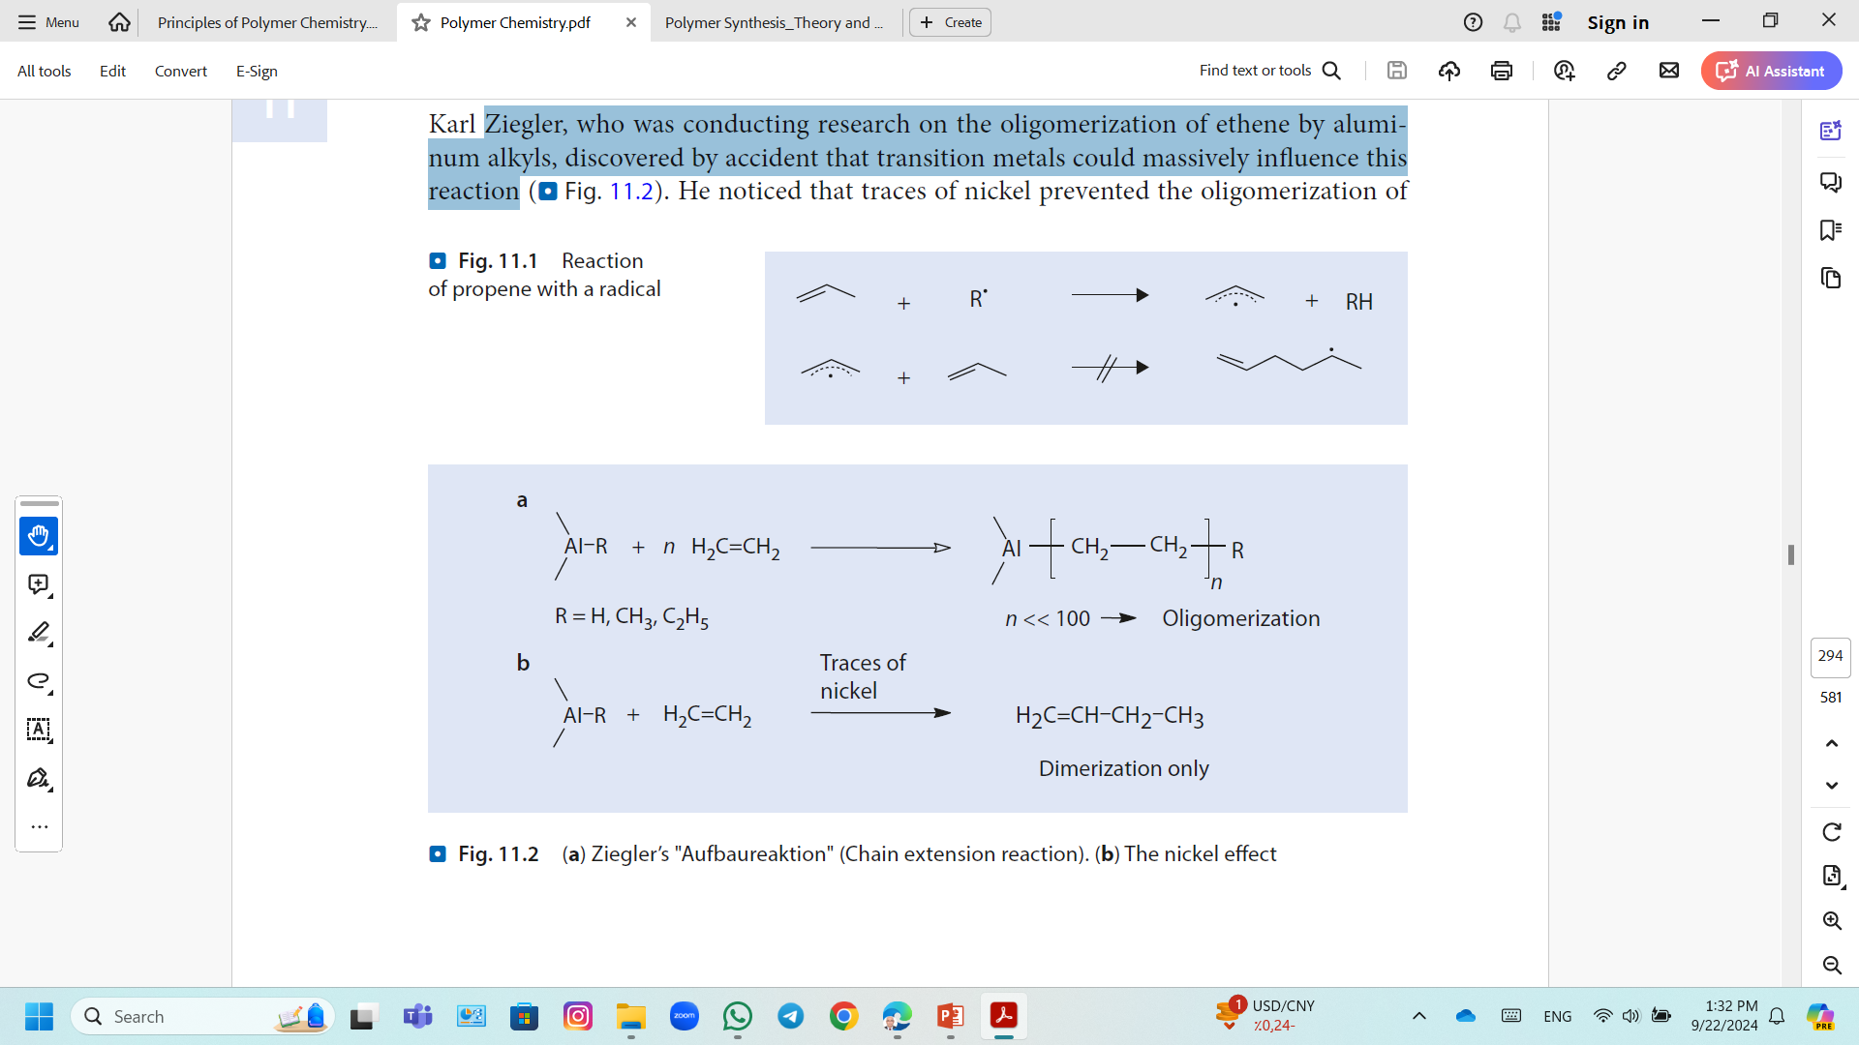
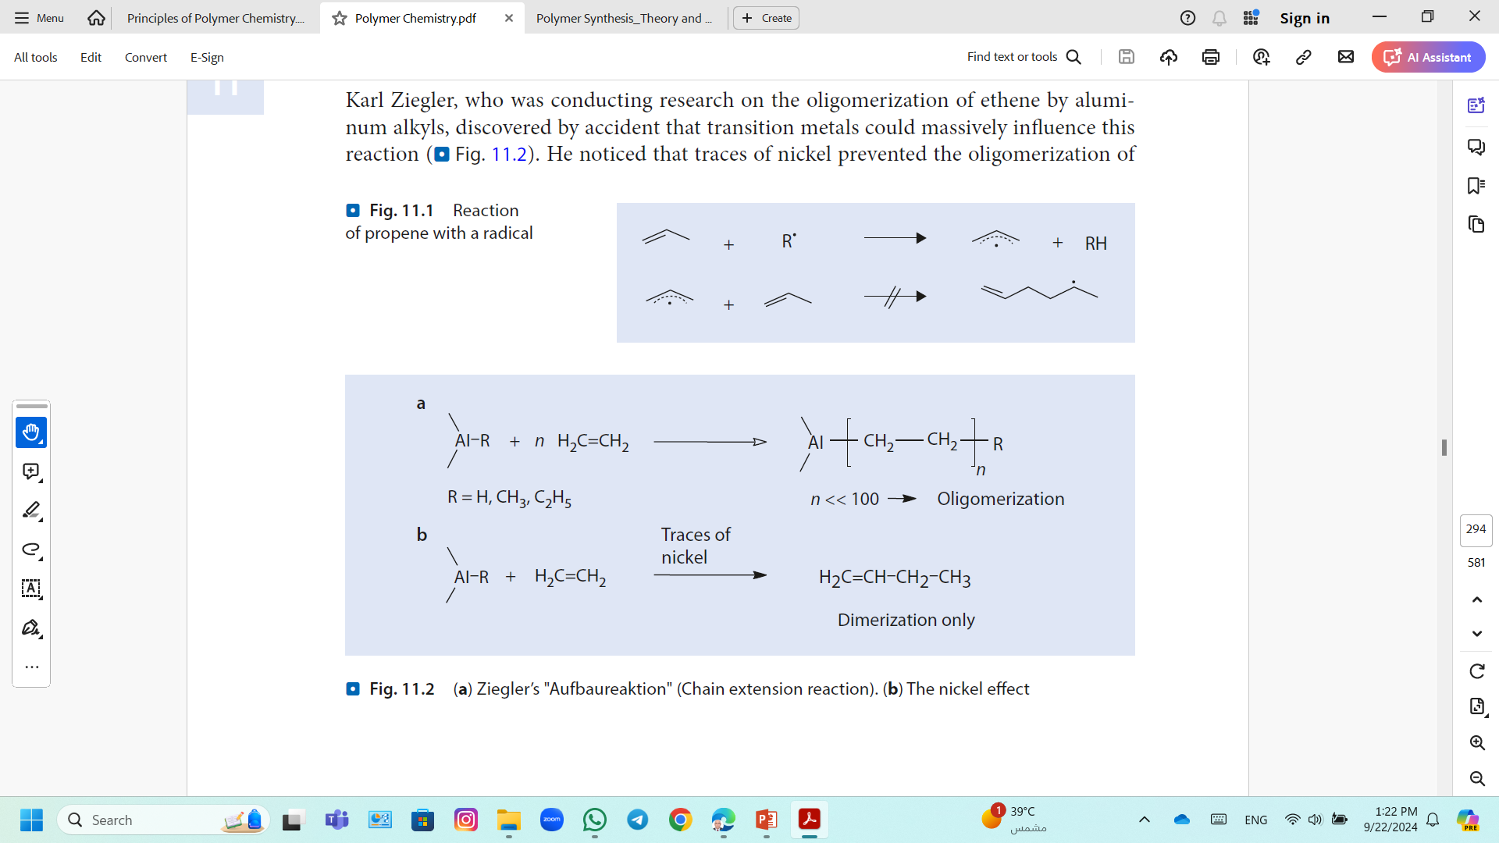
Coordination Polymerization; Heterogeneous Ziegler–Natta Catalysts
Ziegler, was conducting research on the oligomerization of ethene by Aluminum Alkyls, discovered by accident that transition metals could massively influence this reaction.
Ziegler’s "Aufbaureaktion" (Chain extension reaction or Build-up reaction)
The nickel effect; elimination taking place very quickly in the presence of nickel and therefore only a dimerization of the ethene takes place
The nickel effect

Slide 54
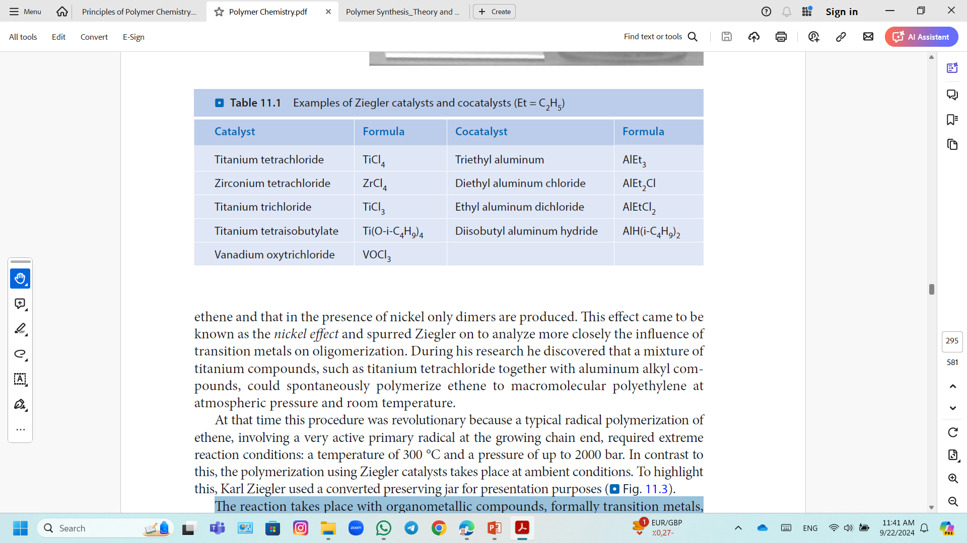
Coordination Polymerization; Heterogeneous Ziegler–Natta Catalysts
Ziegler showed that some transition metal halides, upon reaction with aluminum alkyls, can initiate polymerizations of ethylene.
Natta demonstrated that similar catalysts could polymerize various other olefins like propylene, butylene, and higher α-olefins.
High molecular weight linear polymers form, as well, highly stereospecific ones.
The reaction takes place with organometallic compounds, formally transition metals, and requires a second component, an aluminum alkyl, as a so-called cocatalyst.
Heptane or toluene is used as a solvent.
The active catalysts are insoluble in hydrocarbon solvents and can thus be described as heterogeneous catalysts.

Slide 55

Coordination Polymerization; Heterogeneous Ziegler–Natta Catalysts
Initiation
Titanium (IV) chloride is reduced to Titanium (III) chloride by aluminum compounds.
Alkylation of the titanium centers by the aluminum alkyl on the surface of the formed solid titanium-containing particles.
Initiation process for Ziegler catalysts
Some of the metal centers on the surface are coordinatively unsaturated and have a free coordination point.

Slide 56

Coordination Polymerization; Heterogeneous Ziegler–Natta Catalysts
Growth
Step 1; coordination of ethene molecule with the metal atom via the π-electrons of the double bond.
Step 2; insertion of the ethene molecule over a four-center-four-electron-transition state involving the metal carbon bond already existing takes place.
Chain growth with Ziegler catalysts
The coordination site that was occupied by the ethyl group becomes available again and so the center is ready for another insertion step.
The chain migration during the insertion step leads to a cis-addition (chain migratory mechanism).

Slide 57

Coordination Polymerization; Heterogeneous Ziegler–Natta Catalysts
Termination/Chain Transfer
Instead of insertion; the ß-carbon of the hydrocarbon chain can be transferred in the form of a hydride ion to
Free coordination center (ß-hydride-elimination)
As the ethene concentration increases, the rate of chain growth and the rate of termination remains the same and the molar mass increases.
b) A coordinated monomer molecule (ß-hydride-transfer).
The chain growth and the molar mass is independent of the ethene pressure
An unsaturated polymer is formed.

Slide 58

Coordination Polymerization; Heterogeneous Ziegler–Natta Catalysts
Termination/Chain Transfer
The molar mass can be regulated by the addition of hydrogen.
Molecular hydrogen splits the titanium–alkyl bond (hydrogenolysis).
The resulting hydride species can add further monomers so that the rate of polymerization stays the same but shorter polymer chains are formed
Regulation of molar mass with hydrogen
The titanium alkyl or titanium hydride species formed during these processes are still active polymerization catalysts and can initiate new polymer chains.

Slide 59

Coordination Polymerization; Heterogeneous Ziegler–Natta Catalysts
Reactions of Aluminum Alkyls with Ethene; High Density Polyethylene (HDPE)
Oligomerization of ethene through the “Aufbaureaktion”
Dimerization of ethene through the nickel effect.
Polymerization of ethene to polyethylene (Muelheim polyethylene low-pressure process)

Slide 60

Coordination Polymerization; Homogeneous Metallocene Catalysts
Highly active and stereoselective metallocene catalysts was discovered by Brintzinger in 1995.
These transition metal compounds are soluble in the reaction medium and are therefore referred to as homogeneous catalysts.
Many of the mechanistic details of polyinsertion have been clarified with the aid of these well-defined systems.
Homogeneous catalysts are metallocenes or half sandwich compounds of the early transition metals titanium and zirconium.
Examples of (a, b) homogeneous metallocene catalysts and (c) half-sandwich complexes for the polymerization of olefins

Slide 61

Coordination Polymerization; Homogeneous Metallocene Catalysts
Like the heterogeneous Ziegler catalysts, most of the metallocenes are only active with a cocatalyst.
Examples for Cocatalyst;
Aluminum organic compounds (methyl aluminoxane (MAO))
High Lewis acidity (triphenyl methyl cations [C(C₆H₅)₃]⁺ with weakly coordinated anions such as tetrakis(pentafluorophenyl borane) [B(C₆F₅)₄]⁻
Synthesis of methyl aluminoxane via partial hydrolysis of trimethyl aluminum

Slide 62
Coordination Polymerization; Examples
Polyethylene (PE)
Based on the structure of the molecule of the polyethylene, There are three main types of PE:
High density polyethylene (HDPE),
HDPE is a more linear molecule where there are very few side chains caused by branching, and these side chains are usually very short compared to LDPE.
Low density polyethylene (LDPE),
Branches are relatively long and intertwine and link with other polyethylene molecules
Linear low-density polyethylene (LLDPE)
LLDPE as the name suggests is a more linear, low density polyethylene molecule. It still has many side branches; however, these branches are shorter.
Due to the differences in structure,
HDPE is stronger and has a higher melting point than LDPE,
with LLDPE generally between the two.

Slide 63
Coordination Polymerization; Examples
Polyethylene (PE)
There are three main polymerization reactions used to make polyethylene:
Free radical polymerization;
This type of polymerization is used to make the highly branched LDPE at high pressures (1000-3000 atm), and 150-300ºC.
Ziegler-Natta polymerization;
It is used to make HDPE and LLDPE; uses transition metal catalysts at temperatures of around 70-50ºC and pressures less than 10 atm.
Metallocene catalyst polymerization;
They are very good at allowing the manufacturer to control the exact structure of the polyethylene.
They are commonly used to increase the strength of LDPE and HDPE,
They are also able to make Ultra High-Density Polyethylene (UHDPE) that is very strong.

Slide 64

Coordination Polymerization; Examples
Polypropylene (PP)
Polypropylene has very similar mechanical and chemical properties to its PE cousin.
The different structure also gives PP
It has a higher melting point, around 160ºC.
Structurally PP forms many crystals, making it stronger than polyethylene.
It is also relatively chemically inert and resistant to chemical attack from most solvents, bases and acids.
Like PE, PP also has high electrical resistance, making it a good insulator.
Polypropylene is manufactured by metallocene catalysis

Slide 65
Coordination Polymerization; Examples
Polypropylene (PP)
Alkylation of Ti³⁺ with a vacant orbital
Initiation Step;
Propagation Step;

