Slide 1

Chemistry Department, College of Science, King Saud University
CHEM 241
Organic Chemistry II
FOR CHEMISTRY’ STUDENTS, COLLEGE OF SCIENCE
PRE-REQUISITES COURSE; CHEM 240
CREDIT HOURS; 2 (2+0)
Carbonyl Compounds; Aldehydes and Ketones Based on NCERT

Slide 2
Carbonyl Compounds
Organic compounds containing carbon-oxygen double bond (>C=O) called carbonyl group, which is one of the most important functional groups in organic chemistry.
In aldehydes, the carbonyl group is bonded to a carbon and hydrogen.
In the ketones, the carbonyl group is bonded to two carbon atoms.
In Carboxylic acids, the carbonyl group is bonded to oxygen.
Their Carboxylic acids derivatives (e.g. esters, anhydrides, amides and acyl halides).

Slide 3
Aldehydes and Ketones

Slide 4
Nomenclature of Aldehydes
A) Common Names
The common names of most aldehydes are derived from the common names of the corresponding carboxylic acids by replacing the ending –ic of acid with aldehyde.
The location of the substituent in the carbon chain is indicated by Greek letters α, β, γ, δ, etc.
The α-carbon being the one directly linked to the aldehyde group, β-carbon the next, and so on.

Slide 5
Nomenclature of Aldehydes
B) IUPAC System
Aliphatic aldehydes are named by dropping the suffix -e from the name of the hydrocarbon that has the same carbon skeleton as the aldehyde and replacing it with the suffix -al.
= Alkanal
Alkane - e + al
In case of aldehydes the longest carbon chain is numbered starting from the carbon of the aldehyde group.
The CHO group is assigned the number 1 position.
The CHO group takes precedence over other functional groups such as -OH, C=C, or C-C triple bond.

Slide 6
Nomenclature of Aldehydes
When the aldehyde group is attached to a ring, the suffix carbaldehyde is added after the full name of the cycloalkane.
The name of the simplest aromatic aldehyde carrying the aldehyde group on a benzene ring is benzenecarbaldehyde.
However, the common name benzaldehyde is also accepted by IUPAC.
Other aromatic aldehydes are hence named as substituted benzaldehydes.

Slide 7
Nomenclature of Ketones
A) Common Names
The common names of ketones are derived by naming two alkyl or aryl groups bonded to the carbonyl group.
Alkyl ketone
Alkyl phenyl ketones are usually named by adding the acyl group as prefix to phenone.
The locations of substituents are indicated by Greek letters, α α′, β β′ and so on beginning with the carbon atoms next to the carbonyl group, indicated as αα′.

Slide 8
Nomenclature of Ketones
B) IUPAC System
We find the longest continuous chain carrying the carbonyl group.
Name the parent structure by dropping the suffix –e, and replacing it with the suffix -one.
Alkane - e + one
= Alkanone
The numbering begins from the end nearer to the carbonyl group.
The substituents are prefixed in alphabetical order along with numerals indicating their positions in the carbon chain.
For cyclic ketones, numbering always starts from the C=O group; the carbonyl carbon is numbered one.

Slide 9
Nomenclature of Aldehydes and Ketones; Examples

Slide 10
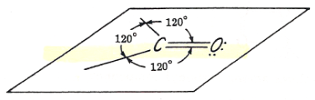
Structure of the Carbonyl Group
The carbonyl carbon atom is sp²-hybridised and forms three sigma (σ) bonds and one π-bond.
In addition, the oxygen atom also has two non bonding electron pairs.
The bond angles are approximately 120° as expected of a trigonal coplanar structure
Orbital diagram for the formation of carbonyl group
The carbon-oxygen double bond is polarized due to higher electronegativity of oxygen relative to carbon.
Hence, the carbonyl carbon is an electrophilic (Lewis acid), and carbonyl oxygen, a nucleophilic (Lewis base).
The high polarity of the carbonyl group is explained on the basis of resonance.
neutral structure
a dipolar structure.

Slide 11
Questions

Slide 12
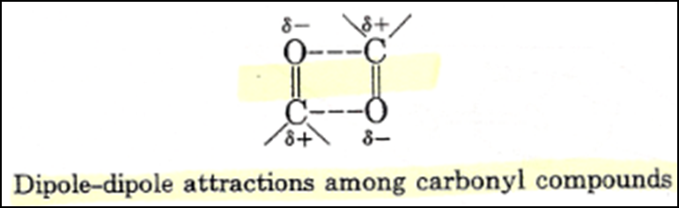
Physical Properties of Aldehydes and Ketones
Physical State
Methanal is a gas at room temperature.
Ethanal is a volatile liquid.
Other aldehydes and ketones are liquid or solid at room temperature.
Boiling Points
The boiling points of aldehydes and ketones are higher than hydrocarbons and ethers of comparable molecular masses.
Also, their boiling points are lower than those of alcohols of similar molecular masses due to absence of intermolecular hydrogen bonding.
Dipole-dipole attractions, although important, are not as strong as interactions due to hydrogen bonding.

Slide 13
Physical Properties of Aldehydes and Ketones
Solubility in Water
The lower members of aldehydes and ketones such as methanal, ethanal and propanone are miscible with water in all proportions, because they form hydrogen bond with water.
However, the solubility of aldehydes and ketones decreases rapidly on increasing the length of alkyl chain.
All aldehydes and ketones are fairly soluble in organic solvents like benzene, ether, methanol, chloroform, etc.
The lower aldehydes have sharp pungent odors.
As the size of the molecule increases, the odor becomes less pungent and more fragrant.
In fact, many naturally occurring aldehydes and ketones are used in the blending of perfumes and flavoring agents.

Slide 14
Questions

Slide 15
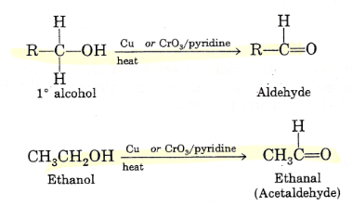
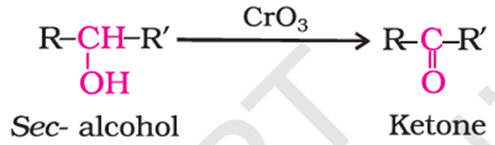
Preparation of Aldehydes and Ketones
1. By oxidation of Alcohols
Aldehydes and ketones are generally prepared by oxidation of primary and secondary alcohols, respectively.

Slide 16
Preparation of Aldehydes and Ketones
2. From Hydrocarbons
(i) Ozonolysis of Alkenes: Ozonolysis of alkenes followed by reaction with zinc dust and water gives aldehydes, ketones or a mixture of both depending on the substitution pattern of the alkene.
(ii) Hydration of Alkynes: Addition of water to ethyne in the presence of H₂SO₄ and HgSO₄ gives acetaldehyde.
All other alkynes give ketones in this reaction

Slide 17
Preparation of Aldehydes and Ketones
2. From Hydrocarbons
(iii) By oxidation of methylbenzene
Strong oxidizing agents oxidize toluene and its derivatives to benzoic acids.
However, it is possible to stop the oxidation at the aldehyde stage with suitable reagents.
(a) Use of chromyl chloride (CrO₂Cl₂) (Etard reaction):
Chromyl chloride oxidizes methyl group to a chromium complex, which on hydrolysis gives corresponding benzaldehyde.
(b) Use of chromic oxide (CrO₃):
Toluene or substituted toluene is converted to benzylidene diacetate on treating with chromic oxide in acetic anhydride.
The benzylidene diacetate can be hydrolysed to corresponding benzaldehyde with aqueous acid.

Slide 18
Preparation of Aldehydes and Ketones
2. From Hydrocarbons
(iv) By side chain chlorination followed by hydrolysis
Side chain chlorination of toluene gives benzal chloride, which on hydrolysis gives benzaldehyde.
This is a commercial method of manufacture of benzaldehyde.

Slide 19
Preparation of Aldehydes and Ketones
3. From Acyl Chloride (Acid Chloride) (Rosenmund Reduction)
Acyl chloride (acid chloride) is hydrogenated over catalyst, palladium on barium sulphate, gives aldehyde.
Treatment of acyl chlorides with dialkylcadmium, prepared by the reaction of cadmium chloride with Grignard reagent, gives ketones.
4. From Benzene or Substituted Benzenes (Friedel-Crafts acylation reaction)
When benzene or substituted benzene is treated with acid chloride in the presence of anhydrous aluminum chloride, it affords the corresponding ketone.

Slide 20
Questions

Slide 21
Chemical Reactions of Aldehydes and Ketones
1. Nucleophilic Addition Reactions
(i) Mechanism of Nucleophilic Addition Reactions
1) A nucleophile attacks the electrophilic carbon atom of the polar carbonyl group from a direction approximately perpendicular to the plane of sp² hybridized orbitals of carbonyl carbon.
3) This intermediate captures a proton from the reaction medium to give the electrically neutral product.
2) The hybridization of carbon changes from sp² to sp³; a tetrahedral alkoxide intermediate is produced.
The net result is addition of Nu– and H⁺ across the carbon oxygen double bond.

Slide 22
Chemical Reactions of Aldehydes and Ketones
1. Nucleophilic Addition Reactions
(ii) Reactivity
Aldehydes are generally more reactive than ketones in nucleophilic addition reactions due to steric and electronic reasons.
Sterically, the presence of two relatively large substituents in ketones hinders the approach of nucleophile to carbonyl carbon than in aldehydes having only one such substituent.
Electronically, aldehydes are more reactive than ketones because two alkyl groups reduce the electrophilicity of the carbonyl carbon more effectively than in former.

Slide 23
Questions

Slide 24
Chemical Reactions of Aldehydes and Ketones
1. Nucleophilic Addition Reactions: Examples
(a) Addition of hydrogen cyanide (HCN):
Aldehydes and ketones react with hydrogen cyanide (HCN) to yield cyanohydrins.
This reaction is catalyzed by a base and the generated cyanide ion (CN-) being a stronger nucleophile readily adds to carbonyl compounds to yield corresponding cyanohydrin.
Cyanohydrins are useful synthetic intermediates.

Slide 25
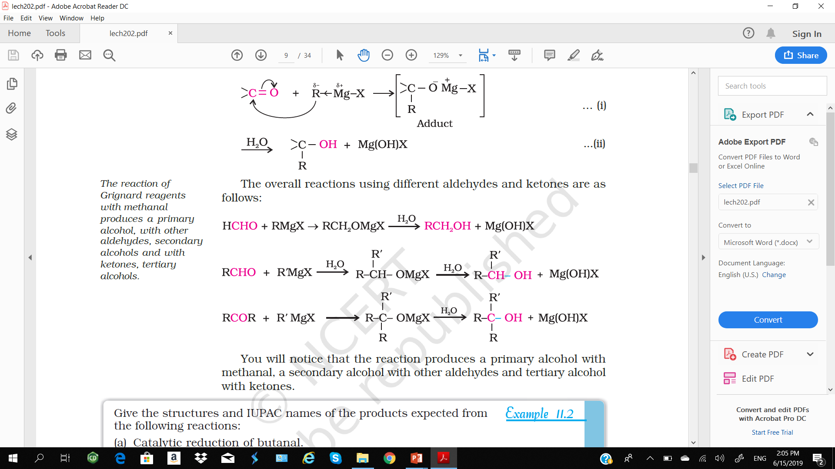
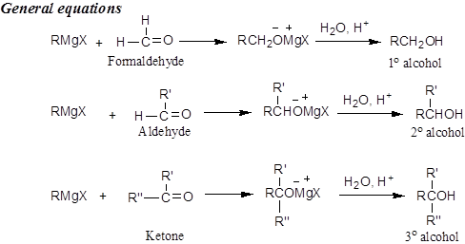
Chemical Reactions of Aldehydes and Ketones
1. Nucleophilic Addition Reactions: Examples
(b) Addition of Grignard Reagents:

Slide 26
Chemical Reactions of Aldehydes and Ketones
1. Nucleophilic Addition Reactions: Examples
(c) Addition of Alcohols:
Aldehydes react with one equivalent of monohydric alcohol in the presence of dry hydrogen chloride to yield alkoxyalcohol intermediate, known as hemiacetals, which further react with one more molecule of alcohol to give a gem-dialkoxy compound known as acetal.
Acetals are hydrolyzed with aqueous mineral acids to yield corresponding aldehydes and ketones respectively.

Slide 27
Chemical Reactions of Aldehydes and Ketones
1. Nucleophilic Addition Reactions: Examples
(d) Addition of Ammonia and its Derivatives:
Nucleophiles, such as ammonia and its derivatives H₂N-Z add to the carbonyl group of aldehydes and ketones.
The reaction is reversible and catalyzed by acid.
The equilibrium favors the product formation due to rapid dehydration of the intermediate to form >C=N-Z.

Slide 28
Chemical Reactions of Aldehydes and Ketones
1. Nucleophilic Addition Reactions: Examples
(d) Addition of Ammonia and its Derivatives:

Slide 29
Chemical Reactions of Aldehydes and Ketones
2. Reduction
(i) Reduction to alcohols:
Aldehydes and ketones are reduced to primary and secondary alcohols respectively by sodium borohydride (NaBH₄) or lithium aluminium hydride (LiAlH₄) as well as by catalytic hydrogenation
(ii) Reduction to hydrocarbons:
The carbonyl group of aldehydes and ketones is reduced to CH₂ group on treatment with:
zinc amalgam and concentrated hydrochloric acid [Clemmensen reduction].
hydrazine followed by heating with sodium or potassium hydroxide in high boiling solvent such as ethylene glycol.

Slide 30
Chemical Reactions of Aldehydes and Ketones
3. Oxidation
Aldehydes are easily oxidized to carboxylic acids on treatment with common oxidizing agents like nitric acid, potassium permanganate, potassium dichromate, etc. Even mild oxidizing agents, mainly Tollens’ reagent and Fehlings’ reagent also oxidize aldehydes.
(i) Tollens’ Test:
On warming an aldehyde with freshly prepared ammoniacal silver nitrate solution (Tollens’ reagent), a bright silver mirror is produced due to the formation of silver metal.
The reaction occurs in alkaline medium.
(ii) Fehling’s Test:
Fehling reagent comprises of two solutions,
Fehling solution A is aqueous copper sulphate and Fehling solution B is alkaline sodium potassium tartarate.
Aldehyde are oxidized to carboxylate anion with Fehling’s reagent, and a reddish brown precipitate is obtained.

Slide 31
Chemical Reactions of Aldehydes and Ketones
3. Oxidation
(iii) Oxidation of Methyl Ketones by Haloform Reaction:
Aldehydes and ketones having at least one methyl group linked to the carbonyl carbon atom (methyl ketones) are oxidized by sodium hypohalite to
sodium salts of corresponding carboxylic acids having one carbon atom less than that of carbonyl compound.
The methyl group is converted to haloform.
This oxidation does not affect a carbon-carbon double bond, if present in the molecule.

Slide 32
Questions

Slide 33
Chemical Reactions of Aldehydes and Ketones
4. Reactions due to α-hydrogen
The acidity of α-hydrogen atoms of carbonyl compounds is due to the strong electron withdrawing effect of the carbonyl group and resonance stabilization of the conjugate base.
(i) Aldol condensation:
Aldehydes and ketones having at least one α-hydrogen undergo a reaction in the presence of dilute alkali as catalyst to form β-hydroxy aldehydes (aldol) or β-hydroxyl ketones (ketol), respectively.

Slide 34
Chemical Reactions of Aldehydes and Ketones
4. Reactions due to α-hydrogen
(ii) Cross aldol condensation
When aldol condensation is carried out between two different aldehydes and / or ketones, it is called cross aldol condensation.
If both of them contain α-hydrogen atoms, it gives a mixture of four products.

Slide 35
Chemical Reactions of Aldehydes and Ketones
5. Other Reactions
(i) Cannizzaro Reaction:
Aldehydes which do not have an α-hydrogen atom, undergo self oxidation and reduction (disproportionation) reaction on heating with concentrated alkali.
One molecule of the aldehyde is reduced to alcohol while another is oxidized to carboxylic acid salt.

Slide 36
Chemical Reactions of Aldehydes and Ketones
5. Other Reactions
(ii) Electrophilic Substitution Reaction:
Aromatic aldehydes and ketones undergo electrophilic substitution at the ring in which the carbonyl group acts as a deactivating and meta-directing group.

Slide 37
Questions

Slide 38
Uses of Aldehydes and Ketones
In chemical industry Aldehydes and ketones are used as solvents, starting materials and reagents for the synthesis of other products.
Formaldehyde is well known as formalin (40%) solution used to preserve biological specimens and to prepare Bakelite (a phenol-formaldehyde resin),
Acetaldehyde is used primarily as a starting material in the manufacture of acetic acid, ethyl acetate, vinyl acetate, polymers and drugs.
Benzaldehyde is used in perfumery and in dye industries.
Acetone and ethyl methyl ketone are common industrial solvents.
They add fragrance and flavor to nature, for example, vanillin (from vanilla beans), salicylaldehyde (from meadow sweet) and cinnamaldehyde (from cinnamon) have very pleasant fragrances.

