Slide 1
KINGDOOM OF SAUDI ARABIA
King Saud University
College of Sciences - Botany and Microbiology Dep.
Plant growth and regulators
BOT 373
Dr. Abdulrahman AL-hashimi

Slide 2
Lecture 9
The Ethylene
Notes:
cytokinin

Slide 3
Ethylene
It is considered the oldest growth regulator, but its importance as a growth regulator was only recently established in 1962.
Perhaps one of the reasons for its delayed discovery was that it is a volatile gas that affects physiology at extremely low concentrations.
It؛s discovery was due to the development of gas-liquid chromatography.
The first recognition of the importance of ethylene was made by the German scientist Girardin in 1864 in Berlin.

Slide 4
Ethylene has been shown to affect root tropism and alter root direction in peas. It also accelerates the ripening of lemons after harvest and accelerates the ripening of apples.
In 1960, Burg and Thimann demonstrated that ethylene occurs naturally in various parts of plants, and in 1969, it was recognized as a plant hormone.

Slide 5
It was found that there are a number of compounds already present in the plant that can be precursors or intermediates for the process of producing ethylene from the amino acid methionine or linolenic acid.

Slide 6
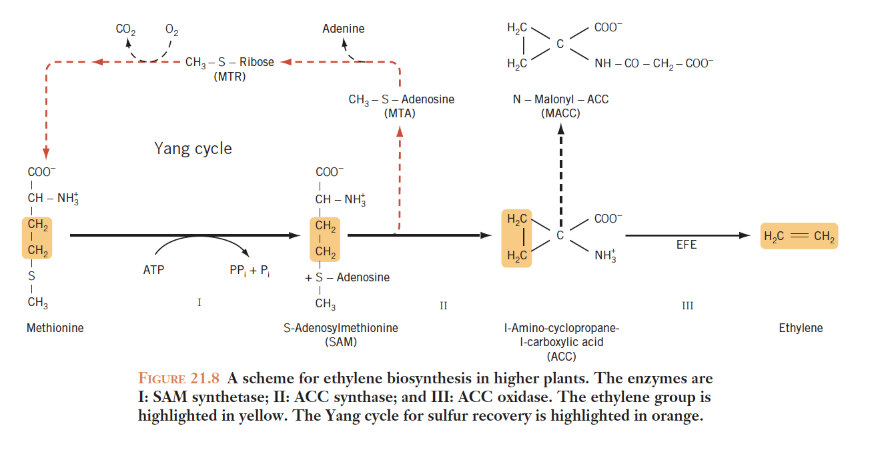
The three-step pathway for ethylene biosynthesis in higher plants is shown in Figure 21.8.

Slide 7
Distribution of ethylene in plants
Ethylene is synthesized extensively in the nodes and meristematic tissues. This has been proven in pea seedlings.
It is predominantly concentrated in the latent buds of apple plants and diminishes as the bud matures.
Concentrations are elevated in the leaves and developing flowers during the senescent phase.
Ethylene is generated at elevated concentrations during the maturation and ripening phases of fruit.

Slide 8
Various sources of ethylene
The majority of plants produce ethylene gas during biological processes.
Plant injuries, contact with rigid surfaces, and severing of plant components generally generate ethylene gas. Pollution and pesticides may also generate ethylene gas.
Ethylene gas is frequently generated during seed germination.
The combustion of gathered plants produces smoke and gases that contain a certain percentage of this gas.
Soil microorganisms, including bacteria and fungus, are capable of producing ethylene gas.

Slide 9
Transport of Ethylene
As a gaseous hormone, the sole hormone in this condition, characterized by low molecular weight and small volume, it traverses within the plant with ease and free. Its transport and penetration into plant tissues are facilitated by its water solubility, which is further enhanced by its lipid solubility.
It also traverses across scattered water and can readily infiltrate cells by permeating the plasma membrane owing to its lipid solubility.

Slide 10
The Significance of Auxin in Ethylene Synthesis
Auxins are the primary catalyst for increasing ethylene production. Consequently, the rate of ethylene production in the vegetative system is contingent upon the concentration of auxins in the plant.
The concentration of plant auxins governs the synthesis of ethylene in vegetative tissues.
Consequently, regions of the plant with elevated ethylene levels, such as the apical meristem and juvenile organs, also exhibit high quantities of auxins.

Slide 11
The one exception to this principle is senescent tissues, whereby auxin levels diminish and ethylene levels may rise.
Research on the influence of auxin on ethylene synthesis in pea and bean seedlings has demonstrated that auxin treatment amplifies ethylene production and synthesis by a factor of 100.

Slide 12
The many impacts of ethylene on plants Endogenous ethylene Burg elucidated that ethylene is inherently synthesized in vegetative and floral tissues, in addition to fruits and seeds. Consequently, it functions as a growth regulator during all phases of plant development, from seed germination to senescence.

Slide 13
Division:
It inhibits division in land plants and counteracts the action of division-stimulating growth hormones such as cytokinin.
Elongation:
It inhibits cell elongation in the diagonal walls, but increases cell volume and wall thickness, thereby inhibiting elongation and increasing cell volume.

Slide 14
This is achieved by organizing, directing, and aligning microtubules. The quality of the alignment and the arrangement of cellulose fibrils determines cell growth.
Ethylene has been found to play a role in directing cellulose fibrils to align in a way that ensures increased cell volume.

Slide 15
Differentiation:
Hinders the differentiation process in land plant cells.
Flowers:
Hinders flower formation or causes flowers to enter the sensecence stage quickly.
Floral wilting In orchids, the bloom will remain unaltered for an extended period if fertilization and pollination do not take place. Subsequently, following pollination, the flower will rapidly wither. Pollination generates ethylene gas, resulting in the wilting and aging of petals.

Slide 16
The correlation between ethylene and the maturation of fruit This association was established by two observations:
firstly, that natural fruit ripening correlates with an increase in ethylene production.
secondly, that the application of ethylene to specific fruits induces an earlier and accelerated ripening process.
Research indicates that under typical settings, a physiological concentration develops in the tissues, sufficient to trigger the ripening of bananas, tomatoes, apples, avocados, pears, and others.
.

Slide 17
Multiple investigations have identified a significant association between the apex of ethylene production and the zenith of respiration rates. :
.

Slide 18
Any
QUESTIONS ?

