Slide 1
KINGDOOM OF SAUDI ARABIA
King Saud University
College of Sciences - Botany and Microbiology Dep.
Plant growth and regulators
BOT 373
Dr. Abdulrahman AL-hashimi

Slide 2
Lecture 6
The Gibberellins

Slide 3
In the early 1900s, Japanese rice farmers observed that certain seedlings grew remarkably quickly in comparison to the other seedlings in the field.
However, because these seedlings were yellow, sterile, and grain-free, the crop suffered a 40% loss; this event was known as silly seedling disease. These plants were examined by scientists, who concluded that the fungus Gibberella vomi-corrhizae was the cause of their infection.

Slide 4
Scientists were able to separate a number of compounds from the Gibberella fungus in the 1930s; some of these compounds impeded development, while others encouraged it. Gibberellin was the stimulating agent responsible for the disease's symptoms. Gibberellic acid GA3 was the first pure chemical that was isolated from the Gibberella fungus.

Slide 5
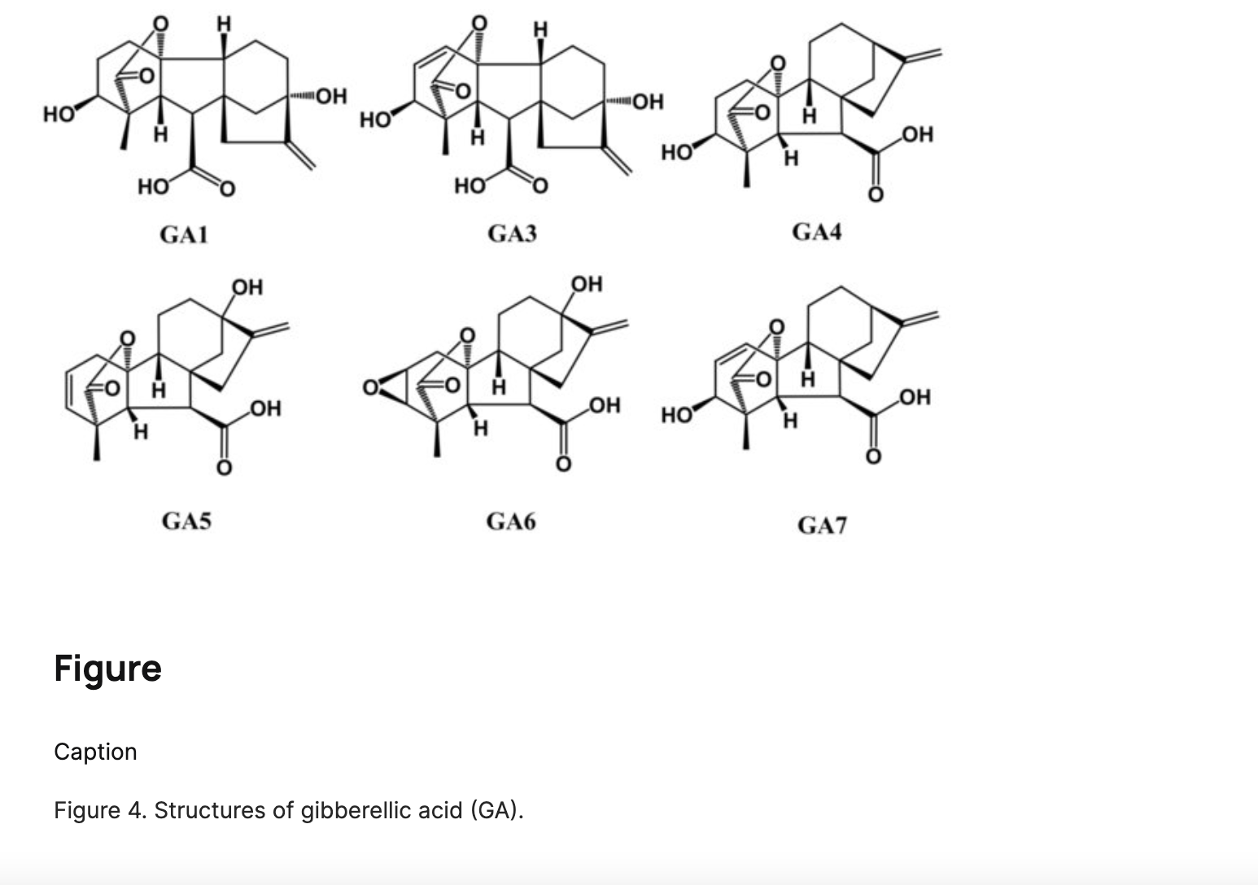

Slide 6
The quantity and location of the hydroxyl group and double bonds in gibberellins vary from one another. Gibberellic acid is the most prevalent of the more than 100 varieties of gibberellins. Each and every gibberellin is white, crystalline, solid, and soluble in water. Despite having certain reactions in common, they serve a different purpose in plants than auxins.

Slide 7
The natural sources of Gibberellins
1- Young leaves of higher plants represent one of the natural sources for the production of gibberellins compared to their counterparts of old leaves.
2- Roots produce gibberellins, but their quantity is limited.
3- Seeds that have not matured contain a high quantity of gibberellins compared to fully mature seeds.

Slide 8
The Gibberellins transports
Gibberellin transport is non-polar. Like the movement of carbohydrates, gibberellins are carried by the phloem in accordance with the flow pattern of organic matter.
Additionally, it was shown that gibberellins are carried by lateral movement between the two vascular tissues in the xylem tissue. Gibberellins were discovered to travel freely along the stems' length and elongation, whether they are lateral, vertical, or basal.
Seasons affect the number of gibberellins and how quickly they migrate; as their speed rises, so does their proportion.

Slide 9
The role growth hormone in different plant stages
1- Cell division:
It plays a role in DNA duplication and works together with auxin to increase the size of the cells that are dividing.
2- Increase cell size
Gibberellin works with auxin to break down the cellulose bonds that make up the cell wall to make it more water-filled and more flexible to increase elongation and turgor pressure.

Slide 10
3- Cell differentiation:
It participates with growth-stimulating hormones in cell differentiation and specialization, so that it activates differentiation genes at the level of the nucleus in the cell and activates the genes that encode for enzymes specific to differentiation to perform their function according to their location in the plant body, so that it has a clear role in differentiating the cells resulting from the cambium to the bark, and auxin contributes to differentiating the cells to wood.

Slide 11
4. Flowers:
It is well recognized that a plant's internal genetic system and hormonal system, particularly gibberellins, both influence the process of determining the floral sex. Gibberellin use results in a decrease in the percentage of female flower formation and an increase in the dominance of male flower formation. In addition, these hormones drive male flowers to bloom earlier and female blossoms later. For example, cucurbit plants produce male blooms when female plants are treated with gibberellins.

Slide 12
5- Fruits:
It has a prominent role in the formation of seedless fruits in cooperation with auxin. Its importance lies in increasing the size of the fruit cells until they reach the stage of maturity. In seedless fruits, an increase in the concentration of gibberellin and auxin was found in the cells surrounding the ovary to complete the fruit’s maturity. If the fruit enters the stage of maturity, the ethylene hormone begins to be active with increased cell respiration, and with it the concentration of gibberellin gradually decreases.

Slide 13
6- Seeds and breaking of cumin:
There are internal factors that cause cumin, including:
The incomplete and immature embryo.
There are also external factors that cause seed cumin, including:
1.Long periods of darkness and light.
2.Low temperatures.

Slide 14
The Gibberellin role in completing the germination process and breaking dormancy
By promoting the synthesis of enzymes like alpha amylase, it counteracts the effects of the abscisic acid hormone, the anti-germination hormone, which plasmolyzes cells and stops them from proliferating by pumping potassium ions out of them, which lowers the osmotic pressure inside the cells and causes them to lose water.
2. Gibberellin uses the alpha amylase enzyme to change sugar from starch to glucose, increasing the osmotic pressure inside the cells and releasing them from the plasmolytic.

Slide 15
There is an environmental timing for germination: Gibberellin concentration with the right moisture breaks the latency in the seed for the action of abscisic hormone, and the abscisic acid hormone, ABA, is concentrated in the seeds prior to germination to keep them from it until they reach their environmental time for germination.

Slide 16
3. The length of the cold season affects how the abscisic acid hormone in the seeds breaks down during the dormant period. As the temperature changes, gibberellin becomes active. This means that the seeds require the full cold season to break down the abscisic acid, indicating that the gibberellin hormone is important in compensating the seeds for the quarters and breaking their dormancy. 4. Since abscisic acid production progressively halts, the warm season and long days also contribute to breaking dormancy.

Slide 17
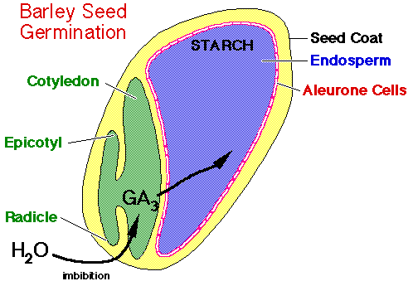

Slide 19
7. Senescence:
By treating fruit trees and ornamental plants with gibberellins in the fall and winter, it has been feasible to prolong their young phase without causing them to lose their leaves, blooms, or fruits, so overcoming the phenomenon of senescence.

Slide 20
8- Shedding:
The hormone abscission acid speeds up the formation of the abscission layer, which causes the leaves to drop, if the gibberellin hormone concentration in the cells drops or its production ceases. Gibberellins have been shown to be effective in preventing leaves, flowers, or fruits from falling. Gibberellin, for instance, prevents the falling of unpollinated tomatoes' high percentage of falling flowers, resulting in fruit without seeds. This is because gibberellin indirectly stimulates the production of auxin.

Slide 21
The physiology roles Gibberellins
Genetic dwarfism Gibberellins' capacity to cure hereditary dwarfism in certain plants, including peas and beans, is one of their most significant characteristics.
Gibberellin levels in dwarf plants are significantly lower than those in taller plants. Because of the presence of a single gene that causes short plants to develop and fails to make gibberellins, dwarfism is a phenomena. Generally speaking, dwarfed plants are around one-fifth the size of typical plants and have short internodes.

Slide 22
When gibberellin concentrations are applied externally to dwarfed plants, their internodes lengthen and grow taller, resembling tall plants. When applied to typical plants, gibberellins have minimal effects.
2- Physiology of flowers:
The flowering process and the vegetative growth process are controlled by some external factors, the most important of which are:
1- The difference in the length of night and day.
2- The difference in temperature.

Slide 23
Various forms of plant photoperiodism
Short-day plants
These are plants that require a short day in order to bloom; that is, they require less than 14 hours of light each day to bloom. If a long night is broken by a burst of red light, their blossoming is hindered and vegetative growth continues.
Short-day plants are actually long-night plants, and the duration of the dark period—rather than the duration of the light period—determines this. A plant cannot flower if there is less darkness than the critical dark time, which is the bare minimum of darkness required for flowering. like certain types of tobacco and coffee plants.

Slide 24
Short-day plants are actually long-night plants, and the duration of the dark period—rather than the duration of the light period—determines this. A plant cannot flower if there is less darkness than the critical dark time, which is the bare minimum of darkness required for flowering. like certain types of tobacco and coffee plants.

Slide 25
Long-day plants
These plants only bloom when exposed to light for longer than 14 hours at a time. These plants, which include spinach, radish, mint, and sugarcane, are also known as short night plants since they require a little time of darkness, usually a few hours.

Slide 26
Day plants that are neutral These plants, like tomato plants, bloom throughout the year as long as the right conditions are present since they are not impacted by the length of the light cycle and bloom across a broad range of day lengths.
Neutral day plants
Like tomato plants, these plants bloom over a wide variety of day lengths and are not affected by the length of the light cycle, so they can bloom all year long if the proper circumstances are met.

Slide 28
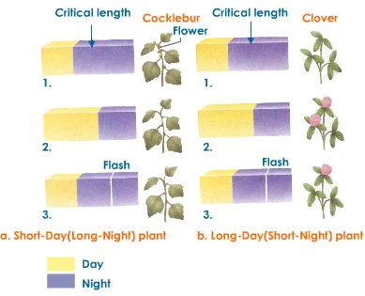

Slide 29
Any
QUESTIONS ?

