Slide 1
KINGDOOM OF SAUDI ARABIA
King Saud University
College of Sciences - Botany and Microbiology Dep.
Plant growth and regulators
BOT 373
Dr. Abdulrahman AL-hashimi

Slide 2
Lecture 3
Phytohormones 2

Slide 3
Auxins play roles in cell division, increase in cell size, differentiation, flowering Fruiting, seed formation, seed dormancy, aging and Shedding.
At :
Cell division:
By increasing the amount of rRNA in the nucleus, auxin plays a key role in DNA replication. This is because it finds the nitrogenous bases needed for DNA replication.
Auxin helps copy synthetic genes by controlling the regulatory gene in the operon during DNA transcription on mRNA.

Slide 4
Increase in cell size:
Cell elongation happens when the pressure on the cell wall drops, the wall relaxes, and the wall's composition changes.
This can happen when the wall's components are interrupted and separated, and new bonds are formed to connect them again.
Since this is the case, it was suggested that auxin breaks the non-covalent hydrogen bonds between polysaccharides and cellulose microfibers.

Slide 5
This lets polysaccharides xyloglucones into cellulose, which causes the cell wall to expand permanently, especially when the pH is low. How this happens is not completely understood. This, of course, encourages increased flexibility or relaxation of the cell wall.
This relaxation leads to a decrease in turgor pressure, and therefore the water potential of the cell juice becomes more negative than that of the neighboring cells, so water diffuses towards the gradient slope, and the cell increases in size

Slide 6
Then comes the role of adding new materials to the wall and re-establishing the non-covalent bonds between cellulose and polysaccharides (xyloglucones),thus forming cells with larger walls.
It seems that the decrease in pH activates the binding of hydrogen ions, which increases the activity of relaxation enzymes or enzymes that work to break the bond between cellulose and xyloglucones.

Slide 7
Auxin breaks down the cellulose bonds that make up the cell wall, which makes it more water-filled and flexible. It does this by increasing the pumping of positive proton ions (+H), which changes the acidity of the medium and makes the medium more flexible so the cell can absorb and grow.
3- Cell differentiation:
As part of the process of cell differentiation and specialization, it works with growth hormones like gibberellin and cytokinin. It does this by turning on differentiation genes in the cell nucleus and genes that make differentiation-specific enzymes that do their job based on where they are in the plant body.

Slide 8
4- Flowers:
Flowers are activated in plants except those related to the quarters and photosynthesis. So that it converts the vegetative bud into a floral one in plants and converts the apical bud into a floral one to form fruits later and produce seeds in annual plants with other stimulating hormones based on environmental conditions and genetic makeup, and because the life of these plants is short, they perform their role in producing seeds before the end of the rainy season.

Slide 9
5- Fruit formation:
In seeded plants:
Mating and zygote formation stimulate the formation of auxin from the ovary cells so that it is secreted from the embryo and endosperm cells in large quantities and moves polarly down to the anther and prevents the formation of the separation layer during the fruit ripening period, i.e. it works to stabilize the fruits in the ripening stage.

Slide 10
The divisions of the endosperm begin before the embryo cells to increase auxin and is followed by an increase in the size of the ovary - the fruit - in the early stages of growth in the logarithmic phase specifically.
The embryo depends on the endosperm for nutrition, and the process of mating and embryo formation makes the ovaries specifically a food consumption area so that they absorb the food found in the leaves full of photosynthesis products just as the embryo benefits from food from the mother through the umbilical cord.

Slide 11
The fruit increases in size and reaches its maximum growth and thus reaches the stage of maturity, which is followed by the stage of maturity, which is characterized by a change in the taste and color of the fruits.
In seedless plants:
Auxin is secreted from the cells surrounding the ovary in flowers, and the ovaries grow in size and reach the stage of maturity, which is followed by maturity later.

Slide 12
6- Seeds:
Auxin plays a prominent role in completing the germination process, as seeds become capable of germination when their internal conditions (hormones and enzymes) and external conditions (heat, humidity and germination inhibitors) are suitable for germination.
Seed germination inhibitors:
1.Inhibitory hormones such as abscisic acid and ethylene
2.Phenolic substances that inhibit germination present in the seed capsule.
3.The hardness of the capsule and its impermeability to water or air.
4.Embryonic dormancy

Slide 13
5.Incomplete embryogenesis: (The embryo does not complete its growth except in the environmental conditions suitable for germination, as it was found that the seeds fall from the fruits and the embryo is not complete. This is a type of adaptation to protect the seed from extinction and ensure its growth in suitable conditions to complete the vegetative, floral and fruiting stages and form seeds again.
6.Hormonal latency

Slide 14
Breaking the dormancy:
The brevity that encompasses germination-inhibiting agents, such as phenolic chemicals, which function at elevated concentrations and interfere with development processes, halting them. They may be eliminated by rinsing the seeds with adequate rainwater to facilitate germination; but, if the rainwater is insufficient for washing away these compounds, they breakdown and are absorbed by the cells, thereby inhibiting germination. The brevity that encompasses colloidal and lipidic particles obstructing intercellular gaps and impeding gas permeability, especially oxygen, into the interior. These contaminants can be eliminated by rinsing the seeds with rainfall.

Slide 15
The shortness that contains colloidal and fatty substances that block the spaces between the cells and prevent the permeability of gases, including oxygen, to the inside.
These substances can be disposed of by washing the seeds with rainwater.

Slide 16
7- Senescence:
When the leaves reach their final size, they begin to deteriorate, where the concentration of auxin hormone decreases to highlight the role of other hormones that have a direct relationship with aging, such as abscisic acid and ethylene, so that the separation layer is formed due to the concentration of inhibitory hormones.

Slide 17
8- Falling:
After the leaf growth is complete and the concentration of auxin in the leaves decreases, this helps in the formation of the separation layer and stopping growth in it.
The fallen leaves before they fall, the plant absorbs all the food in them to make them an empty structure, or a waste repository only.

Slide 18
The physiological effect of Auxin :
1- Auxins and the longitudinal growth of some plant parts:
Roots, buds and stems all respond to auxin in a similar way.
Their growth is delayed at relatively high auxin concentrations, and is activated at relatively low concentrations.
Only low concentrations are suitable for root elongation. High concentrations completely disable it.
That is, the auxin concentrations that would activate stem elongation are the same ones that inhibit elongation in the roots.

Slide 19
2- The role of auxin in tropisms
The movements of the plant organ that arise from its response to the direction of the flow of the environmental stimulus are called tropism.
In it, one of the plant organs moves with slow or rapid growth towards or away from the external stimulus. If the direction of growth is towards the external stimulus, the movement is called positive t

Slide 20
The tropism movement is the movement that occurs under the influence of environmental factors such as tropism to light falling on the stems and roots (phototropism), tropism under the influence of gravity (geotropism), or adopting locomotor positions under the influence of differences in the water content of the soil (hydrotropism), and tropism as a result of physical contact or chemical contact (contact tropism) or (chemotropism).

Slide 21
Phototropism:
Phototropism
When a growing plant is exposed to light from one side, it tends to turn towards the light. The plant's tropism results from the cells on the dark side elongating at a greater rate than the cells on the lighted side. This difference in the plant's growth rate response to light is called phototropism (positive). It results from the irregular distribution of auxin, as the highest concentration of growth hormone is on the shaded side.

Slide 22
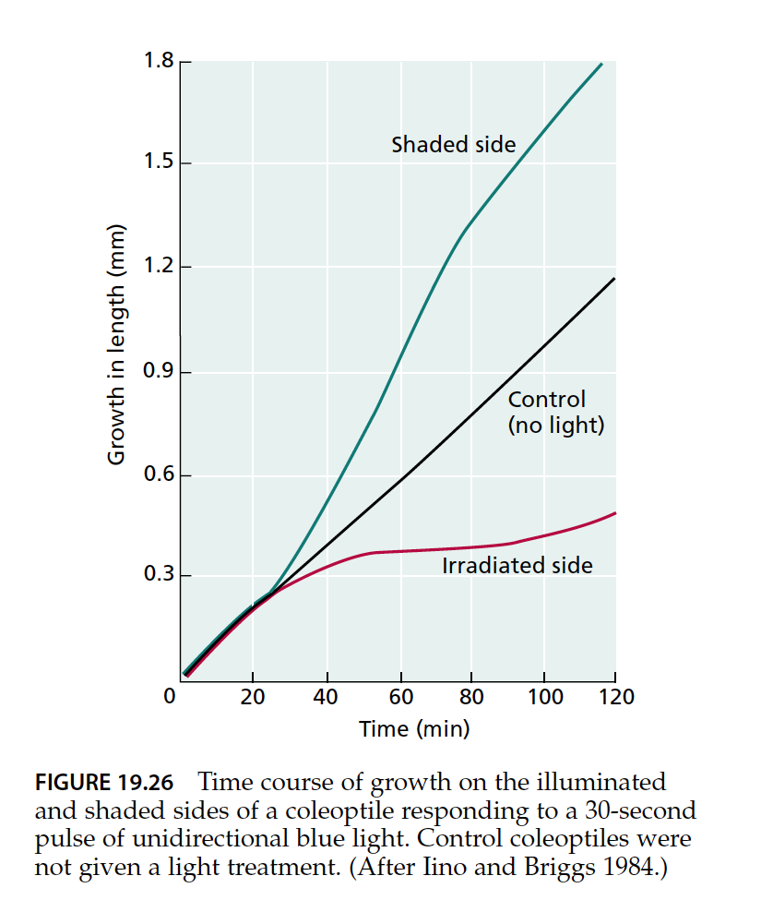

Slide 23
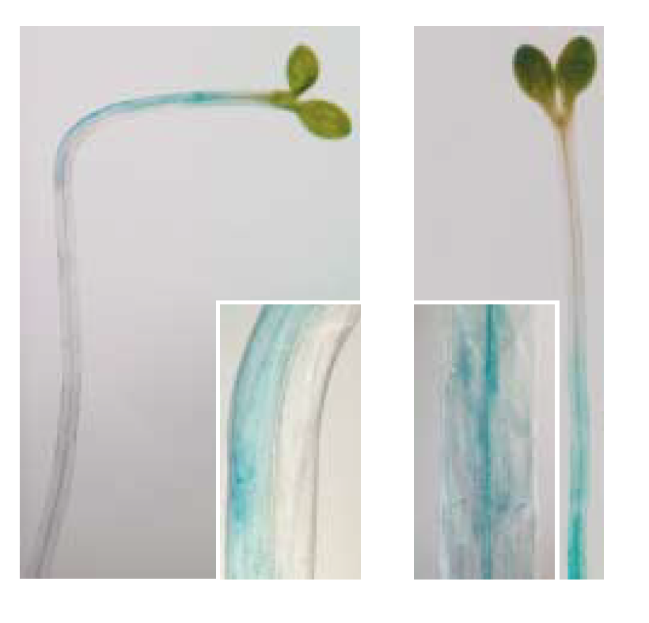
FIGURE 19.29 Lateral auxin gradients are formed in Arabidopsis hypocotyls during the differential growth responses to light (A) and gravity (B). The plants were
transformed with the DR5::GUS reporter gene. Auxin accumulation on the shaded (A) or lower (B) side of the hypocotyls is indicated by the blue staining shown in the
insets. (Photos courtesy of Klaus Palme.)

Slide 24
Migration theory:
A leaf sheath of oats is exposed to light from one side and the top of the sheath is cut off. The sheath is then put on a piece of agar and split in half by a thin sheet of mica to stop lateral diffusion.
This makes the auxin on the side that is illuminated fall into one of the two pieces, while the auxin on the side that is dark falls into the other piece.
By estimating the amount of auxin, it was found that the amount of auxin that descended in the illuminated half = 35% and the dark half 57%.

Slide 25
If the same experiment is conducted in the dark, we find that the amount of auxin in the two pieces is equal = 50%
This experiment has shown that lighting from one side leads to the migration of auxins from the illuminated side to the dark side and as a result the growth rate of the dark side increases over the growth rate of the illuminated side, which leads to tropism

Slide 26
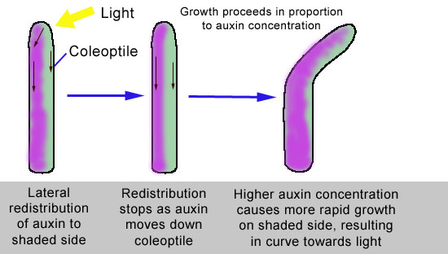

Slide 27
Any
QUESTIONS ?

