Slide 1
KINGDOOM OF SAUDI ARABIA
King Saud University
College of Sciences - Botany and Microbiology Dep.
Plant growth and regulators
BOT 373
Dr. Abdulrahman AL-hashimi

Slide 2
Lecture 2
Phytohormones

Slide 3
Multicellular plants are complex organisms and their orderly development requires an extraordinary measure of coordination between cells.
In order to coordinate their activities, cells must be able to communicate with each other.
The principal means of intercellular communication within plants are the hormones
Hormones are signal molecules that individually or cooperatively direct the development of individual cells or carry information between cells and thus coordinate growth and development.

Slide 4
Plant hormones have been the subject of intensive investigation since auxin was first discovered almost a century ago.
Plant hormones do not have their effect in the cells that produce them, but they must go to the place where they have their effect outside the producing cells, and their effect on the physiological process is determined by activating it, inhibiting it, or modifying it in another direction, such as pushing the bud instead of growing vegetatively to the basic principles.

Slide 5
The term phytohormone cannot be applied to substances necessary for growth, such as sugar or amino acids, because, despite their transport, they do not have a specific physiological effect and cannot work in a hormonal manner.
Phytohormone controls the growth and development of various plant organs, and it’s effect is not limited to metabolic processes but extends to many specialized physiological processes.

Slide 6
Hormonal substances are divided into stimulants and inhibitors.
The activity of the substance is determined by testing its effect on the processes of cell division and elongation.
Stimulants cause division or elongation, or both,
while inhibitors hinder both processes, provided that the selection is made on the plant hormone alone and without the company of other substances that affect its activity.

Slide 7
Plant growth regulator
Plant growth regulators (PGRs) are chemicals used to modify plant growth such as increasing branching, suppressing shoot growth, increasing return bloom, removing excess fruit, or altering fruit maturity.
Numerous factors affect PGR performance including how well the chemical is absorbed by the plant, tree vigour and age, dose, timing, cultivar, and weather conditions before, during, and after application.

Slide 8
Growth Regulators: The most important groups that follow them, arranged according to the date of their discovery, are auxins, gibberellins, and cytokinins. Growth inhibitors: The most important natural hormones that represent them are abscisic acid and ethylene. Products that block the biosynthesis of plant hormones are also available

Slide 9
It means the concentration of the activating or inhibiting substance that has an effect on the plant cell.
To detect and know this concentration, what is known as a bioassay is conducted.
The concentration of auxin in the plant may reach 10-120 mg/g of dry matter, which is a small amount that is not of physiological value because it is less than the physiological concentration, which is much higher than that, meaning that it does not give any result with any of the bioassays.

Slide 10
Therefore, bioassays are the dividing line for knowing the effect of the concentrations present in the plant.
Bioassay: It is a measurement of the physiological effect of the hormone at different levels and measuring this effect through the biological response.

Slide 11
Auxin: growth hormone
Auxin is the first phytohormone discovered. It was discovered by Kogel in 1933, and it was extracted from the growing tips of the corn plant. The word auxin is taken from the Greek word Auxo, which means increase.
It was later proven that auxins are found in all higher vascular plants, that their formation sites are limited to the meristematic regions, active tissues, and seed embryos, and that they have the property of polar transport; their speed varies from 0.5 to 1.5 cm/hour depending on the type, age, and type of transporting tissue.

Slide 12
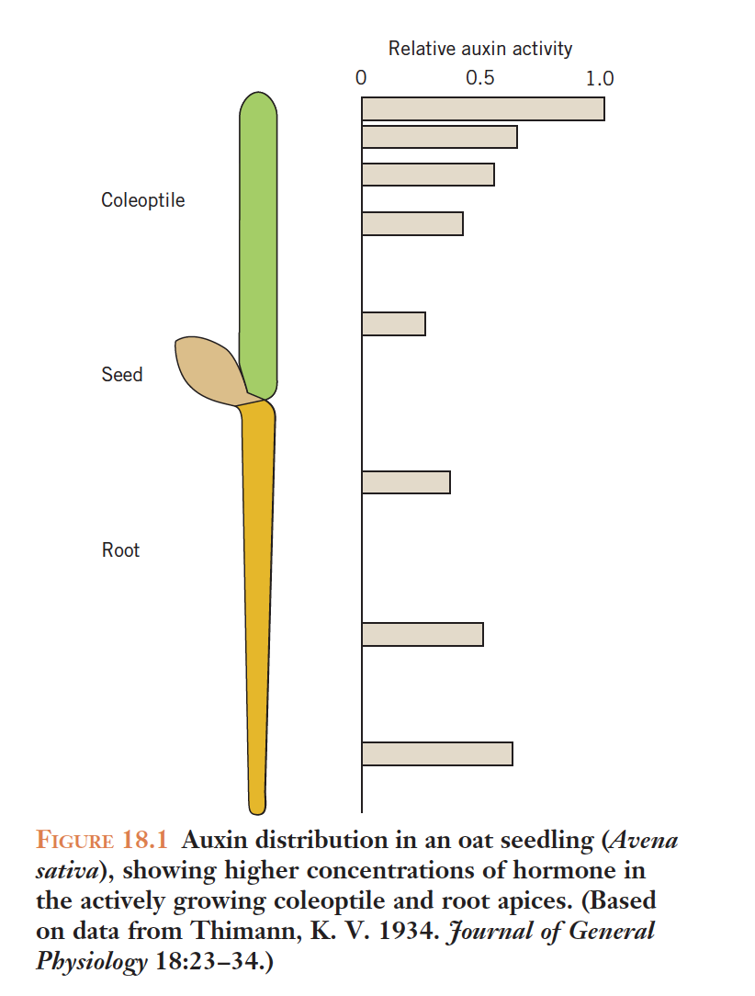

Slide 13
Growth kinetics: whole organs and growth curves
Although a large number of compounds have been discovered with auxin activity, indole-3-acetic acid (IAA) is the most widely distributed natural auxin.
In addition to IAA, several other naturally occurring indole derivatives are known to express auxin activity, including indole-3-ethanol, indole- 3-acetaldehyde, and indole-3-acetonitrile.

Slide 14
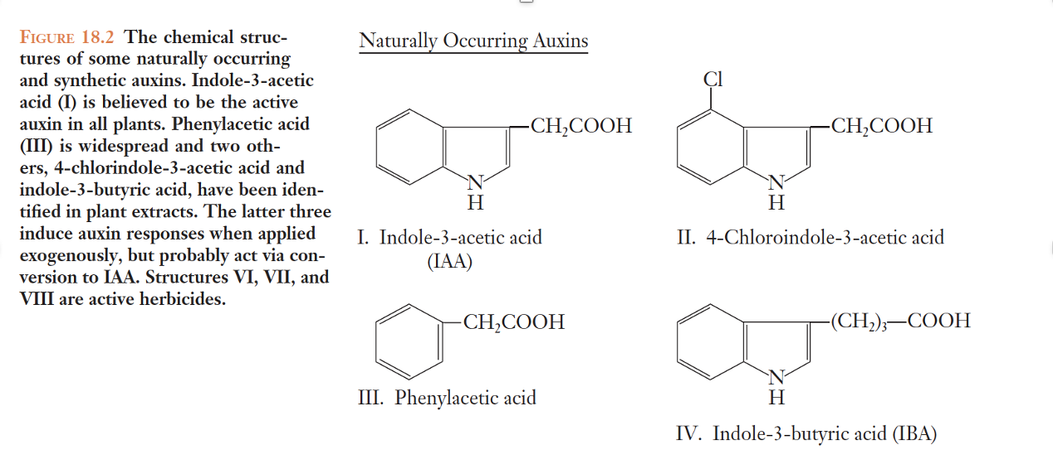

Slide 15
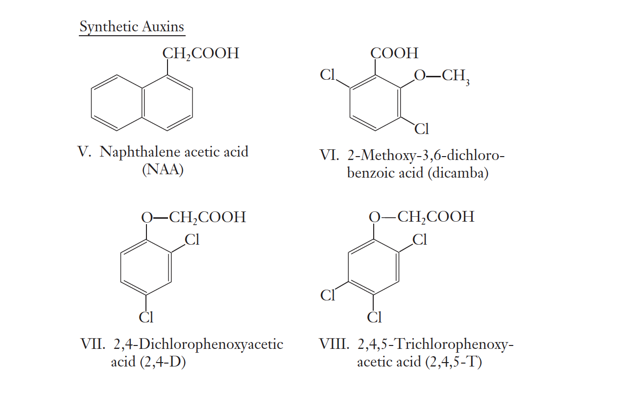

Slide 16
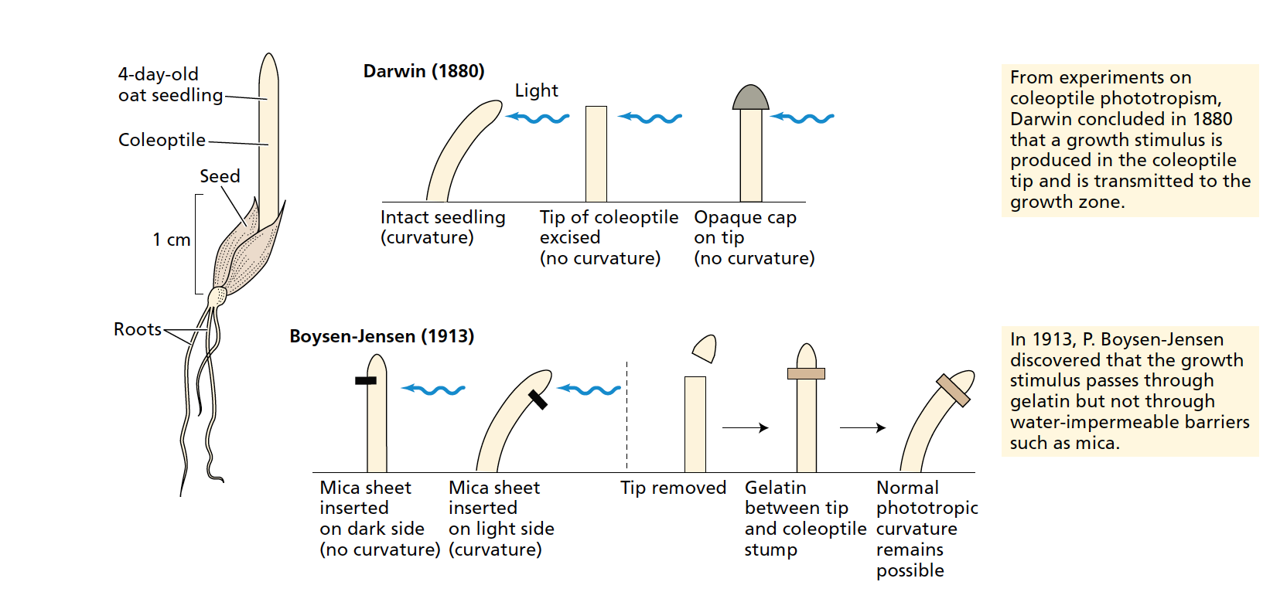
History of Auxin discovery:

Slide 17
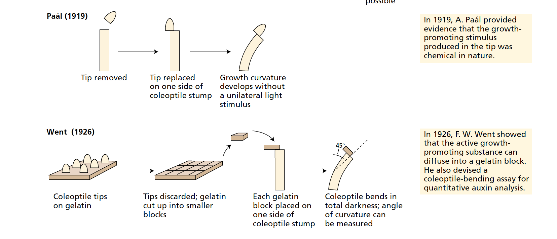

Slide 18
The transfer of auxins depends in some way on:
1- Metabolic energy:
As the transfer is clearly prevented by a lack of metabolic energy due to a lack of oxygen or by using chemical substances that hinder the use of energy released from respiration.
2- Electrical gradient:
It was found that the base of the plant is more positive electrically than the top, so auxins, which represent a negative charge, move towards the more positive side, i.e. from the top to the base.

Slide 19
It was found that the dark or less illuminated side of the plant is more positive than the illuminated side, so auxins move towards the dark side.
It was found that when the shoot part of the plant is placed horizontally, the lower side becomes more positive than the upper side, so auxins move towards the lower side.
Natural auxins have been proven to exist in many plants, and it has been shown that the work of auxins is not specific, meaning that what happens in one plant, happens in other plants, meaning that their work is not usually specific to one plant or another.

Slide 20
Auxins are found in plants in one of the following forms:
1- Active auxins
2- Inactive auxins
3- Origins or components of auxins.
The form that affects growth is the active auxins, which arise from inactive auxins or origins of auxins, and experiments have shown that active auxins in some plants are only 10.3% of the total number of auxin forms, and the rest are from the other two groups.

Slide 21
Factors affecting plant growth:
IAA is structurally related to the amino acid tryptophan,
and early studies on auxin biosynthesis focused on tryptophan
as the probable precursor.
However, the incorporation of exogenous labeled tryptophan (e.g., [3H]tryptophan) into IAA by plant tissues has proved difficult to demonstrate.
Nevertheless, an enormous body of evidence has now accumulated, showing that plants convert tryptophan to IAA by several pathways

Slide 22
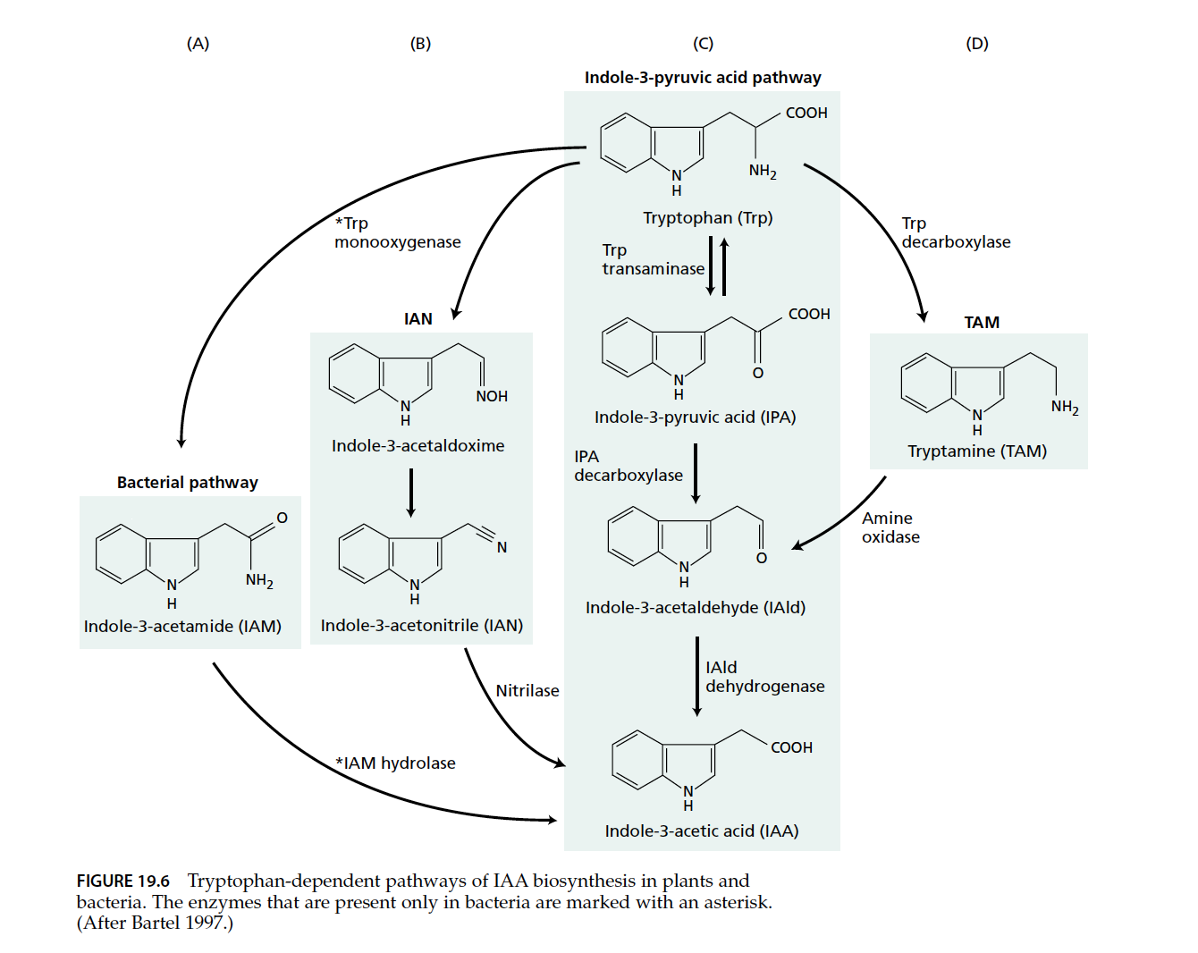

Slide 23
Any
QUESTIONS ?

