Slide 1
KINGDOOM OF SAUDI ARABIA
King Saud University
College of Sciences - Botany and Microbiology Dep.
Plant growth and regulators
BOT 373
Dr. Abdulrahman AL-hashimi

Slide 2
Lecture 2
The measurement growth

Slide 3
Growth: is the irreversible increase in size, and growth can be measured theoretically using one of the growth indicators:
length, area, or weight.
The increase in size is estimated by measuring the expansion in one or two directions, such as the length of the stem, its diameter, or the area of the leaf.

Slide 4
The increase in mass is estimated by harvesting the entire plant or the part to be weighed quickly to avoid evaporation of its water to obtain the fresh mass, which is variable.
For example, the leaf has a greater mass in the morning than in the afternoon due to the loss of some of its water during the transpiration process.

Slide 5
Plant Growth
Dry seeds of plants can be used as a measure of growth. Their tolerance increases for 24 to 48 hours at temperatures between 70 and 80 degrees Celsius and is an accurate way to estimate growth.
The increase in length can be measured in several ways:
Measuring length with the naked eye or ruler
Using a horizontal microscope
Using an auxanometer

Slide 6
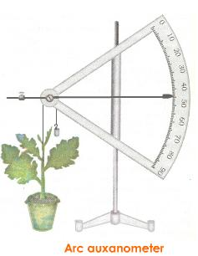

Slide 7
Growth is measurable
Scientists express growth in different ways known as growth equations or growth indices, including:
Biological yield:
It is the dry weight of all plant organs and is the result of the final outcome of the processes of photosynthesis, respiration, water absorption, and nutrients. The root mass may be neglected due to the difficulty of accurately estimating it.

Slide 8
2. Dry weight:
The dry weight of all plant organs accumulated during a specific period of time (the period of time may be a day or a week) and is symbolized by W, i.e. the change in dry weight in a specific period (expressed in grams / day or grams / week or grams / season)

Slide 9
3. Efficiency of light used in photosynthesis.
4. Total leaf area
It is the result of multiplying the total number of leaves in the plant by the average leaf area and is a measure of the plant's ability to photosynthesize.
5. The specific weight of the leaf:
It is the dry weight of the unit area of ​​the leaf and is estimated in cm²/gram. It reflects the thickness of the leaf, as the efficiency of the leaf in carrying out food and photosynthesis increases with increasing leaf thickness.

Slide 10
6. Leaf area index: It is the area of ​​the leaf surface relative to the unit area of ​​land occupied by the plant.
7. Relative growth rate: It is the accumulated dry weight of the plant per unit of the original weight during a specific time unit. 8. Representational efficiency: It is the accumulated dry weight per unit of leaf area per unit of time. It is not an accurate measure of the efficiency of the photosynthesis process, but it is

Slide 11
A measure of the increase in the dry weight of the plant, which is the result of the difference between photosynthesis and respiration.

Slide 12
Growth kinetics: whole organs and growth curves
The growth curve represents the relationship between the size or weight of the organ versus time. The following figure shows the typical sigmoid curve, i.e. in the form of the letter S. The curve reveals three distinct stages of growth:

Slide 13
Growth kinetics: whole organs and growth curves
The first stage is the initial one, which is the logarithmic phase. Where the size v increases with time t, i.e., the growth rate is slow at first, but the rate increases continuously and becomes proportional to the size of the living organ.
The larger living organ, the faster the growth.
The second stage is the linear phase. The size continues to grow at a constant rate and is usually at its maximum speed for some time.

Slide 14
Growth kinetics: whole organs and growth curves
The third stage is the senescence phase, which is characterized by a low growth rate.
it has been noticed a drop in the curve when the plant reaches maturity and enters the senescence phase, as the rates of destructive reactions exceed the rates of construction.

Slide 15
In the lag phase, also known as the stagnation or slow growth phase, then comes the log phase, also known as the logarithmic growth phase, which is characterized by rapid growth.
Then it ends with a third phase, which is the stationary phase, where there is a balance between the number of dividing cells and the number of dead cells.
Finally, senescence occurs when the balance is disturbed and the number of dead cells exceeds the number of dividing cells.

Slide 16
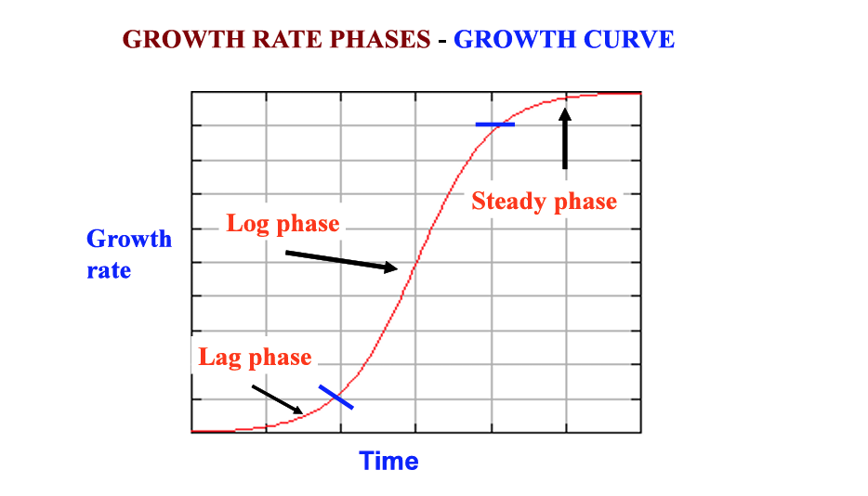
chrome-extension://efaidnbmnnnibpcajpcglclefindmkaj/http://eagri.org/eagri50/PPHY261/lec18.pdf

Slide 17
When estimating growth during the different stages of plant growth by estimating the dry weight and drawing it in the form of an S-shaped curve, where the growth rate increases greatly and at a nearly constant rate during the vegetative growth stage, then decreases during the flowering and fruiting stage, and the dry weight may decrease during the aging stage.

Slide 18
The vegetative growth stage is called the Grand period of growth and varies according to the type of plant. It may last several weeks in some annual plants such as barley, and extend to several months in other plants such as oranges.
It has been noted that removing newly formed flowers and fruits helps to continue vegetative growth in many plants. For example, in tomatoes, the vegetative growth rate decreases after the formation of the fruits, but if the fruits are removed, the plant grows vegetatively for a longer period.

Slide 19
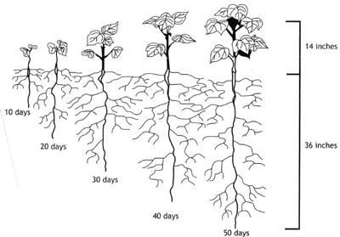

Slide 20
Factors affecting plant growth:
Plant growth is controlled by:
Genetic factors: For example, there are very short strains in corn plants and other long strains, due to the difference in genetic makeup in beans, peas, etc.
Environmental factors: Among the environmental factors: 1. Climatic factors: such as light, temperature, water, harmful or important gases, and wind. 2. Soil factors: soil texture, organic matter, pH, and mineral elements. .

Slide 21
Factors affecting plant growth:
3. Biological factors: weeds, insects, and terrestrial organisms (root nodule bacteria) that fix atmospheric nitrogen.
Internal factors:
1- Rate of photosynthesis
2- Respiration
3- Plant content of pigments, whether chlorophyll or other pigments.
4- Direct effects of the gene.
5- Distribution of photosynthesis products and nitrogen to plant organs

Slide 22
some factors such as:
1- Temperature:
The optimal temperatures for vegetative growth vary depending on the plant and its environment. For polar plants, they reach 10 m, while for temperate plants they range from 25-30 m, and for tropical plants might increase.

Slide 23
2. Light:
Light has a direct effect on the different stages of growth. If the seedlings grow far from light, they appear white or yellow, and their stems are long and bear small-bladed leaves.
These contain a small percentage of mechanical tissue, so they appear weak and worn out and are known as dark pallor. As for the effect of the type of light on growth, the overall growth of the plant is in the full spectrum of light.

Slide 24
3. Water: Water deficiency leads to stunting or stopping growth. On the contrary, an increase in the water percentage may lead to a significant expansion of the cell walls as a result of an abnormally high turgor pressure, so leaf growth is weak and the stage of senescence in the tissues is delayed.

Slide 25
Any
QUESTIONS ?

