Slide 1

KINGDOOM OF SAUDI ARABIA
King Saud University
College of Sciences - Botany and Microbiology Dep.
Plant growth and regulators
BOT 373
Dr. Abdulrahman AL-hashimi

Slide 2
Lecture 1
Introduction to the plant growth

Slide 3
References
Required Textbook:
  Satish. C Bhatla • Manju A. Lal. (2018). Plant Physiology and development the Metabolism , 4th Edition, springer ISBN 978-981-13-2023-1
  https://doi.org/10.1007/978-981-13-2023-1

Slide 4
Exams & Grading System
  Midterm 1: 6th or 7th week.
  Midterm 2: 11th or 12th week.
  Final Exam Lab: 16th week..
  Final Exam: 17th week.
Midterm 1: 15 % | Midterm 2: 15 % | Final Exam: 40 % | Final Lab Exam:30%

Slide 5
Growth
WHAT IS GROWTH?
Growth can be define as an irreversible permanent increase in size of an organ or its parts or even an indivdual cell.
Plant Growth Generally is Indeterminate:
Plant growth is unique because plants retain the capacity unlimited growth throut their life.
This ability of the plants is due to the presence of meristems at the certain locations in their body.

Slide 6
The Cells of such meristems have the capacity to divide and self-perpetuate.
However, the cells lose the capacity to divide and such cells make up the plant body.
This form of the growth wherein new cell are always being added to the plant body by the activity of meristem is called the open form growth.

Slide 7
Growth is measurable
Growth at the cellular level, is principally a consequence of increase in the amount of protoplastm
since measuring the increase in the protoplasm is diffuclt dierctly , one generally measures some quantity which is more or less proportional to it.

Slide 8
Introduction
Therefore, Growth is measured by a variety of parameters some of which are:
1. increase in fresh weight
2. increase in dry weight
3. length
4.area volum
5. cell number

Slide 9
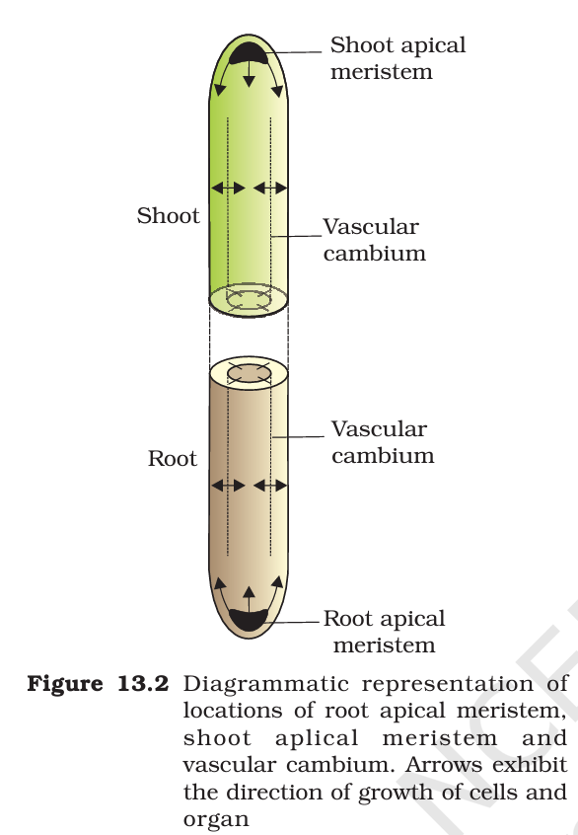
Introduction

Slide 10
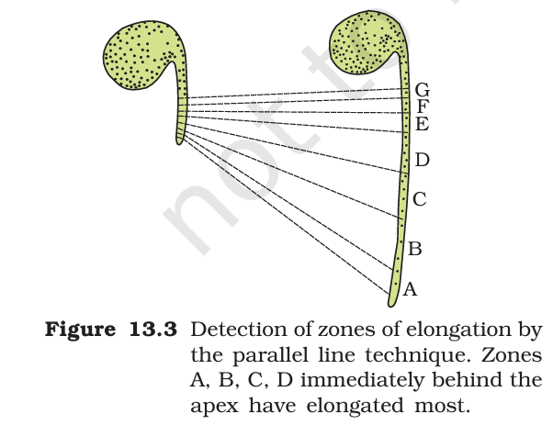
Phases of Growth
  There are three phases:
  1. meristematic
  2. elongation
  3. maturation
The constantly dividing cells, both at the root apex and the shoot apex, represent the meristematic phase of growth.
The cells in this region rich of in protoplasm, possess larg conspicuous nuclei.

Slide 11
Phases of Growth
Moreover, their cell wall are primary thin and cellulosic with aboundant plasmodesmatal commections.
The cells proximal ( just next, away from the tip) to meristematic zone represent the phase of elongation.
Incrreased vacuolation, cell enlargment and away deposition are the characteristics of the cells in this phase.
Further away from apix more proximal to the phase of elongation, lies the portion of axis which is undergoing the phase of maturation.

Slide 12
Growth Rates
  The increased of the per unit time is termed as growth rate.
  Thus, rate of growth can be expressed mathematically. Or the organism can produce more cells in a variety of way.

Slide 13
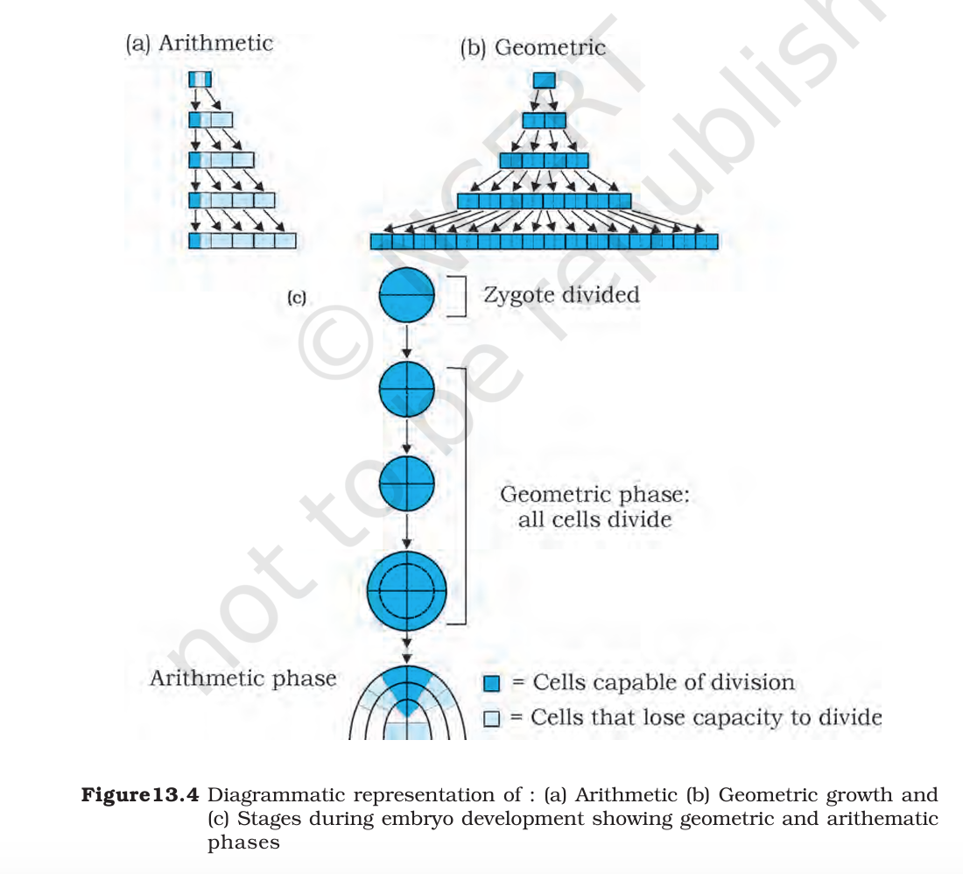
Growth Rates

Slide 14
  Quantitative comparisons between the growth of living system can also be made in two ways :
  (i) Measurement and the comparison of total growth per unit time is called the absolute growth rate.
  (ii) The growth of the given system per unit time expressed on a common basis, e.g., per unit initial parameter is called the relative growth rate.

Slide 15
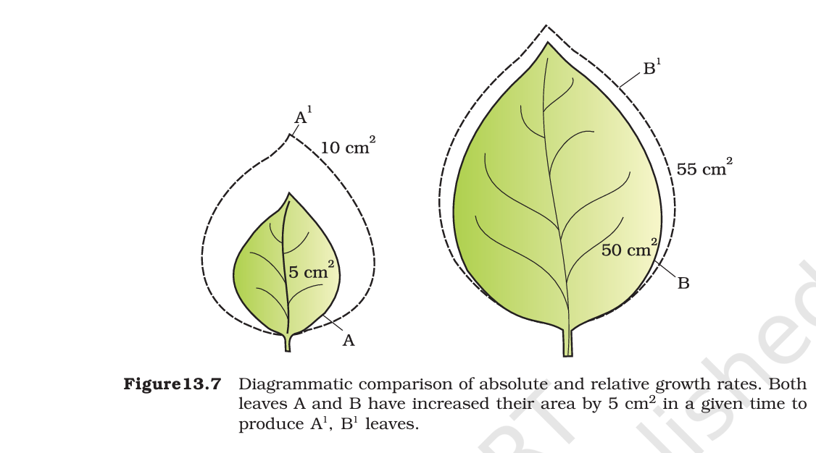
In Figure 13.7 two leaves, A and B, are drawn that are of different sizes but shows absolute increase in area in the given time to give leaves, A1 and B1. However, one of them shows much higher relative growth rate.

Slide 16
  Differentiation: change in the shape and function of cells within tissues and organs to form structures that are distinct in function. It is not growth, but it is associated with it.
  Development: It is the final or total result of growth and differentiation in a specific sequence, or it is the transition from one stage of development to another stage, and the disclosure is followed by a successive series of changes within each organ of the plant during its life cycle

Slide 17
The process of development, which results from growth and distinction, encompasses all the changes a plant experiences throughout its life cycle, from seed germination to the completion of growth, flowering, production, and the end of senescence.

Slide 18
Light reactions
The development of multiple Arab divisions occurs in various meristematic regions and encompasses three types of meristems.
Apical meristems, like stems and branches, cause longitudinal growth.
2. Intercalary meristems: that get bigger in diameter or thickness.
The part of the plant that grows between the nodes and the internodes is sometimes called the intercalary cambium.

Slide 19
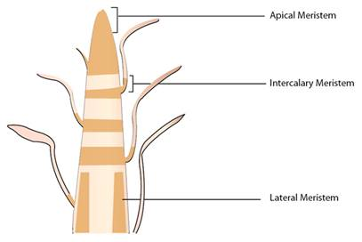
  Lateral meristems: lateral tissues, absorb lateral vegetative growth, flowers and fruits, as in the axillary buds that.

Slide 20
The role of plant hormones in cell elongation
  Cell elongation occurs as a result of decreased wall pressure, relaxation of the cell wall, and changes in the composition of the wall or the interruption and separation of the components of the cell wall with the re-formation of new bonds.
  Therefore, it was suggested that auxin plays a role in breaking the non-covalent hydrogen bonds between the polysaccharides and the cellulose microfibers.

Slide 21
Which allows the infiltration of the polysaccharides xyloglucans into the cellulose, which results in irreversible relaxation of the cell wall, especially when the pH is low.
This encourages increased flexibility or relaxation of the cell wall by activating the binding of hydrogen ions, which increases the activity of relaxation enzymes or enzymes that work to break the bond between cellulose and xyloglucans.

Slide 22
Any
QUESTIONS ?

