Slide 2
KINGDOOM OF SAUDI ARABIA
King Saud University
College of Sciences - Department Botany & Microbiology
Eco- Physiology
BOT 349
Dr. Abdulrahman AL-Hashimi

Slide 3
Lecture 4
The Influence of salinity stress
Part 2

Slide 4
The Adaptive Response of the Plant Cell to salt stress:
An osmotic stressor such as salt caused strain in the plant cell , which can be interpreted as adaptation to the new osmotic condition.
Adaptation means new synthesis of proteins to alleviate the stress.
In the case of osmotic stress, this alleviation comprises:
Reaction to the regain ion homeostasis.
Reactions to adapt to the osmotic potential
Synthesis of specifically acting, protective proteins.

Slide 5
Salinity and salt stress
Salinity occurs due to problems like wrong usage of agricultural lands, lack of rain, excess evaporation, lack of drainage.
Soils that have salt concentrations that prevent plant growth (Ece > 4 dS/m−1).
Soils that do not have salt concentrations that disturb the structure of soil (ESP < 15 ds/m-1) is called saline soil.
Due to the excessive accumulations of these salts, affecting features like plant growth, development, yield, seed quality is called salt stress

Slide 6
Irrigation is being made in 17% of arid and semi-arid lands in the world.
Due to wrong treatments approximately 20% of these irrigated lands are being unproductive.
Soil salinity puts plant into stress with complicating ground-water flow from roots due to high concentrations of salts and with causing toxicity due to accumulation of high concentrations of salt in the plant.
The plants that struggles with salinity try to continue their life cycles by giving morphological, biochemical, physiological responses

Slide 7
Primary salinity occurs by natural factors like oceans, corrosion of rocks, human induced secondary salinity occurs by excessive irrigation in agricultural lands, deterioration of agricultural land structure.
Being estimated that 50% of cultivated agricultural lands will be under salt stress by 2050
NaCl and Na2SO4 salts are the main reasons affecting the salinity of agricultural lands.
It’s easier to understand whether the plant is salt tolerant at non-lethal salt concentrations during germination and early seedling stages, the most damages occurs in these stages

Slide 8
Effect of salinity on plants
Salinity composes stress by damaging ionic and osmotic balances in plants.
Osmotic stress caused by increasing the amount of salt in soil.
decreases the amount of water that plant use and as a result physiological drought occurs.
After these conditions, ionic stress occurs in the plant with deterioration of plant ion balance.
Na and Cl ions which increases in medium with ionic stress, get in competition with essential nutrients such as K+, Ca2+, Mg2+ lead to nutrient deficiency in plant.

Slide 9
While the direct effect of salinity is osmotic and ionic stresses, deteriorations in structure and synthesis of toxic components composes secondary effect.
Secondary effect of salt stress:
The main secondary factors caused by NaCl are, complication in taking of K+ into cells (it is efficient in closure of stomata's), decreasing photosynthetic activity, generation of reactive oxygen species (ROS) and programmed cell deaths.
K element is one of the most vital elements for plants for this reason Na+ ions compete with K+ ions for getting into the cell. Na+ composes stress with blocking K+ influx into the cell.

Slide 10
Ion and hyperosmotic stress causes secondary metabolic effects in plant and the plant has to decrease these stresses for maintain its development

Slide 12
Adaptation Reactions to Restore Ion Homeostasis:
Glycophytes and Halophytes basically make use of the same mechanism to deal with salinity stress.
Halophytes are able to adapt faster and to tolerate extreme salinity, whereas glycophytes adapt stepwise to develop tolerance to a moderate degree of salinity.
In both constitutive types salt tolerance require the expression of certain similar gene. However, the transition from extremely salt –sensitive plants to extremely salt tolerance plants is not clear yet.

Slide 13
Nowadays, many example of the salt stress glycophtes and halophytes having been investigated, it becomes clear that adaptation serves to regain ion homeostasis and the original membrane potentials and PH value.
The better plants is able to achieve this, the better it becomes tolerant of osmotic stress. However, regaining ion homeostasis does not signify a “ return’ to the original ion concentration.

Slide 14
The plant attemts to achieve homeostasis with the entire ionic load, including the NaCl that has been taken up. Depletion of the aggressive NaCl ions in the cytoplasm during adaptation require considerable energy, which can not be supplied with the normal provision of the cellullar transport system.
Therefore, more of those protein are synthesised which contriute either directly or indirectly to the removal of NaCl from the cytoplasm.
Relief of the cystosol by removal of the Na+ ions from the cytoplasm and their transport into the vacuols and the apoplast is effected mainly by mean of Na+/H+ antiportters, both in the plasmalemma area at cell wall.

Slide 15
The Na+ Concentation in the cytosol has returned to the original value , while that in the vacuole has increased many-fold.
The original membrance potential and PH value have never- theless been reestablished.
Over-expression of a vacuolar Na+/H+ antiporter gene in Arabidopsis increased salt tolerance considerably.
The K+ status is the weak point in the cellular ion budget subsequent to an adaption process, irrespective of ion homeostasis.
The reduced growth of the halpophytes and glycophytes under salt stress is possibly related to problematical provision of the cell with K+.

Slide 16
Adaptation of Osmotic Potential
Plants must possess a higher osmotic potential than their medium if they are to take up water and nutrients from a saline milieu i.e.
They must increase their own osmotic potential. It is thus inevitable that changes in their internal concentration relations must take place, something with necessitates further adaptive action.
In addition to maintaining ion homeostasis, in seedling of pea (salt- sensitive) and spinach (salt-resistant) were transferred to nutrient solution and exposed to 100 mM NaCl.
The ion concentrations of the root and leaves, as well as the in tercellular distribution of ions, were monitored.

Slide 17
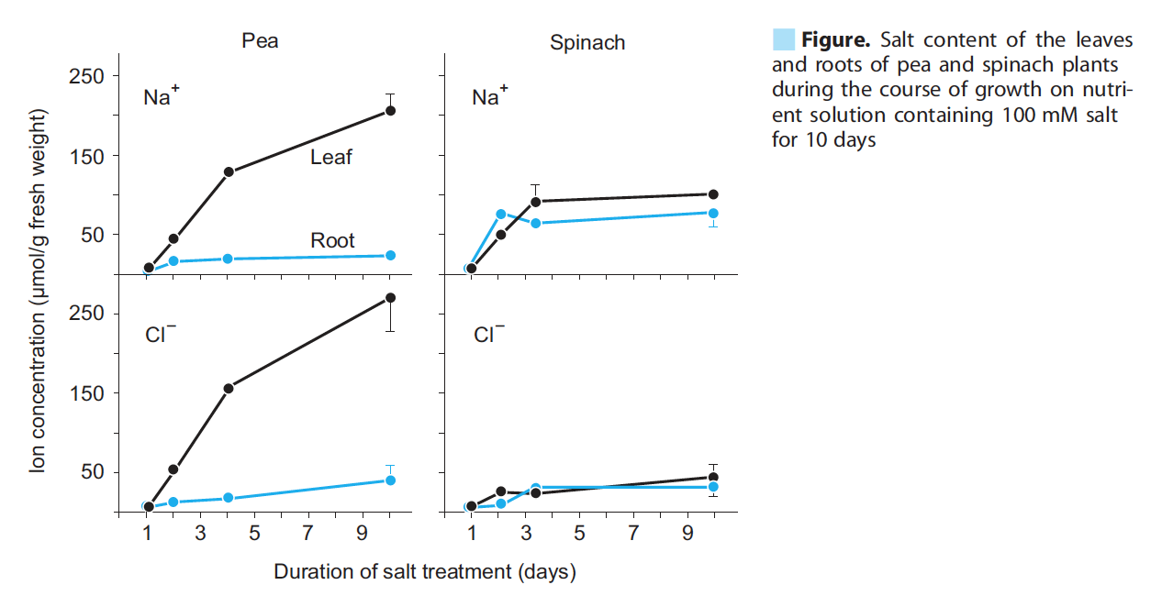

Slide 18
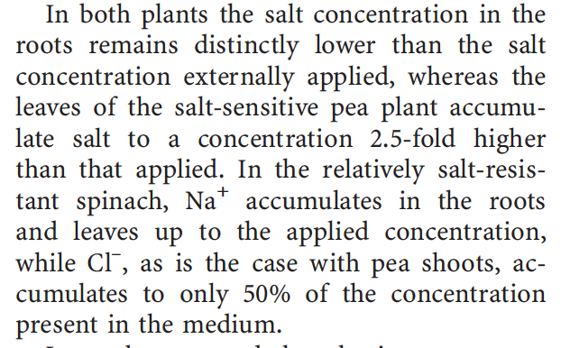

Slide 19
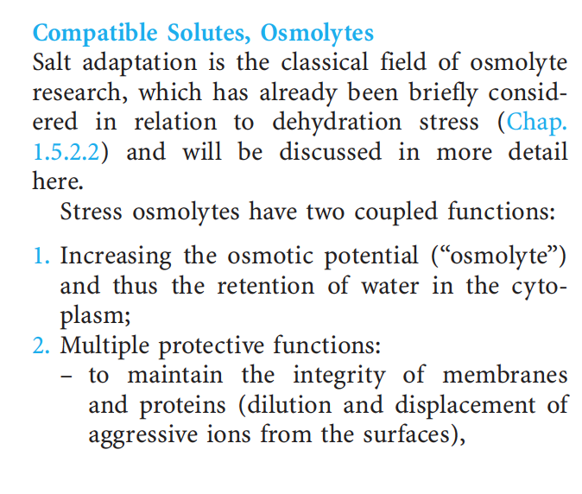

Slide 20
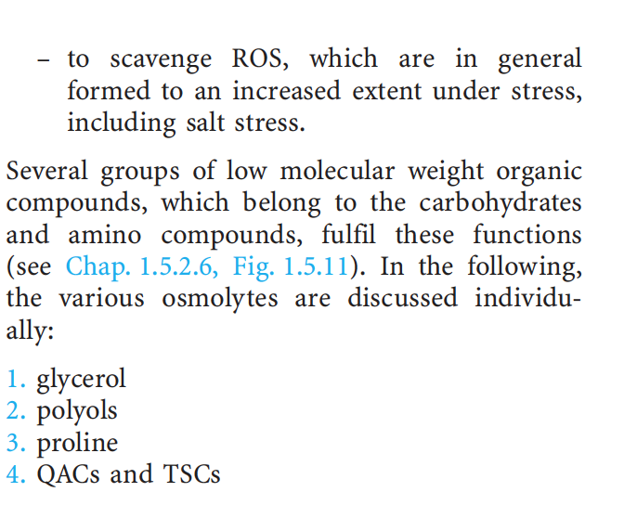

Slide 21
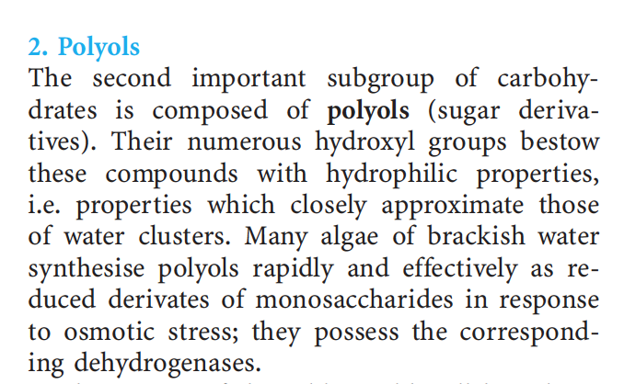

Slide 22
Question:
1.How The Reactive oxygen species (ROS) works in the plant?
2.How the gene SOS1 activated in the plants under stress?
3.Can you summarize the effect of the salt stress on Proline ?

Slide 23
Any
QUESTIONS ?

