Slide 1
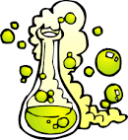
Preparation of Solutions
Lecture 2

Slide 2
Preparation of Solutions
It could be prepared either from:
1- Solid material.
2-Liquid.

Slide 3
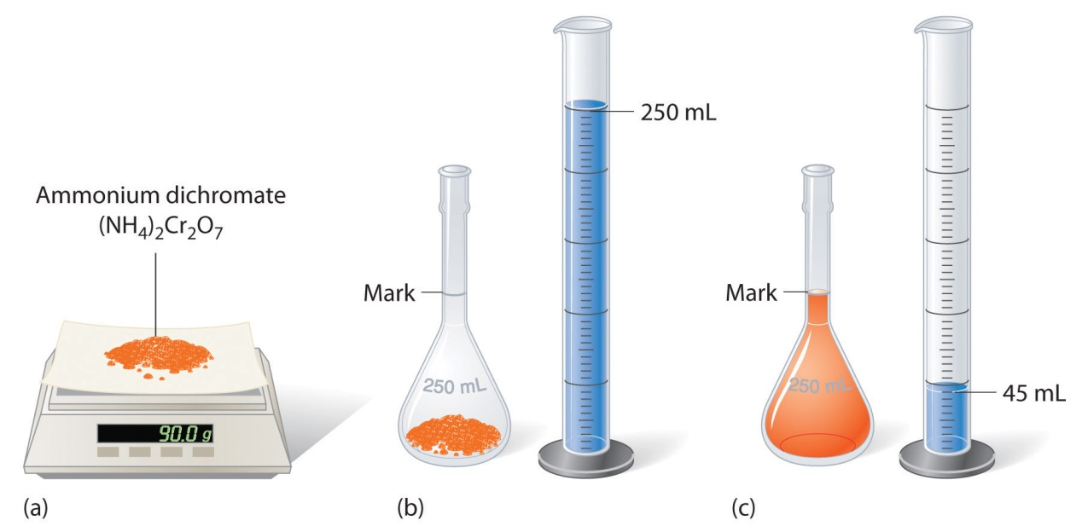
Preparation of Solutions from Solid Material
In general it follows a 4 steps:
Weigh the solute.
Dissolve the solute.
Make up the solution to a known volume.
Homogenise.

Slide 4
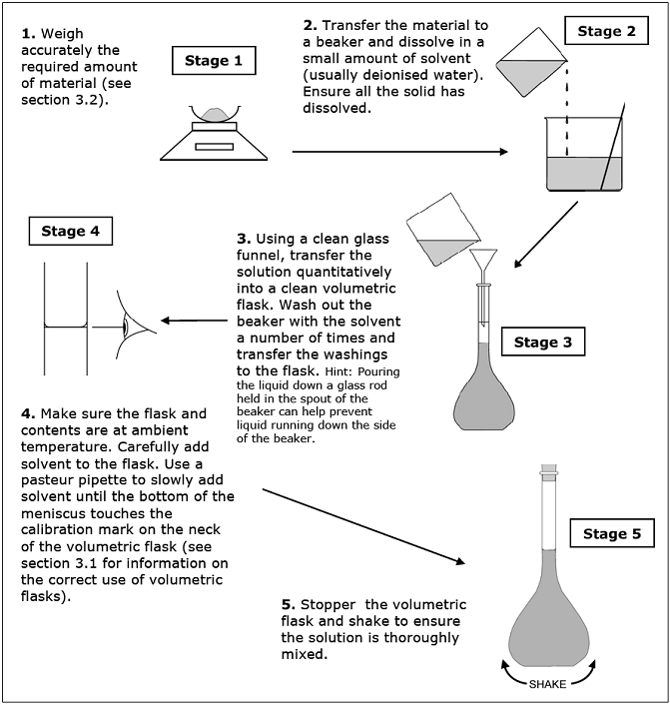

Slide 5
Preparation of Solutions from Liquid
Solutions are often prepared by diluting a more concentrated stock solution.
A known volume of the stock solution is transferred to a new container.
Make up the solution to a known volume.
Homogenize

Slide 6
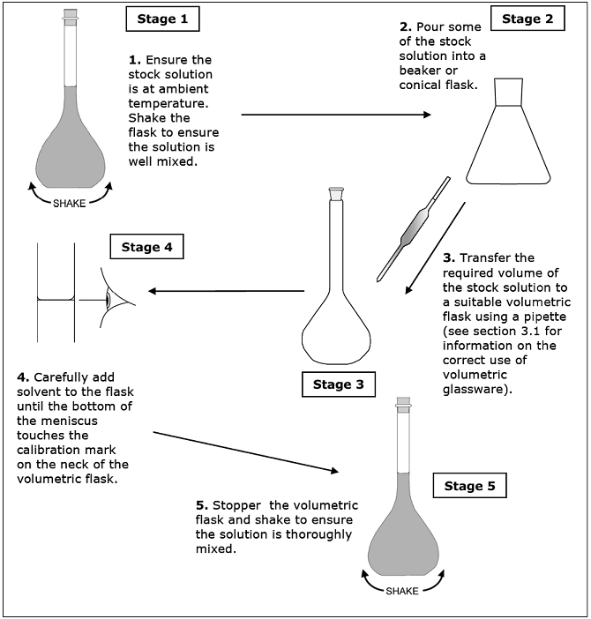

Slide 7
Dilution
It is the procedure for preparing a less concentrated solution from a more concentrated one.
When a solution is diluted, solvent is added to lower its concentration.
The amount of solute remains constant before and after the dilution: moles BEFORE = moles AFTER.
To calculate the concentration: C₁ V₁ = C₂V₂
C₁ ₌ concentration of stock
V₁ = Volume of stock
C₂ ₌ concentration of diluted
V₂₌ Volume of diluted

Slide 8
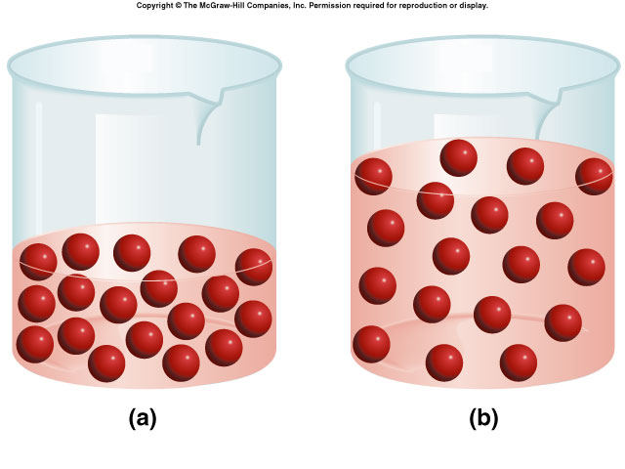
Dilution Continue
Always remember that the number of moles DOES NOT CHANGE.

Slide 9
Dilution Continue
Example
A bottle of 0.5M standard sucrose stock solution is in the lab. How can you use the stock solution to prepare 250 mL of a 0.348M sucrose solution?
C1* V1= C2 * V2
0.5 * V1= 0.348 * 0.25 L
0.348 * 0.25 / 0.5 = 0.174 L
i.e: 174 ml of the stock solution will be diluted with water
to reach the volume of 250 ml.

Slide 10
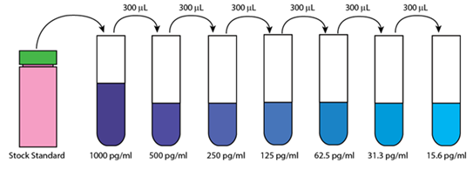
Serial Dilution
The progressive dilution of a substance or infectious agent in a series of tubes or wells in a tray in predetermined ratios.
Dilution starts first with stock solution and each diluted solution produced is used to prepare the next.
A serial dilution is any dilution where the concentration decreases by the same quantity in each successive step.
To calculate the concentration
use the equation:
C₁ V₁ = C₂V₂
600μ l

Slide 11
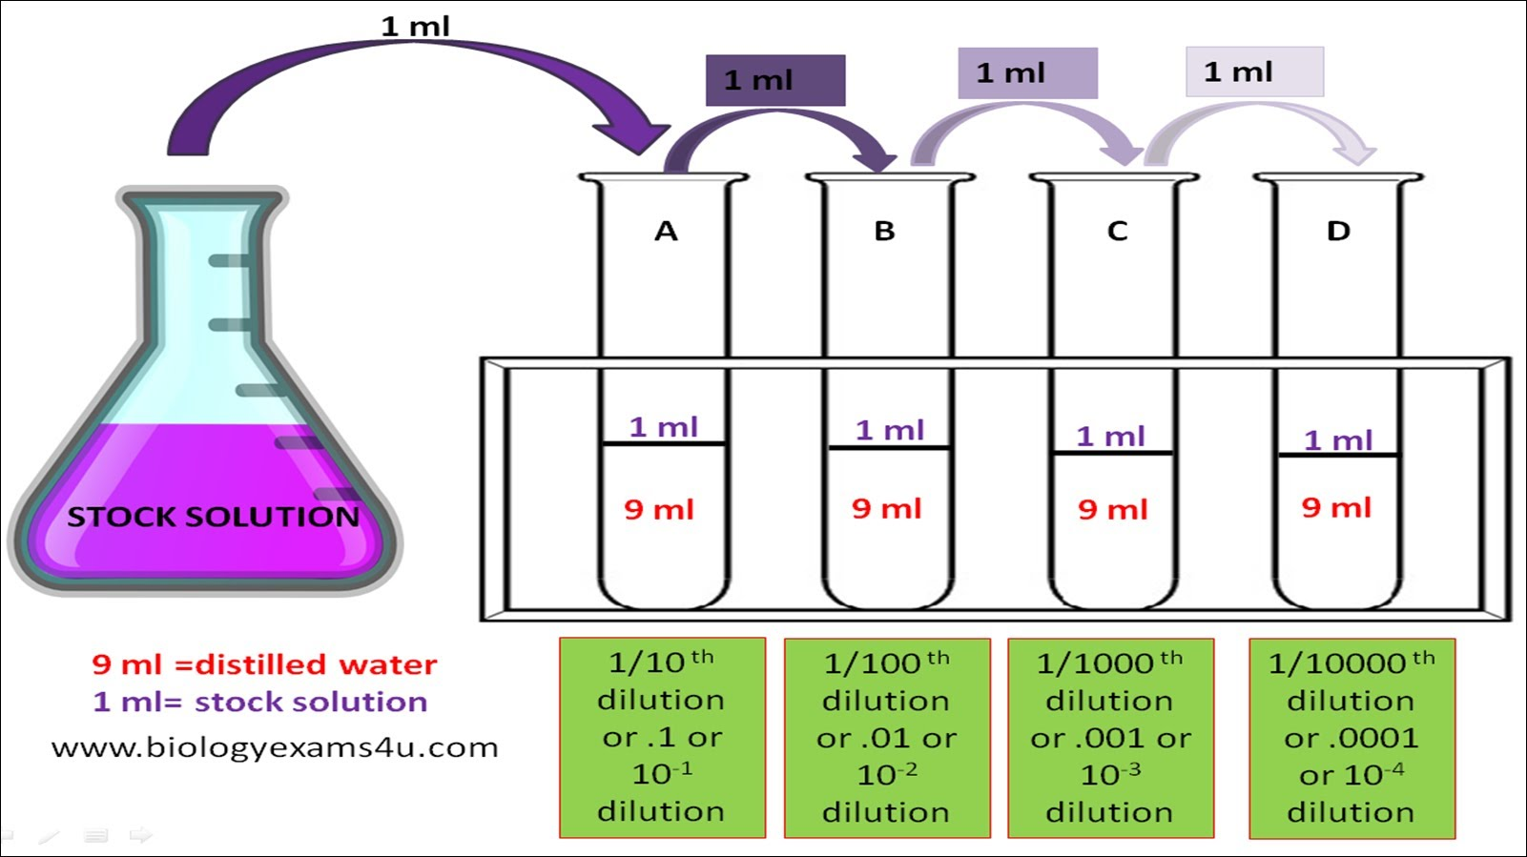
Linear Dilution
Same stock solution is used to produce samples of different
concentrations.
To calculate the concentration: C₁ V₁ = C₂V₂

Slide 12
Dilution Factor
Dilution factor refers to the ratio of the volume of the initial (concentrated) solution to the volume of the final (dilute) solution.
To make a dilute solution without calculating concentrations use a dilution factor.
Divide the final volume by the initial volume.
DF=Vf / Vi
Vi = initial volume
Vf = final volume (aliquot volume + diluent volume)
DF of 100 = ratio 1:100

Slide 13
Dilution Factor Continue
Example:
What is the dilution factor if you add 0.1 ml aliquot of a specimen to 9.9 ml of diluent?
The final volume is equal to the aliquot volume PLUS the diluent volume: 0.1 mL + 9.9 mL = 10 mL
The dilution factor is equal to the final volume divided by the aliquot volume: 10 mL/0.1 mL = 1:100 dilution.

Slide 14
Dilution Factor Continue
Example:
What is the dilution factor when 0.2 ml is added to 3.8 ml diluent?
Dilution factor = final volume/aliquot volume
Final volume = 0.2 +3.8 = 4.0 ml
Aliquot volume = 0.2 ml
4.0/0.2 = 1:20 dilution.

Slide 15
Dilution Factor Continue
Example:
From the previous example if you had 4 tubes what would be the final dilution of tube 4?
Since each dilution is 1:20 and we want to know the dilution of the FORTH tube so in this case it would be 1:20 multiplied FOUR times.
= 1:20 * 1:20 * 1:20 *1:20
= 1:160,000

Slide 16
Importance of Dilution
Example:
A blood glucose of 800 mg/dl was obtained. According to the manufacturer the highest glucose result which can be obtained on this particular instrument is 500 mg/dl.
The sample must be diluted.
The serum was diluted 1:10 and retested.
The result is 80 mg/dL.
THIS IS NOT THE REPORTALBE RESULT!
You must multiply by the dilution factor of 10.
10 x 80 = 800 mg/dl.

