Slide 1
Bacterial Metabolism
311 Basic Bacteriology
AmanyNiazy

Slide 2
Metabolism - all of the chemical reactions within a living organism
1. Catabolism ( Catabolic )
breakdown of complex organic molecules into simpler compounds
releases ENERGY
2. Anabolism ( Anabolic )
the building of complex organic molecules from simpler ones
requires ENERGY

Slide 3
Energy
Prokaryotes in general are grouped according to the energy and carbon sources they utilize.

Slide 4
Nutritional Patterns
Two types of nutritional patterns as determined according toEnergy Source:
1. Phototrophs→ Light is the energy source
2. Chemotrophs→ Redox reactions act as the energy source

Slide 5
Nutritional Patterns
Two types of nutritional patterns as determined according toPrinciple Carbon Source:
1. Autotrophs→CO₂
2. Heterotrophs→Organic compounds

Slide 6
Harvesting Energy
Type | Energy Source | Carbon Source
Photoautotroph | Sunlight | CO2
Photohetrotroph | Sunlight | Organic Compounds
Chemolithoautotroph (=chemoautotroph) | Inorganic chemicals (H2, NH3, H2S ..etc) | CO2
Chemoorganoheterotroph (=Chemoorganotroph) the most common group associated with humans and other animals. | Organic compounds (sugars, amino acids..etc) | Organic Compounds

Slide 7
Metabolic Pathways
Metabolic processes occur as a series of sequential chemical reactions, which constitute:
Metabolic pathway
Series of intermediates
End product.
Can be linear , branched or cyclical.
Cell can regulate these pathways at various intervals to ensure that specific molecules are produced in precise quantities.

Slide 8
BASIC CONCEPTS
Enzymes:
catalysts that speed up and direct chemical reactions.
It accelerate the conversion of a substrate into product.
Enzymes are substrate specific

Slide 9
Naming of Enzymes
Most are named by adding “ase” to the substrate
Sucrose Sucrase
Lipids Lipase
Urea Ureases
DNA DNase
Proteins Protease
removes a Hydrogen Dehydrogenase
removes a phosphate phosphotase

Slide 10
Naming of Enzymes
It can be grouped based on type of reaction they catalyze:
Oxidoreductases oxidation & reduction.
Hydrolases hydrolysis.
Ligases synthesis

Slide 11
BASIC CONCEPTS
Adenosine triphosphate (ATP):
It is an immediate donor of free energy.
It is composed of (sugar ribose, nitrogenous base adenine, and 3 phosophate groups)
ADP →use energy and P_{i}→ATP
ATP→release energy and Pi → ADP

Slide 12
BASIC CONCEPTS
Chemical Energy Source:
Is the compound that is broken down by a cell to release energy.
Harvesting energy from a compound involves a series of coupled oxidation-reduction reactions.
The compound can be:
organic such as glucose
Inorganic such as hydrogen sulfied and ammonia.

Slide 13
Oxidation-Reducion Reactions (=RedoxReacions)
In redox reactions one or more electrons are transferred from one substance to another.
The molecule that loses electrons becomes → oxidized.
The molecule that gains those electrons becomes →reduced.
Often this occurs when the atom becomes bonded to an oxygen
Often this occurs when an atom becomes bonded to a hydrogen

Slide 14
RedoxReacions
Oxidized → donate a pair of electrons
Reduced → accept a pair of electrons

Slide 15
RedoxReacions
In metabolic pathways, we are often concerned with the oxidation or reduction of carbon.
Reduction and oxidation always occurs together in redox reaction.
one substance gets reduced, and another substance gets oxidized.
The thing that gets oxidized is called the electron donor.
The thing that gets reduced is called the electron acceptor.

Slide 16
BASIC CONCEPT
Electron Carriers
Enzymes that catalyze redox reactions typically require a cofactor to “shuttle” electrons from one part of the metabolic pathway to another part.
Cells use designated molecules as carriers of electrons.
There are many different types of electron carriers, and they serve different functions.
E.g NAD⁺, FAD, NADP⁺

Slide 17
Cofactors for Redox Reactions
NAD_{(oxidized)} + H⁺ + Pair of electrons →NADH_{(reduced)}
FAD_{(oxidized)} + H⁺ + Pair of electrons →FADH_{(reduced)}

Slide 18
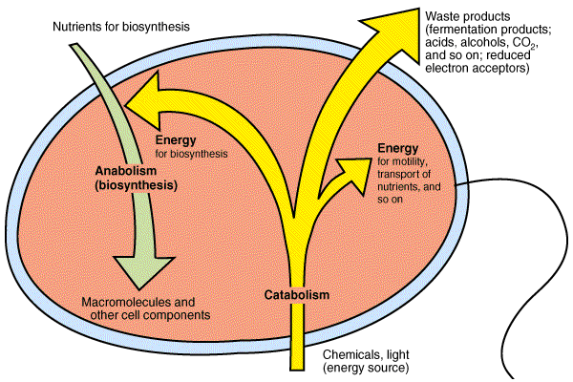
Overview of Cell Metabolism

Slide 19
CENTRAL METABOLIC PATHWAYS
There are 3 key metabolic pathways that are called the central metabolic pathways.
They are used to oxidize glucose, completely to carbon dioxide.
Glucose is the preferred energy source of many cells.
They include:
Glycolysis
Pentose phosphate pathway.
Tricarboxylic acid cycle (TCA cycle)

Slide 20
GLYCOLYSIS
The primary pathway used by many organisms to convert glucose to pyruvate.
Dose not need O_{2,} (can be used by anaerobic bacteria).
It is a 10 step pathway.
One glucose molecule gives:
2 pyruvate molecules
2 ATP molecules → energy
2 NADH molecules.
2 H+ molecules → reducing power
Precursor metabolites.
Around five intermediates of glycolysis as well as the end product, pyruvate, are precursor metabolites used by some bacteria such as E.coli.

Slide 21
Glycolysis
It can be summarized as:
Glucose (6C) + 2NAD⁺ + 2ADP + 2 P_{i}
→ 2 pyruvate (3C) + 2 NADH + 2 H⁺ + 2 ATP

Slide 22
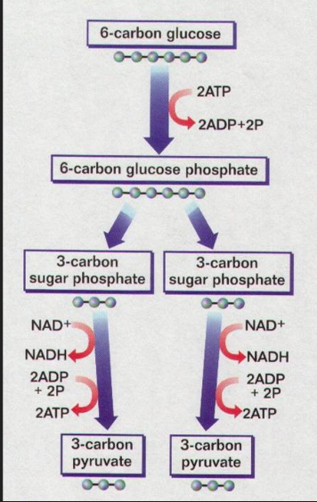

Slide 23
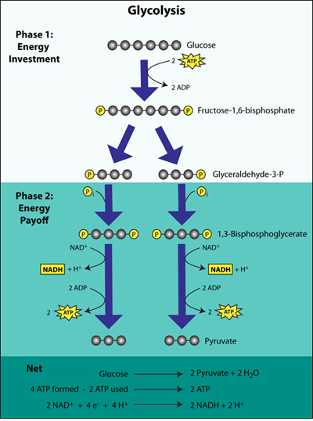
Preparatory phase:
Energy in glucose cannot be readily released unless energy from ATP if added first. In this phase, 2 ATP are added to the reaction, producing a glucose molecule with two phosphate groups. The phosphate groups make glucose less stable and ready for chemical breakdown.
Payoff phase:
This oxidizes and rearranges the 3-carbon molecules to form pyruvate, generating 4 ATP and 2 NADH molecules are formed and as well as two molecules of pyruvate.
Note that the steps of this phase occur twice for each molecule of glucose that entered glycolysis because the 6-carbon sugar was split into two 3-carbon molecules in the previous phase

Slide 24
CENTRAL METABOLIC PATHWAYS
They include:
Glycolysis
Pentose phosphate pathway.
Tricarboxylic acid cycle (TCA cycle)

Slide 25
Pentose Phosphate Pathway.
The greatest importance of the pentose phosphate pathway is its contribution to biosynthesis.
One glucose molecule gives:
NADPH + H⁺ (amount varies)
needed for synthesis of lipid and other cell component.
Two different precursor metabolites
needed for nucleic acid & amino acid synthesis

Slide 26
Transition Step
This step links glycolysis to the TCA cycle. It converts pyrovate into Acytyl-CoA.
It involves:
A redox reaction that generates NADH.
Removal of CO₂
And addition of coenzyme A

Slide 27
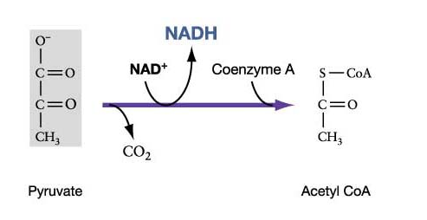

Slide 28
Tricarboxylic Acid Cycle (TCA cycle) (=Krebs Cycle)
This cycle contain 8 steps to complete the oxidation of glucose.
Takes place in the cytoplasm.
Oxygen is required (can’t be used by anaerobic bacteria)
It starts with acetyl group form the transition step.
Net reaction can be summarized as follows:
2 Acetyle Groups (2C) + 6 NAD⁺+ 2FAD + 2ADP + 2 P_{i}
→ 4 CO₂+ 6 NADH + 6H⁺+ 2 FADH₂+ 2ATP

Slide 29
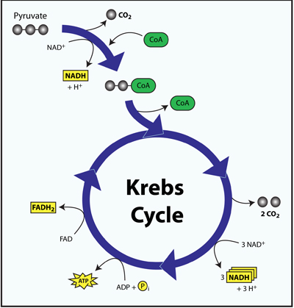

Slide 30
Tricarboxylic Acid Cycle (TCA cycle) (=Krebs Cycle)
TCA cycle generate:
2 ATP
Reducing power in the form of 6 NADH + 6H⁺ and 2 FADH₂
Two different precursor metabolites.

Slide 31
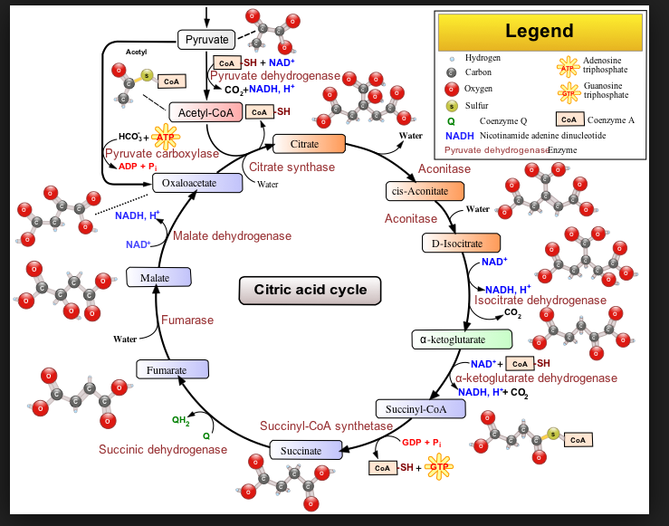
Krebs cycle

Slide 32
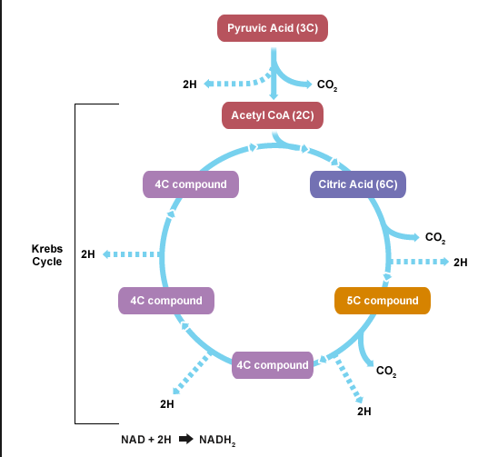

Slide 33
Summary
Glycolysis oxidize glucose to pyruvate, yielding some ATP, NADH and some precursor metabolites. The Pentose Phosphate Pathway initiates the breakdown of glucose and it gives NADPH and to precursor metabolites that are used in biosynthesis. The transition step and the TCA cycle, repeated twice, complete the oxidation of glucose , yielding some ATP , a great deal of reducing power and precursor metabolites.

Slide 34
Respiration
This uses the reducing power (NADH & FADH2) that is generated in glycolysis, the transitional step, and TCA (Krebs cycle) to synthesize ATP.
The process is called:
oxidative phosphorylations.
This occur through the action of two mechanisms:
Electron transport chainwhich generates proton motive force.
ATP synthaseenzyme.

Slide 35
The Electron Transport Chain
It generate proton motive force.
It happens through redox reactions.
It takes place in the cytoplasmic membrane where a group of membrane-embedded electron carriers pass electrons sequentially from one to another.
This result in ejection of protons to the outside of the cells.
This expulsion of protons creates a proton gradient.
Energy of this gradient, proton motive force, can be harvested by cells and used to fuel the synthesis of ATP.

Slide 36
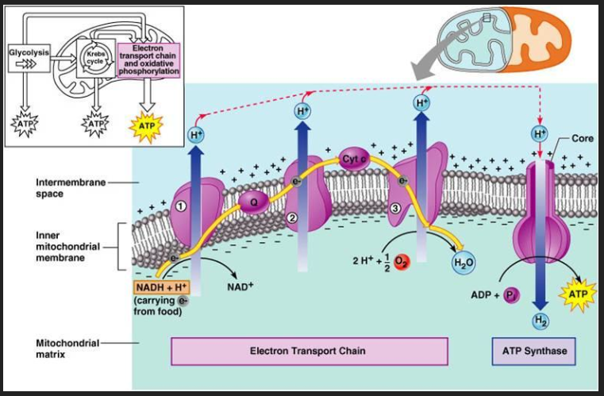
The Electron Transport Chain

Slide 37
ATP Synthase
Harvesting the proton motive force to synthesize ATP.
Just as energy is required to establish a concentration gradient, energy is released when a gradient is eased.
The enzyme ATP synthase uses that energy to synthesize ATP.
One ATP molecule is formed from the entry of approximately three protons.
The precise mechanism of how this occurs is not well understood.

Slide 38
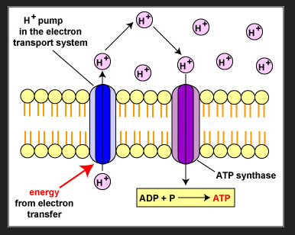

Slide 39
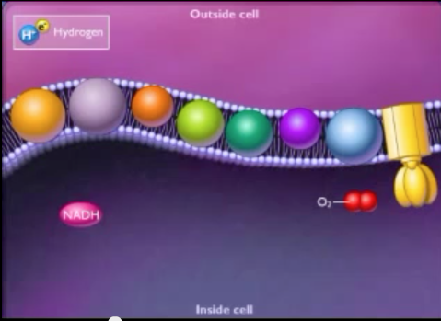
Reducing power (like NADH) gives H⁺
Which consist of electron and proton.
The electrons are carried through special proteins in the cell wall tell they are accepted at the end by an electron accepter like O_{2.}

Slide 40
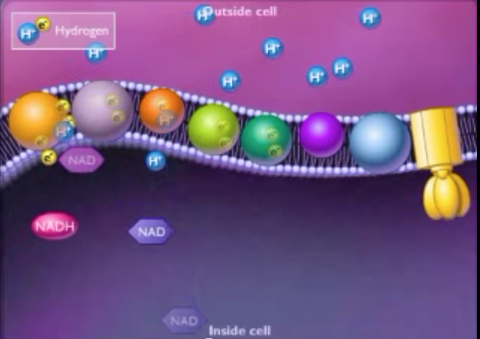
Now protons are high outside the membrane and that enhances the proton motive force.

Slide 41
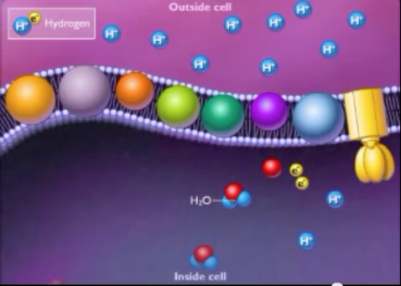
In aerobic respiration the electron accepter is O2 and water is formed.

Slide 42
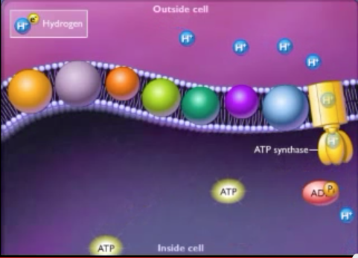
The enzyme ATP synthase utilize the H⁺ to form ATP from ADP.
This enzyme allows the H⁺ to go back into the cells and use the energy for the phosphorelation of ADP to from ATP
http://www.youtube.com/watch?v=lRlTBRPv6xM

Slide 43
Respiration
If the bacteria use O₂ as a terminal electron acceptor then this is called →aerobic respiration.
If the bacteria uses molecules other than O₂ as terminal electron acceptor then this is called →anaerobic respiration.
The process of anaerobic respiration harvests less energy than aerobic respiration.

Slide 44
Anaerobic Respiration
Sulfate reducer: final electron acceptor is sodium sulfate (Na2 SO4)
Methane reducer: final electron acceptor is CO2
Nitrate reducer : final electroon acceptor is sodium nitrate (NaNO3)

Slide 45
Fermentation
Fermentation – the (usually) anaerobic process by which pyruvate is converted to simplier organic (usually acid) or inorganic compounds (i.e., CO₂)

Slide 46
Fermentation
It is used by organisms that cannot respire, either because a suitable inorganic terminal electron acceptor is not available or because they lack an electron transport chain.
The only ATP-yielding reactions of fermentation are those of glycolysis.
The other steps are mainly to recycle the reducing power (NADH), if this was not done their will be no NAD⁺ to be used in glycolysis and so the ATP generataing pathway will be blocked.

Slide 47
Fermentation
Because different organisms use different fermentation pathways the end product of fermentation can be used for identification.
Also fermentation of some organism can be used to produced certain beverage and food.

Slide 48
Fermentation
Example of some end product of some organisms:
Lactic acid
Lactic acid bacteria are used in creating the flavor and texture of cheese, yogurt, pickles and other food. (e.g. lactobacilli)
On the other hand lactic acid causes tooth decay and spoilage of some foods.

Slide 49
Fermentation
Ethanol
This is important in the production of biofuel.
E.g. Zymomonas
Mixed acids:
Many different acids can be produced and this helps in identification especially in the members of Enterobacteriaceae

Slide 50
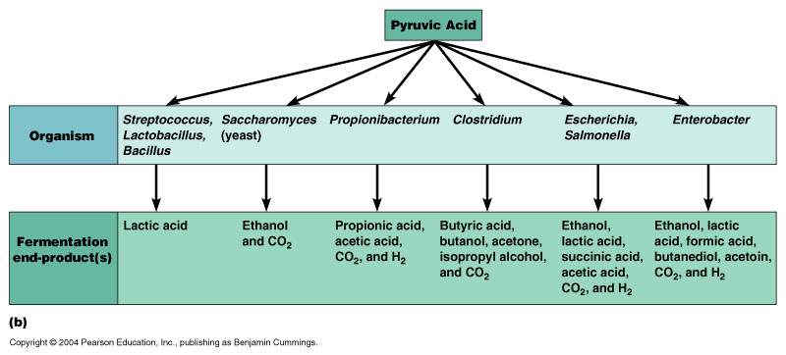

Slide 51
Overview of Cell Metabolism

Slide 52
Energy Generating Patterns
After Sugars are made or obtained, they are the energy source of life.
Breakdown of sugar (catabolism) different ways:
Aerobic respiration →final electron acceptor always O₂
Anaerobic respiration→final electron acceptor never O₂
Fermentation

Slide 53
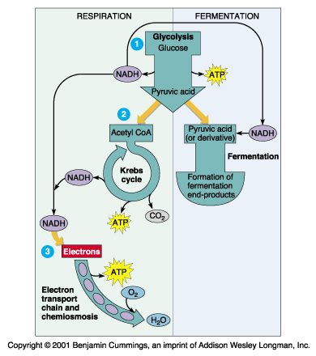

Slide 54
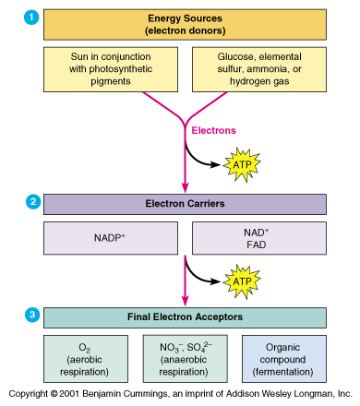

Slide 55
Catabolism of organic Compounds Other Than Glucose
Microbes can use a variety of organic compounds other than glucose as energy sources (e.g. polysaccharides, lipids, and proteins).
Hydrolytic enzymes are needed for that.
Cells secrete the appropriate hydrolytic enzyme in the surrounding medium to break these macromolecule and then transport the resulting subunits into the cell.

Slide 56
Catabolism of organic Compounds Other Than Glucose
Inside the cells these subunits are further degraded to form appropriate precursor metabolites.
The precursor metabolites can be:
Oxidized in one of the central metabolic pathways
Or used in biosynthesis.

Slide 57
Polysaccharides and Disaccharides.
Glucose can enter glycolysis directly but the other sugars must first be modified.
Example of some of the enzymes that modify sugar other than glucose:
Amylases → digest starches.
Cellulases→ digest cellulose
Disaccharidases→ digest disaccharides including lactose, maltose, and sucrose.

Slide 58
Lipids
Fat → lipase enzymes →fatty acids joined to glycerol.
Glycerol componenet is then converted to precursor metabolite which enters the glycolytic pathway.
Fatty acid is degraded giving carbon unit to form acetyl-CoA.

Slide 59
Proteins
Proteins → enzymes proteases →amino acid subunits.
We end up with carbon skeletons that are converted into the appropriate precursor molecules.

Slide 60
Anabolic Pathways
The pathways used for synthesizing subunits from precursor molecules.
Prokaryotes are similar in their biosynthetic processes.
Anabolic pathways needs:
Energy in form of ATP
Reducing power in form of NADPH
Precursor metabolites formed in the central metabolic pathways.

Slide 61
Anabolic Pathways
Organisms lacking one or more enzymes in a given biosynthetic pathway must have the end product provided from an external source.
Once subunits are synthesized or taken up, they can be assembled to make macromolecules.
This is way fastidious bacteria require many different growth factors.

Slide 62
Anabolic Pathways
Most are subunits are synthesized from precursor metabolites formed during the main metabolic pathways.
Bacteria can control what to synthesize by regulating the enzymes used in a specific pathway.

Slide 63
Lipid Synthesis
Have 2 essential components :
Fatty acid synthesis
Glycerol synthesis

Slide 64
Amino Acid Synthesis
Proteins are composed of various combinations of 20 different amino acids.

Slide 65
Nucleotide Synthesis
RNA & DNA → are composed of three units:
5-carbon sugar
Phosphate group
Nitrogenous base (purine or pyrimidine)

