Slide 1
The muscular tissues

Slide 2
General characteristics of the muscular tissues:
The cells of the muscular tissues are elongated elements, named muscle fibers.
The cytoplasm of the muscle fiber, the sarcoplasm, contains myofibrils. These fibrils are made up of the proteins actin and myosin.
The plasma membrane of the muscle fiber is called the sarcolemma.
Muscle fibers are called striated or smooth (non-striated) according to the presence or absence of transverse striations
Muscle fibers may be voluntary (when their contraction is under the control of will), or involuntary (when it is beyond the control of will).
There are three types of muscle fibers:
Skeletal muscles, which are voluntary and striated.
Smooth muscles, which are involuntary and non-striated.
Cardiac muscles, which are involuntary and striated.

Slide 3
Skeletal (Striated muscle)
An elongated, unbranched, cylindrical cell, with numerous peripheral flattened nuclei attached to the skeleton
Transversely striated
Voluntary
Nucleus shape & location
An elongated or rod-shaped located peripherally

Slide 4
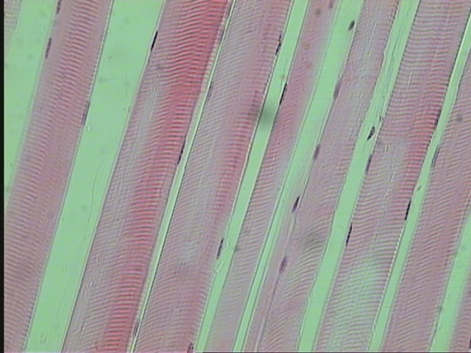
L.S of Striated Muscles Fibers (skeletal muscle fibers)
sarcolemma
nuclei
Connective
tissue
Dark and light bands
Muscle fiber

Slide 5
T.S of skeletal muscle:
Each individual muscle fiber is surrounded by a delicate connective tissue, the endomysium.
Bundles or groups of fibers are wrapped by a dense connective tissue called the perimysium.
- The whole muscle (formed of several bundles) is covered by a dense connective tissue sheath, the epimysium.

Slide 6
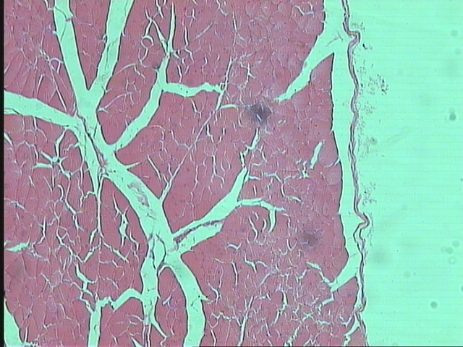
T.S of Striated Muscles Fibers (skeletal muscle fibers)
Endomysium
Perimysium
Epimysium

Slide 7
Smooth (Unstriated muscle)
An elongated, spindle-shaped cells with pointed ends
unstriated
Involuntary
In the blood vessels, digestive, respiratory, urinary and reproduction system
Nucleus shape & location
An elongated or rod-shaped
Centrally located in the cytoplasm at the widest part of the cell

Slide 8
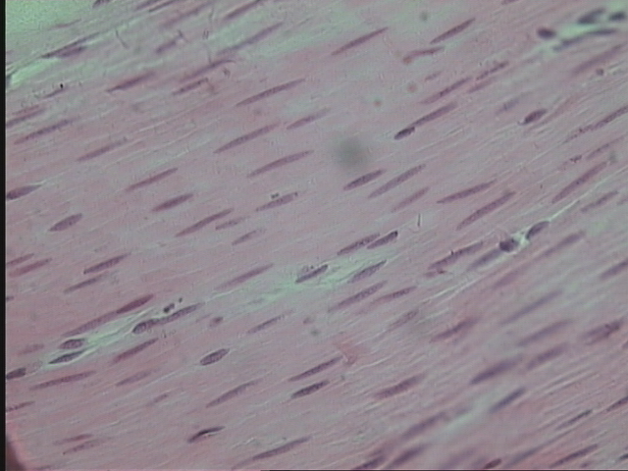
L.S of Smooth Muscles Fibers
nuclei
Muscle fiber
Connective
tissue

Slide 9
Cardiac muscle
An elongated, branched, mononucleate or binucleate
Striated
Involuntary
In the heart
Nucleus shape & location
Oval
Centrally located

Slide 10
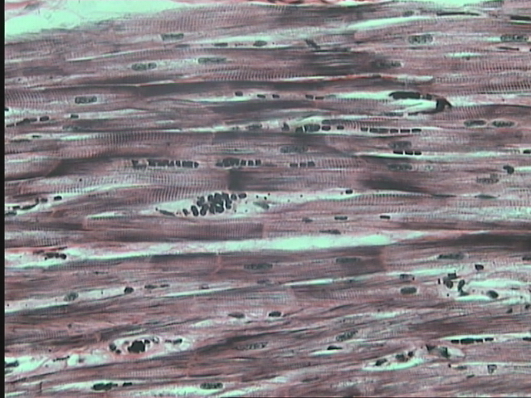
L.S of Cardiac Muscles Fibers
nuclei
Dark and light bands
Connective tissue
intercalated disc
Muscle fiber

Slide 11
Types of muscle fibers
 | Skeletal (Striated muscle) | Smooth (Unstriated muscle) | Cardiac muscle
Shape | An elongated, unbranched, cylindrical cell, with numerous peripheral flattened nuclei. | An elongated, spindle-shaped cells with pointed ends. | An elongated, branched, mononucleate or binucleate.
Nucleus shape | An elongated or rod-shaped. | An elongated or rod-shaped. | Oval.
Nucleus location | Peripheral. | Centrally located in the cytoplasm at the widest part of the cell. | Centrally located.
Striation | Transversely striated. | unstriated. | Striated.
Voluntariness | Voluntary. | Involuntary. | Involuntary.
Location | Attached to the skeleton. | In the blood vessels, digestive, respiratory, urinary and reproduction system. | In the heart.

