Slide 1
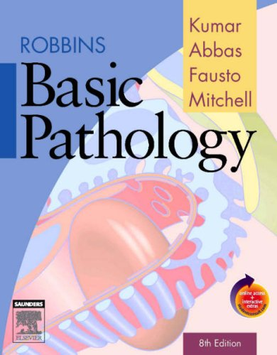
CLS 223

Slide 2
Lecture #3
Inflammation

Slide 3
Cellular response to stress
Cellular response to stress may be adaptive or non adaptive.
Adaptive | Non-adaptive (cell injury-----cell death)
hypertrophy | Dysplasia
hyperplasia | neoplasia
Atrophy | Degeneration
Metaplasia | Necrosis, apoptosis & gangrene
Reversible | Reversible* / Irreversible
1) Change in cell number, size, type
2) Inflammation and repair
3) Immune response
*to a certain limit

Slide 4
Inflammation
Inflammation is a protective adaptive response or mechanism
intended to eliminate the initial cause of cell injury
(foreign invaders e.g. infectious agents)
as well as damaged and necrotic tissues.
It then initiates the events that eventually heal and repair the site of injury.
Nomenclature:
It ends with “itis” e.g. hepatitis, meningitis, pancreatitis, tonsillitis…
Types:
Acute, sub-acute, chronic.
Notes:
Definition, aim, nomenclature, types
Although inflammation helps clear infections and initiates repair , the inflammatory reaction and the subsequent repair process can cause considerable harm (how)? The components of the inflammatory reaction that destroy and eliminate microbes and dead tissues are capable of also injuring normal tissues.

Slide 5
Causes of inflammation
Chemical: acids, alkalies, poisons
Physical: excess heat or cold, radiations
Mechanical: trauma, cut
Biological: bacteria, virus, parasite and fungi
Immunological reactions against environmental substances or against self tissue.
Notes:
Against enviromental substance (hypersensitivity)_
Against self tissue (autoimmunity)

Slide 6
Acute inflammation
- Rapid in onset and of short duration.
- Shows classical signs of inflammation which are:
Redness 2) Hotness 3) Swelling 4) Pain 5) Loss of function
-mostly neutrophils migrate to the site of injury.
Chronic inflammation
- Gradual in onset and of prolonged duration .
- Classical Signs of inflammation may be absent.
- Monocytes (macrophages) and lymphocytes.
Sub-acute inflammation
- Between the acute and chronic.

Slide 7
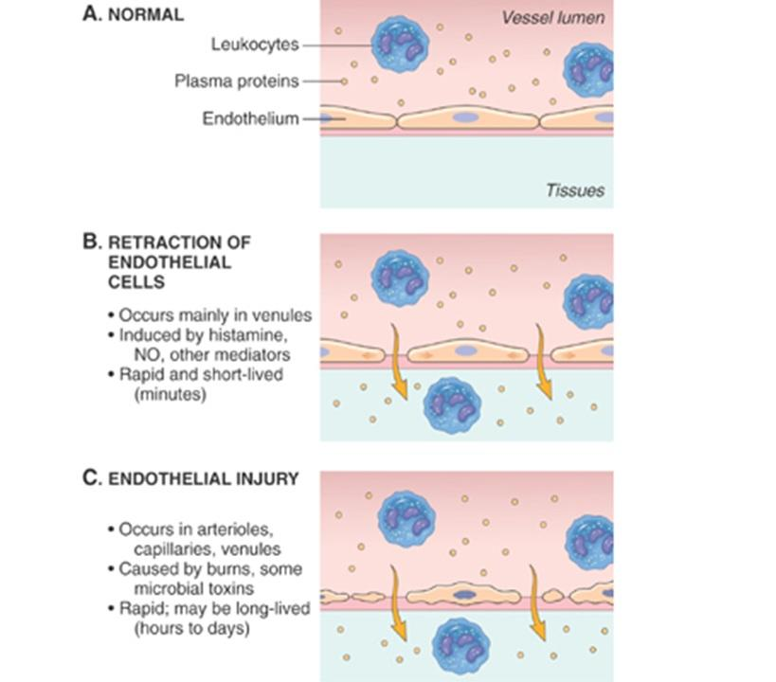
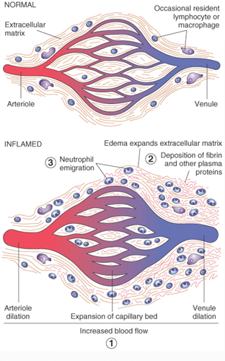
components of the inflammatory mechanism:
The main components of inflammation are Local Vascular Reaction and cellular response; both are activated by chemical mediators (e.g. histamine, serotonin, prostaglandins and others) derived from plasma proteins and various cells.
Notes:
Chemokines released from injured cells as a kind of signal alarm that stg is wrong!
Mast cells become activated and release histamine that act on the capillary endothelium (vasodilatation and increase permeability). Mostly neutrophils are attracted to the chemokines and now can migrate from the capillary towards the injured tissue (margination, diapedesis, positive chemotaxis, phagocytosis) mast cells in the connective tissue release histamine changing the blood vessle behaviour in at that sight of injury)
Histamine is normally present in (mast cells, basophils, eosinophils).
Histamine goes to the endothelial cells of the capillaries and make them go further apart. Secreted from mast cells basophils and eosinophils

Slide 8
Local Vascular reaction:
Rapid vasoconstriction of blood vessels occurs in injured area , followed by vasodilation.
Vasodilation of arterioles → increase in local blood flow → redness and hotness.
Increase vascular permeability → leakage of protein rich fluid and leukocytes into the extravascular tissue (exudate) → swelling or edema.
Pain + swelling → loss of function.
Notes:
Pain is due to the pressure of the exudate on the sensory nerves.

Slide 9
2) Cellular response: (leukocytes -mostly neutrophils- recruitment to site of inflammation)
Margination:
leukocytes settle on the margin of the endothelial lining of the capillaries and adhere.
Diapedesis:
leukocytes pass through the intact walls of the capillaries.
Chemotaxis:
Leukocytes is directed to the site of injury under the influence of chemotactic agents (chemokines).
Phagocytosis:
The recognition, ingestion and destruction of the irritant by phagocytic leukocyte.
Notes:
Diapedesis : also called emigration (squeezing through the walls)
Irritant: bacteria, necrotic debris …
How does the wbc----ameboid motion

Slide 10
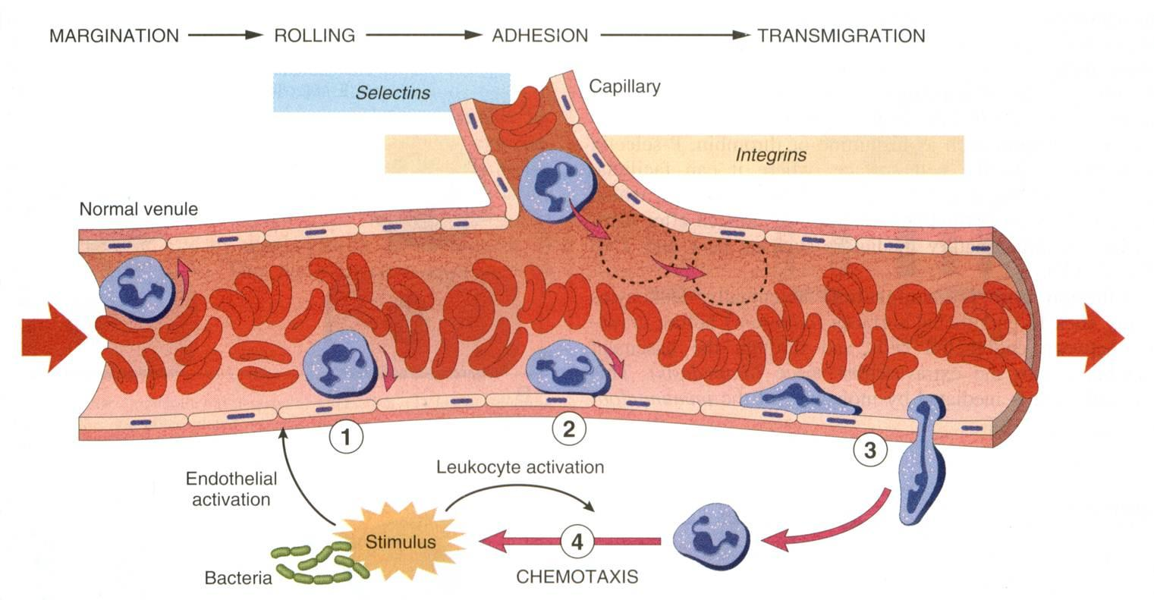

Slide 11
Prognosis of acute inflammation
Resolution
Progression to chronic inflammation (Chronicity)
Scarring and fibrosis
Notes:
Depending on the nature and intensity of the injury, the site and tissue affected
Resolution: irritant removed with no or minimal tissue damage. The tissue is capable of replacing the injured cells
Progression to chronic inflammation: if the irritant isn’t removed
Scarring and fibrosis: when inflammation occurs in tissues that don’t regenerate

Slide 12
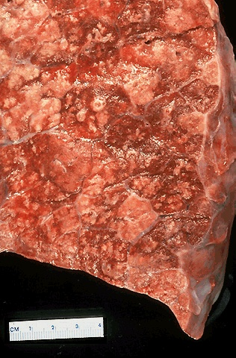
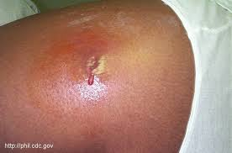
Types of acute inflammation
1)Suppurative inflammation: Characterized by pus formation.
Composition of pus:
- Bacteria (living & dead) and their toxins - Liquefied necrotic tissue (due to release of proteolytic enzymes)
Inflammatory cells (neutrophils),
pus cells, macrophages and RBC
Inflammatory fluid (exudate)
e.g. bronchopneumonia
e.g. abscess
Notes:
Multiple bacterial abscesses in lung in case of bronchopneumonia

Slide 13
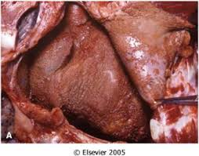
2) Non-suppurative inflammation:
A- Serous inflammation: characterized by excess clear watery fluid. E.g. Mild burns
B- Fibrinous inflammation: characterized by an exudate rich in fibrinogen. E.g. Fibrinous pericarditis →
C- Haemorrhagic inflammation: characterized by exudate rich in RBC vascular damage. E.g. small pox

Slide 14
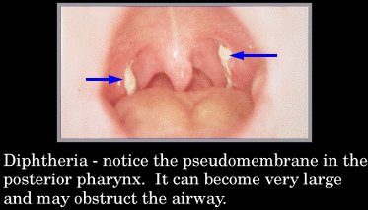
D- Catarrhal inflammation: mild acute inflammation characterized by excess mucous secretion. E.g. in common cold.
E- Membranous inflammation: severe acute inflammation characterized by the formation of a Pseudomembrane on the affected surface. E.g. Diphtheria.

Slide 15
Note
Although inflammation helps clear infections and initiates repair (physiological role) , the inflammatory reaction and the subsequent repair process can cause considerable harm (pathological consequence of inflammation).
The components of the inflammatory reaction that destroy and eliminate microbes and dead tissues are capable of also injuring normal tissues.
Notes:
Neutrophil and monocytes are phagocytes
Neutrophil increases in acute infections
Monocytes increase during chronic infections
Monocytes are macrophages once they migrate to tissue
Basophils eosinophils mast cells secrete histamin
Mast cells are not blood cells, they are tissue residents.
Eosinophils increase in case of parasitic infections
Lymphocytes mostly increase in viral infections and graft rejections and some chronic diseases.

