Slide 1



Opportunistic Mycoses &
Miscellaneous Mycoses
MBI 531

Slide 2
Opportunistic Systemic Mycoses
Produced by relatively non-pathogenic or contaminant fungi in a host whose immunological defense mechanisms are weakened by
Endogenous causes - cancer, leukemia
Exogenous causes - immuno suppressive therapy, AIDS.
Important cause of morbidity & mortality in hospitalized patients.

Slide 3
Opportunistic Mycoses
Includes - Candidiasis
  Cryptococcosis
  Aspergillosis
  Zygomycosis / Mucormycosis
  Pneumocystosis
  Penicilliosis
  Miscellaneous opp. mycoses.

Slide 4
CRYPTOCOCCOSIS
Caused by an encapsulated yeast Cryptococcus neoformans, pathogenic to man & animals.
₂nd
most common fungal infection
after
■
candidiasis in HIV - infected individuals.
Isolated from pigeon nests, droppings, old buildings & nitrogenous soil - Creatine favour the growth.

Slide 5
Virulence factors
Capsule – Inhibits phagocytosis.
Melanin production by the enzyme phenol oxidase. L- DOPA Melanin
Melanin - Antioxidant - protects the organism from intracellular killing by phagocytes

Slide 6
Pathogenesis
Infection occurs by inhalation, but sometimes through
skin or mucosa.
Weakening of immune system leads to reactivation & dissemination to CNS and other sites.
Visceral forms simulate tuberculosis & cancer clinically.
Cutaneous form varies form small ulcers to granulomas.

Slide 7
Clinical Features
Seen in HIV +ve patients when CD4+ count falls below 200 cells / mm³
Extra pulmonary cryptococcosis is one of the AIDS – defining disease.
Clinical types :
  Pulmonary
  Extrapulmonary – CNS, viscera, bones & skin Cryptococcal meningitis is the most serious type of infection,
resembles TB and is often seen in AIDS patients.

Slide 8
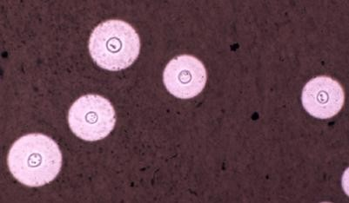
Laboratory Diagnosis
Specimen – Serum, CSF, body fluids
Direct examination
Wet mount: India ink - budding yeast cells
5-20μ, with a distinct halo
Gram‟s stain - Gram +ve budding yeast cells

Slide 9
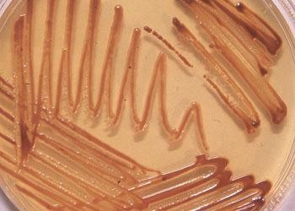
Fungal Culture & Serology
SDA - highly mucoid, cream to buff
colored colonies.
Birdseed (Niger seed) agar – selective media
- Brown colored colonies due to melanin production.
Crypto LA test – Ag detection in Serum, CSF & Urine
- Titer > 1:8 is significant.

Slide 10
ASPERGILLOSIS
Systemic infection in immunocompromised as well as
immunocompetent individuals
Infection occurs by
  Inhalation of conidia
  Direct entry through wounds or during surgery.
Imp. species – A. niger, A. fumigatus, A. flavus

Slide 11
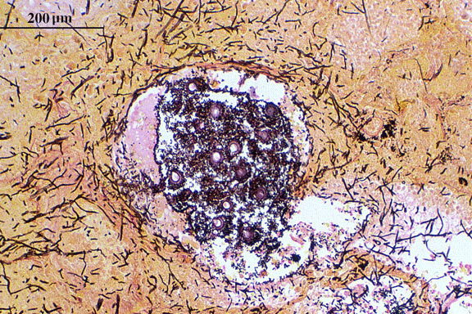
Clinical types
Pulmonary Aspergillosis
3 categories depending upon whether the host is atopic or immunocompromised.
Allergic aspergillosis
  Aspergillus asthma
    Atopic individuals
    Inhalation of spores

Slide 12
Allergic bronchopulmonary aspergillosis(ABPA)
  Repeated & heavy exposure to spores
  Breathlessness, fever & malaise
Obstructive aspergillosis
  Plugs of entangled mycelia & mucus block segments of lung tissue & even entire lobe.
  Productive cough: contains aspergillus hyphae.

Slide 13
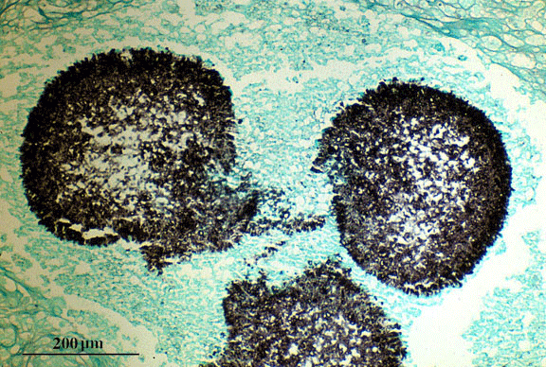
B. Aspergilloma
Non invasive
Colonization in a pre- existing cavity (tubercular)
Compact mass of fungal mycelia surrounded by dense fibrous walls : FUNGUS BALL
Usually solitary 8-10 cm
C. Invasive Aspergillosis
Important cause of morbidity & mortality
May disseminate to kidneys & brain.

Slide 14
Extrapulmonary Aspergillosis – CNS, Paranasal sinus, skin, endocardium (in prior cardiac surgery)
Miscellaneous forms
  Eye (oculomycosis)
  Ear (otomycosis)
  Nails (onychomycosis)

Slide 15
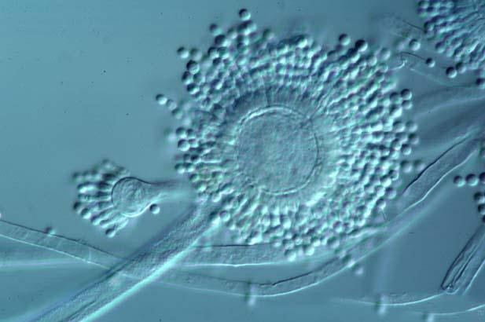
Laboratory Diagnosis
Common lab contaminant – hence repeated isolation from
specimen is mandatory.
Specimen – sputum, BAL, tracheobronchial biopsy.
Direct Examination
Wet mount – 10% KOH, CFW
- hyaline, septate hypha, 3-6μ with acute angled (45º)
branching.

Slide 16
Fungal Culture
SDA - Grows easily & quickly on routine media.
Identification of species by induction of sporulation on special media :
  Czapek Dox agar
  2% malt extract agar
Colony characteristics & the morphology help in
identifying the species.

Slide 17
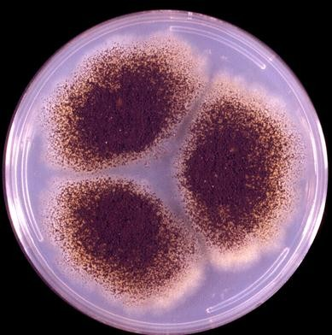
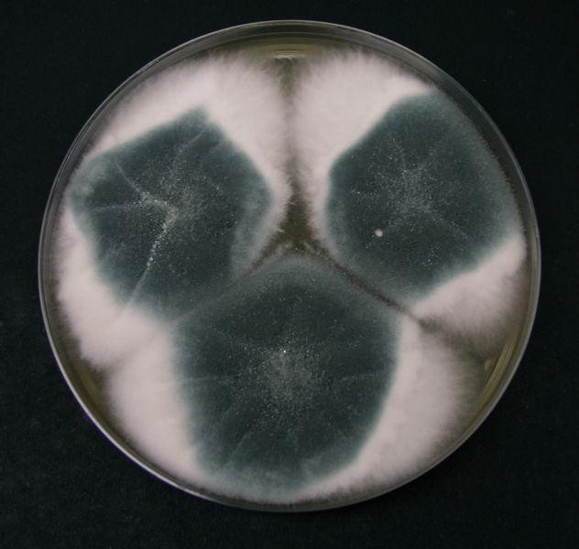
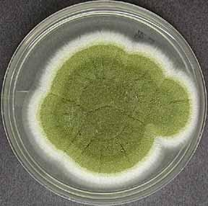
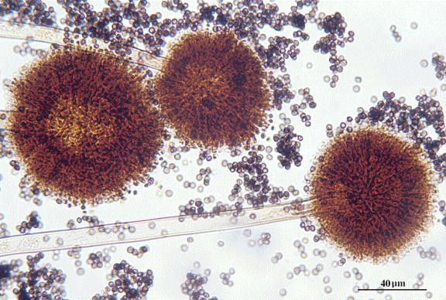
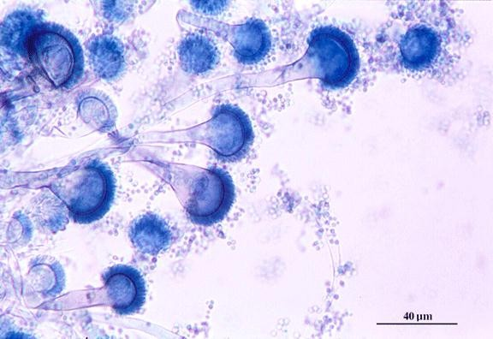
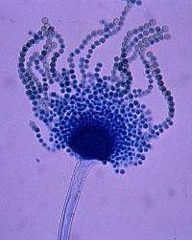
Aspergillus – Cultural characteristics
A.niger
A.fumigatus
A.flavus

Slide 18
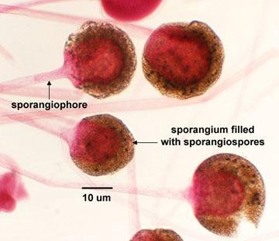
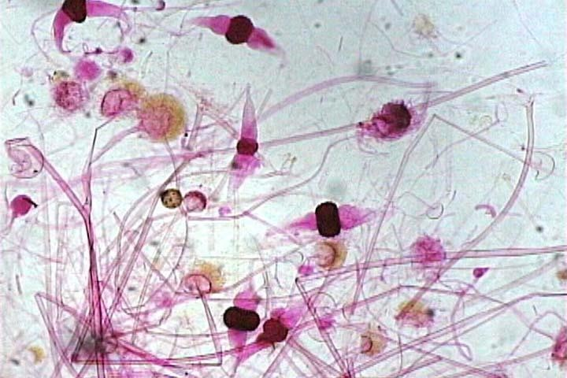
MUCORMYCOSIS
fungi –
Invasive disease caused by lower Zygomycetes
Found in food items, soil & air.
Common lab contaminants
Reproduction
Asexual – Sporangiospores within sporangium.
Sexual – single, dark thick walled spores called Zygospores.
1.
2.

Slide 19
Introduction
Includes following genera
Mucor
Rhizopus
Absidia
Rhizomucor
distinguished on the basis of morphology.
Usually occurs in diabetic patients with ketoacidosis.
* high glucose & acidotic condition favours their growth.

Slide 20
Clinical types
1° infection occurs in URT or nose by inhalation
Rhinocerebral – commonest, fulminant type
Nasal mucosa
– Turbinate bones
Paranasal sinus
Orbit, Palate & Brain
Pulmonary
Cutaneous
Disseminated – lungs, kidney, brain, heart & GIT.

Slide 21
Laboratory Diagnosis
Specimen – nasal discharge, sputum, biopsy
Direct Examination
KOH – irregular broad, aseptate ribbon like hyphae with
wide angle (90º) branching at irregular intervals.
Special stains – must
- HE, GMS

Slide 22
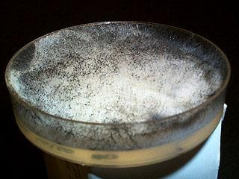
Fungal Culture
Cottony, dense & floccose colony.
LPCB mount – for microscopic details & species identification.

Slide 23
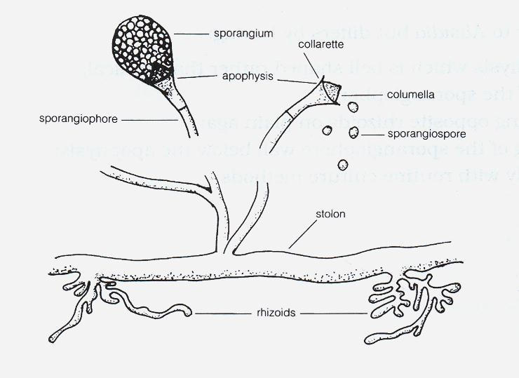
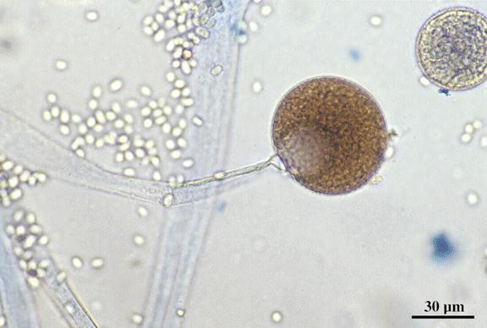




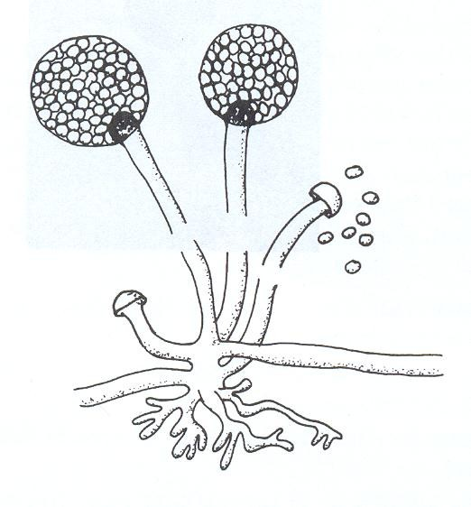

MUCOR
ABSIDIA
RHIZOPUS

Slide 24
Treatment & Prophylaxis
A life threatening condition
4 concomitant approaches :
  Rapid correction of underlying predisposing conditions like diabetic ketoacidosis.
  Surgical debridement of necrotizing tissue.
  Antifungals (not azoles)
  Adjunctive therapy with hyperbaric oxygen.
Ideal treatment = surgical debridement + I.V. AMB

Slide 25
PENICILLIOSIS
Caused by Penicillium marneffei, a dimorphic facultative
intracellular fungi.
Only species of genus Penicillium which causes
infection.
3rd most common AIDS - related opportunistic infection
after TB & Cryptococcosis.

Slide 26
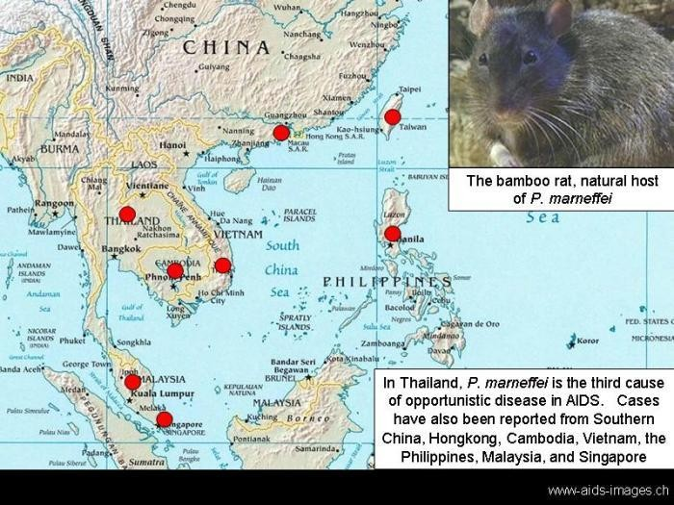
Epidemiology
Route of transmission
  Inhalation of conidia
  Ingestion (eating rats, China)
  Direct inoculation of skin.
Bamboo rat harbors P. marneffei in their internal organs.
Isolated from
  feces
  soil samples from their burrows.

Slide 27
Pathogenesis & Pathology
RES is the 1⁰ site of infection.
3 histologic patterns of disease:
  Granulomatous – granulomas
  Suppurative – multiple abscesses
- lungs, skin & subcutaneous tissue of immunocompetent individuals.
  Necrotizing - immunocompromised pt.

Slide 28
Laboratory diagnosis
Clinical diagnosis difficult as symptoms are very similar
to other fungal pathogens like H.capsulatum
Presumptive diagnosis
  yeast forms with cross- walls in biopsy.
  CD4+count < 50 cells /mm³
Definitive diagnosis : direct demonstration & isolation of
organisms in culture

Slide 29
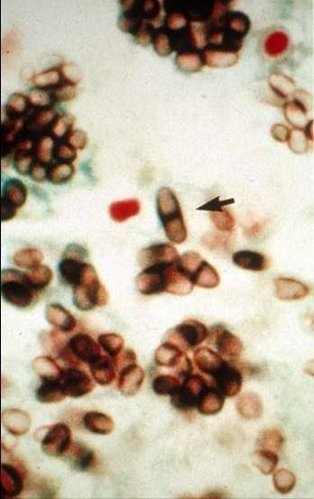
Direct Examination
Wrights‟s, Giemsa stain of skin,
biopsies – septate yeast like cells.
Tissues – PAS, GMS
Peripheral blood smears – AIDS
patient.

Slide 30
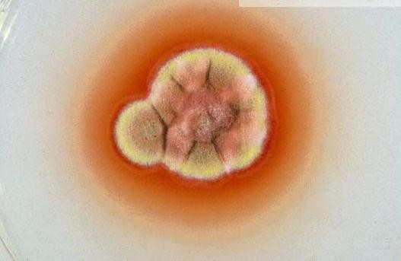
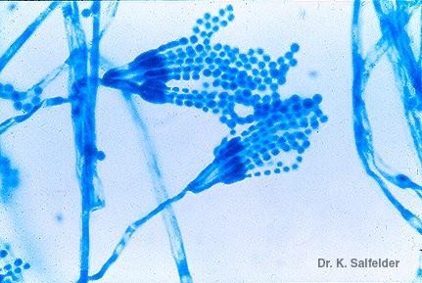
Fungal Culture
Isolated from blood, skin, BM, sputum, LNs, pleural fluid, urine & BAL
SDA & BA at 25⁰C : woolly pigmented colonies, reverse is bright rose color.
Microscopy:- short, septate hyphae with branching.
- Brush like conidiophores bearing
conidia.

Slide 31
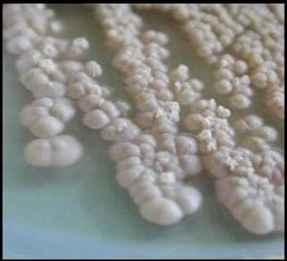
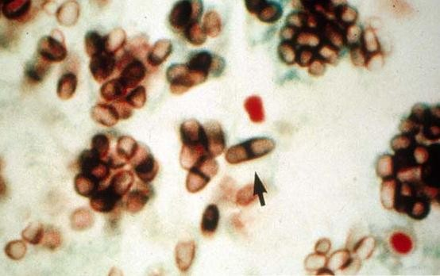
Culture
At 37⁰ C - SDA, BHIA, 5% sheep BA & Pine‟s medium
Colony – white chalk like LPCB – pleomorphic yeast cells with transverse septa.
Treatment - Amphotericin B & Itraconozole

Slide 32
PNEUMOCYSTOSIS
Infection by inhalation of droplet nuclei
– leads to
interstitial cell pneumonia, primarily involves alveoli.
Caused by Pneumocystis carinii, a unicellular eukaryote.
Initially it was considered as a protozoa but now considered as a fungi - shares biological features of both groups fungi & protozoa.

Slide 33
Features of Pneumocystis carinii
Stained with the fungal stains like GMS.
Does not grow on fungal culture media but requires
tissue culture or cell lines.
Susceptible to anti-protozoan agents like Pentamidine & TMP-SMZ.
Insensitive to antifungals because of lack of ergosterols.
Produces chitin.
Cyst wall ultrastructure similar to Ascomycetes.
Hence classified as “Atypical” fungus.

Slide 34
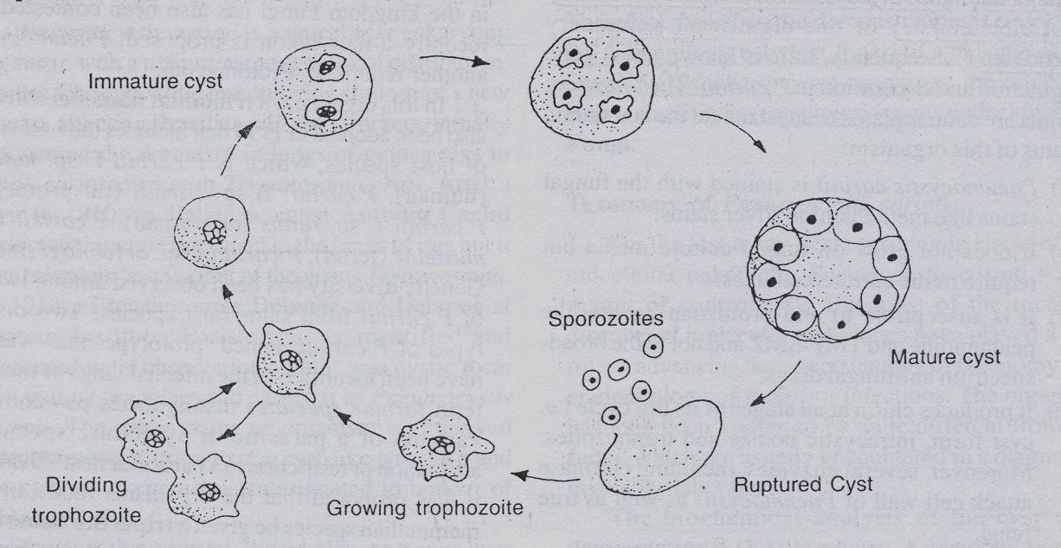
Life Cycle
Divided into 3 stages :
  Trophozoite (asexual): fill the alveoli
  Cyst (sexual)
  Sporozoite (Intracystic body)
The transition phase between trophic & cystic stage is
called Precyst (SPOROCYST)

Slide 35
Clinical features
Incubation period : 4 to 8 weeks.
Pulmonary manifestations – non productive cough, dyspnoea, fever, 2⁰ infections, cyanosis (late sign)
Extrapulmonary manifestations – in advance HIV infection
- LNs, BM, spleen, liver, stomach, small intestine, pancreas, thyroid & eyes.
- CNS (late complication of AIDS)

Slide 36
Radiodiagnosis
„Ground – glass‟ OR Honey comb like appearance – classical finding in PCP.
Laboratory diagnosis
CD4+ count < 200 cells / mm³
Clinical specimen – sputum, BAL or lung biopsy.

Slide 37
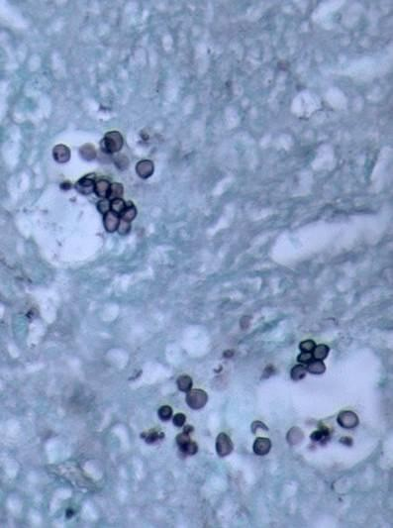
Direct Examination
Selective stains – GMS,
Toluidine blue.
Lung biopsy - frothy edema fluid in alveoli.
Immunofluorescence

Slide 38
Culture
Cannot be cultured on fungal media.
Requires tissue culture :
  A- 549, a continuous cell line derived from human lung adenocarcinoma cells.
  Human embryonic lung fibroblasts (WI- 38)

Slide 39
Treatment & Prophylaxis
Combination of TMP & SMZ I.V. – drug of choice
Pentamidine Isothionate I.V. – who cannot tolerate TMP- SMZ.
Dapsone

Slide 40
Miscellaneous Mycoses
Oculomycoses
Fungal disease of eye. Can be :
  Mycotic keratitis – follows corneal trauma, overuse of corticosteroids.
  Endophthalmitis
  Infections of ocular adnexa
Causative agents – Aspergillus, Fusarium, C. albicans
Treatment : Local – AMB, Nystatin

Slide 41
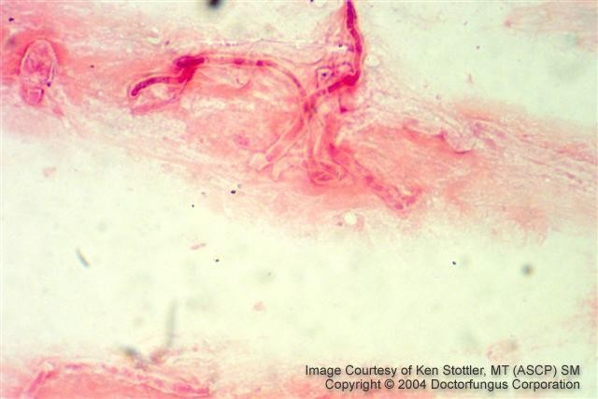
A picture of a Gram stain of scrapings from a corneal ulcer. This was from a farmer who had a piece of vegetable matter embedded in his cornea. The culture grew a pure culture of Aspergillus fumigatus.

Slide 42
Otomycoses
External ear.
Usually caused by Aspergillus species.
Secondary to bacterial infection, injury or excessive
accumulation of cerumen (wax).

Slide 43
Mycotic Poisoning
2 types :
1. Mycetism – fungus which is eaten, itself causes toxic effects.
- GI disease, dermatitis or death.
e.g. Psilocybe species
2. Mycotoxicosis – food contaminated by fungal toxins.
- “Aflatoxin” produced by A.flavus.

Slide 44
ANTIFUNGAL AGENTS
Ergosterol – present in the cytoplasmic membrane of only fungi.
  most important site of action of most antifungals.
Classification
  Antifungal antibiotics
  Synthetic antifungals
  Miscellaneous antifungals

