Slide 1
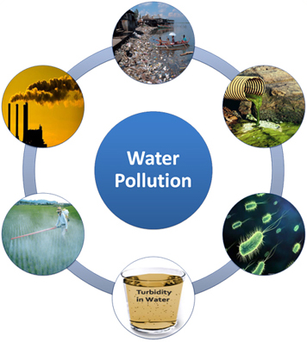
Water
Lecture 3

Slide 2
Objectives
Chemical and physical properties of water.
Sources of water.
Water cycle.
Types and sources of water pollution.
Processing drinking water.
Environmental hazards from water pollution.

Slide 3
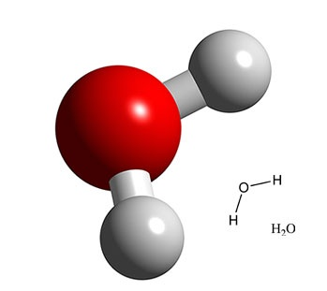
Introduction
What is water?
Humans may not survive more than three (3) days without water.
Dehydration
2% – thirst.
5% – fatigue, nausea, headache.
10-15% – muscle spasms, delirium.
> 15% – death.
Compound made up of 2 atoms of hydrogen and one atom of oxygen (H₂O).
Gas, liquid and solid state.
Essential for life on earth.
Biochemical reactions.
Water in oceans and lakes holds heat and helps to control earth’s temperature.

Slide 4
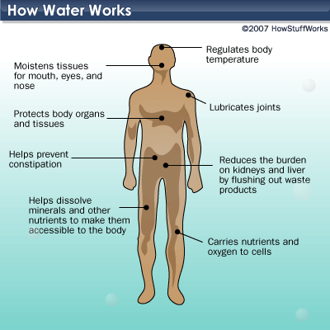
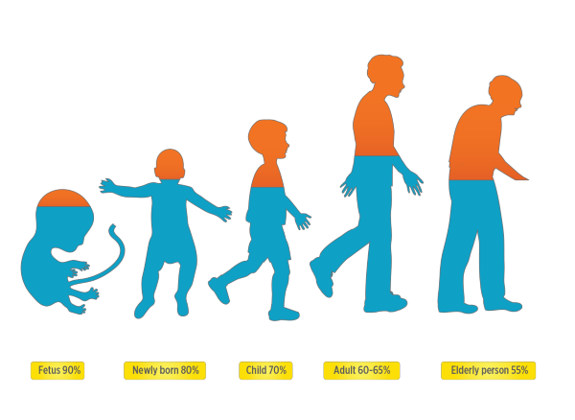

Slide 5
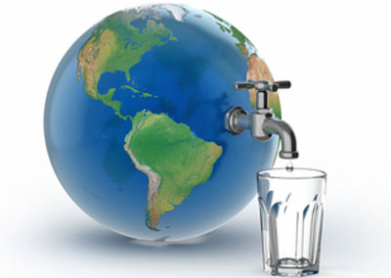
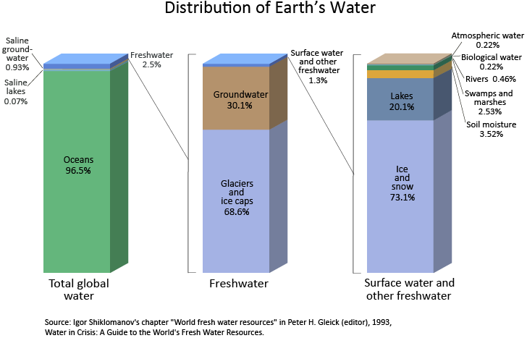
Introduction
Water facts
2/3 of earth’s surface covered by water
Only ~3% is fresh water
~ 30% of it is underground water.
~ 1% is in the atmosphere.
~0.3% is in rivers and lakes.
The rest is in the form of ice.
Middlecamp CH et al.Chemistry in Context: Applying Chemistry to Society. 7th Edition. McGrawHill. 2012

Slide 6
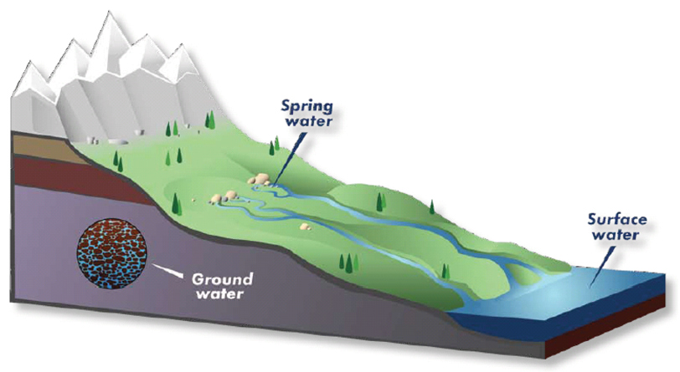
Sources of water
Surface water – fresh water from rivers, lakes, streams.
Ground water – sweet water in aquifers.
Sea water – salty water that needs desalination before use.
Ice caps and glaciers – frozen water.
In Saudi Arabia, supplies of fossil ground water in aquifers have been rapidly depleted.
Desalination of sea water to convert sea water into fresh drinkable water.
Middlecamp CH et al.Chemistry in Context: Applying Chemistry to Society. 7th Edition. McGrawHill. 2012

Slide 7
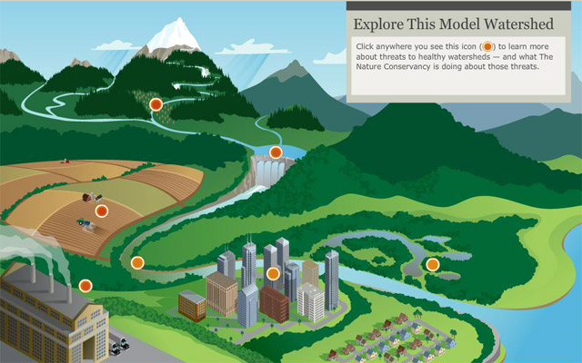
Watershed
Watershed: carries water "shed" from the land after rain falls and snow melts.
Stream, lake, wetland, the ocean.
Supplies water for drinking, agriculture, manufacturing, recreation and the habitat to plants and animals.
http://water.epa.gov/type/watersheds/whatis.cfm What is a watershed?
http://www.nature.org/ourinitiatives/regions/northamerica/unitedstates/indiana/journeywithnature/watersheds-101.xml

Slide 8
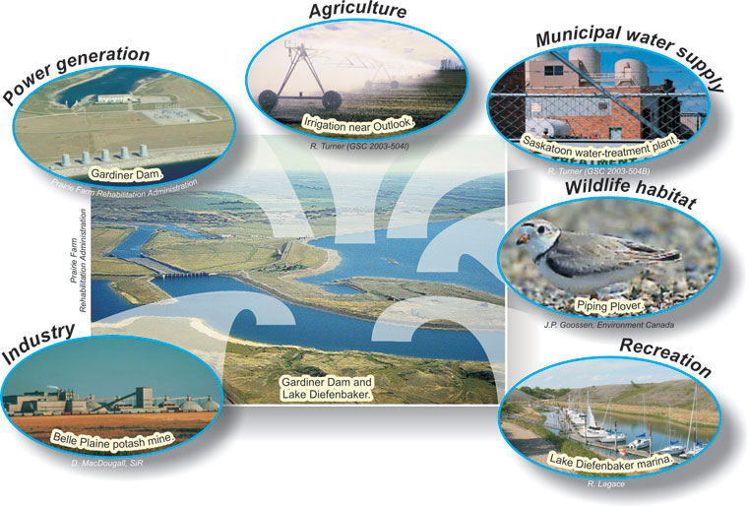
Uses of water
Domestic – drinking, cooking, cleaning.
Public use – parks, fire-fighting.
Agricultural – crop irrigation.
Recreational – lakes, rivers.
Industrial – energy, cooling, heating.
Environmental – habitat for fauna and flora.

Slide 9
Water cycle
https://www.youtube.com/watch?v=9pqh6tlEOhs

Slide 10
Factors affecting the water cycle
Natural factors
A particle of water make take from a few days to thousands of years to complete the water cycle.
Trapped water – underground or in glaciers.
Needs to get back into the atmosphere.
Seasons.
Winter and trees losing their leaves – very little transpiration.
Air temperature.
Changes affect the rate of water evaporation, transpiration.
Evaporation and transpiration increase with air temperature.

Slide 11
Factors affecting the water cycle
Vegetation
Environment determines the type of vegetation and the rate of transpiration.
Desert plants transpire little to save water.
Amount of sunshine
Sun provides the energy to naturally evaporate water.
Desert areas have a lot of sunshine and high rates of evaporation.
Landscape (geography)
Run-off and percolation change with soil type a geography of terrain.
Precipitation (rain) is higher in hills and mountains than in lower areas.

Slide 12
Factors affecting the water cycle
Humidity
Amount of water vapor in the air.
Evaporation decreases when the air has high humidity.

Slide 13
Factors affecting the water cycle
Global climate changes
Affect the water cycle, environment and living organisms.
Excess rain, storms and floods and water contamination and scarcity.
Drought.
Melting glaciers.
Reduced precipitation in mountain tops, means no ice in winter, and no lakes or rivers in the summer.
Change animal patterns of migration.
Infectious diseases outbreaks.

Slide 14
Water pollution
Presence of substances not normally found in water and that can be harmful to living organisms.
Chemical, physical, radioactive, pathogenic substances.
Natural or man-made.
Degree of pollution has to do with the quantity of pollutant in the water.
Following the use of water, water needs disposal, recycling, and possibly reusing.
Wastewater treatment/disposal and public health.
Natural water cycles and water purification take a long time.

Slide 15
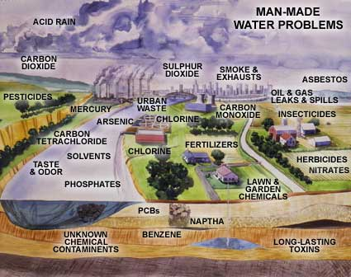
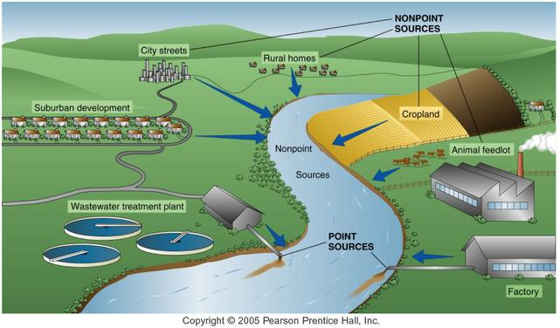
Sources of water pollution
Natural and man-made
Point and Non-Point Sources

Slide 16
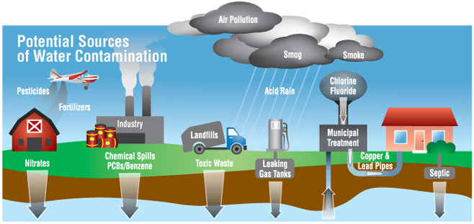
Causes of water pollution
Industrial and agricultural waste
Radioactive waste
Oil pollution/spills
Solid waste (any garbage)
Sewage/waste water
Global warming

Slide 17
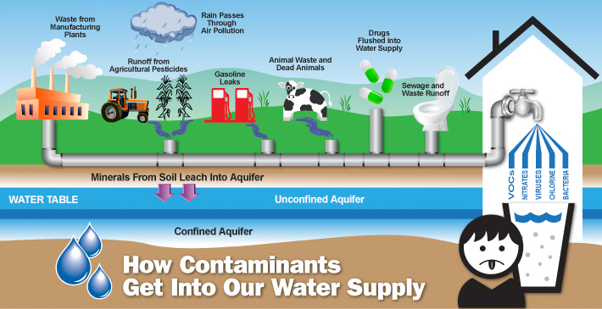
Types of Water Pollution
Chemical pollution
Sources
Household
Drugs, antibiotics dumped in sewage.
Cleaning chemicals.
Food waste.
Agriculture
Pesticides, herbicides, fertilizers
Radioactive materials from phosphate rock-made fertilizers.
The Encyclopedia of Earth. Water pollution. http://www.eoearth.org/view/article/156920/

Slide 18
Types of Water Pollutants
Chemical pollution
Water and sewage treatment.
Chlorinated organic molecules from sewage and water treatment.
Landfill (site of disposal waste).
Industrial
Runoffs, oil spills.
Heavy metals from mining.
Chemicals from manufacturing.
Radioactive materials from nuclear power plants.
The Encyclopedia of Earth. Water pollution. http://www.eoearth.org/view/article/156920/

Slide 19
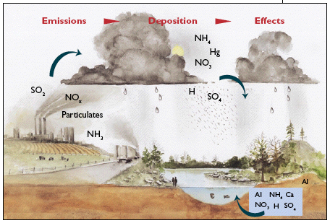
Types of Water Pollution
Acid Rain
Sulfur dioxide (SO₂) and nitrogen oxides (NO_{x}) react in the atmosphere with water, oxygen, and other chemicals to form a mild solution of sulfuric acid and nitric acid.
Natural sources – volcanoes and decaying vegetation.
Man-made sources – emissions from fossil fuel combustion.
It includes any form of precipitation with acids.
Acid rain increases acidity and aluminum content in lakes and streams in a watershed.
Harm to biodiversity.
Toxic to fish and other aquatic life.
http://www3.epa.gov/acidrain/effects/surface_water.html

Slide 20
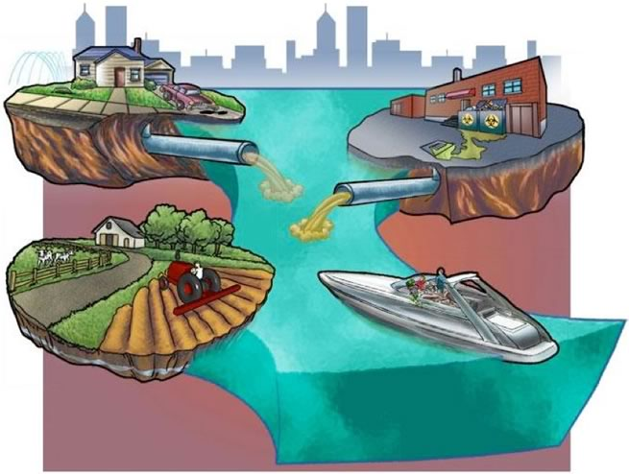
Types of Water Pollution
Physical pollution
Temperature changes
Heat, steam from industrial activities (point source).
Solid debris
Vegetation, animal or human waste.
Excessive sediment (dirt) load from farming, construction, gardening.
Solid waste from human activity (plastic bags, bottles, construction).
Three big pollutants. http://water.epa.gov/learn/resources/bigpollutants.cfm

Slide 21
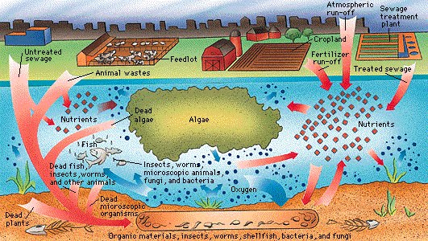
Types of Water Pollution
Nutrient pollution
Nitrogen, phosphorus.
Fertilizers from farms and gardens.
Animal waste.
Detergents.
Effect on the environment
Death of aquatic life.
Interfere with water treatment.
The Encyclopedia of Earth. Water pollution. http://www.eoearth.org/view/article/156920/

Slide 22
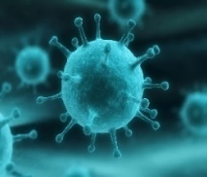
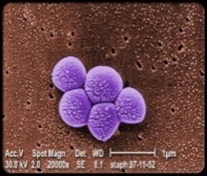
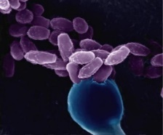
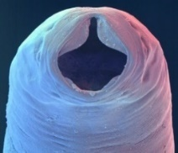
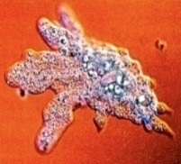
Types of Water Pollution
Microbial pollution
Common waterborne pathogens
Protozoa, bacteria, viruses, fungi.
Untreated sewage, surface runoff.
Landfill and dump runoff.
Animal waste from farms.
Entamoeba histolytica – protozoa.
Salmonella, Shigella, E. coli, Vibrio cholerae – bacteria.
Usually associated with fecal contamination of water.
Influenza virus
Staph Aureus
Fungi
Hookworm
Amoeba
Three big pollutants. http://water.epa.gov/learn/resources/bigpollutants.cfm

Slide 23
Water Pollution and waterborne disease
Transmitted by contaminated water carrying the infective agent.
Gastroenteritis – diarrhea, cramps, nausea, vomiting.
Life-threatening for the young, the elderly, pregnant women and the immunocompromised.
Amebiasis – caused by the parasite Entamoeba histolytica.
Amoeba produces cysts that are carried in feces.
intestinal infections.
Giardiasis and Cryptosporidiosis – caused by parasites in animal and human feces.
Especially at risk are the immunocompromised.
Diarrhea, cramps, headache.
Chlorine destroys Giardia but not Cryptosporidium.
Boiling water for >1minute will destroy these and other pathogens.

Slide 24
Water Pollution and waterborne disease
Legionnaire’s disease
Lung infections – pneumonia.
High fever, cough, chest pain, abdominal pain and diarrhea.
Contaminated aerosol particles from home water systems, cooling systems and stagnant water.
Some protozoa (amoebas) serve as host for the bacteria.
Naegleria fowleri
‘Brain-eating’ amoeba.
Normally harmless and found in warm freshwater lakes and in soil.
Can infect the brain via the nasal passages, breaking down nerve cells.
Tap water, saline solutions.

Slide 25
Water consumption
Maximum contaminant level goal (MCLG) – ideal situation.
Maximum level of a contaminant in drinking water at which no known or anticipated adverse effect on human health would occur.
For known carcinogens the goal is zero, because any small amount is considered a risk.
Maximum contaminant level (MCL) – real situation.
It is the legal limit for the concentration of a contaminant in drinking water.
Set as close as possible to the MCLG considering the practicality of it.
Most MCL are the same as MCLG, except for carcinogens.
Chemistry in Context: Applying Chemistry to Society. 7th Edition. Middlecamp C et al.. McGrawHill. 2012

Slide 26
Water consumption
Some contaminants can affect liver, kidney function, or the nervous system.
Lead is particularly harmful to children, accumulate in bone and brain, affecting brain and neural development.
Industrial waste.
Lead pipes and lead-lined tanks in water coolers.
Making water safe to drink
Whether water is safe to drink or not depends on:
What is in the water.
How much of it is in the water.
How much water someone drinks in a day.
Contaminants harmful to human health have legal limits according to their toxicity.
Limits take into account the technology available for removal.

Slide 27
Water consumption
Radionuclides
Alpha and beta particles, radium and uranium.
Biological agents
Cryptosporidium, Giardia, Legionella, fecal coliforms (E. coli) and intestinal viruses.
Disinfectants
Chloramines, chlorine, chlorine dioxide.
Disinfection byproducts
Bromate, chlorite, haloacetic acids, trihalomethanes.
Contaminants regulated in drinking water
Inorganic chemicals
Heavy metals – copper, cadmium, chromium, mercury, lead.
Non-metal ions – nitrate, fluoride, arsenic.
Organic chemicals
Pesticides, solvents, and compounds for plastics manufacturing.
http://www.epa.gov/your-drinking-water/table-regulated-drinking-water-contaminants

Slide 28
Contaminants in drinking water
Water disinfectants
Chloramines
Eye/nose irritation, stomach problems, anemia.
Chlorine
Eye/nose irritation, stomach problems.
Chlorine dioxide
Anemia, CNS problems in infants and children.
Water disinfection byproducts
Bromate
Increased cancer risk.
Chlorite
Anemia and CNS problems in infants and children.
Haloacetic acids and Total triahalomethanes (TTHMs).
Increased cancer risk.
TTHMs – liver, kidney or CNS.
Drinking Water Contaminants. http://water.epa.gov/drink/contaminants/#List

Slide 29
Secondary drinking water contaminants
Contaminant | Secondary MCL | Noticeable Effects above the Secondary MCL
Aluminum | 0.05 to 0.2 mg/L* | colored water
Chloride | 250 mg/L | salty taste
Color | 15 color units | visible tint
Copper | 1.0 mg/L | metallic taste; blue-green staining
Corrosivity | Non-corrosive | metallic taste; corroded pipes/ fixtures staining
Fluoride | 2.0 mg/L | tooth discoloration
Foaming agents | 0.5 mg/L | frothy, cloudy; bitter taste; odor
Iron | 0.3 mg/L | rusty color; sediment; metallic taste; reddish or orange staining
Manganese | 0.05 mg/L | black to brown color; black staining; bitter metallic taste
Odor | 3 TON (threshold odor number) | "rotten-egg", musty or chemical smell
pH | 6.5 - 8.5 | low pH: bitter metallic taste; corrosion high pH: slippery feel; soda taste; deposits
Silver | 0.1 mg/L | skin discoloration; graying of the white part of the eye
Sulfate | 250 mg/L | salty taste
Total Dissolved Solids (TDS) | 500 mg/L | hardness; deposits; colored water; staining; salty taste
Zinc | 5 mg/L | metallic taste
Non-mandatory standards established only as guidelines to assist public water systems in managing their drinking water for taste, color, and odor.
These contaminants are not considered a risk to health.
Problems related to secondary contaminants
Aesthetic — taste, color or odor.
Cosmetic — skin or teeth discoloration.
Technical — damage to water equipment or reduced effectiveness of treatment.

Slide 30
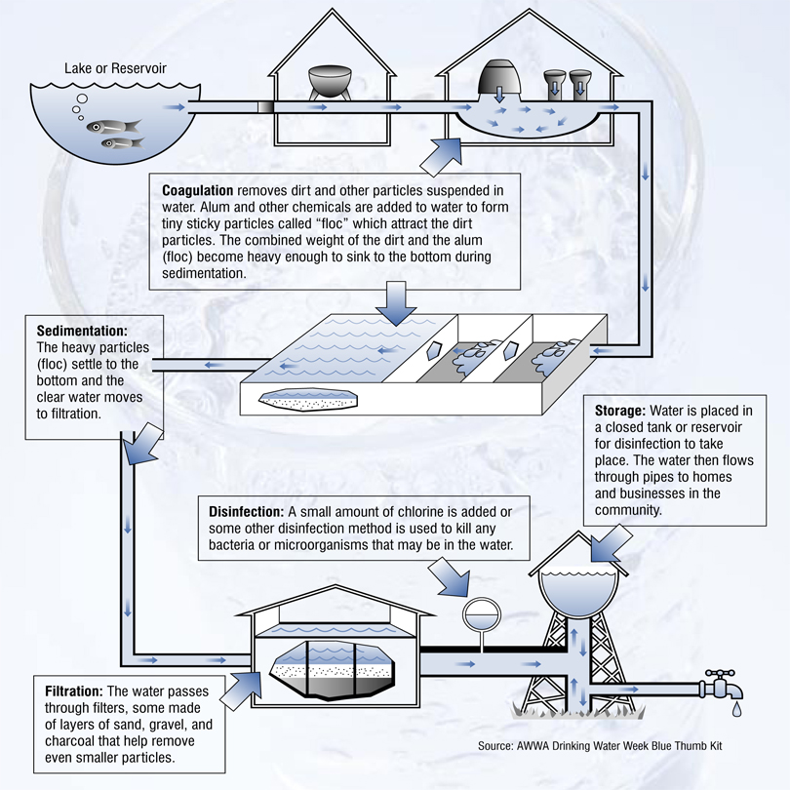
Treating drinking water
1. Water purification
Screen-removal of debris.
Plant material, garbage.
Coagulation and Flocculation.
Addition of aluminum sulfate and calcium hydroxide to form a gel that collects suspended dirt particles.
Sedimentation.
Particles settle at the bottom.
Filtration.
Charcoal or gravel, and sand.
Disinfection
Kill disease-causing microbes.
Additional steps
Spraying the water in the air to remove volatile compounds.
Adding fluoride.

Slide 31
Treating drinking water
2. Disinfection
Toxicity concerns
Chlorine-containing compounds that remain after disinfection.
Gases that keep the water form getting contaminated during transport.
Chlorine can react with organic matter in drinking water forming toxic compounds.
Trihalomethanes – chlorine, bromine.
A. Chlorine
Kills microorganisms by direct contact.
Cannot kill bacteria or viruses inside dirt particles.
Dirt particles must be removed before chlorination.

Slide 32
Treating drinking water
Disinfection
B. Ozone treatment
O₃ can kill bacteria when used for water disinfection.
Advantages
Smaller amounts of O₃ compared to chlorine are used.
More effective against viruses than chlorine.
Disadvantages
Expensive to treat small amounts of water.
Ozone decomposes quickly and water can get contaminated during transport.
Small amount of chlorine is added to ozonated water before leaving the treatment plant.

Slide 33
Treating drinking water
Disinfection
C. Ultraviolet light
UV-C light that can breakdown nucleic acids and DNA in microorganisms like bacteria, viruses, molds, parasites.
Advantages
Fast, inexpensive, can be used in a small scale.
Rural homes with unsafe well water.
Disadvantages
It does not destroy microbes hidden inside suspended particles.
Water can get contaminated after leaving the treatment plant.

Slide 34
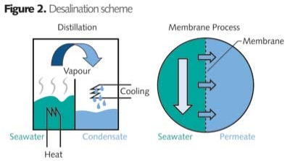
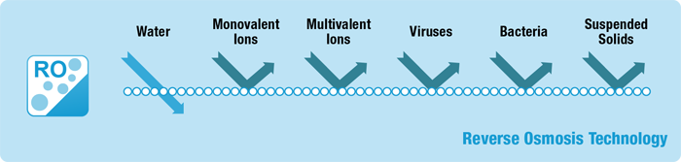
Water Desalination
Removal of the sodium and chloride ions from the water.
Sea water has high salt content (3.5%).
Distillation – heating sea water, and condensing and collecting the vapor.
Energy-consuming process (-).
The heat purifies the water (+).
Reverse osmosis – membranes and pressure to separate the sodium and chlorine ions from the water.

Slide 35
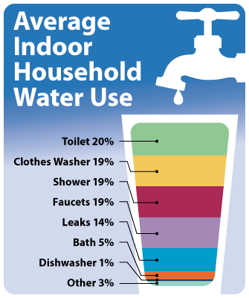
Prevention of water pollution and waste
Conserve water.
Turn off the tap when running water is not necessary.
Cut down water spent on household cleaning.
Mind the waste that goes down the drains.
Reduce use of household chemicals.
Cleaning and personal use.
Pesticides and fertilizers.

Slide 36
Consequences of water pollution
Harm to living organisms - long-term and short-term exposure.
Industrial waste and heavy metals
Toxic to immune system, reproductive system, liver, kidneys, developmental problems, cancer.
Acid rain
Harm to aquatic life.
Microbial pollutants from sewage.
Waterborne infectious diseases.
Cholera and typhoid fever.
Suspended particles in freshwater affect the quality of drinking water for humans and the environment for aquatic life.
Can reduce the amount of sunlight penetrating the water, disrupting the growth of photosynthetic plants and micro-organisms.

Slide 37
References
Frumkin H. Environmental Health: From Global to Local. 2nd Ed. Jossey-BSS, Wiley Imprint. 2010.
Middlecamp CH et al. Chemistry in Context: Applying Chemistry to Society. 7th Edition. McGrawHill. 2012.
The Encyclopedia of Earth. Water pollution. http://www.eoearth.org
The water cycle. http://www.futuresparks.org.au/media/20852/pearson_science_7_sb_chapter_3_unit_3.3.pdf
USGS. Summary of the water cycle. http://water.usgs.gov/edu/watercyclesummary.html
Drinking Water Contaminants. http://water.epa.gov/drink/contaminants/#List
Water: drinking water. http://water.epa.gov/drink/
Penn State Extension. Lead in drinking water. http://extension.psu.edu/natural-resources/water/drinking-water/water-testing/pollutants/lead-in-drinking-water Based on Lead in Drinking Water, 1994, by Bryan Swistock and William Sharpe. Updated January 2016 by Amy Galford and Bryan Swistock.

Slide 38
Reading (optional)
http://waterandme.tamu.edu/WaterPollution/waterpollution.pdf

Slide 39


Slide 40
Thank you!

