Slide 1
Spectrophotometric Methods for Determination of Proteins Concentration
Lab# 3
BCH 333 [practical]

Slide 2
Objectives:
Getting familiar with how to determine protein concentration using three spectrophotometric methods:
Bicinchoninic acid (BCA, Smith) Method.
Bradford Method.
Biuret test.
Warburg-Christian Method ( A280/ A260 Method).

Slide 3
Qualitative test:
Refers to descriptions or distinctions based on some quality or characteristic rather than on some quantity or measured value. It can be a form of analysis that yields the identity of a compound.
Quantitative:
Refers to a type of information based in quantities or else quantifiable data.

Slide 4
-In this lab, three of these methods will be studied. Two are newer methods which are widely used and one is an older method.
- In the newer methods chemical reagents are added to the protein solutions to develop a color whose intensity is measured in a spectrophotometer.[BCA and Bradford Method ]
- The third method relies on direct spectrophotometric measurement.
[( A280/ A260 Method)].

Slide 5
1.Bicinchoninic acid (BCA, Smith) Method:
-The method has a high sensitivity, as low as 1 μg protein can be detected.
-Slow.
Principle:
The purple color resulting from this method is due to:
A] The nitrogens in peptide bonds in protein, reduce Cu²⁺ ions → to Cu⁺
(a temperature dependent reaction) under alkaline conditions. [reduction reaction].
B] (Cu+), chelated by two molecules of BCA, to produce a (copper-BCA complex) [purple color] with maximum absorption (λmax) of 562 nm.
concentration

Slide 6
STEP 1. (A)
Figure-1: Principle of BCA Method
OH⁻
Cu⁺
Cu⁺²
STEP 2. (B)
Cu⁺

Slide 7
2.Bradford Method:
-This method is based on protein binding of a dye to arginine residues and aromatic amino acid.
-Fast, accurate and high sensitivity [1 μg protein can be detected].
-The method is recommended for general use, especially for determining protein content of cell fractions and assessing protein concentrations for gel electrophoresis, about 1- 20 μg protein for micro assay or 20-200μg protein for macro assay.

Slide 8
Principle:
-Binding of the dye Coomassie Brilliant Blue G-250 to protein in acidic solution, causes a shift in wavelength of maximum absorption (λmax) of the dye from 465nm to 595nm.
-Both hydrophobic and ionic interactions stabilize the anionic form of the dye, causing a visible color change.
-The absorbance at 595nm is directly proportional to the concentration of the protein. [The color is stable for one hour.]

Slide 9
Figure-2: Principle of Bradford Method

Slide 10
Test tubes containing:
Bradford reagent alone.
Test tubes containing:
Bradford reagent with protein added.
(λmax) is shifted to 595nm.
(λmax) of the dye 465nm

Slide 11
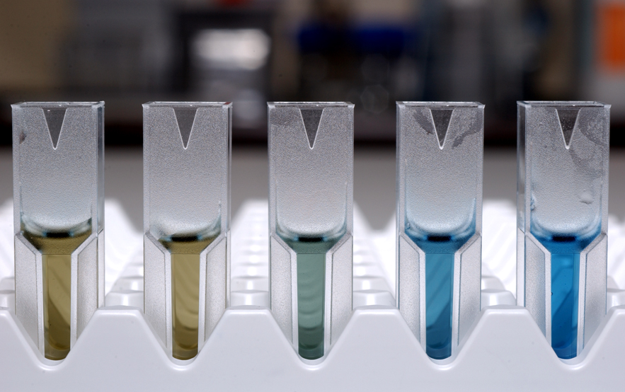

Slide 12
Biuret assay of protein:
The biuret reagent is: alkaline copper sulphate. The biuret reagent reacts with peptides and proteins to give a purple colored Cu2+ - peptide complex.
This colored complex can be measured quantitatively by a spectrophotometer in the visible region. The color obtained is directly proportional to the number of peptide bonds present in the protein.
In this experiment the amount of isolated protein from the skeletal muscle is determined by the biuret assay and from the standard curve of bovine serum albumin (BSA).

Slide 13
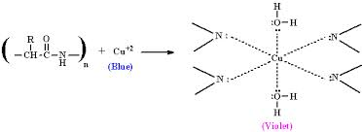
Biuret assay

Slide 14
3.Warburg-Christian Method ( A280/ A260 Method):
Is easy, sensitive and fast. It has a sensitivity of about 0.05- 2.0 mg protein/ml.
It is not accurate.
Principle:
-This method is based on the relative absorbance of proteins and nucleic acids at 280nm and 260nm, respectively.
-Tyrosine and tryptophan residues in a protein absorb in the ultraviolet at 280nm.
-Nucleic acids which contaminate samples interfere with this method. This problem is overcome by the fact that nucleic acids absorb more strongly at 260nm than at 280nm, while the reverse is true for proteins.

Slide 15
-Calculating the unknown concentration of a protein sample, will be as following :
1-[A280 x correction factor =……… mg/ml protein].
A280 =…………………
A260 =…………………
A280/ A260 =…………………
Correction factor =…………………
Unknown concentration =………………… mg/ml
2-Or [groves formula]:
Protein concentration [mg/ml]=[1.55 X A280]-[0.76 X A260]

Slide 16
-A protein solution that has a high A280/A260 ratio: Less contaminated by DNA.
[It shows a low absorbance at 260nm and high absorbance at 280nm].
-A protein solution that has a low A280/A260 ratio: Highly contaminated by DNA.
[It shows a high absorbance at 260nm and low absorbance at 280nm].

