Slide 1
Patient assessment

Slide 2
outlines
Introduction
Scene assessment
Patient assessment:
Primary survey
Secondary survey
Care of unconscious patient:
Emergency care
Long term care

Slide 3
Introduction
Assessment is the cornerstone of excellent patient care.
First goal is to find out patient’s condition.
Urgent intervention must be rapidly initiated.
All conditions needing attention prior to moving patient must be done quickly and efficiently.

Slide 4
Scene assessment
Failure to perform preliminary actions may put your life and your patients at risk.
Assess for hazards, safe to approach victim.
Note mechanism of injury.
Note number of victims.
Note special equipment needed.
Need to additional help.

Slide 5
Patient assessment
A- Primary survey
B- Secondary survey.

Slide 6
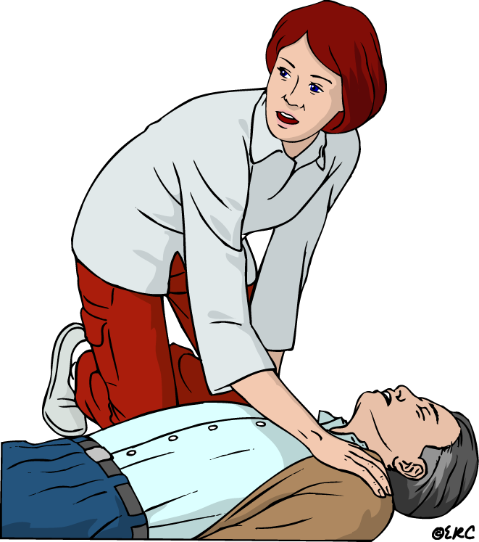
A - Primary survey
Aims to detect life threatening conditions.
Should not take over 2 minutes.
Stress rapid evaluation and movement to hospital with critical patients.
Five steps:
Airway and cervical spine control
Breathing
Circulation and hemorrhage control
Disability (neurological examination)
Expose and examine

Slide 7
1- Airway and cervical spine control
Check patency and no danger of obstruction
Head tilt – chin lift.
When checking airways, attention to cervical injury.
Excessive movement while establishing airways may cause neurological damage to fractured spine.

Slide 8
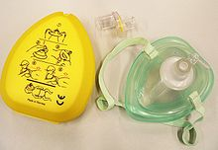
2 - Breathing
Look, listen, feel for adequate breathing.
Absent spontaneous
breathing,
accomplish ventilation .
Conditions compromising breathing:
A- pneumothorax
B- Pulmonary contusion

Slide 9
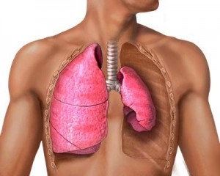

Slide 10
3 - Circulation
Cardiovascular status can be checked by:
A- Pulse:
Assess quality, rate, regularity.
Pulse reveal information about systolic B.P.
Non-palpable radial pulse = systolic BP<80
Non-palpable carotid pulse = systolic BP<60

Slide 11
B- Capillary refill:
Capillary blanch test: assessing peripheral perfusion (nail bed or hypothenar eminence).
In normo-volemic patient, color returns normal within 2 seconds.

Slide 12
4- Disability
Objectives: level of consciousness and neurologic status of patient.
Level of consciousness can be determined by the acronym AVPU
Alert
Verbal stimulus response
Painful stimulus response
Unresponsive

Slide 13
5 – Expose and examine
Expose chest, abdomen and extremities to facilitate thorough examination.
Primary survey is a rapid priority at scene prior to transport.

Slide 14
B – Secondary survey
Objective:
To discover injury-related problems with no immediate threat to survival.
Assessment:
Head – toe evaluation.

Slide 15
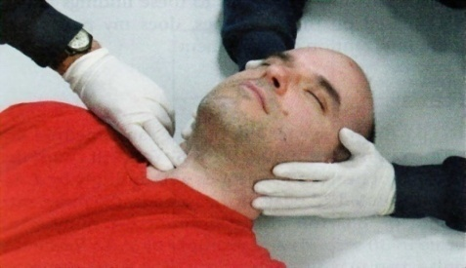
1 - Scalp
Check for lacerations and contusions
Do not move the patient’s head
Gently slide your hand beneath to palpate for blood.
2 – skull
* Palpate for fracture (tenderness or depression)
* Bluish discoloration over mastoid bone (behind ear) indicates probable basilar skull fracture

Slide 16
3 – Ear / nose
Check for discharge of fluid or blood.
Blood from ears is a sign of skull fracture
Clear fluid from nose (CSF) indicates probable skull fracture

Slide 17
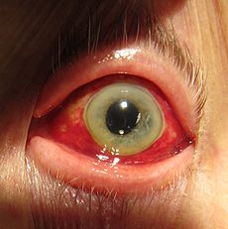
4 – Eyes
Check trauma or swelling about orbit.
Ecchymoses around eyes without evidence of direct trauma indicates probable skull fracture
Check for hemorrhage in sclera

Slide 18
5 – Pupils
Note: size, equality and reaction to light.
Note eye movements, normally conjugate
Dysconjugate gaze indicates head injury
6 – Neck
Gently palpate back of neck for tenderness
If suspecting spinal injury, immobilization of neck should precede all maneuvers.

Slide 19
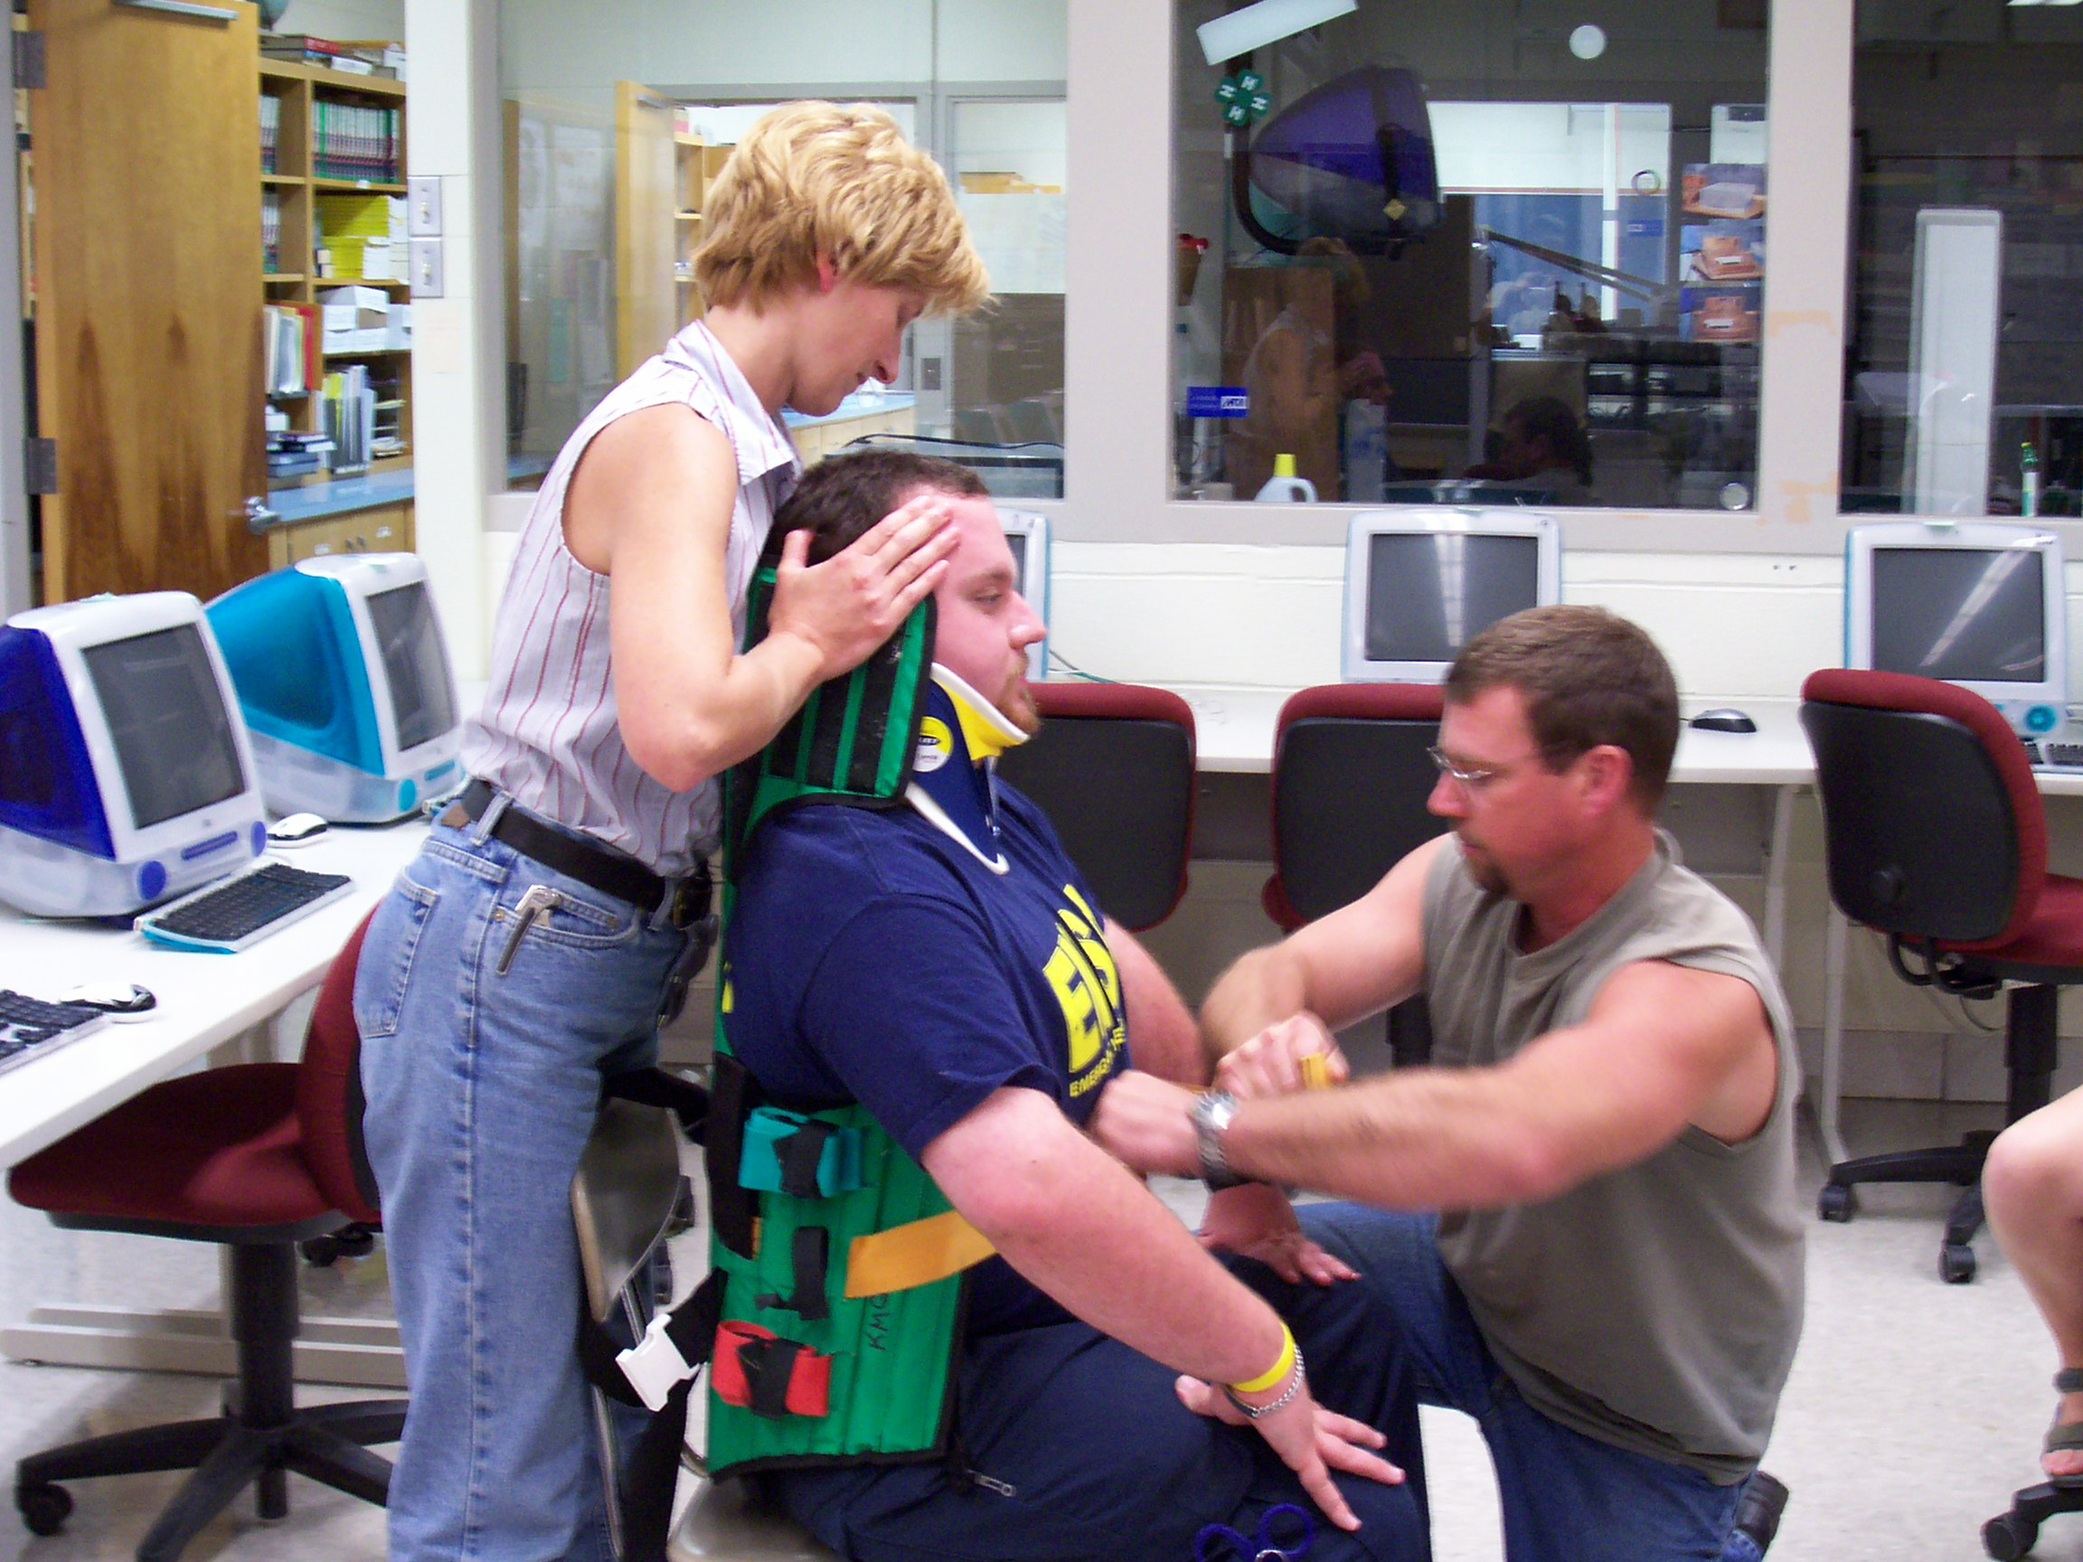

Slide 20
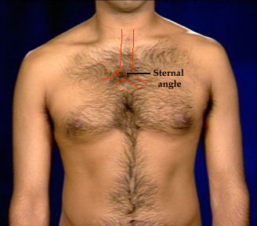
7 - Trachea
Inspect, palpate
normally in midline.

Slide 21
8-chest
Inspect chest anterior and posterior
Observe movements.
Check for contusion or abrasion
Palpate chest cage, each rib and clavicles
Evaluate internal structures (auscultation)
Pneumothorax → sounds at apex
Hemothorax → sounds at base
Cardiac tamponade → distant heart sounds and distended neck veins

Slide 22
9 - Abdomen
Look for signs of blunt or penetrating trauma
Feel for tenderness → internal bleeding
Distended and tender → hemorrhagic shock
10 – Extremities
* Examination starts with clavicle and pelvis then proceeds to distal parts.
Examine for deformity and hematoma.
Palpate for crepitation, tenderness, movement
Suspected fracture → immobilization till X ray

Slide 23
11 – Neurological examination
A- pupil response: unequal pupils indicates cerebral edema or intracranial hemorrhage.
B- eye opening: by stimuli vocal, tactile, pain
C- verbal response:
speech is highest brain function.
Incomprehensible speech indicates brain dysfunction
D- motor response: extremity response indicates brain functions.
Response may be purposeful or not.

Slide 24
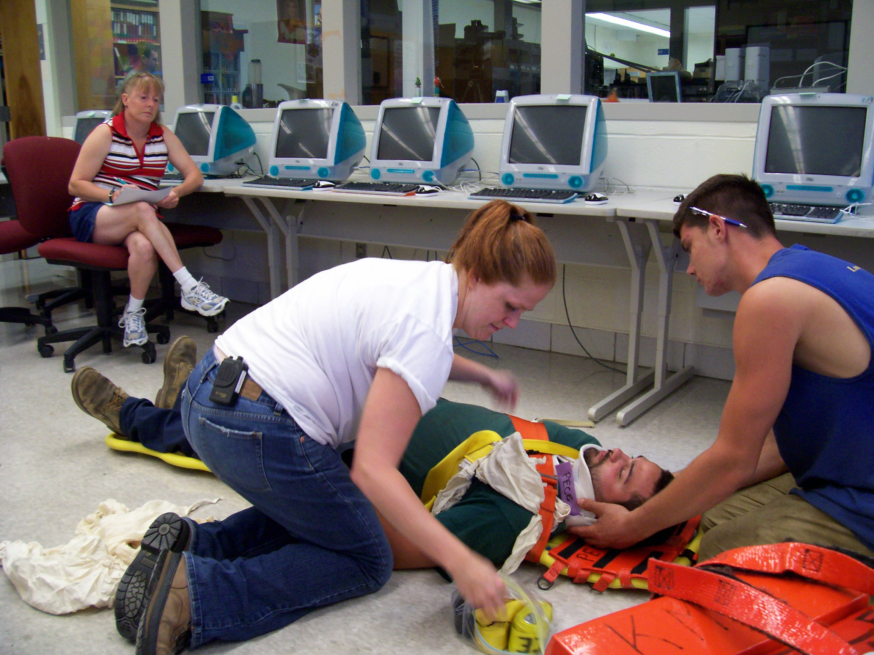
Care of unconscious patient

Slide 25
Definitions
Consciousness:
Awareness and attention to surroundings.
Sleep:
A physiological process of reduction of brain impulses to our body. The person is arousable with maintained protective reflexes
Unconsciousness: partial or complete
Loss of basic protective reflexes (free airways, coughing and swallowing, withdrawal from noxious stimuli)

Slide 26
Causes of unconsciousness
Shock
Asphyxia (F.B, fluid, fumes)
Poisoning (gas, inhaled or ingested)
Head injury
Stroke
Epilepsy
Hysteria
Infantile convulsions
Hypothermia or hyperthermia
D.M
Heart attack

Slide 27
Care of unconscious patient:
A- Emergency care
B- Long term care

Slide 28
A – Emergency care
Remove victim from hazard, attention to spine
Loosen tight clothes
Check breathing, remove airway obstruction.
If not breathing → CPR
Check pulse, if no pulse → CPR
Place in semi-prone position
Watch breathing and pulse constantly
Keep warm, cover with blanket.
Remove to hospital as soon as possible

Slide 29
B - Long term care
In hospital:
History taking
Examination
Investigations
Determining required care
Determining required personnel
ICU

Slide 30
Thank you

