Slide 1
HEALTH INEQUITY

Slide 2
Definitions
Health inequity: unjust distribution of health and health care. Inequities in health predictably put groups of individuals who are already socially disadvantaged (the poor, females, and minority groups) in a disadvantage. (Whitehead 1990)

Slide 3
Definitions
WHO (1998) defined equity in health as “minimizing avoidable disparities in health and its determinants- including but not limited to health care- between groups of people who have different level of underlying social advantage or privilege.

Slide 4
Definitions
The most concise and widely used acceptable definition of health inequity was stated by Whitehead is “equity in health implies that, ideally, everyone could attain their full health potential and that no one should be disadvantaged from achieving this potential because of their social position or other socially determined factors”

Slide 5
Measuring health inequalities
Assessing health inequalities according to the following principles:
Health inequalities refer to differences in health status indicators and protective factors or risk factors capable of being shaped by polices.

Slide 6
Measuring health inequalities
2. We need to select an indicator of social position: by categorizing people into groups based on their social position.
In the Saudi context, social position is mostly reflected in income, nationality and gender (Al-Yassini 1982; Metz 1992).
In the USA the emphasis has been on health differences by race/ethnicity and colour.

Slide 7
Measuring health inequalities
3. We need to compare differences in health/health determinants across different social groups.

Slide 8
Health measures(indicators)
1 Self-reported health (SRH)
Subjective measure that reflects the feelings and beliefs that the individual has about her/his health. It is a vital determinant that contributes to utilizing formal medical care .

Slide 9
Health measures(indicators)
2. Self-reported illnesses and injuries(morbidity)
Morbidity indicators measure the current chronic and acute illnesses and injuries that happen within specific recall period in a period of two to four weeks.
3. Diagnosed long-standing medical conditions
The prevalence of major chronic diseases and their risk factors in different socio-economic groups

Slide 10
Health measures(indicators)
4 .Self- reported disability
The World Health Organization's International Classification of Functioning, Disability and Health (ICF) describes disability as an umbrella term for impairments, activity limitations, and participation restrictions as part of a broader classification scheme covering three main domains:
body functioning and structure,
activities and participation,
and environmental factors (Filmer 2008)

Slide 11
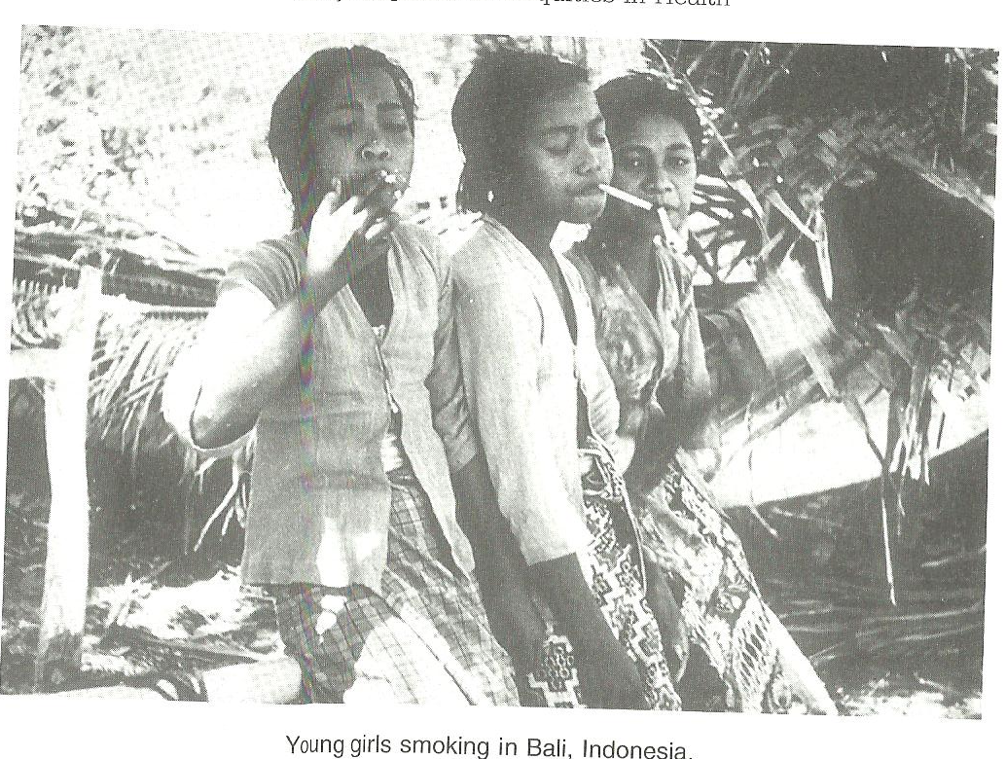
Health measures (indicators)
5. Life-style factors and their impact on inequities in health:
Tsolekile, (2007) pointed out that “Lifestyle refers to the way a person (or a group) lives, which includes patterns of social relations, food consumption, behaviours and interests. A lifestyle typically also reflects an individual's attitudes and one’s interaction with the world”.
e.g. smoking, physical inactivity, nutritional habits.

Slide 12
Global health status

Slide 13
life expectancy at birth

Slide 14
Global variation in Morbidity

Slide 16
Global variation in mortality and causes of death(adult)

Slide 17
Key points
Many health inequities are avoidable(policy can influence) .
The gap between the healthiest and unhealthiest is gradient (there is a gradient in health outcomes in any population often matched by social gradient of wealth/deprivation).
A multi-agency partnership approach is essential to tackle(causes and solution) health inequalities.

Slide 18
Health inequities causes and interventions

Slide 19
The reasons of health inequities
The poverty and uneven distribution of resources ( alone does not cause illness)
The more deprived population→ the poorer health (heart diseases, mental health, cancer & most health problem)
The reasons range across the spectrum of health determinants; economic, social, psychological and environmental factors interact with individual health behavior and access to care.
Those who are more comfortable are more likely to take up the opportunities to improve health.

Slide 20
Solutions and interventions
1. Health equity audit; accurate assessment of population health needs and comparison with services provision(demands/use of services). ERPHO, 2002
Aims at improving health outcomes.
2. Targeting groups; in specific geographical areas which are mostly deprived.
Targeting deprived areas will only reach minority of those whom we want to reach.
Targeting may be stigmatistic e.g. free school meals.
The most effective step is designing access around those who most in need.

Slide 21
(assignment) Alcohol addiction : reasons and solutions
Potential reasons:
Unemployment
Isolation
Poor housing
Addictive personality
Potential solution
I s the existence of preventive &curative health care services adequate?
What about difficulty of living?
The better educated (high income groups)may using these services disproportionately!

Slide 22
Thank you

