Slide 1
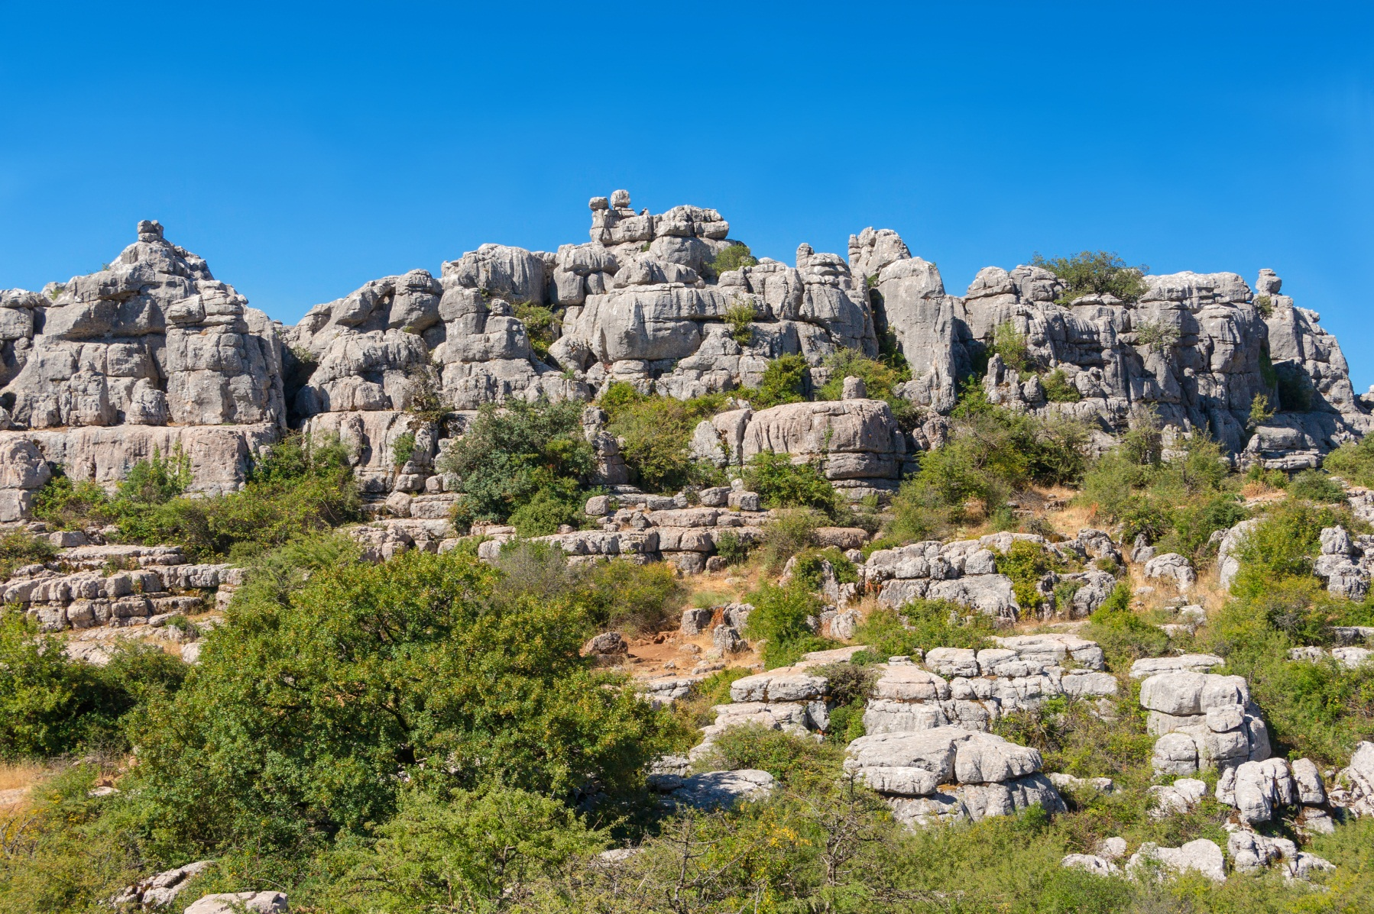
Biogenic and Chemical Sedimentary Rocks
UNIT 3

Slide 2
Chemical Sedimentary Rocks
In contrast to detrital rocks, which form from the solid products of weathering, chemical sediments derive from ions that are carried in solution to lakes and seas.
This material does not remain dissolved in the water indefinitely, however.
Some of it precipitates to form chemical sediments. These become rocks such as limestone, chert, and rock salt.
This precipitation of material occurs in two ways. Inorganic processes such as evaporation and chemical activity can produce chemical sediments.
Organic (life) processes of water dwelling organisms also form chemical sediments, said to be of biochemical origin.

Slide 3
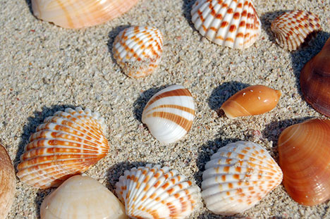
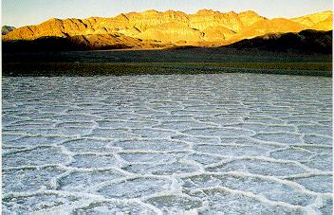
Biogenic and Chemical Sedimentary Rocks
In areas where there are not many detrital sediments, sedimentary rocks are formed by other processes.
Marine organism have shells made up of calcium carbonate which accumulates in the sea after their death to form limestones.
Chemical processes result in the formation of evaporites.

Slide 4
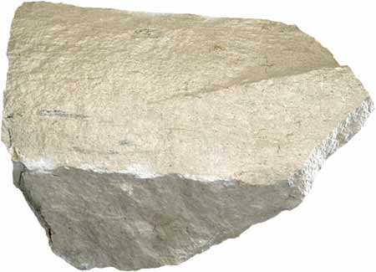
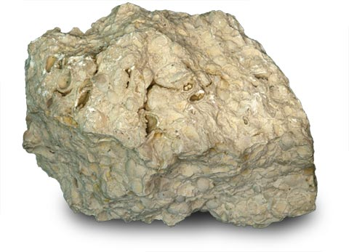
Limestone
Limestone is the most commonly found chemical sedimentary rock.
Calcium Carbonate (CaCO3) is the main compound in limestone.
Sediments that solidify to form limestones are called as calcareous sediments.
Sedimentary rocks may also be made up of carbonates of other elements such as Magnesium or Iron.
These group of sediments and sedimentary rocks are known as carbonates.

Slide 5
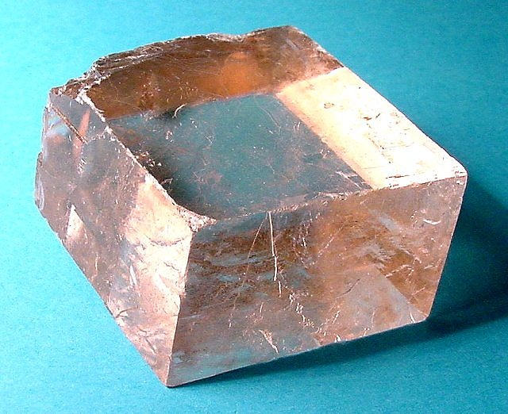
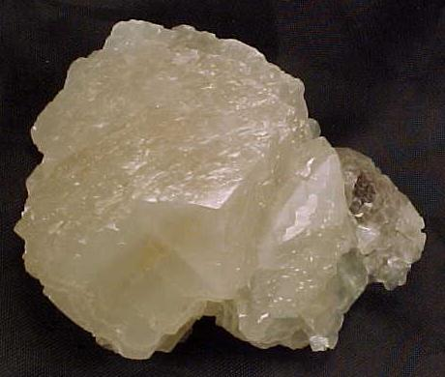
Carbonate Mineralogy
CALCITE
The most common carbonate mineral is Calcite (CaCO3).
Pure crystal of calcite is colorless or white and can be confused with Quartz however there are a few differences:
Calcite has a hardness of 3 on the Moh’s scale whereas Quartz has a hardness of 7.
Calcite reacts with dilute Hydrochloric acid (HCl).
Calcite most commonly has a biogenic origin that is it is formed from as a part of a plant or animal.
Magnesium ion can sometimes replace calcite and can form two kinds of calcite:
Low Mg Calcite (less than 4% Mg)
High Mg Calcite ( 11-19% Calcite)

Slide 6
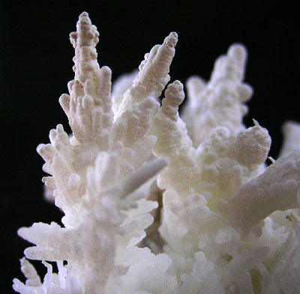
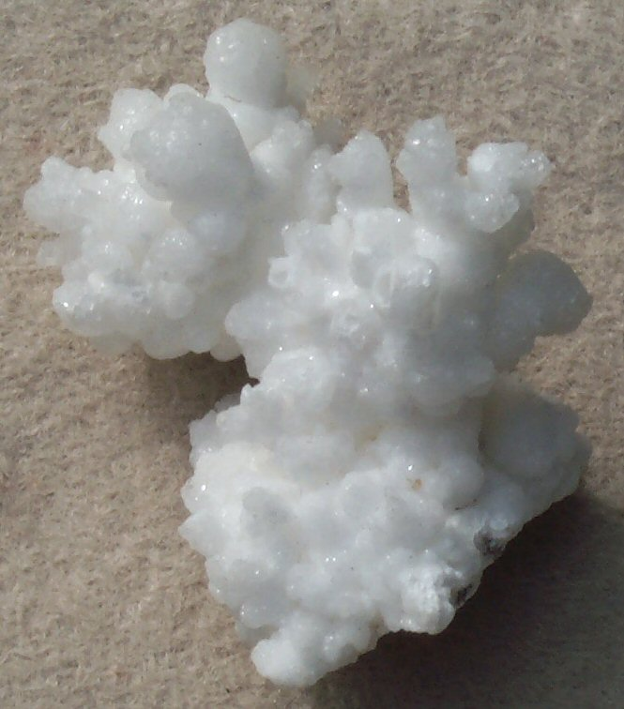
Carbonate Mineralogy
ARAGONITE
There is no chemical difference between aragonite and Calcite.
The difference is only in the crystal/mineral form.
Aragonite has a hardness of 3.5 to 4 on the Moh’s scale as compared to calcite which has a hardness of 3.
The specific gravity of aragonite (2.95) is slightly more than that of calcite (2.72-2.94).
Many invertebrates use aragonite to build their hard parts including corals.

Slide 7
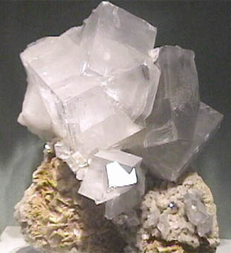
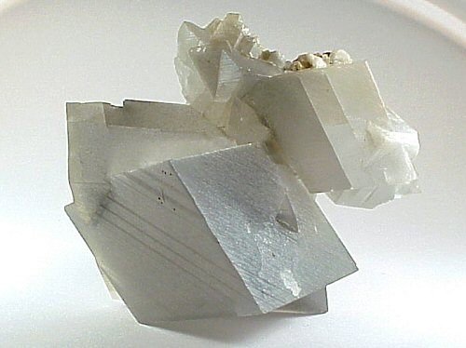
Carbonate Mineralogy
DOLOMITE
Calcium magnesium carbonate (CaMg(CO3)2) is a common rock forming mineral and is known as dolomite.
A common chemical sedimentary rocks is dolostone which is formed from dolomite.
The minerals looks same as calcite or aragonite and has the same hardness as that of aragonite.
Dolomite does not react with hydrochloric acid like calcite.

Slide 8
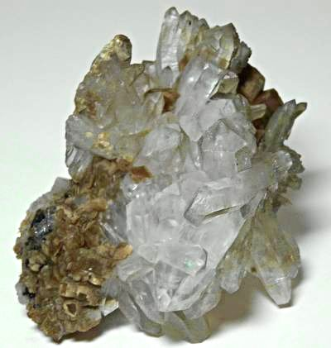
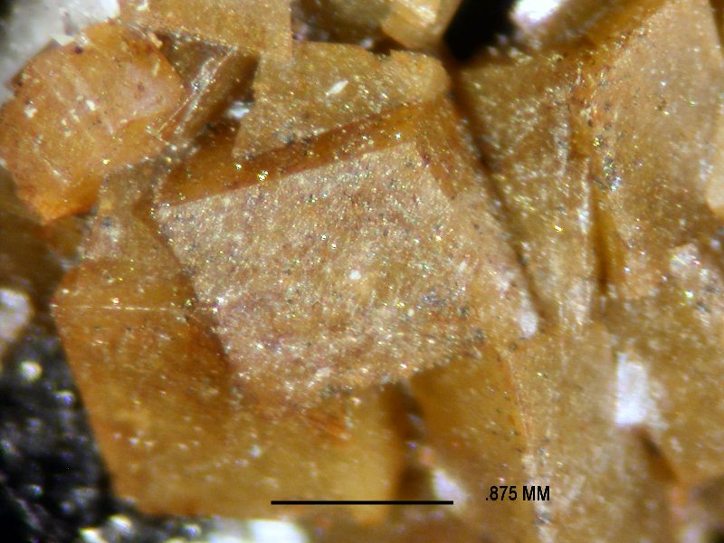
Carbonate Mineralogy
SIDERITE
Siderite is Iron carbonate (FeCO3) with the same structure as that of calcite.
Siderite is normally formed within sediments and it is very difficult to differentiate between iron and calcium carbonates on mineralogical grounds.
It is rarely pure, often containing some magnesium or manganese substituted for iron in the Limestone lattice.

Slide 9
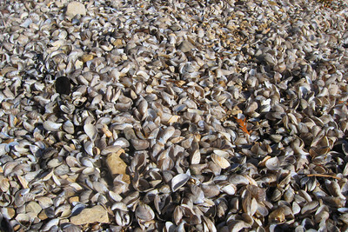
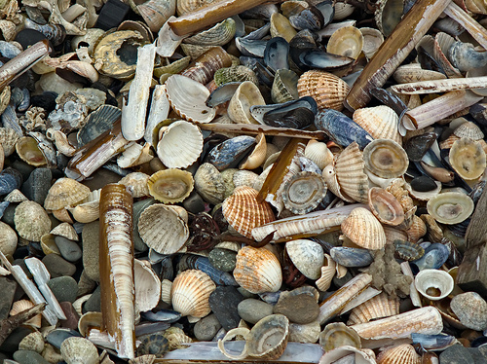
Biomineralised carbonate sediments
Carbonate forming organisms include both plants and animals.
Their hard parts are made up of either low or high Mg calcite or aragonite or sometimes both.
The skeletal fragments in carbonates are whole or broken pieces of the hard body parts of organisms that use calcium carbonate minerals as a part of their structure.

Slide 10
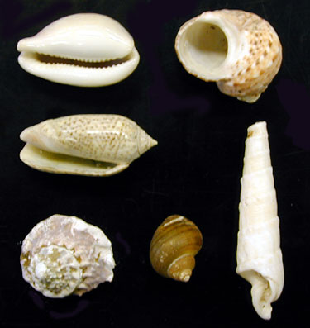
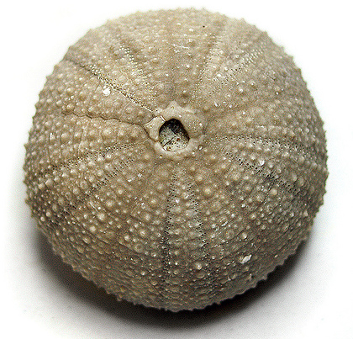
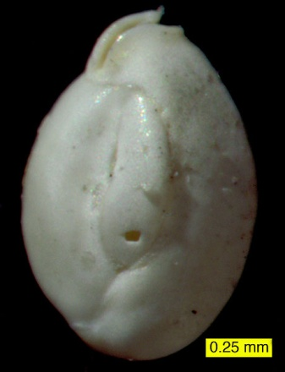
Carbonate forming animals
Molluscs (Gastropods and cephalopods) have calcareous hard parts.
Brachipod shells are made up of low magnesium calcite and were common during the Palaeozoic and Mesozoic Era.
Echinoid are another group of marine organisms consisting of calcareous hard parts.
Formanifera and corals are also made up of calacreous hard parts and form limestone beds

Slide 11
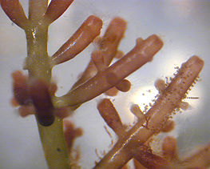
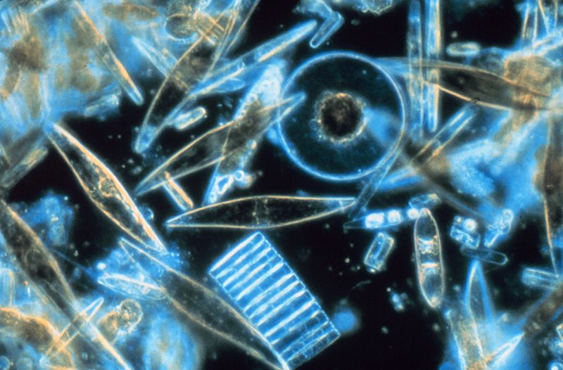
Carbonate forming plants
Algae is an important source of biogenic carbonates.
The group includes the red algae, green algae and nanoplanktons.
Cyanobacteria also acts as a trap for fine grained carbonates.

Slide 12
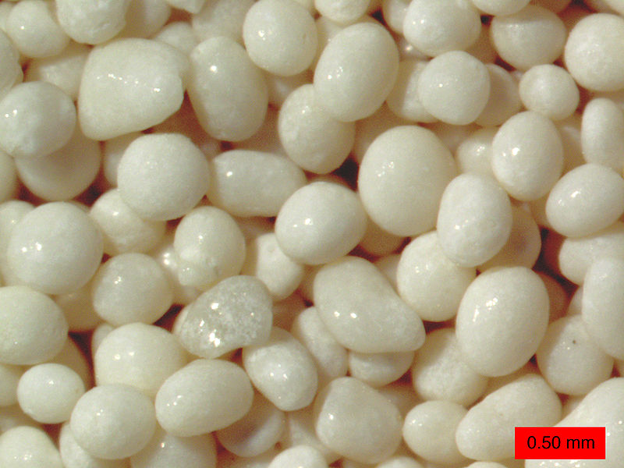
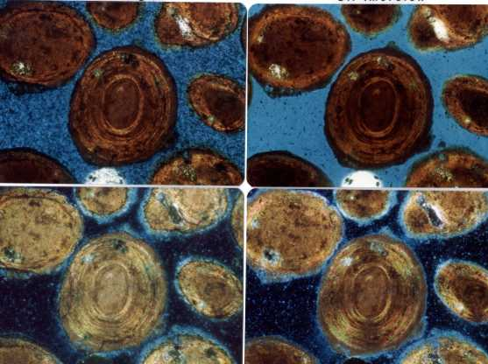
Non-biogenic constituents of limestones
A variety of other types of grain also occur commonly in carbonate sediments and sedimentary rocks.
Ooids are spherical bodies of calcium carbonate less than 2 mm in diameter.
A rock made up of carbonate ooids is commonly known as oolitic limestone.
Other non-biogenic constituents include pisoids, peloids and intraclasts.
All of them are made up of calcium carbonate.

Slide 13
Carbonate Mud
Fine grained calcium carbonate particles less than 4 microns are referred to as lime mud, carbonate mud or micrite.
The source of these material can be either chemical precipitation, or breakdown of skeletal fragments, algal or bacterial origin.
Lime mud is found in many carbonate forming environments and can be the main constituent of limestone.

Slide 14
Classification of Limestones
The Dunham Classification is the most widely used scheme for classification of limestones.
The classification is based on the texture of the rock which describes the proportion of carbonate mud present and the framework of the rock.
The firs step is to identify whether the limestone is matrix supported or clast supported.
Matrix supported limestone is divided into carbonate mudstone (less than 10 % clasts) and wackestone (more than 10 % clasts)

Slide 15
Classification of Limestones
Clast supported limestone is called as packstone if mud is present.
It is called grainstone if there is little or no matrix.
A boundstone has an organic framework such as a coral colony.

Slide 16
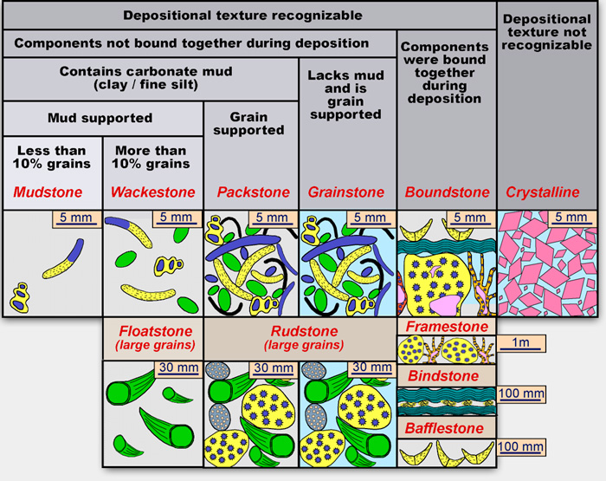
Classification of Limestones

Slide 17
Evaporite Minerals
These minerals are formed by precipitation out of solution as ions become more concentrated when water evaporates.
The least soluble compounds are precipitated first so calcium carbonate is the first to be precipitated followed by calcium sulphate and sodium chloride.

Slide 18
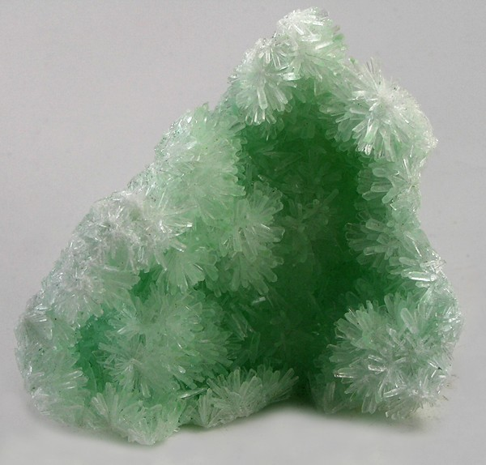
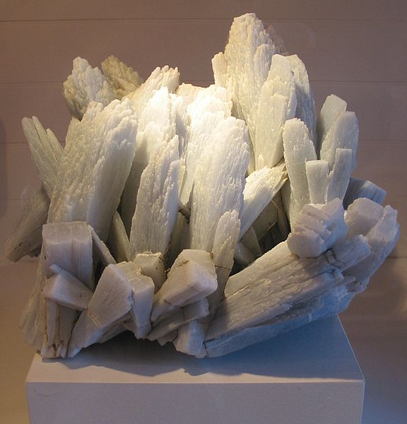
Gypsum & Anhydrite
Calcium Sulfate is the most common evaporite mineral.
It is known as Gypsum or Anhydrite.
Gypsum is the hydrous form of the mineral (CaSo₄.2H₂O).
Anhydrite has no water in its crystal structure.
Gypsum can be easily distinguished from calcium carbonate as it is less harder (hardness is 2) and does not react with dilute hydrochloric acid.
However anhydrite is harder (3.5 hardness) than gypsum and is commonly white in hand specimen.

Slide 19
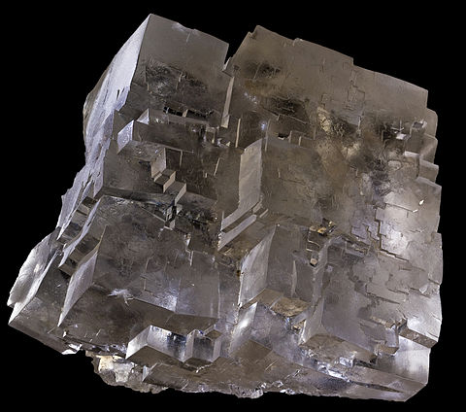
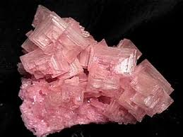
Halite
Halite (NaCl) precipitates out of seawater once it has been concentrated to 9.5% of its original volume.
Naturally occurring halite is Rock Salt.
It can be differentiated by other minerals by its taste.
Halite has a hardness of 2.5 which is slightly more than Gypsum.

Slide 20
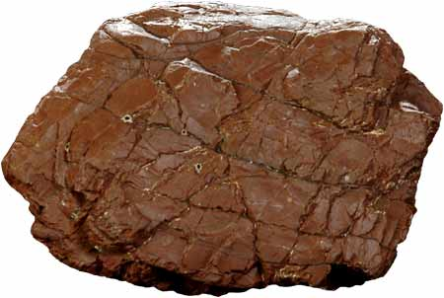
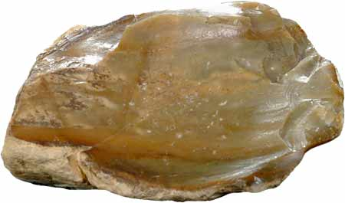
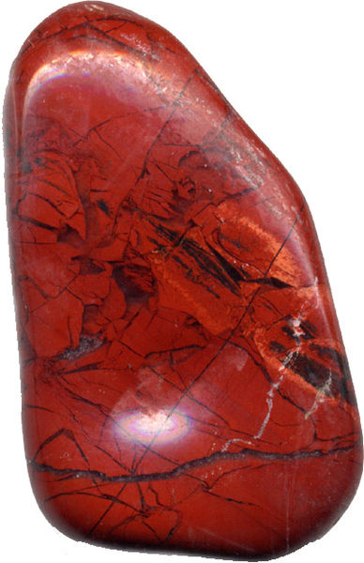
Cherts
Cherts are fine grained siliceous sedimentary rocks made up of micro-crystalline quartz and chalcedony.
Dense internal structure of interlocking micro-quartz grain and fiber makes chert the hardest sedimentary rock.
Jasper is a variety of chert which is red in color due to the presence of Hematite.

Slide 21
Carbonaceous Deposits
Sediments and sedimentary rocks with high proportion of organic matter are called carbonaceous because they are rich in Carbon.
A deposit/rock is called carbonaceous if the proportion of organic matter is higher than average. (> 2% for mudrock, > 0.2% for limestone, > 0.05% for sandstone)
Strata containing high concentration of organic material are of economic importance. (Coal, oil and gas).

Slide 22
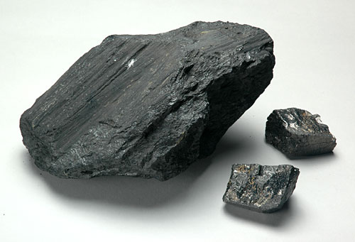
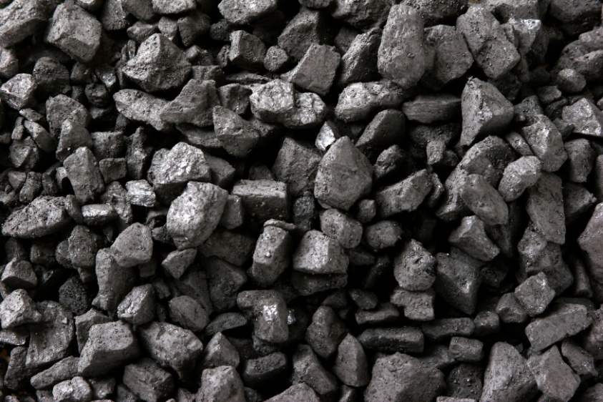
Coal
If over two-thirds of a rock is solid organic matter, it may be called coal.
Most coals have less than 10 % non-organic, non-combustible material that is often referred to as ash.
Coal is black in color and has a low density.

Slide 23
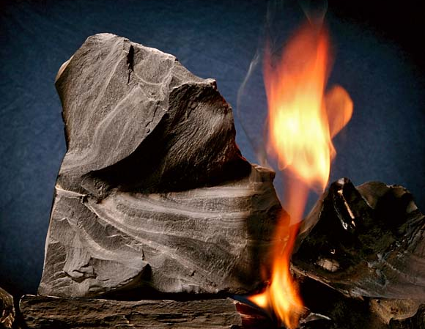
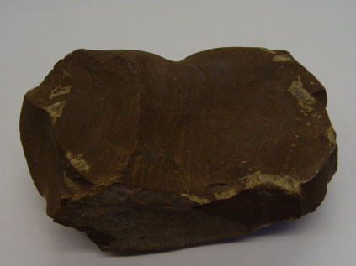
Oil shales and tar sands
Mudrock that contains high proportion of organic material that can be taken out as a liquid or gas by heating are called oil shales.
The organic matter is usually the remains of algae that have broken down during diagenesis to form kerogen.
Kerogen are long chained hydrocarbons that form petroleum.
Oil shales are therefore important source rocks for hydrocarbons.

Slide 24
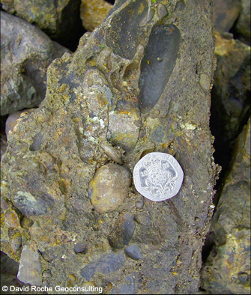
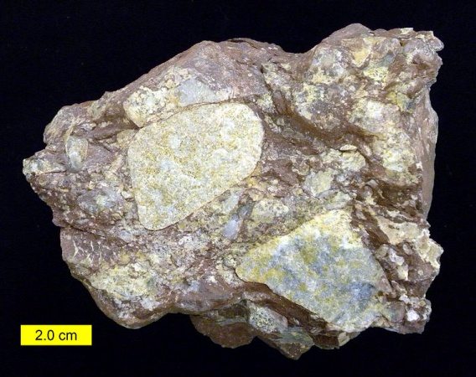
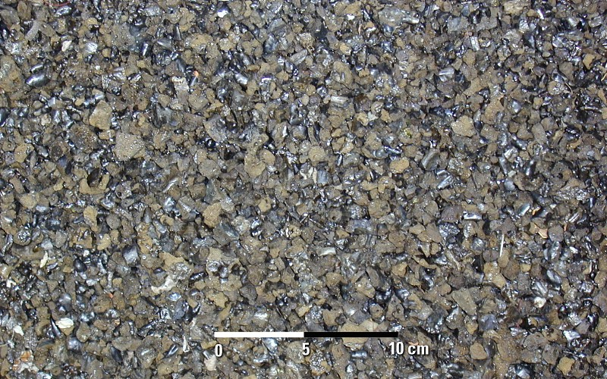
Volcaniclastic Sedimentary Rocks
Volcanic eruptions result in the formation of igneous as well as sedimentary rocks.
The molten lava which comes out during the eruption solidifes to form extrusive igneous rocks whereas the material that is ejected from the volcanic vent forms the volcaniclastic deposit.

Slide 25
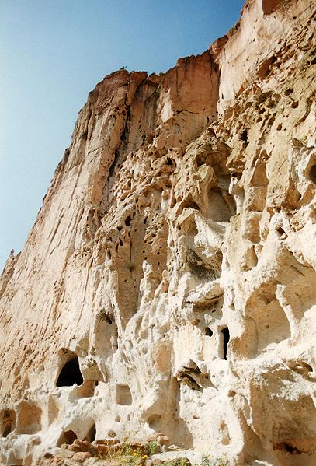
Classification of Volcaniclastic Rocks
Clast Size | Unconsolidated | Consolidated
>64 mm | Bombs | Agglomerate
 | Blocks | Volcanic Breccia
2-64 mm | Lapilli | Lapillistone
1/16-2 mm | Coarse Ash | Coarse Tuff
<1/16 mm | Fine Ash | Fine Tuff

