Slide 1
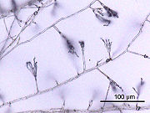
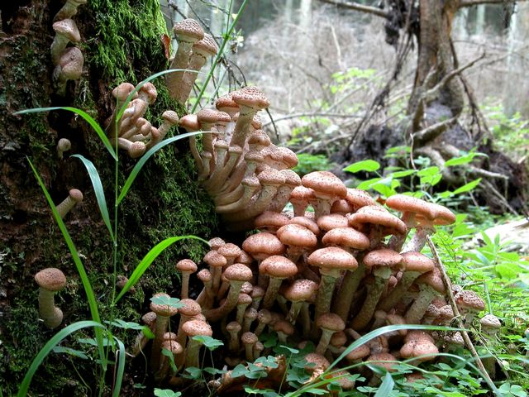
fungus

Slide 2
Mycology is science of fungi or study of fungi
Mycologist is the person how study fungi
General charactaristic
There is 5 kingdom:
Procaryotae------------Bacteria
Protista---------------Algae and protozoea.
Fungi------------------fungi
Plantea---------------plant
Animalia------------- animals and human .
fungi are in a kingdom all by themselves .

Slide 3
Harmful fungi that cause deterioration of leather ,plastics, jam ,pickles, and other foods.
Beneficial fungi help in the production of cheese, yogurt ,drugs (immunosuppressant drug as cyclosporine) and antibiotics.
Fungi are diverse group of eukaryotic organisms that includes yeast, mold , and mushrooms.
Fungi is Eukaryotic, saprophytic fungi living on organic material in water and soil and other . their main source of food is dead and decaying organic matter it secret a digestive enzyme into dead plants and animals matter to compose it into absorbable nutrients for themselves and other living organisms thus they are original recycle.

Slide 4
Fungi is not a plant or algae ; they are not photosynthetic by lacking the chlorophyll or other photosynthetic pigments .
fungi is Heterotrophic
The cell wall of algal and plant contain cellulose (polysaccharide) but fungal cell wall do not, it contain polysaccharide called chitin.
saprobic fungi or saprobes who derive their nutrition from nonliving organic material.
Saprobic symbiotoic parasitic

Slide 5
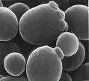
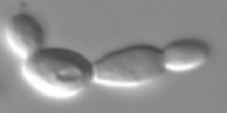
Structure of fungi:
Unicellular (Yeast) either :
True yeast cell retain individually.
Yeast like cells attached to each others side by side forming pseudohypha
Example: candida albican

Slide 6

It is reproduce by budding or by binary fission

Slide 7
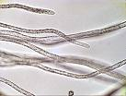
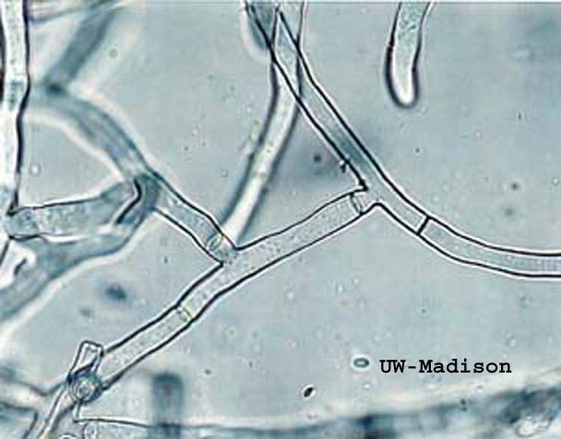
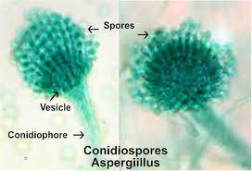
Filamentous (molds) hypha-hyphea this hypha either septated or non septated hypha
Example : aspergillus
Group of hyphea = myeclium
Hypha develop from fungal spore

Slide 8
Dimorphic fungi: have two forms depending in changing in the environmental factor like temp. medium and culture.

Slide 9
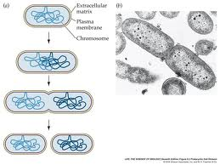
Reproduction
it is reproduce by sporulation asexually or sexually
A sexually : only by mitotic cell division in or on specialized hyphea.
1.Somatic yeast by budding hypheal
binary fission
mold by fragmentation.

Slide 10
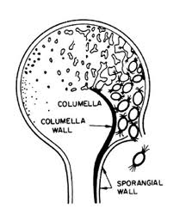
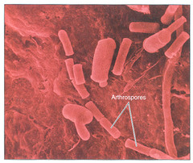
2. Spore formation :

Slide 11
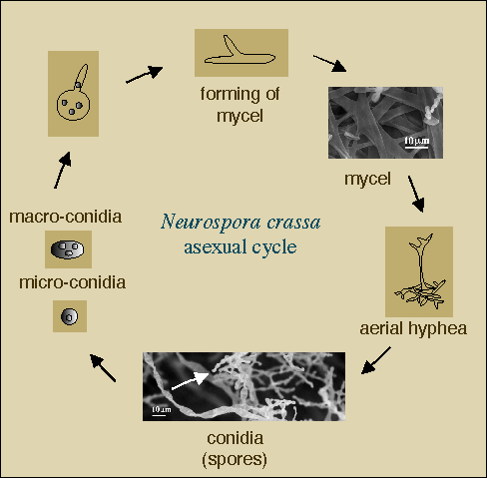

Slide 12
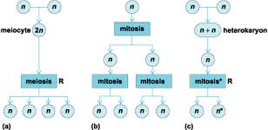
Sexual reproduction: fusion ,mitosis , meiosis.
Oospore , zygospore, basidiospore. Ascospore.

Slide 13
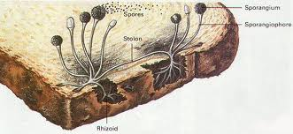
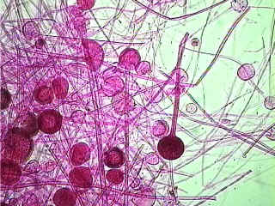
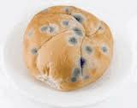
Classification of fungi
This classification is based on method of sexual reproduction except for the fourth group :
Zygomycetes : multicellular example black bread mold (Rhizopus) it is reproduced both sexually and Asexually .

Slide 14
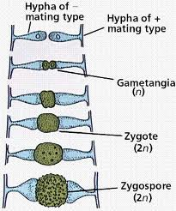
sexually by zygospores
a sexuall develop of spore in sporangia.
special non septated hyphea (sporangiophore )
Produce sporangia
Most common is a sexual reproduction

Slide 15
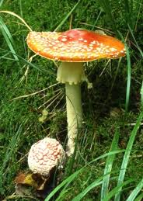
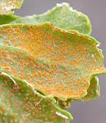
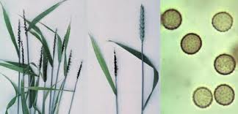
Basidiomycetes: it is multicellular mycella ,group include mushrooms,smuts,rusts

Slide 16

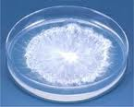

Slide 17
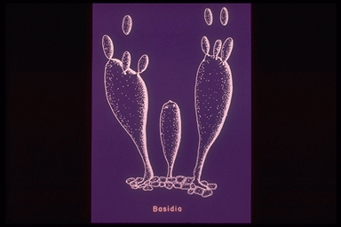
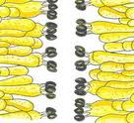
It is mainly reproduced by sexual reproduction by producing basidiospore from basidiophores on the top of hyphae.

Slide 18
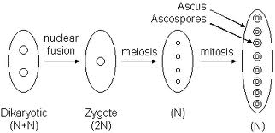
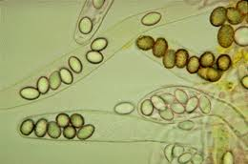
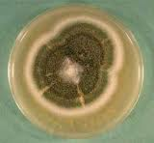
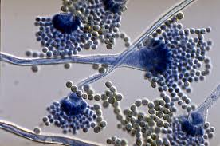
Ascomycetes: unicellular and multicellular with septated hyphea it is reproduced sexually with the production of sac on special hyphea ( bakers yeast ,aspergillus

Slide 19
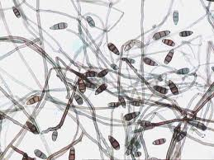
Deuteromycetes : imperfect fungi a number of these are human pathogens it is reproduced Asexually by budding and unknown sexual reproduction.

Slide 20
Metabolic and growth
Some fungi are halphillic ;can grow in a high salt media
It grow with wide range of PH & temperature from room temperature to 45c°thermophillic.
can grow on a temperature below freezing point
Aerobic & facultative anaerobe
Prefer acid condition to grow.
It produce digradative enzyme that digest organic substance for growth and energy.

Slide 21
Medical important fungi:
Fungus cause disease called mycoses and it classified by the location on or in the body where the infection occur :
Superficial mycoses.
Cutaneous mycoses.
Subcutaneous mycoses.
Systemic mycoses.
Opportunistic mycoses.

Slide 22
Superficial mycoses:
It affect the uppermost dead layers of skin and hair shift.
Tinea versicolor.(pityriasis versicolor)
Brown or discolored or white patches on the skin.
Tinea niger: dark brown lesion on the palm of the hand or on sole of foot or other.
Piedra nodules of the on hair shaft:
Black piedra.
White piedra.

Slide 23
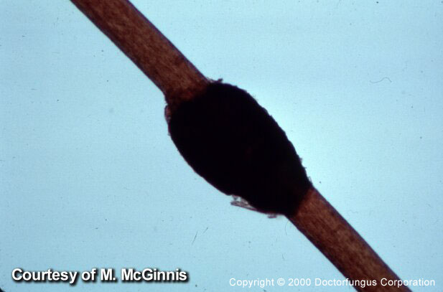
Black Piedra
Etiological agent (causative agent): Piedraia hortae

Slide 24
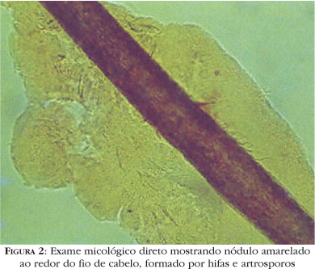
White Piedra
Etiological agent
“Trichosporon beigelii”

Slide 25

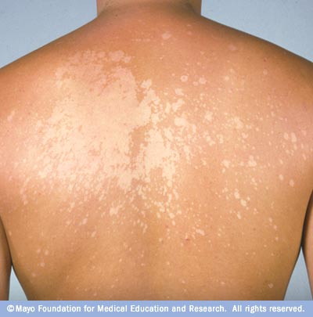
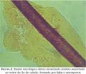
Tinea versicolor
Black piedra.
White piedra.

Slide 26
cutaneous infection:
It is called Dermatophytes that infect keratinized tissue and structures such as skin, hair and nail (ring worm infection). Examples:
Tinea pedis ( athlete`s foot) Dermatophytes.
Tinea corpories it affect non hairy parts
Tinea capitis (ring worm) affect the scalp of the head.
Candida albican in the mucouse membrane gastro intestinal , mouth, vagina, and skin

Slide 27
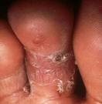

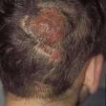
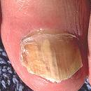
The clinical types of Dermatophytes
Tinea exists in any part of the body depending on the location
it is given a different name:
Athlete's foot or tinea pedis
Ringworm of the body or tinea corpora
Scalp ringworm or tinea capitis
Ringworm of the nail, Onychomycosis,
or tinea unguium

Slide 28
Subcutanouse infection
They are more sever of mycoses
It infect the subcutanouse tissue and bone usually the causative agent resideu in the soil
example; Mycetoma madura foot
This is foot infection lead to swelling of the foot with pus , blood, serum discharge through sinuses and colored grain (black,white,red) and it may disseminate causing bone destruction. The causative agent is madurella spp.

Slide 29
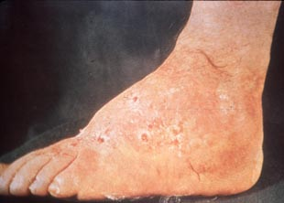
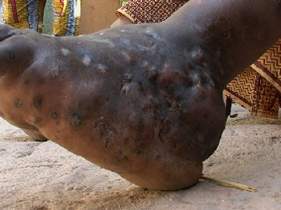

Slide 30
Systemic infection
Fungi infect main organs as brain heart liver kidney etc.
The organism responsible for this infection fall in 2 categories:
fungus affect the immune competent example:
coccidiomycosis: inhalation of the arthrospore (hypheal) lungs germination spread onto bone &CNS.
.

Slide 32

Opportunistic mycosis: Candidosis
It is any infection caused by species of the fungus candida
it is usually opportunistic but there are some forms are not
1- Oral thrush:
Infection of the mouth surface by candida
Very common in:
AIDS patients. And in young babies,
new born, and children
Also it can occur in adults and very old people
Lesion: white patches in the tongue and oral surfaces

Slide 33
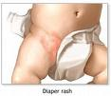
2- Diaper or Napkin rash
Common in babies who their mothers do
not change their diaper frequently
Symptoms: red area in groin area
It may spread by the baby himself from the
groin area to the face part
It usually goes away by correct conditions
3- Vaginitis
Infection of vaginal mucosa by candida
Symptoms: itching, white or yellowish discharges from vaginal surface or pus
60% of the vaginal discharge is caused by candida albican
It is very common in KSA
It is more in pregnant and diabetic ladies

Slide 34
Thank u

