Slide 1
ARITHMETIC IN C

Slide 2
1 Arithmetic in C
Most C programs perform calculations using the C arithmetic operators (Fig. 2.9).
Note the use of various special symbols not used in algebra.
The asterisk (*) indicates multiplication and the percent sign (%) denotes the remainder operator, which is introduced below.
In algebra, to multiply a times b, we simply place these single-letter variable names side by side as in ab.
In C, however, if we were to do this, ab would be interpreted as a single, two-letter name (or identifier).
Therefore, C requires that multiplication be explicitly denoted by using the * operator as in a * b.
The arithmetic operators are all binary operators.
For example, the expression 3 + 7 contains the binary operator + and the operands 3 and 7.

Slide 4
1.1 Arithmetic in C (Cont.)
Integer Division and the Remainder Operator
Integer division yields an integer result.
For example, the expression 7 / 4 evaluates to 1 and the expression 17 / 5 evaluates to 3.
C provides the remainder operator, %, which yields the remainder after integer division.
The remainder operator is an integer operator that can be used only with integer operands.
The expression x % y yields the remainder after x is divided by y.
Thus, 7 % 4 yields 3 and 17 % 5 yields 2.

Slide 6
1.2 Arithmetic in C (Cont.)
Parentheses for Grouping Subexpressions
Parentheses are used in C expressions in the same manner as in algebraic expressions.
For example, to multiply a times the quantity b + c we write a * ( b + c ).

Slide 7
1.3 Arithmetic in C (Cont.)
Rules of Operator Precedence
C applies the operators in arithmetic expressions in a precise sequence determined by the following rules of operator precedence, which are generally the same as those in algebra:
Operators in expressions contained within pairs of parentheses are evaluated first. Parentheses are said to be at the “highest level of precedence.” In cases of nested, or embedded, parentheses, such as
( ( a + b ) + c )
the operators in the innermost pair of parentheses are applied first.

Slide 8
1.3 Arithmetic in C (Cont.)
Multiplication, division and remainder operations are applied next. If an expression contains several multiplication, division and remainder operations, evaluation proceeds from left to right. Multiplication, division and remainder are said to be on the same level of precedence.
Addition and subtraction operations are evaluated next. If an expression contains several addition and subtraction operations, evaluation proceeds from left to right. Addition and subtraction also have the same level of precedence, which is lower than the precedence of the multiplication, division and remainder operations.
The assignment operator (=) is evaluated last.

Slide 9
1.3 Arithmetic in C (Cont.)
The rules of operator precedence specify the order C uses to evaluate expressions. When we say evaluation proceeds from left to right, we’re referring to the associativity of the operators.
Figure 2.10 summarizes these rules of operator precedence for the operators we’ve seen so far.

Slide 11
1.3 Arithmetic in C (Cont.)
Figure 2.11 illustrates the order in which the operators are applied.

Slide 13
2. Relational and equality operators
The relational operators used in the C language are shown in Fig. 2.12.
The relational operators all have the same level of precedence and they associate left to right.
The equality operators have a lower level of precedence than the relational operators and they also associate left to right.
In C, a condition may actually be any expression that generates a zero (false) or nonzero (true) value.

Slide 14
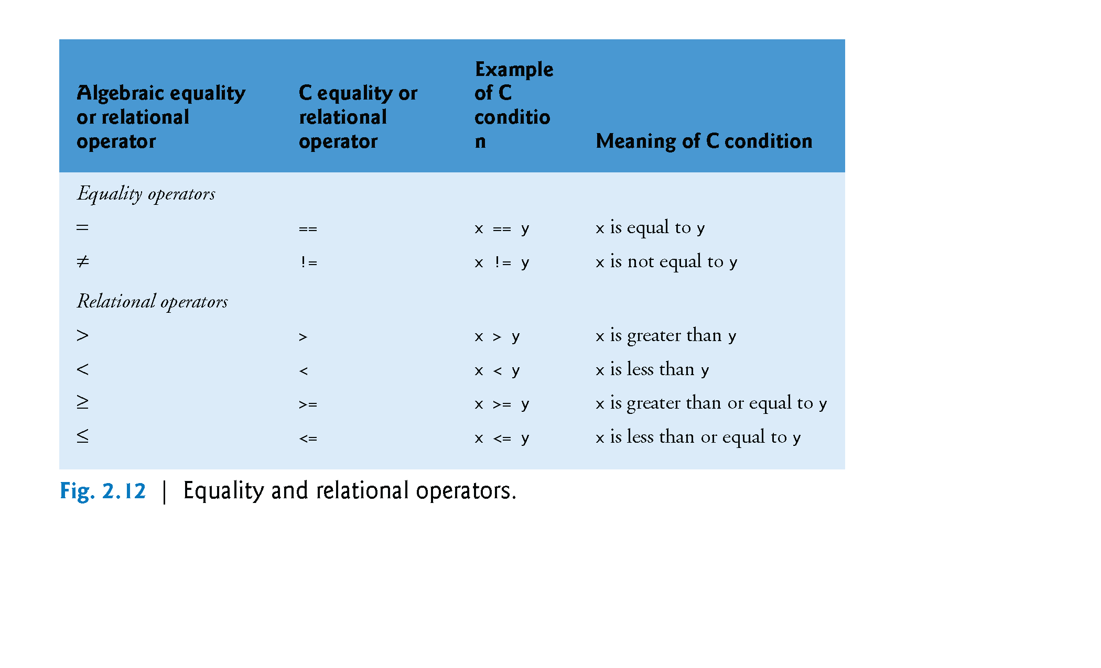
LOWER
HIGHER

Slide 17
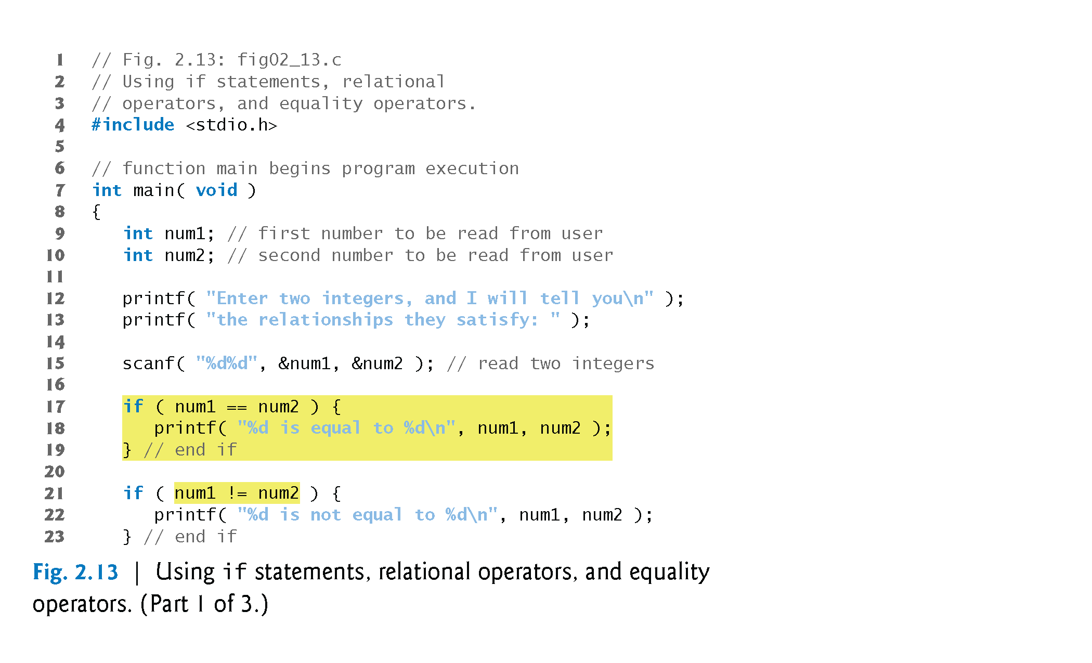
3. A SAMPLE PROGRAM

Slide 18
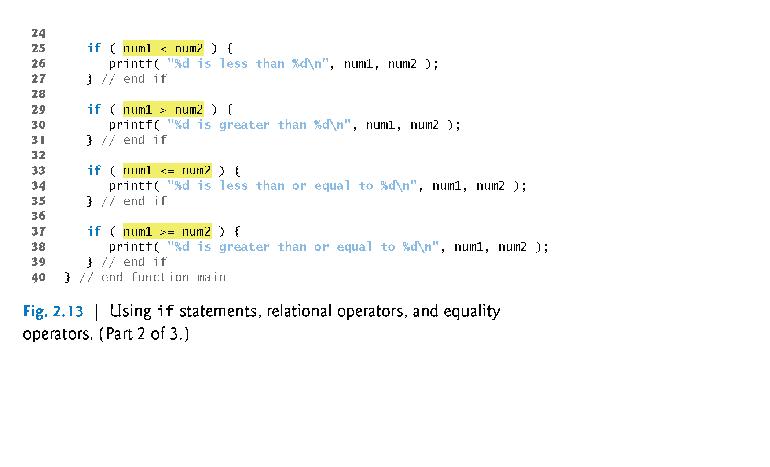
3. A SAMPLE PROGRAM (Cont’d)

Slide 19
3. A SAMPLE PROGRAM (Cont’d)
The program uses scanf (line 15) to input two numbers.
Each conversion specifier has a corresponding argument in which a value will be stored.
The first %d converts a value to be stored in the variable num1, and the second %d converts a value to be stored in variable num2.

Slide 21
4. rules of precedence - revisited
Figure 2.14 lists from highest to lowest the precedence of the operators introduced in this chapter.
Operators are shown top to bottom in decreasing order of precedence.
The equals sign is also an operator.

Slide 24
5. Conversion cONSTANT
#define is used to define constant macros.
Syntax:
#define PI 3.141593 /* conversion constant */
This statement associates PI with the value 3.141593
As a result, the line:
area = PI * radius * radius;
is read by the compiler as:
area = 3.141593 * radius * radius;
Note that the #define and #include lines do not end with a semi colon.

Slide 25
6. Comments
Syntax:
#define PI 3.141593 /* conversion constant */
/* … */ is another way to write comments
Each /* must be closed by */
Remember that // is also used to write a comment. The comment written in this way spans the whole line
Example:
// The following program calculates the circle area

Slide 26
7. giving values to variables
Before using any variable it must have a value.
This value may be obtained by one of the following ways:
1) Input by the user using scanf
int age;
printf (“Enter your age\n”);
scanf (“%d”, &age);
2) Using an assignment statement:
int age;
age = 20;
3) Initialized while declaration
int age = 20;

