Slide 1
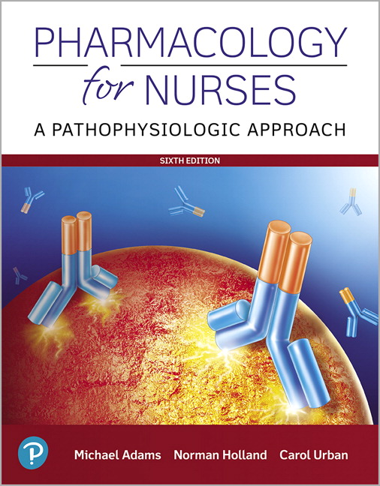
Pharmacology for Nurses: A Pathophysiologic Approach
Sixth Edition
Chapter 8
Drug Administration Throughout the Lifespan
Copyright © 2020, 2017, 2014 Pearson Education, Inc. All Rights Reserved
Notes:
If this PowerPoint presentation contains mathematical equations, you may need to check that your computer has the following installed:
1) MathType Plugin
2) Math Player (free versions available)
3) NVDA Reader (free versions available)

Slide 2
Learning Outcomes (1 of 2)
8.1 Describe physiologic changes during pregnancy that may affect the absorption, distribution, metabolism, and excretion of drugs.
8.2 Describe the placental transfer of drugs from mother to infant.
8.3 Identify examples of drugs that fall into the five U.S. Food and Drug Administration pregnancy risk categories.
8.4 Identify factors that influence the transfer of drugs into breast milk.
8.5 Identify techniques the breastfeeding mother can use to reduce drug exposure to the newborn.

Slide 3
Learning Outcomes (2 of 2)
8.6 Explain how differences in pharmacokinetic variables can affect drug response in pediatric patients.
8.7 Discuss the nursing and pharmacologic implications associated with each pediatric developmental age group.
8.8 Describe physiologic and biochemical changes that occur in the older adult and how these affect pharmacotherapy.
8.9 Develop nursing interventions that maximize pharmacotherapeutic outcomes in the older adult.

Slide 4
Pharmacotherapy across the Lifespan
Extension of holistic medicine
Each person is an individual
Many ways to approach individual variation in pharmacotherapeutic response

Slide 5
Drug Administration during Pregnancy and Lactation
Drug therapy is postponed until pregnancy is over with the exception of serious conditions
  Epilepsy
  Hypertension/gestational hypertension
  Gestational diabetes
  Infections
90% of women take at least one medication during pregnancy
  Must weigh the benefits against the risks

Slide 6
Physiologic Changes during Pregnancy That Affect Pharmacotherapy
Absorption of drugs
  Hormonal changes affect absorption
  Inhaled drugs may be absorbed faster
Distribution and metabolism
  Changes in cardiac output, plasma volume, and regional blood flow change distribution and metabolism
Drug excretion
  Rate of excretion may increase

Slide 7
Teratogen
A substance, organism, or physical agent to which an embryo or fetus is exposed that causes permanent abnormality in structure or function and causes retardation or death
No absolute teratogens; risk increases with dose

Slide 8
Gestational Age and Drug Therapy
Preimplantation period: weeks 1 to 2 of first trimester
  Teratogen either causes death of embryo or has no effect
Embryonic period: weeks 3 to 8
  Teratogens have maximum impact
Fetal period: weeks 9 to 40 or until birth
  Blood flow increases and placental membranes thin, maximizing substance transfer to fetus
  Medications have prolonged duration of action within fetus

Slide 9
Pregnancy Drug Categories
Developed by F D A
  No testing on humans is possible, so data sometimes limited
Categories — A, B, C, D, X
Give no specific clinical information to help guide nurses or their patients about a medication’s true safety

Slide 10
Pregnancy Category A Drugs
Studies performed with pregnant women
No increased risk of fetal abnormalities shown

Slide 11
Pregnancy Category B Drugs
Studies in animals have shown no risk to fetus, but no studies done with pregnant women O R
Animal studies show adverse effect, but adequate and well-controlled studies in pregnant women have failed to show risk

Slide 12
Pregnancy Category C Drugs
Animal studies have shown a risk to fetus, and no studies done with pregnant women O R
No animal studies conducted and no adequate, well-controlled studies in pregnant women

Slide 13
Pregnancy Category D Drugs
Risk to fetus shown
If benefits outweigh risk, may be acceptable

Slide 14
Pregnancy Category X Drugs—Contraindicated
Studies done with animals or pregnant women
Fetal abnormalities shown
Drug contraindicated in women who are or may become pregnant

Slide 15
Table 8.1 Current F D A Pregnancy Category Ratings with Examples (1 of 2)
Risk Category | Interpretation | Drugs
A | Adequate, well-controlled studies in pregnant women have not shown an increased risk of fetal abnormalities to the fetus in any trimester of pregnancy. | Prenatal multivitamins, insulin, thyroxine, folic acid
B | Animal studies have revealed no evidence of harm to the fetus; however, there are no adequate and well-controlled studies in pregnant women. Or Animal studies have shown an adverse effect, but adequate and well-controlled studies in pregnant women have failed to demonstrate risk to the fetus in any trimester. | Penicillins, cephalosporins, azithromycin, acetaminophen, ibuprofen in the first and second trimesters
C | Animal studies have shown an adverse effect, and there are no adequate and well-controlled studies in pregnant women. Or No animal studies have been conducted, and there are no adequate and well-controlled studies in pregnant women. | Most prescription medicines; antimicrobials such as clarithromycin, fluoroquinolones, and Bactrim; selective serotonin reuptake inhibitors (S S R Is); corticosteroids; and most antihypertensives

Slide 16
Table 8.1 Current F D A Pregnancy Category Ratings with Examples (2 of 2)
Risk Category | Interpretation | Drugs
D | Adequate well-controlled or observational studies in pregnant women have demonstrated a risk to the fetus. However, the benefits of therapy may outweigh the potential risk. For example, the drug may be acceptable if needed in a life-threatening situation or serious disease for which safer drugs cannot be used or are ineffective. | Alcohol, A C E inhibitors, angiotensin receptor blockers (A R Bs) in the second and third trimesters, gentamicin, carbamazepine, cyclophosphamide, lithium carbonate, methimazole, mitomycin, nicotine, nonsteroidal anti-inflammatory drugs (N S A I Ds) in the third trimester, phenytoin, propylthiouracil, streptomycin, tetracyclines, valproic acid
X | Adequate well-controlled or observational studies in animals or pregnant women have demonstrated positive evidence of fetal abnormalities or risks. The use of the product is contraindicated in women who are or may become pregnant. There is no indication for use in pregnancy. | Clomiphene, fluorouracil, isotretinoin, leuprolide, menotropins, methotrexate, misoprostol, nafarelin, oral contraceptives, raloxifene, ribavirin, statins, temazepam, testosterone and thalidomide, and warfarin

Slide 17
Pharmacotherapy of the Lactating Patient
Fortunately few instances of harm to infant
Dangerous drugs usually have safe alternatives
Drugs with high protein-binding ability are less likely to enter breast milk

Slide 18
Factors That Affect Drug Exposure through Lactation
Time between drug administration and breastfeeding
Mother’s use of illicit drugs
Amount of drug administered
Amount that reaches fetus tissue
Infant's ability to metabolize drug

Slide 19
Recommendations for Drug Use during Lactation
Administer drug after breastfeeding
Teach mother to avoid alcohol, illicit drugs, tobacco
Drugs with a shorter half-life are preferable
Drugs with a long half-life should be avoided
Select drugs with high protein-binding ability
Avoid all O T C herbal, dietary supplements

Slide 20
Pharmacotherapy of Infants
Birth to first 12 months
Safety of child is primary
Have child ingest all medication; difficult to estimate how much lost if spit up
Nurse/parent should be aware of special procedures for drug administration
  Example: child should be held and cuddled while medication is administered

Slide 21
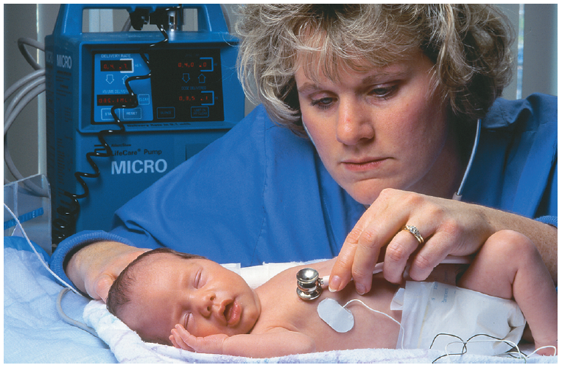
Figure 8.3 (1 of 2)
Treating the infant
Source: Pearson Education, Inc.

Slide 22
Pharmacotherapy of Toddlers
Period from 1 to 3 years
Teach parent about proper storage of drugs; no toddler access to medications
Give toddler short, concise explanations; provide comfort after
Oral drugs can be mixed with foods like jam, syrup, or fruit puree
Injections are given at specific locations with toddlers

Slide 23
Pharmacotherapy of Preschoolers and School-Age Children
Preschoolers
  3 to 5 years of age
  Safe storage = out of reach
  Can begin to assist with medications
  Brief explanation followed by administration
School-age children
  Between 6 and 12 years old
  Most children healthy in this period
  Offer longer, more detailed explanations
  Encourage cooperation
  Offer choices when appropriate

Slide 24
Pharmacotherapy of Adolescents
Between ages 13 and 16 years
Need support, approval, and presence
Educate about
  Hazards of tobacco and substance abuse
  Sexual intercourse
  Eating disorders
Provide important medication information
Allow time for questions
Allow privacy and control

Slide 25
Pharmacotherapy of Young and Middle-Aged Adults
Young adults
  Minimal need for prescription drugs unless chronic diseases or immune-related conditions exist
  Positive medication compliance
  Educate about substance abuse and treatment of sexually transmitted infections
Middle-aged adults
  Health changes begin around 45 years of age
  Prescribed drugs for stress-related illnesses
  Numerous life transitions
  Positive lifestyle changes could prevent drug therapy

Slide 26

Figure 8.5
Treating the middle-aged adult
Source: Rob/Fotolia

Slide 27
Illnesses Requiring Drug Therapy for Late Middle-Age Adults
Cardiovascular disease
Hypertension
Obesity
Arthritis
Cancer
Anxiety

Slide 28
Pharmacotherapy of Older Adults
Commonly take multiple medications concurrently (polypharmacy)
Some predictable ailments, but much variability remains
More adverse drug events in geriatric patients
Reminder aids for administration may be used
Maintain independence and dignity

Slide 29

Figure 8.6
Treating the older adult
Source: Barabas Attila/Fotolia

Slide 30
Absorption of Drugs Slower in Older Adults
Diminished gastric motility
Decreased blood flow to digestive organs
Increased gastric p H

Slide 31
Distribution Diminished in Older Adults
Increased body fat
Reduced plasma level
Less body water
Liver produces less albumin:
  Decreased plasma protein-binding ability
  Increased levels of free drugs
    Increases potential for drug–drug interaction
Decreased cardiac output

Slide 32
Metabolism Reduced in Older Adults
Reduced first-pass metabolism
Decreased production of liver enzymes
Plasma level elevated
Half-life of many drugs increased
Tissue concentrations increased

Slide 33
Excretion Reduced in Older Adults
Reduced renal blood flow
Reduced glomerular filtration rate
Decreased active tubular secretion
Decreased nephron function
Decreased drug excretion for drugs processed by the kidneys

Slide 34

Copyright
This work is protected by United States copyright laws and is provided solely for the use of instructors in teaching their courses and assessing student learning. Dissemination or sale of any part of this work (including on the World Wide Web) will destroy the integrity of the work and is not permitted. The work and materials from it should never be made available to students except by instructors using the accompanying text in their classes. All recipients of this work are expected to abide by these restrictions and to honor the intended pedagogical purposes and the needs of other instructors who rely on these materials

