Slide 1

Fundamentals of Organic Chemistry
CHEM 108
King Saud University
College of Science, Chemistry Department
CHAPTER 3. AROMATIC HYDROCARBONS
CHEM 108

Slide 2
Aromatic Hydrocarbons
Originally called aromatic due to fragrant odors, although this definition seems inaccurate as many products posses distinctly non-fragrant smells!
Currently a compound is said to be aromatic if it has benzene-like in its properties.
Their properties differ markedly from those of aliphatic hydrocarbons.
Aromatic hydrocarbons undergo electrophilic substitution whereas aliphatic hydrocarbons undergo electrophilic addition to double and triple bonds and free radical substitution.

Slide 3
The Structure of Benzene Ring
Benzene is the parent hydrocarbon of aromatic compounds, because of their special chemical properties.
Today a compound is said to be aromatic if it is benzene-like in its properties.
Structure of Benzene
- Molecular formula = C₆H₆
The carbon-to-hydrogen ratio in benzene, suggests a highly unsaturated structure.
- Benzene reacts mainly by substitution.
It does not undergo the typical addition reactions of alkenes or alkynes.

Slide 4
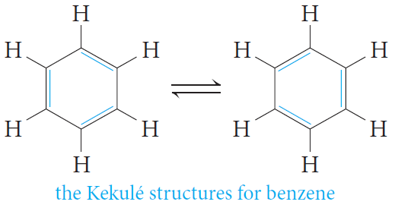
The Structure of Benzene Ring
Kekulé structure for benzene.
He suggested that six carbon atoms are located at the corners of a regular hexagon, with one hydrogen atom attached to each carbon atom.
He suggested that single and double bonds alternate around the ring (conjugated system of double bonds).
Kekulé suggested that the single and double bonds exchange positions around the ring so rapidly that the typical reactions of alkenes cannot take place.

Slide 5
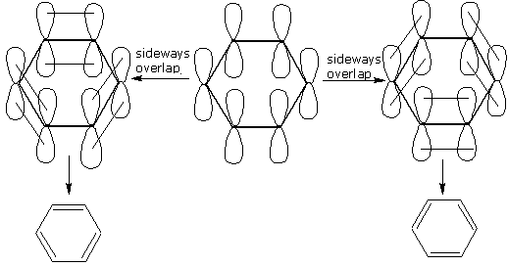
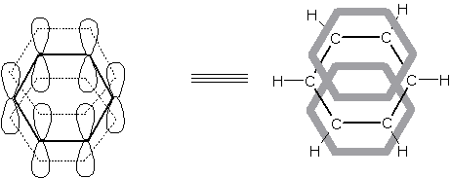

Slide 6
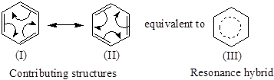
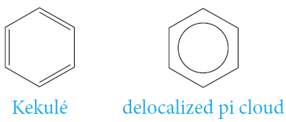
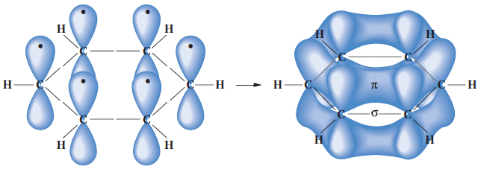
The Structure of Benzene Ring
Resonance Model for Benzene.
Benzene is planar.
All of the carbon–carbon bond lengths are identical: 1.39 Aº, intermediate between typical single (1.54Aº) and double (1.34 Aº) carbon–carbon bond lengths.
Each carbon is therefore sp2-hybridized.
Bond angles of 120°.

Slide 7
Aromatic Character (Aromaticity)
To be classified as aromatic, a compound must have:
◆ Cyclic structure
❖ Cyclic structure contains what looks like a continuous system of alternating
double and single bonds
⬥ Aromatic compounds must be planar
 Fulfill Hückel’s rule
The number of π electrons in the compound = (4n + 2)
Where (n = 0,1, 2, 3, and so on).

Slide 8
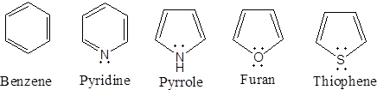
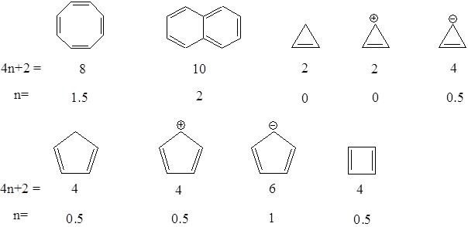
Aromatic Character (Aromaticity)
Structure and name of aromatic compound | 4n + 2 | n
6 | 1
Examples

Slide 9
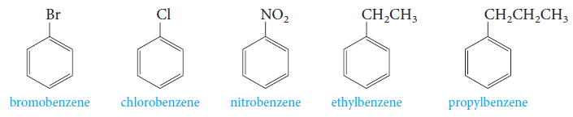
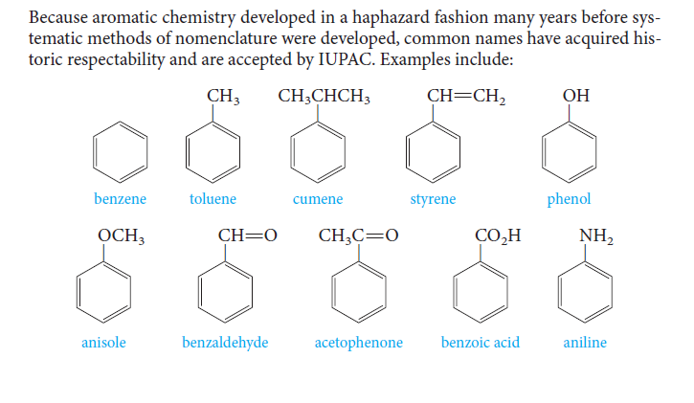
Nomenclature of Aromatic Compounds
Monosubstituted benzenes that do not have common names accepted by IUPAC are named as derivatives of benzene.
Common names are accepted by IUPAC (parent compounds).

Slide 10
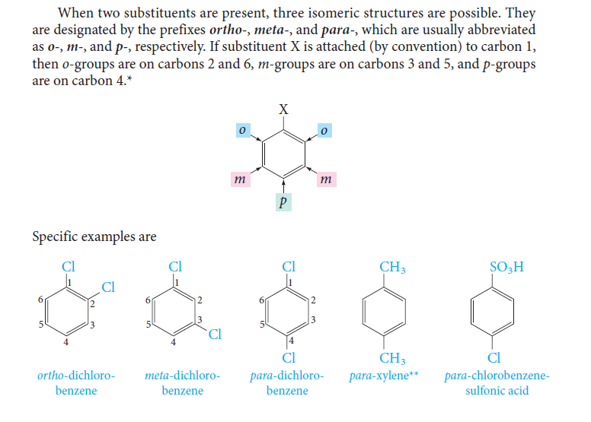
Nomenclature of Aromatic Compounds
When two substituents are present, three isomeric structures are possible.
They are designated by the prefixes; ortho- (o-), meta- (m-) and para- (p-).
If substituent X is attached to carbon 1; o- groups are on carbons 2 and 6, m- groups are on carbons 3 and 5, and p- groups are on carbon 4.
Examples;

Slide 11
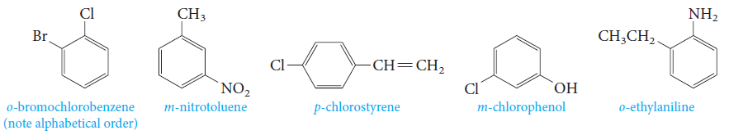
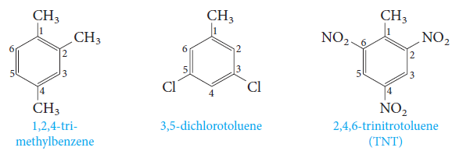
Nomenclature of Aromatic Compounds
The prefixes; ortho- (o-), meta- (m-) and para- (p-) are used when the two substituents are not identical.
When more than two substituents are present, their positions are designated by numbering the ring.

Slide 12
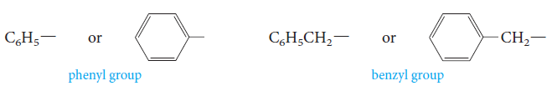
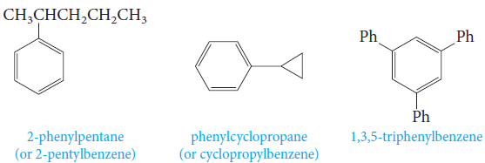
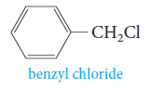
Nomenclature of Aromatic Compounds
Two groups with special names occur frequently in aromatic compounds; the phenyl group and the benzyl group.
Examples;

Slide 13
Nomenclature of Aromatic Compounds
Polynuclear aromatic hydrocarbons containing two, three & four rings are :

Slide 14
Electrophilic Aromatic Substitution Reactions
In this reaction, an electrophile E ⁺ replaces a hydrogen atom, from the aromatic ring system.
This reaction is in contrast to electrophilic addition to the double bonds of alkene

Slide 15
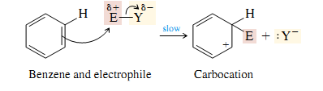
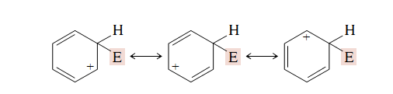
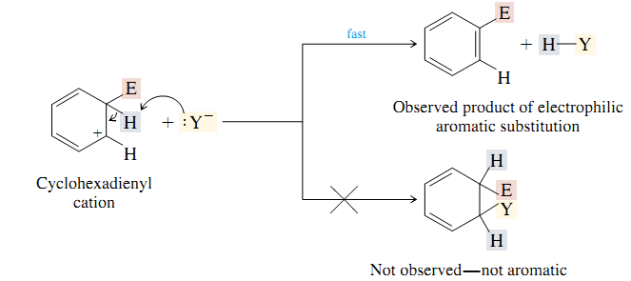
Electrophilic Aromatic Substitution Reactions
The electrophile E⁺ approaches the cloud of the aromatic ring and forms a bond to carbon, creating a +ve charge in the ring
The removal of the proton by the nucleophile Y ⁻ , which leads to the restoration of the aromatic ring
The net overall result is the substitution of the group E⁺ for a proton H⁺.

Slide 16
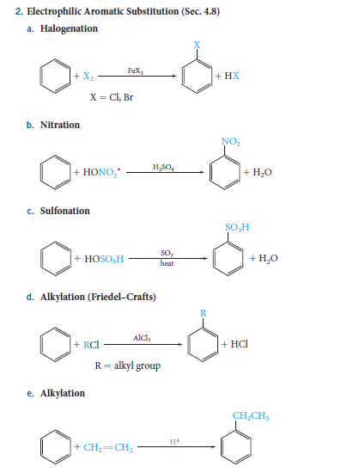
Reactions of Benzene
Electrophilic Aromatic Substitution Reactions
1) Halogenation
2) Nitration
3) Sulfonation

Slide 17
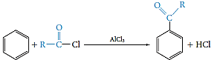
Reactions of Benzene
Electrophilic Aromatic Substitution Reactions
4) Alkylation (Friedel-Crafts)
5) Acylation (Friedel-Crafts)
The Mechanism of Electrophilic Aromatic Substitution
We can generalize this two-step mechanism for all the electrophilic aromatic substitutions.

Slide 18
Reactions of Benzene
Electrophilic Aromatic Substitution Reactions
The Mechanism of Electrophilic Aromatic Substitution
Halogenation

Slide 19
Reactions of Benzene
Electrophilic Aromatic Substitution Reactions
The Mechanism of Electrophilic Aromatic Substitution
Nitration
In aromatic nitration reactions, the sulfuric acid catalyst protonates the nitric acid, which then loses water to generate the nitronium ion (NO₂⁺), which contains a positively charged nitrogen atom.

Slide 20
Reactions of Benzene
Electrophilic Aromatic Substitution Reactions
The Mechanism of Electrophilic Aromatic Substitution
Sulfonation
We use either concentrated or fuming sulfuric acid, and the electrophile may be sulfur trioxide, SO₃, or protonated sulfur trioxide, ⁺SO₃H.

Slide 21
Reactions of Benzene
Electrophilic Aromatic Substitution Reactions
The Mechanism of Electrophilic Aromatic Substitution
Friedel–Crafts Alkylation
The electrophile is a carbocation, which can be formed either by removing a halide ion from an alkyl halide with a Lewis acid catalyst (for example, AlCl₃) .

Slide 22
Reactions of Benzene
Electrophilic Aromatic Substitution Reactions
The Mechanism of Electrophilic Aromatic Substitution
Friedel–Crafts Acylation
The electrophile is an acyl cation generated from an acid derivative, usually an acyl halide. The reaction provides a useful general route to aromatic ketones.

Slide 23
Electrophilic Aromatic Substitution Reactions

Slide 24
Disubstituted Benzenes: Orientation
Introduction of a second group, G, into a monosubstituted benzene, C₆H₅ – E

Slide 25
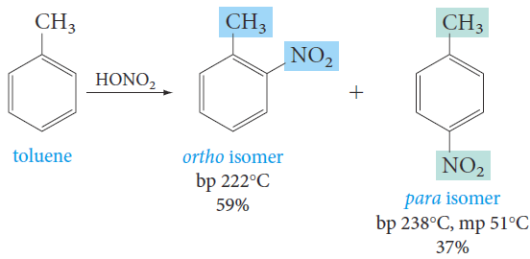
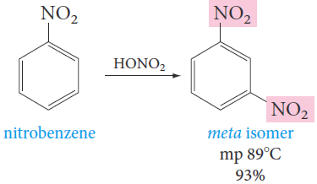
Reactions of Benzene
Disubstituted Benzenes: Orientation
Substituents already present on an aromatic ring determine the position taken by a new substituent.
Example; nitration of toluene gives mainly a mixture of o- and p-nitrotoluene.
On the other hand, nitration of nitrobenzene under similar conditions gives mainly the meta isomer.

Slide 26
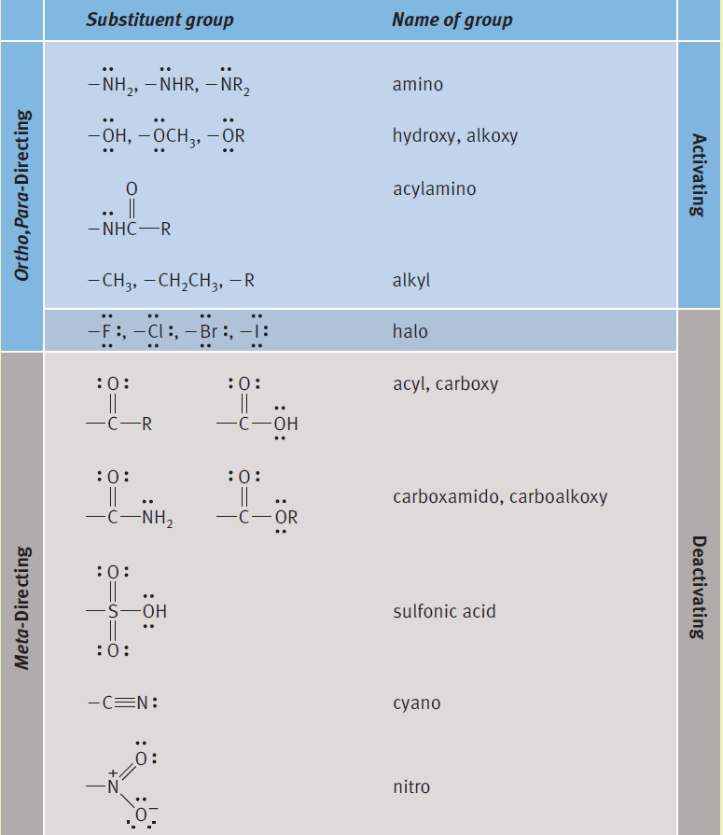
Reactions of Benzene
Disubstituted Benzenes: Orientation& Reactivity
Directing and Activating Effects of Common Functional Groups
Substituents that release electrons to the ring will activate the ring toward electrophilic substitution.
Substituents that withdraw electrons from the ring will deactivate the ring toward electrophilic substitution.

Slide 27
Disubstituted Benzenes: Orientation
Substituent | Effect on reactivity
o,p- director
-NH₂, -NHR, -NR₂ , -OH, | Very strongly activating
-NHCOR , OR | Strongly activating
-C₆H_{5,} -CH₃, -R (Alkyl), CH₂=CHR | Moderately activating
H | Standard for comparison
-F, -Cl, -Br, -I | Deactivating
m- director
-SO₃H, -COOH, -COOR | Strongly deactivating
, -CHO, -COR, -CN
-NO₂, -CF₃ | Very strongly deactivating

Slide 28
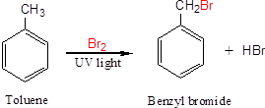
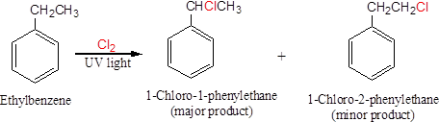
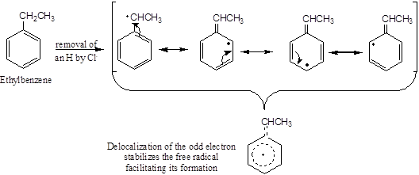
Reactions of Benzene
Side-Chain Reactions of Benzene-Derivatives
1. Halogenation of an Alkyl Side Chain

Slide 29
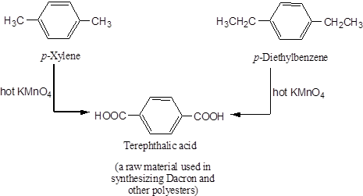
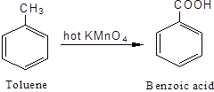
Reactions of Benzene
Side-Chain Reactions of Benzene-Derivatives
2. Oxidation of an Alkyl Side Chain
Conversion into a carboxyl group, -COOH, by treatment with hot potassium permanganate.
Regardless the length of the alkyl chain, the product is always the same.

