Slide 2
Content
3A Entropy
3B Entropy changes accompanying specific processes (go to this topic)
3C The measurement of entropy (go to this topic)
3D Concentrating on the system (go to this topic)
3E Combining the First and Second Laws (go to this topic)

Slide 3
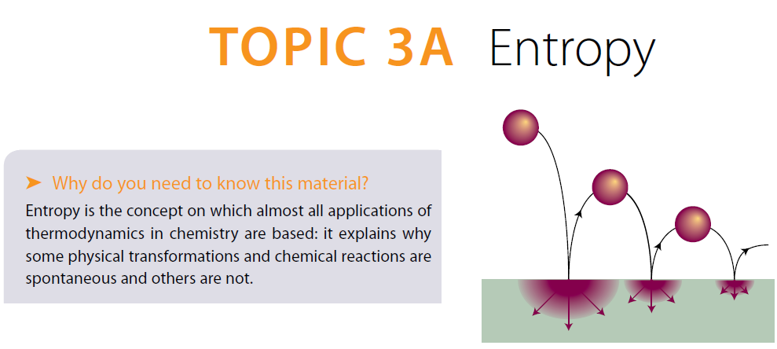

Slide 4
Entropy – the central idea
What determines the direction of spontaneous change? It is not a tendency to achieve a lower energy, because the First Law asserts that the total energy of the universe does not change in any process.
Notes:
Introduce entropy as a direction-giving concept. Emphasize why some processes happen naturally and others do not.

Slide 5
Entropy – the central idea
It turns out that the direction is determined by the manner in which energy and matter are distributed. This concept is made precise by the Second Law of thermodynamics and made quantitative by introducing the property known as ‘entropy’.
Notes:
Introduce entropy as a direction-giving concept. Emphasize why some processes happen naturally and others do not.

Slide 6
Spreading of energy and matter
The direction of spontaneous change for a ball bouncing on a floor. On each bounce some of its energy is degraded into the thermal motion of the atoms of the floor, and that energy then disperses.

Slide 7
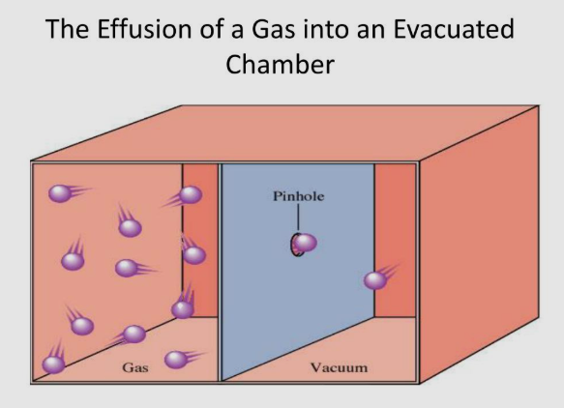
Spreading of energy and matter
The expansion of the gas to an evacuated part of the container is an example of spreading of matter.

Slide 8
3A.1 The Second Law
The signpost of spontaneous change has been identified:
look for the direction of change that leads to the dispersal of Energy or/and Matter
The Second Law of thermodynamics expresses these conclusions more precisely and without referring to the behaviour of the molecules that are responsible for the properties of bulk matter.

Slide 9
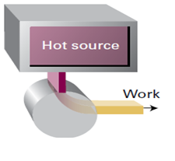

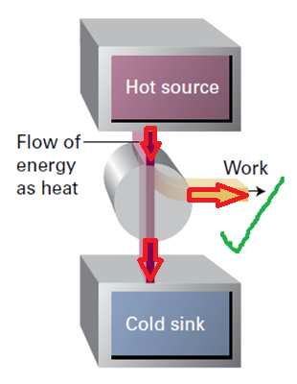
3A.1 The Second Law
Kelvin statement:
No process is possible in which the sole result is the absorption of heat from a reservoir and its complete conversion into work.

Slide 10
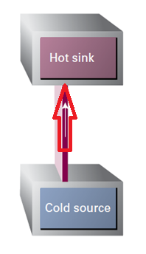
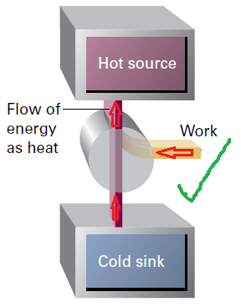
3A.1 The Second Law
Clausius statement:
Heat does not flow spontaneously from a cool body to a hotter body.

Slide 11
3A.1 The Second Law
The entropy of an isolated system increases in the course of a spontaneous change:
ΔS_{tot} > 0
The two statements can be summarized in a single statement which is called :
The Second Law
The entropy (S) is a new state function that we will define in the next slide

Slide 12
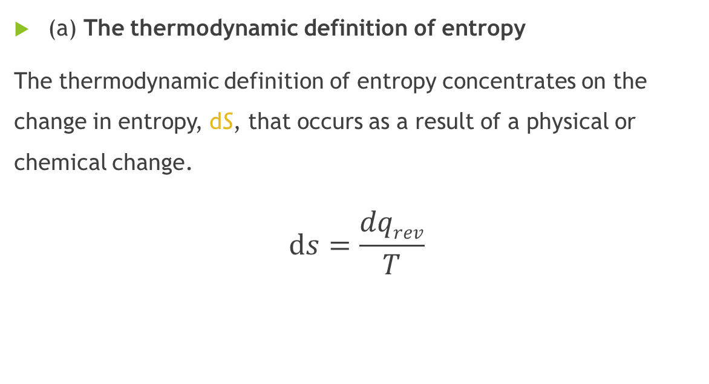
3A.2 The definition of entropy
(a) The thermodynamic definition of entropy
The thermodynamic definition of entropy concentrates on the change in entropy, dS, that occurs as a result of a physical or chemical change.
$$ⅆs=\frac{dqrev}{T}$$
Notes:
Introduce entropy as a direction-giving concept. Emphasize why some processes happen naturally and others do not.

Slide 13
3A.2 The definition of entropy
Let’s see how the definition of entropy is consistent with Kelvin’s and Clausius’s statements
Notes:
Introduce entropy as a direction-giving concept. Emphasize why some processes happen naturally and others do not.

Slide 14
3A.2 The definition of entropy
Notes:
Introduce entropy as a direction-giving concept. Emphasize why some processes happen naturally and others do not.

Slide 15
3A.2 The definition of entropy
Notes:
Introduce entropy as a direction-giving concept. Emphasize why some processes happen naturally and others do not.

Slide 16
3A.2 The definition of entropy
Notes:
Introduce entropy as a direction-giving concept. Emphasize why some processes happen naturally and others do not.

Slide 17
3A.2 The definition of entropy
(b) The statistical definition of entropy
The molecular interpretation of the Second Law and the ‘statistical’ definition of entropy start from the idea that atoms and molecules are distributed over the energy states available to them in accord with the Boltzmann distribution.
S = k ln W
where k is Boltzmann’s constant and W is the number of microstates, the number of ways in which the molecules of a system can be distributed over the energy states for a specified total energy.
Notes:
Introduce entropy as a direction-giving concept. Emphasize why some processes happen naturally and others do not.

Slide 18
3A.2 The definition of entropy
Notes:
Introduce entropy as a direction-giving concept. Emphasize why some processes happen naturally and others do not.

Slide 19
3A.3 The entropy as a state function
Entropy is a state function. To prove this assertion, it is necessary to show that the integral of dS between any two states is independent of the path between them.
Or to show that:
Notes:
Introduce entropy as a direction-giving concept. Emphasize why some processes happen naturally and others do not.

Slide 20
3A.3 The entropy as a state function
The Carnot cycle
Notes:
Introduce entropy as a direction-giving concept. Emphasize why some processes happen naturally and others do not.

Slide 21
3A.3 The entropy as a state function
The Carnot cycle
Notes:
Introduce entropy as a direction-giving concept. Emphasize why some processes happen naturally and others do not.

Slide 22
The Carnot Cycle
 | q | w | ∆U
1st step
2nd step
3rd step
4th step
Cycle
q_{h}=nRT_{h}Ln(V_{B}/V_{A})
-nRT_{h}Ln(V_{B}/V_{A})
0
0
nC_{V}(T_{c} - T_{h})
nC_{V}(T_{c} - T_{h})
q_{c}=nRT_{c}Ln(V_{D}/V_{C})
-nRT_{c}Ln(V_{D}/V_{C})
0
0
nC_{V}(T_{h} - T_{c})
nC_{V}(T_{h} - T_{c})
q_{h} + q_{c}
-(q_{h} + q_{c})
0

Slide 23

The Carnot Cycle
 | q | ∆S
1st step
2nd step
3rd step
4th step
Cycle
q_{h}=nRT_{h}Ln(V_{B}/V_{A})
nRLn(V_{B}/V_{A})
0
0
q_{c}=nRT_{c}Ln(V_{D}/V_{C})
-nRLn(V_{C}/V_{D})
0
0
q_{h} + q_{c}
ΔS_{tot} = ????
$$We must show that: \frac{V_{B}}{V_{A}}=\frac{V_{C}}{V_{D}}$$

Slide 24

The Carnot Cycle
$$\frac{V_{B}}{V_{A}}=\frac{V_{C}}{V_{D}}$$
ΔS_{tot} = 0

Slide 25
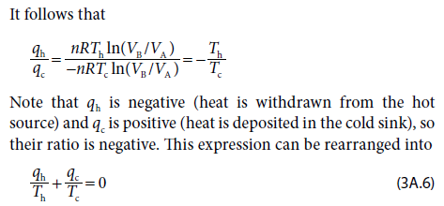

Slide 26
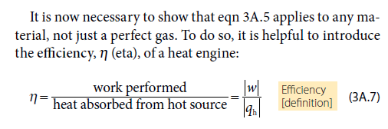
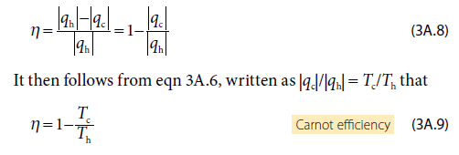

Slide 27
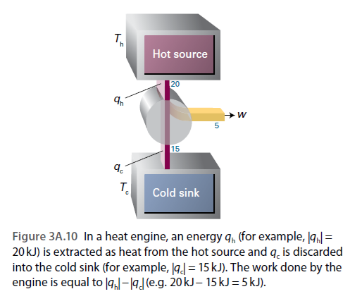

$$η=\frac{w}{q_{h}}=\frac{5}{20}=0.25$$

Slide 28
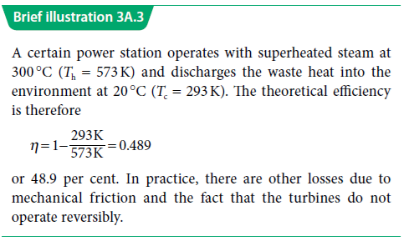

Slide 29
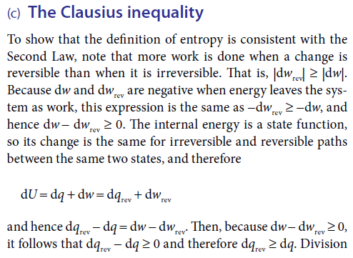

Slide 30
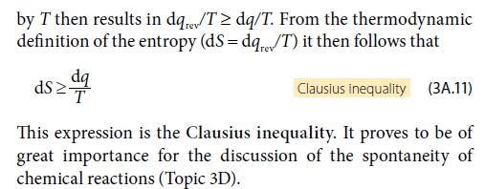


Slide 31
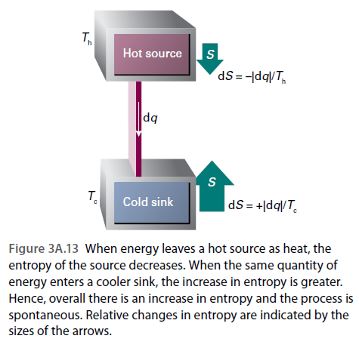

Slide 32
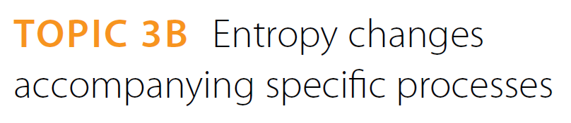

Slide 33
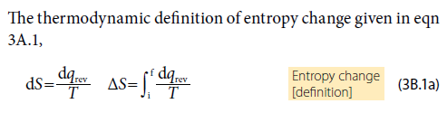
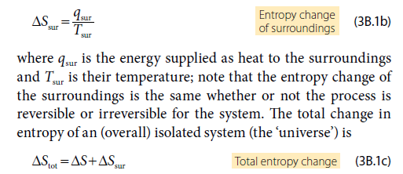

Slide 34
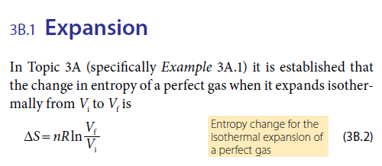

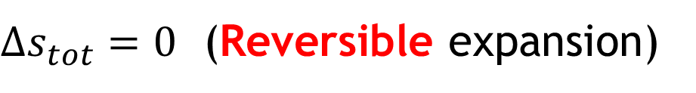
$Δs_{tot}=0$ (Reversible expansion)

Slide 35
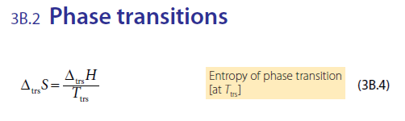
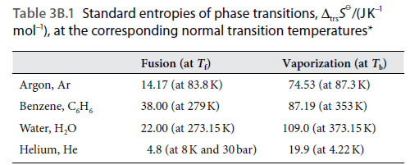

Slide 36
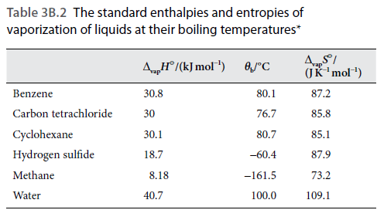
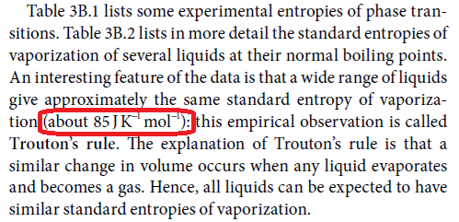

Slide 37
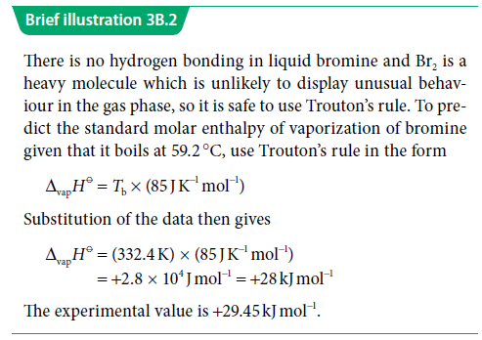

Slide 38
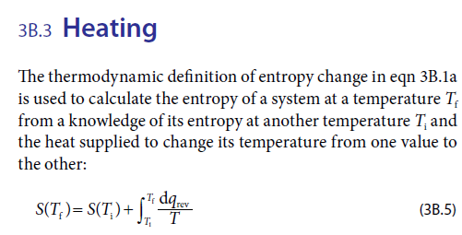


Slide 39
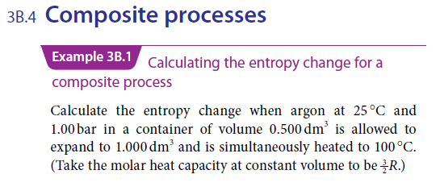
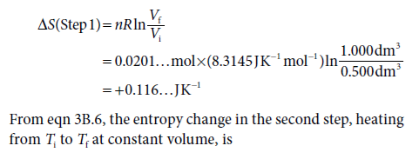

Slide 40
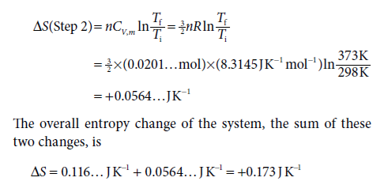

Slide 41


Slide 42

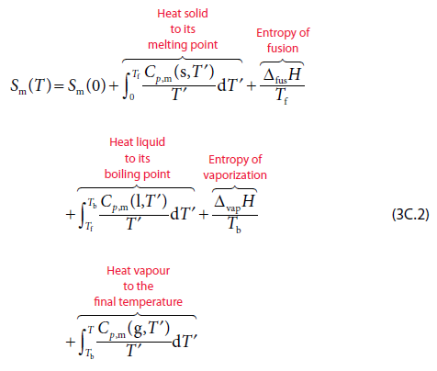

Slide 43
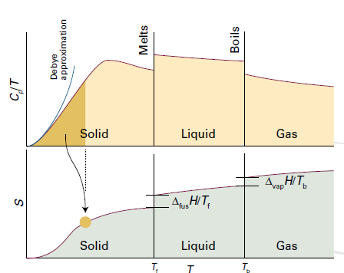
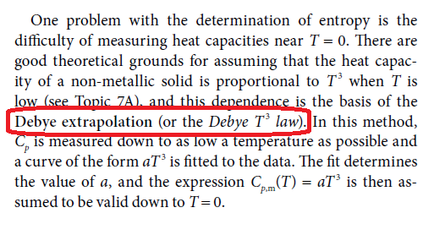

Slide 44
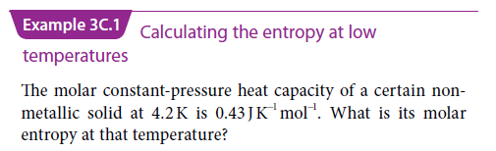
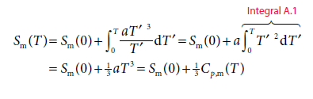


Slide 45
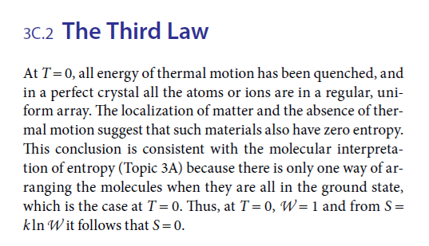

Slide 46
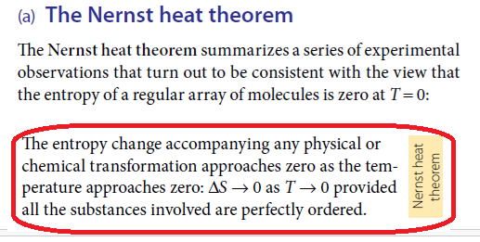

Slide 47
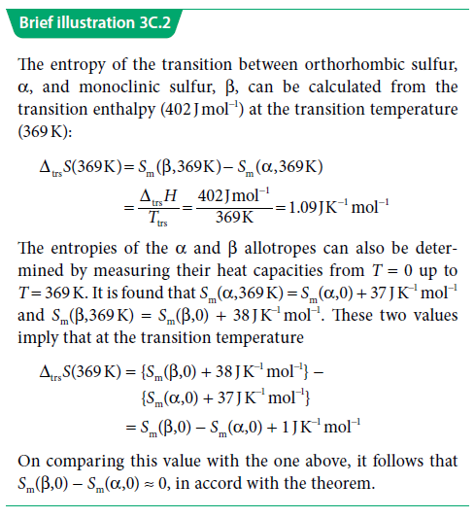

Slide 48
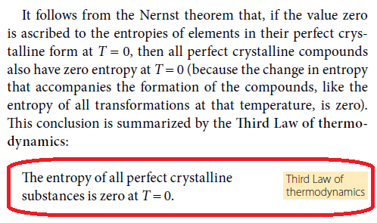

Slide 49
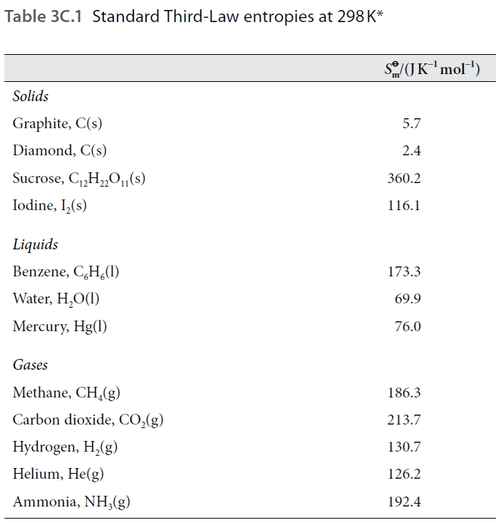

Slide 50
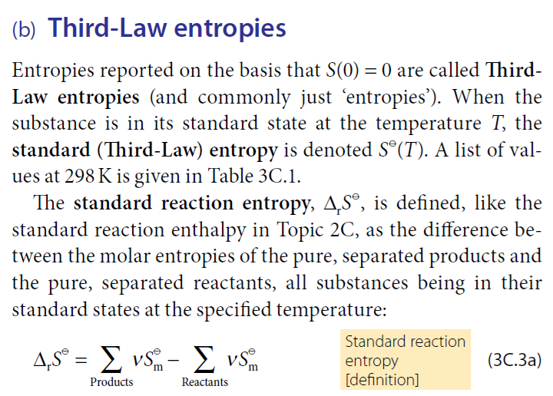

Slide 51
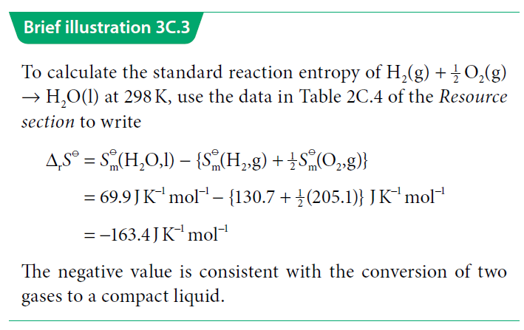

Slide 52
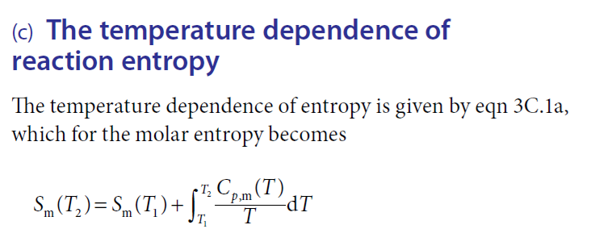
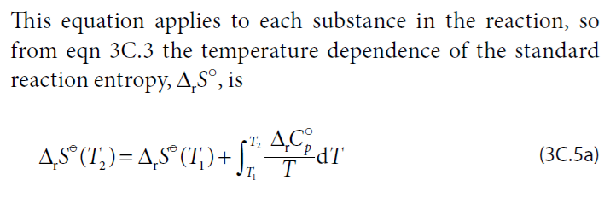

Slide 53
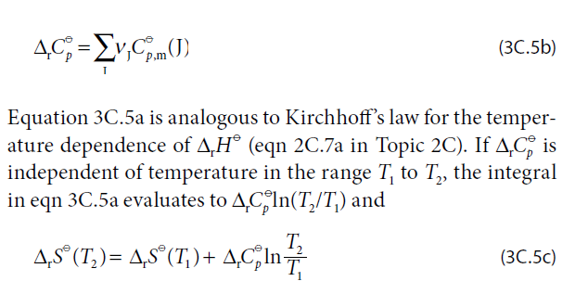

Slide 54
