Slide 1
2nd : Define Medical Terminology
The main ideas:
Define Medical Terminology.
2. Word Parts.
3. Combining Forms.
4. Suffixes

Slide 2
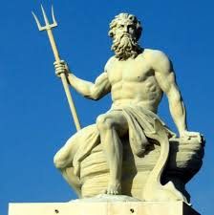
Define Medical Terminology?
Medical terminology is a special vocabulary used by health care professionals for effective and accurate communication.
Because it is based mainly on Greek and Latin words, medical terminology is consistent and uniform throughout the world.

Slide 3
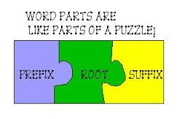
Word Parts :
Words are formed from roots, prefixes, and suffixes.
1)Word Root:
The fundamental unit of each medical word. This establishes the basic meaning of the word and is the part to which modifying prefixes and suffixes are added.
2)A suffix:
Is a short word part or series of parts added at the end of a root to modify its meaning., such as -itis.
3)A prefix:
Is a short word part added before a root to modify its meaning., such as pre.

Slide 4
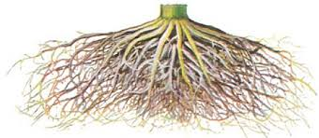

Slide 5
Combining Forms:
When a suffix beginning with a consonant is added to a root, a vowel (usually an o) is inserted between the root and the suffix to aid in pronunciation.
A combining vowel may be added between a root and a suffix.
-Thus, when the suffix –logy, meaning “study of,” is added to the root neur, meaning “nerve or nervous system,”
a combining vowel is added:
neur + o + logy = neurology (study of the nervous system)

Slide 7
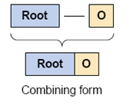
Combining Forms:
*Roots shown with a combining vowel are called combining forms.
Note: A combining vowel usually is not used if the ending begins with a vowel.
The root neur is combined with the suffix -itis, meaning “inflammation of,” in this way:
neur + itis = neuritis (inflammation of a nerve)

Slide 8
When a word ending in x has a suffix added, the x is changed to a g or a c. For example, pharynx (throat) becomes pharyngeal (fa-RIN-je-al), to mean “pertaining to the throat”; coccyx
1- Words Ending In x
2- Suffixes Beginning With rh
When a suffix beginning with rh is added to a root, the r is doubled:
hem/o (blood) + -rhage (bursting forth) = hemorrhage (a bursting forth of blood)
men/o (menses) + -rhea (flow, discharge) = menorrhea (menstrual flow)
(terminal portion of the vertebral column) becomes coccygeal (kok-SIJ-e-al), to mean “pertaining to the coccyx”; thorax (chest) becomes thoracotomy (thor-a-KOT-o-me) to mean “an incision into the chest.”

Slide 9
D. combining vowel
A combining vowel is an important connector between the root to aid in pronunciation, and it is comes to link the root to the suffix or to the other root.
A combining vowel is usually the letter (O) , which has no meaning of its own
It is not used if the ending ( suffix) begins with a vowel as in neuritis .

Slide 10
Examples:
 | Cardi | / o / | gram
Component | Word root | Combining | Suffix
Meaning | Heart | Vowel | Record
 | Nephr | / o / | Logy
Component | Word root | Combining | Suffix
Meaning | Kidney | Vowel | Study of

Slide 11
E. Combining Form
Is the combination of word root with the combining vowel ( o ) .
Example :
Cardi / o is a combining form consists of cardio with h means heart , and the combining vowel ( o ) .

Slide 12
Exercise(1):
1)Fill in the blanks:
1. A root with a vowel added to aid in pronunciation is called a
2. A word part that comes before a root is a(n)
3. Combine the word parts dia-, meaning “through,” and -rhea, meaning “flow,” to form a word meaning" passage of fluid stool.”.
4. Combine the root psych, meaning “mind,” with the suffix -logy, meaning “study of,” to form a word meaning “study of the mind.”
Combining Forms
Prefix
Diarrhea
Psychology

Slide 13
Multiple choice(MCQs): Select the best answer and write the letter of your choice to the left of each number.
_____ 5. Which of the following is a compound word?
a. urinary
b. skeletal
c. gastrointestinal
d. coronary
e. artery

Slide 14
_____ 6. The -ist in the word neurologist is a:
a. prefix
b. root
c. suffix
d. combining form
e. conjunction

Slide 15
_____ 7. Endo- in endoscopic is a:
a. root
b. suffix
c. combining form
d. prefix
e. derivation

Slide 16
Important W0rd Parts
Root- gives the essential meaning of the term.
Suffix- is the word ending.
Prefix- is a small Part added to the beginning of a term.
Combining vowel- connects roots to suffixes and roots to other roots.
Combining form- is the combination of the root and the combining vowel.

