Slide 1
Basic computer principles
Alanoud Al Saleh

Slide 2
Classification:
Computers are classified according to their :
Processing capabilities
Storage capacity
Size
Cost

Slide 3
Types of computers:
Supercomputer
mainframe.
Minicomputer.
Microcomputer.

Slide 4
Supercomputers
They are large , high capacity computers
They can process data at high speed
They are used in oil exploration on studies ,weather forecasts , research …etc
Notes:
6
6

Slide 5
Main frame computer
They are large , high level computers, capable of rigorous computations at high speed .
They have large primary memories and can support many pieces of peripheral equipment which enable multiple users to access the primary memory .
They are used in organization such as banks, universities and government .

Slide 6
Minicomputers
They are mid level computers built to perform complex computation while dealing efficiently with a high level of input and output from users
They usually connect to other minicomputers on a net work
They are used in tomography and magnetic resonance imaging .
Notes:
7
7

Slide 7
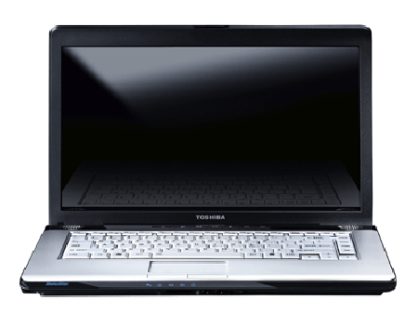
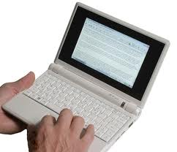
Microcomputer
Also called Personal Computers (PC).
They are small digital computers available in variety of size such as laptops or notebook.
Notes:
8
8

Slide 8
Types of computers: 1-Analog computers 2-Digital computers

Slide 9
Analog computers :
operate on continuous physical quantities .
Digital computers :
operate on digital data.

Slide 10
What is DSP (digital signal processor)?
Analog Computer
a bit loud
Digital Computer
DSP
ADC
DAC
OUTPUT
1010
1001

Slide 11
Digital computers are used in radiological applications therefore it is important to understand the digital systems.

Slide 12
Elements of a digital signal processor
Digital
signal
Digital
output
Digital
processor
DAC
ADC
Analog
signal
Analog
signal
ADC : analogues to digital converter
DAC : digital to analogous converter

Slide 13
Analogue- to- digital conversion
Converts the analogue signal into a sequence of numbers having finite precession

Slide 14
ADC essential parts:
1-Sampler
2-Quantizer
3-Coder
Sampler
Quantizer
Coder
Analog
Input
signal
digital
Input
signal

Slide 15
Sampler
The conversion of continuous time signal into a discrete signal obtained by taking “samples” of a continuous-time signal at a discrete time instants.

Slide 16
Quantizer
The conversion of a discrete-time, discrete-valued (digital) signal.
The value of each signal sample is represented by a value selected from a finite set of possible values.

Slide 17
Coding
The assignment of a binary bit sequence to each discrete output from the quantizer

Slide 18
Digital to analog conversion :
The digital signal processor outputs digital data that are subsequently converted into the analog signals needed to operate analog display devices such as television monitors.
DAC :
Made of solid-state electronics that generates an output voltage to the input digital number

Slide 19
DAC characteristic
Most important is resolution.
It is how finely an analog voltage may be represented, which is determined by the number of digital bits.
DAC resolution
Example:
an 8-bit DAC outputs 256 (2 to the power of 8) analog voltage.
A 12-bit DAC outputs 5096 (2 t0 the power of 12) analog voltage
Which indicates significantly better resolution.

Slide 20
Computer Hardware
Input hardware
Processing hardware
Output hardware

Slide 21
Input hardware
Input refers to the information entered into the computer for processing.
The information can be processed immediately or stored (on magnetic medium).
Input hardware can be placed in two categories:
Keyboard and non-keyboard devices

Slide 22
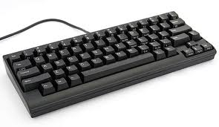
Keyboard devices
Special electromechanical devices that resembles a typewriter keyboard with some additional features. Keyboards are available in different sizes and shapes.

Slide 23
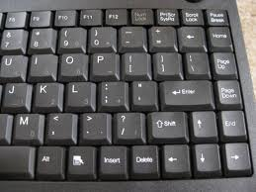
Keyboard devices
They all have at least four common features:
Regular typewriter key with alphabet characters.
Numeric keys (numbers)
Special function keys called programmable keys
Cursor movement keys

Slide 24
Keyboard devices
When characters are entered from the keyboard they are converted into binary codes then sent to the CPU for processing.

Slide 25
Terminals
Terminals are an input- output device with a display screen.
Keyboards are part of terminal and are of three types:
Dumb terminal
Smart terminal
Intelligent terminal

Slide 26
Terminals
Dumb terminals:
Can process information and can only display the
input received from the input hardware.
Smart terminals:
Can process and store information but can not perform any programming operations.
Intelligent terminal:
Are microcomputers that can process data and store it
internally and externally and therefore they can carry out
programming.

Slide 27
Non-keyboard devices
Pointing devices: Light pens, digitizers, touch screen and mouse.
Scanning devices: Image scanner, fax machines, bar code reader.
Voice input devices: Change human speech into eclectic signals.

Slide 28
Processing hardware
Most important characteristics of computers:
Speed---How fast the computer processes data.
Power---Includes speed and other characteristics such as storage capacity and memory size.

Slide 29
Micro-processing speeds
Early computers: 1milliseconds(ms=10 to the power -3 sec) to 1 microseconds (10 to the power -6 sec)
Modern computers 1 nanosecond
Now picoseconds computers

Slide 30
Microprocessor speed
It is expressed in cycles per second, megahertz (MHz) or gigahertz (GHz=10 to the power of 9 cycles per second).

Slide 31
Processing hardware (CPU)
The control unit
Arithmetic-logic unit (ALU)
Registers
Memory

Slide 32
What Goes on Inside the Computer

Slide 33
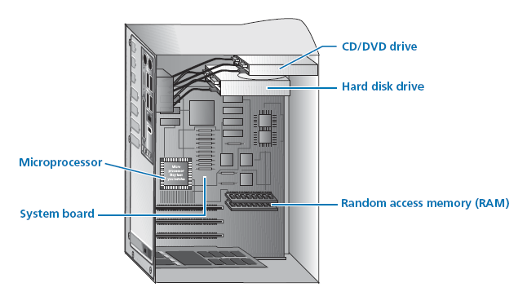
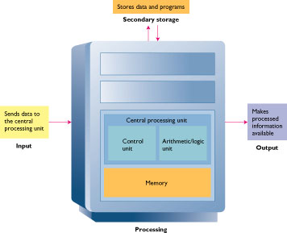
The Central
Processing Unit:

Slide 34
Control Unit- CU
Directs the activities of the computer through programs stored in memory.
Example: it indicates when information is to be moved from memory to ALU and which operations the ALU should carry.
Directs the flow of data from the CPU to the input-output hardware.

Slide 35
Arithmetic / Logic Unit ALU
Executes arithmetic and logic operations including addition, subtraction, multiplication and comparisons such as “equal to”(=), “is less than”(<) or “is greater than”(>).

Slide 36
Registers
Are temporary storage electronic devices.
They hold the data for a short period then send it to internal memory, when it is stored temporarily.

Slide 37
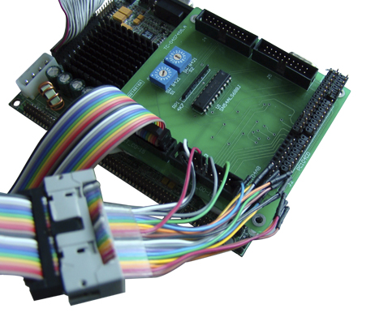
Bus Line

Slide 38
+ The movement of data among other ALU components, it provides a path for the flow of electrical signals between units.
Bus width:
The amount of data transported at a single moment.
Three types:
Data bus (data signal)
Address bus sends data from internal memory
Control bus sends signals from the control unit.
+ A computer with a larger bus size will be faster because it can transfer more data at one time, will have larger memory, and can accommodate an increase in the number and variety of instructions.

Slide 39
Primary storage
Can be referred to as internal memory or simply memory.
They are available in the form of chip, semiconductor chips or integrated circuits.

Slide 40
Internal Memory
The information entered to the computer.
The program that provides the instruction for processing the input information.
The results of the processing

Slide 41
Main Types of Memory
RAM
Random Access Memory
ROM
Read Only Memory

Slide 42
RAM chips
ROM chips
Provides for temporary storage of data and programs that would be lost if the computer loses power.
Storage capacity is expressed in megabytes (MB).
RAM chips type:
Statistic – faster
Dynamic
Contain data and programs to make the computer hardware work and cannot be changed, erased or lost when the computer is turned off.

Slide 43
Out Put Hardware
After the input data and instructions have been processed by the CPU, the results can be stored permanently or made available as soft copy or hard copy output

Slide 44
Hard Copy
Refers to printed output or permanent media, such as papers and films

Slide 45
Hard Copy Devices
Printers,plotters,camera output microforms such as microfiche and microfilm and voice out put devices.

Slide 46
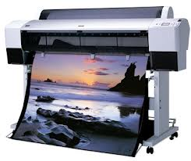
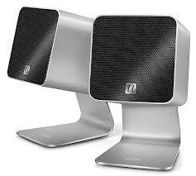
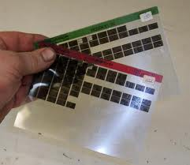
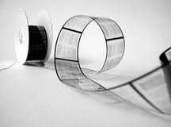
Hard Copy Devices

Slide 47
Printers
Fall into two categories:
Impact
Non impact

Slide 48
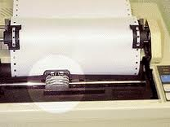
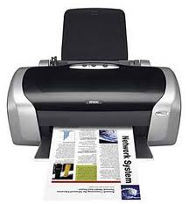
Printers
Impact printers:
They make contact with the paper and include, letter-quality, dot matrix and high speed printers.
Non impact printers:
Includes inject, thermal and laser printers

Slide 49
Plotters
Produce graphics such as 3D drawings, bar charts (graphs) and maps.
They are categorized as :
Drum plotters
Flat-bed plotters
They both use pens for drawing
Electrostatic plotter
Use electrostatic charges on a special paper to produce drawings

Slide 50
Voice Output Devices
They are based on pre-recorded vocalized sounds and the computer can output synthesized words in response to certain codes.

Slide 51
Soft Copy Output
There are two common types of video devices:
Cathode ray tube (CRT)
Flat-panel or flat-screen devices.

Slide 52
Cathode Ray Tube (CRT)
Consists of an electron gun that directs a stream of electrons to strike a phosphor-coated screen located at the opposite end of the gun.
Positioned in front of the screen is a shadow mask, which consist of numerous tiny holes that directs a small part of the beam to strike the screen.

Slide 53
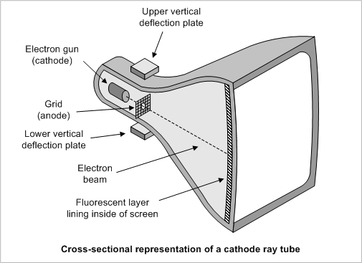
Cathode Ray Tube

Slide 54
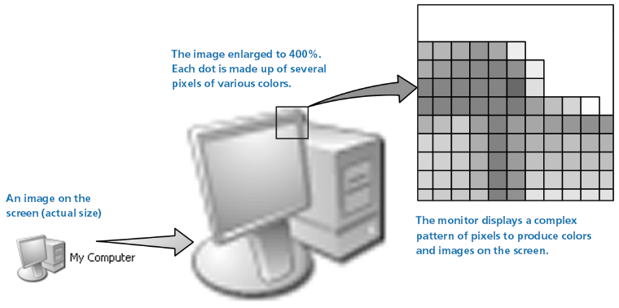
Cathode Ray Tube (CRT)
Each tiny spot that glows on the screen is called a picture element or pixel.
The display image on the screen is thus composed of pixels in both the horizontal and the vertical directions.
This number of pixels determines the resolution or sharpness of the CRT image. In general, the greater the number of pixels the better the resolution.

Slide 55
Flat-screen output devices
They are based on flat-screen technologies and were developed primarily for portable computers.
They include three display technologies:
Liquid crystal display (LCD)
Electro luminescent display (ELD)
Gas plasma display panel (PDP)

Slide 56
Storage Hardware
Includes magnetic tapes and disks and optical disks.
These devices constitute secondary storage , which is nonvolatile , as opposed to primary storage which is volatile.

Slide 57
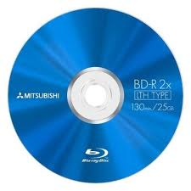
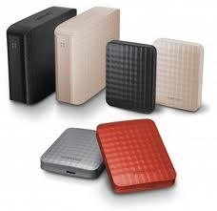
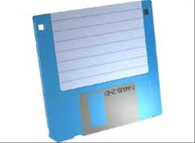
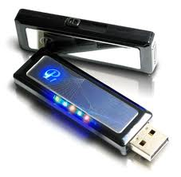
Secondary storage
Magnetic disk storage
floppy disk or hard disk
flash drives

Slide 58
Data Access method
Magnetic storage media can be classified as either
1- sequential access memory
2- random access memory.

Slide 59
Sequential access method
It is analogous to finding a favorite song on an audiotape.
The information is stored in a specific sequence, such as alphabetically and the information is therefore retrieved alphabetically.

Slide 60
Direct random access method
The desired information is accessed directly and therefore this method is much faster than sequential access.

Slide 61
Storage capacity
It is determined by the number of bytes that the device can hold.
Storage capacity are expressed in kilobytes (K), megabytes (MB), gigabytes (GB) and terabytes (TB)

Slide 62
Thank you

