Slide 1
King Saud University College of Engineering IE – 341: “Human Factors” Spring – 2016 (2nd Sem. 1436-7H)
Chapter 3. Information Input and Processing
Part – 5: Memory – Attention
Prepared by: Ahmed M. El-Sherbeeny, PhD

Slide 2
Contents
Memory
Attention

Slide 3
Memory

Slide 4
Memory
Memory: storage of information
Human Memory Subsystems
Sensory storage
Working memory
Long-term memory
Discuss here
Each of 3 subsystems (see next slide)
How information is coded in each
Practical applications in each subsystem
Notes:
Source: Sander and McCormick (Ch. 3), 1993

Slide 5
Cont. Memory

Slide 6
Cont. Memory
Sensory Storage
Mechanism
Part of each sensory channel
Keeps record of stimulus for short period after stimulus is finished then fades
Allows further processing of stimulus
Associated with visual system
“iconic storage”
Lasts $< 1 s$
Associated with auditory system
“echoic storage”
Last: few seconds
Information Representation:
Information not coded
Info. kept in original representation
Sensory representation cannot be prolonged
To keep for longer time ⇒ transfer to working memory
Notes:
Source: Sander and McCormick (Ch. 3), 1993

Slide 7
Cont. Memory
Working Memory (aka Short-term memory)
Information coded as
Visual code
Phonetic code
Semantic code
Note, all 3 can exist at same time in WM for particular stimulus
Visual and phonetic codes
Visual or auditory representations of stimuli
Generated:
Internally from long-term memory (without hearing or seeing)
Using opposite stimulus
e.g. when seeing word DOG ⇒ coded as sound (the word)
e.g. when hearing the word DOG ⇒ visual code/picture of dog
Semantic code
Abstract representations of meaning of stimulus
Important in long-term memory
Notes:
Source: Sander and McCormick (Ch. 3), 1993

Slide 8
Cont. Memory
Cont. Working Memory
Capacity of Working Memory
Information maintained by rehearsal (i.e. paying attention to process)
Example:
Think of four letters (e.g. J, T, N, L)
Count backwards by $3s$ from $187$
What happens? You forget letters after $15s$, why? No rehearsal*
When list of items in memory increases
This “decay” occurs faster
Due to greater gap ⇒ delay in rehearsing each item
Imp. Q: what is max. # of items that can be held in working memory?
Miller, 1956: “magical number”: $7±2$ (i.e. $5−9$) items/units
Made of “chunks” of familiar units (e.g. words), i.e. $7±2$ chunks
This increases capacity of working memory
Example:
C.A.T.D.O.G.R.A.T.: string of 9 items
But CAT.DOG.RAT: 3 chunks (within $7±2$ limit)
Notes:
* Try it with Arabic or English letters

Slide 9
0 5 3 4 2 9 6 7 5 1
055 649 5378
Notes:
Exercise: show slide for a few seconds, then ask a few seconds later what were numbers on screen; numbers below are chunked (3) and so easier to rehearse and keep in Working Memory
Note, same can be done with symbols (e.g. on car plates)

Slide 10
Cont. Memory
Cont. Working Memory
Cont. Capacity of Working Memory
Summary:
Don’t present more than $5−9$ chunks of information to remember
Make chunks meaningful (e.g. $055$)
Provide training on recalling chunked information
Searching Working Memory
Time to search for item in WM list (e.g. names) ↑ as list items ↑ linearly
Time to search for item in WM per item of memory $= 38 ms$
All items are searched for equally
Notes:
* Try it with Arabic or English letters

Slide 11
Cont. Memory
Long-term memory
Transferring information from WM to LTM
Transferred by semantic coding
i.e. by adding meaning to information + linking to items already in LTM
e.g.: studying for exams:
If by repeating material ⇒ hard to recall info.
Effective method: semantically encode info.
Ways to recall information from LTM
Analyze, compare, relate to past knowledge
Organizing info. at start ⇒ easier to transfer to LTM ⇒ more organized info. in LTM ⇒ easier to recall/retrieve info. from LTM
Using “mnemonics” to organize info.:
i.e. use first letter of item in a list and attach word/image to it
Makes info. retrieval faster
Notes:
Source: Sander and McCormick (Ch. 3), 1993

Slide 12
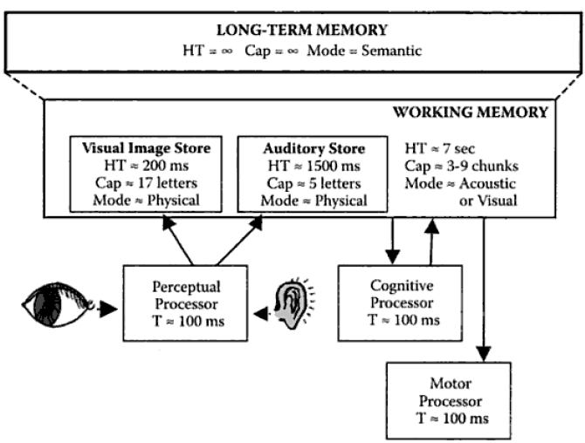
Cont. Memory

Slide 13
Attention

Slide 14
Attention
Four types of attention tasks / situations
Selective attention
Focused attention
Divided attention
Sustained attention
Notes:
Source: Sander and McCormick (Ch. 3), 1993

Slide 15
Cont. Attention
Selective attention
Monitoring several sources of info. (aka channels) to perform a single task
E.g.: A pilot scanning the instruments
E.g.: player looking for opening in soccer field
Improving selective attention
Use as few channels to be scanned for signals as possible
Tell user which channel is more important ⇒ more effective attention
Reduce level of stress on person ⇒ scan more channels
Show person where signal is more likely to show up
Train person on how to scan effectively
Visual channels: keep close together (to scan easier)
Auditory channels: make sure they don’t mask each other
Notes:
Source: Sander and McCormick (Ch. 3), 1993

Slide 16
Cont. Attention
Focused attention
Attending one source of information and excluding other sources
e.g.: trying to read while someone is talking on the phone
e.g.: listening to a person talk in a crowded, noisy gathering
Improving focused attention
Make competing channels as distinct as possible from channel of interest
Separate (in physical space) competing channels from channel of interest
Reduce number of competing channels
Make channel of interest (vs. competing channels)
Larger
Brighter
Louder, etc.
Notes:
Source: Sander and McCormick (Ch. 3), 1993

Slide 17
Cont. Attention
Divided attention
Paying attention to
Two (or more) sources of information,
Perform two (or more) tasks simultaneously (aka time-sharing)
E.g.: driving a car while talking to a passenger
Driving: visual input and manual response
Talking: auditory input and vocal responses
E.g.: eating dinner while watching evening news
Theories existing to explain performance in divided attention:
Single-resource theories: 1 source of resources, shared by all mental processes
Multiple-resource theories: multiple, independent resource pools
Improving divided attention
Minimize as much as possible sources of information
Decrease as much as possible difficulty of tasks
Make tasks as different as possible in terms of input/output modes
Good way to divide attention: prioritize tasks relatively
Notes:
Source: Sander and McCormick (Ch. 3), 1993

Slide 18
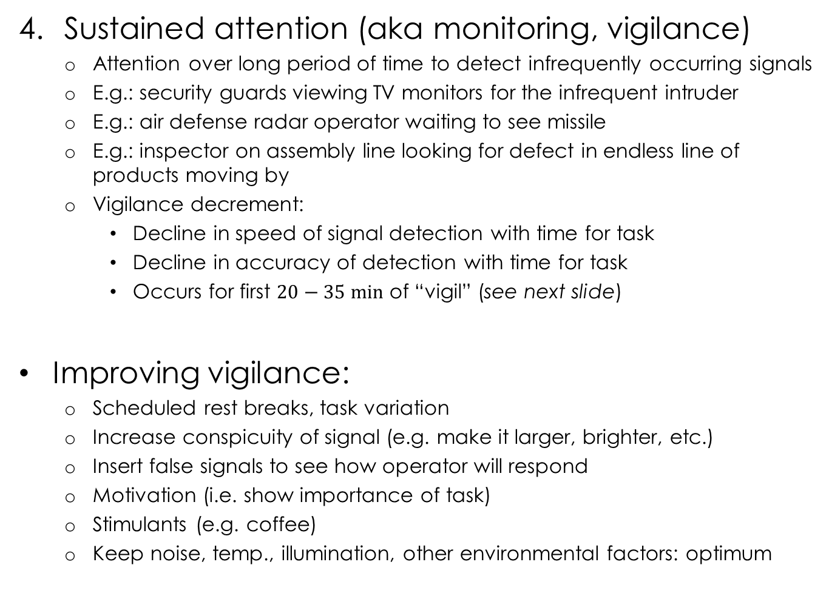
Cont. Attention
Sustained attention (aka monitoring, vigilance)
Attention over long period of time to detect infrequently occurring signals
E.g.: security guards viewing TV monitors for the infrequent intruder
E.g.: air defense radar operator waiting to see missile
E.g.: inspector on assembly line looking for defect in endless line of products moving by
Vigilance decrement:
Decline in speed of signal detection with time for task
Decline in accuracy of detection with time for task
Occurs for first $20−35 min$ of “vigil” (see next slide)
Improving vigilance:
Scheduled rest breaks, task variation
Increase conspicuity of signal (e.g. make it larger, brighter, etc.)
Insert false signals to see how operator will respond
Motivation (i.e. show importance of task)
Stimulants (e.g. coffee)
Keep noise, temp., illumination, other environmental factors: optimum
Notes:
Source: Sander and McCormick (Ch. 3), 1993

Slide 19
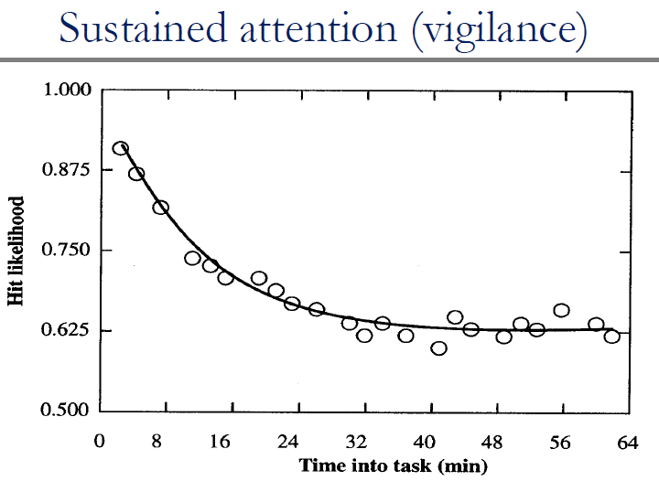
Cont. Attention
Notes:
Source: Sander and McCormick (Ch. 3), 1993

