Slide 1
King Saud University College of Engineering IE – 341: “Human Factors Engineering” Fall – 2017 (1st Sem. 1438-9H)
Chapter 3. Information Input and Processing
Part – 3: Choice Reaction Time Experiments
Prepared by: Ahmed M. El-Sherbeeny, PhD

Slide 2
Contents
Information Theory
Unit of Measure of Information
Choice Reaction Time Experiments
Simple reaction time tasks (SRT)
Choice response time tasks (CRT) - Hick’s Law
Hick-Hyman Law
Summary

Slide 3
Information Theory

Slide 4
Information Theory
Information Processing is AKA:
Cognitive Psychology
Cognitive Engineering
Engineering Psychology
Objectives of Information Theory:
Finding an operational definition of information
Finding a method for measuring information
Note, most concepts of Info. Theory are descriptive (i.e. qualitative vs. quantitative)
Information (Definition):
“Reduction of Uncertainty”
Emphasis is on “highly unlikely” events
Example (information in car):
“Fasten seat belt”: likely event ⇒ not imp. in Info. Th.
“Temperature warning”: unlikely event ⇒ imp.
Notes:
Cognitive: المعرفي

Slide 5
Unit of Measure of Information
Case 1: ≥ 1 equally likely alternative events:
H : amount of information [Bits]
N: number of equally likely alternatives
e.g.: 2 equally likely alternatives ⇒ ⇒ Bit (Def^{n}): “amount of info. to decide between two equally likely (i.e. 50%-50%) alternatives”
e.g.: 4 equally likely alternatives⇒
e.g.: equally likely digits (0-9) ⇒
e.g.: equally likely letters (a-z) ⇒
Note, for each of above, unit [bit] must be stated.

Slide 6
Cont. Unit of Measure of Information
Case 2: ≥ 1 non-equally likely alternatives:
: amount of information [Bits] for single event, i
: probability of occurrence of single event, i
Note, this is not usually significant (i.e. for individual event basis)

Slide 7
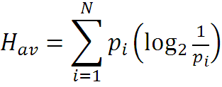
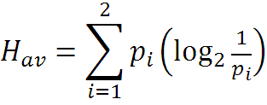
Cont. Unit of Measure of Information
Case 3: Average info. of non-equally likely series of events:
: average information [Bits] from all events
: probability of occurrence of single event, i
N : num. of non-equally likely alternatives/events
e.g.: 2 alternatives (N = 2)
Enemy attacks by land, p₁ = 0.9
Enemy attacks by sea, p₂ = 0.1
⇒

Slide 8
Cont. Unit of Measure of Information
Case 4: Redundancy:
If 2 occurrences: equally likely ⇒
p₁ = p₂ = 0.5 (i.e. 50% each)
⇒ H = H_{max} = 1
In e.g. in last slide, departure from max. info.
= 1 – 0.47 = 0.53 = 53%
Note, as departure from equal prob. ↑ ⇒ %Red. ↑
e.g.: not all English letters equally likely: “th”,“qu”
⇒ %Red. of English language = 68 %
ps. how about Arabic language?

Slide 9
Choice Reaction Time Experiments

Slide 10
Choice Reaction Time Experiments
Important information theory applications:
Simple reaction time tasks (SRT)
Choice response time tasks (CRT) or Hick’s Law
Hick-Hyman Law

Slide 11
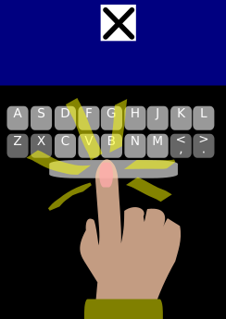
Cont. Choice Reaction Time Experiments
Simple Reaction Time Tasks (SRT)
Used to test how fast human responds in presence of 1 stimulus
e.g. starting to run when hearing starting gun in a race, or moving car when traffic light is green, etc.
try experiment (aka Deary-Liewald task): as fast as you see icon on screen, press ‘space bar’:
Note, how this tests has two aspects:
Correct response rate
How fast you respond ($ms$)
How much did you score?
Experiment shows: humans can score for 1 choice: $<200 ms$
How much do you expect when there is more than one choice?
Notes:
Link to test: http://www.psytoolkit.org/lessons/experiment_simple_choice_rts.html
Source: http://www.psytoolkit.org/lessons/simple_choice_rts.html

Slide 12
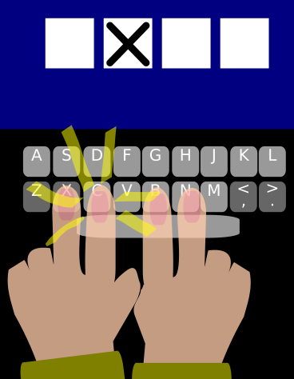
Cont. Choice Reaction Time Experiments
Choice Response Time task (CRT)
Used to test how fast human responds in presence of more than 1 stimulus, i.e. multiple stimuli
e.g. choosing a digit on keyboard from ‘0’ to ‘9’
Each stimulus requires a different response
In general, more stimuli/responses ⇒ slower RT
try 2nd experiment: there are now 4 blocks (choices), with ‘X’ appearing in either of 4 possible positions (i.e. 4 stimuli)
As fast as you see ‘X’ come on, press letter on keyboard that corresponds to it
Note how RT/error rate are now greater
Notes:
My best results for SRT: 250 ms (0% error); CRT: 559 ms (0% error)
Source: http://www.psytoolkit.org/lessons/simple_choice_rts.html

Slide 13
Cont. Choice Reaction Time Experiments
Cont. Choice Response Time task (CRT)
Simplest CRT experiment: 2 stimuli/responses ⇒
Minimum RT = $250 ms$
Typical average: $350 −450 ms$
Note, results greatly affected by type of stimulus & response mode (e.g. verbal/ written/ physical, etc.)
Also, response speed proven to be affected greatly by:
Age
Intelligence
Conditions (e.g. rested vs. tired, hungry or not, etc.)
Speed-accuracy tradeoff (i.e. your aim to make less mistakes or higher speed)
Notes:
Source: http://www.psytoolkit.org/lessons/simple_choice_rts.html

Slide 14
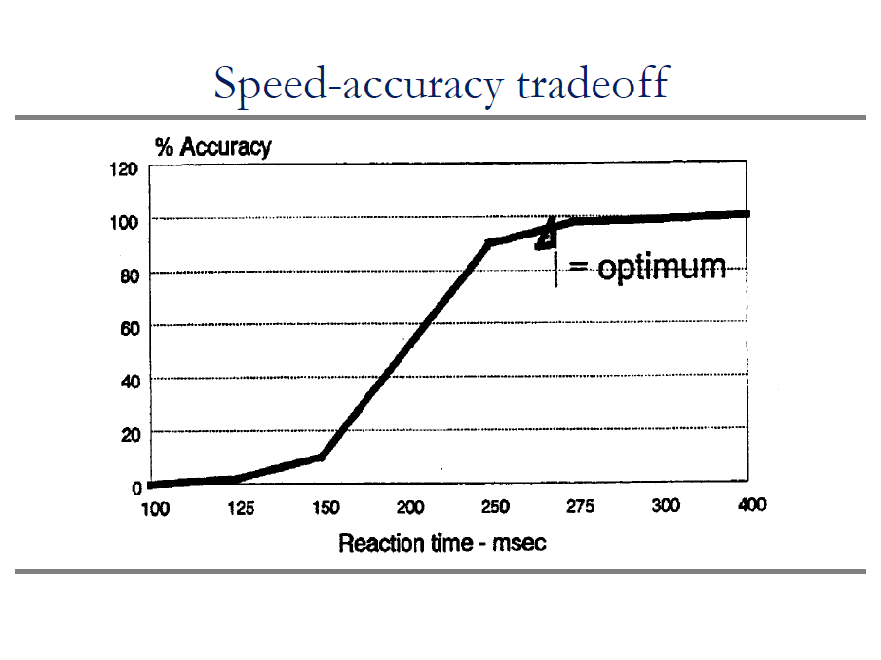
Cont. Choice Reaction Time Experiments
Notes:
Source: http://www.psytoolkit.org/lessons/simple_choice_rts.html

Slide 15
Cont. Choice Reaction Time Experiments
Cont. Choice Response Time task (CRT)
So what is significance of measuring CRT?
RT is indication of time required to
Process/interpret information (i.e. stimuli)
Retrieve information from memory
Initiate muscle responses
i.e. gives good indication of time required to “think” (basic thought process)
This is important part of “cognitive psychology” field
Notes:
Source: http://www.psytoolkit.org/lessons/simple_choice_rts.html

Slide 16
Hick’s and Hick-Hyman Laws
Hick’s Law
Named after British psychologist William E. Hick
Conducted experiments on CRT in 1950’s
He found (1952):
Cognitive information capacity: is assessed as rate of gain of information
As # of equally likely stimuli alternatives ↑ ⇒ RT to stimuli ↑ logarithmically
i.e. RT vs. # stimuli in Bits: linear function (amazing find!)
Given n equally likely choices, $\overline{RT}$ ($T$) required to choose among the choices is:
$$T=b∙\log_{2}\left(n+1\right)$$
where,
$b$: empirical constant (determine from data for person)
Note how $\log_{2}$ indicates how “binary” search is performed
Also, note how “+1” is used to account for 1 choice*
Notes:
* i.e. should you or should you not make a choice; also note how 1 choice give T = b * 1 Bit = b (i.e. minimum time for making a choice as in SRT experiment)
Source: https://en.wikipedia.org/w/index.php?title=Hick%27s_law&redirect=no, Sander’s and McCormick “Human Factors in Engr. and Design”

Slide 17
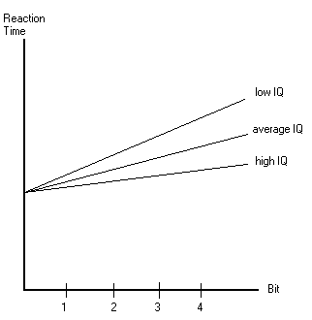
Cont. Choice Reaction Time Experiments
Cont. Hick’s Law
More recent research (E. Roth, 1964): RT affected by IQ
Time (T) required to make a decision,
$$T=Processing Speed∙\log_{2}{n}$$
Example/summary of Hick’s law is shown below
Also, note how this indicates that we don’t think equally of all alternatives (we tend to cancel out ½ alternatives every time we think, as indicated by eq^{n} )
Notes:
Source: https://en.wikipedia.org/w/index.php?title=Hick%27s_law&redirect=no

Slide 18
Cont. Choice Reaction Time Experiments
Hick-Hyman Law (1953):
Hick’s law further analyzed by US psychologist: Ray Hyman
Kept number of stimuli (alternatives) fixed
Varied prob. of occurrence of events/choices (e.g. size of targets) ⇒ law is generalized as follows:
$$T=b∙H$$
$$H=\sum_{i}^{n}{p_{i}}\log_{2}\left(\frac{1}{p_{i}}+1\right)$$
He found: “Hick-Hyman Law”
AGAIN: Reaction time vs. Stimulus (in Bits): linear function!
Compare Hick, Hick-Hyman, Fitts’s Laws in next slide
Notes:
Source: https://en.wikipedia.org/w/index.php?title=Hick%27s_law&redirect=no, Sander’s and McCormick “Human Factors in Engr. and Design”

Slide 19
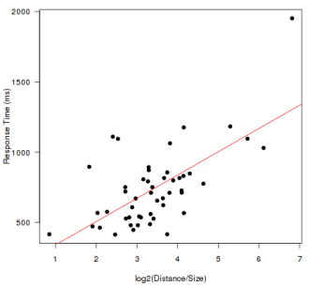
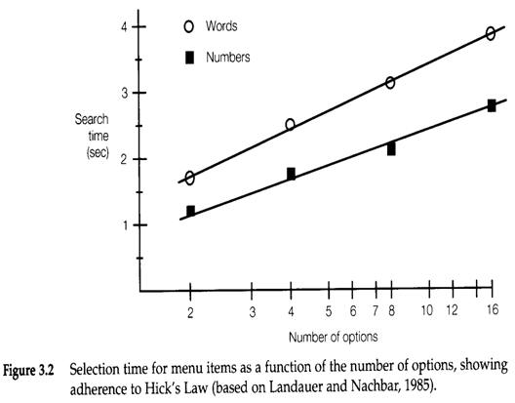
SUMMARY
B
A
C
Notes:
Which is which? A: Fitts’s Law; B: Hick-Hyman Law; C: Hick’s Law

Slide 20
References
Human Factors in Engineering and Design. Mark S. Sanders, Ernest J. McCormick. 7th Ed. McGraw: New York, 1993. ISBN: 0-07-112826-3.
Simple and choice reaction time tasks. From: PsyToolkit. Available at: http://www.psytoolkit.org/lessons/simple_choice_rts.html
Hick's law. From Wikipedia, the free encyclopedia. Available at: https://en.wikipedia.org/w/index.php?title=Hick%27s_law&redirect=no

