Slide 1

CHEM 344 (REQUIRED COURSE)
ORGANIC REACTION MECHANISM
FOR CHEMISTRY’ STUDENTS, COLLEGE OF SCIENCE
Pre-requisites Course; CHEM 241
Credit Hours: 2(2+0)
Prof. Mohamed El-Newehy
Chemistry Department, College of Science, King Saud University
https://faculty.ksu.edu.sa/en/melnewehy
Prof. Zainab Almarhoon
Chemistry Department, College of Science, King Saud University
https://faculty.ksu.edu.sa/en/zalmarhoon

Slide 2
Nucleophilic Substitution Reactions

Slide 3
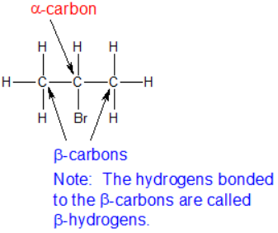
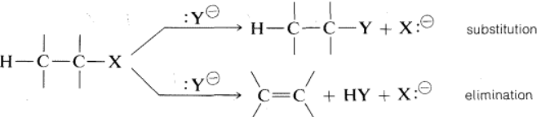
Alkyl Halide Structure
The carbon bonded to a halide is called the alpha-carbon and the carbons bonded to the alpha-carbon are called beta-carbons.
Alkyl halides are polarized at the carbon-halide bond, making the carbon electrophilic.
Alkyl halides can undergo two major types of reactions:
Substitution reactions and/or
Elimination reactions
Nucleophiles will replace the halide in C-X bonds of many alkyl halides (reaction as Lewis's base).
Nucleophiles that are Brønsted bases produce elimination.

Slide 4
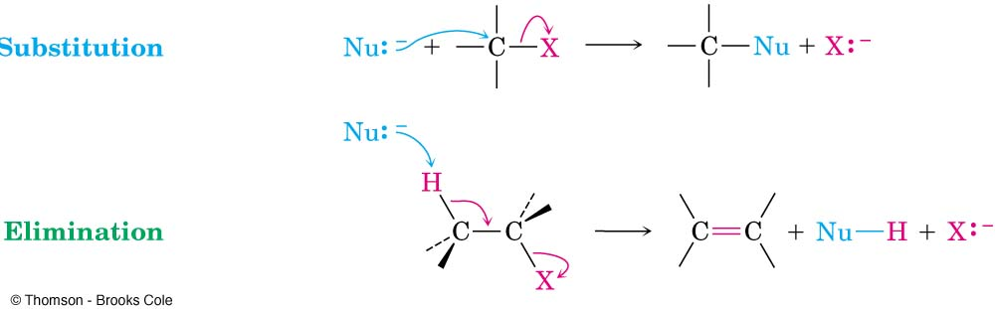
Substitution Reactions
Nu is called the attacking group or a nucleophile
X is called the leaving group or nucleofuge.
In the process forms a new compound R -Nu
The solvent can play the dual role of functioning as a medium or a reactant.
When the solvent acts as one of the reactants the process is called solvolysis.
Many other alkyl derivatives such as alcohols, ethers, esters, and "onium ions" also can undergo S_{N} reactions if conditions are appropriate.

Slide 5
Substitution Reactions: Types of Nucleophilic Substitution Mechanisms
1) S_{N}² (Nucleophilic Substitution Reaction Bimolecular).
One step without intermediate
Occurs in 1º, 2º alkyl halide
2) S_{N}¹ (Nucleophilic Substitution Reaction Unimolecular).
Two steps with carbocation intermediate
Occurs in 3º, allyl, benzyl halide
The mechanism of substitution reaction and the reactivity of a given alkyl compound RX towards a nucleophile Nu depend upon
The nature of R, X, and Nu, and
The nature of the solvent;
It is very important to select a solvent that will dissolve both the alkyl compound and the nucleophilic reagent.

Slide 6
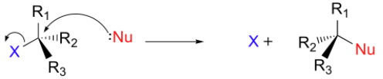
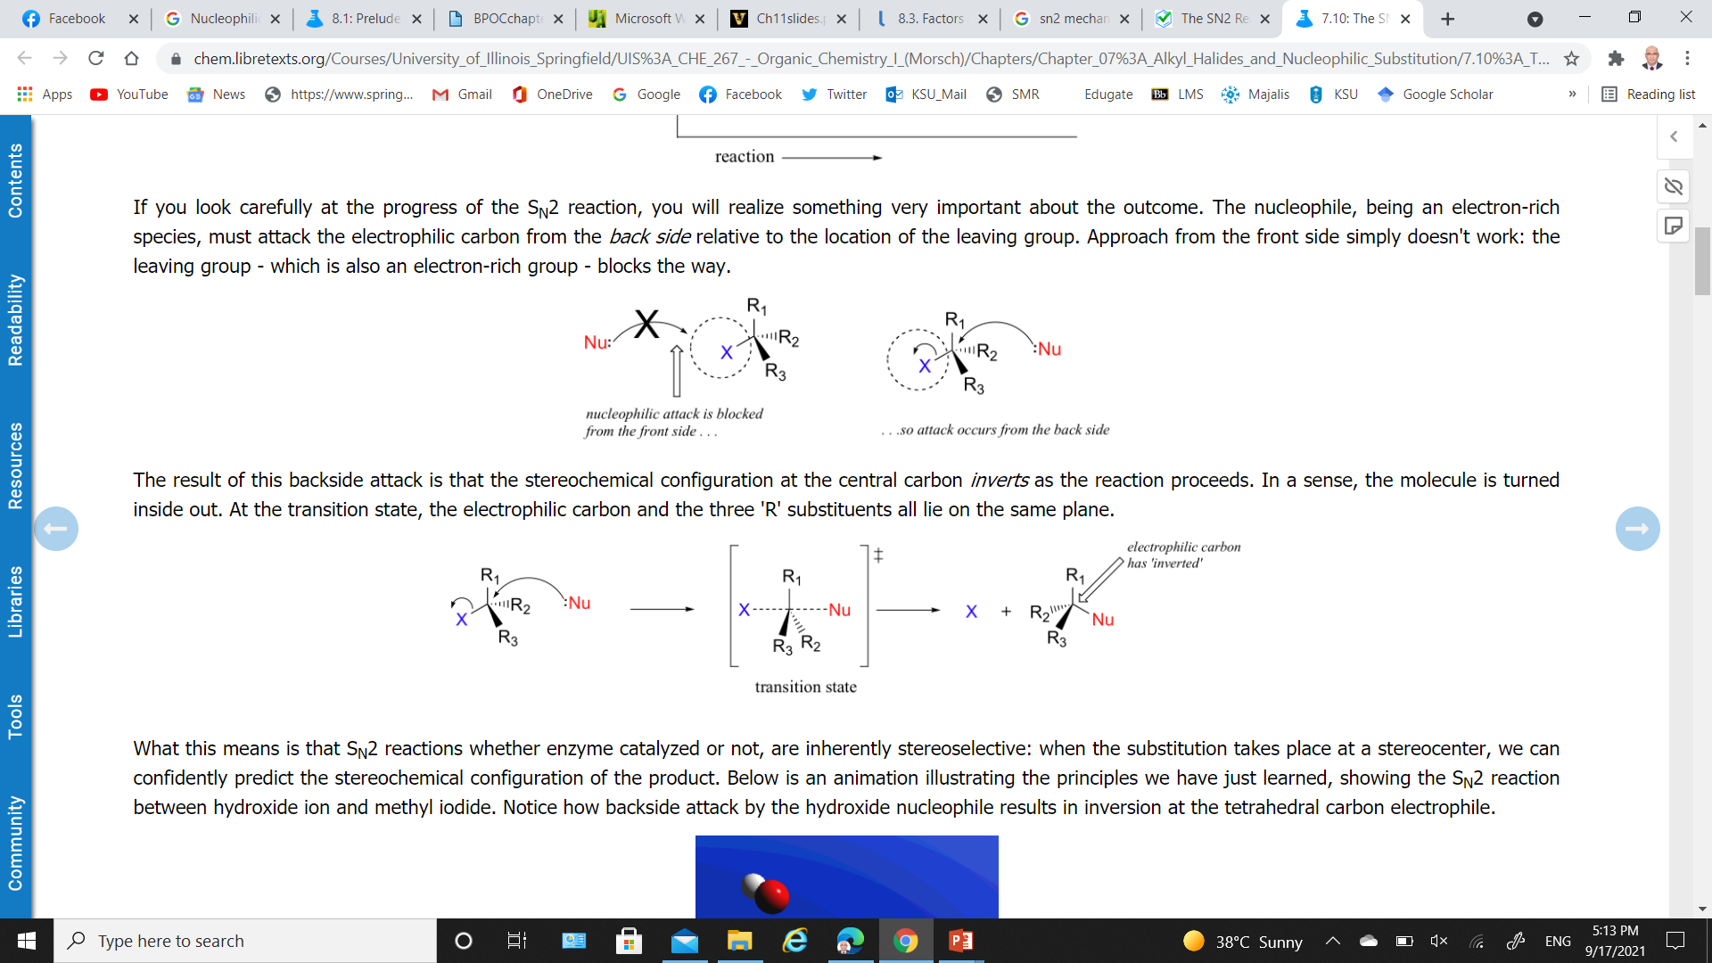
S_{N}² Reaction: Reaction Process
The reaction takes place in a single step; bond-forming and bond-breaking occur simultaneously.
The reaction involves a transition state (TS) .

Slide 7
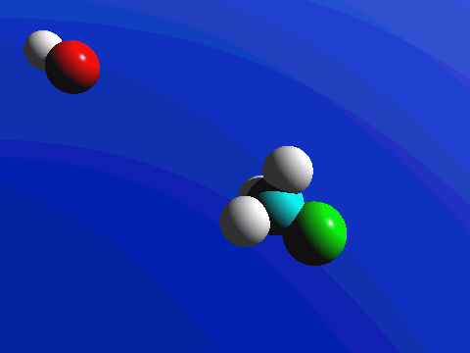
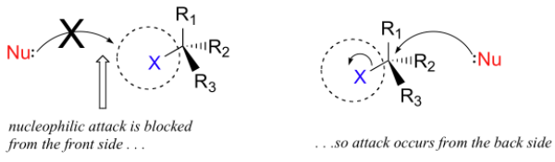
S_{N}² Reaction: Reaction Process
The nucleophile, being an electron-rich species, must attack the electrophilic carbon from the backside relative to the location of the leaving group.
Approach from the front side simply doesn't work: the leaving group - which is also an electron-rich group - blocks the way.

Slide 8
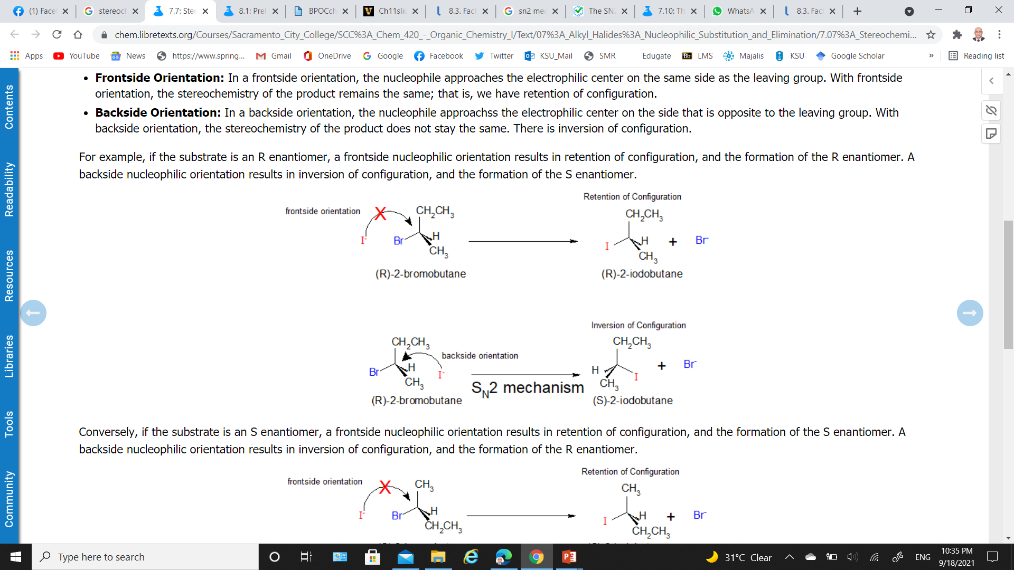
S_{N}² Reaction: Stereochemistry of S_{N}² Reactions
Frontside Orientation:
The nucleophile approaches the electrophilic center on the same side as the leaving group.
The stereochemistry of the product remains the same; retention of configuration.
Backside Orientation
The nucleophile approaches the electrophilic center on the opposite side to the leaving group.
The stereochemistry of the product remains the same; inversion of configuration.

Slide 9
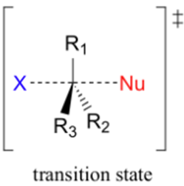
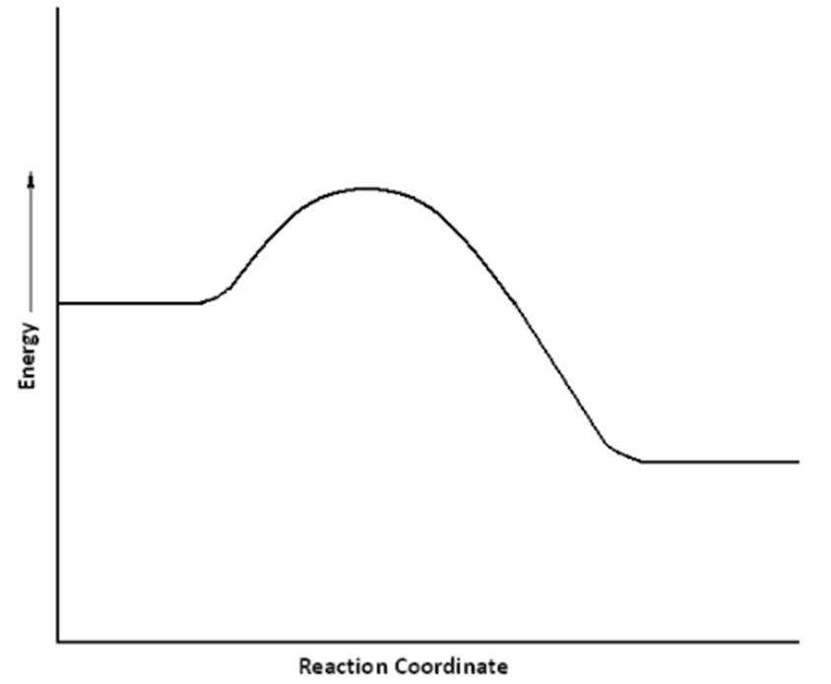
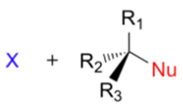
S_{N}² Reaction: Energy Profile Diagram
A potential energy diagram for this reaction shows the transition state (TS) as the highest point on the pathway from reactants to products.
Upon nucleophilic attack, a single transition state is formed.
A transition state, unlike a reaction intermediate, is a very short-lived species that cannot be isolated or directly observed.
Again, this is a single-step, concerted process with the occurrence of a single transition state.

Slide 10
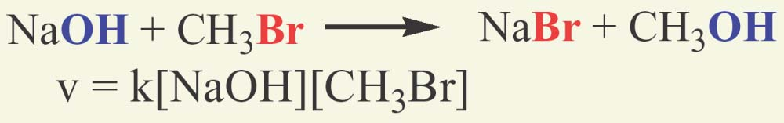
S_{N}² Reaction: Reaction Kinetics
Bimolecular; there are two molecules involved in the rate determining step.
The rate of reactions depends on the concentration of both the haloalkane and the nucleophile.
Rates decrease as concentrations decrease but the rate constant does not
Rate units: [concentration]/time such as L/(mol x s)
The order of a reaction is sum of the exponents of the concentrations in the rate law – the example is second order
In the presence of large excess of nucleophile, the kinetics tends to follow first order even though the mechanism is bimolecular.

Slide 11
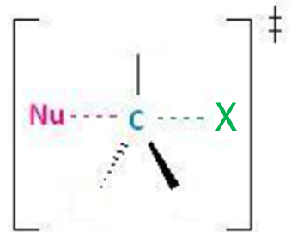
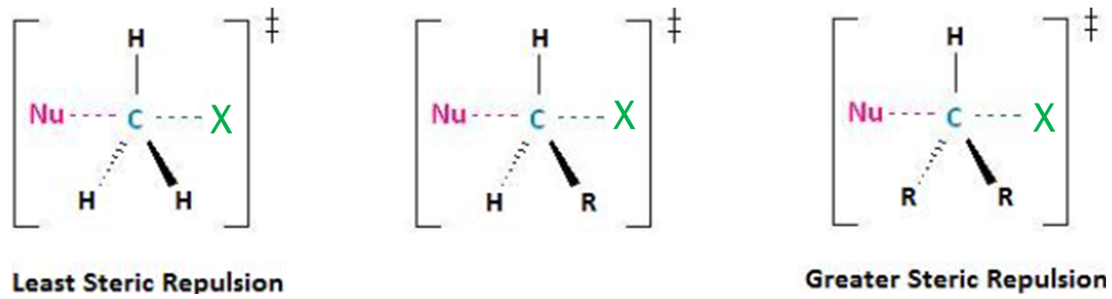
S_{N}² Reaction: Steric Hindrance Effect on the S_{N}² Reaction Rate
Transition state; there are a total of five groups around the electrophilic center; the nucleophile, the leaving group and three substituents.
If the hydrogens were replaced by R groups, there would be an increase in steric repulsion with the incoming nucleophile.

Slide 12
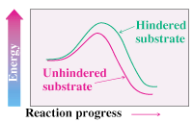
S_{N}² Reaction: Steric Hindrance Effect on the S_{N}² Reaction Rate
Steric Hindrance raises Transition State Energy
Very hindered
Steric effects destabilize transition states
Severe steric effects can also destabilize ground state

Slide 13
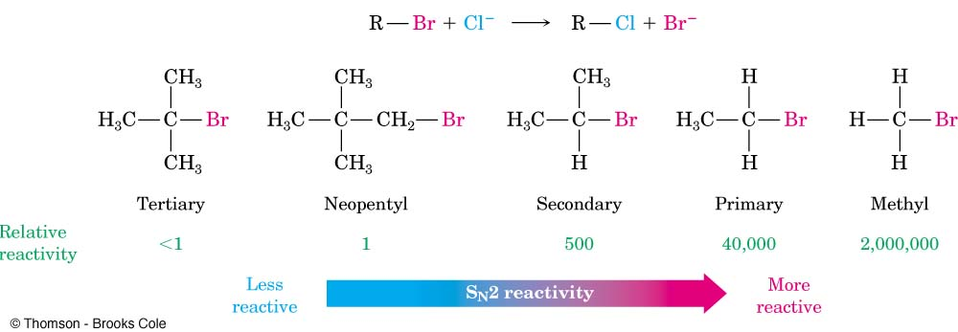
S_{N}² Reaction: Factors Affecting The S_{N}² Reaction
The Electrophile: Structure of the alkyl group
If the groups attached to the carbon are larger, though, like methyl groups;
the transition state energy increases, the activation energy increases, and the reaction becomes much slower.
This means that the reactivity order for alkyl halides in S_{N}² reactions is:

Slide 14
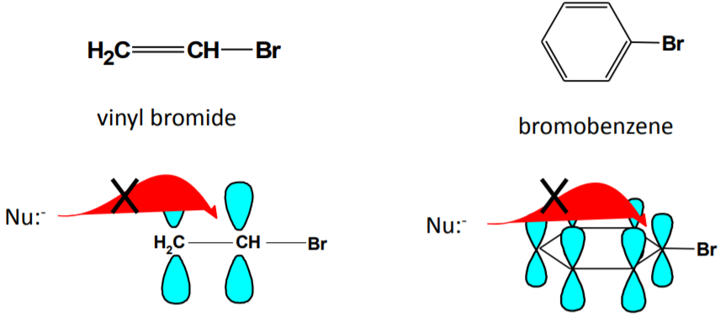
S_{N}² Reaction: Factors Affecting The S_{N}² Reaction
The Electrophile: Structure of the alkyl group
The α-carbon in vinyl and aryl halides, as in 3º carbocation, is completely hindered and these alkyl halides do not undergo S_{N}² reactions.
The overlapping p-orbitals that form the π-bonds in vinyl and aryl halides completely block the access of a nucleophile to the back side of the α-carbon

Slide 15
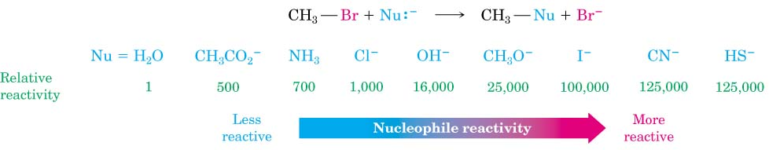
S_{N}² Reaction: Factors Affecting The S_{N}² Reaction
The Nucleophile: Structure Function Correlation with Nucleophile
In S_{N}² reaction, stronger the nucleophile faster would be the reaction.
More free nucleophile, more nucleophilicity
NaOH_{DMSO} > NaOH_{water} (Basicity)
In water, Na⁺ and HO⁻, both are solvated.
While in DMSO, Na⁺ is solvated preferably than HO⁻ leaving HO⁻ as free nucleophile.

Slide 16
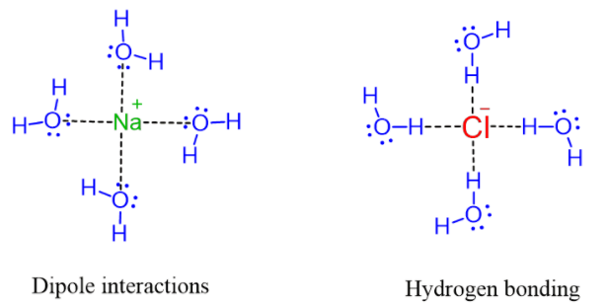
S_{N}² Reaction: Factors Affecting The S_{N}² Reaction
The Solvent: The Role of Solvent in S_{N}² Reactions
Polar protic solvents; contain a hydrogen connected to an electronegative atom.
Examples: water and alcohols.
They can make intermolecular hydrogen bonding and dipole-dipole interactions
Polar protic solvent solvate both cations and anions and puts the nucleophile in a cage, thus making it weaker
HO⁻

Slide 17
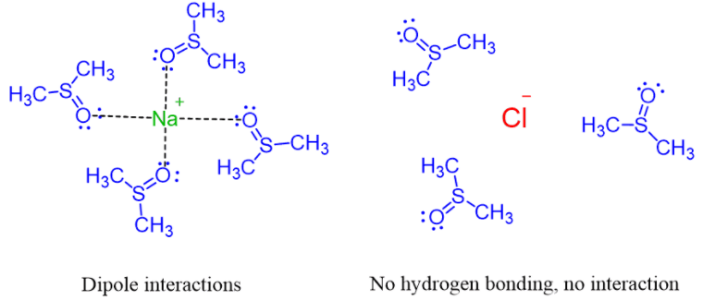
S_{N}² Reaction: Factors Affecting The S_{N}² Reaction
The Solvent: The Role of Solvent in S_{N}² Reactions
Polar aprotic solvents; are the ones without a hydrogen
Examples: acetone, acetonitrile, DMF, DMSO, HMPA.
Lack of intermolecular hydrogen bonding but can make dipole-dipole interactions.
Polar aprotic solvent solvates only the cation leaving the anion free.
HO⁻
As a result, in the polar aprotic solvent, it becomes a stronger nucleophile since the countering does reduce its reactivity.

Slide 18
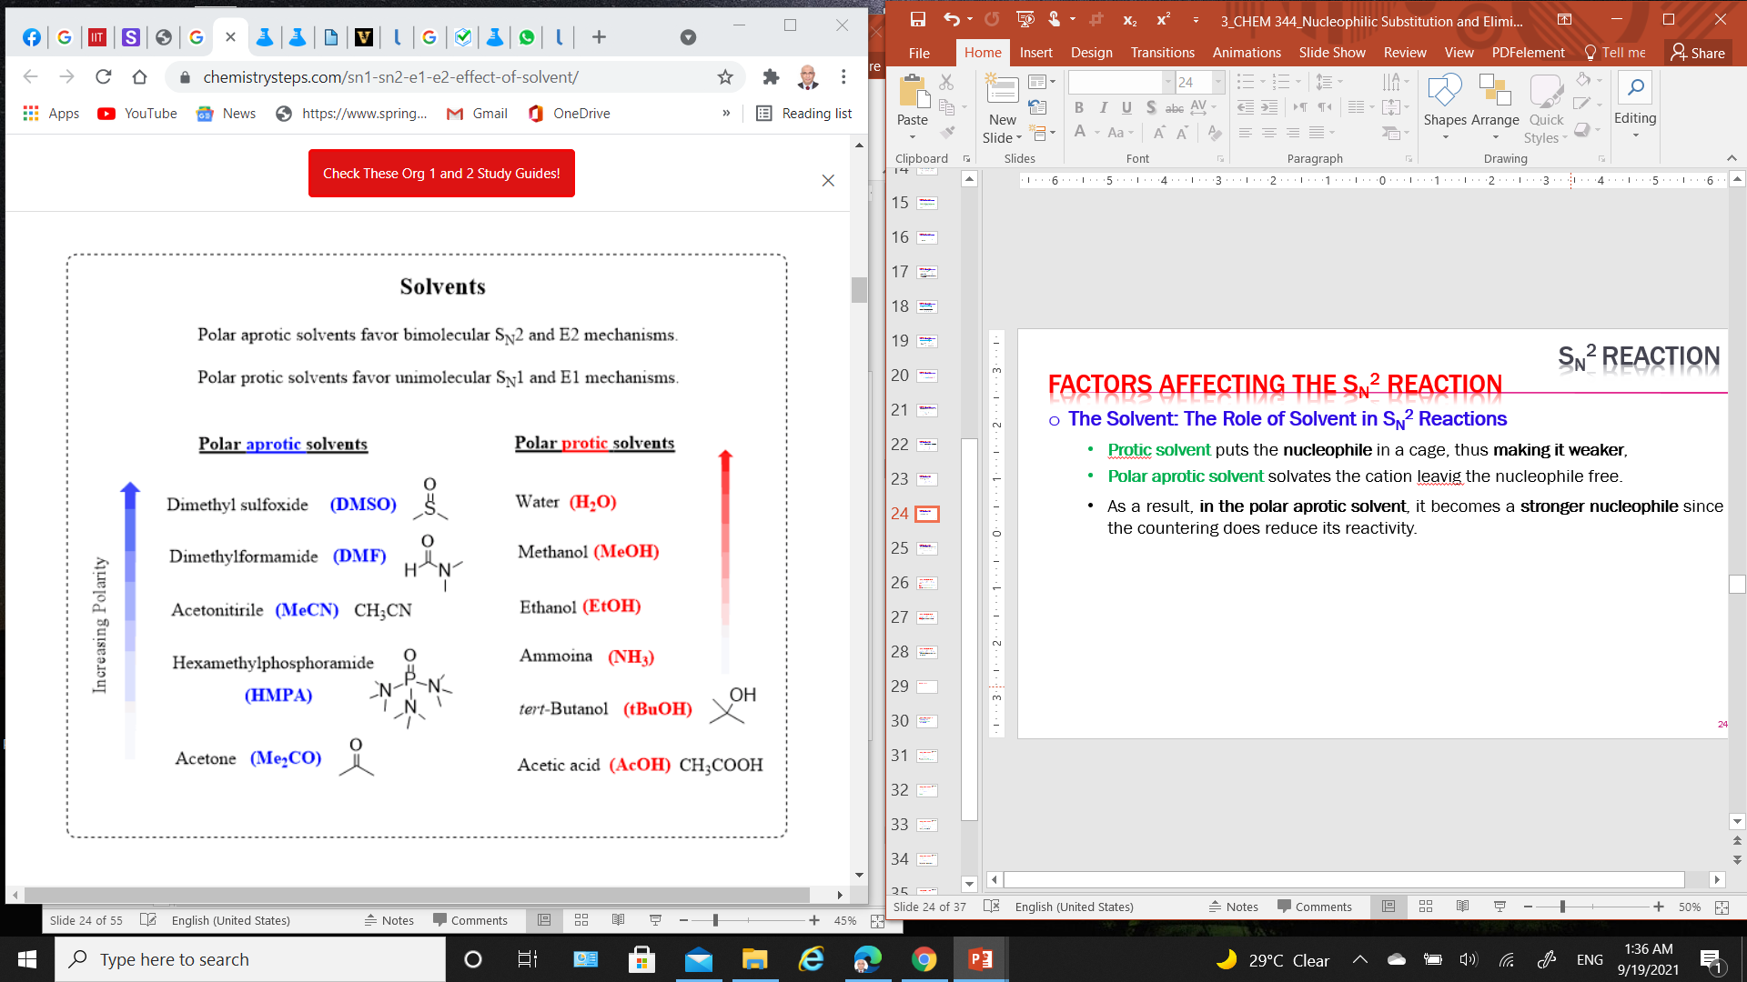
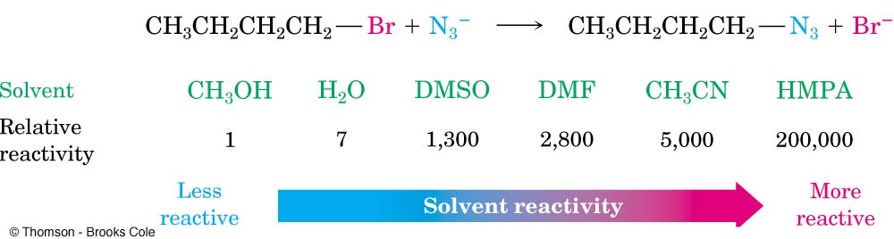
S_{N}² Reaction: Factors Affecting The S_{N}² Reaction
The Solvent: The Role of Solvent in S_{N}² Reactions
Polar protic solvents that can donate hydrogen bonds (-OH or –NH) slow S_{N}² reactions by associating with reactants.
Energy is required to break interactions between reactant and solvent.
Polar aprotic solvents (no NH, OH, SH) form weaker interactions with substrate and permit faster reaction.
Polar aprotic solvents favor bimolecular S_{N}² and E2 mechanisms.
Polar protic solvents favor bimolecular S_{N}¹ and E1 mechanisms.

Slide 19
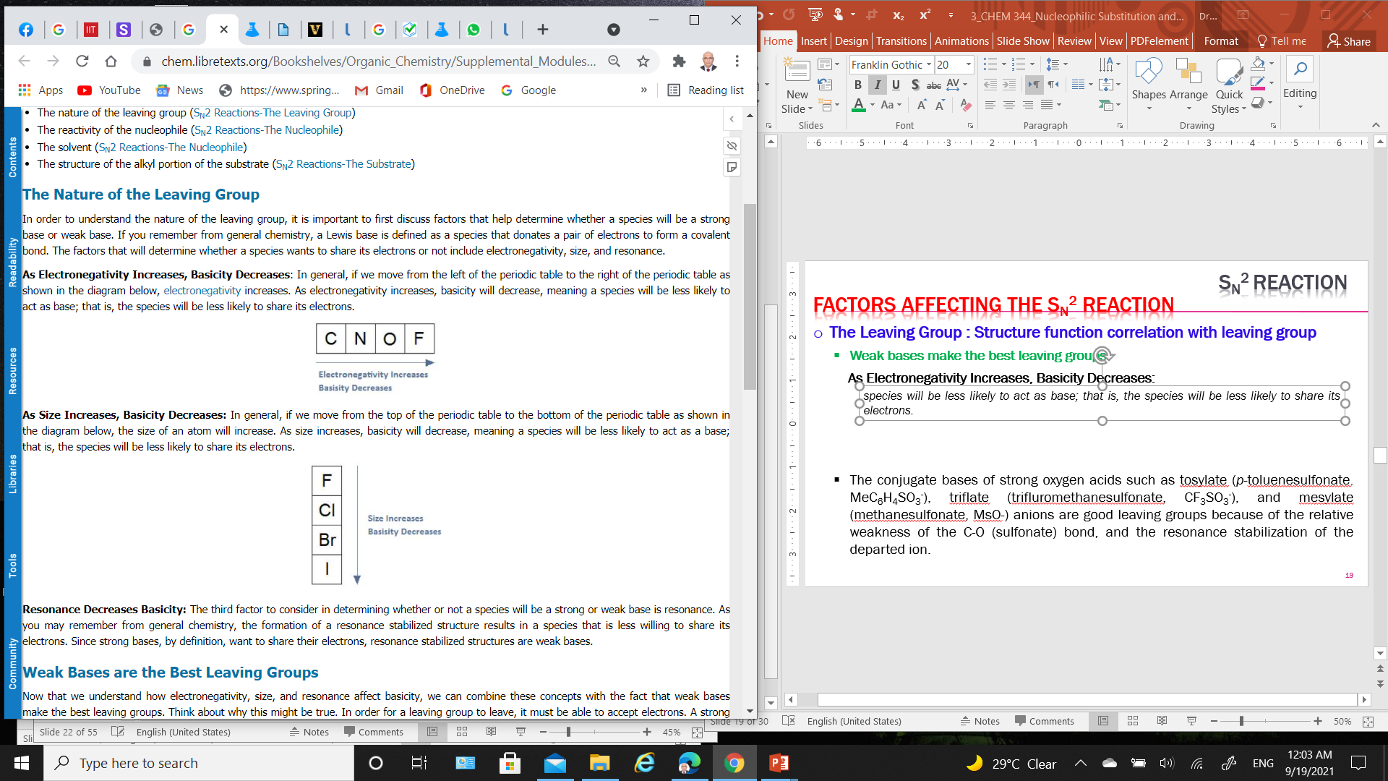
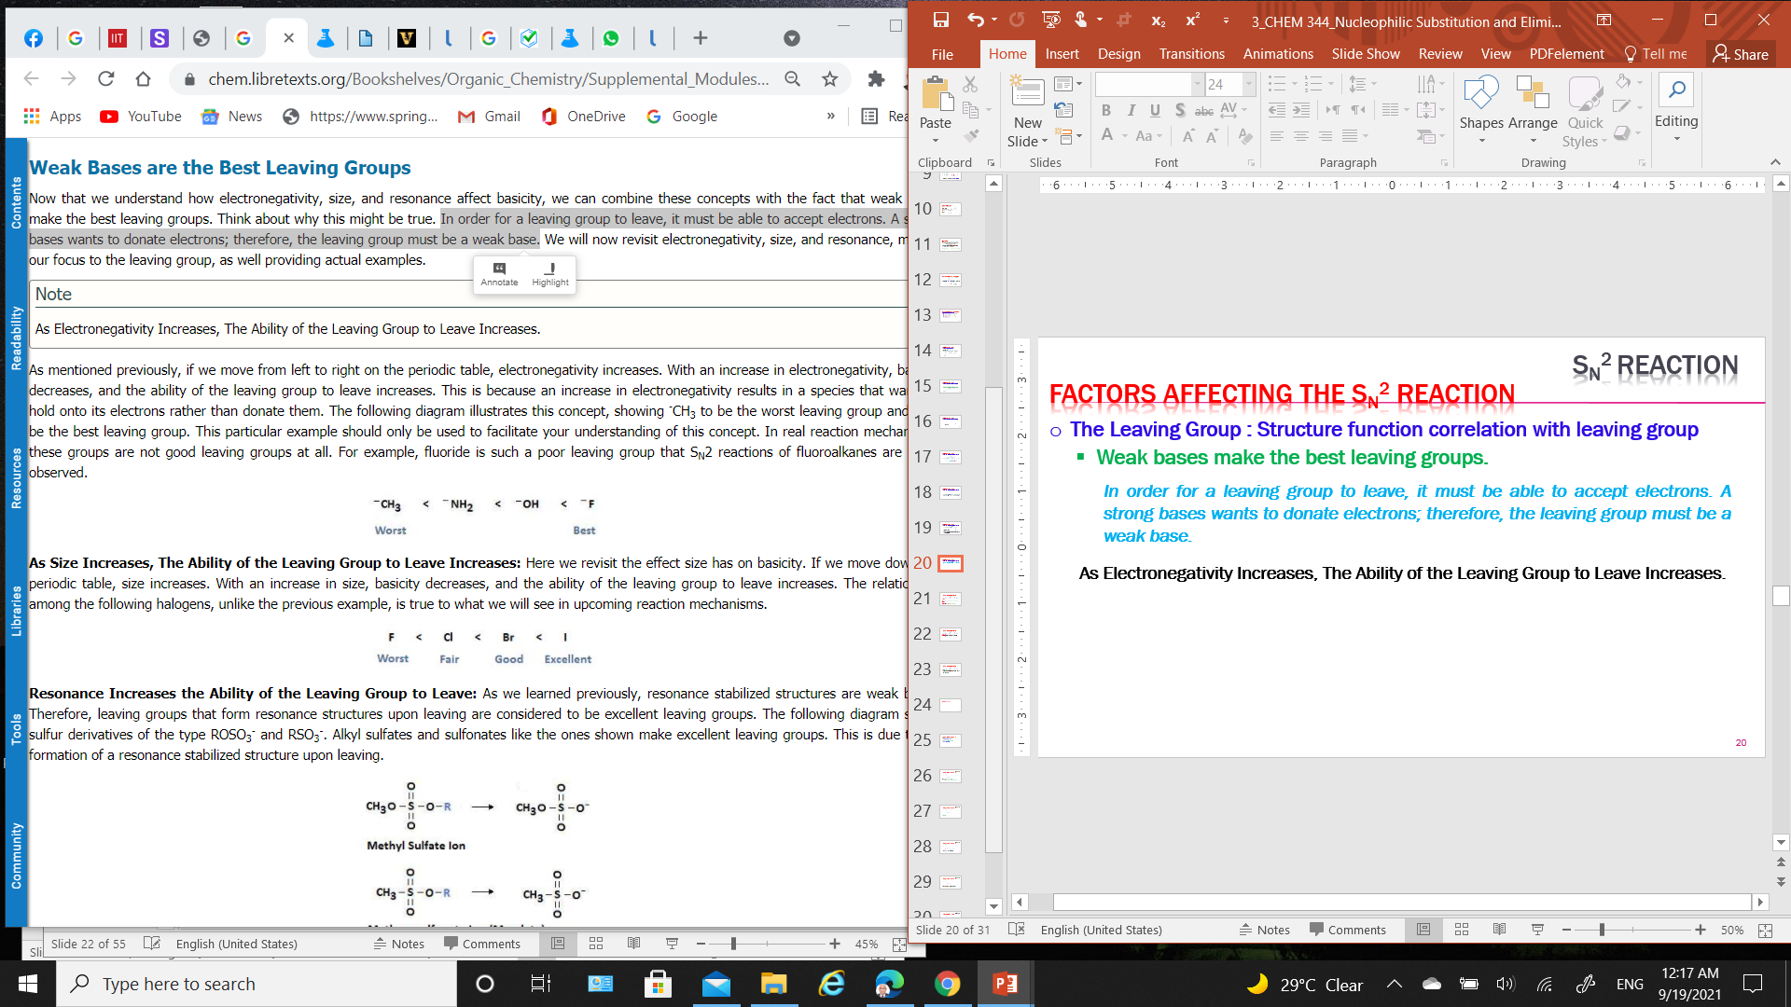
S_{N}² Reaction: Factors Affecting The S_{N}² Reaction
The Leaving Group: Structure function correlation with leaving group
Weak bases make the best leaving groups.
For a leaving group to leave, it must be able to accept electrons.
A strong base wants to donate electrons; therefore, the leaving group must be a weak base.
The basicity decreases with increasing Electronegativity and Size results in increasing ability of the leaving group to leave.
Electronegativity:
This is because an increase in electronegativity results in a species that wants to hold onto its electrons rather than donate them.
Size:
With an increase in size, basicity decreases, and the ability of the leaving group to leave increases.

Slide 20
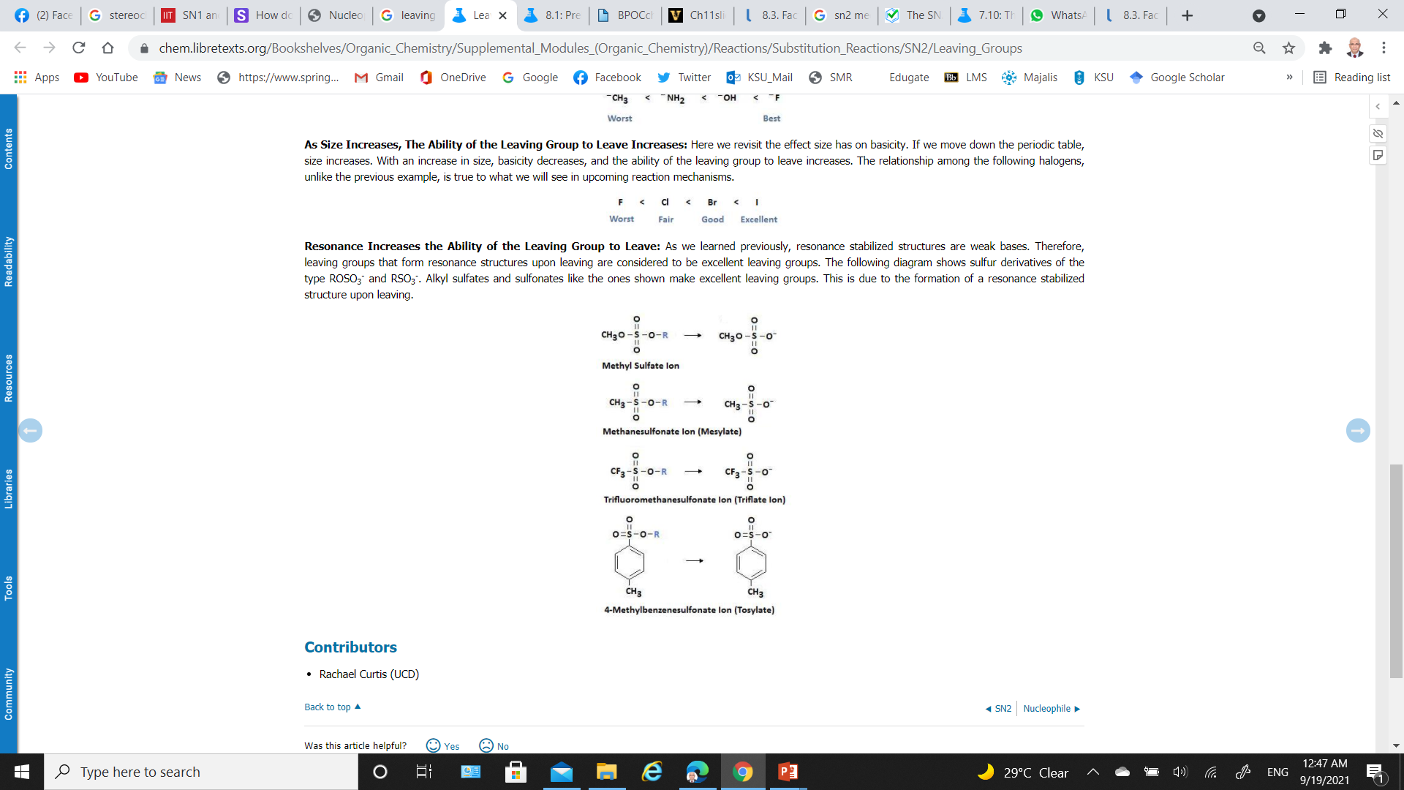
S_{N}² Reaction: Factors Affecting The S_{N}² Reaction
The Leaving Group: Structure function correlation with leaving group
Resonance decreases Basicity and subsequently increases the ability of the leaving group to leave:
Resonance stabilized structures are weak bases.
Therefore, leaving groups that form resonance structures upon leaving are considered to be excellent leaving groups due to stabilization by resonance that leads to weak bases.

Slide 21
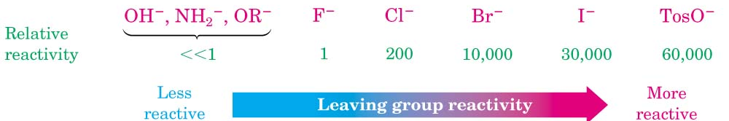
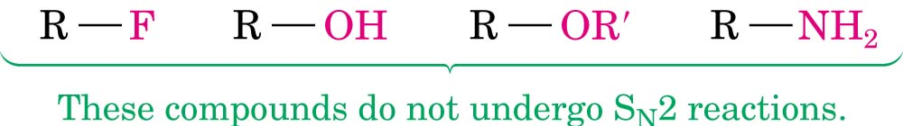
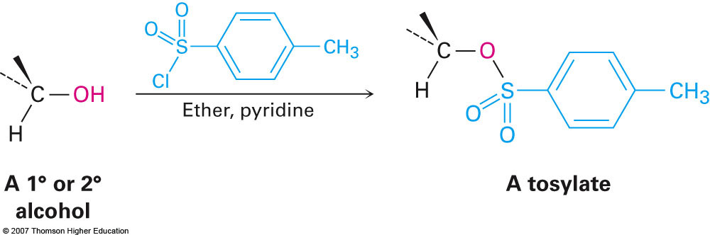
S_{N}² Reaction: Factors Affecting The S_{N}² Reaction
The Leaving Group: Structure function correlation with leaving group
Better the leaving group, faster is the reaction.
Good leaving groups are large, of low electronegativity and low nucleophilicity.
The iodide ion (I⁻) is larger in size, thus has high polarizability, and is better solvated by the solvent, therefore, it is better leaving group than fluoride ion.
Poor Leaving Groups; Alkyl fluorides, alcohols, ethers, and amines.
Poor Leaving groups can be made into good leaving groups.
“Tosyl chloride”

Slide 22
S_{N}² Reaction: Summary
Reaction is:
Stereospecific (Walden Inversion of configuration)
Concerted - all bonds form and break at same time
Bimolecular - rate depends on concentration of both nucleophile and substrate
Substrate:
Best if primary alkyl halide (one substituent on carbon bearing leaving group)
works if secondary, fails if tertiary alkyl halide
Nucleophile: Best if more reactive (i.e. more anionic or more basic)
Leaving Group: Best if more stable (i.e. can support negative charge well):
TsO- (very good) > I- > Br- > Cl- > F- (poor)
RF , ROH , ROR , RNH₂ are NEVER Substrates for S_{N}² reactions
Leaving Groups on double-bonded carbons are never replaced by S_{N}² reactions
Solvent:
Polar Aprotic (i.e. no OH) is best
Protic solvents (e.g. H₂O or ROH) deactivate nucleophile by hydrogen bonding.

Slide 23
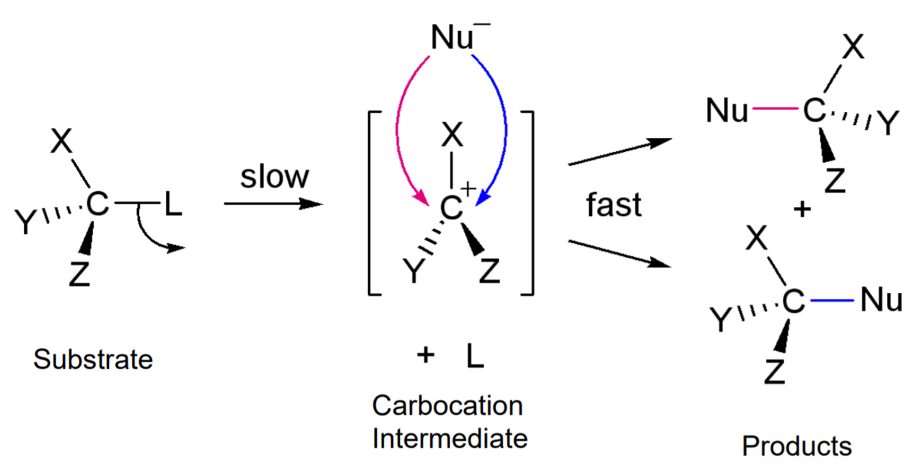
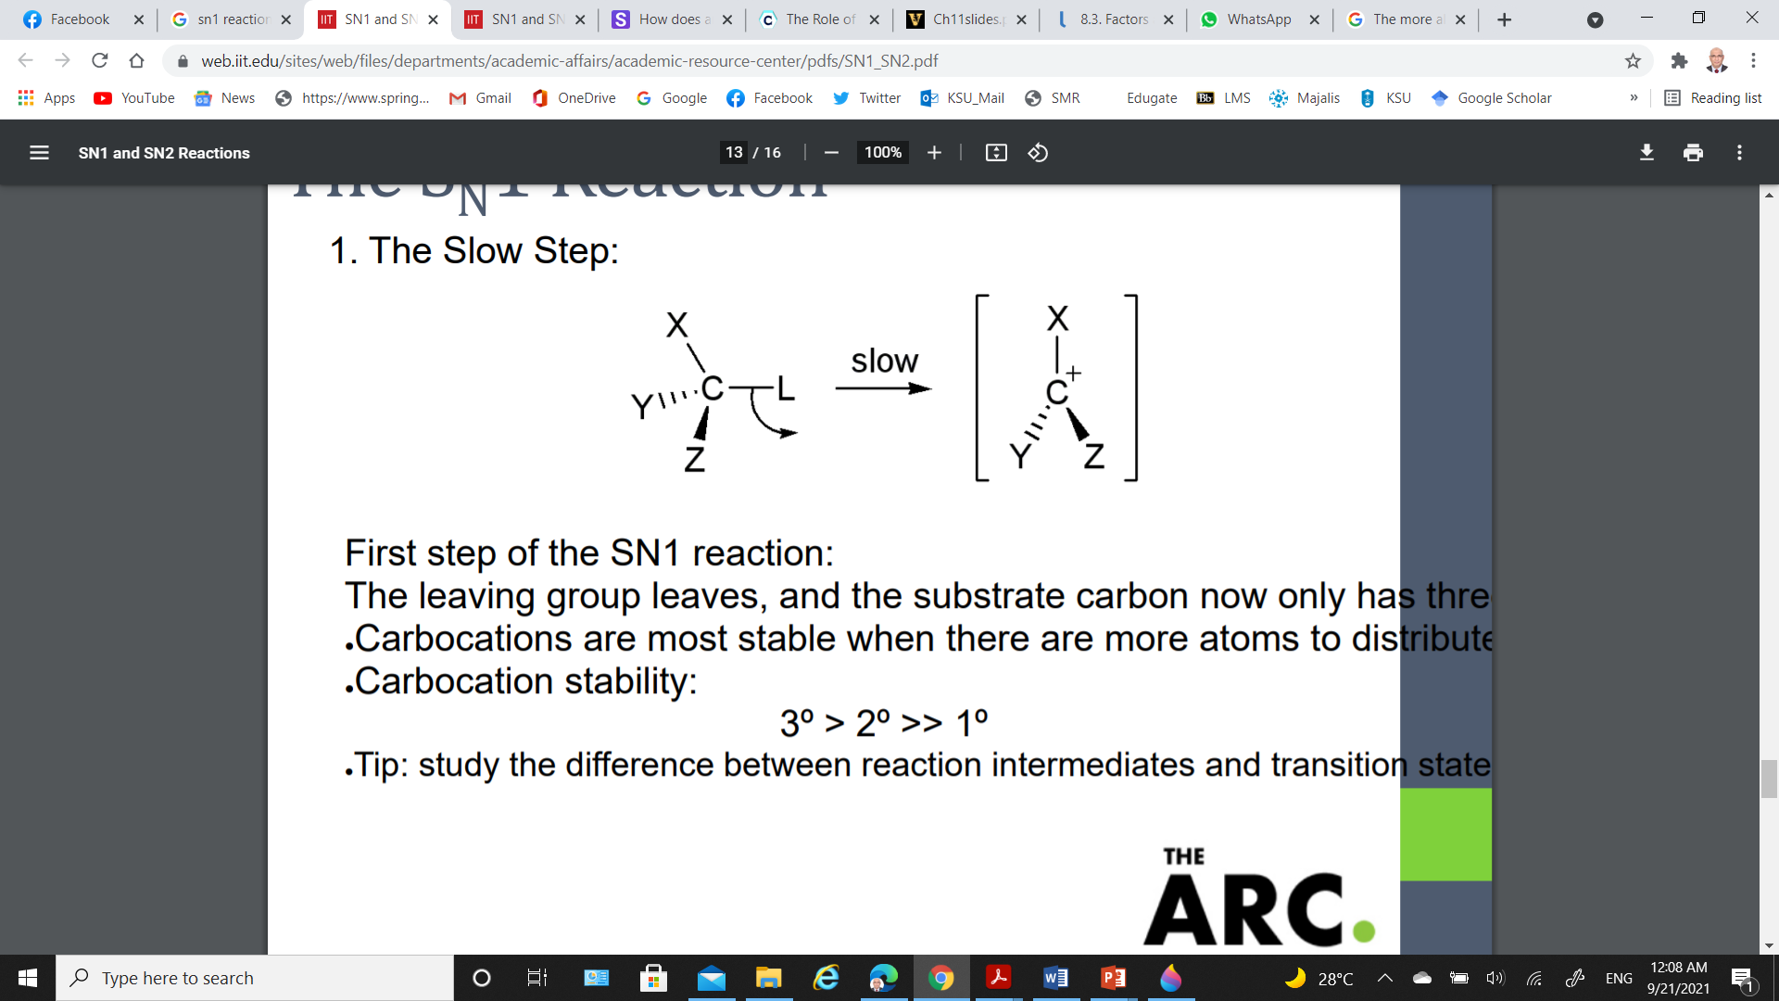
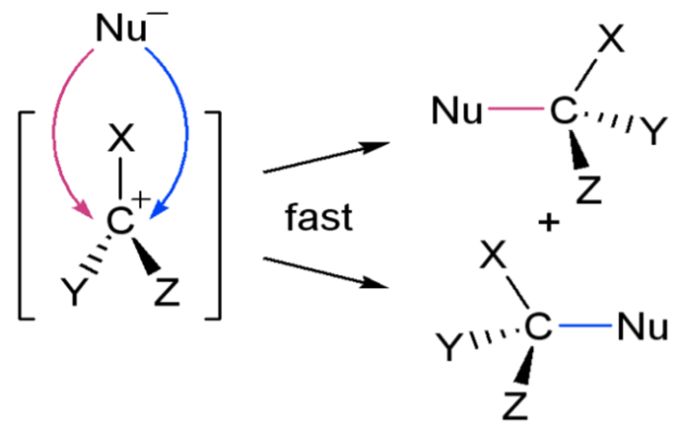
S_{N}¹ Reaction: Reaction process
S_{N}¹ reactions: involve replacing of a leaving group by a nucleophile and the rate of this reaction depends only on the concentration of one reactant (substrate) (i.e., unimolecular).
S_{N}¹ reactions happen in two steps:
(1) The Slow Step:
The leaving group leaves, and the substrate forms a carbocation intermediate (Carbocation stability: 3º > 2º >> 1º).
The rate-Limiting Step
(2) The Fast Step:
The nucleophile attacks the carbocation, forming the product.
The substrate loses any stereospecificity during the carbocation intermediate

Slide 24
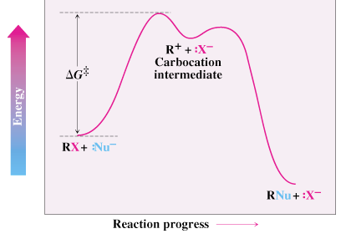
S_{N}¹ Reaction: Energy Profile Diagram
The overall rate of a reaction is controlled by the rate of the slowest step.
Step through highest energy point is rate-limiting (k₁ in forward direction)
S_{N}¹ Reaction: Reaction kinetics
Unimolecular; the rate of reaction depends on the concentration of the substrate (haloalkane) that involved in the rate-determining stepand the nucleophile does not involve.
The overall rate of a reaction is dependent upon the slowest step: rate-determining step
V = k[RX]

Slide 25
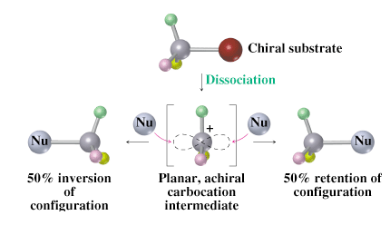
S_{N}¹ Reaction: Stereochemistry of S_{N}¹ Reactions
The carbocation intermediate (the highly reactive intermediate) is in trigonal planar shape, with the empty 2p orbital particular to the plane.
There is the same possibility for the nucleophile to attack from either side of the plane, (racemic mixture).

Slide 26
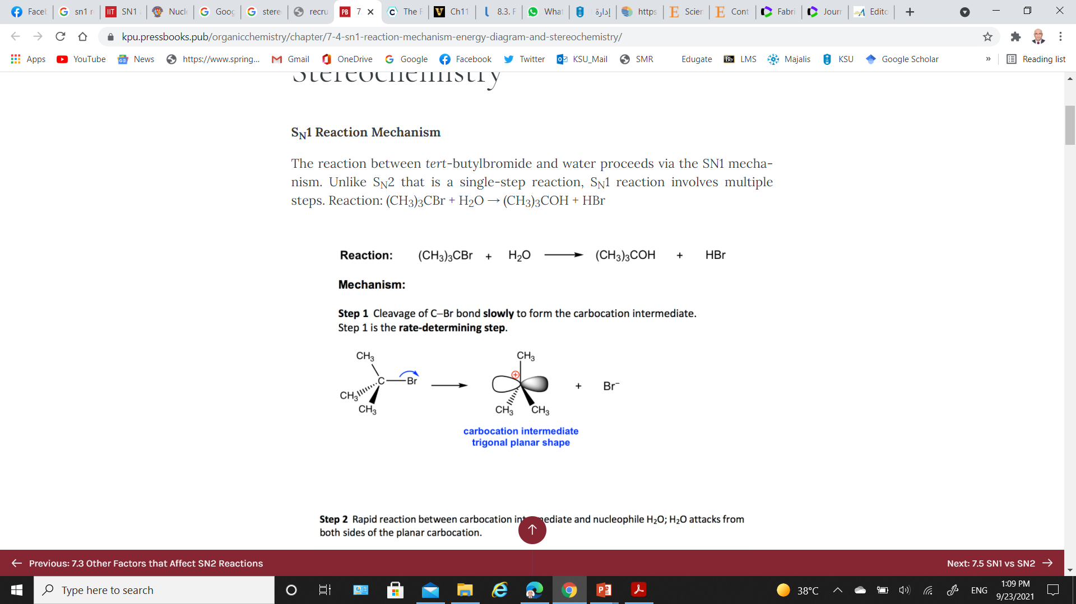
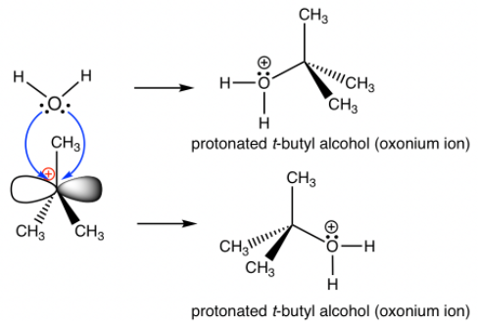
S_{N}¹ Reaction: Example
Reaction:
Mechanism:
Step 1, Rate-determining Step: Cleavage of C-Br bond slowly to form the carbocation intermediate.
Step 2, Fast Step: Rapid reaction between carbocation intermediate and nucleophile H₂O; H₂O attacks from both sides of the planar carbocation.

Slide 27
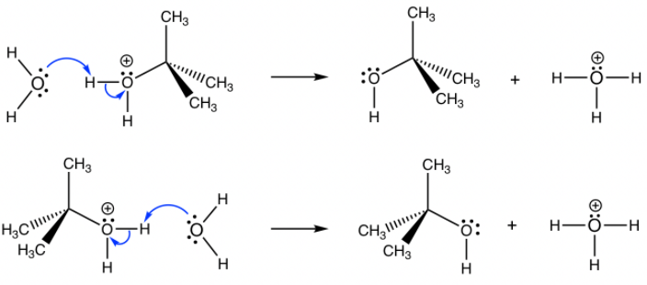
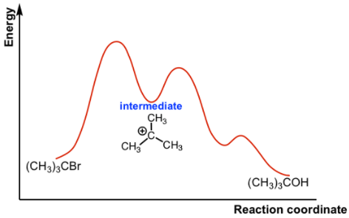
S_{N}¹ Reaction: Example
Step 3: Rapid deprotonation to produce neutral final product t-butyl alcohol (very fast step and sometimes can be combined with step 2 together as one step).
Energy Diagram of S_{N}¹ Mechanism:

Slide 28
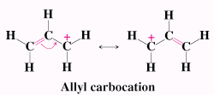
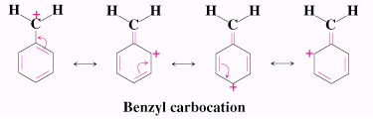
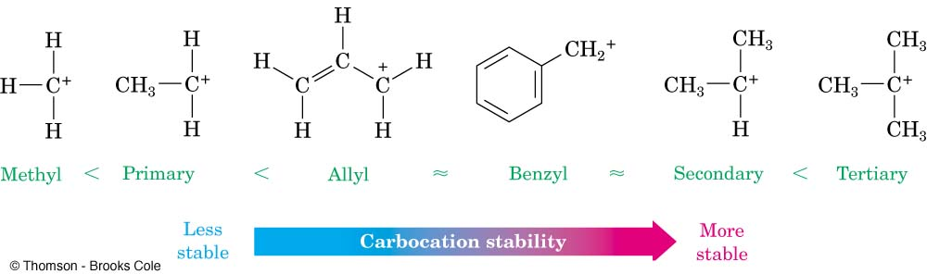
S_{N}¹ Reaction: Factors Affecting The S_{N}¹ Reaction
The Substrate: Stability of Carbocation
Highly substituted alkyl halides (substrates) form a more stable carbocation.
Alkyl groups stabilize carbocations by hyperconjugation and Inductive effect
Allyl and benzyl halides; their carbocations stabilize due to their resonance forms which delocalize charge over an extended π-system
Relative Stability of All Types of Carbocations.

Slide 29
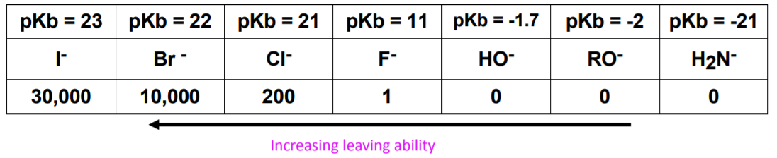
S_{N}¹ Reaction: Factors Affecting The S_{N}¹ Reaction
The Nucleophile:
The rate-determining step of S_{N}¹ reaction does not include nucleophile, so theoretically the strength of nucleophile has no effect on S_{N}¹ reaction.
A weaker nucleophile is a better choice for S_{N}¹.
Neutral substances such as H₂O, ROH, RCOOH are usually used as nucleophiles in S_{N}¹ reaction, and they also serve as solvents and such reaction is also called the solvolysis reaction.
The Leaving Group:
The nature of the leaving group has the same effect on both S_{N}¹ and S_{N}² reactions.
The better the leaving group, the faster a C⁺ can form and hence the faster will be the S_{N}¹ reaction.
The leaving group usually has a negative charge.

Slide 30
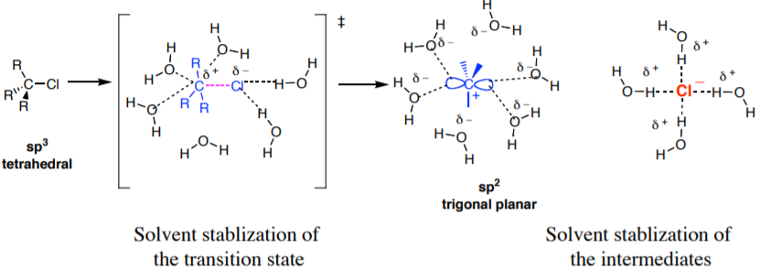
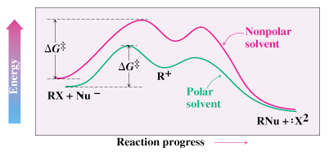
S_{N}¹ Reaction: Factors Affecting The S_{N}¹ Reaction
The Solvent:
Polar protic solvents, such as water and alcohols, stabilize the transition state by solvating the carbocation intermediate and therefore increase the reaction rate even more.
Polar protic solvents are able to solvate both cations and anions through hydrogen bonds.
Stabilization of the intermediate carbocation and the transition state by polar protic solvents in the S_{N}¹ reaction

Slide 31
S_{N}¹ Reaction: Summary
Reaction is:
Non-stereospecific (attack by nucleophile occurs from both sides)
Non-concerted - has carbocation intermediate
Unimolecular - rate depends on concentration of only the substrate
Substrate:
Best if tertiary or conjugated (benzylic or allylic) carbocation can be formed as leaving group departs
Nucleophile: Best if less reactive
Leaving Group: Best if more stable (i.e. can support negative charge well):
Same as S_{N}²
Examples: TsO⁻ (very good) > I⁻ > Br⁻ > Cl⁻ > F⁻ (poor)
Solvent:
Polar protic solvents, such as water and alcohols, stabilize the transition state.
Polar solvents are favored over non-polar for the S_{N}¹ reaction.
Protic solvents are favored over aprotic for the S_{N}¹ reaction

