Slide 1

CHEM 342 (REQUIRED COURSE)
POLYMERS AND PETROCHEMICALS
FOR CHEMISTRY’ STUDENTS, COLLEGE OF SCIENCE
Pre-requisites Course; CHEM 241
Credit Hours: 2(2+0)
Prof. Mohamed El-Newehy
Chemistry Department, College of Science, King Saud University
http://fac.ksu.edu.sa/melnewehy/home

Slide 2
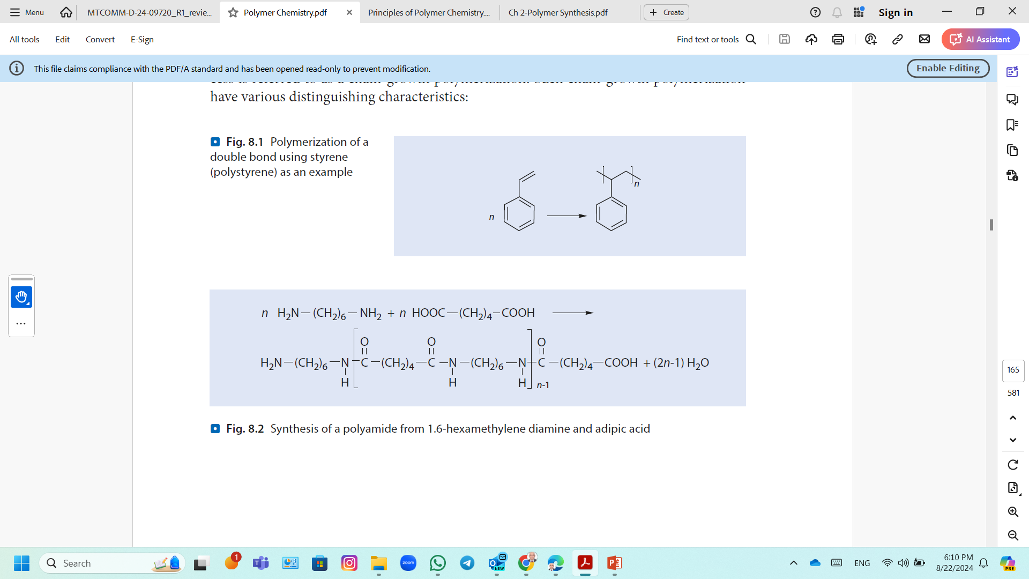
Methods for Synthesis of Polymers
Synthetic processes of producing polymers from their monomers can be divided into.
1) Step-Growth Polymerization (Condensation Polymerization )
Synthesis of a polyamide from 1,6-hexamethylene diamine and adipic acid
2) Chain-Growth Polymerization (Addition Polymerization)
Polymerization of a double bond using styrene (polystyrene)
These two polymer formation reactions are fundamentally different in their:
Mechanisms,
Intermediate products,
The way the molar mass increases as a function of monomer conversion.

Slide 3
Step-Growth Polymerization
(Condensation Polymerizations)
Step-Addition Polymerization
(Polyaddition)

Slide 4
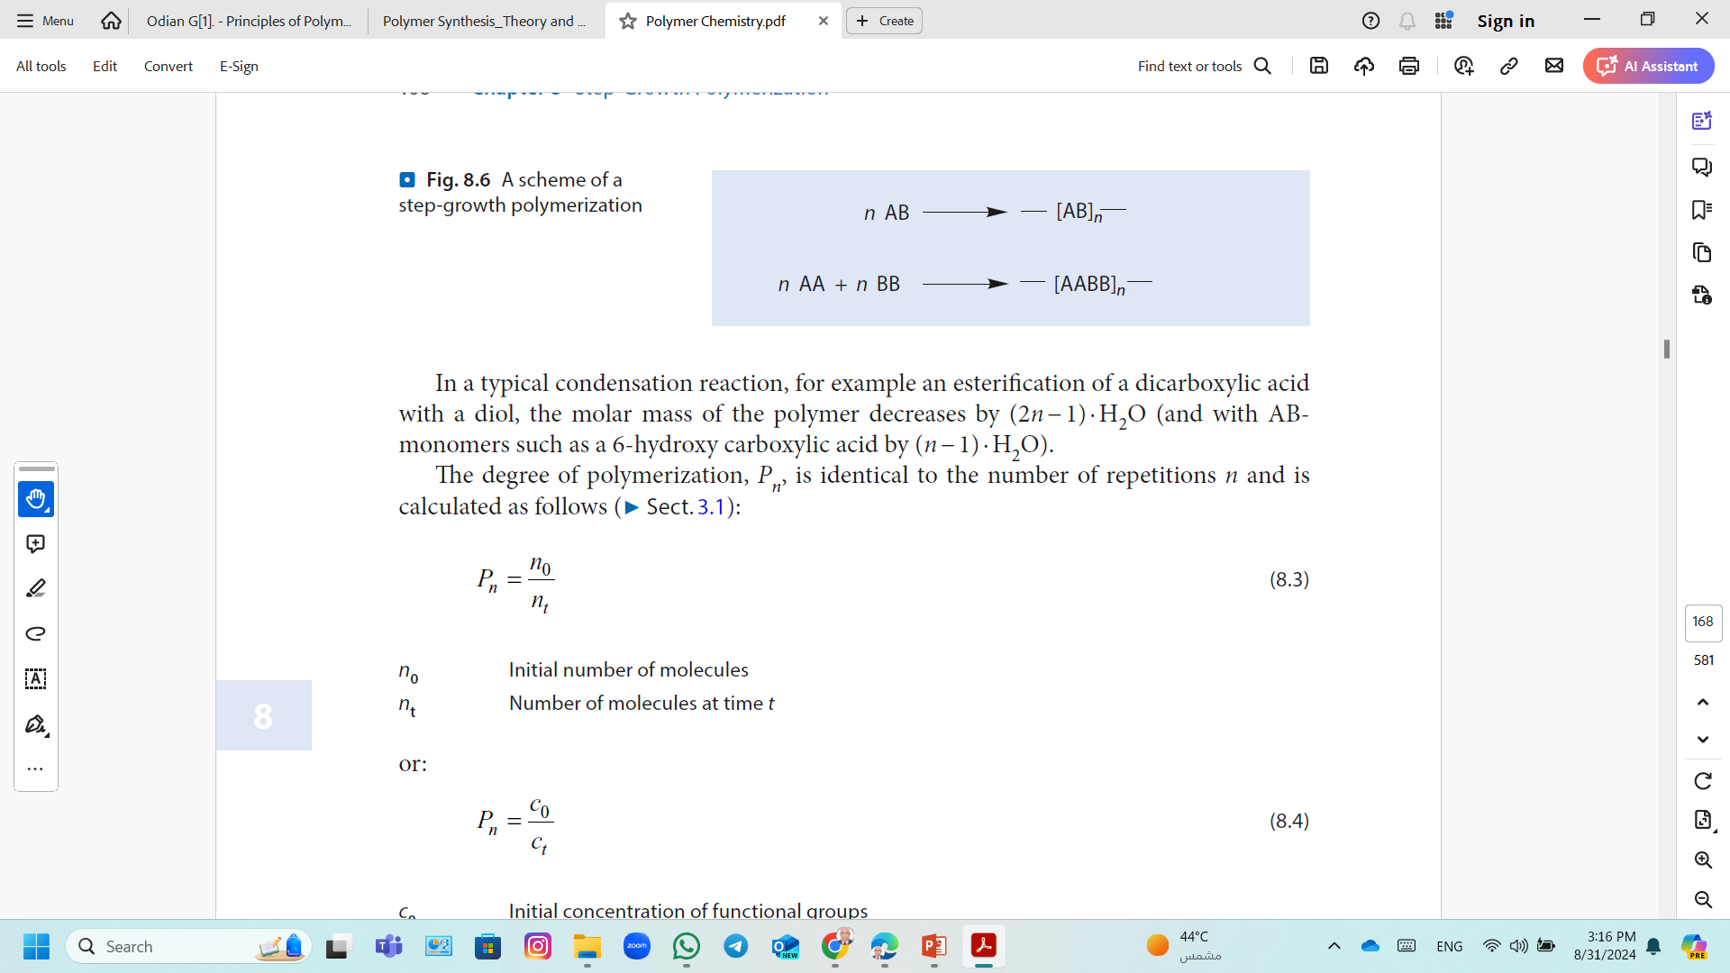
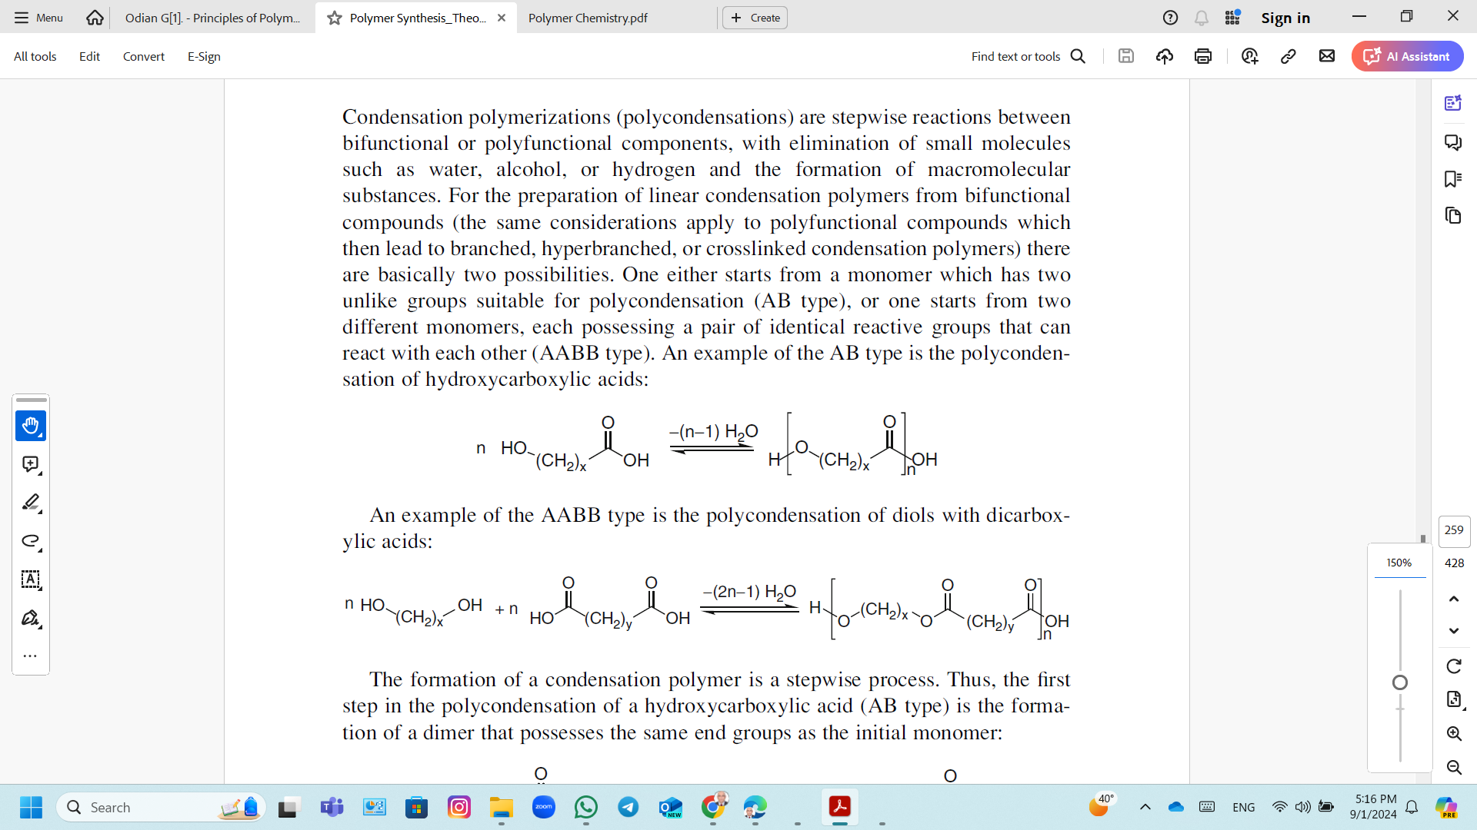
Step-Growth Polymerization
Step-Growth Polymerization is also known as Condensation polymerizations (polycondensations).
Step-growth polymerization are stepwise reactions between bifunctional or polyfunctional components (AB-monomer or of a stoichiometric AA/BB-system), with elimination of small molecules such as water, alcohol, or hydrogen halide and the formation of macromolecular substances.
AB-monomer; these functions can be united in the same molecule.
AA and BB-monomer; two bi- or multi-functional molecules can react with each other.

Slide 5
Step-Growth Polymerization
Monomers;
Bifunctional compounds lead to Linear condensation polymers.
Polyfunctional compounds lead to branched, hyperbranched, or crosslinked condensation polymers
AA and BB, are needed in stoichiometry of the reacting molecules.
If there is an excess of BB monomer, all the A-functionalities react and the oligomers are terminated with B groups, which cannot react with each other.
This polymerization is activated by heat, and no chemical initiator.
It takes considerable time for polymers with a high molar mass to form.
A new monomer results from each individual reaction step and has the same reactivity as the original monomers and all intermediate products are stable and can be isolated.

Slide 6
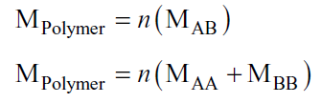
Step-Growth Polymerization
The molar mass is calculated by multiplying the molar mass of the components AB, AA and BB, respectively, by the number n of repetitions in the polymer molecule:
M_{Polymer} represents the molar mass of the polymer,
M_{AB} the molar mass of the monomer AB,
M_{AA} the molar masses of the monomer AA,
M_{BB} the molar masses of the monomer BB.

Slide 7
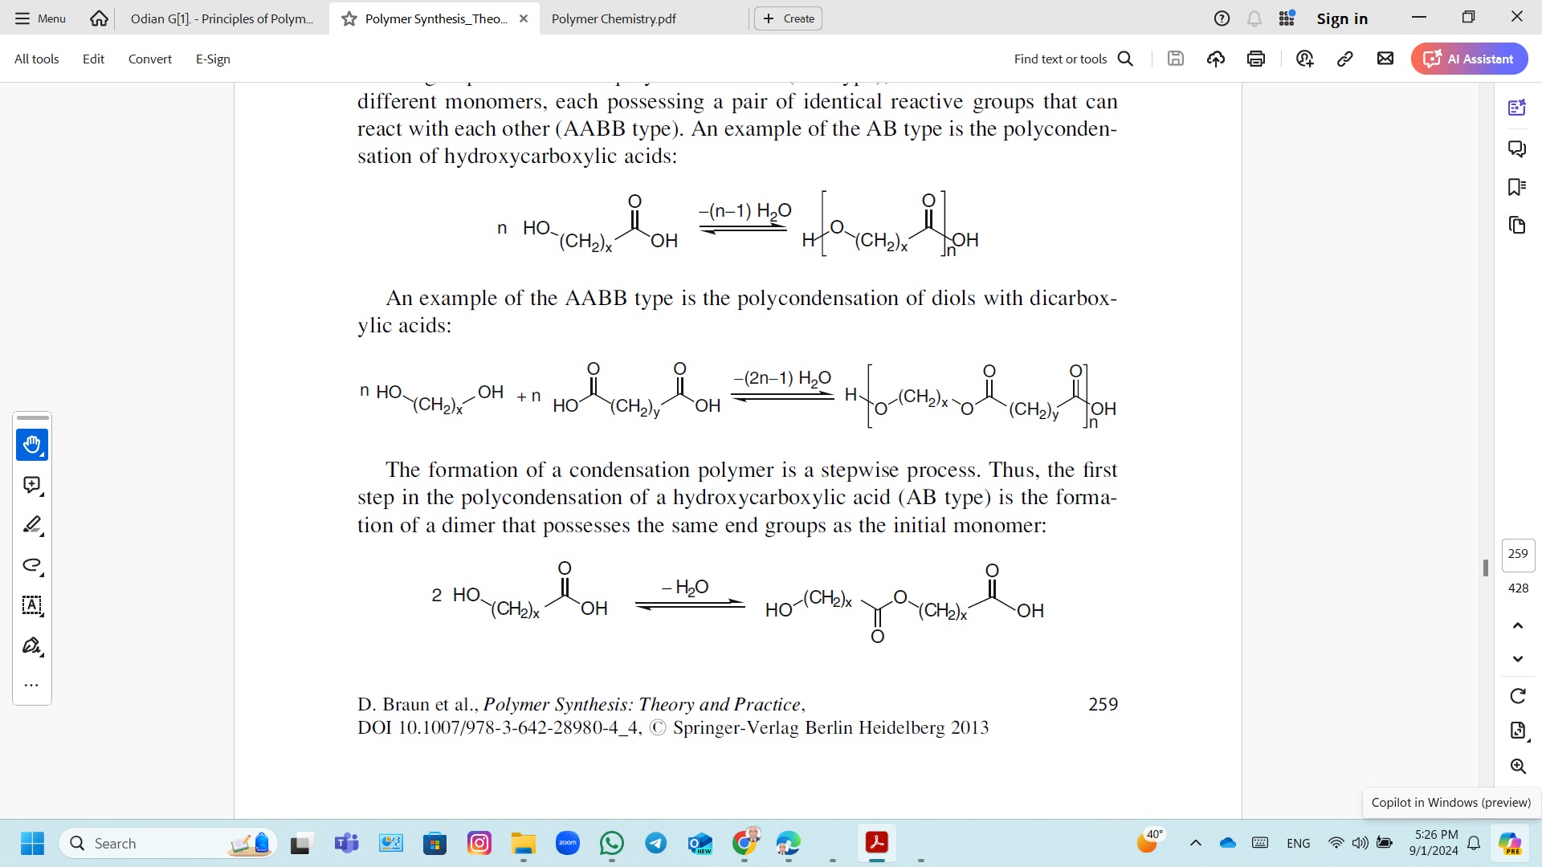
Step-Growth Polymerization
The formation of a condensation polymer is a stepwise process.
The first step; the formation of a dimer that possesses the same end groups as the initial monomer:
The next step; the end groups of this dimer can react either with the monomeric compound or with another dimer molecule, and so on.
The molecular weight of the resulting macromolecules increases continuously with reaction time, unlike addition polymerizations.
The intermediates are oligomeric and polymeric molecules with the same functional end groups as the monomeric starting compound.

Slide 8
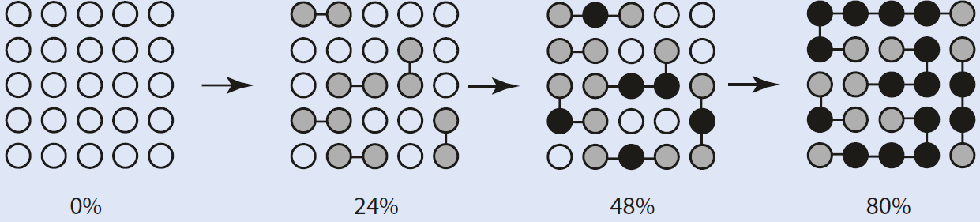
Step-Growth Polymerization
A visualization of a polycondensation at 0%, 24%, 48%, and 80% functional group conversion.
White balls represent monomers, which have not reacted yet,
Gray balls those monomers, which have reacted at one of their two active groups,
Black balls are those molecules which have reacted at both ends
With a conversion of 80% of the functional groups, there are five “polymer chains” with “degrees of polymerization” of 3, 4, 5, 6, and 7.

Slide 9
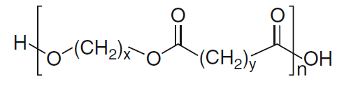
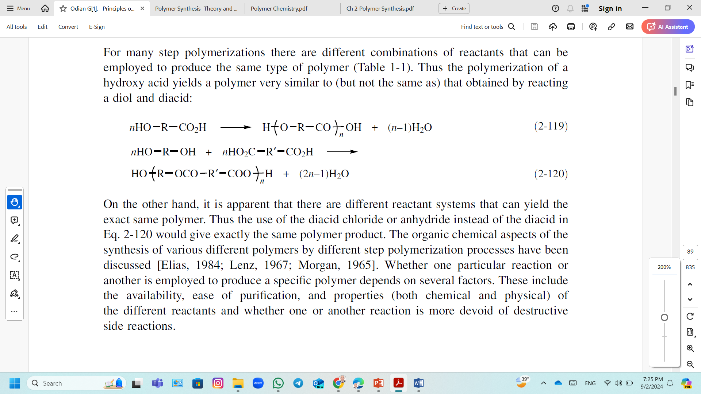
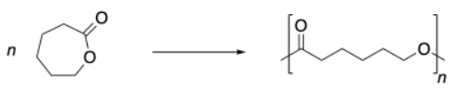
Step-Growth Polymerization; Polyesters
Polyesters are macromolecules whose monomeric units are linked with an ester group.
Polyesters can be produced by direct esterification of
Polycondensation of hydroxycarboxylic acids,
Polycondensation of diols with dicarboxylic acids,
Ring-opening polymerization (ROP) of lactones.
Cyclic esters (lactones) are opened up by the release of ring strain to make extended chain structures.
For example, caprolactone is ring-opened to produce polycaprolactone.

Slide 10
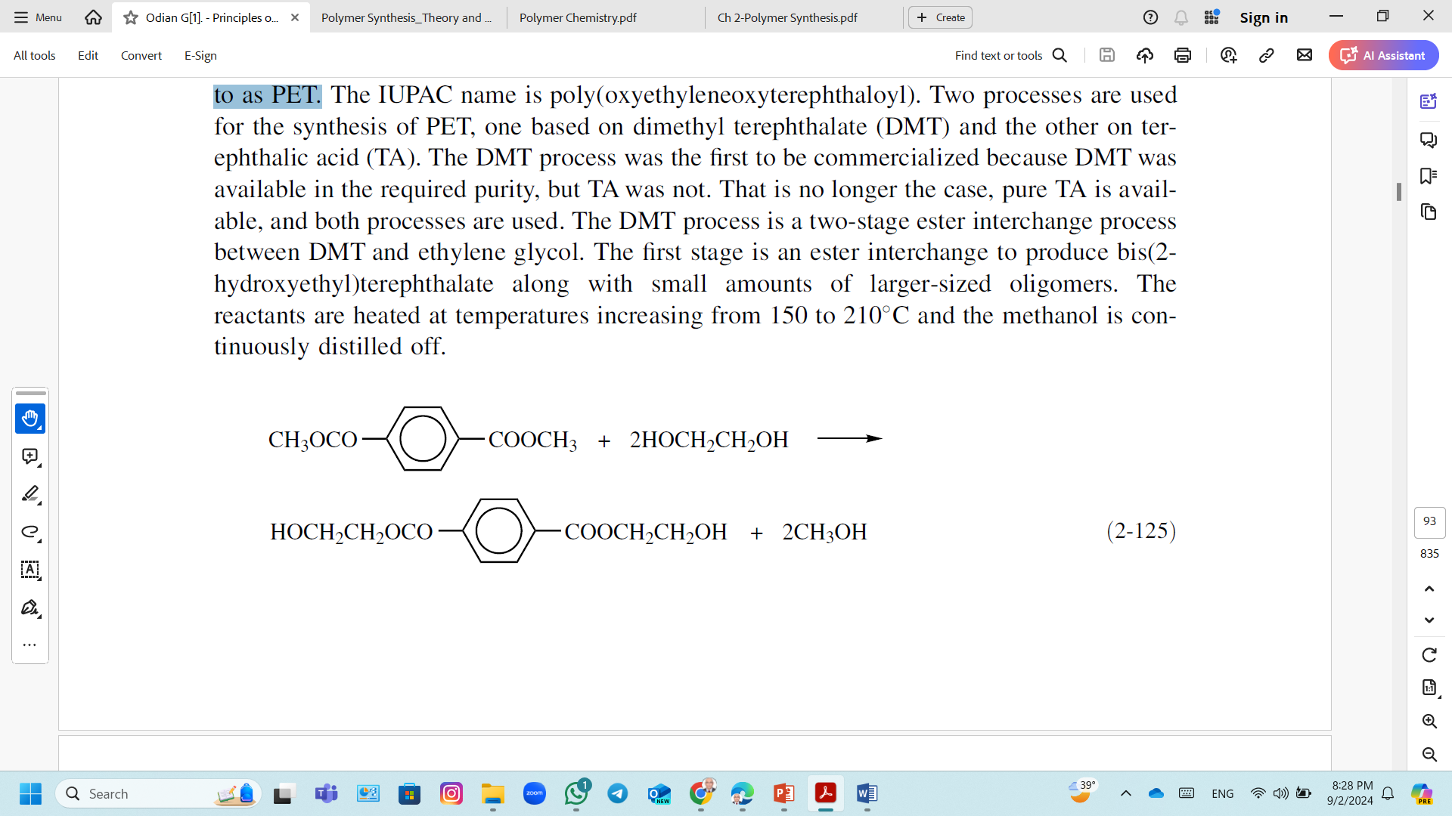
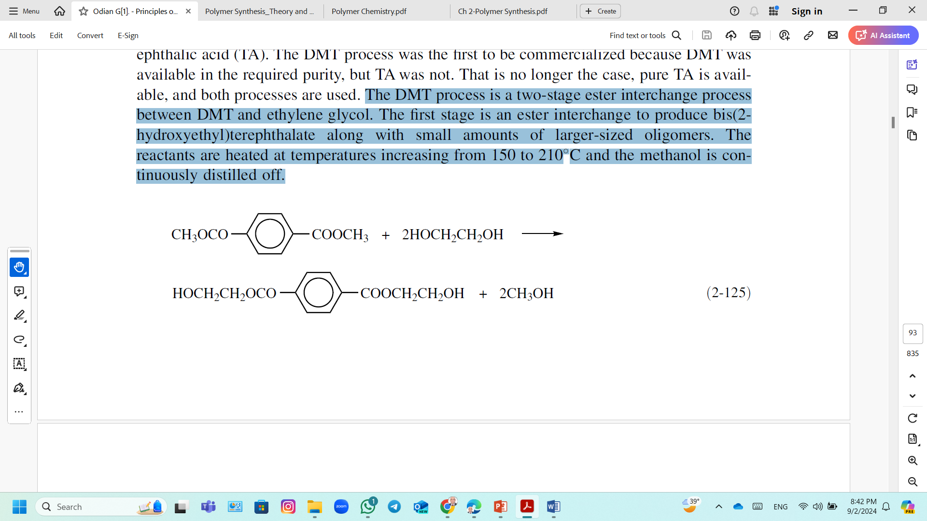
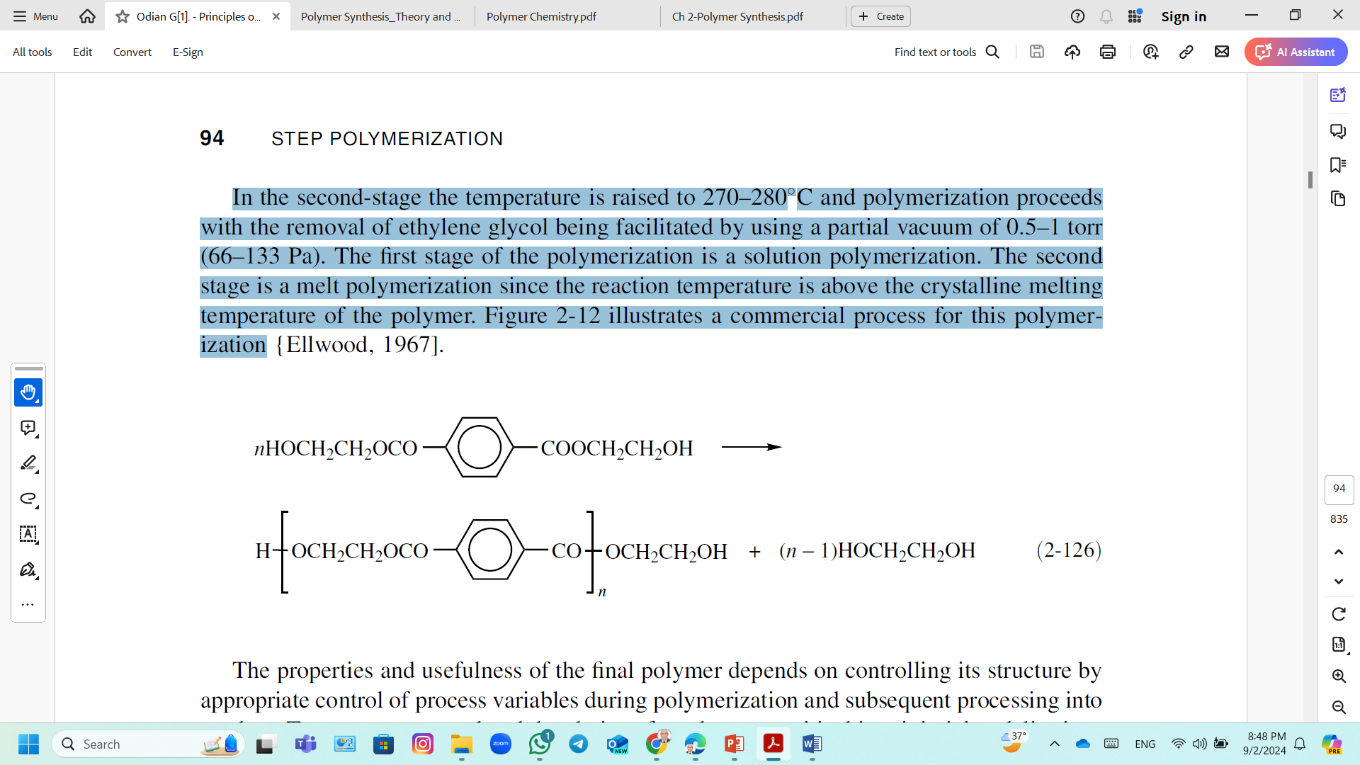
Step-Growth Polymerization; Polyesters
The most important commercial polyester is poly(ethylene terephthalate) (PET).
Two processes are used for the synthesis of PET, based on dimethyl terephthalate (DMT) or terephthalic acid (TA)
Two-stage ester interchange process between DMT and ethylene glycol.
Stage 1: Ester interchange to produce bis(2-hydroxyethyl)terephthalate.
The reactants are heated at temperatures increasing from 150-210°C and methanol is distilled off.
Stage 2; Polymerization proceeds
The temperature is raised to 270–280 ° C with the removal of ethylene glycol.

Slide 11
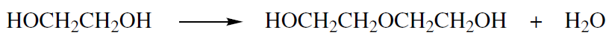
Step-Growth Polymerization; Polyesters
Polycondensation of diols with dicarboxylic acids,
Control of the reaction temperature is important to minimize side reactions such as dehydration of the diol to form diethylene glycol
The T_{m} is decreased by the introduction of diethylene glycol units in place of ethylene glycol units in the polymer chain.
Ester interchange, typically using a dimethyl ester, has often been used because the reaction is fast and the dimethyl ester is often more easily purified and has better solubility characteristics.
Direct reactions of diacids or anhydrides with diols are often avoided because of the high temperatures required to eliminate water and are used to produce low-molecular-weight and crosslinked polyesters based on phthalic and maleic anhydrides.

Slide 12
Step-Growth Polymerization; Polyesters
General properties of PET
High crystalline melting temperature (270C).
Stiff polymer chains.
Good mechanical strength, toughness, and fatigue resistance up to 150–175C.
Good chemical, hydrolytic, and solvent resistance.
Applications of PET
Fiber applications
About 45% of the total PET production
PET fiber as textile
has crease resistance,
has good abrasion resistance,
can be blended with cotton and other cellulosic fibers to give better feel and moisture permeation.
Plastics applications; For blow-molded bottles for soft drinks, beers, spirits, and other food products.

Slide 13
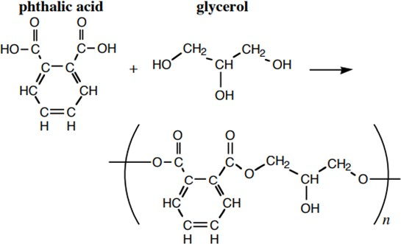
Step-Growth Polymerization; Crosslinked Polyesters
Crosslinked polyester can be obtained by reacting phthalic anhydride and glycerol in the presence of metal acetate.
Glyptal resin
Glyptals are used in paints, lacquers and surface coatings.

Slide 14
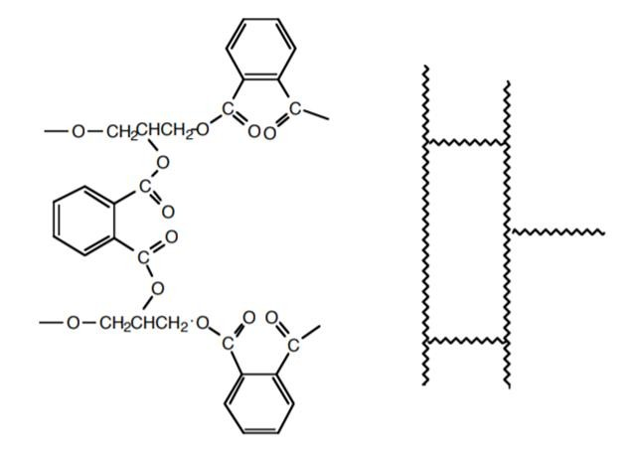
Step-Growth Polymerization; Crosslinked Polyesters
Glyptal can be modified by a process known as crosslinking.
A crosslinked polymer is one in which the long chains of molecules are joined to each other by covalent bonds.

Slide 15
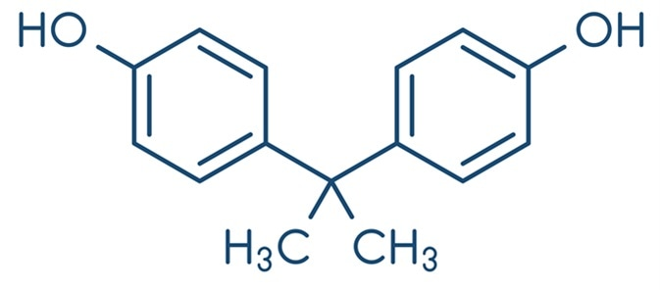
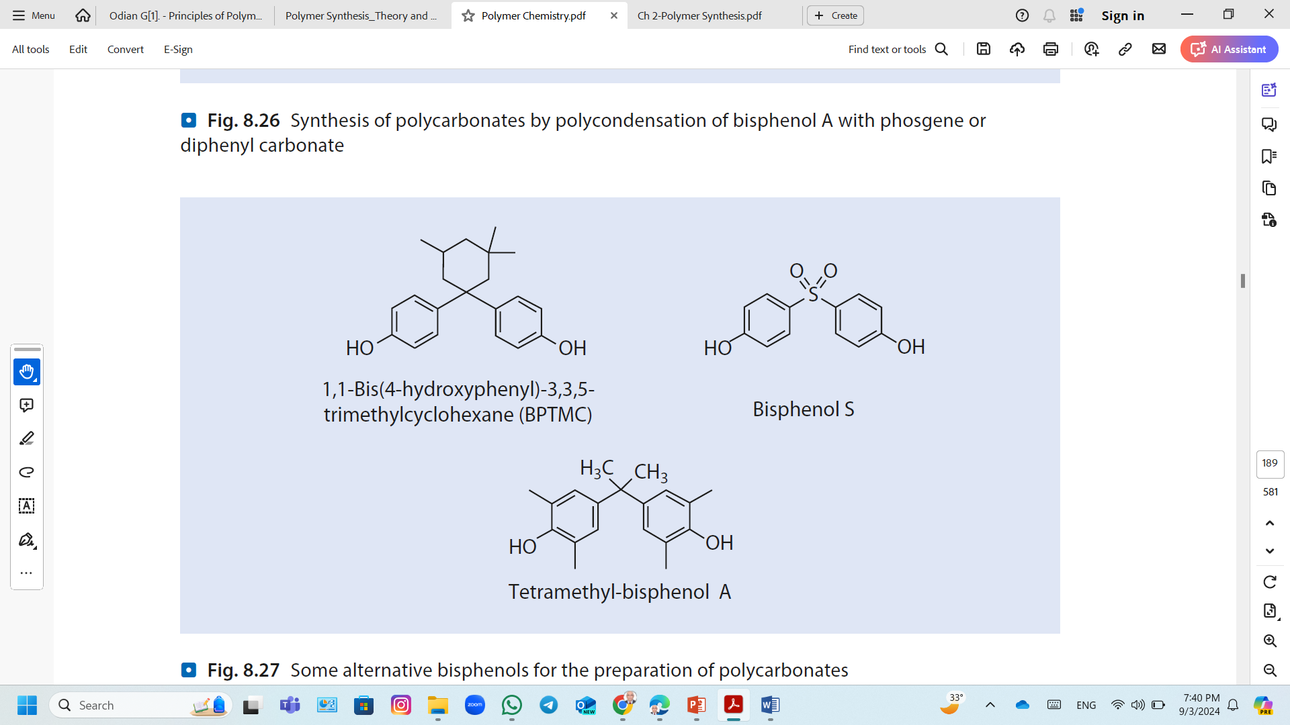
Step-Growth Polymerization; Polycarbonates (PC)
Polycarbonates are linear polyesters of carbonic acid.
The most important commercial polycarbonate is based on 2,2’-bis(4-hydroxyphenyl)propane (bisphenol A).
Some alternative bisphenols for the preparation of polycarbonates
Interfacial Polymerization:
This method involves the reaction of bisphenol A (BPA) with phosgene in the presence of a solvent.
The reaction occurs at the interface of two immiscible phases, producing high Mol. Wt. PC.
It poses challenges due to phosgene toxicity and the generation of wastewater containing solvents

Slide 16
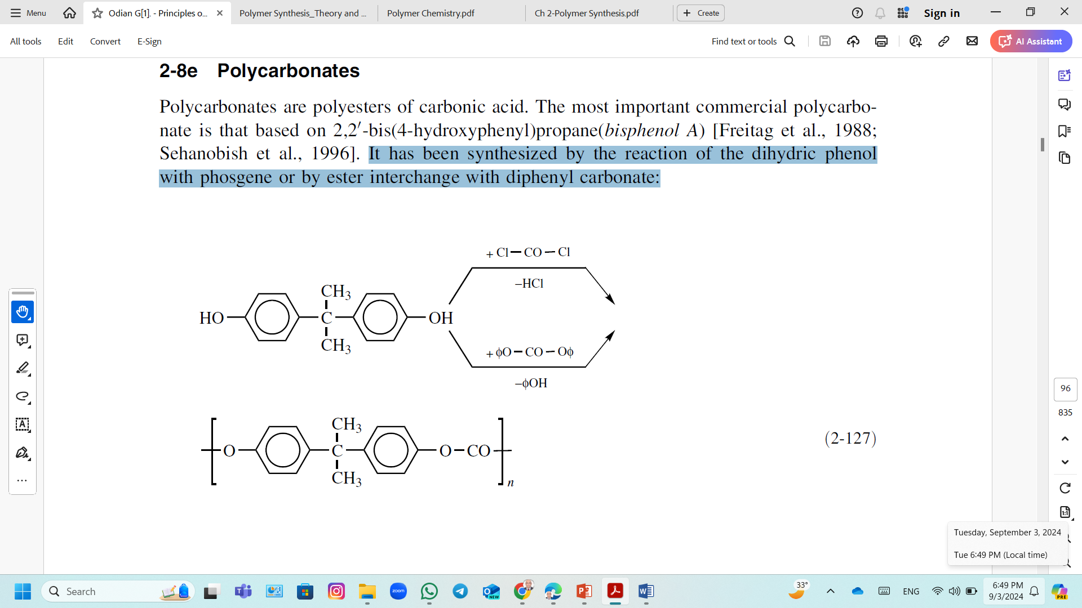
Step-Growth Polymerization; Polycarbonates (PC)
Interfacial polymerization is usually a two-stage reaction at 0-50°C;
Oligomers are formed in the first stage.
Bisphenol A is dissolved in aqueous alkali to form the phenolate salt and then the organic solvent added followed by phosgene.
The organic solvent prevents the loss of phosgene by hydrolysis and precipitation of the polymer before it has reached the desired molecular weight.
Tertiary amines are added in the second stage to
Enhance the transfer of the phenolate salt across the interfacial boundary into the organic phase.
Catalyze the further reaction to high-molecular-weight polymer.

Slide 17
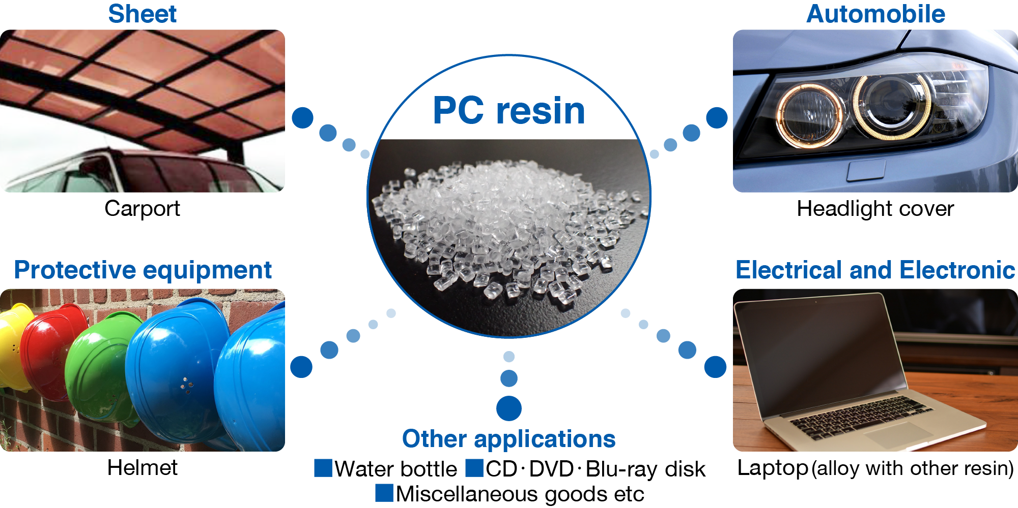

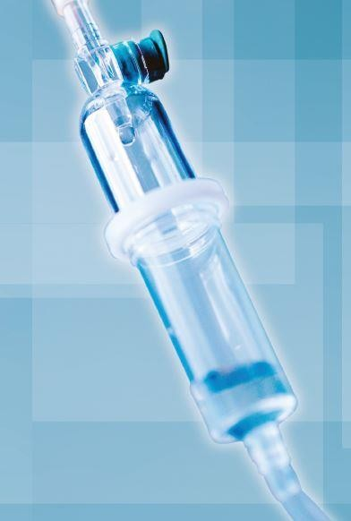
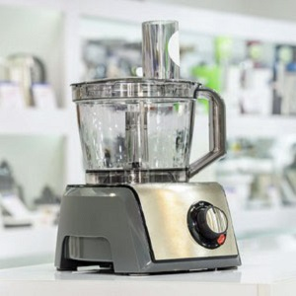
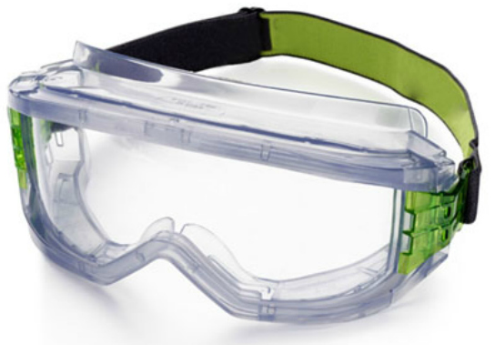
Step-Growth Polymerization; Polycarbonates (PC)
Trade names of polycarbonates are Makrolon (Bayer Material Science), Lexan (SABIC), and Xantar (Mitsubishi).
General properties of PC
PC has excellent resistance to acids and oxidants, better than PET.
PC is less resistant to bases compared to PET.
PC is comparable to PET in resistance to organic solvents at ambient temperature.
PC finds are transparency and impact resistance (toughness).
Applications include
Compact disks
Glazing (windows, doors, face shields, sunglasses, aircraft interiors)
Automotive (instrument panels and components, exterior panels)
Medical (components for dialysis, blood collection, and surgical devices),

Slide 18
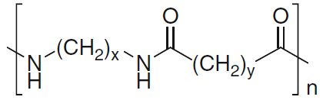
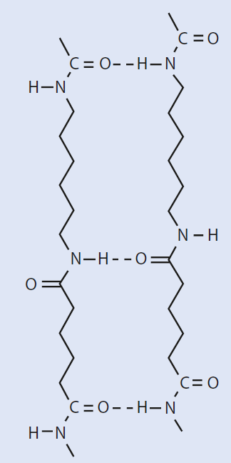
Step-Growth Polymerization; Polyamides
Polyamides are macromolecules whose constitutional repeating units are joined by amide groups.
Aliphatic Polyamides
Example;
Polyamide-6,6 (Nylon-6,6); from hexamethylenediamine and adipic acid.
Polyamide-6,10 (Nylon-6,10); from hexamethylenediamine and sebacic acid.
Polyamide-6 (Nylon-6); from an aminocarboxylic acid (ε-aminocaproic acid) or from ring-opening polymerization of lactams (ε-caprolactam).
Many properties of polyamides are attributed to the formation of hydrogen bonds between NH and CO groups of neighboring macromolecules.
Aliphatic polyamides are used as fibers.

Slide 19
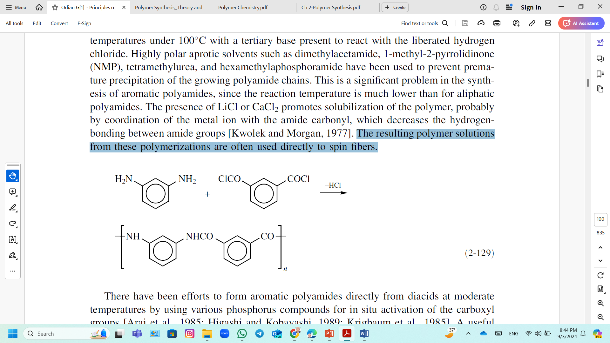
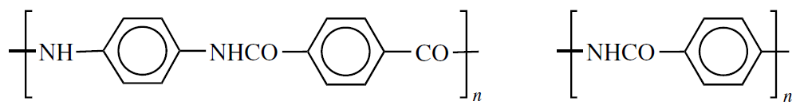
Step-Growth Polymerization; Polyamides
Aromatic Polyamides (Aramid Polymers)
Aromatic polyamides are produced by using the faster reaction of a diamine with a diacid chloride.
Examples; poly(m-phenylene isophthalamide) (trade name: Nomex).
The polymerization is carried out in solution at 100°C with a tertiary base in highly polar aprotic solvents such as dimethylacetamide, to prevent the precipitation of the growing polyamide chains.
The resulting polymer solutions from these polymerizations are often used directly to spin fibers.
Examples;
Poly(imino-1,4-phenyleneiminoterephthaloyl) is synthesized from para-diamine and diacid chloride.
Poly(iminocarbonyl-1,4-phenylene) is based on p-aminobenzoic acid.
Poly(imino-1,4-phenyleneiminoterephthaloyl)
(trade names: Kevlar, Twaron)
Poly(iminocarbonyl-1,4-phenylene)
(trade name; Kevlar)

Slide 20
Step-Growth Polymerization; Polyamides
Aromatic Polyamides (Aramid Polymers)
Aramid polymers are much more expensive than the aliphatic polyamides.
The use of aramid polymers is limited to those applications that justify the high cost.
The applications;
very high flame resistance (clothing for firefighters and welders, protective shield and drapes),
heat resistance (ironing board covers, insulation film for electrical motors),
strength and modulus (circuit boards and automobile tire cord).

Slide 21
Step-Growth Polymerization; Polyamides
The following are the main reactions employed for the preparation of polyamides:
1) Direct Amidation; Polycondensation of diamines with dicarboxylic acids.
Polycondensation of diamines with derivatives of dicarboxylic acids (e.g., acid chlorides).
2) Ring-Opening polymerization of lactams0.
3) Self-Amidation; Polycondensation of ω-Aminocarboxylic acids.

Slide 22
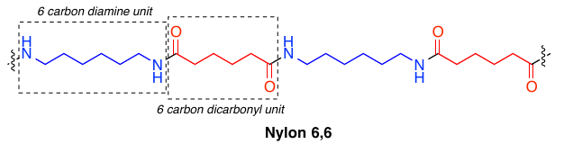
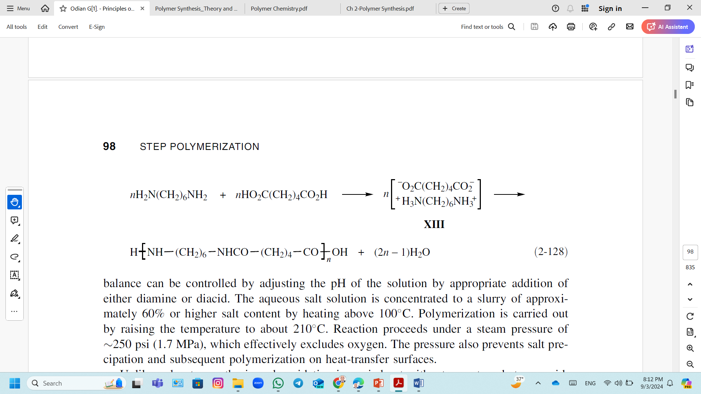
Step-Growth Polymerization; Polyamides
1) Direct Amidation; Polycondensation of diamines with dicarboxylic acids
Poly(hexamethylene adipamide) (nylon-6,6) is synthesized from hexamethylene diamine and adipic acid.
Stoichiometric balance of amine and carboxyl groups is obtained by preliminary formation of 1:1 ammonium salt (nylon salt) in aqueous solution at a concentration of 50%.
nylon salt
Polymerization is carried out by raising the temperature to about 210°C without an external strong acid.
Molecular weight can be controlled by addition of a calculated amount of a monofunctional acid such as acetic acid.

Slide 23
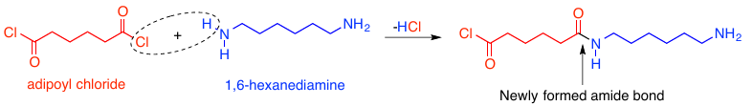
Step-Growth Polymerization; Polyamides
1) Direct Amidation; Polycondensation of diamines with dicarboxylic acid chlorides
Polycondensation of dicarboxylic acid chlorides and diamines can be carried out in solution or interfacial polycondensation.
Interfacial polycondensation of dicarboxylic acid and diamine
Advantages:
It is carried out at low temperature (0–40°C) without side reactions.
It is very fast; the reaction yields a high-molecular weight polymer in a short .
Disadvantages;
Large amounts of solvent must be purified and handled.
Large amounts of salts are formed as by-products.

Slide 24
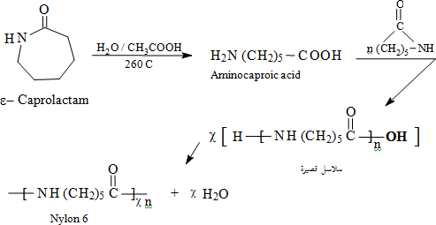
Step-Growth Polymerization; Polyamides
2) Ring-Opening Polymerization of Lactams
The mechanism starts with cleavage of amide linkage, Leading to the formation of the corresponding amino-carboxylic acid.
The reaction proceed in short chains in the beginning.
Although the reaction proceed with only caprolactam and water present, a material such as (phosphoric or acetic acid) at low concentration to act as a chain stabilizer and help to achieve the desired final viscosity.

Slide 25
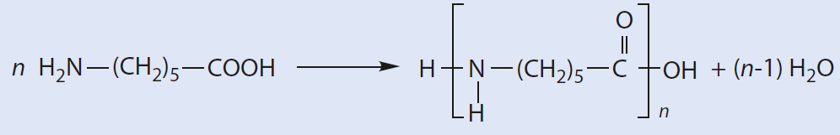
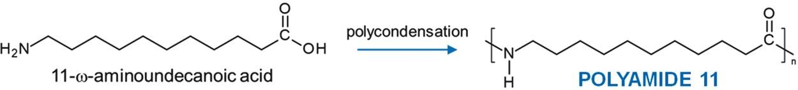
Step-Growth Polymerization; Polyamides
3) Self-Amidation; Polycondensation of ω-Aminocarboxylic acids
The formation of polyamides by elimination of water from aminocarboxylic acids at high temperature is generally possible with acids having more than four methylene groups between the amino and carboxyl groups.
Example; Synthesis of polyamide 6 (Nylon-6)
Example; Synthesis of polyamide 11 (Nylon-11)

Slide 26



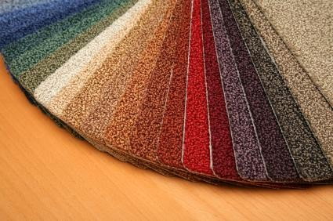

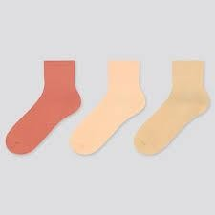


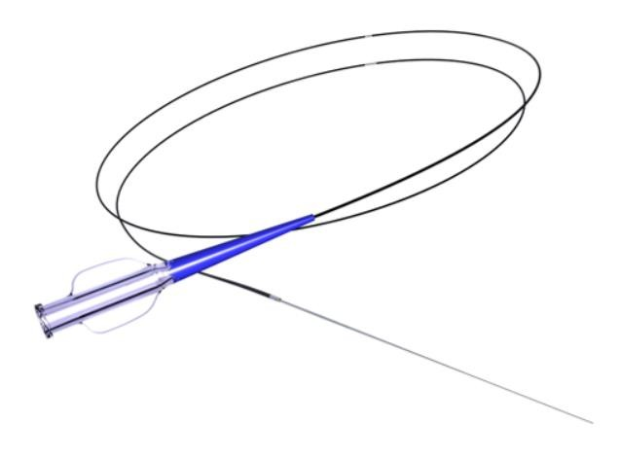
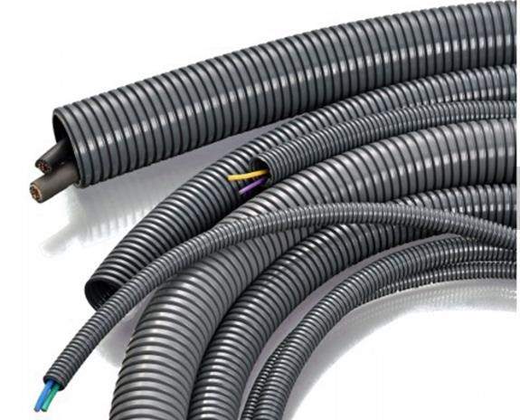
Step-Growth Polymerization; Polyamides
Polyamide finds applications in fields ranging from the clothing business to the automotive industry. They are used in making, electrical appliances.
Carpets
Furniture fabrics
Women's socks
Openable double shell
Medical instruments

Slide 27
Step-Addition Polymerization (Polyaddition)
Stepwise Addition Polymerization involve a stepwise reaction of at least two bifunctional compounds, leading to the formation of macromolecules.
In contrast to condensation polymerization,
No low-molecular-weight compounds are eliminated; coupling of the monomer units.
Like condensation polymerization,
It is also a stepwise reaction.
The average molecular weight of the resulting polymer steadily increases during the reaction.
The oligomeric and polymeric products formed in the individual steps possess the same functional end groups and the same reactivity as the starting materials.
They are governed by kinetic laws like those for condensation polymerization.

Slide 28
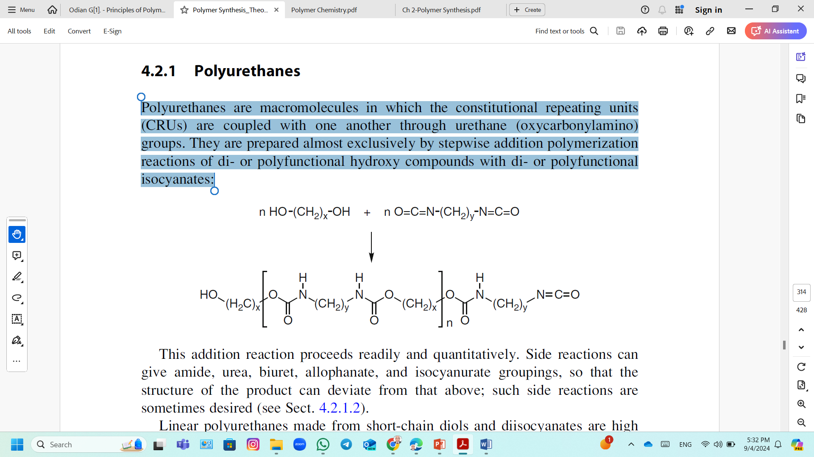
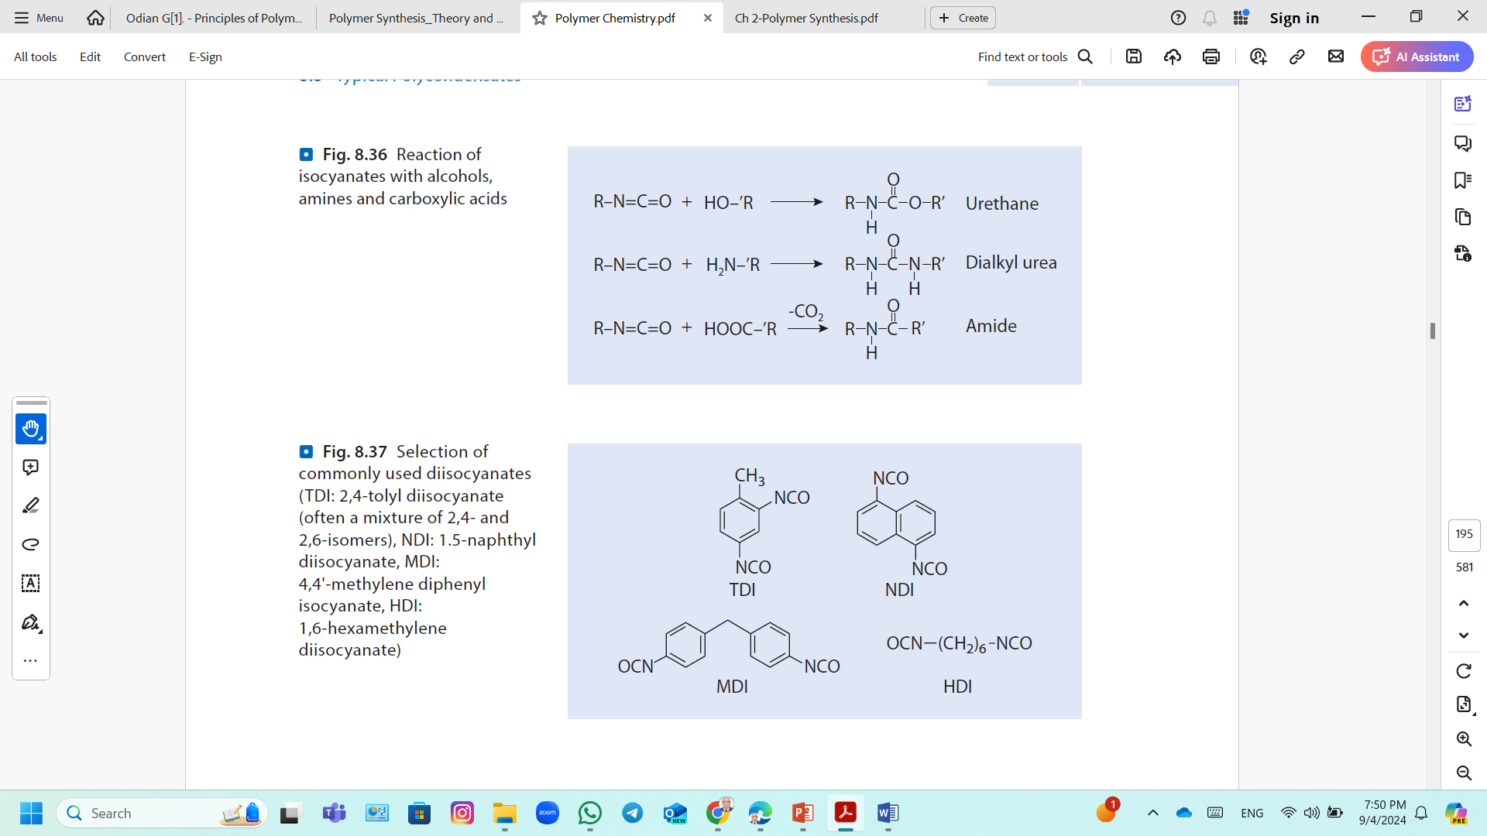
Step-Addition Polymerization (Polyaddition); Polyurethanes
Polyurethanes are macromolecules in which the constitutional repeating units (CRUs) are coupled with one another through urethane (oxycarbonylamino) groups.
They are prepared by stepwise-addition polymerization reactions of di- or polyfunctional hydroxy compounds with di- or polyfunctional isocyanates:
Diol
Diisocyanate
Commonly used diisocyanates;
TDI: 2,4-tolyl diisocyanate
NDI: 1.5-naphthyl diisocyanate,
MDI: 4,4'-methylene diphenyl isocyanate,
HDI: 1,6 hexamethylene diisocyanate)

Slide 29
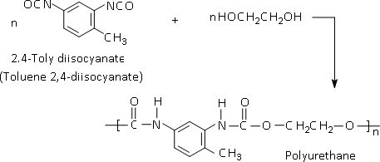
Step-Addition Polymerization (Polyaddition); Polyurethanes
Primary aromatic diisocyanates: toluene diisocyanate (TDI) used in the production of Aromatic polyurethanes.

Slide 30
Step-Addition Polymerization (Polyaddition); Polyurethanes
Linear Polyurethanes
They made from short-chain diols and diisocyanates.
They are high melting, crystalline, thermoplastic substances whose properties are comparable with those of the polyamides because of the similarity in chain structure.
The addition of isocyanates to hydroxy compounds is inhibited by acid compounds and can be accelerated by basic compounds and metal salts or organometallic compounds.
Linear polyurethanes with a high molecular weight can be prepared in solution (inert solvents; toluene, xylene);
The diisocyanate is normally dripped into the solution of the dihydroxy compound at the desired temperature (boiling point of the solvent).
The resulting polyurethane often separates from the reaction mixture.
Linear polyurethanes with molecular weights up to about 15,000 can be obtained.

Slide 31
Step-Addition Polymerization (Polyaddition); Crosslinked Polyurethanes
Branched and Crosslinked Polyurethanes
Reaction of linear oligourethanes, which possess either hydroxy or isocyanate end groups, with suitable reactive compounds; Low-molecular-weight, aliphatic polyester or polyether with hydroxy end groups (poly(ethylene oxide), poly(propylene oxide) or poly(oxytetramethylene) with molecular weights around 2,000) is reacted with an excess of diisocyanate.
Crosslinked Polyurethanes Reaction of Polyisocyanates with Diols
In such case using tri-isocyanate with ethylene glycol is a good way to form crosslinked Polyurethane.
Branching and crosslinking tends to increase by time .

Slide 32
Step-Addition Polymerization (Polyaddition); Crosslinked Polyurethanes
Polyurethane Foams (Crosslinking with Water)
Pairs of isocyanate end groups in the chain-extended polymer OCN–X–NCO first react with a molecule of water; this results in a linear coupling through urea groupings, with elimination of CO₂.
When the polymerization reaction begins, the mixture is a liquid, and carbon dioxide produced is bubbled away.
During the reaction progresses, and molecular weight increases, the mixture will become more viscous.
As consequence, the carbon dioxide bubbles will be trapped in the viscous liquid.
When the polymer finally solidifies, the CO₂ gas bubbles trapped and make the polymer a foam.

Slide 33
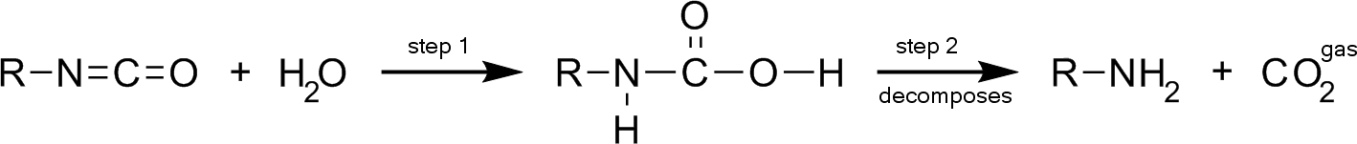
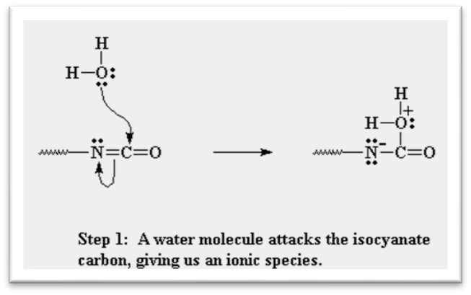
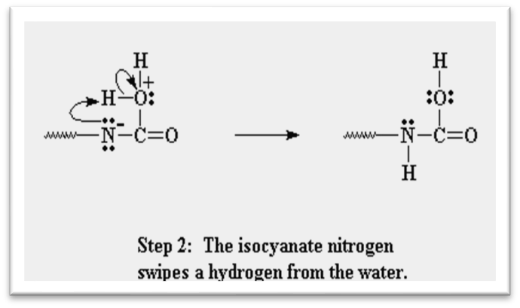
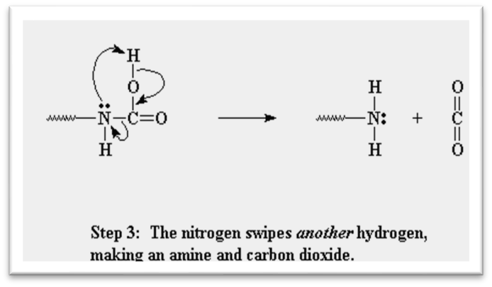
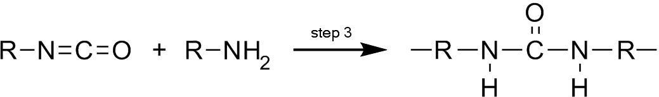
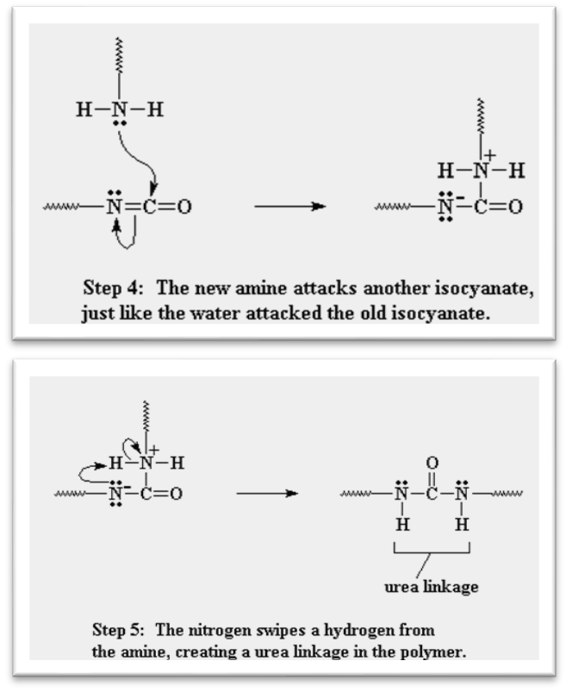
Step-Addition Polymerization (Polyaddition); Crosslinked Polyurethanes

Slide 34
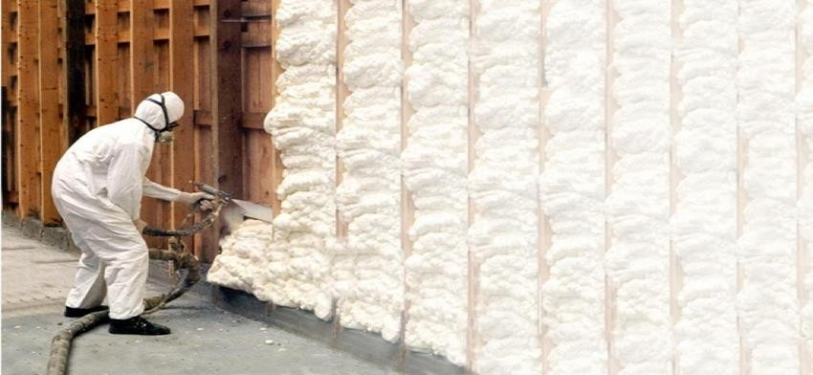
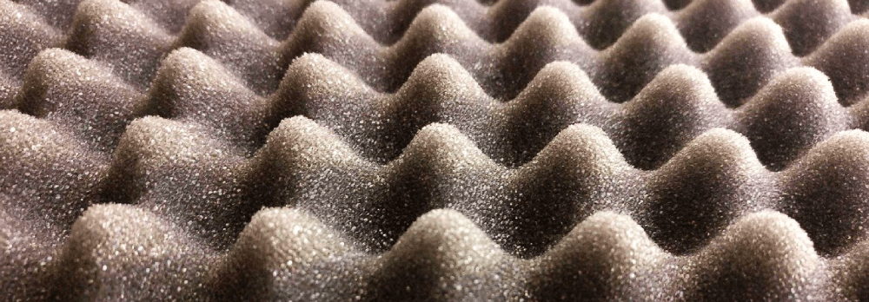
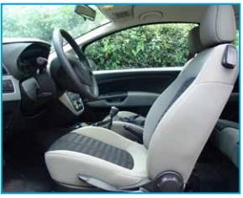
Step-Addition Polymerization (Polyaddition); Crosslinked Polyurethanes
Polyurethane Foam Application
Building Insulation
Prevents air, moisture, vapor and sound infiltration, as well as reduce energy usage and heating and cooling costs.
Polyurethane foam also, helps absorbing noise in sport halls but also in many other places of leisure such as theatres and cinemas.
Transportation
i.e., trimming, seats, headrests, (air-conditioning) filters and acoustic insulation

Slide 35
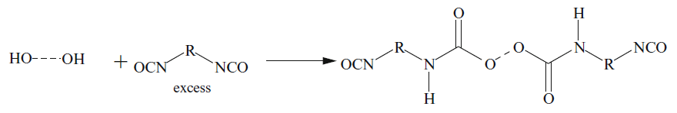

Step-Addition Polymerization (Polyaddition); Crosslinked Polyurethanes
Crosslinking with Glycols or Diamines
Crosslinking with glycols or diamines proceeds according to a similar scheme (without elimination of CO₂).
With glycols, this occurs with the formation of urethane groups, which can then react with residual isocyanate end groups to give crosslinking.
With diamines. The reaction mixture is then chain-extended with a diamine:.
Crosslinking with glycols and diamines plays a major role in the preparation of polyurethane elastomers.

Slide 36
Step-Growth Polymerization; Network Polymers
Three steps are needed to prepare a network polymer
Prepolymer
Shaping
Curing
In these type of polymers, monomeric units are linked together to constitute 3D network.
The links involved are called crosslinks. And they are hard, rigid and brittle due to their network structure.

Slide 37
Phenolic Resins (Phenol-Formaldehyde Resin)
Condensation of phenol with formaldehyde can yield low molar mass, soluble, often still liquid intermediate materials (prepolymers).
By further reactions (e.g., by heating), prepolymers can be converted into networks that are insoluble and do not melt.
The condensation of phenol with formaldehyde in aqueous solution is pH-dependent.
Novolac; prepolymers prepared in acidic solution.
Resole; prepolymers obtained in an alkaline medium
Phenolic resins are used mainly as molding compounds with fillers.
The hardened (cross-linked) resins are tough construction materials with good resistance to stress cracking.
Webs of paper or tissues impregnated with phenolic resins can be processed into laminates.

Slide 38
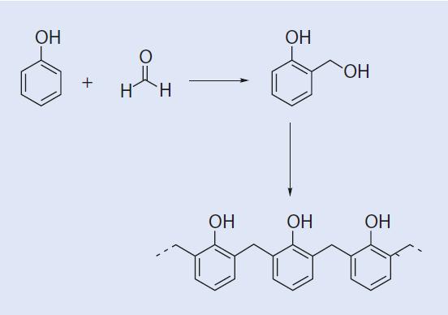


Phenolic Resins (Phenol-Formaldehyde Resin)
Novolac Resins
Synthesis of Novolac (at pH ≤ 3, ratio of phenol : formaldehyde = 1:0.8)
At 150°C, methyl groups are predominantly formed as formaldehyde and water are eliminated.
The crosslinking of Novolac is achieved by adding crosslinking agents, such as hexamethylene tetramine.
The cross-linking of Novolac with dimethylol amine

Slide 39



Phenolic Resins (Phenol-Formaldehyde Resin)
Novolac Resins
In aqueous solution, formaldehyde exists in equilibrium with methylene glycol.
The initial reaction is between methylene glycol and phenol.
The reaction continues with additional phenol and splitting off water.

Slide 40



Phenolic Resins (Phenol-Formaldehyde Resin)
Resole Resins;
Synthesis of resole (in a basic medium, ratio of phenol : formaldehyde = 1:1.5)
Cross-linking of resoles is accomplished by heating.
At 130 °C, methylol phenols simply dehydrate.

Slide 41





Phenolic Resins (Phenol-Formaldehyde Resin)
Resole Resins;
In aqueous solution, formaldehyde exists in equilibrium with methylene glycol.
Phenol reacts with methylene glycol to form methylol phenol:
Methylol phenol can react with itself to form a longer chain methylol phenolic:

Slide 42
Phenolic Resins (Phenol-Formaldehyde Resin)
Resole Resins | Novolac Resins
Reaction is carried out in basic medium. | Usually obtain in acidic medium.
Phenol functionality is ortho, meta & para | Phenol functionality is ortho and para.
Phenol: formaldehyde is 1:1.2 | Phenol: formaldehyde is 1:0.8
Already cross-linked | Can be cross-linked
Not soluble after complete cross-linking. | Soluble in alcohol, lower ester, ketone and dilute alkali.
Very high MW due to the three-dimensional crosslinking structure | Average MW is between 600-1500
Melting point starts at > 350◦ C | Melting point is between 100◦ C & 140◦ C
Thermoset polymer | Thermoplastic

Slide 43


Urea Resins (Urea-Formaldehyde Resin)
The reaction products of formaldehyde with urea (carbamide) are called urea resins.
This reaction is pH-dependent.
In a neutral to slightly alkaline environment; conversion of urea with formaldehyde to urea resin precursors
In an acidic environment; individual steps of the acid-catalyzed cross-linking of urea resin precursors.
The cross-linking can be continued to incorporate all the -NH₂ groups.

Slide 44

Urea Resins (Urea-Formaldehyde Resin)
In a neutral to slightly alkaline environment; Trimerization of urea in an acidic environment
Thereafter, the NH₂ groups can react further and cross-link.
The urea resins are similar in their properties and their applications to phenolic resins.

Slide 45


Melamine Resins (Melamine-Formaldehyde Resins)
Melamine (1,3,5-triaminotriazine) and formaldehyde react stepwise to yield intermediates, which have similar structures to those of urea resins.
Formation of melamine resin precursors from melamine and formaldehyde
Principle step in the cross-linking of melamine resins with elimination of water and formaldehyde

Slide 46
Melamine Resins (Melamine-Formaldehyde Resins)
At elevated temperatures (140–160°C), the molecules bridge and form a network.
Cross-linked melamine resins have slightly better mechanical and thermal properties than both phenolic and urea resins.
They are used especially to produce light-colored or white components, instead of phenolic and urea resins which have a dark, natural color.

Slide 47


Epoxy Resins
Epoxy resins are usually understood to be products of reaction of polyfunctional hydroxy compounds with 1-chloro-2,3-epoxypropane (epichlorohydrin) in basic medium.
In the simplest case two mol of epichlorohydrin react, with one mol of bisphenol A:
They have molecular weights between 450 and 4,000
Higher-molecular-weight result from coupling of epoxide with further bisphenol:

Slide 48
Epoxy Resins
The structure and molecular weight of the resulting epoxy resin are strongly influenced by the reaction conditions:
A large excess of epichlorohydrin favors the formation of terminal epoxy groups.
The molecular weight of the product decreases with increasing amount of epichlorohydrin.
High temperatures promote secondary reactions such as hydrolytic cleavage of epoxy groups, leading to the formation of additional hydroxy groups.
Crosslinking (curing) can be brought about with any di- or polyfunctional compound that adds to epoxy groups (e.g., amines, aminoamides, thiols).
Self-crosslinking can also be achieved by addition of catalytic amounts of a tertiary amine or acid compound, such as a sulfonic acid.
The crosslinking is carried out in bulk (casting resin), but sometimes in solution (lacquers, adhesives).
Most crosslinking reactions set in at higher temperatures, so the epoxy resin and crosslinker (polybasic carboxylic acids, acid anhydrides, and amines) can be mixed and stored at room temperature.

Slide 49

Differences Between Step-Growth and Chain-Growth Polymerizations

