Slide 1
240 Chem
Aromatic Compounds
Chapter 6

Slide 2
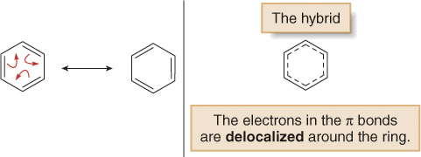
The expressing aromatic compounds came to mean benzene
and derivatives of benzene.
Structure of Benzene: Resonance Description
C₆H₆
It contains a six-membered ring and three additional degrees of unsaturation.
It is planar.
All C—C bond lengths are equal.

Slide 3
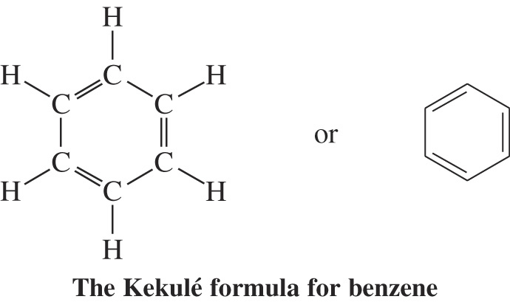
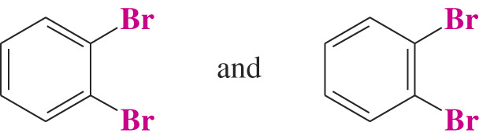
The Kekule Structure for Benzene
    Kekule was the first to formulate a reasonable representation
    of benzene:
    The Kekule structure suggests alternating double and single carbon-carbon bonds.
      Based on the Kekule structure one would expect there to be
      two different 1,2-dibromobenzenes but there is only one.

Slide 4
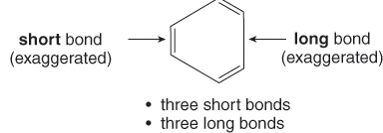
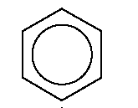
The Kekule structures satisfy the first two criteria but not the third, because having three alternating π bonds means that benzene should have three short double bonds alternating with three longer single bonds.
The true structure of benzene is a resonance hybrid of the two Lewis structures, with the dashed lines of the hybrid indicating the position of the π bonds.
Or

Slide 5
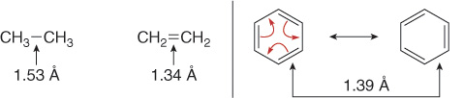
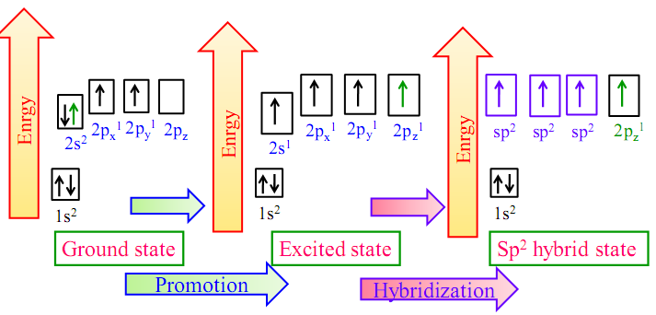
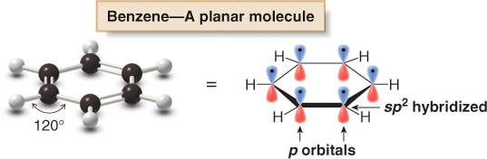
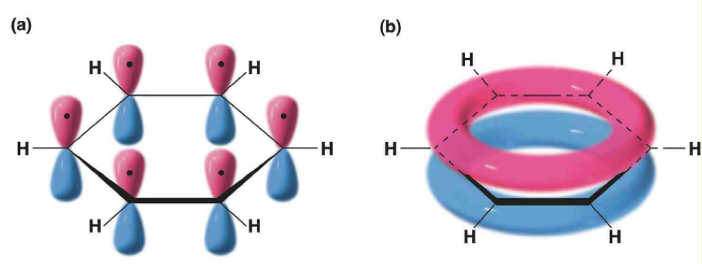
In benzene, the actual bond length (1.39 Å) is intermediate between the carbon—carbon single bond (1.53 Å) and the carbon—carbon double bond (1.34 Å).
Benzene-Molecular Orbital Description:

Slide 6
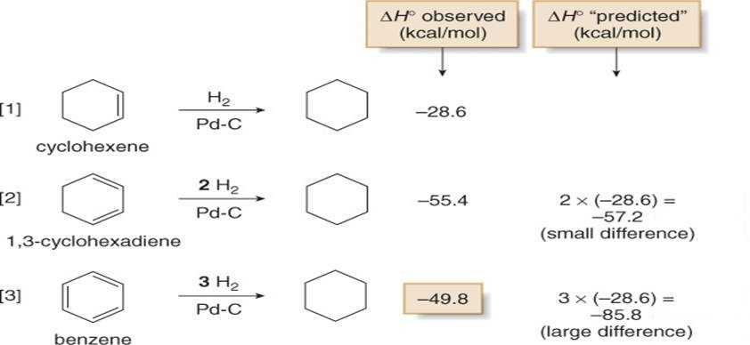
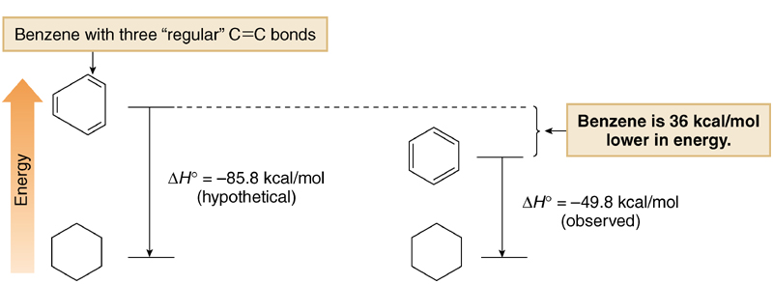
Stability of Benzene:
This energy difference ( 36 kcal/mol ) is the stabilization of benzene. It is commonly referred as the resonance stabilization of benzene.

Slide 7
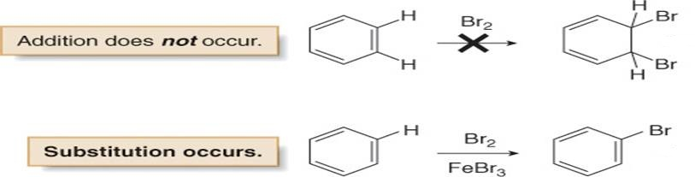
The low heat of hydrogenation of benzene means that benzene is especially stable even more so than conjugated polyenes. This unusual stability is characteristic of aromatic compounds.
Benzene’s unusual behavior is not limited to hydrogenation. Benzene does not undergo addition reactions typical of other highly unsaturated compounds, including conjugated dienes.

Slide 8
Aromatic Character: The (4n + 2 ) π Rule
Hückel’s Rule
A molecule must be cyclic.
A molecule must be planar.
A molecule must be completely conjugated.
A molecule must satisfy Hückel’s rule, and contain a particular
number of π electrons.
4n+2 π electrons ( n= 0, 1, 2, 3, ….= 2, 6, 10, 14, ….)

Slide 9
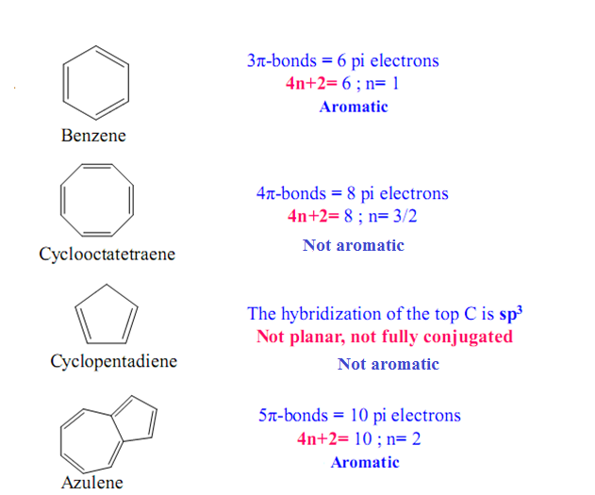
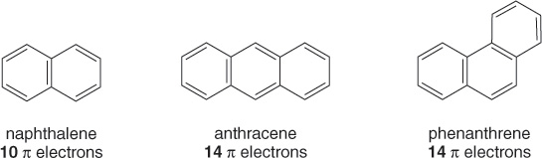
Examples:

Slide 10
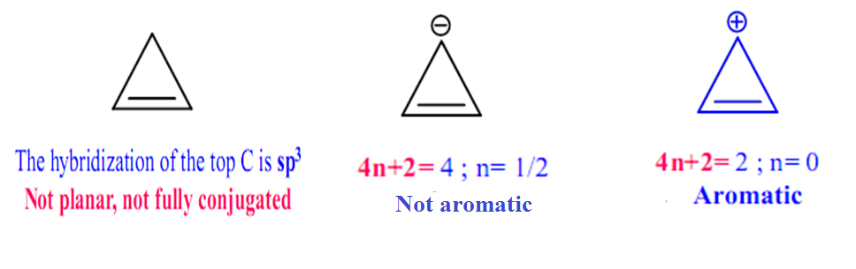
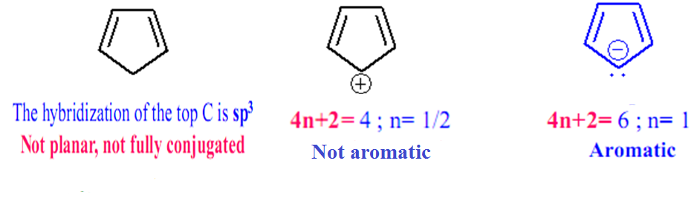
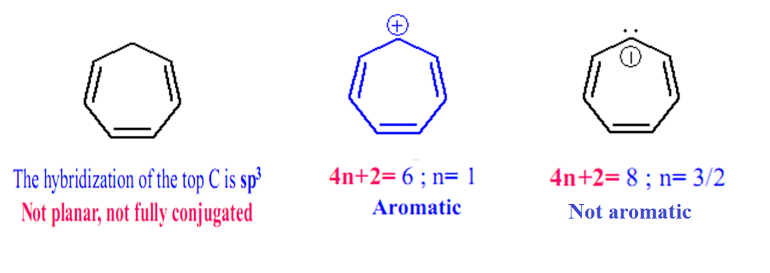

Slide 11
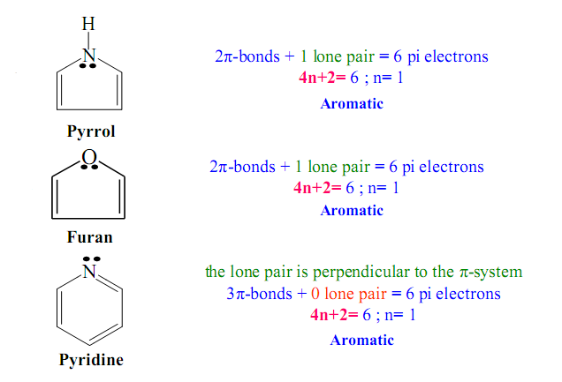
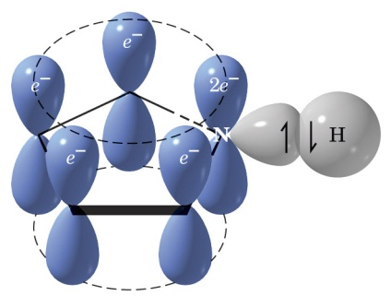
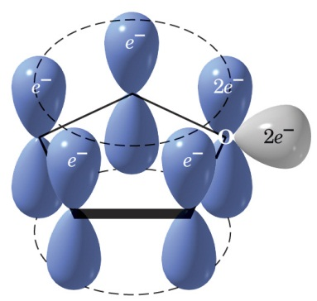
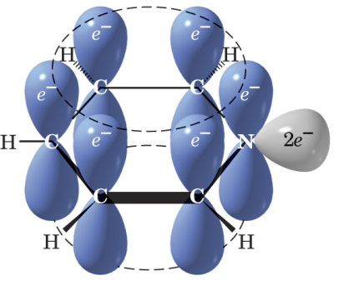

Slide 12
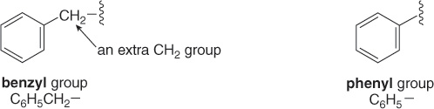
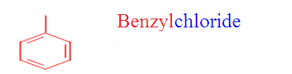
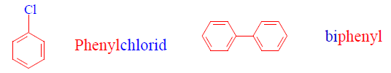
Nomenclature of Aromatic compounds
When a benzene ring is a substituent, the term phenyl is used (for C₆H₅-)
  You may also see “Ph” or “φ” in place of “C₆H₅”
“Benzyl” refers to “C₆H₅CH₂-”
CH₂Cl

Slide 13
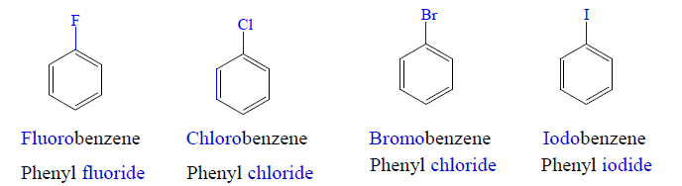
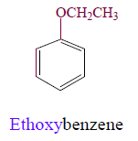
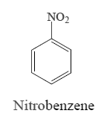
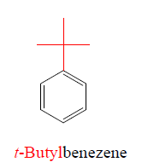
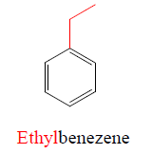
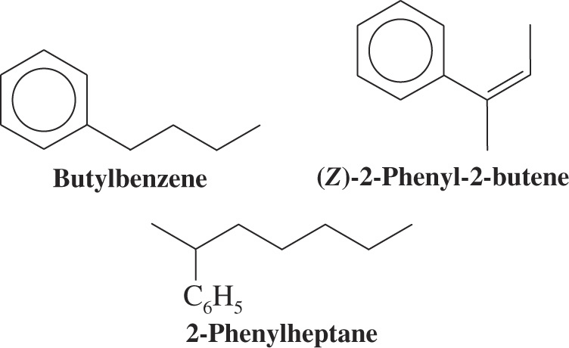
    Benzene is the parent name for some monosubstituted benzenes; the substituent name is added as a prefix.
    The C₆H₅- group is called phenyl when it is a substituent
      A hydrocarbon with a saturated chain and a benzene ring is named by choosing the larger structural unit as the parent
      If the chain is unsaturated then it must be the parent and the benzene is then a phenyl substituent

Slide 14
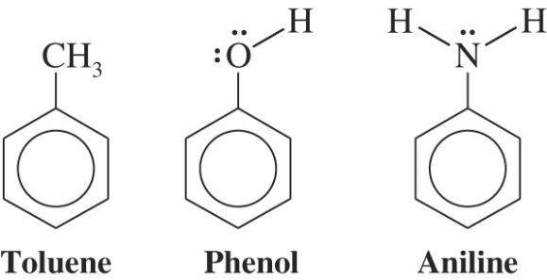

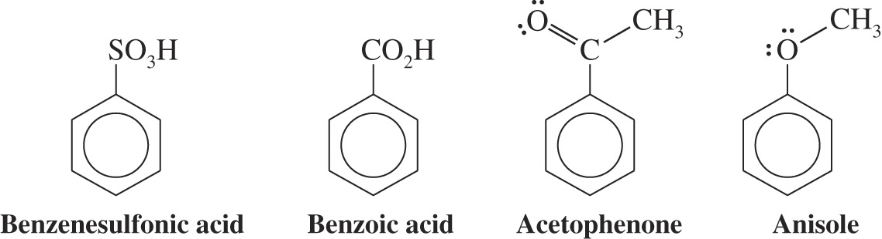
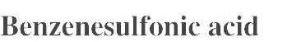
    For other monosubstituted benzenes, the presence of the substituent results in a new parent name.

Slide 15
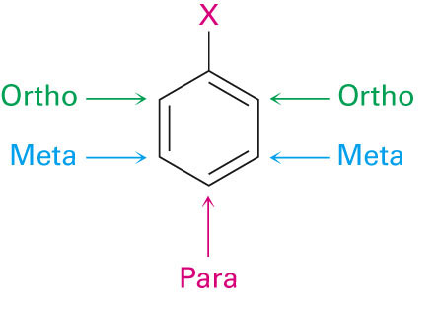
    When two substituents are present their position may be indicated by the prefixes ortho, meta, and para (o, m and p) or by the corresponding numerical positions.
If the two groups on the benzene ring are different, alphabetize the names of the substituents preceding the word benzene.
If one substituent is part of a common root, name the molecule as a derivative of that monosubstituted benzene.

Slide 16
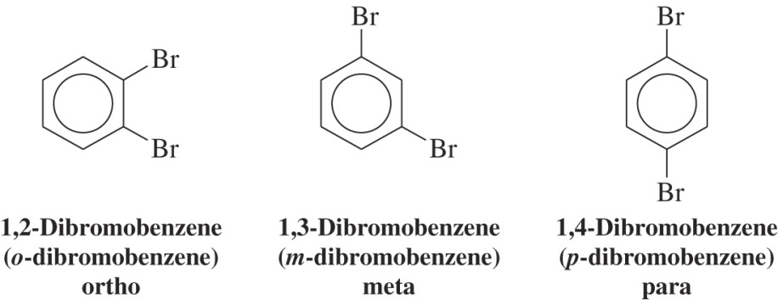
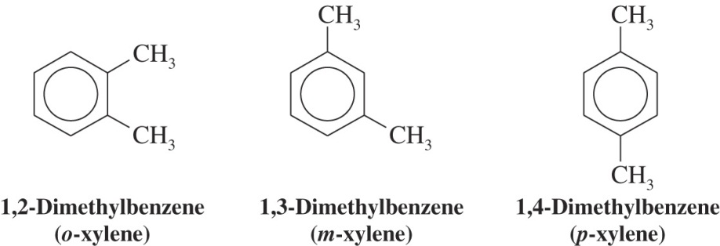
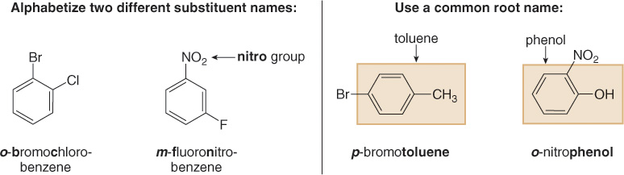
1-Bromo-2-chlorobenzene
o-Bromochlorobenzene
1-Fluoro-3-nitrobenzene
m-Fluoronitrobenzene

Slide 17
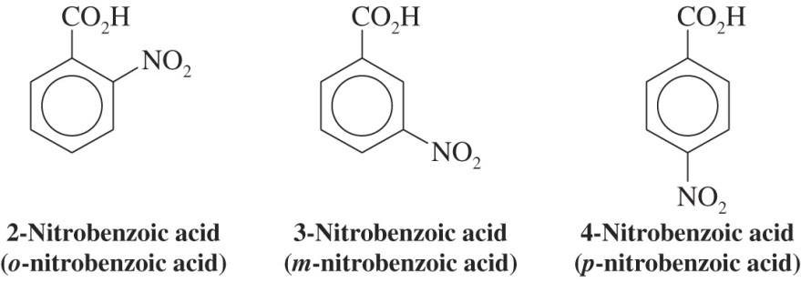

Slide 18
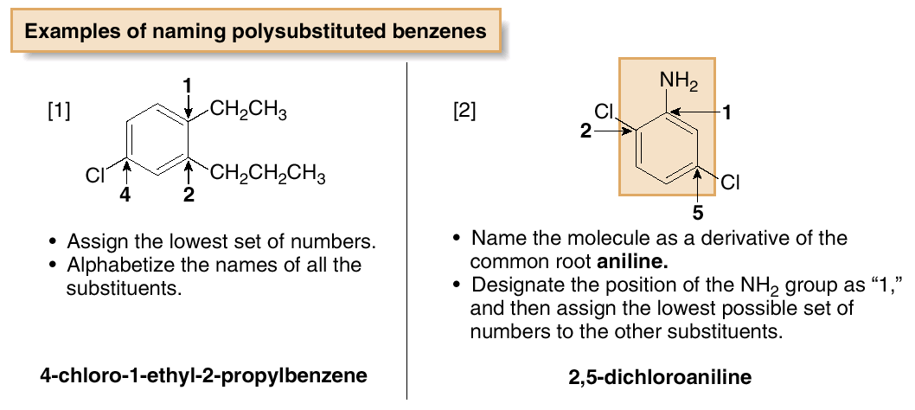
For three or more substituents on a benzene ring:
  Number to give the lowest possible numbers around the ring.
  Alphabetize the substituent names.
  When substituents are part of common roots, name the molecule as a derivative of that monosubstituted benzene. The substituent that comprises the common root is located at C1.

Slide 19
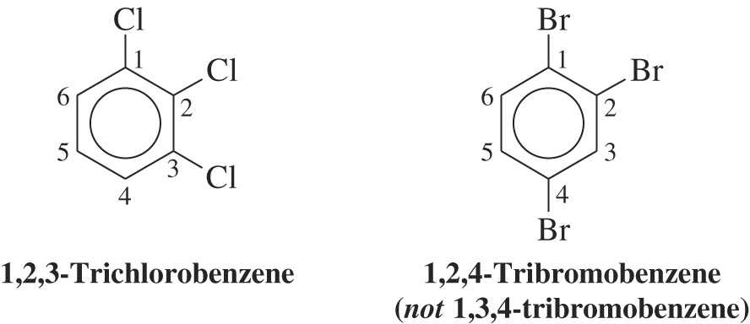
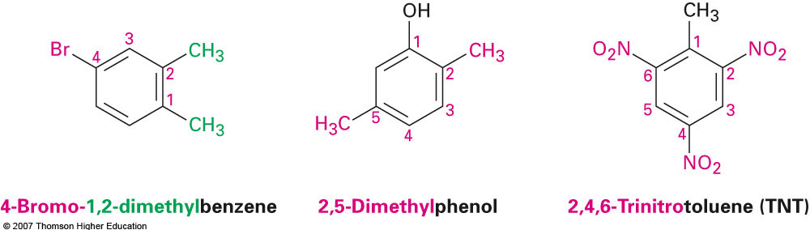
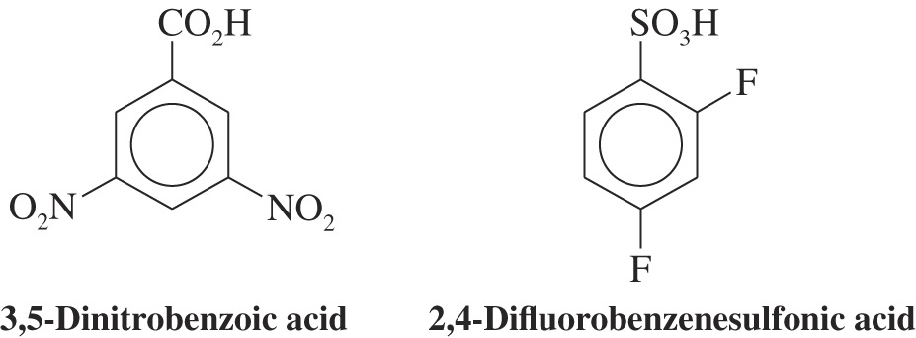

Slide 20
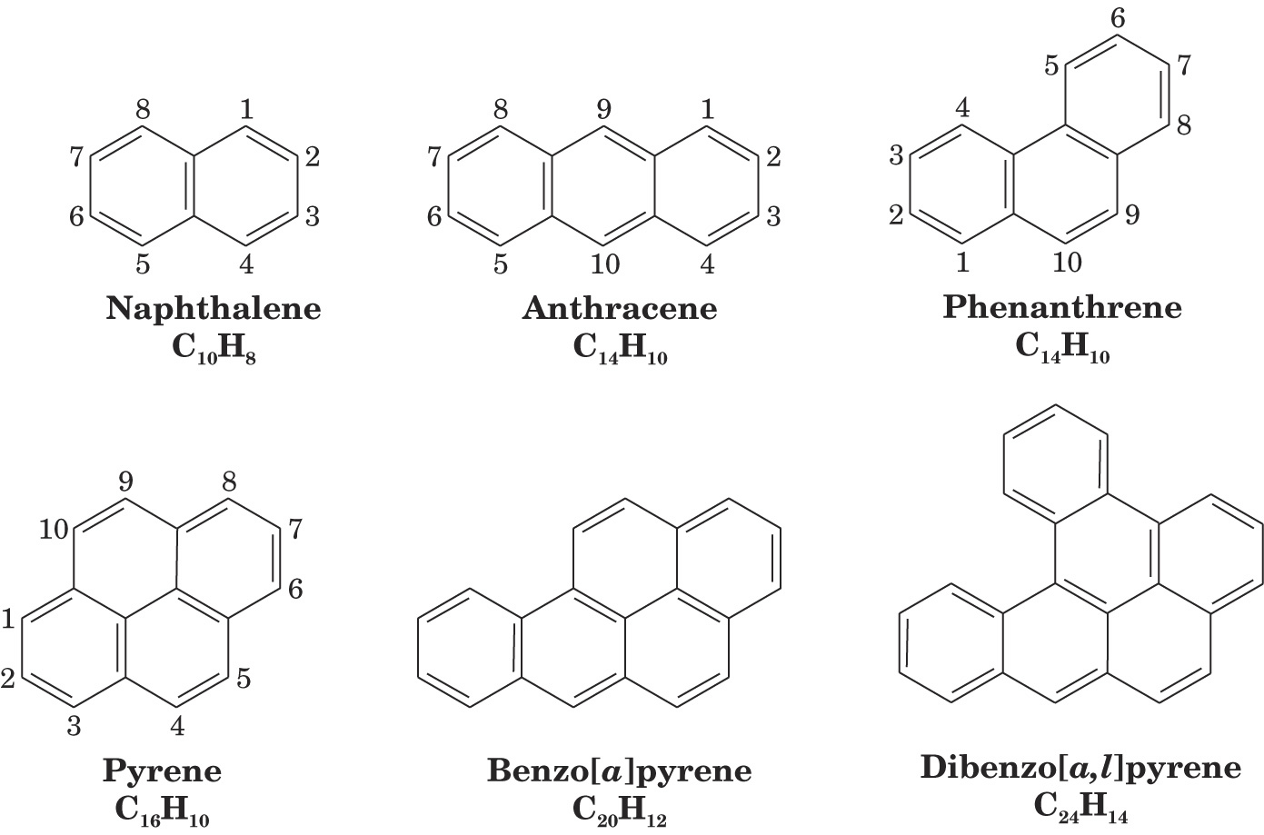
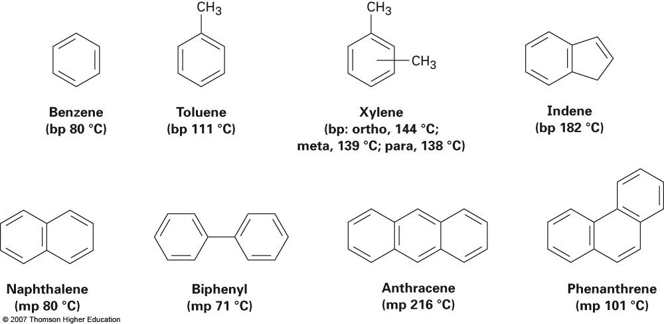
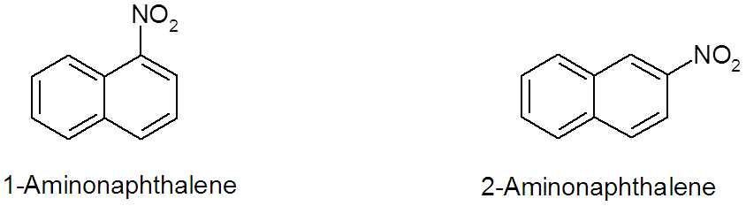
Polynuclear Aromatic Hydrocarbons:
1-Nitronaohthalene
α-Nitronaohthalene
2-Nitronaohthalene
β-Nitronaohthalene

Slide 21
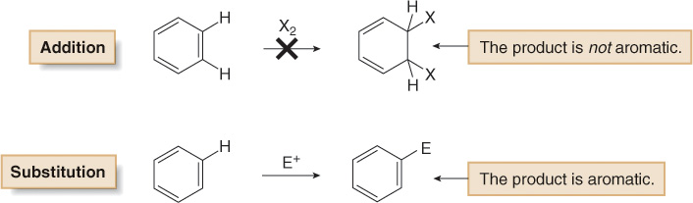
Electrophilic Aromatic Substitution
1- Specific Electrophilic Aromatic Substitution Reactions
Benzene does not undergo addition reactions like other unsaturated hydrocarbons, because addition would yield a product that is not aromatic.
Substitution of a hydrogen keeps the aromatic ring intact.
Halogenation, Alkylation, Nitration, and Sulfonation
are the typical electrophilic aromatic substitution reactions.

Slide 22
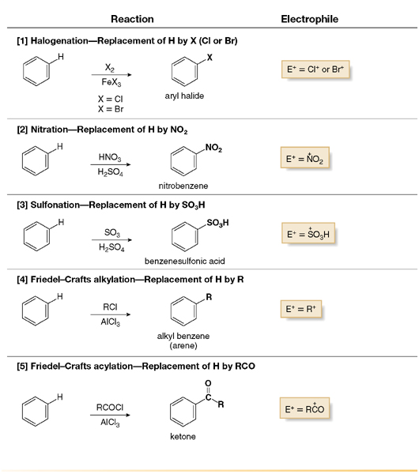

Slide 23
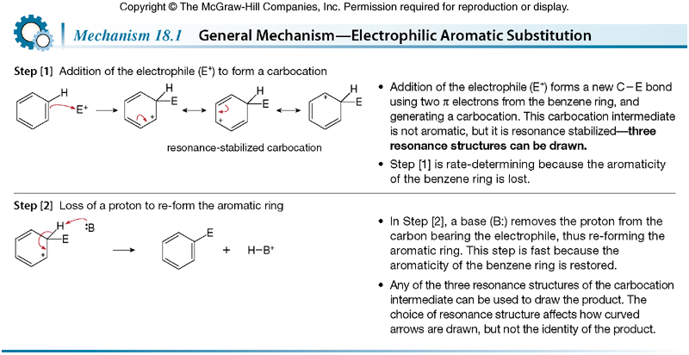
General Mechanism-Electrophilic Aromatic Substitution

Slide 24
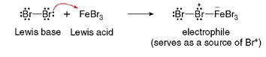
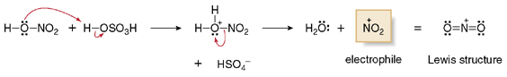


Formation of the Electrophile for Bromination
Formation of the Electrophile NO₂⁺ for Nitration
Formation of the Electrophile SO₃H⁺ for Sulfonation
Formation of the Electrophile in Friedel-Crafts Acylation

Slide 25


Formation of the Electrophile in Friedel-Crafts Alkylation
Friedel-Crafts Alkylation involving Carbocation rearrangement

Slide 26


Examples:

Slide 27





Slide 28


2- Side-Chain Reactions of Aromatic Compounds
A) Halogenation of an Alkyl Side-Chain

Slide 29


B) Oxidation of an Alkyl Side-Chain

Slide 30

Disubstituted Benzenes: Orientation
Product ratio conclusion:
40% ortho, 40% meta, 20% para

Slide 31

Orientation and Reactivity Effects of Substitutions Y in Electrophilic Aromatic Substitution

Slide 32


Slide 33




Examples:

Slide 34





