Slide 1
240 Chem
Unsaturated Hydrocarbons II:
Alkynes
Chapter 4

Slide 2
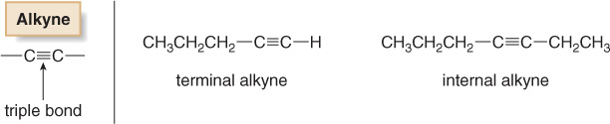
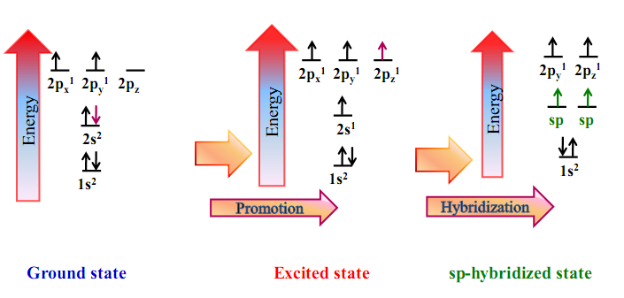
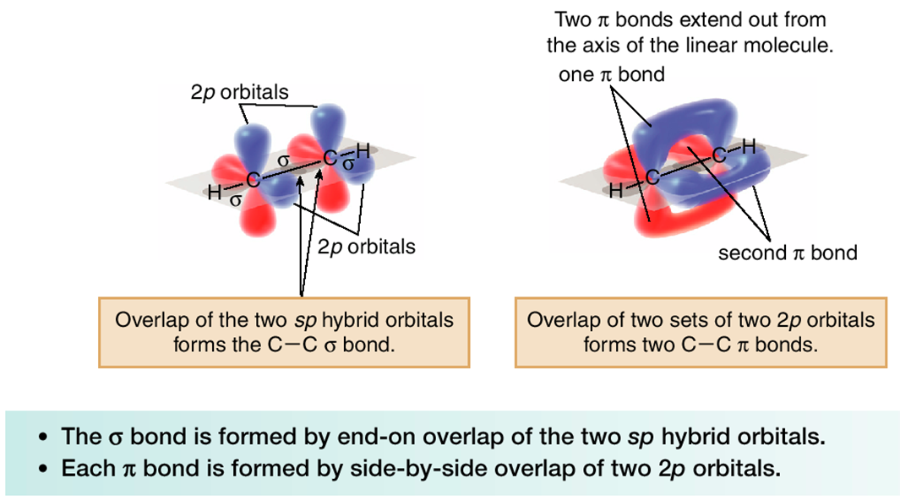
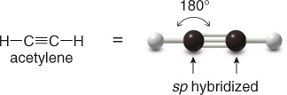
Alkynes
C_{n}H_{2n-2}
Crabon-carbon triple bond
Hybridization in Alkynes:
=

Slide 3
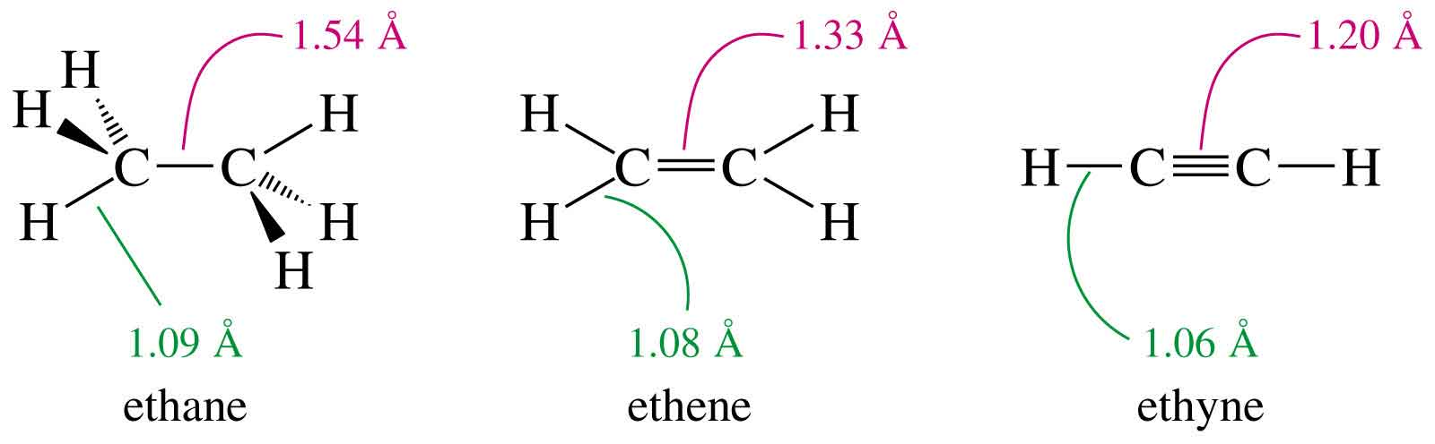
The comparative between alkane, alkene and alkyne:
109.5°
120°
180°
sp³
sp²
sp
Tetrahedral
Trigonal planar
Linear

Slide 4
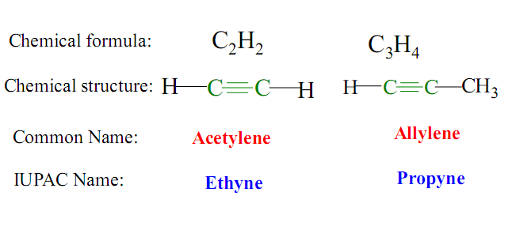
Nomenclature of Alkynes
ane
yne
The simplest alkyne:
Common Names: Named as substituted acetylene.
Methylacetylene
Isobutylisopropylacetylene

Slide 5
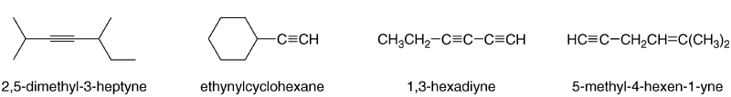
Examples:
4-methyl-1-hexen-5-yne
The two-carbon alkyl group derived from acetylene is called an ethynyl group.

Slide 6
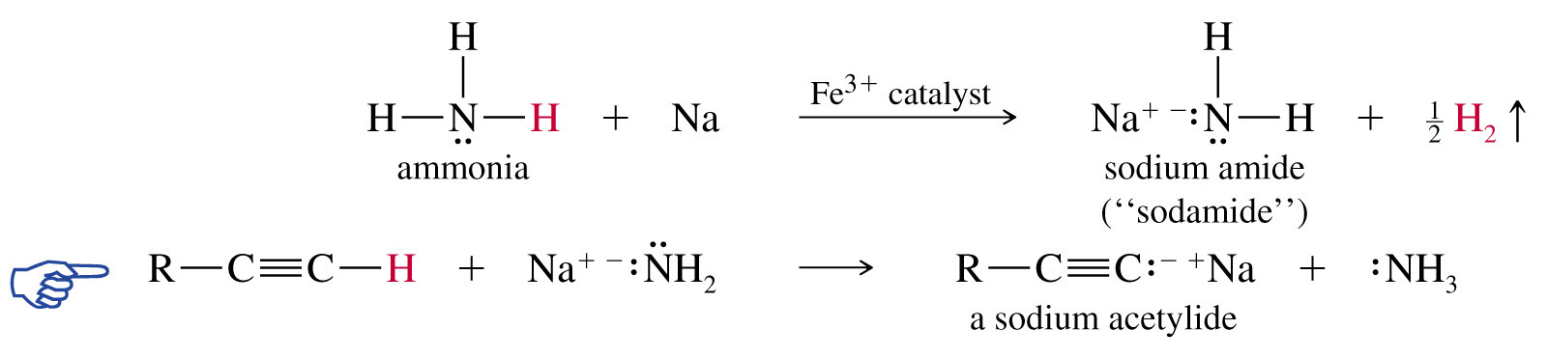
Terminal and Internal alkynes
Terminal alkynes are more acidic than other hydrocarbons.
Physical Properties
C₁-C₄
gases
C₅-C₁₈
liquids
More than C₁₈
solids
Alkynes are nonpolar compounds. Thus alkynes are soluble in the nonpolar solvents
such as carbon tetrachloride (CCl₄) and benzene (C₆H₆),
but they are insoluble in polar solvents such as water.

Slide 7
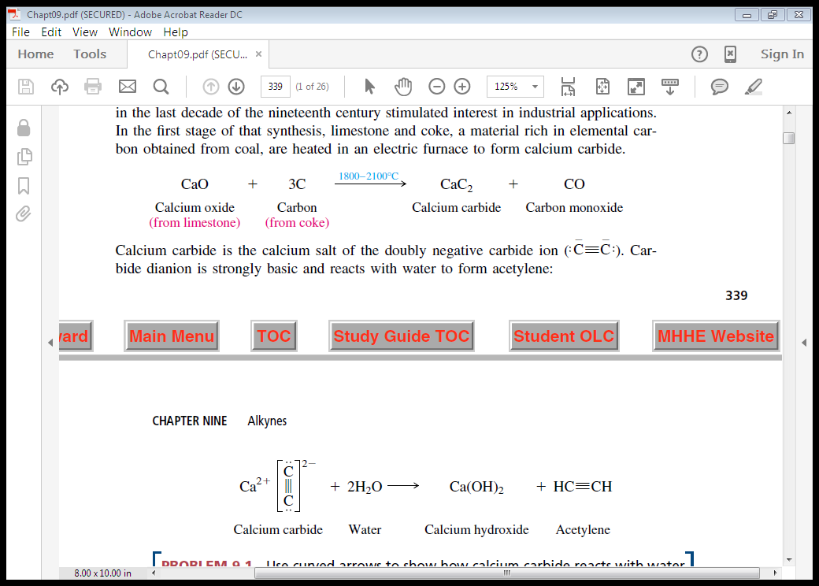
Preparation of Alkynes
1- Industrial
From Calcium carbide

Slide 8
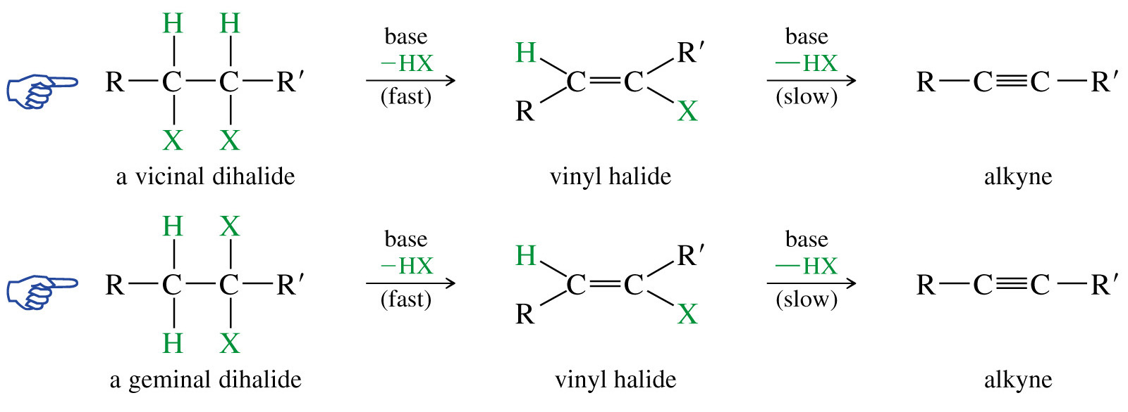
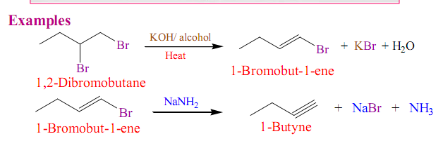
2- Dehydrohalogenation of Alkyl Dihalides
Example:

Slide 9
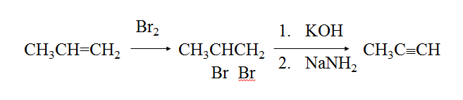
X₂
1. KOH
alkene
Vicinal dihalide
alkyne
2. NaNH₂
or 2 NaNH₂
Example:

Slide 10
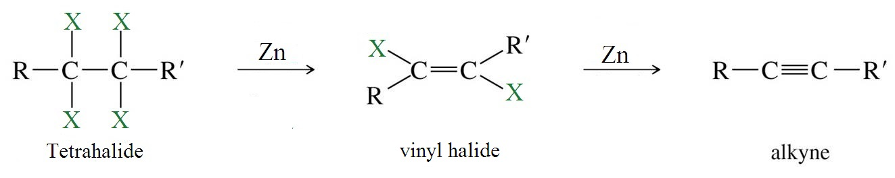
3- Dehalogenation of Tetrahalides
Example:

Slide 11
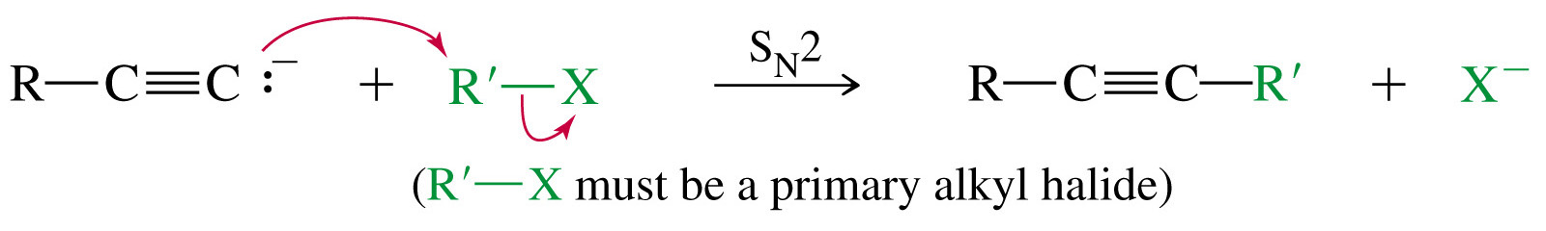
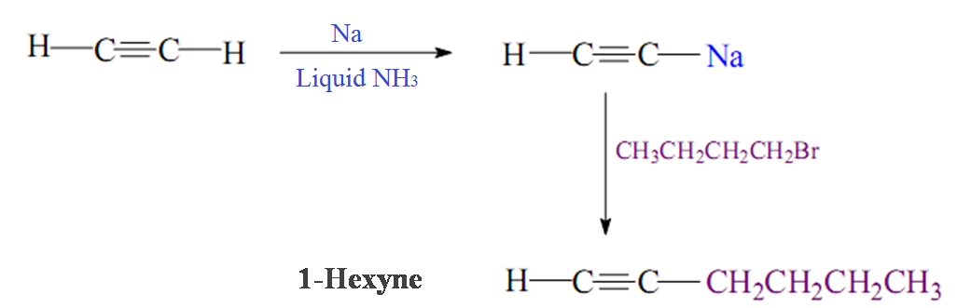
4- Reaction of Sodium Acetylide with Primary Alkyl Halides
Example:

Slide 12
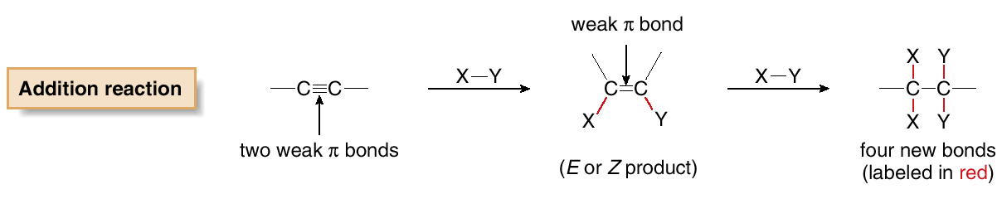
Reactions of Alkynes
Addition Reaction

Slide 13
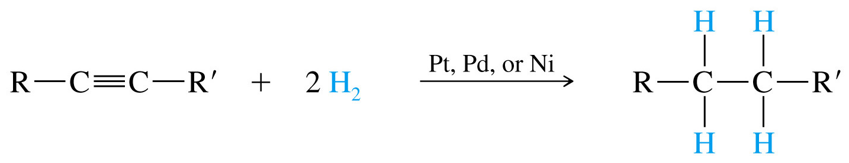
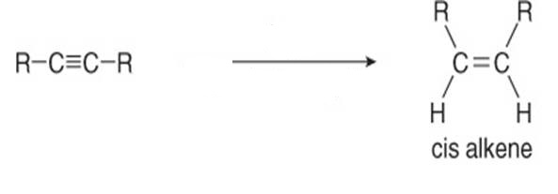
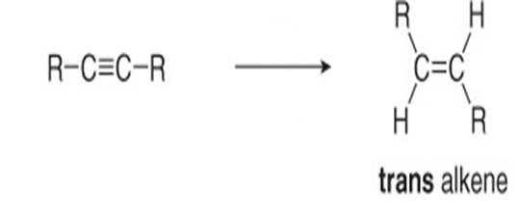


1- Addition of Hydrogen (Reduction)
A)
B)
Lindlar Catalyst ( Lindlar Pd )
Pd / CaCO₃
+ H₂
Lead acetate,
quinoline
2- Metal-Ammonia Reduction

Slide 14
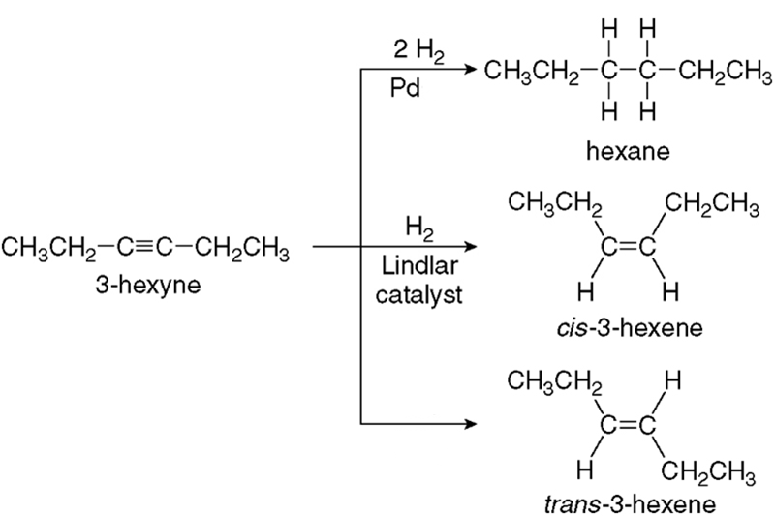
Examples:

Slide 15
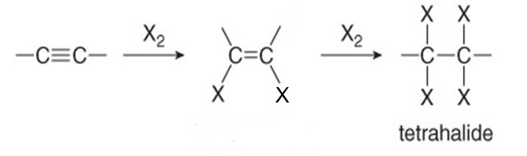
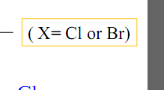
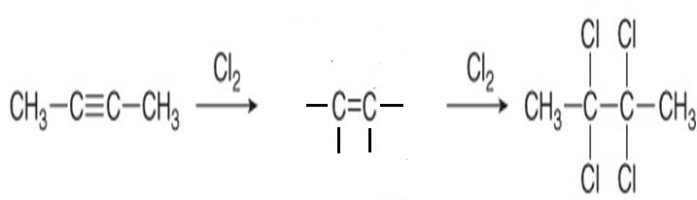


3- Addition of Halogen: Halogenation
Examples:

Slide 16
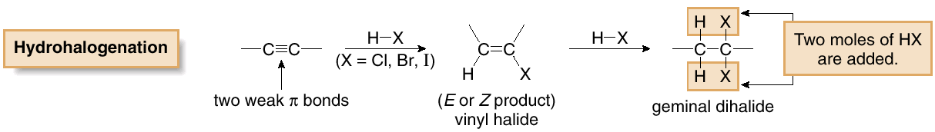
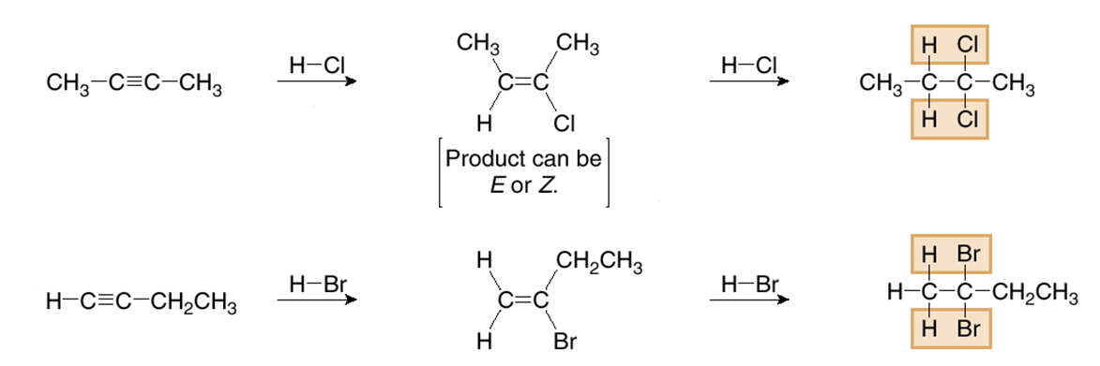
3- Addition of Hydrogen Halide: Hydrohalogenation
HX = HI, HBr, HCl
Markovnikov addition
Examples:

Slide 17
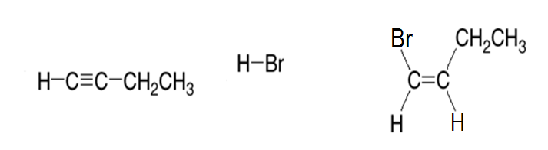
Free-radical Addition
hν or
peroxide
Anti Markovnikov addition

Slide 18
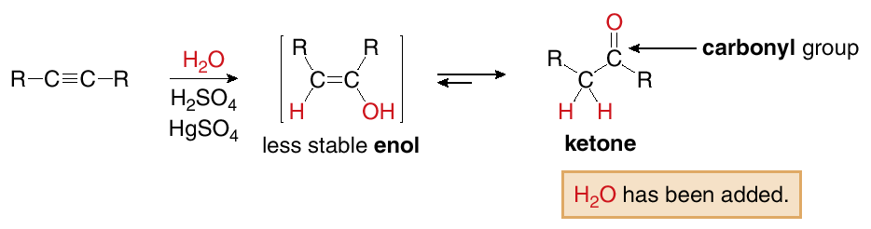
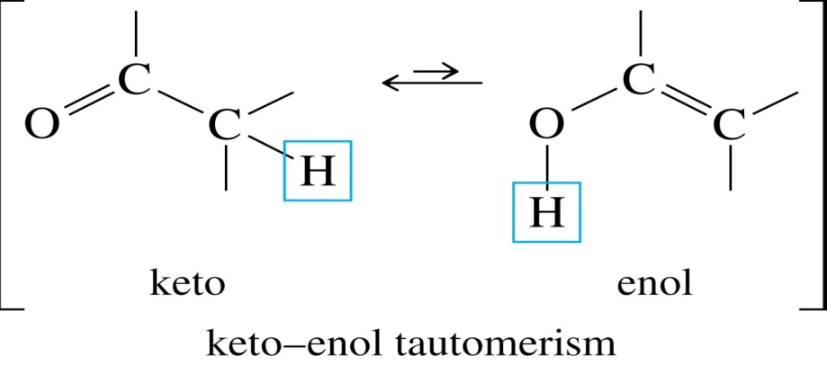

4- Addition of Water : Hydration
Markovnikov addition

Slide 19
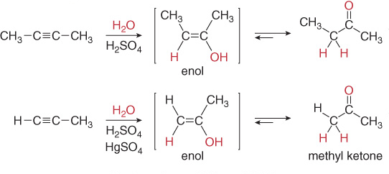
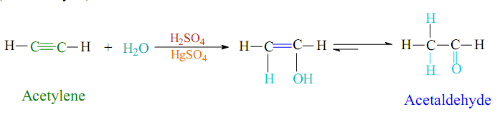
Examples:

Slide 20
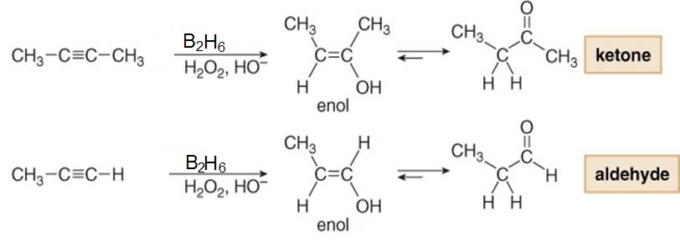
5- Addition of Born Hydried
Examples:
Aldehyde
Ketone

Slide 21
6- Oxidation of alkynes
Example:

Slide 22
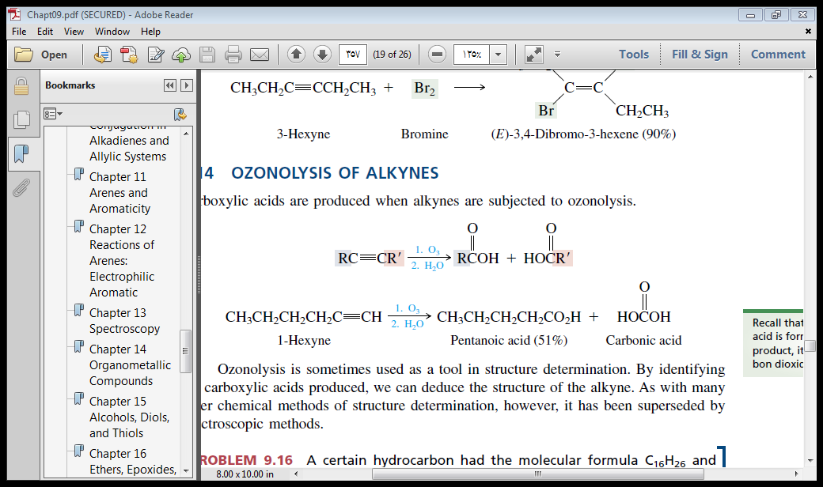
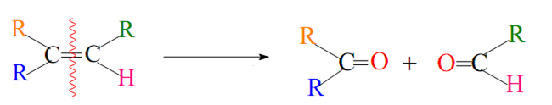
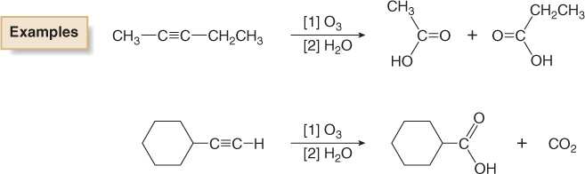
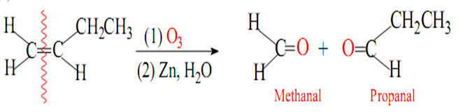
7- Ozonolysis of alkynes
1) O₃
2) H₂O, Zn
Examples:
1) O₃
2) H₂O, Zn
1) O₃
2) H₂O, Zn

