Slide 1
PHT 226 Lab # 3
Gram’s stain
Acid fast stain
Spore stain
Hanging drop technique

Slide 2
Staining of Bacteria
Types of staining technique:-
Simple staining
(use of a single stain)
Differential staining
(use of two contrasting stain)
For visualization of morphological
shape & arrangement.
Identification
Visualization
of structure
Gram
stain
Acid fast
stain
Spore
stain
Capsule
stain

Slide 3
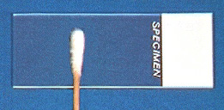
Smearing out of the sample

Slide 4
Smear Fixation

Slide 5
Principle of Differential Stains
* Application of the primary stain.
* Decolourization.
*Application of the counter-stain.

Slide 6
Gram Stain
Materials:-
Cultures of Staphylococci, Candida, Bacillus, gram –ve bacteria
Crystal violet (primary stain)
Gram’s iodine (mordant)
Acetone-alcohol (decolorizing agent)
Safranin (counter stain)

Slide 7
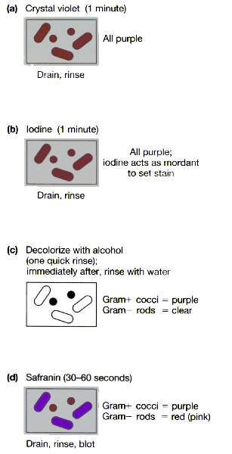
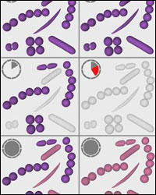
Gram Staining
“One of the most common mistakes is to decolorize a smear for too long a time period. Even Gram-positive cells can lose the crystal violet-iodine complex during prolonged decolorization.

Slide 8
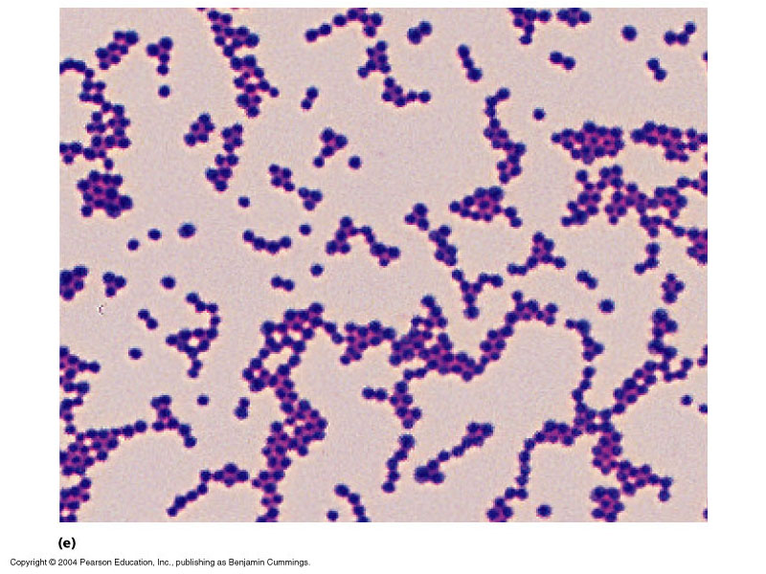
Results:
Shape: Cocci
Arrangement: clusters
Colour: Violet
Gram’s reaction: Gram’s +ve
Name of microorganism: Staphylococci

Slide 9
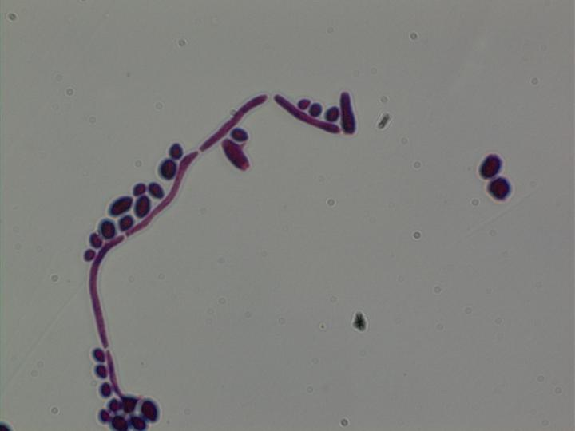
Results:
Shape: Oval
Arrangement: Single
Colour: Violet
Gram’s reaction: Gram’s +ve
Name of microorganism:
Candida

Slide 10
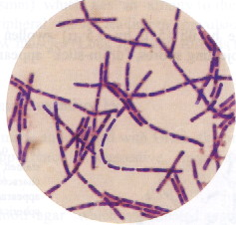
Results:
Shape: Bacilli
Arrangement: Chains
Colour: Violet
Gram’s reaction: Gram +ve
Name of microorganism:
Bacillus

Slide 11
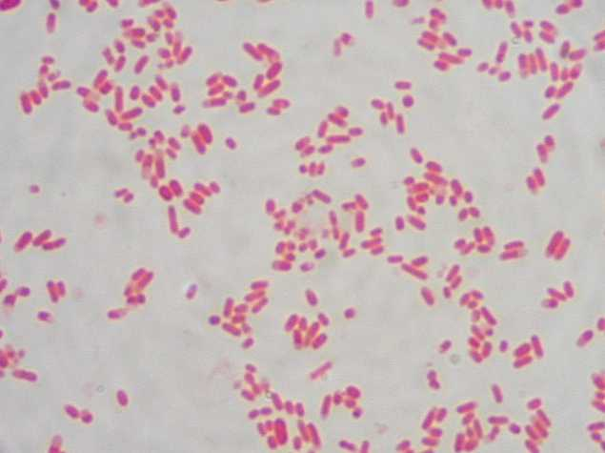
Results:
Shape: Rods
Arrangement: Single
Colour: red
Gram’s reaction: Gram -ve
Name of microorganism:
Gram –ve bacteria

Slide 12
Acid Fast Stain
Acid fast bacteria (ex; Mycobacteria) are difficult to be stained by simple or Gram’s stain, because they have a high lipid (waxy) content in their cell walls which prevent the penetration of ordinary aniline dyes.
Once these organisms are stained, they resist decolorization even with a very strong decolorizing agent such as acid-alcohol.

Slide 13
Acid Fast Stain e.g., Ziehl-Neelsen Stain
AFS is an important diagnostic value in identifying pathogenic members of genus Mycobacterium such as M. tuberculosis and M. leprea.
Materials:-
Culture of M. phelei
Conc. carbol fuchsin (primary dye)
Acid-alcohol (decolorizing agent)
Methylene blue (counter stain)

Slide 14
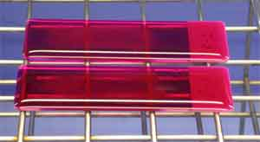
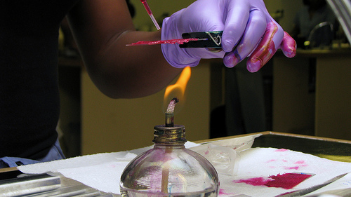
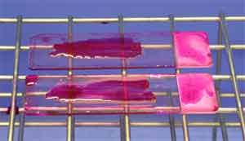
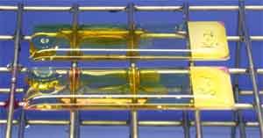
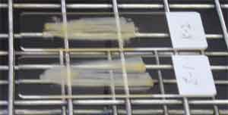
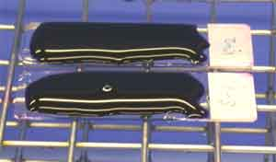
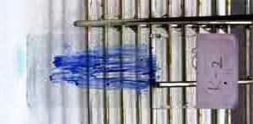
Ziehl-Neelsen Stain
1 2 3
4 5 6
7

Slide 15
Acid Fast Stain
Procedure:-
5 min
Carbol
fuchsin
\\\\
alcohol
MB
30-60 sec
1 min

Slide 16
Role of Methylene blue?

Slide 17
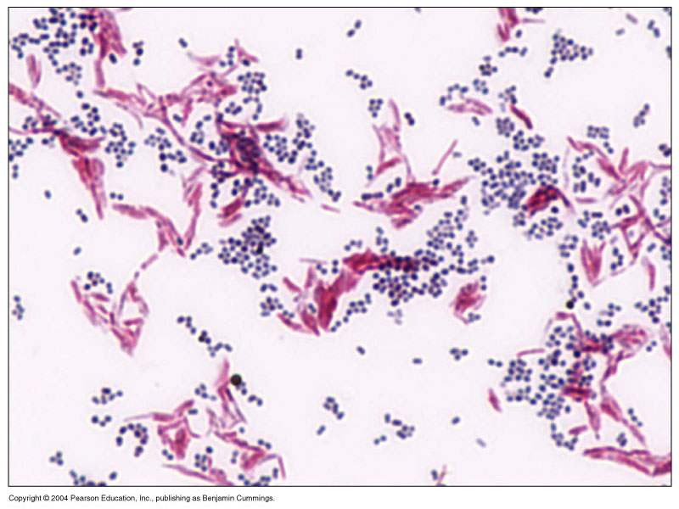
Results
Name of Stain: Acid fast stain
Shape: branched beaded bacilli
Arrangement: Tree shaped
Colour: red
Name of microorganism: M.phelei

Slide 18
The Spore Stain
Some bacteria form resistant bodies in the cell known as endospores.
Bacterial spores are highly resistant to physical & chemical agents & are not easily stained by routine staining.
Heat is required in spore staining to promote the penetration of the dye into the spore.
Once the spores stained they resist the decolorization.

Slide 19
The Spore Stain
Materials :-
Culture of B. subtilis
Malachite green (primary stain)
Safranine (counter stain)

Slide 20
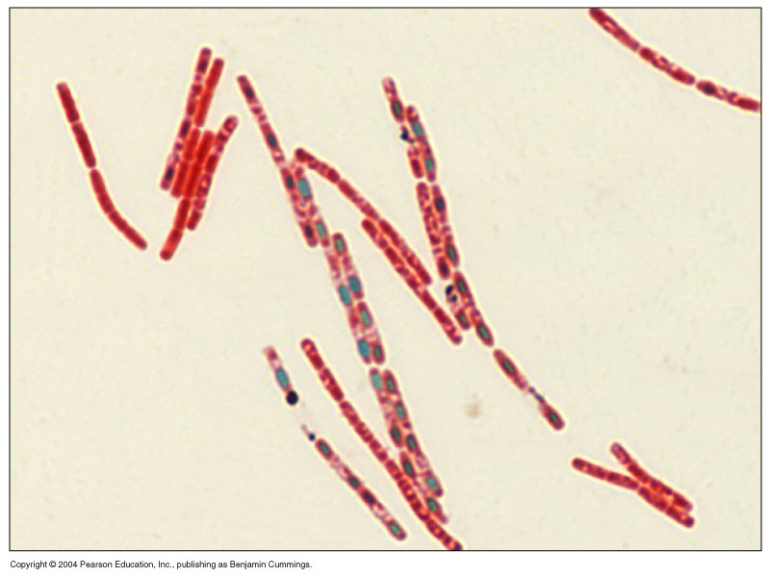
Spore Stain of Bacillus subtilis
Name of Stain: Spore stain
Shape: bacilli
Arrangement: Chains
Colour of spores: green
Colour of vegetative cells: red
Name of microorganism:
B. subtilis

Slide 21
Identification of Bacteria
Microscopical Examination:
Examination of wet mount preparation.
Examination of stained preparation.
Macroscopical Examination:
Characters of colonies.
Hemolysis on blood agar.
Pigment production.

Slide 22
Identification of Bacteria
Biochemical Tests.
Additional Tests:
such as serological tests

Slide 23
Examination of living bacteria for motility (Hanging drop technique)
Examination of wet mount
preparation.
In stained slide preparation the cells are heat-killed prior to staining. Thus the motility in not observable .
Direct observation of a drop from a liquid containing bacteria is an excellent method of studying motility as in hanging drop preparations

Slide 24
(Hanging drop technique)
True motility:- it is the active movement of the organism from place to place.
Brownian movement:- is a vibratory movement of the cells due to their bombardment by water molecules in the suspension

Slide 25
(Hanging drop technique)
Materials:-
Culture of Proteus vulgaris
Plasticine, slide, cover slip

Slide 26
Thank You

