Slide 1
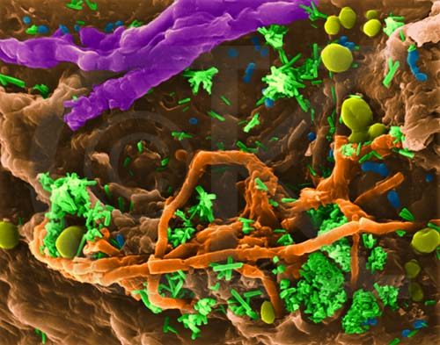
226 PHT
Lab#2
Staining techniques

Slide 2
Identification of Bacteria
Microscopical Examination:
Examination of wet mount preparation.
Examination of stained preparation.
Macroscopical Examination:
Characters of colonies.
Hemolysis on blood agar.
Pigment production.

Slide 3
Identification of Bacteria
Biochemical Tests.
Additional Tests:
such as serological tests

Slide 4
Staining of Bacteria
Bacteria cells are almost colorless, and for this reason a staining technique is often applied to the cells to color them so that their shape and size can be easily determined under the microscope.

Slide 5
Staining of Bacteria
Types of staining technique:-
Simple staining
(use of a single stain)
Differential staining
(use of two contrasting stain)
For visualization of morphological
shape & arrangement.
Identification
Visualization
of structure
Gram
stain
Acid fast
stain
Spore
stain
Capsule
stain

Slide 6
Staining of Bacteria
Principle of staining:-
Dye are generally salts in which one of the ions is colored.
Example: methylene blue (simple dye) is the salt of methylene blue chloride (MBC)
MBC MB + C
Dyes may be either:
    Acidic dyes [ -ve]
    Basic dyes [ +ve]
+
-

Slide 7
Indirect staining with acidic dye (Negative staining)
The negative stain technique does not stain the bacteria but stain the background.
The bacteria will appear clear against a dark background.
No heat fixation or strong chemicals are used, so the bacteria less distorted than in other staining procedure.
Example: Nigrosine are acidic stain (negatively charged), so the –ve stain doesn’t stain the bacteria due to ionic repulsion of bacterial cell wall

Slide 8
Preparation and Fixation of Bacteria for Staining
(Preparation of Smear)
Objective:-
To kill the microorganism &fix them to the slide to prevent them from being washed out during the process of staining.

Slide 9
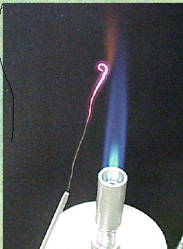
Preparing a smear for staining.
(The following procedure is used for all of our staining)
1. Flame (sterilize) your inoculating loop/needle before and after use. Heat from base to tip. Be sure to get the entire wire red hot.
Make sure that you are collecting your hair

Slide 10
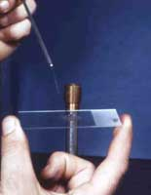

2. Prepare the smear
.
  a. With solid culture
(agar colony), place a small drop of distilled water on a clean slide. Drag the sterile inoculating needle tip through the edge of an isolated colony. Gently spread the mixture into a circle the size of a quarter.
b. With liquid culture
(A loop of liquid culture can be placed directly on the slide and spread out.)
3. Let the smear air dry completely. Do not apply heat while drying because this can lyse the cells

Slide 11
Smear preparation
S
Fixation

Slide 12
Simple Staining
Objective:-
To show the morphological shapes and arrangement of bacterial cells.
Direct staining with basic dye:
Materials:-
    Cultures of Staphylococci, Bacillus
    Methylene blue stain

Slide 13
Simple Staining
Procedure:-
MB
1-2 min

Slide 14
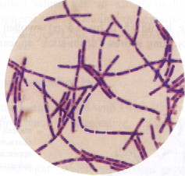
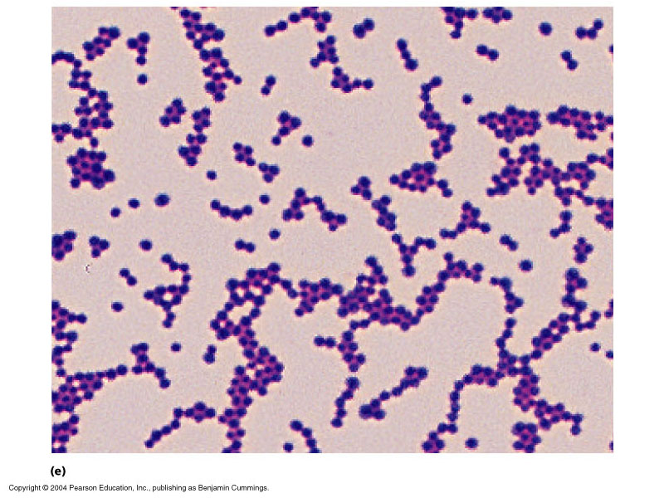
Basic Shapes of Bacteria
Cocci
Bacilli

Slide 15

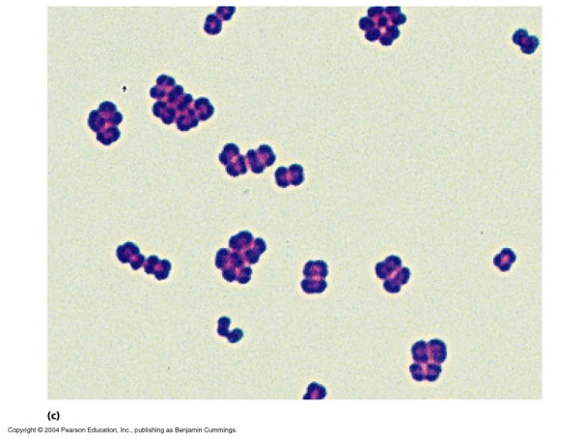
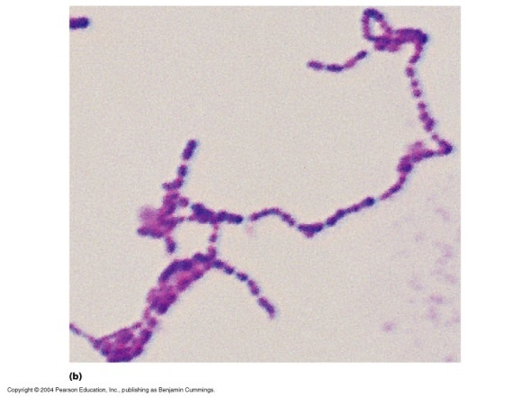
Arrangements
Cocci
Irregular Clusters
Tetrads
Chains or Pairs
Staphylococci
Micrococci
Streptococci

Slide 16
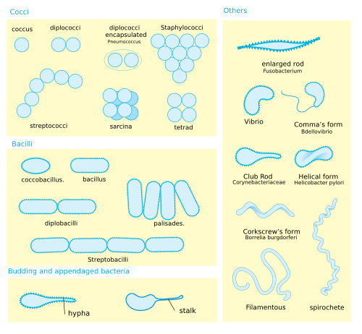
Bacterial
Arrangement
Clusters (group).
Chains.
Pairs (diploids).
No special arrangement.

Slide 17
Results
Name of staining technique:
Name of dye:
Shape of cells:
Arrangement of cells:
Color:
Name of m.o:

Slide 18
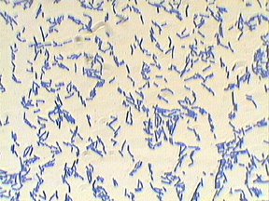
Simple Staining
Name of stain. tech.:- Simple Stain
Name of dye:- Methylene blue
Shape of cells:- bacilli
Arrangement of cells:- Chinese letter
Color:- Blue
Name of m.o:- Coryebacteria

Slide 19
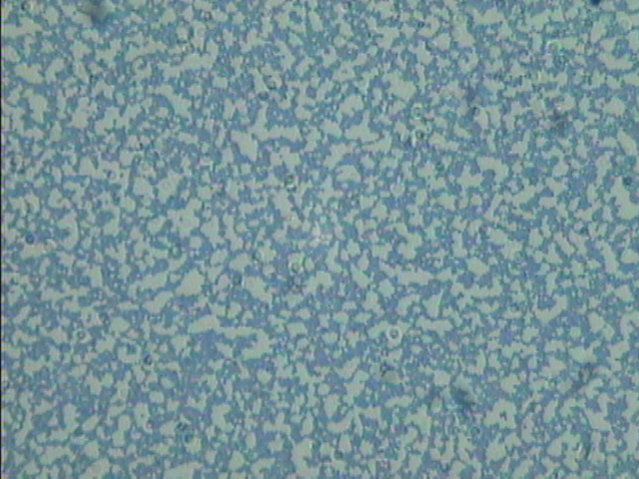
Simple Staining
Name of stain. tech. :- simple stain
Name of stain:- Methylene blue
Shape of cells:- cocci
Arrangement of cells:- clusters
Color:- Blue
Name of m.o:- Staphylococci

Slide 20
Simple Staining
Name of stain. tech. :- simple stain
Name of stain:- Crystal violet
Shape of cells:- cocci
Arrangement of cells:- clusters
Color:- purple
Name of m.o:- Staphylococci

Slide 21
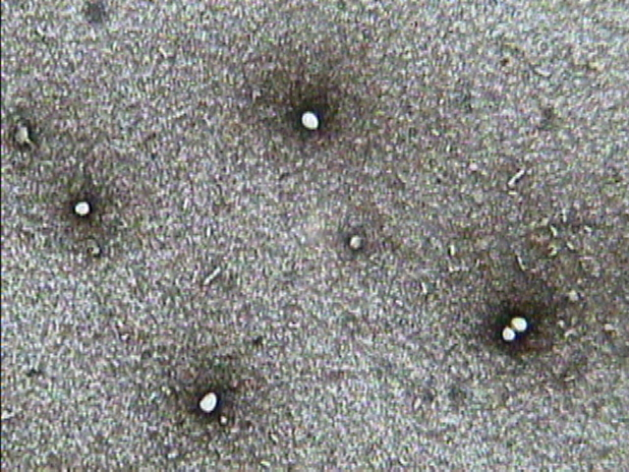
Negative staining
Candida

Slide 22
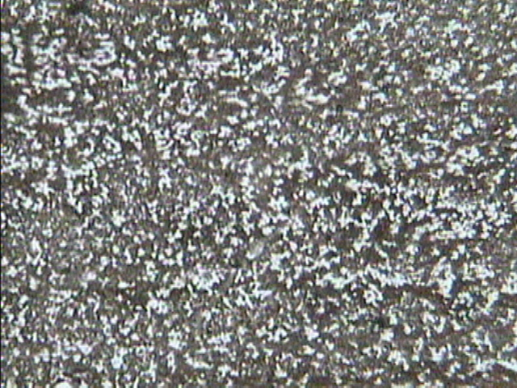
Negative staining
Staphylococci

Slide 23
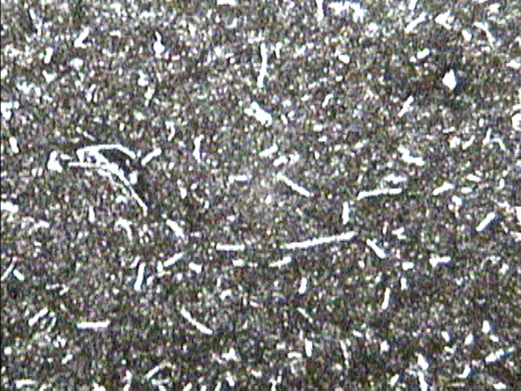
Negative staining
Bacillus

Slide 24
Principle of Differential Stains
* Application of the primary stain.
* Decolourization.
*Application of the counter-stain.

Slide 25
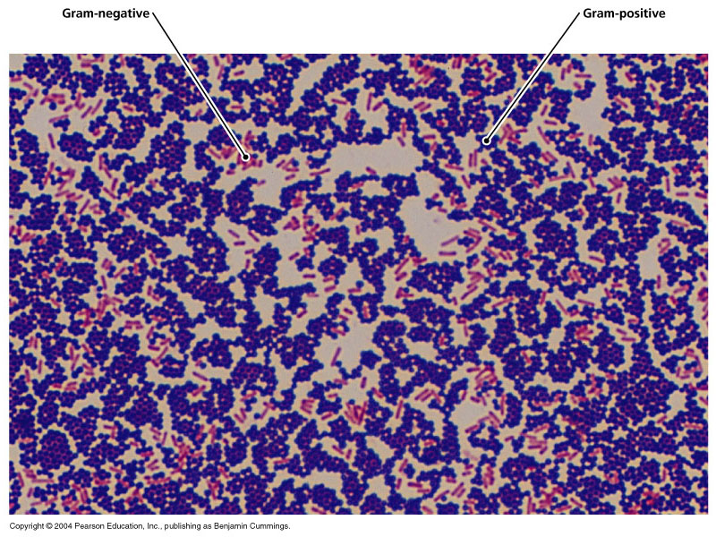
Gram Stain
It is the most important differential stain used in bacteriology because it classified bacteria into two major groups:
Gram positive:
Appears violet after Gram’s stain
b) Gram negative:
Appears red after Gram’s stain

Slide 26
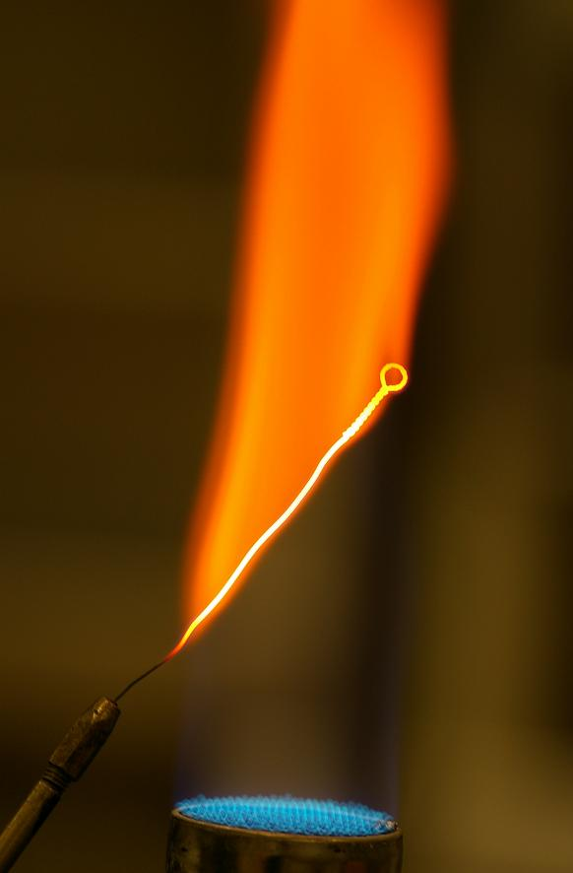
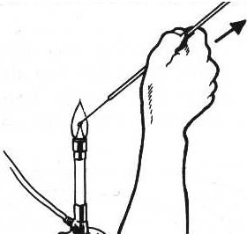
Flaming of Loop

Slide 27
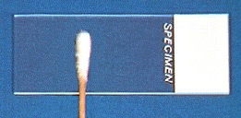
Smearing out of the sample

Slide 28
Smear Fixation

Slide 29
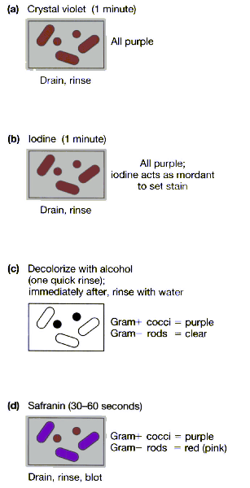
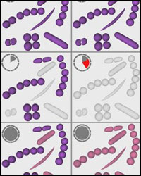
Gram Staining
“One of the most common mistakes is to decolorize a smear for too long a time period. Even Gram-positive cells can lose the crystal violet-iodine complex during prolonged decolorization.

Slide 30
Gram Stain
Gram-positive bacteria
Have a thick peptidoglycan layer surrounds the cell.
The stain gets trapped into this layer and the bacteria turned violet.
Retain the color of the primary stain (crystal violet) after decolorization with alcohol
Gram-negative bacteria
have a thin peptidoglycan layer that does not retain crystal violet stain.
Instead, it has a thick lipid layer which dissolved easily upon decoulorization with Acetone-Alcohol.
Therefore, cells will be counterstained with safranin and turned red.

Slide 31
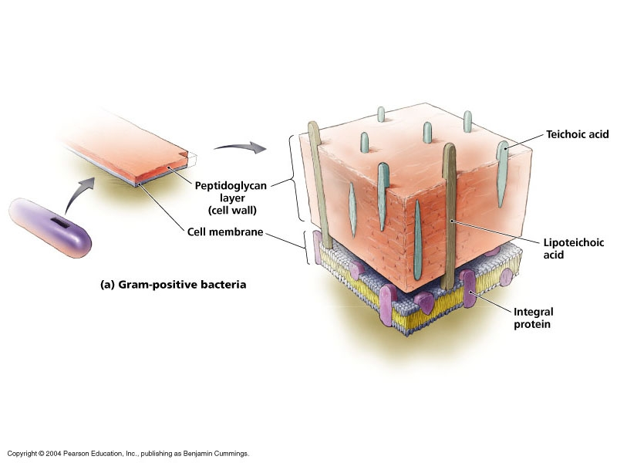
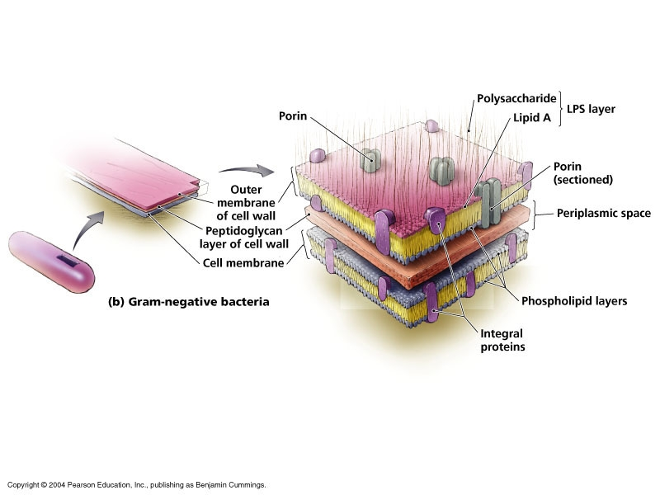
Gram’s +ve Bacteria
Gram’s -ve Bacteria

Slide 32
Gram Stain
Materials:-
    Cultures of Staphylococci, Candida, Bacillus, gram –ve bacteria
    Crystal violet (primary stain)
    Gram’s iodine (mordant)
    Acetone-alcohol (decolorizing agent)
    Safranin (counter stain)

Slide 33
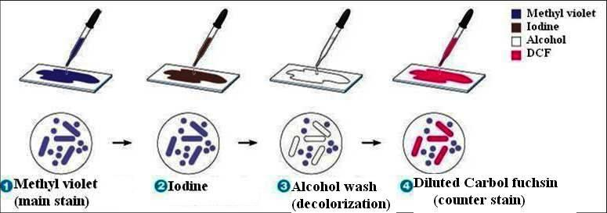
Gram Staining Technique

Slide 34
Gram +ve
Staphylococci
Gram –ve
bacteria
Step 1: Crystal Violet
Step 2: Gram’s Iodine
Step 3: Decolorization
(Aceton-Alcohol)
Step 4: Safranin Red

Slide 35
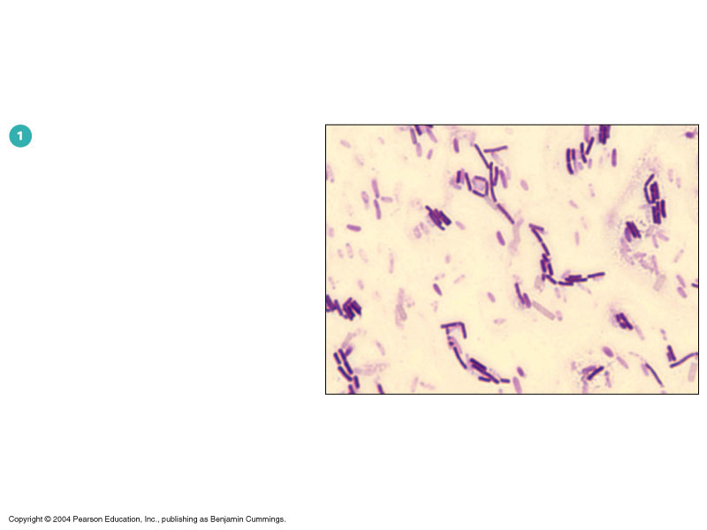
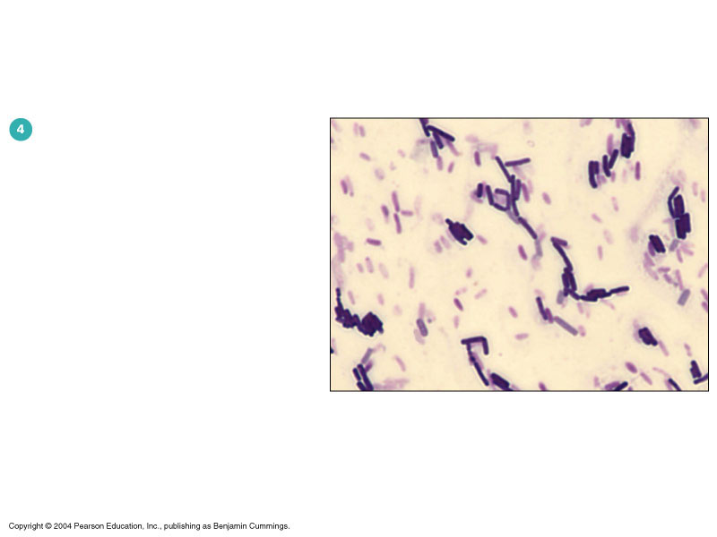
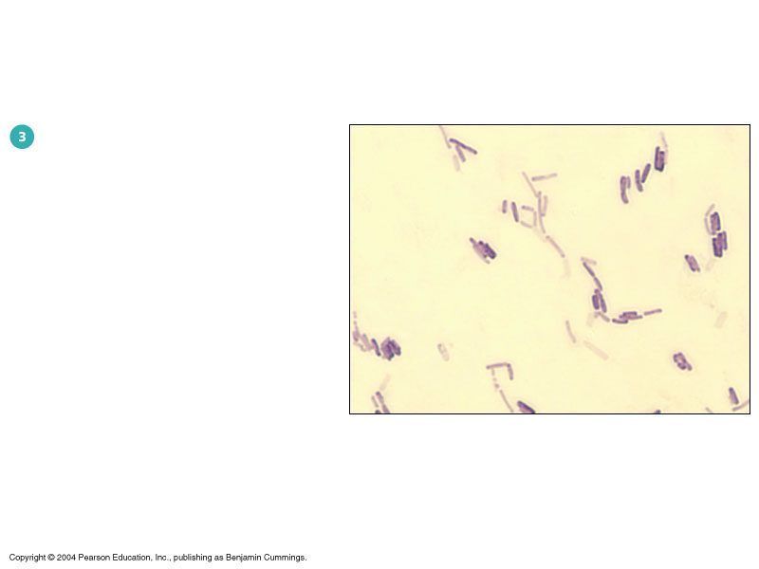
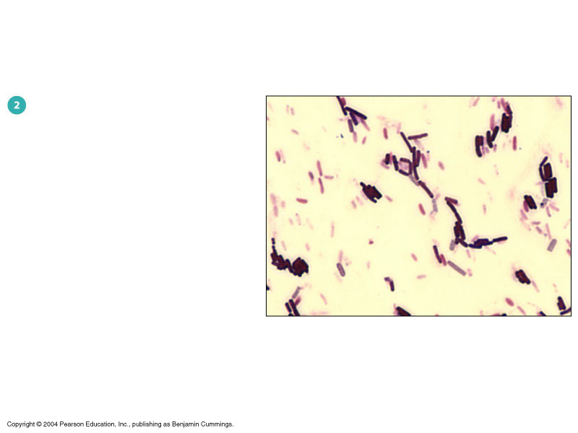
Step 1: Crystal Violet
Step 2: Gram’s Iodine
Step 3: Decolorization
(Aceton-Alcohol)
Step 4: Safranin Red

Slide 36
Results:
Shape: Cocci
Arrangement: clusters
Colour: Violet
Gram’s reaction: Gram’s +ve
Name of microorganism: Staphylococci

Slide 37
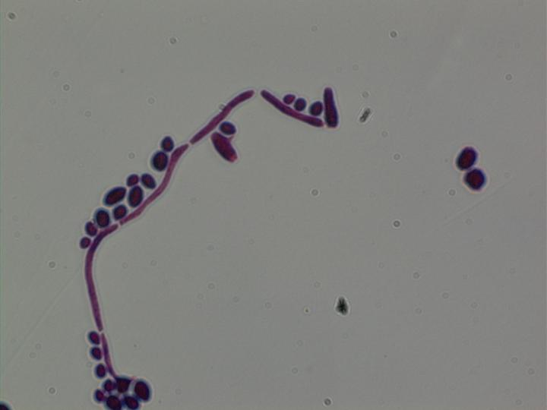
Results:
Shape: Oval
Arrangement: Single
Colour: Violet
Gram’s reaction: Gram’s +ve
Name of microorganism:
Candida

Slide 38
Results:
Shape: Bacilli
Arrangement: Chains
Colour: Violet
Gram’s reaction: Gram +ve
Name of microorganism:
Bacillus

Slide 39
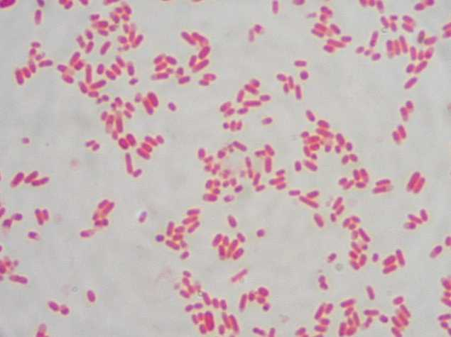
Results:
Shape: Rods
Arrangement: Single
Colour: red
Gram’s reaction: Gram -ve
Name of microorganism:
Gram –ve bacteria

Slide 40


Thank you
40

