Slide 1
Overloading
Ch 6.4

Slide 2
Overloading slides guide
Message to Instructors, please cover these:
Outside slides - see here
Information Hiding - continue here (slide 11)
Message to Students:
The following slides provide similar information about “overloading” as covered above, it is for you to read as self-study
Make sure you read and understand the example (listing 6.16 class Money) and the demo (listing 6.17 class MoneyDemo)

Slide 3
Overloading: Outline
Overloading Basics
Overloading and Automatic Type Conversion
Overloading and the Return Type
Programming Example: A Class for Money

Slide 4
Overloading Basics
A method's name and number and type of parameters is called the signature
When two or more methods have same name within the same class they are said to be overloaded, they must have different signatures though.
Java distinguishes the methods by number and types of parameters
If it cannot match a call with a definition, it attempts to do type conversions

Slide 5
Overloading Basics
View example program, listing 6.15 class Overload
Note overloaded method getAverage
Sample screen output

Slide 6
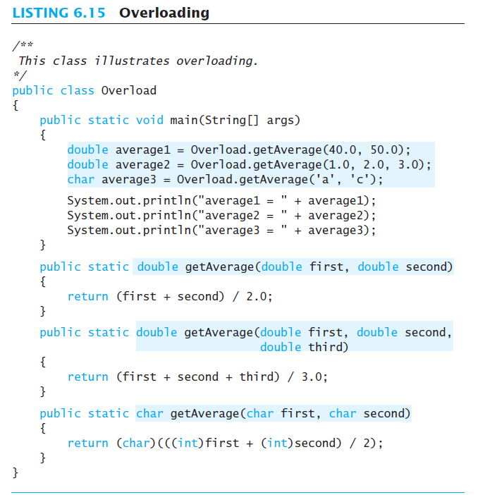
Overloading Basics
Sample screen output

Slide 7
Overloading and Type Conversion
Overloading and automatic type conversion can conflict
Recall definition of Pet class of listing 6.1
If we pass an integer to the constructor we get the constructor for age, even if we intended the constructor for weight
Remember the compiler attempts to overload before it does type conversion
Use descriptive method names, avoid overloading

Slide 8
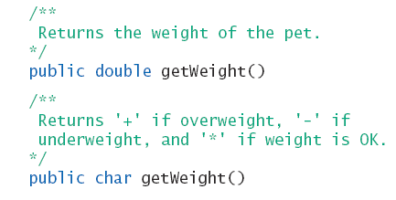
Overloading and Return Type
You must not overload a method where the only difference is the type of value returned
return value is NOT part of the signature

Slide 9
Programming Example
A class for money
View sample class, listing 6.16 class Money
Note use of
Private instance variables
Methods to set values
Methods for doing arithmetic operations
Self Study!!!
Let us know if you have questions

Slide 10
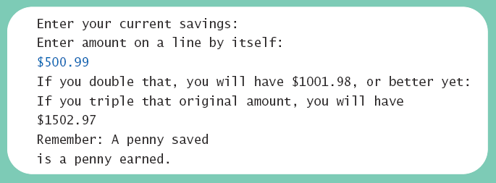
Programming Example
View demo program, listing 6.17 class MoneyDemo
Sample screen output

Slide 11
Information Hiding Revisited
Ch6.5

Slide 12
Information Hiding Revisited
Privacy Leaks
Instance variable of a class type contain address where that object is stored
Assignment of class variables results in two variables pointing to same object
Use of method to change either variable, changes the actual object itself
View insecure class, listing 6.18 class petPair

Slide 13
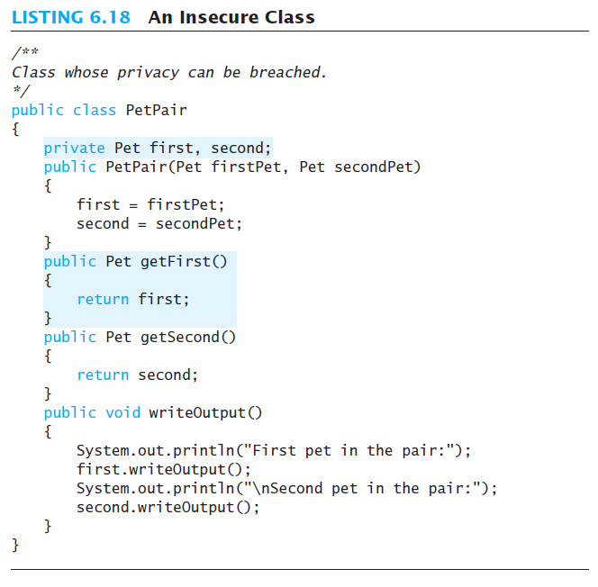

Slide 14
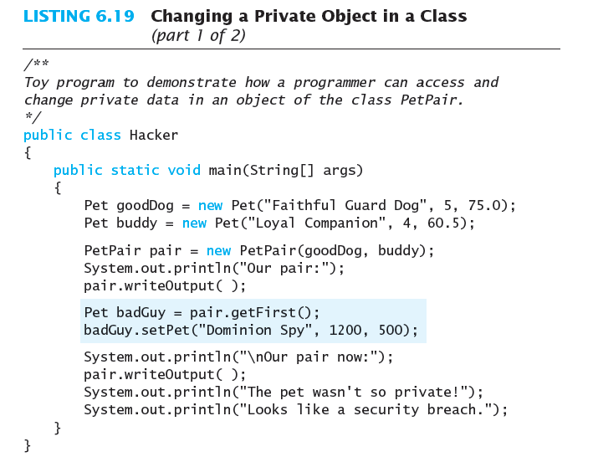
Sequence of execution:
goodDog 100 200
buddy 110 300
pair 120 500
badGuy 130 200
200 Faithful..
5, 75.0
300 Loyal..
4, 60.5
500 P1:200,
P2:300
?
?
?
?
What will this do now?

Slide 15
Sequence of execution:
goodDog 100 200
buddy 110 300
pair 120 500
badGuy 130 200
200 Dominion Spy
1200, 500
300 Loyal..
4, 60.5
500 P1:200,
P2:300

Slide 16
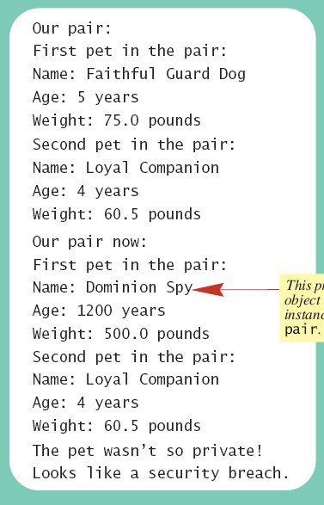
Sample screen output

Slide 17
Summary
Constructor method creates, initializes object of a class
Default constructor has no parameters
Within a constructor use this as name for another constructor in same class
A static variable shared by all objects of the class
Divide method tasks into subtasks
Test all methods individually
Methods with same name, different signatures are overloaded methods

