Slide 1
Chapter 1 Marketing: Creating and Capturing Customer Value
Copyright ©2014 by Pearson Education, Inc. All rights reserved

Slide 2
Creating and Capturing Customer Value
Topic Outline
What Is Marketing?
Understanding the Marketplace and Customer Needs
Designing a Customer-Driven Marketing Strategy
Preparing an Integrated Marketing Plan and Program
Building Customer Relationships
Capturing Value from Customers
The Changing Marketing Landscape
Copyright ©2014 by Pearson Education, Inc. All rights reserved
Notes:
Objective 1 Define marketing and outline the steps in the marketing process.
What Is Marketing?
Objective 2 Explain the importance of understanding customers and the marketplace and identify the five core marketplace concepts.
Understanding the Marketplace and Customer Needs
Objective 3 Identify the key elements of a customer-driven marketing strategy and discuss the marketing management orientations that guide marketing strategy.
Designing a Customer-Driven Marketing Strategy
Preparing an Integrated Marketing Plan and Program
Objective 4 Discuss customer relationship management and identify strategies for creating value for customers and capturing value from customers in return.
Building Customer Relationships
Capturing Value from Customers
Objective 5 Describe the major trends and forces that are changing the marketing landscape in this age of relationships.
The Changing Marketing Landscape

Slide 3
What Is Marketing?
-Marketing is a process by which companies create value for customers and build strong customer relationships to capture value from customers in return.
Copyright ©2014 by Pearson Education, Inc. All rights reserved
Notes:
Note to Instructor:
Discussion Question
Ask students for examples of either national or local companies that are excellent at marketing and ask how they reflect the definition given in this slide.
The twofold goal of marketing is
to attract new customers by promising superior value and
to keep and grow current customers by delivering satisfaction.
Sound marketing is critical to the success of every organization.
Large for-profit firms
not-for-profit organizations, such as colleges, hospitals, museums, symphony orchestras, and even churches.
Marketing—it’s all around you.
abundance of products at your nearby shopping mall
ads that fill your TV screen, spice up your magazines, or stuff your mailbox.
websites
smartphone apps
online social networks and blogs.
These new approaches do more than just blast out messages to the masses. They reach you directly and personally. Today’s marketers want to become a part of your life and enrich your experiences with their brands—to help you live their brands.

Slide 4
Marketing Process
Notes:
This important figure (Figure 1.1) shows the simple, five-step model of the marketing process. By creating value for customers, marketers capture value from customers in return.
This five-step process forms the marketing framework for the rest of the chapter and the remainder of the book.
In the first four steps, companies work to understand consumers, create customer value, and build strong customer relationships.
In the final step, companies reap the rewards of creating superior customer value. By creating value for consumers, they in turn capture value from consumers in the form of sales, profits, and long-term customer equity.
In this chapter, we review each step but focus more on the customer relationship steps—understanding customers, building customer relationships, and capturing value from customers..
Marketing is all about creating value for customers. So, as the first step in the marketing process, the company must fully understand consumers and the marketplace in which it operates.

Slide 5
1-Understanding the Marketplace and Customer Needs
Customer Needs, Wants, and Demands
Needs
Physical—food, clothing, warmth, safety
Social—belonging and affection
Individual—knowledge and self-expression
Wants
Demands
Form that needs take as they are shaped by culture and individual personality
Wants backed by buying power
States of deprivation
Copyright ©2014 by Pearson Education, Inc. All rights reserved
Notes:
Discussion Question:
Ask the students to
1) give an example of a product (good or service) they purchased recently
2) Tell how did that product satisfy a need, want or desire.
Marketing must be understood in the new sense of satisfying customer needs.
Human needs are states of felt deprivation. They include basic physical needs for food, clothing, warmth, and safety; social needs for belonging and affection; and individual needs for knowledge and self-expression.
Marketers did not create these needs; they are a basic part of the human makeup.
Wants are the form human needs take as they are shaped by culture and individual personality. An American needs food but wants a Big Mac, french fries, and a soft drink. A person in Papua, New Guinea, needs food but wants taro, rice, yams, and pork. Wants are shaped by one’s society and are described in terms of objects that will satisfy those needs. When backed by buying power, wants become demands. Given their wants and resources, people demand products with benefits that add up to the most value and satisfaction.
Outstanding marketing companies go to great lengths to learn about and understand their customers’ needs, wants, and demands. They conduct consumer research and analyze mountains of customer data.

Slide 6
Market offerings are some combination of products, services, information, or experiences offered to a market to satisfy a need or want
Marketing myopia is focusing only on existing wants and losing sight of underlying consumer needs
Copyright ©2014 by Pearson Education, Inc. All rights reserved
Notes:
Consumers’ needs and wants are fulfilled through market offerings
physical products
services—activities or benefits offered for sale that are essentially intangible and do not result in the ownership of anything.
persons, places, organizations, information, and ideas
Many sellers make the mistake of paying more attention to the specific products they offer than to the benefits and experiences produced by these products. These sellers suffer from marketing myopia. They forget that a product is only a tool to solve a consumer problem. A manufacturer of quarter-inch drill bits may think that the customer needs a drill bit. But what the customer really needs is a quarter-inch hole. These sellers will have trouble if a new product comes along that serves the customer’s need better or less expensively. The customer will have the same need but will want the new product.
Smart marketers look beyond the attributes of the products and services they sell. By orchestrating several services and products, they create brand experiences for consumers.

Slide 7
Customers
Value and satisfaction
Marketers
Set the right level of expectations
Not too high or low
Copyright ©2014 by Pearson Education, Inc. All rights reserved
Notes:
Note to Instructor:
Discussion Question
Ask students what online retailers deliver exceptional value and satisfaction.
Why do marketer’s not always understand customer needs? How can they better identify customer needs?
Marketer’s often work in a vacuum and do not consider the customer’s needs as much as they should. Future chapters will talk about market research and marketing information, important tools for understanding customer’s needs. Students might be familiar with survey research or focus groups as techniques for gathering information or they might be asked for their zip code when they purchase in certain retailers
Marketers must be careful to set the right level of expectations. If they set expectations too low, they may satisfy those who buy but fail to attract enough buyers. If they set expectations too high, buyers will be disappointed. Customer value and customer satisfaction are key building blocks for developing and managing customer relationships.

Slide 8
Exchange is the act of obtaining a desired
object from someone by offering
something in return
-Marketing actions try to create, maintain,
grow exchange relationships.
-Markets are the set of actual and potential buyers of a product
Copyright ©2014 by Pearson Education, Inc. All rights reserved
Notes:
Note to Instructor:
Marketing consists of actions taken to build and maintain desirable exchange relationships with target audiences involving a product, service, idea, or other object.
Beyond simply attracting new customers and creating transactions, the goal is to retain customers and grow their business with the company.
The marketer tries to bring about a response to some market offering.
Marketing consists of actions taken to create, maintain, and grow desirable exchange relationships with target audiences involving a product, service, idea, or other object. Companies want to build strong relationships by consistently delivering superior customer value.

Slide 9
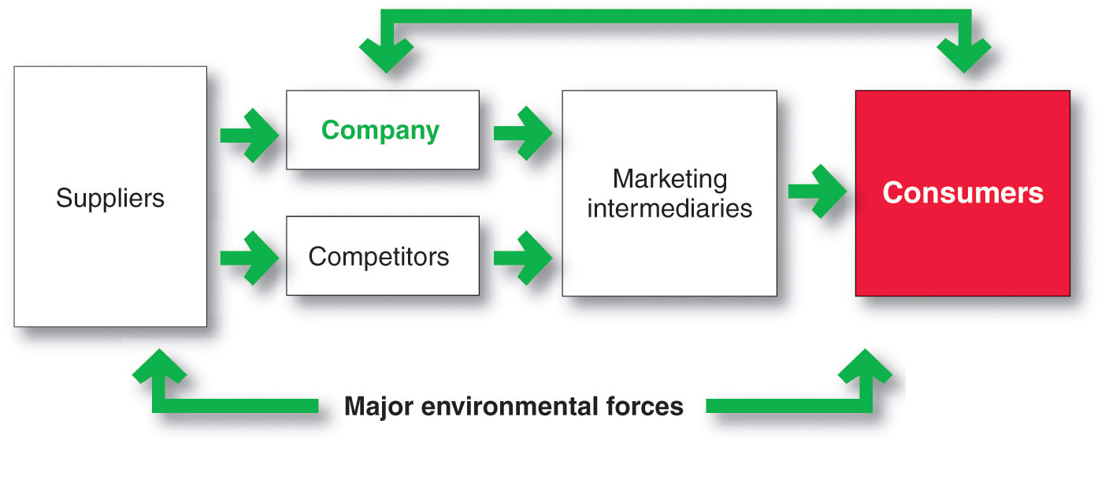
Copyright ©2014 by Pearson Education, Inc. All rights reserved
Notes:
As shown in Figure 1.2, a market is the set of actual and potential buyers of a product or service. These buyers share a particular need or want that can be satisfied through exchange relationships.
Sellers must search for buyers, identify their needs, design good market offerings, set prices for them, promote them, and store and deliver them. Activities such as consumer research, product development, communication, distribution, pricing, and service are core marketing activities.
Consumers market when they search for products, interact with companies to obtain information, and make their purchases. In fact, today’s digital technologies, from websites and online social networks to smartphones, have empowered consumers and made marketing a truly interactive affair. Thus, in addition to customer relationship management, today’s marketers must also deal effectively with customer-managed relationships. Marketers are no longer asking only “How can we reach our customers?” but also “How should our customers reach us?” and even “How can our customers reach each other?”
Figure 1.2 shows the main elements in a marketing system. Marketing involves serving a market of final consumers in the face of competitors. The company and competitors research the market and interact with consumers to understand their needs. Then they create and send their market offerings and messages to consumers, either directly or through marketing intermediaries. Each party in the system is affected by major environmental forces (demographic, economic, natural, technological, political, and social/cultural).
Each party in the system adds value for the next level. The arrows represent relationships that must be developed and managed. Thus, a company’s success at building profitable relationships depends not only on its own actions but also on how well the entire system serves the needs of final consumers.
.

Slide 10
2-Designing a Customer-Driven Marketing Strategy
Marketing management is the art and science of choosing target markets and building profitable relationships with them
What customers will we serve?
How can we best serve these customers?
Market segmentation refers to dividing the markets into segments of customers
Target marketing refers to which segments to go after
Copyright ©2014 by Pearson Education, Inc. All rights reserved
Notes:
Now that the company fully understands its consumers and the marketplace, it must decide which customers it will serve and how it will bring them value.
The marketing manager’s aim is to find, attract, keep, and grow target customers by creating, delivering, and communicating superior customer value.
To design a winning marketing strategy, the marketing manager must answer two important questions: What customers will we serve (what’s our target market)? and How can we serve these customers best (what’s our value proposition)?

Slide 11
Designing a Customer-Driven Marketing Strategy
Choosing a Value Proposition
A brand’s Value Proposition is the
set of benefits or values a company
promises to deliver to customers to
satisfy their needs
Copyright ©2014 by Pearson Education, Inc. All rights reserved
Notes:
Discussion Question: Have the student evaluate one of the following value propositions in terms of how well the company delivers on the proposition.
Facebook helps you “connect and share with the people in your life,”
YouTube “provides a place for people to connect, inform, and inspire others across the globe.”
BMW promises “the ultimate driving machine,”
the diminutive Smart car suggests that you “Open your mind to the car that challenges the status quo.”
New Balance’s Minimus shoes are “like barefoot only better”
Vibram FiveFingers shoes, “You are the technology.”
The company must also decide how it will serve targeted customers—how it will differentiate and position itself in the marketplace. A brand’s value proposition is the set of benefits or values it promises to deliver to consumers to satisfy their needs.
Value propositions differentiate one brand from another. They answer the customer’s question, “Why should I buy your brand rather than a competitor’s?” Companies must design strong value propositions that give them the greatest advantage in their target markets.

Slide 12
Designing a Customer-Driven Marketing Strategy
Marketing Management Orientations
Production concept
Product concept
Selling concept
Marketing concept
Societal concept
Copyright ©2014 by Pearson Education, Inc. All rights reserved
Notes:
Marketing management wants to design strategies that will build profitable relationships with target consumers. But what philosophy should guide these marketing strategies? What weight should be given to the interests of customers, the organization, and society? Very often, these interests conflict.
There are five alternative concepts under which organizations design and carry out their marketing strategies: the production, product, selling, marketing, and societal marketing concepts.

Slide 13
Marketing Management Orientations
a)Production concept:
Consumers will favor products that are available and highly affordable
b)Product concept:
Consumers favor products that offer
the most quality, performance, and features
Focus is on continuous product improvements
Copyright ©2014 by Pearson Education, Inc. All rights reserved
Notes:
The production concept holds that consumers will favor products that are available and highly affordable. Therefore, management should focus on improving production and distribution efficiency. This concept is one of the oldest orientations that guides sellers.
The production concept is still a useful philosophy in some situations.
However, although useful in some situations, the production concept can lead to marketing myopia. Companies adopting this orientation run a major risk of focusing too narrowly on their own operations and losing sight of the real objective—satisfying customer needs and building customer relationships.

Slide 14
Marketing Management Orientations
c)Selling concept:
Consumers will not buy enough of the firm’s products unless it undertakes a large scale selling and promotion effort
d)Marketing concept:
Knowing the needs and wants of the target markets and delivering the desired satisfactions better than competitors do
Copyright ©2014 by Pearson Education, Inc. All rights reserved
Notes:
The selling concept is typically practiced with unsought goods—those that buyers do not normally think of buying, such as insurance or blood donations. These industries must be good at tracking down prospects and selling them on a product’s benefits.
Such aggressive selling, however, carries high risks. It focuses on creating sales transactions rather than on building long-term, profitable customer relationships. The aim often is to sell what the company makes rather than making what the market wants. It assumes that customers who are coaxed into buying the product will like it. Or, if they don’t like it, they will possibly forget their disappointment and buy it again later. These are usually poor assumptions.

Slide 15
Marketing Management Orientations
e)Societal marketing:
Make good marketing
decisions by considering:
consumers’ wants and
long-term interests,
company’s requirements,
society’s long-run interests
Copyright ©2014 by Pearson Education, Inc. All rights reserved
Notes:
Discussion Questions
What companies can you identify with social Marketing?
What do these companies do that ties to the societal marketing concept?
Students might be familiar with many different companies that practice societal marketing through their Corporate Social Responsibility (CSR) initiatives. Students might be familiar with local retailers who are also involved in societal marketing. (Target, TOMS shoes). They will note that these companies donate, contribute, or offer services to charities and not-for-profit organizations.
The societal marketing concept holds that marketing strategy should deliver value to customers in a way that maintains or improves both the consumer’s and society’s well-being. It calls for sustainable marketing, socially and environmentally responsible marketing that meets the present needs of consumers and businesses while also preserving or enhancing the ability of future generations to meet their needs.
Even more broadly, many leading business and marketing thinkers are now preaching the concept of shared value, which recognizes that societal needs, not just economic needs, define markets.

Slide 16
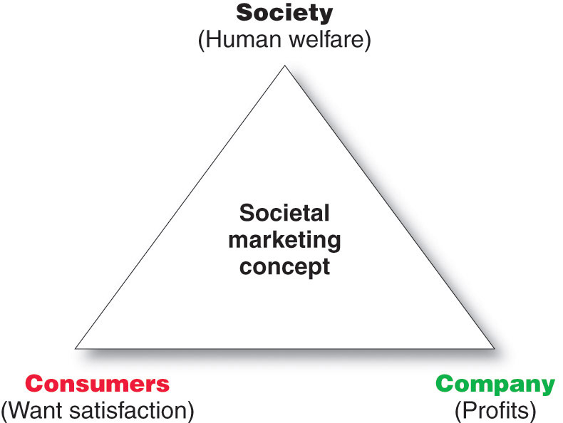
Designing a Customer-Driven Marketing Strategy
Copyright ©2014 by Pearson Education, Inc. All rights reserved
Notes:
Note to Instructor
This slide shows companies should balance three considerations in setting their marketing strategies. Figure 1.4
The customer-driven marketing strategy outlines which customers the company will serve (the target market) and how it will serve them (the value proposition). Now, the company develops marketing plans and programs—a marketing mix—that will actually deliver the intended customer value.
Discussion Question
Ask students how the societal concept influences their buying decisions including brand selection and where they make purchases.

Slide 17
3-Preparing an Integrated Marketing Plan and Program
The marketing mix: set of tools (four Ps) the firm uses to implement its marketing strategy. It includes product, price, promotion, and place.
Integrated marketing program: comprehensive plan that communicates and delivers the intended value to chosen customers.
Copyright ©2014 by Pearson Education, Inc. All rights reserved
Notes:
The company’s marketing strategy outlines which customers it will serve and how it will create value for these customers. Next, the marketer develops an integrated marketing program that will actually deliver the intended value to target customers. The marketing program builds customer relationships by transforming the marketing strategy into action. It consists of the firm’s marketing mix, the set of marketing tools the firm uses to implement its marketing strategy.
The major marketing mix tools are classified into four broad groups, called the four Ps of marketing: product, price, place, and promotion. To deliver on its value proposition, the firm must first create a need-satisfying market offering (product). It must then decide how much it will charge for the offering (price) and how it will make the offering available to target consumers (place). Finally, it must communicate with target customers about the offering and persuade them of its merits (promotion). The firm must blend each marketing mix tool into a comprehensive integrated marketing program that communicates and delivers the intended value to chosen customers.

Slide 18
4-Building Customer Relationships
Customer Relationship Management (CRM)
The overall process of building and maintaining profitable customer relationships by delivering superior customer value and satisfaction
Copyright ©2014 by Pearson Education, Inc. All rights reserved
Notes:
The first three steps in the marketing process—understanding the marketplace and customer needs, designing a customer-driven marketing strategy, and constructing a marketing program—all lead up to the fourth and most important step: building and managing profitable customer relationships.
Customer Relationship Management
Customer relationship management is perhaps the most important concept of modern marketing. Some marketers define it narrowly as a customer data management activity (a practice called CRM). By this definition, it involves managing detailed information about individual customers and carefully managing customer touchpoints to maximize customer loyalty.
Most marketers, however, give the concept of customer relationship management a broader meaning. In this broader sense, customer relationship management is the overall process of building and maintaining profitable customer relationships by delivering superior customer value and satisfaction. It deals with all aspects of acquiring, keeping, and growing customers.

Slide 19
Relationship Building Blocks:
Customer Value and Satisfaction
Customer- perceived value
Customer satisfaction
The difference between total customer value and total customer cost
The extent to which a product’s perceived performance matches a buyer’s expectations
Copyright ©2014 by Pearson Education, Inc. All rights reserved
Notes:
The key to building lasting customer relationships is to create superior customer value and satisfaction. Satisfied customers are more likely to be loyal customers and give the company a larger share of their business.
Customer Value. Attracting and retaining customers can be a difficult task. Customers often face a bewildering array of products and services from which to choose. A customer buys from the firm that offers the highest customer-perceived value—the customer’s evaluation of the difference between all the benefits and all the costs of a market offering relative to those of competing offers. Importantly, customers often do not judge values and costs “accurately” or “objectively.” They act on perceived value.
Customer satisfaction depends on the product’s perceived performance relative to a buyer’s expectations. If the product’s performance falls short of expectations, the customer is dissatisfied. If performance matches expectations, the customer is satisfied. If performance exceeds expectations, the customer is highly satisfied or delighted.
Outstanding marketing companies go out of their way to keep important customers satisfied. Most studies show that higher levels of customer satisfaction lead to greater customer loyalty, which in turn results in better company performance. Smart companies aim to delight customers by promising only what they can deliver and then delivering more than they promise. Delighted customers not only make repeat purchases but also become willing marketing partners and “customer evangelists” who spread the word about their good experiences to others.
For companies interested in delighting customers, exceptional value and service become part of the overall company culture.
Although a customer-centered firm seeks to deliver high customer satisfaction relative to competitors, it does not attempt to maximize customer satisfaction. A company can always increase customer satisfaction by lowering its price or increasing its services. But this may result in lower profits. Thus, the purpose of marketing is to generate customer value profitably. This requires a very delicate balance: The marketer must continue to generate more customer value and satisfaction but not “give away the house.”

Slide 20
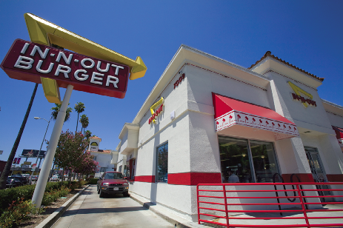
Building Customer Relationships
Customer Relationship Levels and Tools
Basic Relationships
Full Partnerships
Copyright ©2014 by Pearson Education, Inc. All rights reserved
Notes:
Note to Instructor
Companies can build customer relationships at many levels, depending on the nature of the target market. At one extreme, a company with many low-margin customers may seek to develop basic relationships with them. For example, Nike does not phone or call on all of its consumers to get to know them personally. Instead, Nike creates relationships through brand-building advertising, public relations, and its numerous websites and apps. At the other extreme, in markets with few customers and high margins, sellers want to create full partnerships with key customers. For example, Nike sales representatives work closely with the Sports Authority, Dick’s Sporting Goods, Foot Locker, and other large retailers. In between these two extremes, other levels of customer relationships are appropriate.
Beyond offering consistently high value and satisfaction, marketers can use specific marketing tools to develop stronger bonds with customers. For example, many companies offer frequency marketing programs that reward customers who buy frequently or in large amounts.
Other companies sponsor club marketing programs that offer members special benefits and create member communities. For example, Apple encourages customers to form local Apple user groups. More than 800 registered Apple user groups worldwide offer monthly meetings, a newsletter, advice on technical issues, training classes, product discounts, and a forum for swapping ideas and stories with like-minded Apple fans. Similarly, buy one of those Weber grills and you can join the Weber Nation—“the site for real people who love their Weber grills.” Membership gets you exclusive access to online grilling classes, an interactive recipe box, grilling tips and 24/7 telephone support, audio and video podcasts, straight-talk forums for interacting with other grilling fanatics, and even a chance to star in a Weber TV commercial. “Become a spatula-carrying member today,” says Weber.
Discussion Question
Ask students what frequency or club marketing programs they belong to and why?

Slide 21
The Changing Nature of Customer Relationships
Relating with more carefully selected customers uses selective relationship management to target fewer, more profitable customers
Relating more deeply and interactively by incorporating more interactive two way relationships through blogs, Websites, online communities and social networks
Copyright ©2014 by Pearson Education, Inc. All rights reserved
Notes:
Note to Instructor
This will be a point for a lively discussion.
Discussion Question
Ask students how marketers have used facebook, myspace, linkedin or other social networks for marketing purposes.
Significant changes are occurring in the ways companies relate to their customers. Yesterday’s companies focused on mass marketing to all customers at arm’s length. Today’s companies are building deeper, more direct, and lasting relationships with more carefully selected customers. Here are some important trends in the way companies and customers are relating to one another.
Relating with More Carefully Selected Customers
Few firms today still practice true mass marketing—selling in a standardized way to any customer who comes along. Today, most marketers realize that they don’t want relationships with every customer. Instead, they target fewer, more profitable customers. “Not all customers are worth your marketing efforts,” states one analyst. “Some are more costly to serve than to lose.”
Many companies now use customer profitability analysis to pass up or weed out losing customers and target winning ones for pampering. One approach is to preemptively screen out potentially unprofitable customers. Progressive Insurance does this effectively. It asks prospective customers a series of screening questions to determine if they are right for the firm. If they’re not, Progressive will likely tell them, “You might want to go to Allstate.” A marketing consultant explains: “They’d rather send business to a competitor than take on unprofitable customers.” Screening out unprofitable customers lets Progressive provide even better service to potentially more profitable ones.
But what should the company do with unprofitable customers that it already has? If it can’t turn them into profitable ones, the company may want to dismiss those customers who are too unreasonable or that cost more to serve than they are worth. “Save your company by firing your customers,” advises one marketer. “Well, not all your customers—just the ones who ask for more than they give.” Adds another marketer, “Firing the customers you can’t possibly please gives you the bandwidth and resources to coddle the ones that truly deserve your attention and repay you with referrals, applause, and loyalty.”
Elizabeth A. Sullivan, “Just Say No,” Marketing News, April 15, 2008, p. 17. Also see Raymund Flandez, “It Just Isn’t Working? Some File for Customer Divorce,” Wall Street Journal, November 16, 2009, p. B7.
Sullivan, “Just Say No,” p. 17.

Slide 22
The Changing Nature of Customer Relationships
-Customer-managed relationships
Customers, empowered by today’s new digital technologies, interact with companies and each other to shape their relationships with brands.
-Partner relationship management involves working closely with partners in other company departments and outside the company to jointly bring greater value to customers
Copyright ©2014 by Pearson Education, Inc. All rights reserved
Notes:
Discussion Question: Ask students for examples of companies with whom they interact. Ask them to explain why they interact with a particular company, but not with another company.
Companies are now relating with chosen customers in deeper, more meaningful ways. Rather than relying on one-way, mass-media messages only, today’s marketers are incorporating new, interactive approaches that help build targeted, two-way customer relationships.
Interactive Customer Relationships. New technologies have profoundly changed the ways in which people relate to one another. New tools for relating include everything from e-mail, websites, blogs, mobile phones, and video sharing to online communities and social networks, such as Facebook, YouTube, Pinterest, and Twitter.
This changing communications environment also affects how companies and brands relate to customers. The new communications approaches let marketers create deeper customer involvement and a sense of community surrounding a brand—to make the brand a meaningful part of consumers’ conversations and lives. “Becoming part of the conversation between consumers is infinitely more powerful than handing down information via traditional advertising,” says one marketing expert. It’s no longer about “just pushing messages out,” says another. “It’s allowing the individual, the person, to really feel like they're part of your brand in a unique way.”
At the same time that the new technologies create relationship-building opportunities for marketers, however, they also create challenges. They give consumers greater power and control. Today’s consumers have more information about brands than ever before, and they have a wealth of platforms for airing and sharing their brand views with other consumers. Thus, the marketing world is now embracing not only customer relationship management, but also customer-managed relationships.
Greater consumer control means that companies can no longer rely on marketing by intrusion. Instead, marketers must practice marketing by attraction—creating market offerings and messages that involve consumers rather than interrupt them. Hence, most marketers now augment their mass-media marketing efforts with a rich mix of direct marketing approaches that promote brand-consumer interaction.
For example, many brands are creating dialogues with consumers via their own or existing online social networks. To supplement their traditional marketing campaigns, companies now routinely post their latest ads and made-for-the-Web videos on video-sharing sites. They join social networks. Or they launch their own blogs, online communities, or consumer-generated review systems, all with the aim of engaging customers on a more personal, interactive level Quotes from Andrew Walmsley, “The Year of Consumer Empowerment,” Consumer-Generated Marketing. A growing part of the new customer dialogue is consumer-generated marketing, by which consumers themselves are playing a bigger role in shaping their own brand experiences and those of others. This might happen through uninvited consumer-to-consumer exchanges in blogs, video-sharing sites, and other digital forums. But increasingly, companies are inviting consumers to play a more active role in shaping products and brand messages.
Some companies ask consumers for new product and service ideas.
Other companies are inviting customers to play an active role in shaping ads.
However, harnessing consumer-generated content can be a time-consuming and costly process, and companies may find it difficult to glean even a little gold from all the garbage. Consumer-generated marketing, whether invited by marketers or not, has become a significant marketing force. Through a profusion of consumer-generated videos, reviews, blogs, and websites, consumers are playing an increasing role in shaping their own brand experiences. Beyond creating brand conversations, customers are having an increasing say about everything from product design, usage, and packaging to pricing and distribution. Brands need to accept and embrace the emergence of consumer power. Says one analyst, “Humans, formerly known as either consumers or couch potatoes, are now creators and thought leaders, passive no more.”

Slide 23
Partner Relationship Management
Partners inside the company is every functional area interacting with customers
Electronically
Cross-functional teams
- Marketers connect with their suppliers, channel partners, and competitors by developing partnerships
-Supply chain is a channel that stretches from raw materials to components to final products to final buyers
Copyright ©2014 by Pearson Education, Inc. All rights reserved
Notes:
Traditionally, marketers have been charged with understanding customers and representing customer needs to different company departments. However, in today’s more connected world, every functional area in the organization can interact with customers. The new thinking is that—no matter what your job is in a company—you must understand marketing and be customer focused. Rather than letting each department go its own way, firms must link all departments in the cause of creating customer value.

Slide 24
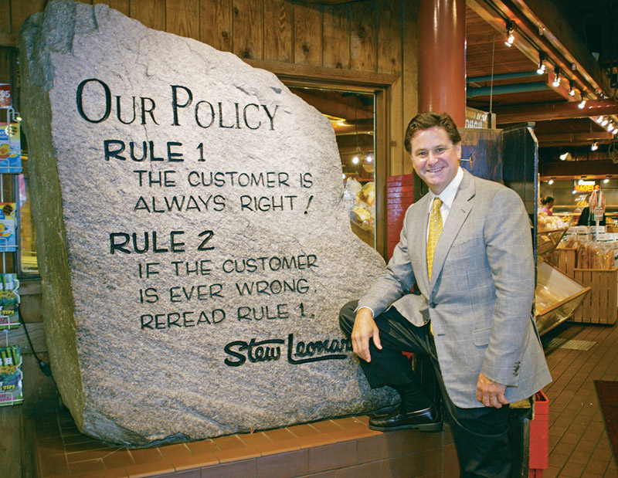
5-Capturing Value from Customers
Creating Customer Loyalty and Retention
Customer lifetime value is the value of the entire stream of purchases that the customer would make over a lifetime of patronage
Copyright ©2014 by Pearson Education, Inc. All rights reserved
Notes:
Note to Instructor
Losing a customer means losing more than a single sale. It means losing the entire stream of purchases that the customer would make over a lifetime of patronage. For example, here is a classic illustration of customer lifetime value:
The final step in the marketing process involves capturing value in return in the form of sales, market share, and profits. By creating superior customer value, the firm creates highly satisfied customers who stay loyal and buy more. This, in turn, means greater long-run returns for the firm. Here, we discuss the outcomes of creating customer value: customer loyalty and retention, share of market and share of customer, and customer equity.
Discussion Question
Ask students if they know of other retailers build this kind of exciting environment.

Slide 25
Growing Share of Customer
Share of customer is the portion of the customer’s purchasing that a company gets in its product categories
Customer equity is the total combined customer lifetime values of all of the company’s customers
Copyright ©2014 by Pearson Education, Inc. All rights reserved
Notes:
Beyond simply retaining good customers to capture customer lifetime value, good customer relationship management can help marketers increase their share of customer—the share they get of the customer’s purchasing in their product categories. Thus, banks want to increase “share of wallet.” Supermarkets and restaurants want to get more “share of stomach.” Car companies want to increase “share of garage,” and airlines want greater “share of travel.”
To increase share of customer, firms can offer greater variety to current customers. Or they can create programs to cross-sell and up-sell to market more products and services to existing customers. For example, Amazon.com is highly skilled at leveraging relationships with its 173 million customers to increase its share of each customer’s spending budget:

Slide 26
Building Customer Equity
Right relationships with the right customers involves treating customers as assets that need to be managed and maximized
Different types of customers require different relationship management strategies
Copyright ©2014 by Pearson Education, Inc. All rights reserved
Notes:
Companies should manage customer equity carefully. They should view customers as assets that need to be managed and maximized. But not all customers, not even all loyal customers, are good investments. Surprisingly, some loyal customers can be unprofitable, and some disloyal customers can be profitable. Which customers should the company acquire and retain?
The company can classify customers according to their potential profitability and manage its relationships with them accordingly.
classifies customers into one of four relationship groups, according to their profitability and projected loyalty. Each group requires a different relationship management strategy. Strangers show low potential profitability and little projected loyalty. There is little fit between the company’s offerings and their needs. The relationship management strategy for these customers is simple: Don’t invest anything in them.
Butterflies are potentially profitable but not loyal. There is a good fit between the company’s offerings and their needs. However, like real butterflies, we can enjoy them for only a short while and then they’re gone. An example is stock market investors who trade shares often and in large amounts but who enjoy hunting out the best deals without building a regular relationship with any single brokerage company. Efforts to convert butterflies into loyal customers are rarely successful. Instead, the company should enjoy the butterflies for the moment. It should create satisfying and profitable transactions with them, capturing as much of their business as possible in the short time during which they buy from the company. Then, it should cease investing in them until the next time around.
True friends are both profitable and loyal. There is a strong fit between their needs and the company’s offerings. The firm wants to make continuous relationship investments to delight these customers and nurture, retain, and grow them. It wants to turn true friends into true believers, who come back regularly and tell others about their good experiences with the company.
Barnacles are highly loyal but not very profitable. There is a limited fit between their needs and the company’s offerings. An example is smaller bank customers who bank regularly but do not generate enough returns to cover the costs of maintaining their accounts. Like barnacles on the hull of a ship, they create drag. Barnacles are perhaps the most problematic customers. The company might be able to improve their profitability by selling them more, raising their fees, or reducing service to them. However, if they cannot be made profitable, they should be “fired.”
The point here is an important one: Different types of customers require different relationship management strategies. The goal is to build the right relationships with the right

Slide 27
The Changing Marketing Landscape
Changing Economic Environment
New consumer frugality
Marketers focus on value for the customer
Copyright ©2014 by Pearson Education, Inc. All rights reserved
Notes:
Notes to Instructor
Target focus changes to the ‘pay less’ part of the slogan, adjusting prices to compete with WalMart.
Beginning in 2008, the United States and world economies experienced a Great Recession, a stunning economic meltdown unlike anything since the Great Depression of the 1930s. The stock market plunged, and trillions of dollars of market value simply evaporated. The financial crisis left shell-shocked consumers short of both money and confidence as they faced losses in income, a severe credit crunch, declining home values, and rising unemployment.
The Great Recession caused many consumers to rethink their spending priorities and cut back on their buying. After two decades of overspending, consumers tightened their purse strings and changed their buying attitudes and habits. More than just a temporary change, the new consumer values and consumption patterns will likely remain for many years to come. Even as the economy strengthens, consumers continue to spend more carefully and sensibly
In response, companies in all industries—from discounters such as Target to luxury brands such as Lexus—have aligned their marketing strategies with the new economic realities. More than ever, marketers are emphasizing the value in their value propositions. They are focusing on value-for-the-money, practicality, and durability in their product offerings and marketing pitches
Discussion Question: This is a good slide to prompt discussion on personal observations and experiences of consumer frugality and marketers’ responses.

Slide 28
The Changing Marketing Landscape Digital Age
Online marketing is the fastest-growing
Click- and- mortar companies evolved
Copyright ©2014 by Pearson Education, Inc. All rights reserved
Notes:
The explosive growth in digital technology has fundamentally changed the way we live—how we communicate, share information, learn, shop, and access entertainment. In turn, it has had a major impact on the ways companies bring value to their customers. For better or worse, technology has become an indispensable part of our lives:
Adapted from information in Brad Stone, “Breakfast Can Wait. Today’s First Stop Is Online,” New York Times, August 10, 2009, p. A1; with information from R. Gary Bridge, “Get Connected for Better Service,” Marketing Management, Winter 2011, pp. 21-24.
The digital age has provided marketers with exciting new ways to learn about and track customers and create products and services tailored to individual customer needs. Digital technology has also brought a new wave of communication, advertising, and relationship building tools—ranging from online advertising and video-sharing tools to online social networks and smartphone apps. The digital shift means that marketers can no longer expect consumers to always seek them out. Nor can they always control conversations about their brands. The new digital world makes it easy for consumers to take marketing content that once lived only in advertising or on an online brand site with them wherever they go and share it with friends. More than just add-ons to traditional marketing channels, the new digital media must be fully integrated into the marketer’s customer-relationship-building efforts.
The most dramatic digital technology is the Internet. Almost 78 percent of the U.S. adult population now has Internet access. Of all adults with Internet access, 91 check their e-mail, 84 percent search for maps or driving directions, 76 percent get the news, 64 percent keep in touch with friends on social-networking sites such as Facebook and LinkedIn, and 61 percent do online banking. By 2020, many experts believe, the Internet will be accessed primarily via a mobile device operated by voice, touch, and even thought or “mind-controlled human-computer interaction.”
Online marketing is now the fastest-growing form of marketing. These days, it’s hard to find a company that doesn’t use the Internet in a significant way. In addition to the click-only dot-coms, most traditional brick-and-mortar companies have now become click-and-mortar companies. They have ventured online to attract new customers and build stronger relationships with existing ones. Today, 71 percent of American online users use the Internet to shop. Last year, consumer online retail spending topped $161.5 billion, up more than 13 percent over the previous year. Business-to-business (B-to-B) online commerce is also booming.

Slide 29
The Changing Marketing Landscape
Not-for-profit marketing growth
Rapid Globalization
Sustainable marketing
Copyright ©2014 by Pearson Education, Inc. All rights reserved
Notes:
Marketing has also become a major part of the strategies of many not-for-profit organizations, such as colleges, hospitals, museums, zoos, symphony orchestras, and even churches. The nation’s not-for-profits face stiff competition for support and membership. So marketing can help them attract membership, funds, and support.
As they are redefining their customer relationships, marketers are also taking a fresh look at the ways in which they relate with the broader world around them. Today, almost every company, large or small, is touched in some way by global competition. American firms have been challenged at home by the skillful marketing of European and Asian multinationals.
Companies are not just selling more of their locally produced goods in international markets; they are also sourcing more supplies and components abroad.
Thus, managers in countries around the world are increasingly taking a global, not just local, view of the company’s industry, competitors, and opportunities. They are asking: What is global marketing? How does it differ from domestic marketing? How do global competitors and forces affect our business? To what extent should we “go global”?
Marketers are reexamining their relationships with social values and responsibilities and with the very Earth that sustains us. As the worldwide consumerism and environmentalism movements mature, today’s marketers are being called on to develop sustainable marketing practices. Corporate ethics and social responsibility have become hot topics for almost every business. And few companies can ignore the renewed and very demanding environmental movement. Every company action can affect customer relationships. Today’s customers expect companies to deliver value in a socially and environmentally responsible way.
The social-responsibility and environmental movements will place even stricter demands on companies in the future. Some companies resist these movements, budging only when forced by legislation or organized consumer outcries. Forward-looking companies, however, readily accept their responsibilities to the world around them. They view sustainable marketing as an opportunity to do well by doing good. They seek ways to profit by serving immediate needs and the best long-run interests of their customers and communities.

Slide 30
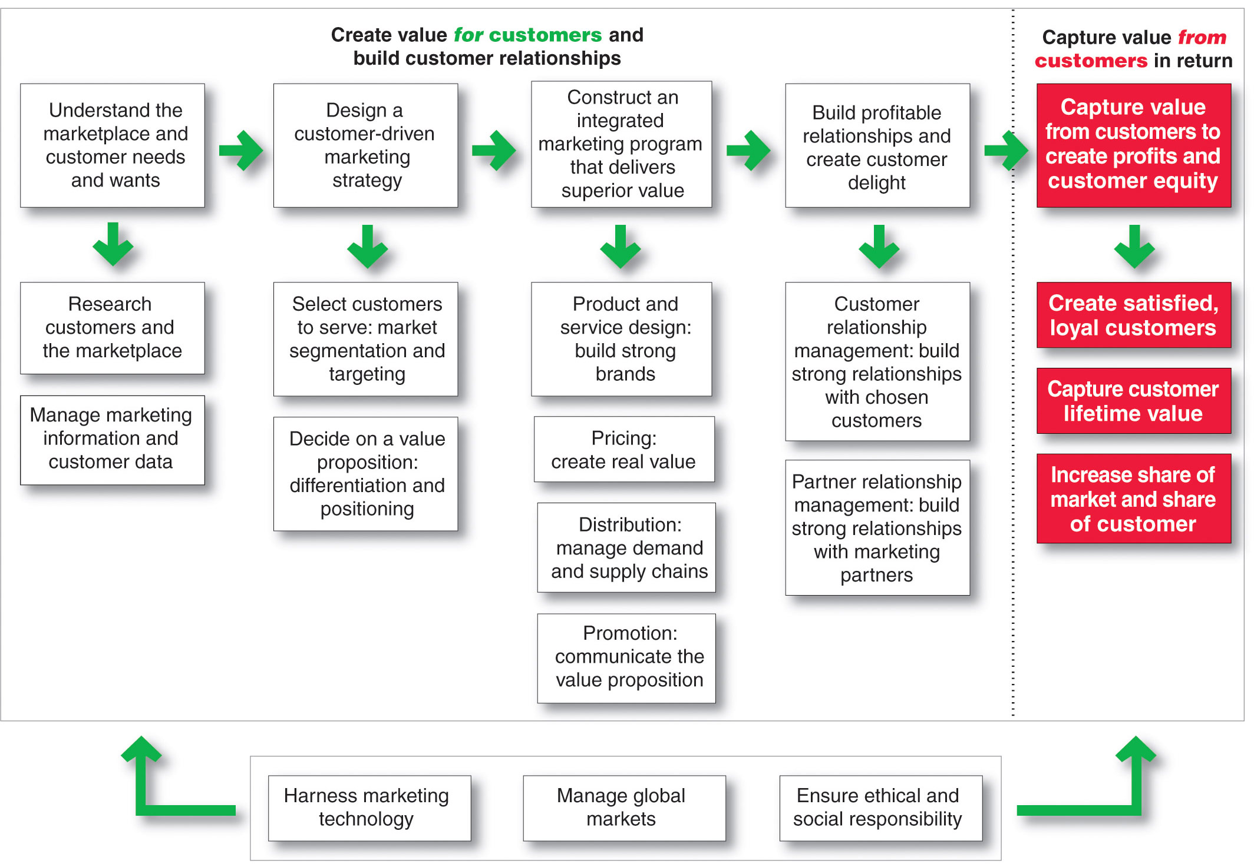
So, What Is Marketing? Pulling It All Together
Copyright ©2014 by Pearson Education, Inc. All rights reserved
Notes:
Figure 1.6 shows marketing is the process of building profitable customer relationships by creating value for customers and capturing value in return.
The first four steps of the marketing process focus on creating value for customers. The company first gains a full understanding of the marketplace by researching customer needs and managing marketing information. It then designs a customer-driven marketing strategy based on the answers to two simple questions. The first question is “What consumers will we serve?” (market segmentation and targeting). Good marketing companies know that they cannot serve all customers in every way. Instead, they need to focus their resources on the customers they can serve best and most profitably. The second marketing strategy question is “How can we best serve targeted customers?” (differentiation and positioning). Here, the marketer outlines a value proposition that spells out what values the company will deliver to win target customers.
With its marketing strategy chosen, the company now constructs an integrated marketing program—consisting of a blend of the four marketing mix elements—the four Ps—that transforms the marketing strategy into real value for customers. The company develops product offers and creates strong brand identities for them. It prices these offers to create real customer value and distributes the offers to make them available to target consumers. Finally, the company designs promotion programs that communicate the value proposition to target customers and persuade them to act on the market offering.
Perhaps the most important step in the marketing process involves building value-laden, profitable relationships with target customers. Throughout the process, marketers practice customer relationship management to create customer satisfaction and delight. In creating customer value and relationships, however, the company cannot go it alone. It must work closely with marketing partners both inside the company and throughout its marketing system. Thus, beyond practicing good customer relationship management, firms must also practice good partner relationship management.
The first four steps in the marketing process create value for customers. In the final step, the company reaps the rewards of its strong customer relationships by capturing value from customers. Delivering superior customer value creates highly satisfied customers who will buy more and buy again. This helps the company capture customer lifetime value and greater share of customer. The result is increased long-term customer equity for the firm.
Finally, in the face of today’s changing marketing landscape, companies must take into account three additional factors. In building customer and partner relationships, they must harness marketing technology, take advantage of global opportunities, and ensure that they act in an environmentally and socially responsible way.

