Slide 1
The Connective Tissues
&
The Nervous tissue

Slide 2
General characteristics :
Found in most parts of the body.
Its function is to connect different tissues or organs together.
Supporting frame work for the organs and the body as a whole.
has different types of cells and a large amount of intracellular substance called the matrix

Slide 3
the matrix made up of :
Amorphous ground substance
Protein fibers
Collagen (white) fibers
Elastic (yellow) fibers
Occur in bundles
Occur as single
Not branched, but the bundle could be branched
Branched
soft as in the connective tissue proper
liquid as in blood and lymph
semisolid and solid as in cartilage and bone, respectively, which make the skeletal tissue

Slide 4
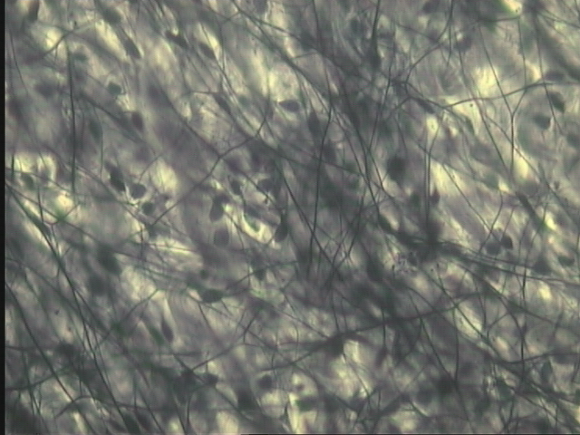
Areolar Connective Tissue
Yellow fibers
matrix
white fibers

Slide 5
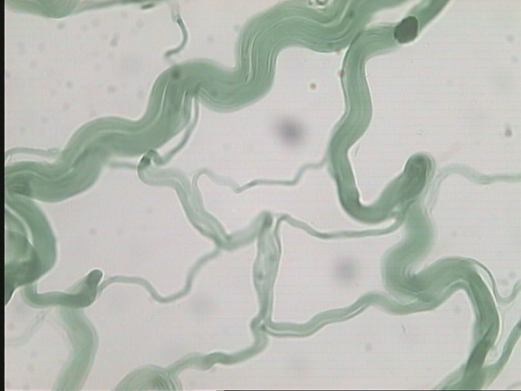
Areolar Connective Tissue
matrix
white fibers
Yellow fibers

Slide 6
Cartilage
Cartilage is studied as an example of skeletal connective tissue
The hyaline cartilage:
It is called hyaline (hyalos=gloss) because of its glossy, whitish blue appearance in the fresh state.
The matrix is semi-solid and contains very delicate collagen fibers. The refractive index of the matrix is equivalent to that of its fibers, so it appears clear.
It is the most common form of cartilage.

Slide 7
It has four main functions, these are:
1-It form the majority of the temporary skeleton in the mammalian embryos until it is replaced by bone.
2-In adults, it supports the structures of the nasal septum, ear pinna, larynx, trachea and bronchi.
3-It covers the articular surfaces of movable joints.
4-It form the epiphyseal plate, the growing region in the large bones.

Slide 8
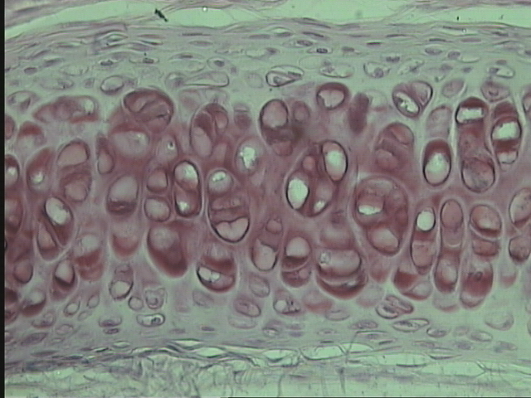
Hyaline Cartilage From Trachea
Lacuna
Chondrocytes
Matrix

Slide 9
The Nervous tissue
The nervous system is divided anatomically into:
The central nervous system (CNS)
The peripheral nervous system (PNS)
consisting of
composed of :
nerve fibers forming :
the brain
the spinal cord
the cranial nerves
the spinal nerves
the ganglia

Slide 10
The Nervous tissue
Structurally, the nervous tissue consists of two cell classes
The supporting cells (glia cell)
The neurons
the functional units transmitting the nerve impulses
support, nourishes and insulate the neurons and perform the defense processes in the nervous system
They are mainly of two types
Neuroglia cells
inside the CNS
Schwann cells
outside the CNS (in the PNS)

Slide 11
Structure of the neuron
Neurons have diverse sizes and shapes, but typically each consists of:
The cell body
The dendrites
The axon
They are multiple cytoplasmic processes specialized in receiving stimuli and transmitting them to the cell body
A single, usually long process specialized in conducting nerve impulses to other cells.
It is also called the perikaryon or soma.

Slide 12
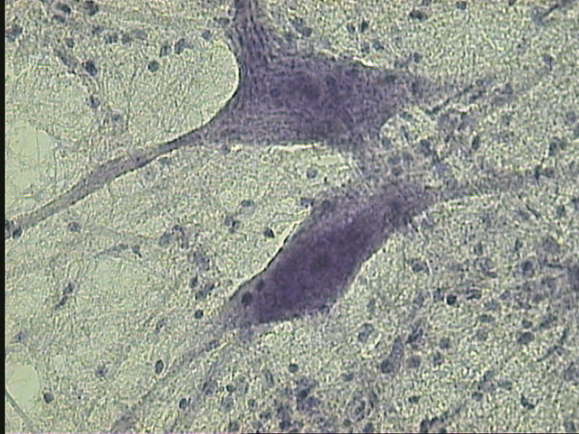
Nervous tissue
(Enlarged part of grey matter)
Neurons
Glial cell nucleus

Slide 13
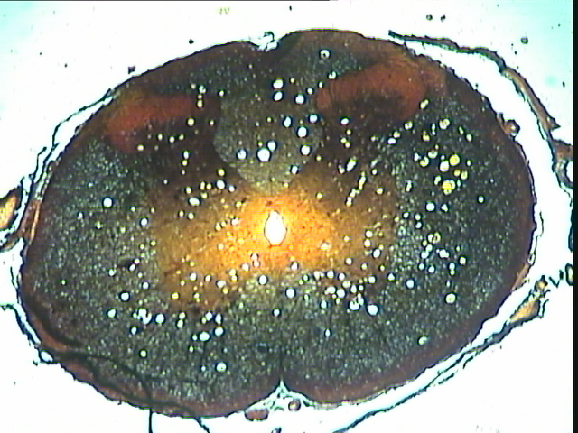
The spinal cord
It is a cylindrical tissue in the form of a hollow tube lying within the spinal cavity of the vertebral column, and is surrounded closely by a loose connective tissue layer called the pia matter
In the center, there is a central canal lined by simple epithelial cells

Slide 14
In cross section, the spinal cord appears to be more or less oval with two deep dorsal and ventral grooves known as the dorsal fissure and the ventral fissure, respectively. These fissures divide the cord into right and left symmetrical halves. The ventral fissure is deeper and wider than the dorsal fissure
According to its color in the fresh condition, the spinal cord in cross section appears is differentiated into :
A central zone called the gray matter, shaped like the letter H and contains the nerve cell bodies and glial cells
A peripheral zone called the white matter composed entirely of myelinated nerve fibers and neuroglia cells.
The two dorsal limbs of the H-shaped gray matter are called the dorsal horns and the two shorter and broader limbs are called the ventral horns. The two central bars of the H, passing transversely above and below the central canal, are called the dorsal and ventral commissures.

Slide 16
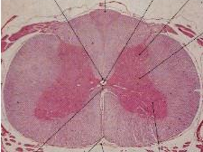
Dorsal commissure
Central canal
Dorsal horn
White matter
Grey matter
ventral commissure
ventral horn

Slide 17
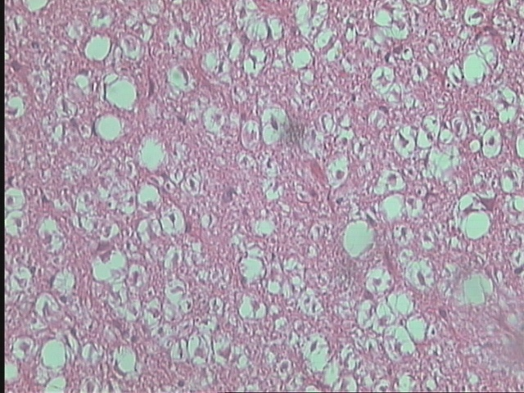
Nervous tissue
(Enlarged part of white matter)
Nerve fibers

Slide 18
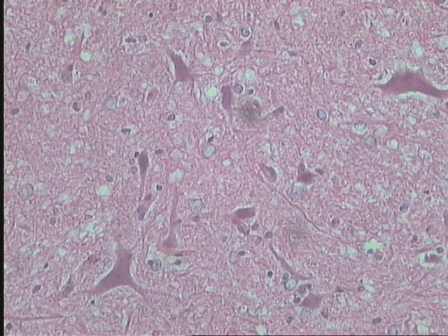
Nervous tissue
(Enlarged part of grey matter)
Cell body of the neuron
Glial cell nucleus

Slide 19


