Slide 1
Preparation of Biological Solutions and Serial Dilutions
BCH 312 [PRACTICAL]

Slide 2
Objective:
  1- To learn how to prepare solutions with different concentration expression.
2-To get familiar with solution dilutions.

Slide 3
Introduction:
-It is very important to understand how to prepare solutions and make dilutions and it is an essential skill for biochemists which is necessary knowledge needed for doing any experiment.
- A simple solution is basically two substances that are evenly mixed together. One of them is called the solute and the other is the solvent. A solute is the substance to be dissolved (sugar). The solvent is the one doing the dissolving (water). forming a homogenous mixture.
-Solution can be composed from one or more solute dissolved in a solvent forming
a homogenous mixture.

Slide 4
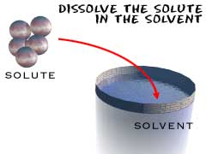

Slide 5
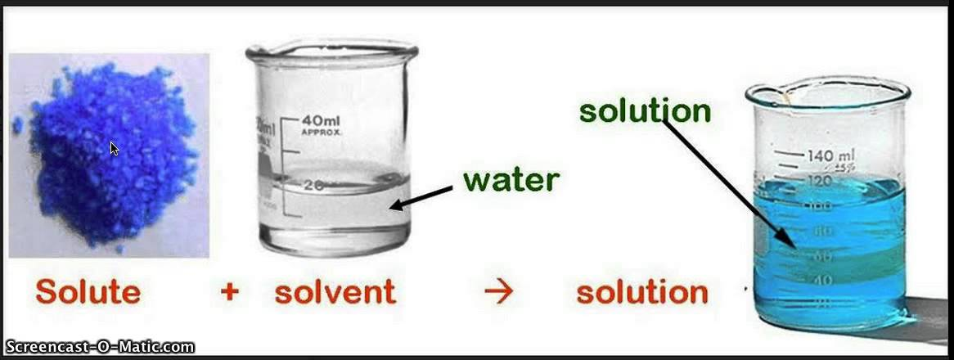
Solutions

Slide 6
A. Preparation of solutions:
Solution concentration define as: quantity of a substance dissolved in per unit quantity of another substance (the relative amounts of solute and solvent in a solution).
There are many units for concentration:
1.Molarity.
2.W/V %.
3.W/W %.

Slide 7
1.Molarity:
is the number of moles of solute dissolved in one liter of solution.
Molar = Number of mole/ Volume in L.
remember that:
No of mole = weight (g) / molecular weight.
Example:
0.5 Molar (M) solution: that mean there are 0.5 mole dissolved in 1000ml (1L).
Unit of molarity : Molar (M).

Slide 8
Example:
how many gram I need to prepare 2 Molar NaCL???
-Prepare 2 M of solid NaCL, in 100 ml.
2 M means, 2 mole of NaCl present in 1000 ml [ or 1Liter ] of solvent (dis.H₂O) .
And we know that →No of mole = weight in (g) / molecular weight.
So,
[2 mole= weight (g) / 58.5] → weight (g) = 2 x 58.5 = 117 g.
-But, this weight needed if 1000 ml is required to be prepared.
Since we need to prepare only 100 ml.
So,
117 g → 1000 ml.
? g →100 ml.
[(100 x 117)/1000] = 11.7 g.
11.7 g of NaCl dissolved in small volume of dis.H₂O, then complete the volume up to 100 ml.
Note: The MW of NaCl is 58.44 =(35.5+23)

Slide 9
Practically how to prepare 2M NaCl:
1.Place a beaker in a balance and zero the balance.
2.Weight 11.7 grams of NaCl , in the beaker and dissolve in little water (less than 100 ml).
3.Once the solid is dissolved the volume is transferred to 100 ml volumetric flask.
4.Brought up to a final volume 100 ml.

Slide 10
2.W/V % (Weight/Volume Percentage Concentration):
- The number of grams of solute dissolved in 100 mL of solution. (% = 100).
weight of solute in (g)
volume of solution in (ml)
W/V% =
X 100

Slide 11
For example:
- Prepare 3% of solid NaOH:
Mean 3 grams of NaOH is dissolved in 100 ml of the solution.
Example:
Prepare 50 ml of 4% NaOH
4g------> 100 ml
?-------->50 ml
The Weight in grams of NaOH needed to prepare 4% NaOH is = (4 x 50)/100 = 2 g.
So,
-2 grams of NaOH is dissolved in little water and the volume made up to 50 ml
how many grams of NaOH I need to prepare 50ml of 4%NaOH solution?

Slide 12
3.W/W % (Weight/Weight Percentage Concentration):
-The number of grams of solute dissolved in 100 gram of solution.
-The concentrations of many commercial acids are giving in terms of w/w%.
- In order to calculate the volume of the stock solution required for a given preparation the density (specific gravity) of stock solution should be provided.
weight of solute in (g)
weight of solution in (g)
W/W% =
X 100
- Weight ( wt) = volume (ml) x SG x w/w% (as decimal).
- To calculate w/w% as decimal = (w/w)/100. For example: w/w%= 13% ➔ 13 / 100 = 0.13

Slide 13
Prepare 100ml with 0.4 M HCl solutions starting with the concentrated HCl solution you are provided with. (w/w% = 36% , S.Gr = 1.15 ).
Weight= volume(ml) x SGr x w/w% (as decimal)
•Important Note!!!: the volume in this formula is not the required volume in the question, it is the volume of the concentrated HCl that you must add to make the solution.
First, we must calculate the weight needed from (conc. HCl) by the following:
Mole=Molarity x volume in liter
= 0.4 x 0.1=0.04 mole
Weight= mole x MWt
=0.04 x 36.5= 1.46 g
Second, substitute:
Weight (wt) = volume (ml) x SG x w/w% (as decimal)
1.46 g = volume x 1.15 x 0.36
Volume= 3.53 ml
So, 3.53 ml of stock (i.e. concentrated HCl) solution is needed and the volume made up to 100 ml by the addition of water.

Slide 14
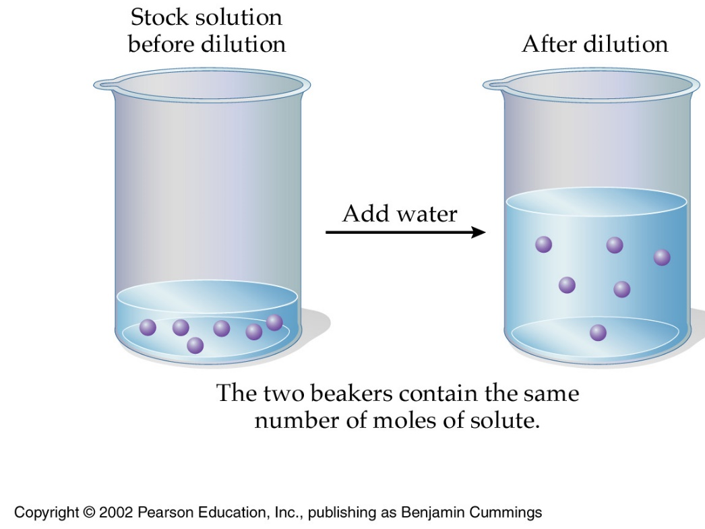
B .Dilution of Solution :
Volume to volume dilutions (ratio).
Preparing dilutions by using the V1XC1=V2XC2 formula.
Serial Dilutions.

Slide 15
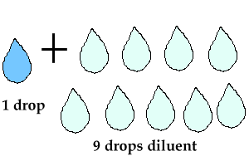
1) Volume to volume dilutions (ratio):
This type of dilutions describes the ratio of the solute to the final volume of the dilute solution.
-For example, to make 1:10 dilution of a 1.0 M NaCl solution, one part of the 1.0 M NaCl solution, should be mixed with nine parts of water, for a total of ten parts, therefore 1 :10 dilution means 1 part + 9 parts of water .
-Thus if 10 ml of the 1:10 dilution was needed, then 1ml of 1.0 M NaCl should be mixed with 9 ml of water. If 100 ml of 1:10 dilution was needed, then 10 ml of the 1.0 M NaCl should be mixed with 90 ml of water. [The final concentration of NaCl in both cases will be 0.1 M. (1/10) = 0.1]
1:4 dilution ?
1 ml from solute + 3 ml from solute = total volume 4
vol. Of solute
Total vol.

Slide 16
Example:
-Prepare 2:10 dilution of solution (A)with 7 M , but the total volume is 20ml not 10 ml??
-Dilution factor (D.F) = 10/2 = 5
2 ml → 10 ml
?? → 20 ml
= (2 X 20) / 10
= 4 ml
So,
-4 ml from solution(A) of 7 M is needed and complete volume up to 20 ml (adding 16 ml water).
Note:
[16 ml water= 4 ml -20 ml].

Slide 17
From previous example:
How to Know the concentration of solution A after dilution?
First we will find the DILUTION FACTOR by the following :
Dilution factor (D.F) = final volume / aliquot volume
=10/2 = 5
Then we will divide the stock concentration (before dilution) by the D.F:
7/5 = 1.4M
Note: To find out the stock concentration you will multiply the diluted concentration by the D.F

Slide 18
:(2)Preparing dilutions by using the V1XC1=V2XC2 formula
Sometimes it is necessary to use one solution to make a specific amount of a more dilute solution .To do this the following formula can be used: V₁ X C₁=V₂ X C₂.
Where:
V₁= Volume of starting solution needed to make the new solution (volume of stock solution).
C₁= Concentration of starting solution (stock solution).
V₂= Final volume of new solution.
C₂= Final concentration of new solution.

Slide 19
For example: Make 5ml of 0.25M solution from a 1.0M solution:
Since: V₁ x C₁= V₂x C_{2.} .
( V₁) x (1M) = (5ml) x (0.25M).
V₁ = [(5 x 0.25)/1] = 1.25 ml
So 1.25ml of the 1M solution is needed (starting solution) then complete the volume up to 5 ml.
Note:
(since the diluted solution should have a final volume of 5ml)
(V₁-V₂ ) ₌ 5ml – 1.25ml = 3.75ml).
3.75ml of diluent (generally water) should be added to the 1.25ml of starting solution.
Where: V1 = ? , C1= 1M ,V2= 5ml ,C2 = 0.25M

Slide 20
3) Serial Dilutions:
-It is a stepwise dilution of a solution, where the dilution factor is constant at each step.
-The source of dilution material for each step comes from the diluted material of the previous step.

Slide 21
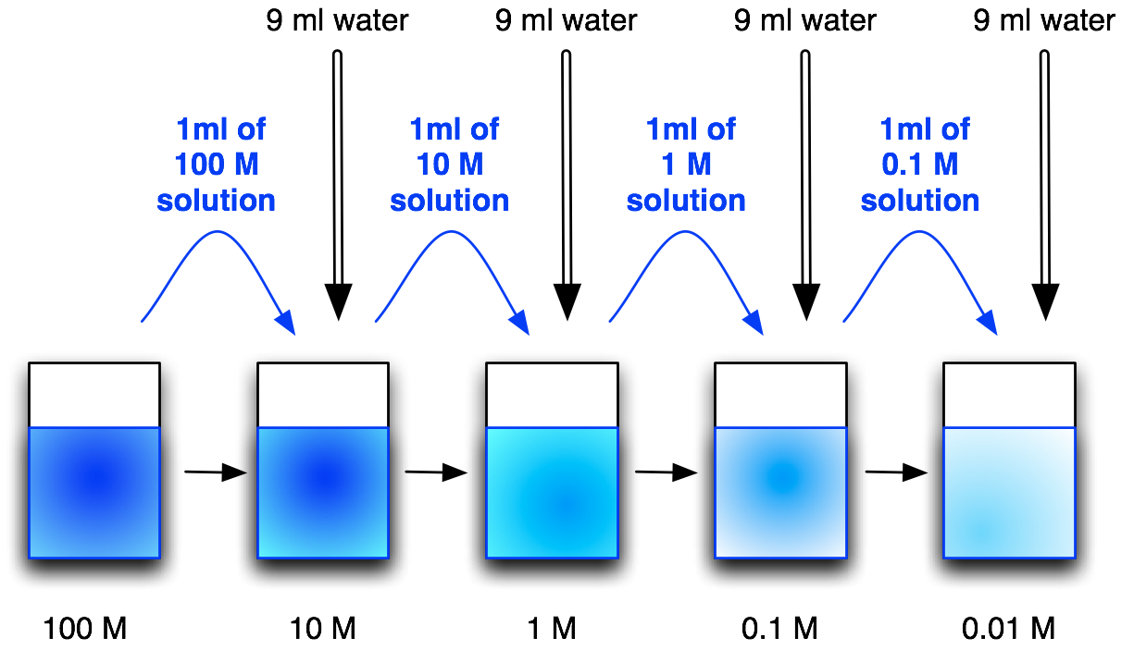
1:10
100 /10 = 10
10 /1 = 10
1 /0.1 = 10
0.1 /0.01 = 10
Dilution factor (D.F) = final volume / aliquot volume
= 10 /1 = 10 (for each step)

Slide 22
Find out the concentration of the diluted solutions:
Dilution factor (D.F) = final volume / aliquot volume = 10 /1 = 10 (for each step)
From the lower concentrated solution to the higher one
X10
X10
X10
X10
÷10
÷ 10
÷ 10
÷ 10
From the more concentrated solution to the lower one

Slide 23
Example:
Starting with a 2.0 M stock solution of hydrochloric acid, prepare four standard solutions by serial dilution of the following Molarity respectively 1 M, 0.5 M, 0.25 M, 0.125 M. [with 1:2 dilution]
Dilution factor (D.F) = 2/1 = 2 → 1:2
-To prepare standard solution 1, 1 ml of the stock 2.0M solution is needed and volume made up to 2 ml with distilled water (never forget to mix properly).
-To prepare standard solutions 2-4, 1 ml of the previously diluted solution is taken and volume is made up to a final volume of 2 ml by the addition of distilled water.

Slide 24
1
1
1
1
1 ml of 2 M solution
1 ml of 1 M solution
1 ml of 0.5M solution
1 ml of 0.25 M solution
2 M
1 M
0.5 M
0.25 M
0.125 M

Slide 25
how to calculate the concentration of the diluted solutions if they unknown ?
➔ First: find the D.F:
Dilution factor (D.F) = final volume / aliquot volume
= 2/1 = 2
➔ Second: divide the previous solution concentration by the D.F:
-concentration of solution 1 = 2.0 M stock solution /2 =1 M
-concentration of solution 2 = 1M/2 = 0.5 M
-concentration of solution 3 = 0.5M/2 =0.25 M
-concentration of solution 4 = 0.25/2 =0.125 M

