Slide 1
2. Linear regression
CSC 462 [THPMLB:3;HMLSKT:4]

Slide 2
Optimization and Generalization
Machine learning also has intimate ties to optimization
Many learning problems are formulated as minimization of some loss function on a training set of examples.
Loss functions express the discrepancy between the predictions of the model being trained and the actual problem instances
For example, in classification, one wants to assign a label to instances, and models are trained to correctly predict the pre-assigned labels of a set of examples.
The difference between optimization and machine learning arises from the goal of generalization
While optimization algorithms can minimize the loss on a training set, machine learning is concerned with minimizing the loss on unseen samples.
Characterizing the generalization of various learning algorithms is an active topic of current research, especially for deep learning algorithms.
Optimization
Generalization

Slide 3
Linear Regression
with one variable

Slide 4
Supervised learning regression problem
Housing Prices
Supervised Learning: Given the “right answer” for each example in the data
Regression Problem: Predict real-valued output
Price
Size

Slide 5
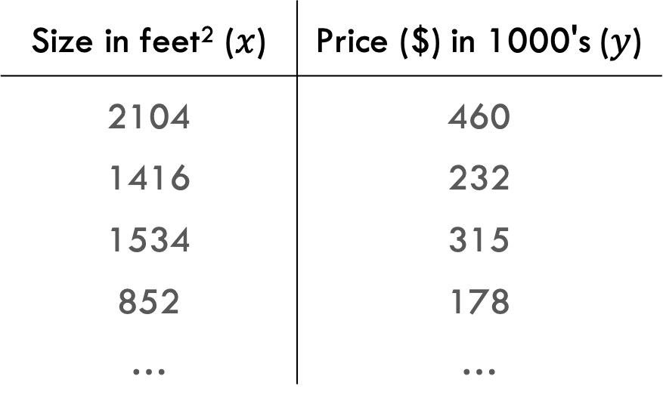
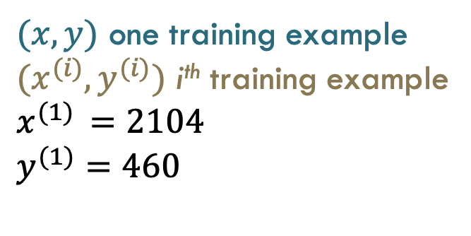
Supervised learning regression problem
Training set of housing prices
Size in feet² ($x$) | Price ($) in 1000's ($y$)
2104 | 460
1416 | 232
1534 | 315
852 | 178
… | …
$(x,y)$ one training example
$(x^{(i)},y^{(i)})$ i^{th} training example
$x^{(1)} =2104$
$y^{(1)}=460$

Slide 6
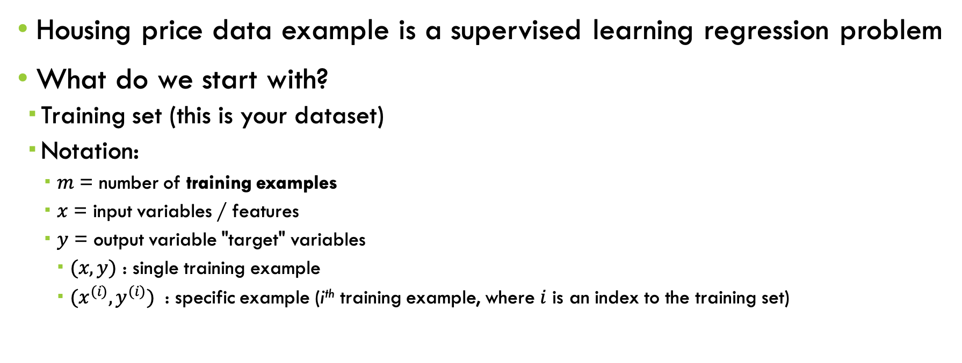
Supervised learning: regression problem
Housing price data example is a supervised learning regression problem
What do we start with?
  Training set (this is your dataset)
  Notation:
    $m$ = number of training examples
    $x$ = input variables / features
    $y$ = output variable "target" variables
      $(x,y)$ : single training example
      $(x^{(i)},y^{(i)})$ : specific example (i^{th} training example, where $i$ is an index to the training set)

Slide 7
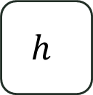
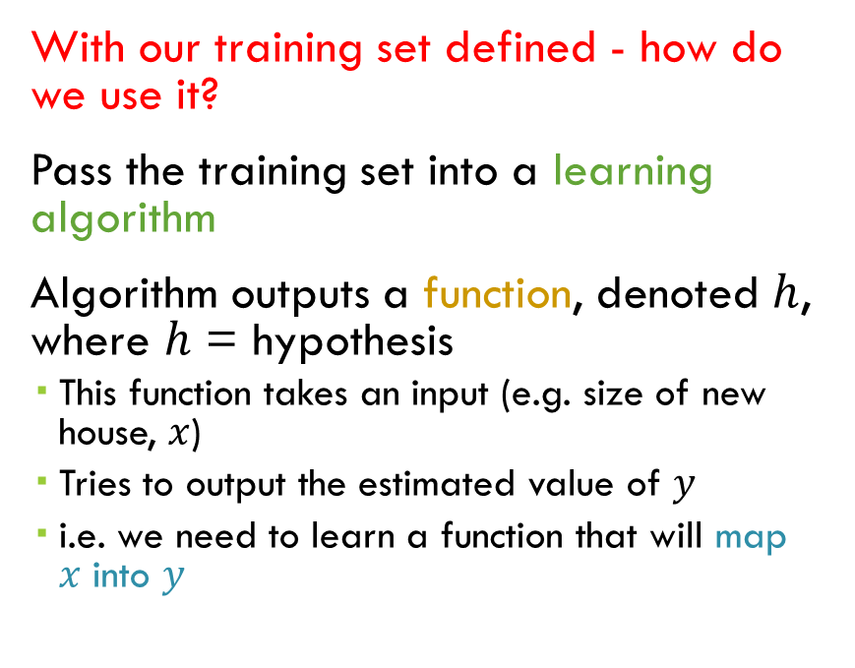
How to use the training set?
Training Set
With our training set defined - how do we use it?
Pass the training set into a learning algorithm
Algorithm outputs a function, denoted $h$, where $h$ = hypothesis
  This function takes an input (e.g. size of new house, $x$)
  Tries to output the estimated value of $y$
  i.e. we need to learn a function that will map $x$ into $y$
Learning Algorithm
Size of house
$$h$$
Estimated price
$x$ hypothesis estimated price $y$

Slide 8




How to represent $h$?
$$y$$
How do we represent hypothesis $h$?
Going to represent $h$ as;
  $hθ(x) = θ0 + θ1x$
  Or $h(x)$ (shorthand)
  $h$ will map $x$’s to $y$’s
Linear regression with one variable: Univariate Linear Regression
$$x$$

Slide 9
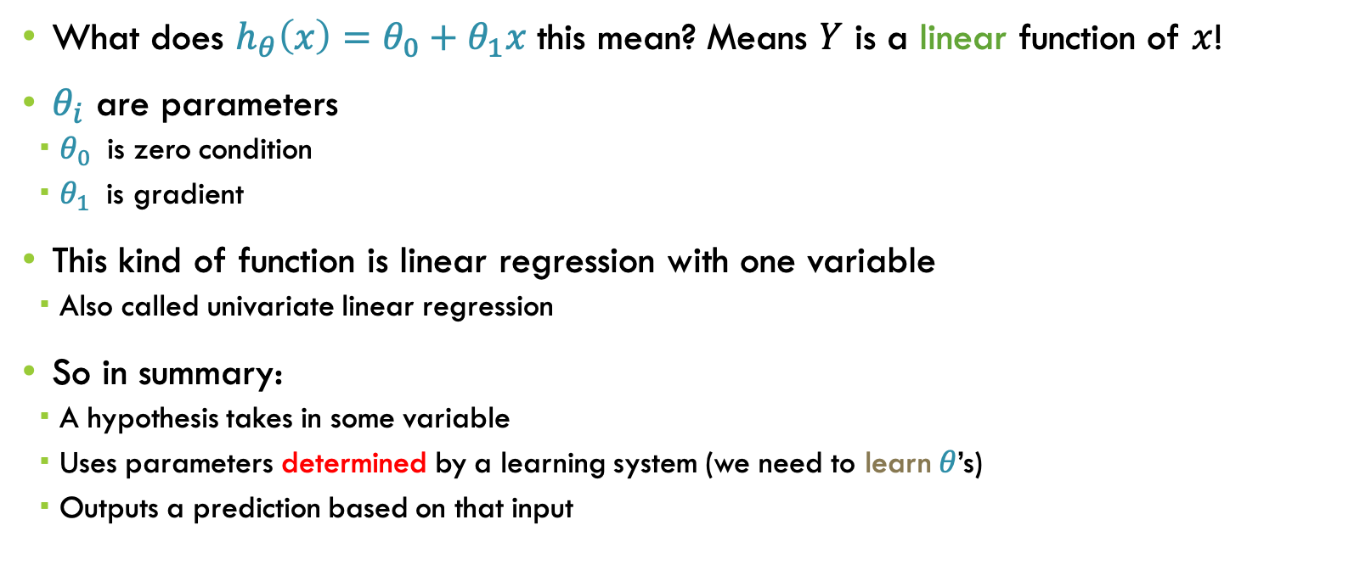
Univariate linear regression
What does $h_{θ}\left(x\right)=θ_{0}+θ_{1}x$ this mean? Means $Y$ is a linear function of $x$!
$θ_{i}$ are parameters
  $θ_{0}$ is zero condition
  $θ_{1}$ is gradient
This kind of function is linear regression with one variable
  Also called univariate linear regression
So in summary:
  A hypothesis takes in some variable
  Uses parameters determined by a learning system (we need to learn $θ$’s)
  Outputs a prediction based on that input

Slide 10

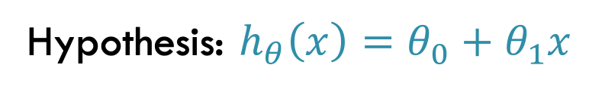

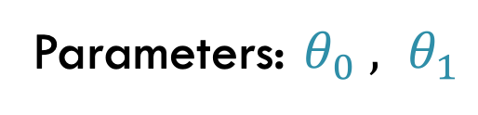
Univariate Linear regression: How to choose $θ$‘s ?
Training set
Size in feet² ($x$) | Price ($) in 1000's ($y$)
2104 | 460
1416 | 232
1534 | 315
852 | 178
… | …
Hypothesis: $h_{θ}\left(x\right)=θ_{0}+θ_{1}x$
Parameters: $θ_{0} , θ_{1}$
How to choose: $θ$’s

Slide 11
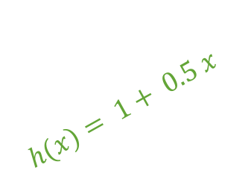
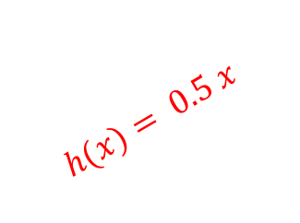
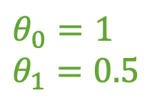
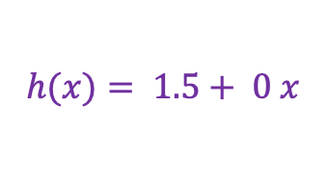
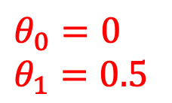
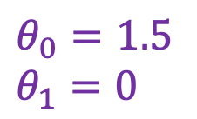

Examples
$$h_{θ}\left(x\right)=θ_{0}+θ_{1}x$$
$$h(x)= 1.5+ 0 x$$
$$h(x)= 1+ 0.5 x$$
$$h(x)= 0.5 x$$
$$θ_{0}=1.5$$
$$θ_{1}=0$$
$$θ_{0}=0$$
$$θ_{1}=0.5$$
$$θ_{0}=1$$
$$θ_{1}=0.5$$

Slide 12
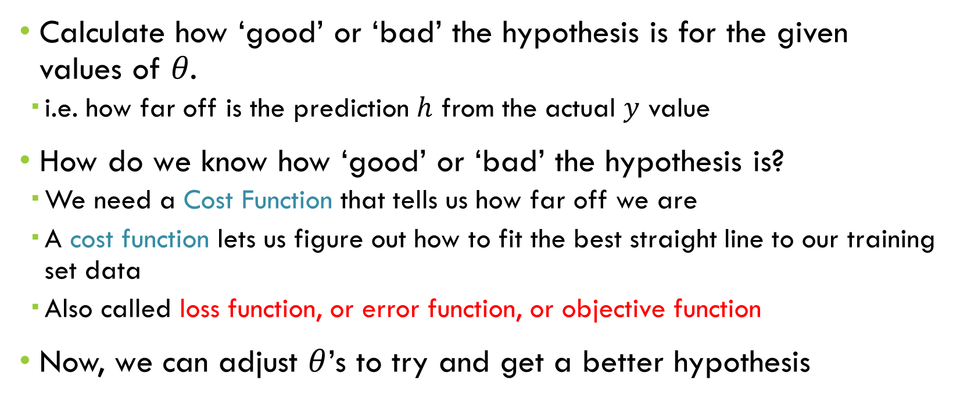

Univariate Linear regression: How to choose $θ$‘s ?
Calculate how ‘good’ or ‘bad’ the hypothesis is for the given values of 𝜃.
  i.e. how far off is the prediction $h$ from the actual $y$ value
How do we know how ‘good’ or ‘bad’ the hypothesis is?
  We need a Cost Function that tells us how far off we are
  A cost function lets us figure out how to fit the best straight line to our training set data
  Also called loss function, or error function, or objective function
Now, we can adjust $θ$’s to try and get a better hypothesis

Slide 13

Cost Function: Mean squared Error
Measures the squared average magnitude of errors in a group of predictions
$$MSE= \frac{1}{m}\sum_{i=1}^{m}{{\left(y^{(i)}−{\hat{y}}^{(i)}\right)}^{2}}$$
$y$: ground truth value, $\hat{y}$: predicted value
Objective/Cost function
Loss function

Slide 14
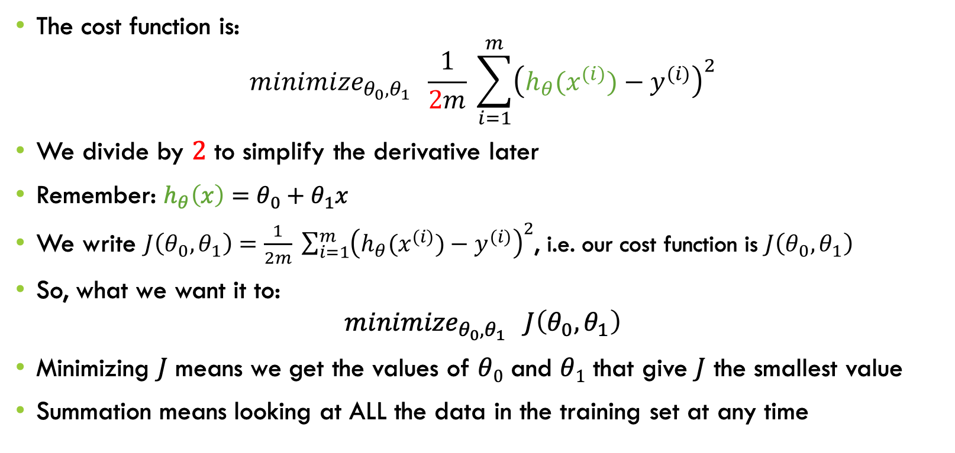
Linear regression - implementation (cost function)
The cost function is:
$${minimize}_{θ_{0},θ_{1}} \frac{1}{2m} \sum_{i=1}^{m}{{\left(h_{θ}(x^{(i)})−y^{(i)}\right)}^{2}}$$
We divide by $2$ to simplify the derivative later
Remember: $h_{θ}\left(x\right)=θ_{0}+θ_{1}x$
We write $J\left(θ_{0},θ_{1}\right)=\frac{1}{2m} \sum_{i=1}^{m}{{\left(h_{θ}(x^{(i)})−y^{(i)}\right)}^{2}}$, i.e. our cost function is $J\left(θ_{0},θ_{1}\right)$
So, what we want it to:
$${minimize}_{θ_{0},θ_{1}} J\left(θ_{0},θ_{1}\right)$$
Minimizing $J$ means we get the values of $θ0$ and $θ1$ that give $J$ the smallest value
Summation means looking at ALL the data in the training set at any time
y
x

Slide 15
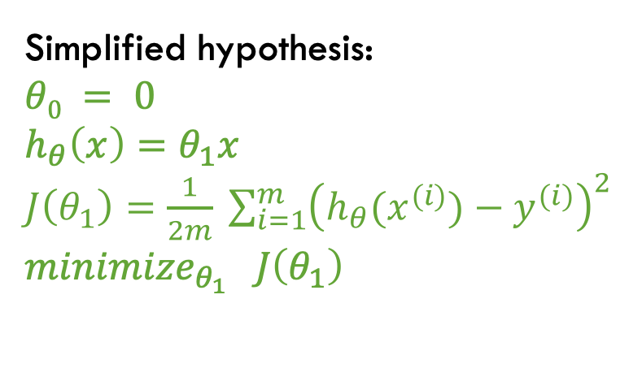
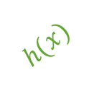
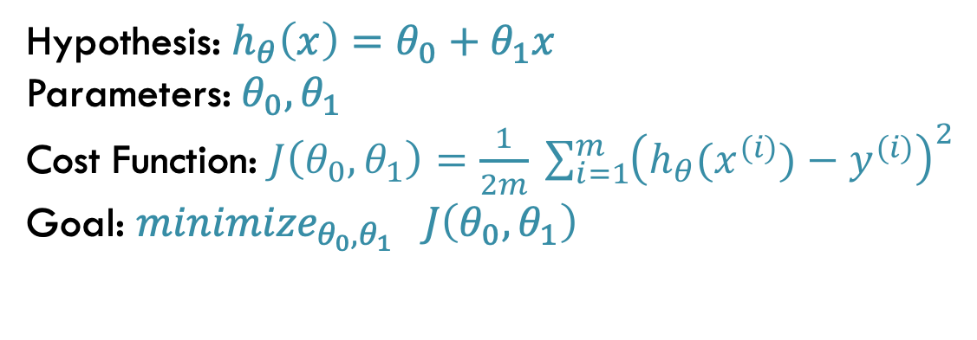
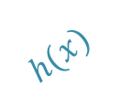
$$h(x)$$
Hypothesis: $h_{θ}\left(x\right)=θ_{0}+θ_{1}x$
Parameters: $θ_{0},θ_{1}$
Cost Function: $J\left(θ_{0},θ_{1}\right)=\frac{1}{2m} \sum_{i=1}^{m}{{\left(h_{θ}(x^{(i)})−y^{(i)}\right)}^{2}}$
Goal: ${minimize}_{θ_{0},θ_{1}} J\left(θ_{0},θ_{1}\right)$
  Simplified hypothesis:
  $θ0 = 0$
  $h_{θ}\left(x\right)=θ_{1}x$
  $J\left(θ_{1}\right)=\frac{1}{2m} \sum_{i=1}^{m}{{\left(h_{θ}(x^{(i)})−y^{(i)}\right)}^{2}}$
  ${minimize}_{θ_{1}} J\left(θ_{1}\right)$
$$h(x)$$

Slide 16
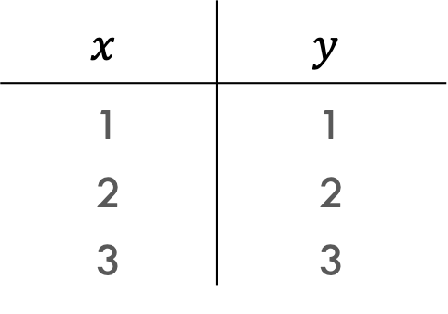



$$p_{3}$$
Training set
$$p_{2}$$
$$x$$ | $$y$$
1 | 1
2 | 2
3 | 3
$$p_{1}$$

Slide 17

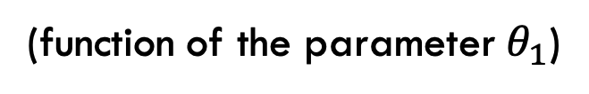
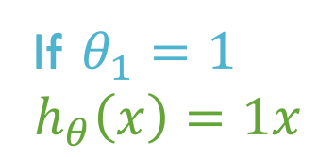



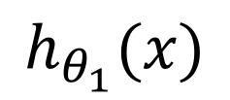
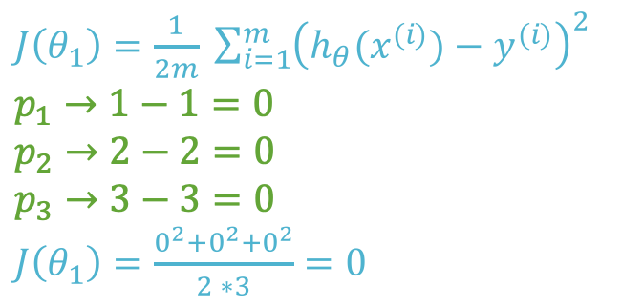

$$h_{θ_{1}}(x)$$
$$J\left(θ_{1}\right)$$
(function of the parameter $θ_{1}$)
$$J\left(θ_{1}\right)$$
$J\left(θ_{1}\right)=\frac{1}{2m} \sum_{i=1}^{m}{{\left(h_{θ}(x^{(i)})−y^{(i)}\right)}^{2}}$
$p_{1}→1−1=0$
$p_{2}→2−2=0$
$p_{3}→3−3=0$
$J\left(θ_{1}\right)=\frac{0^{2}+0^{2}+0^{2}}{2 ∗3}=0$
$$p_{3}$$
$$p_{2}$$
$$p_{1}$$
$$θ_{1}$$
X
If $θ_{1}=1$
$h_{θ}\left(x\right)=1x$

Slide 18

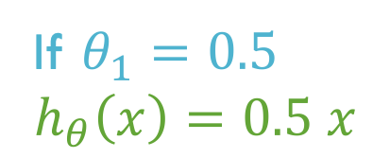
$$h_{θ_{1}}(x)$$
$$J\left(θ_{1}\right)$$
(function of the parameter $θ_{1}$)
$J\left(θ_{1}\right)=\frac{1}{2m} \sum_{i=1}^{m}{{\left(h_{θ}(x^{(i)})−y^{(i)}\right)}^{2}}$
$p_{1}→0.5−1=−0.5$
$p_{2}→1−2=−1$
$p_{3}→1.5−3=−1.5$
$J\left(θ_{1}\right)=\frac{{(−0.5)}^{2}+{(−1)}^{2}+{(−1.5)}^{2}}{2 ∗3}=$
$\frac{0.25+1+2.25}{2 ∗3}=\frac{3.5}{6}=0.583$
$$J\left(θ_{1}\right)$$
y
X
$$θ_{1}$$
x
X
If $θ_{1}=0.5$
$h_{θ}\left(x\right)=0.5 x$

Slide 19

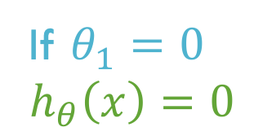
$$h_{θ_{1}}(x)$$
$$J\left(θ_{1}\right)$$
(function of the parameter $θ_{1}$)
$J\left(θ_{1}\right)=\frac{1}{2m} \sum_{i=1}^{m}{{\left(h_{θ}(x^{(i)})−y^{(i)}\right)}^{2}}$
$p_{1}→0−1=−1$
$p_{2}→0−2=−2$
$p_{3}→0−3=−3$
$J\left(θ_{1}\right)=\frac{{(−1)}^{2}+{(−2)}^{2}+{(−3)}^{2}}{2 ∗3}=$
$\frac{1+4+9}{2 ∗3}=\frac{14}{6}=2.33$
$$J\left(θ_{1}\right)$$
X
y
X
$$θ_{1}$$
x
X
If $θ_{1}=0$
$h_{θ}\left(x\right)=0$

Slide 20

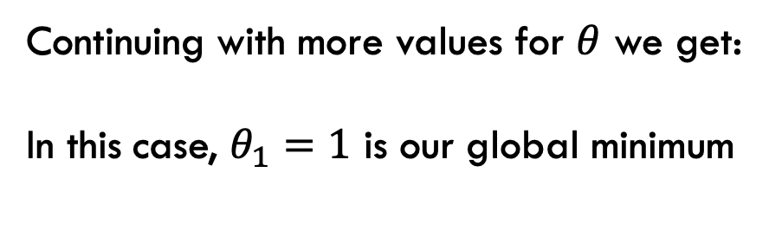


Continuing with more values for $θ$ we get:
In this case, $θ_{1}=1$ is our global minimum
$$J\left(θ_{1}\right)$$
$$J\left(θ_{1}\right)$$
X
X
X
X
X
X
$$θ_{1}$$
X

Slide 21
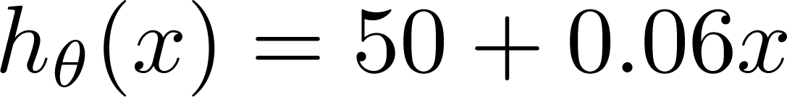
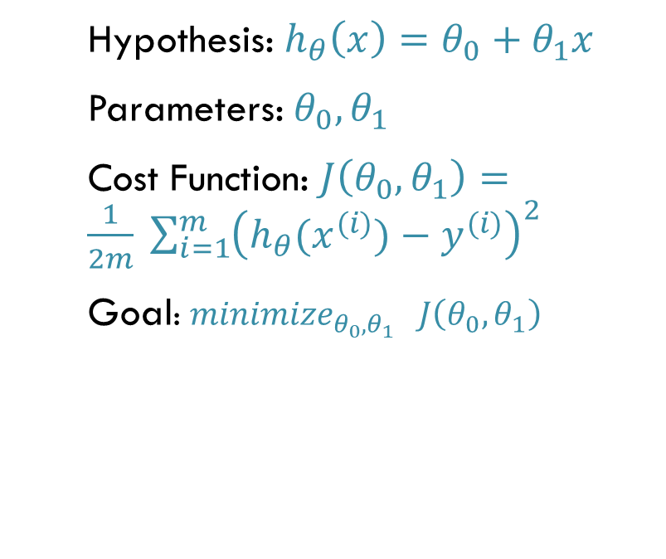
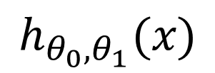

Recap
$$h_{{θ_{0}, θ}_{1}}(x)$$
Price ($)
in 1000’s
Hypothesis: $h_{θ}\left(x\right)=θ_{0}+θ_{1}x$
Parameters: $θ_{0},θ_{1}$
Cost Function: $J\left(θ_{0},θ_{1}\right)=\frac{1}{2m} \sum_{i=1}^{m}{{\left(h_{θ}(x^{(i)})−y^{(i)}\right)}^{2}}$
Goal: ${minimize}_{θ_{0},θ_{1}} J\left(θ_{0},θ_{1}\right)$
Size in feet² ($x$)

Slide 22
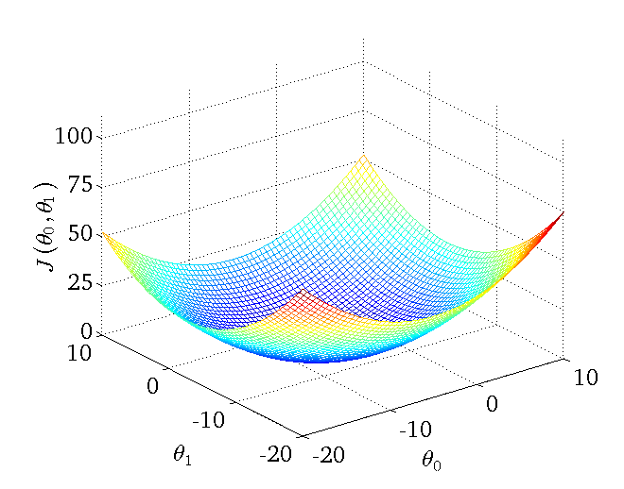
Cost function

Slide 23
The linear regression cost function is always a convex function - always has a single minimum (Bowl shaped)
One global optima. So gradient descent will always converge to global optima

Slide 24
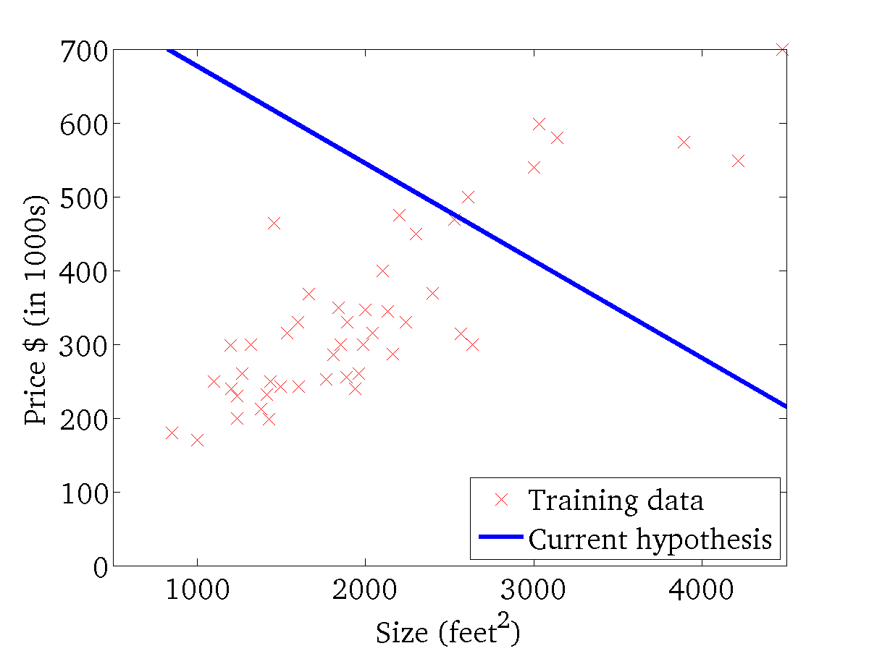
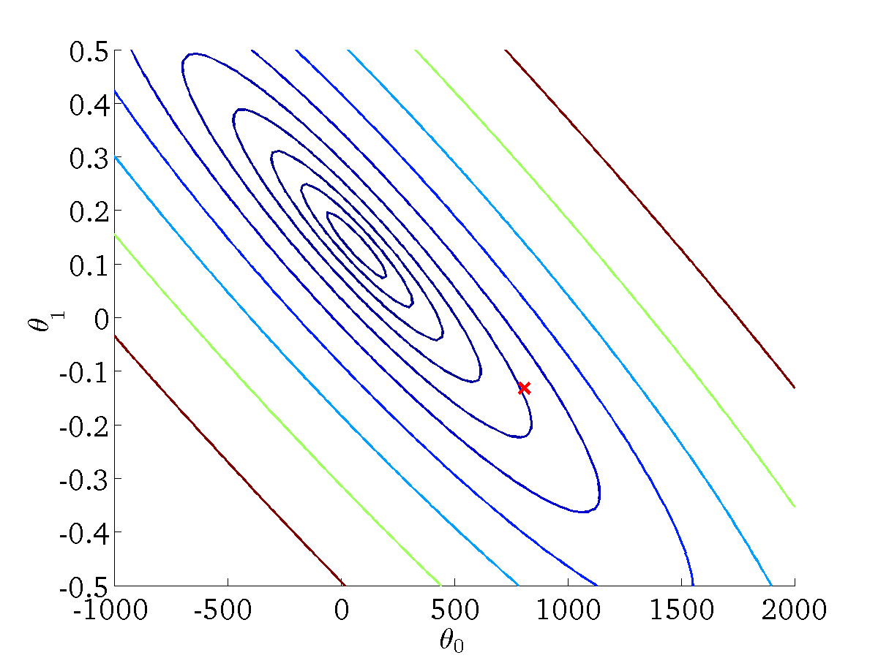

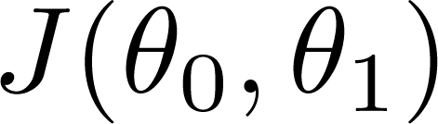
Contour plot (contour figure)

Slide 25
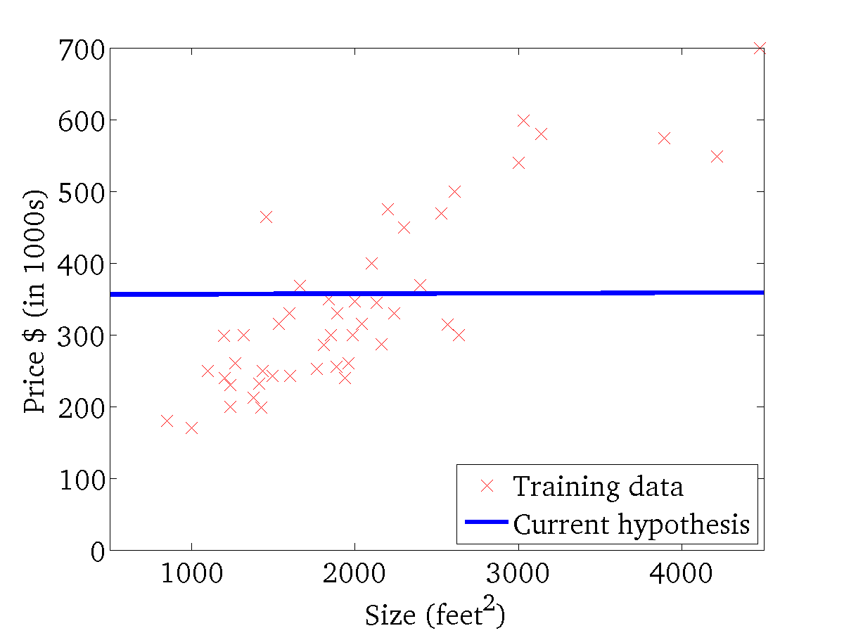
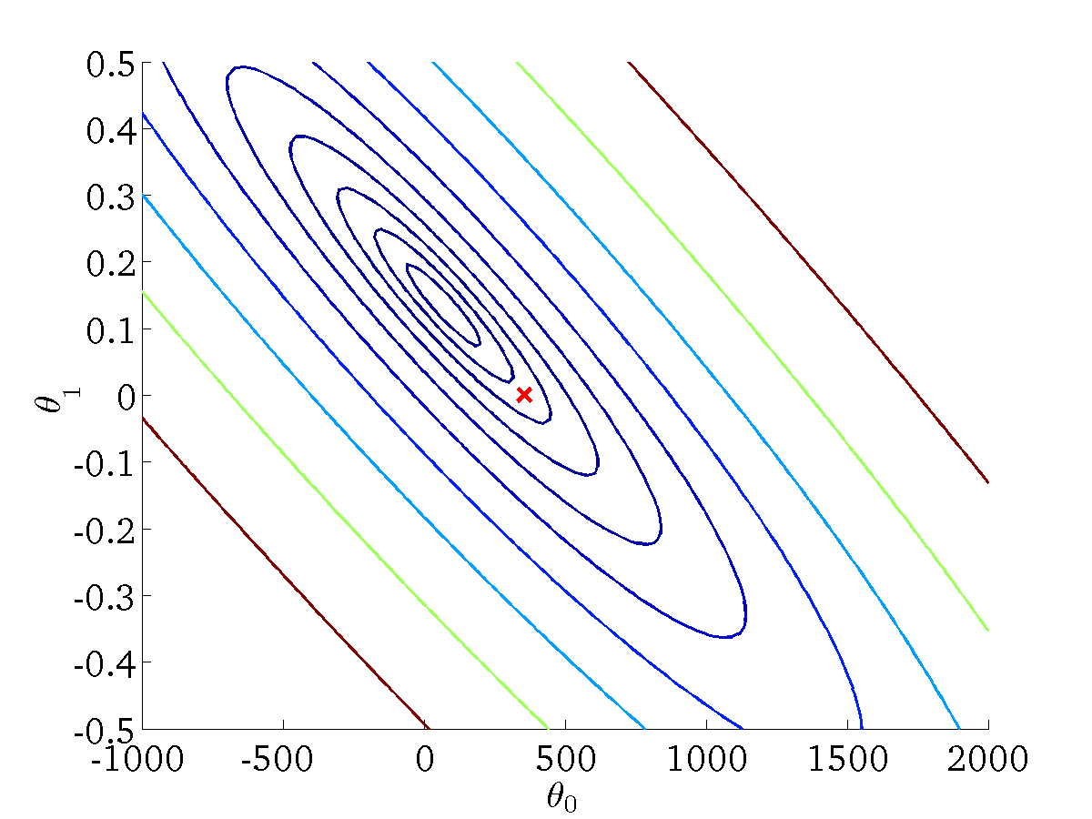
Contour plot (contour figure)

Slide 26
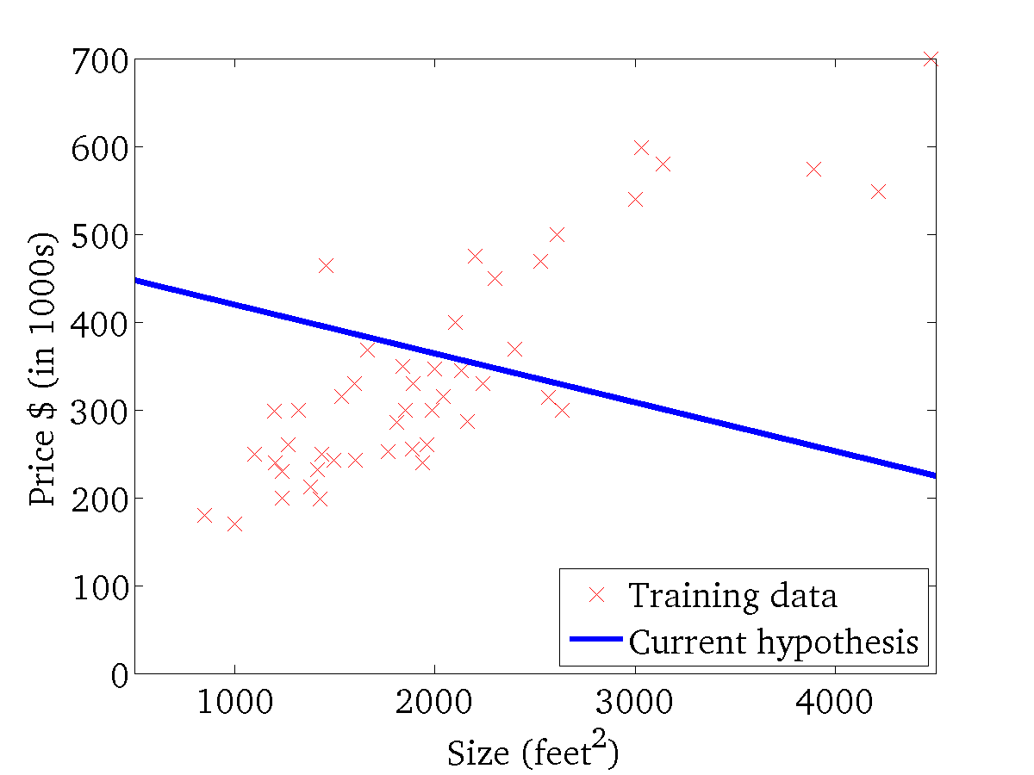

Contour plot (contour figure)

Slide 27
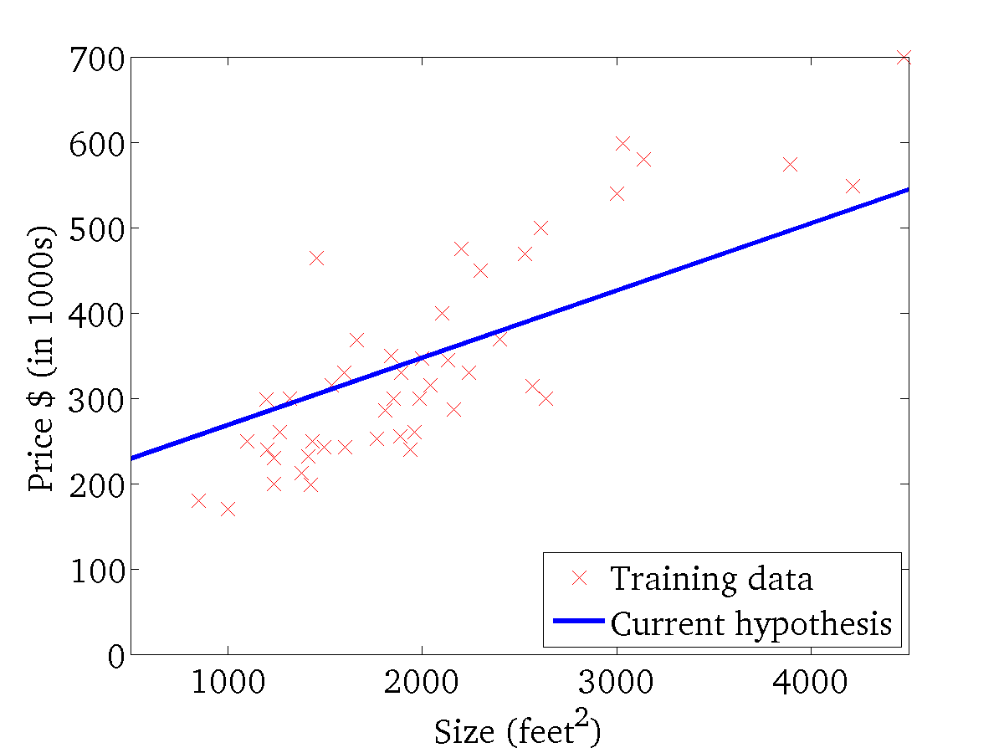
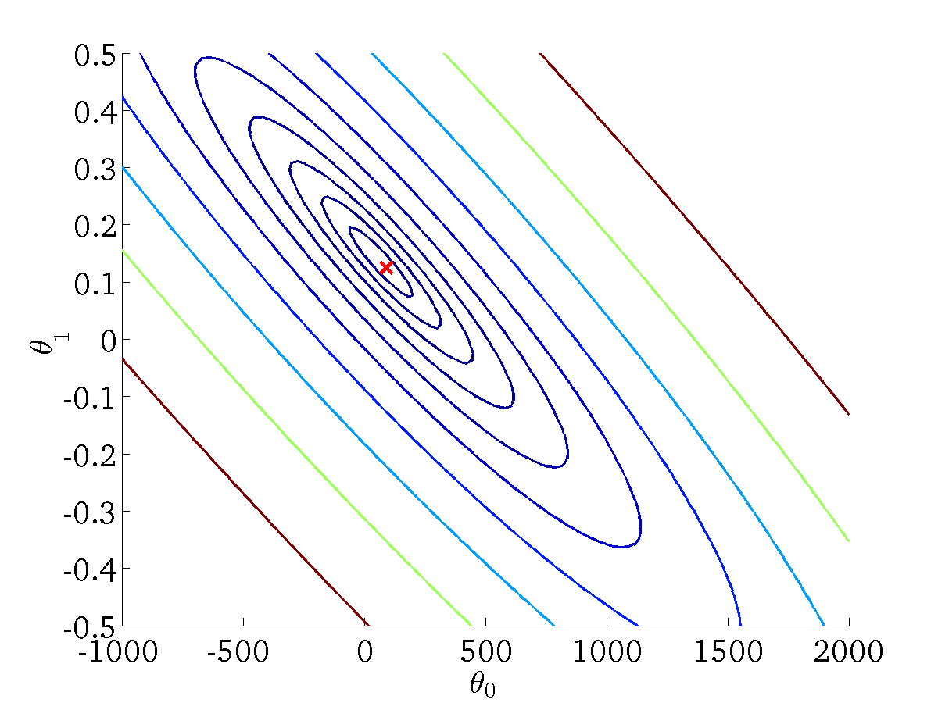
Contour plot (contour figure)

Slide 28
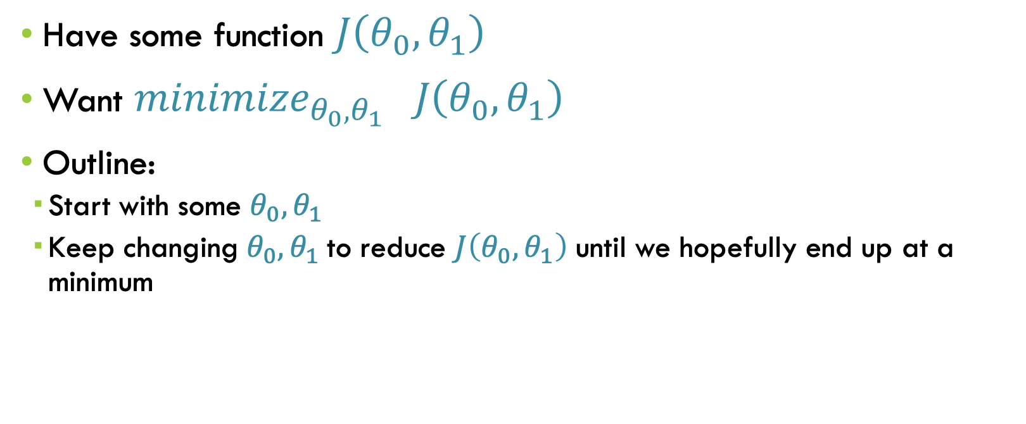
Gradient descent algorithm
Have some function $J\left(θ_{0},θ_{1}\right)$
Want ${minimize}_{θ_{0},θ_{1}} J\left(θ_{0},θ_{1}\right)$
Outline:
  Start with some $θ_{0},θ_{1}$
  Keep changing $θ_{0},θ_{1}$to reduce $J\left(θ_{0},θ_{1}\right)$ until we hopefully end up at a minimum

Slide 29
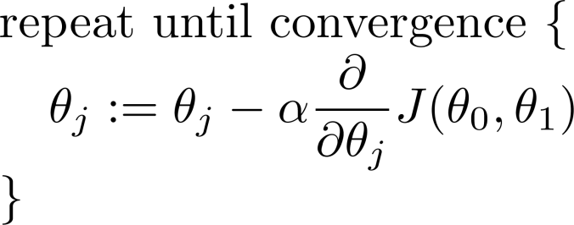
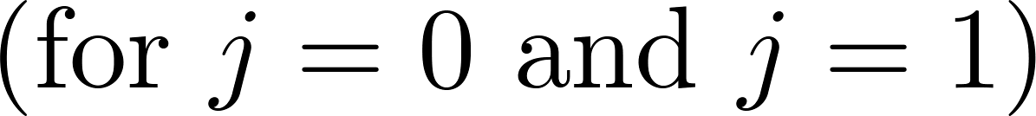
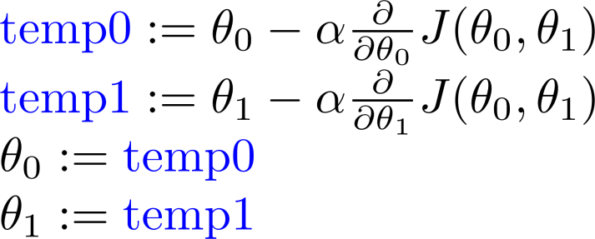
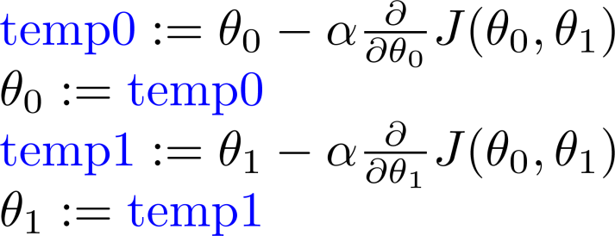
Gradient descent algorithm
  Start with some $θ_{0},θ_{1}$
Learning rate
Derivative
Correct: Simultaneous update
Incorrect: non-simultaneous update

Slide 30
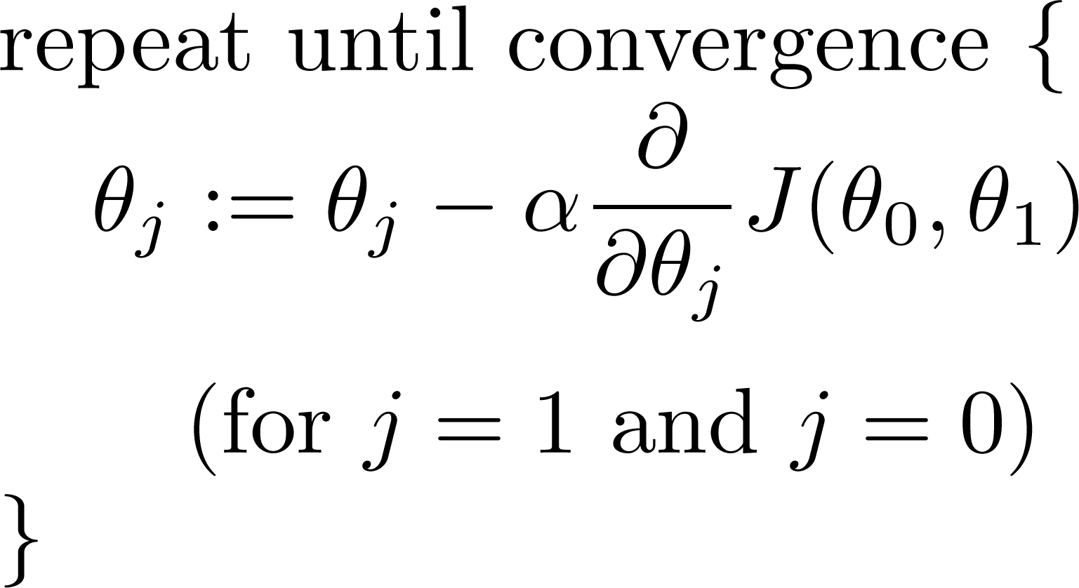


Derivatives
$$\frac{∂}{∂θ_{j}} J\left(θ_{0},θ_{1}\right)=\frac{∂}{∂θ_{j}} \frac{1}{2m} \sum_{i=1}^{m}{{\left(h_{θ}(x^{(i)})−y^{(i)}\right)}^{2}}$$
$$=\frac{∂}{∂θ_{j}} \frac{1}{2m} \sum_{i=1}^{m}{{\left(θ_{0}+θ_{1}x^{(i)}−y^{(i)}\right)}^{2}}$$

Slide 31



Derivatives
$$\frac{∂}{∂θ_{j}} J\left(θ_{0},θ_{1}\right)=\frac{∂}{∂θ_{j}} \frac{1}{2m} \sum_{i=1}^{m}{{\left(θ_{0}+θ_{1}x^{(i)}−y^{(i)}\right)}^{2}}$$
$$j=0: \frac{∂}{∂θ_{0}} J\left(θ_{0},θ_{1}\right)=\frac{1}{m} \sum_{i=1}^{m}{\left(h_{θ}(x^{(i)})−y^{(i)}\right)}$$
$$j=1: \frac{∂}{∂θ_{1}} J\left(θ_{0},θ_{1}\right)=\frac{1}{m} \sum_{i=1}^{m}{\left(h_{θ}(x^{(i)})−y^{(i)}\right)∙x^{(i)}}$$

Slide 32


Gradient descent algorithm
  Start with some $θ_{0},θ_{1}$
update $θ$’s simultaneously

Slide 33






Why does gradient descent work?
Positive
Negative
$$J\left(θ_{1}\right)$$
$$J\left(θ_{1}\right)$$
$$J\left(θ_{1}\right)$$
$$J\left(θ_{1}\right)$$
$$θ_{1}$$
$$θ_{1}$$

Slide 34




Learning rate
$$J(θ_{1})$$
$$J(θ_{1})$$
If α is too large, gradient descent can overshoot the minimum. It may fail to converge, or even diverge.
If α is too small, gradient descent can be slow.

Slide 35


Convergence to a local minimum
Gradient descent can converge to a local minimum, even with the learning rate α fixed.
As we approach a local minimum, gradient descent will automatically take smaller steps. So, no need to decrease α over time.

Slide 36


Gradient descent
“Debugging”: How to make sure gradient descent is working correctly.
How to choose learning rate $α$

Slide 37




gradient descent is working correctly
The cost function should decrease after each iteration.
Example of automatic convergence test:
Declare convergence if decreases by less than
in one iteration.
No. of iterations

Slide 38
Linear Regression in Action

Slide 39




(for fixed , this is a function of x)
(function of the parameters )
h(x)=900-0.1 x

Slide 40

(for fixed , this is a function of x)
(function of the parameters )

Slide 41


(for fixed , this is a function of x)
(function of the parameters )

Slide 42


(for fixed , this is a function of x)
(function of the parameters )

Slide 43

(for fixed , this is a function of x)
(function of the parameters )

Slide 44

(for fixed , this is a function of x)
(function of the parameters )

Slide 45


(for fixed , this is a function of x)
(function of the parameters )

Slide 46

(for fixed , this is a function of x)
(function of the parameters )

Slide 47


(for fixed , this is a function of x)
(function of the parameters )

Slide 48





gradient descent is not working correctly
Gradient descent is not working.
Use smaller $α$
For sufficiently small $α$, $J(θ)$ should decrease on every iteration
But if $α$ is too small, gradient descent can be slow to converge
No. of iterations
No. of iterations
No. of iterations

Slide 49
Gradient decent with different learning rates
On the left, the learning rate is too low: the algorithm will eventually reach the solution, but it will take a long time.
In the middle, the learning rate looks pretty good: in just a few iterations, it has already converged to the solution.
On the right, the learning rate is too high: the algorithm diverges, jumping all over the place and actually getting further and further away from the solution at every step.

Slide 50
The terrain of the cost function
Finally, not all cost functions look like nice regular bowls.
There may be holes, ridges, plateaus, and all sorts of irregular terrains, making convergence to the minimum very difficult.
Figure shows the two main challenges with Gradient Descent:
  if the random initialization starts the algorithm on the left, then it will converge to a local minimum.
  If it starts on the right, then it will take a very long time to cross the plateau, and if you stop too early you will never reach the global minimum.

Slide 51

Tips on choosing the learning rate and number of iterations
How to set the number of iterations?
If it is too low, you will still be far away from the optimal solution when the algorithm stops.
If it is too high, you will waste time while the model parameters do not change anymore.
A simple solution: set to a very large number of iterations but to interrupt the algorithm when the gradient vector becomes tiny
That is, when its norm becomes smaller than a tiny number ϵ (called the tolerance)—because this happens when Gradient Descent has (almost) reached the minimum.
How to set the learning rate $α$?
If $α$is too small: slow convergence.
If $α$ is too large: $J(θ)$ may not decrease on every iteration; may not converge.
Initial values to try for$α$:
$$…, 0.001, 0.003, 0.01, 0.03, 0.1, 0.3, …, 1, …$$
Consider using GridSearch

Slide 52
Stochastic Gradient Descent
The earlier implementation of GD is known as Batch Gradient Descent because it uses the whole training set to compute the gradients at every step, which makes it very slow when the training set is large.
At the opposite extreme, Stochastic Gradient Descent just picks a random instance in the training set at every step and computes the gradients based only on that single instance.
Obviously this makes the algorithm much faster since it has very little data to manipulate at every iteration.
It also makes it possible to train on huge training sets, since only one instance needs to be in memory at each iteration

Slide 53

Stochastic Gradient Descent
Due to its stochastic nature, this algorithm is much less regular than Batch Gradient Descent: instead of gently decreasing until it reaches the minimum, the cost function will bounce up and down, decreasing only on average.
Over time it will end up very close to the minimum, but once it gets there it will continue to bounce around.
So once the algorithm stops, the final parameter values are good, but not optimal.

Slide 54
Stochastic Gradient Descent
When the cost function is very irregular, this can actually help the algorithm jump out of local minima.
Therefore, randomness is
    good to escape from local optima,
    but bad because it means that the algorithm can never settle at the minimum.
    Also Sensitive to noise
One solution to this dilemma is to gradually reduce the learning rate.

Slide 55
Mini-batch Gradient Descent
At each step, instead of computing the gradients based on the full training set (as in Batch GD) or based on just one instance (as in Stochastic GD), Minibatch GD computes the gradients on small random sets of instances called minibatches.

