Slide 1
Laboratory Diagnosis of
Fungal Infections
MBI 531

Slide 2
Introduction
To confirm clinical suspicion to establish fungal cause of disease.
To help in -
  Choosing a therapeutic agent
  Monitoring the course of disease
  Confirming mycological cure

Slide 3
Sites & Types of Specimens
Specimen collection depends on the
corresponding disease.
Very important to proceed for a final
diagnosis.

Slide 4
(a) Superficial Mycosis
Clean the part with 70% alcohol
Collect the material in a sterile paper or a sterile petridish to -
  Allow drying of the specimen
  Reduce bacterial contamination
  Maintain viability

Slide 5
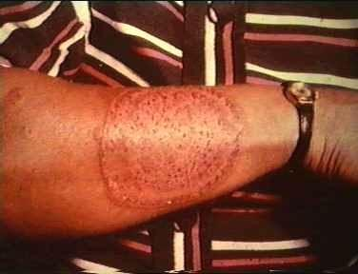
(a) Superficial Mycosis
Dermatophytic lesion – spreads outward in
a concentric fashion with healing in the center
– scrape outwards from the edge of the lesion with a scalpel blade or use Cellophane tape
Scalp lesion – scraping with a blunt scalpel, including hair stubs, scales & contents of plugged follicles.

Slide 6
(a) Superficial Mycosis
Scalp lesion – Woodlamp’s examination of infected hair – fluorescence
Hairbrush sampling technique
Onychomycosis – stop antifungals one week
prior to collection
Mucosal infections – mucosal scrapings

Slide 7
(b) Subcutaneous Mycosis
Scrapings or crusts from the superficial parts of lesions
Pus aspirates
Biopsy

Slide 8
(c) Systemic Mycosis
Pus
Biopsy
Feces
Urine
Sputum
CSF
Blood
Scrapings or swabs from the edge of lesions.

Slide 9
Collection & Transport of
specimen
Proper collection of specimen and in adequate quantity.
Early transport to the lab to avoid overgrowth
of contaminant
Respiratory specimens
  Sputum – early morning sample, after mouth wash, flakes to be used for culturing
  Bronchoscopy – if non productive cough
  Bronchial brushings or lung biopsy – to rule out invasion or colonisation

Slide 10
Collection & Transport of
specimen
Blood
  In biphasic Brain Heart Infusion agar
  Inoculated in 2 bottles – for dimorphic fungi
Cerebrospinal fluid
  Should be immediately processed else stored at RT or at 30°C in an incubator
  Centrifuge & use sediment for culture

Slide 11
Collection & Transport of
specimen
Skin, Hair & Nail
  Taken for dermatophytic infections
  Hair – plucked with forceps
Tissue, BM & Body fluids
  Tissues – grind or mince before culturing
  Body fluids – centrifuge & use sediment for culture
Urine – centrifuge & use sediment for culture

Slide 12
Laboratory Diagnosis
Direct examination
Fungal culture
Serological tests
Skin tests
PCR & other molecular methods

Slide 13
Direct Examination
Very decisive in the diagnosis of fungal infections
Wet mounts
  Slide & tube KOH mounts – 10 to 20% KOH – digests protein debris, dissolves keratin. DMSO can be added to KOH to hasten clearing in skin scrapings & nail clippings
  Calcofluor white – fluorescent stain – excellent
morphology of pathogenic fungi
  India ink – capsulated fungi

Slide 14
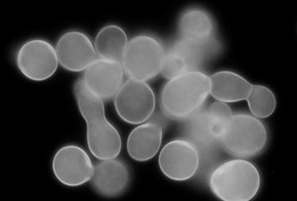
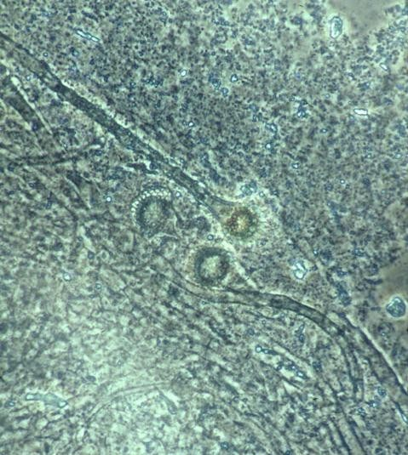


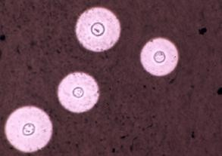




CFW – yeast form of Blastomyces
KOH - Aspergillus
India ink -
Cryptococcus

Slide 15
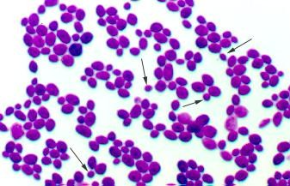
Direct Examination
Gram stain – fungi are Gram +ve
Histopathology - yeast cells, hyphae, pseudohyphae, arthrospores, chlamydospores, and spherules.
  Routine stain – Hematoxylin & Eosin (HE) - very useful to visualize the host's response
Superficial infection – acute, subacute or chronic dermatitis with folliculitis
Subcutaneous & systemic infections – granulomatous reaction with fibrosis or pyogenic inflammation

Slide 16
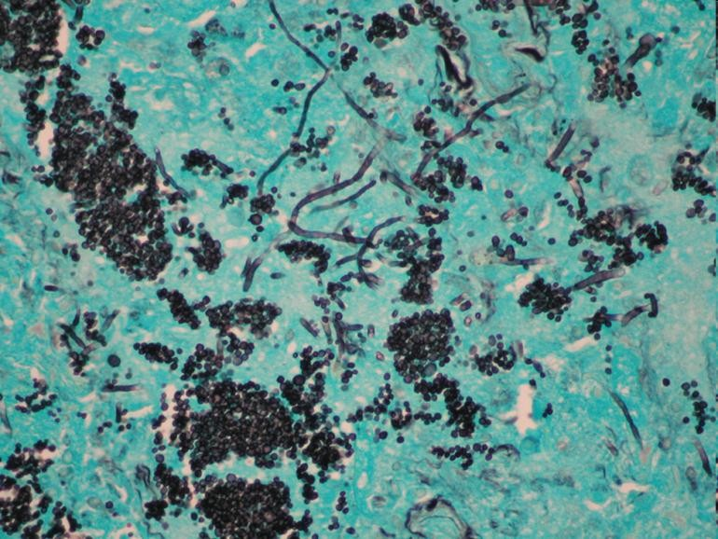
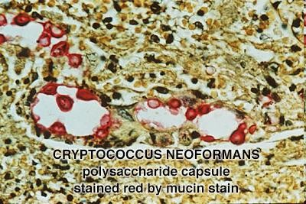
Direct Examination
Histopathology
  Special stains – PAS (Per Iodic acid), GMS (Grocott Gomori Methanamine Silver), Mayer’s mucicarmine, Gridley’s stain
  GMS is more advantageous since it stains old and nonviable fungal elements more efficiently than the others
  Mucin stains, like Mayer's mucicarmine stain the mucopolysaccharide capsule of Cryptococcus neoformans

Slide 17
Direct Examination
Fluorescent- antibody staining
  To detect fungal Ag in clinical specimen such
as pus, blood, CSF, tissue sections
  Adv – can detect fungus even when few
organisms are present

Slide 18
Fungal Culture
Sabouraud Dextrose Agar (SDA)
  Contains 2% dextrose, antibiotics (gentamicin,
chloramphenicol) and cycloheximide
Selective media
  Corn meal agar (CMA) – sporulation, chlamydospore formation
  Bird seed agar – cryptococcus, forms brown
colonies
  Brain Heart Infusion (BHI) agar – dimorphic & other fastidious fungi

Slide 19


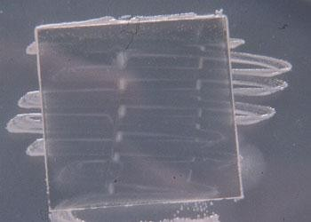
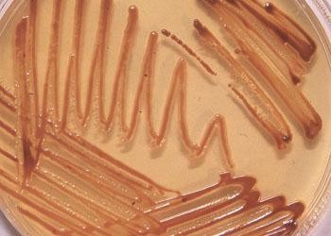
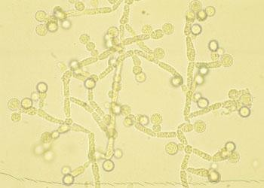


Corn Meal Agar
Bird Seed Agar

Slide 20
Fungal Culture
Temperature requirement
  Majority of fungi – 37°C
  Superficial mycosis – 30°C
  Dimorphic fungi – 25°C & 37°C
Incubation time
  At least 4 weeks
  Usually positive cultures are obtained in 7-10 days
  Candida & Aspergillus - 24 to 72 hrs

Slide 21
Fungal Culture
Specimens should be cultured on agar
slants:
  Safe
  Require less space
  More resistant to drying during prolonged
incubation
  Blood cultures should be inoculated in to biphasic blood culture bottles

Slide 22
Interpretation of Fungal
Culture
Isolation of an established pathogen like
H. capsulatum or C. neoformans – evidence of
infection
Isolation of commensal or opportunistic fungi like Candida or Aspergillus – consider following points:
1. Isolation of same strain in all culture tubes
2.
Repeated isolation of same strain in multiple
specimens
Isolation of same strain from different sites
Immune status
Serological evidence

Slide 23
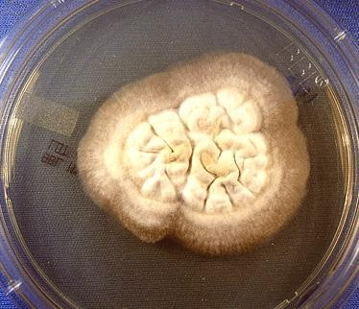
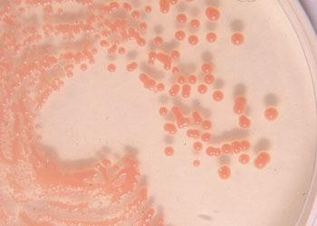
Identification of fungal
cultures
Colony morphology – colour, texture, pigment

Slide 24
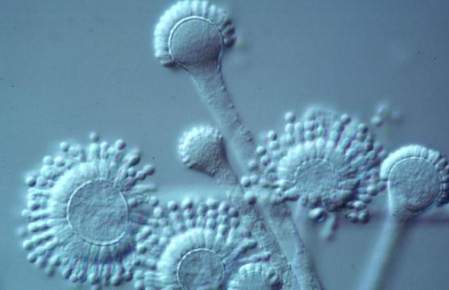
Identification of fungal
cultures
Fungal morphology
under microscope – using Lactophenol Cotton Blue (LPCB) stain
Composition of LPCB
  Lactic acid - preserves fungal
structure
  Phenol – kills any live organism
  Glycerol – prevents drying
  Cotton blue – imparts blue color to structures

Slide 25
Identification of fungal
cultures
Special culture techniques – Slide culture to see sporing structures & spore arrangement, CHROM agar for candida sps.
Biochemicals – ability to assimilate carbon
& nitrogen, sugar fermentation

Slide 26
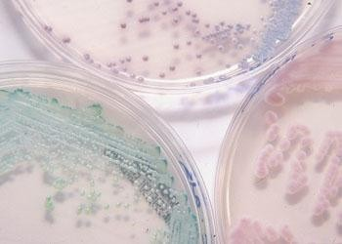







C.tropicalis
C.krusei
C.albicans
CHROM Agar

Slide 27
Serology & Immunology
Detection of Ag or Ab in serum or body fluids
  Ab detection:
    Diagnosis of systemic & subcutaneous mycoses
    Assess prognosis of the disease
    Assess response to treatment
  Ag detection:
    Early stages of infection
    In patients with impaired immunity
Delayed hypersensitivity tests – with Ags like
candidin, histoplasmin, etc.

Slide 28
Serological tests used in Medical
Mycology
Agglutination
  Whole cell agglutination
  Latex particle agglutination
  Passive haemagglutination
Immunodiffusion – most widely used
Counter immunoelectrophoresis (CIEP)
Indirect fluorescent Ab detection
ELISA, RIA

Slide 29
Other Methods
PCR – Polymerase Chain Reaction
RFLP - Restriction fragment length
polymorphism
Protein electrophoresis
Nucleic acid probes
Serotyping
Karyotyping

